Slide 1
Exploitation of HPC for HEP data intensive applications
Wahid, Andy, Pete etc.
UoE

Slide 2
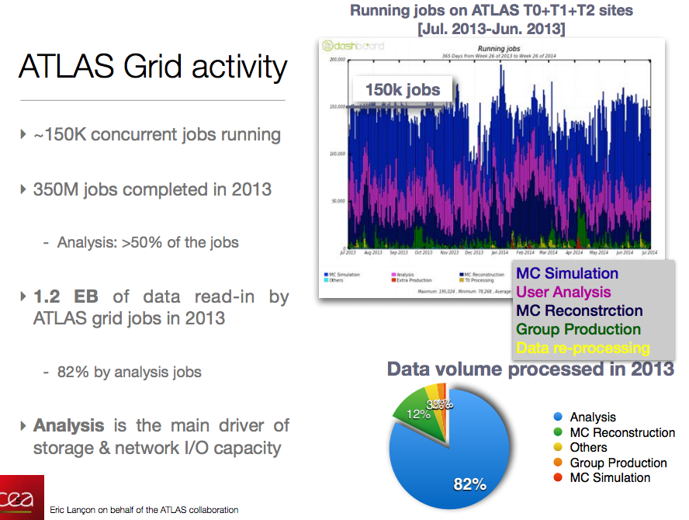
Backdrop
> 50% of ATLAS jobs are “analysis”
Current LHC on HPC work has ignored these workflows
Meanwhile improvements in HEP data: e.g. “Federations”, WAN access, I/O optimizations allow more flexible access.

Slide 3
Challenges/ constraints
Network access to HPC more restrictive that LHC grid compute
  Including no WN WAN access
  Pre-fetching of data
Data on shared filesystem rather than WN

Slide 4
Solutions/ Goals
Improvement in the I/O layer of HEP software to make optimal use of limited bandwidth or high latency scenarios.
  Relates to Francesco’s question: “If remote I/O is available, is the latency too high? is the bandwith too little? how to hide the latency? how to save on bandwidth?”
Use of caching solutions to enable high-performance data access while making effective use of existing HPC scratch storage resources.
  “How to cope with constraints in network connectivity (inbound to site services, outbound from nodes)?” and “What is the interface to the HPC centre?”
  On both of these goals there are other approaches that could be more appropriate to highly parallel /IO so add here “and data delivery solutions going beyond existing data structures”.
Development of interoperable solutions using standard protocols to enable the use of existing high-volume data storage whether at local or remote sites.

Slide 5
More Concrete Tasks
Phase 1
Enabling key HPC centres to access data from existing LHC data stores. (0.25 FTE/year)
Developing benchmark applications for data access performance and scale testing. (0.25 FTE/year)
Phase 2
Optimising I/O layer of the benchmark applications (porting improvements to all HEP software). (0.5 FTE/year)
Deploying caching services at HPC centres to improve data throughput. (0.5 FTE/year)
Phase 3
Enabling interoperation with non-LHC data storage, including multi-discipline data-stores developed as part of other projects. (0.5 FTE/year)

