Slide 1
New 3D Layouts
Gian-Franco Dalla Betta
University of Trento and TIFPA INFN, Trento, Italy
New pixels for Phase 2:
50x50, 25x100
How to test them with FEI4 ?

Slide 2
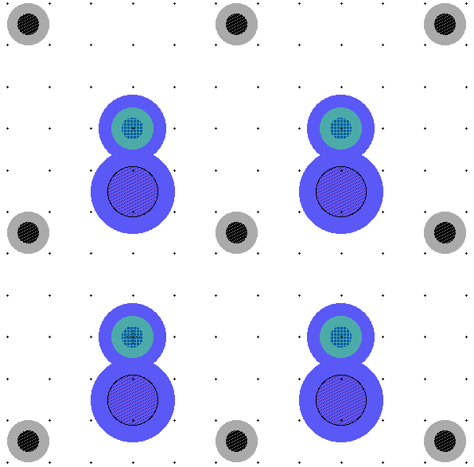
3D cell layout 1: 50 x 50
50 μm
50 μm
15 μm
P col.
Bump
pad
N col.

Slide 3
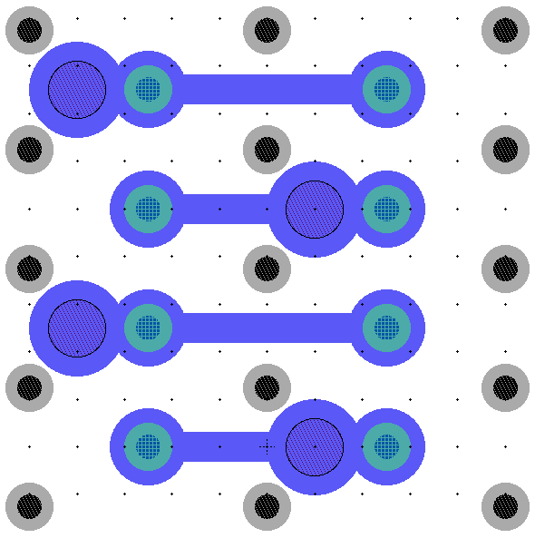
3D cell layout 2: 25 x 100
100 μm
~56 μm
50 μm
25 μm
P col.
N col.
Bump
pad

Slide 4
FEI4 bump pad array layout
50 μm
450 μm
50 μm
450 μm
Bump
Pads (x 336)

Slide 5
Test pixels 50 x 50
2x50 + 2x450
4x250
4x50 + grid
450 μm
50 μm
450 μm

Slide 6
Test pixels 25 x 100
2x100 + 2x400-500
2x200 + 2x300-500
4x100 + grid
450 μm
50 μm
450 μm

Slide 7
Summary Table
Thickness (μm) | Pixel size (μm²) | Capacitance (fF)
150 | 50 x 50 | 53
 | 50 x 100 | 103
 | 50 x 150 | 152
 | 50 x 200 | 202
 | 50 x 250 | 251
 | 50 x 300 | 310
 | 50 x 350 | 350
 | 50 x 400 | 400
 | 50 x 450 | 449
Thickness (μm) | Pixel size (μm²) | Capacitance (fF)
150 | 25 x 100 | 98
 | 25 x 200 | 192
 | 25 x 300 | 286
 | 25 x 400 | 380
 | 25 x 500 | 473
25 x 100 → (25 x 400 + 25 x 500) → ~850 fF
25 x 200 → (25 x 300 + 25 x 500) → ~ 760 fF

