Slide 1
NEWS: Nuclear Emulsions for Wimp Search
Natalia Di Marco (Laboratori Nazionali del Gran Sasso)
on behalf of
Italy
Napoli University “Federico II”
LNGS – INFN
Bari University
Roma University “La Sapienza”
Japan
Nagoya University

Slide 2
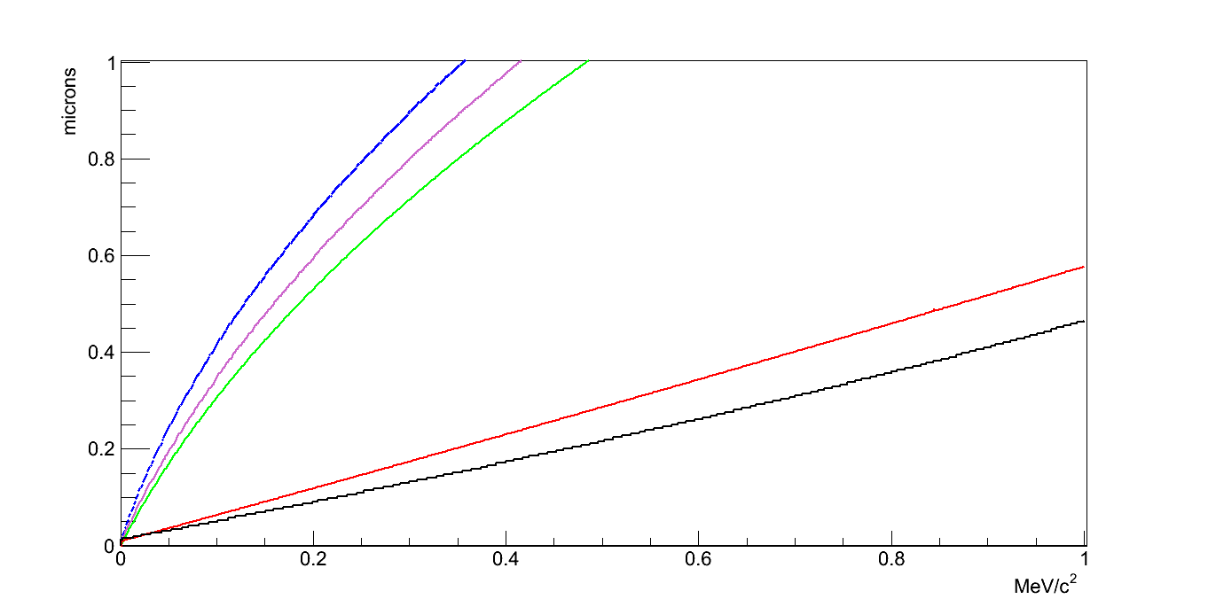
NEWS: Nuclear Emulsions for Wimp Search
Solar system movement in the galaxy → WIMP Flux is expected to be not isotropic @earth.
Directional measurement for a strong signature and unambiguous proof of the galactic DM origin
Use nuclear emulsions, i.e. solid detector → incomparably more sensitive than gas detectors
Short recoil track length O(100 nm)
Earth
WIMP wind
Sun
230km/s
N
O
Range [μm]
C
Br
Ag
Scattered Wimp
Θ
Recoil energy [MeV]
Recoil Nuclei direction
Both light and heavier nuclei

Slide 3
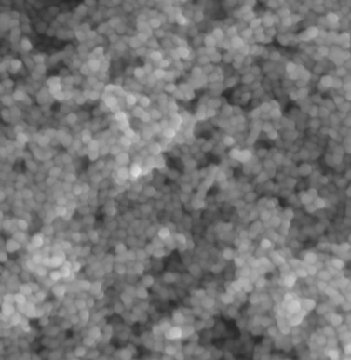
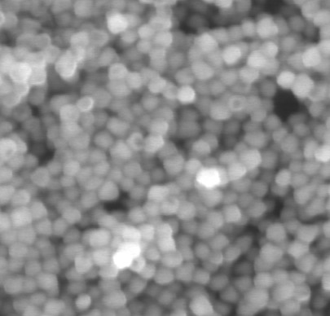
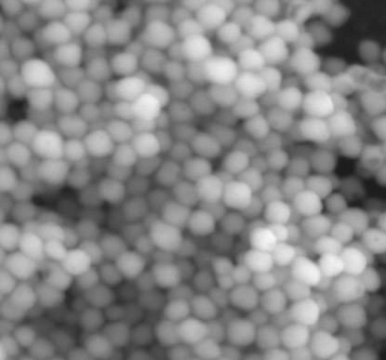
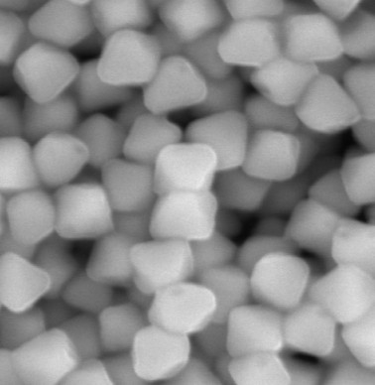
NIT emulsion films: Nano Imaging Trackers
35 nm crystal
70 nm crystal
100 nm crystal
200 nm crystal
Natsume et al,
NIM A575 (2007) 439
Size
R&D

Slide 4
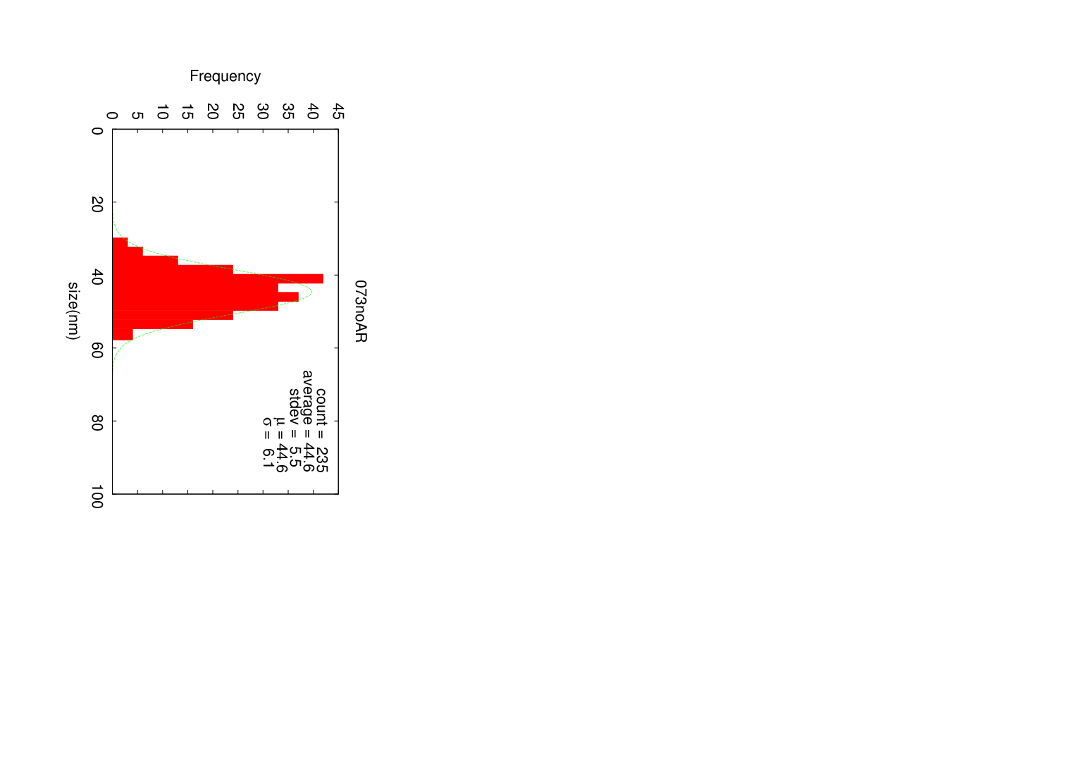
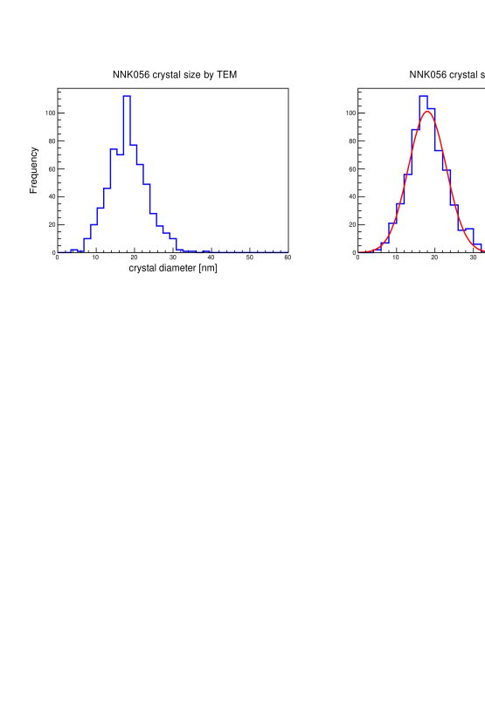
NIT emulsion films: Nano Imaging Trackers
35 nm crystal
70 nm crystal
100 nm crystal
200 nm crystal
Natsume et al,
NIM A575 (2007) 439
Size
R&D
NIT
U-NIT
Mean : 44.6 +- 0.4 [nm]
Sigma : 6.1 +- 0. 3 [nm]
Mean : 18.0 +- 0.2 [nm]
sigma: 4.9 +- 0.2 [nm]
Crystal diameter [nm]
Crystal diameter [nm]

Slide 5
NIT emulsion films: Nano Imaging Trackers
35 nm crystal
70 nm crystal
100 nm crystal
200 nm crystal
Natsume et al,
NIM A575 (2007) 439
Size
R&D
NIT
U-NIT
Mean : 44.6 +- 0.4 [nm]
Sigma : 6.1 +- 0. 3 [nm]
Mean : 18.0 +- 0.2 [nm]
sigma: 4.9 +- 0.2 [nm]
Crystal diameter [nm]
Crystal diameter [nm]
 | NIT | U-NIT
AgBr density | 12 AgBr/µm | 29 AgBr/µm
Detectable range | > 200 nm | > 100 nm
Tracking E threshold | > 80 keV@C | > ~ 30 keV@C

Slide 6
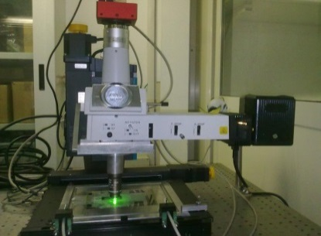
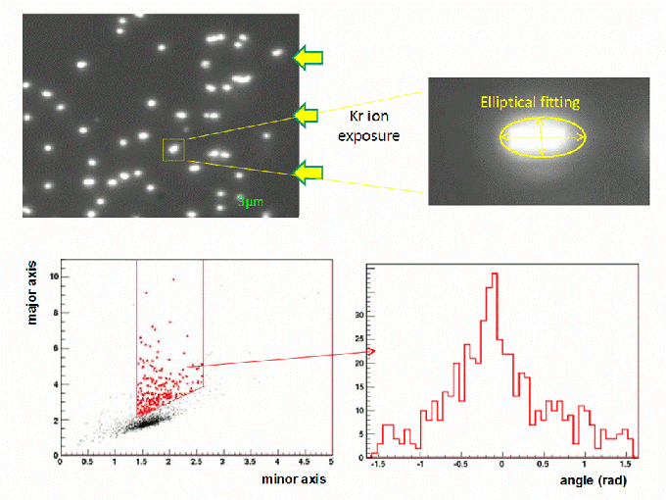
Concept of readout: step I
Scanning with optical microscope and shape recognition analysis
Test using 400 keV Kr ions
θ
Direction detected!
Nucl.Instrum.Meth. A680 (2012) 12-17

Slide 7
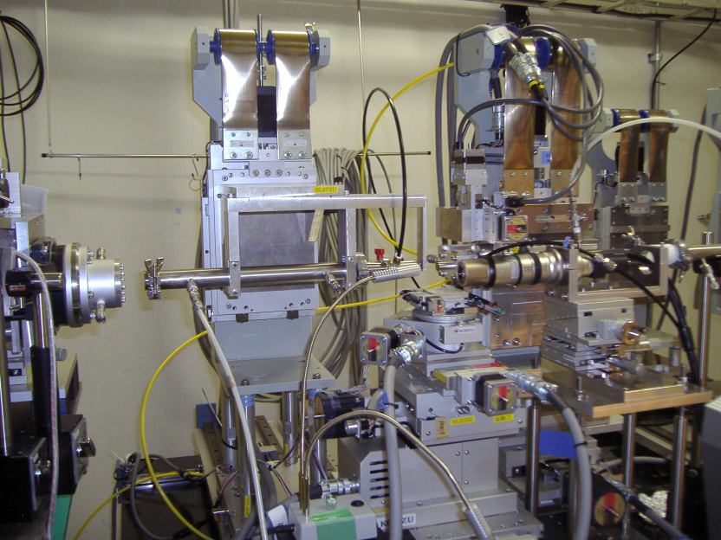

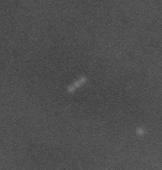

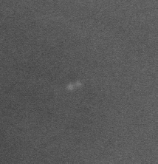
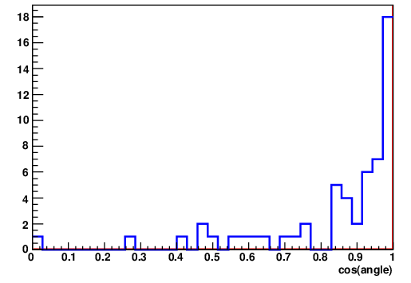

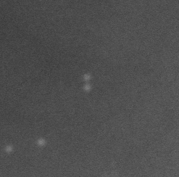
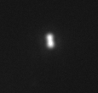
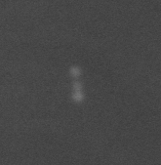
Concept of readout: step II
Scanning with X-ray microscope of preselected zones
Matching of recoiled tracks between Optical and X-ray microscope
Optical microscope
486nm
X-ray microscope
Success rate of matching
572/579=99%
236nm
330nm
600nm
 | angular resolution [degrees]
optical microscope | 31.4 +- 4.7 degree @original range: 150-250nm
X-ray microscope | 16.8+-2.9 degree @original range: 150-250nm

Slide 8
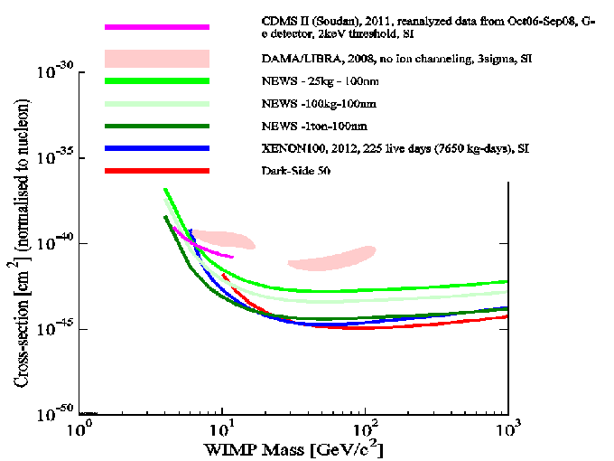
Sensitivity
Zero-background hypothesis
90% C.L.
100 nm tracking threshold
directionality information not included

Slide 9
R&D activity
Optical read-out system
Measurement of sub-micrometric length tracks:
angular resolution and efficiency evaluation
Intrinsic background measurement
External background evaluation
MC simulation
NIT technology
Future?
Notes:
* v. Yoshimoto + Machii (parte finale)

Slide 10
R&D activity
Optical read-out system
Measurement of sub-micrometric length tracks:
angular resolution and efficiency evaluation
Intrinsic background measurement
External background evaluation
MC simulation
NIT technology
Future?
Notes:
* v. Yoshimoto + Machii (parte finale)

Slide 11

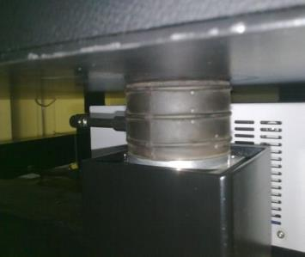
Goal -> emulsion scanning system with 200nm spatial resolution and 20cm²/h speed (=0.5 Kg/year)
Microscope with EPI illumination : 2014 prototype
Optical read-out system
Bonito CL/CMC-4000
CMOS Camera
4 Mpix, @100 fps
Resolution: 28 nm/pixel
View Size: 65.2 x 48.3 µm
Magnifying lens,
Nikon VM C-2.5x
Pneumatic Vibration Dumper
100W
Halogen
Lamp
Nikon Oil Objective
100x, 1.25 N.A., Plan
Green Optical Filter

Slide 12
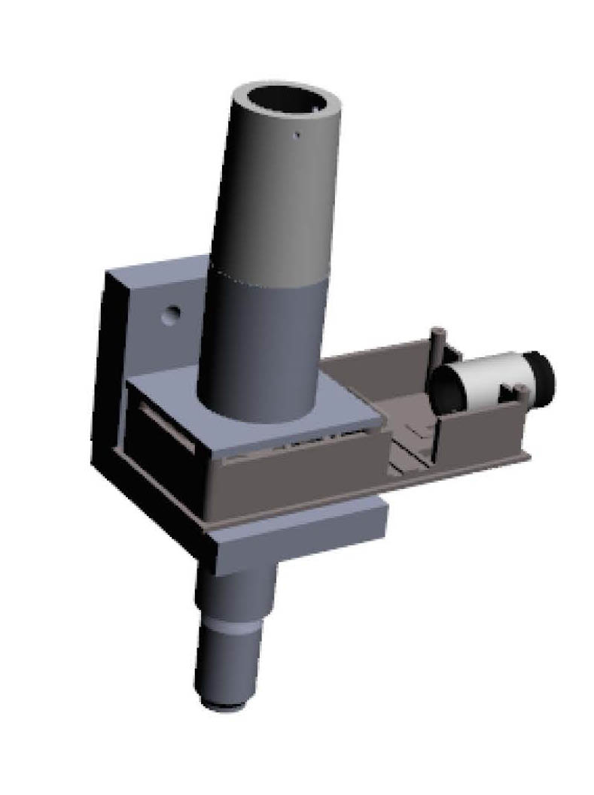
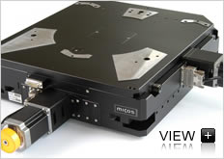
Scanning speed and further upgrades
RESOLUTION | Field of view (micron²) | Speed (kg/y) | Frame rate
4 Mpix Mikrotron 4096 X 3072 12 Mpix | 204 x 153 | 0.5 | 560 f/s CoaXPress 180 f/s CoaXpress
Custom mechanics for the optical path
More rigid
Lighter
Custom LED
Tune magnification through the camera position
Tune the illumination optical path
Repeatability 0,2 micron (1)
Yaw 20 microrad (500)
X-Y stage

Slide 13
R&D activity
Optical read-out system
Measurement of sub-micrometric length tracks:
angular resolution and efficiency evaluation
Intrinsic background measurement
External background evaluation
MC simulation
NIT technology
Future?
Notes:
* v. Yoshimoto + Machii (parte finale)

Slide 14
R&D activity
Optical read-out system
Measurement of sub-micrometric length tracks:
angular resolution and efficiency evaluation
Intrinsic background measurement
External background evaluation
MC simulation
NIT technology
Next test beams and exposures
    Measurement of neutron-background at LNGS underground
    Ion implantation
    Exposure to neutron sources
NIT as sub-micrometric tracking detector
Demonstrators:
Slow Ion implantation
Neutron test beam
Notes:
* v. Yoshimoto + Machii (parte finale)

Slide 15
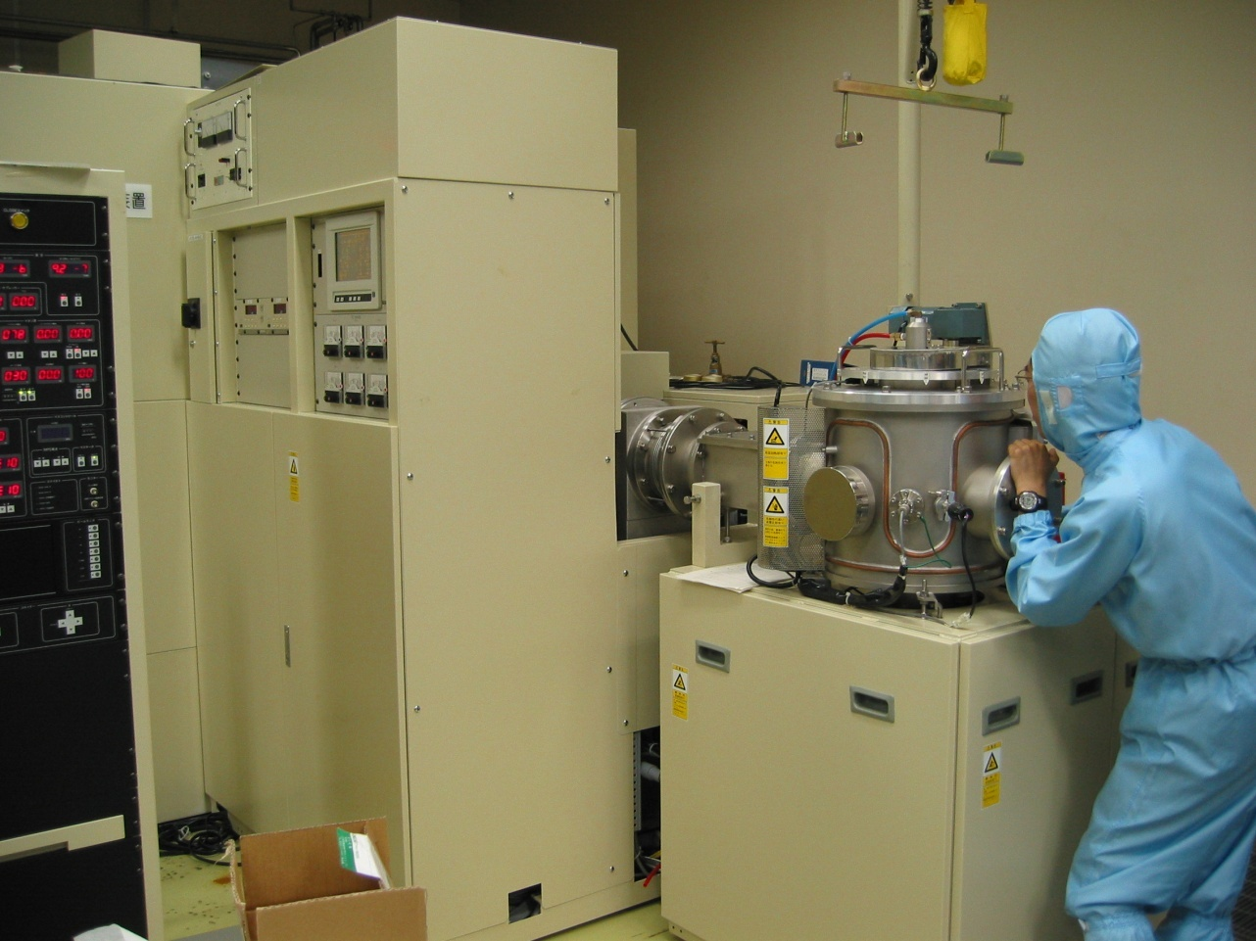
Slow Ion Implantation
gas: Kr or C
Energy: 30 ~ 200 [keV] * ion valence
→min 5 keV (Feb 2014, upgrade)
- implantation density > 10⁷ /cm²
Ion implantation system@Nagoya Univ.
sample
horizontal
density ~ 10⁷ /cm²
“Simulation” of WIMP-induced nuclear recoil
**
(exposure time ; 0.1 sec)
vertical
200keV, 300keV, 400keV Kr-ion
(130nm, 200nm, 250nm)
Notes:
** aggiungere SRIM simulation

Slide 16
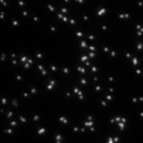
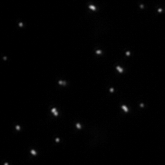
Actual images with E600 MS
Slow Ion Implantation
gas: Kr or C
Energy: 30 ~ 200 [keV] * ion valence
Irradiation direction ⦿
Irradiation direction
10µm
Vertical
Kr 400keV
Horizontal
Kr 400keV

Slide 17
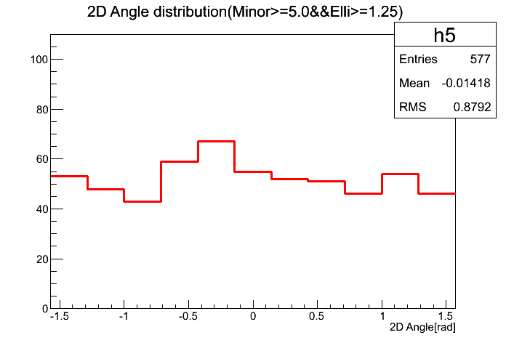
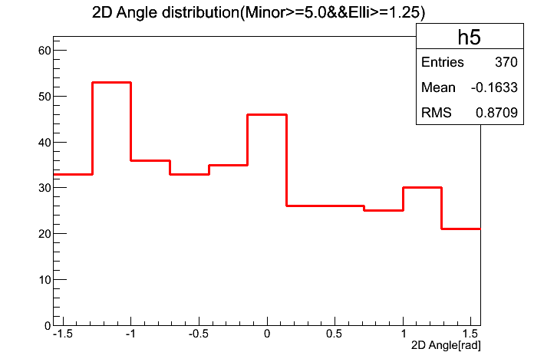
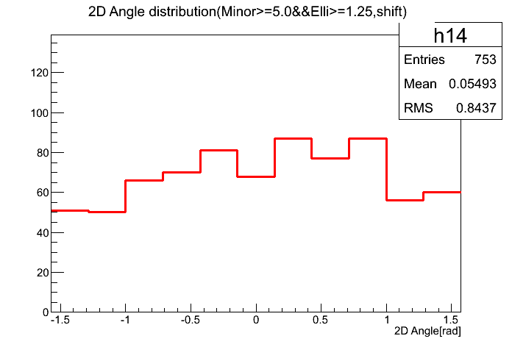
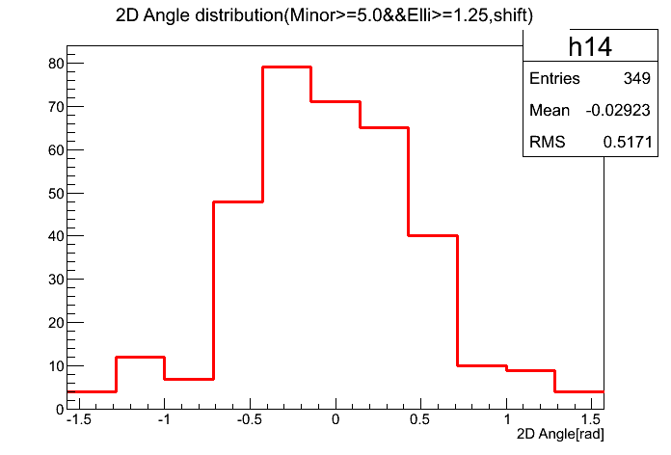
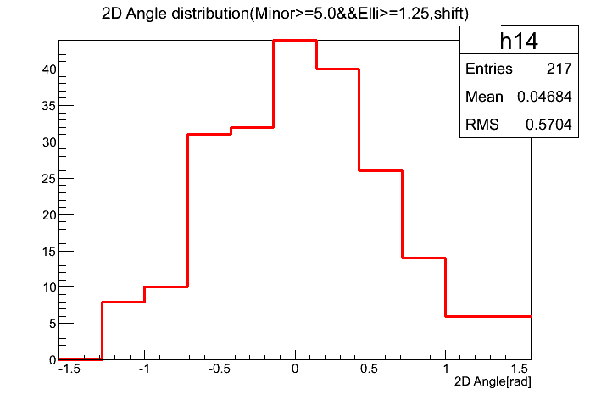
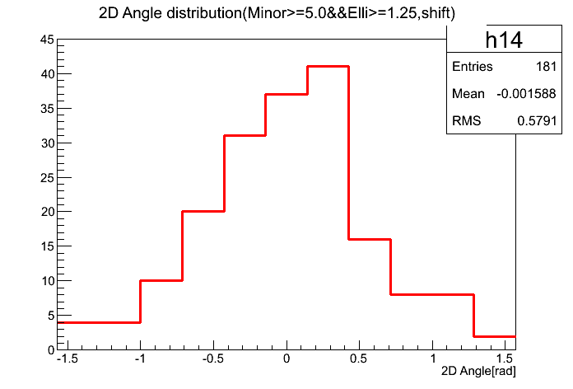
Horizontal 400keV
Angular distribution
Vertical 400keV
Vertical 300keV
Vertical 200keV
Horizontal 300keV
Horizontal 200keV
Notes:
Sigma: 500, 570, 580 mrad
Length: 250, 200, 130nm

Slide 18
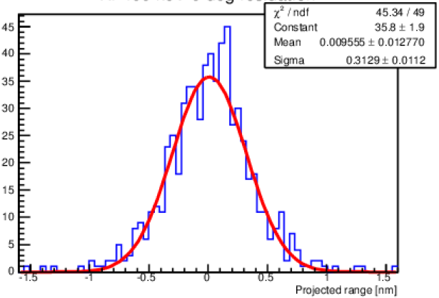
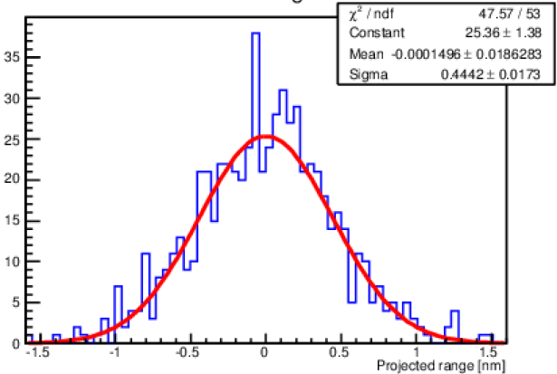
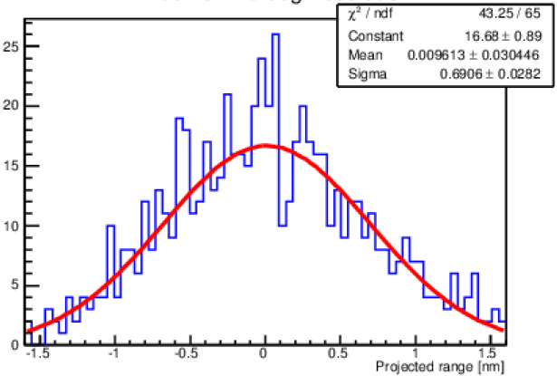
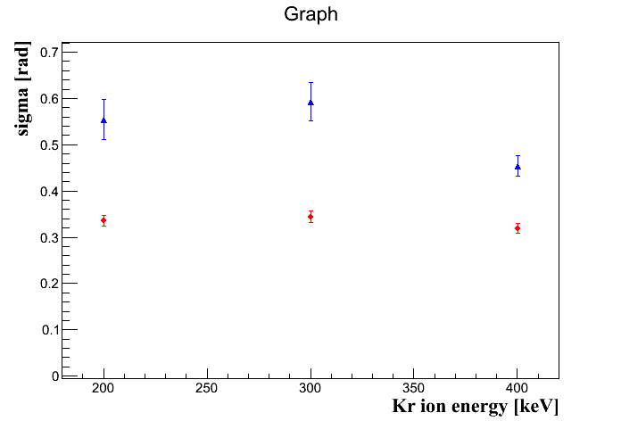
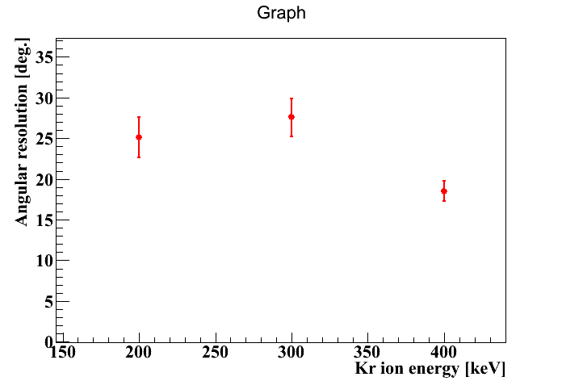
Angular distribution
Simulation
Simulation
Simulation
400keV
Angu.reso
Angu.reso
Angular
resolution
0 deg.
20deg.
40deg.
(only scattered)
Preliminary
- simulation (scattering)
－ data
σ_{data}² = σ_{scatt}² + σ_{resolusion}²

Slide 19
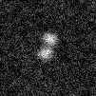
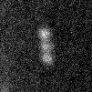
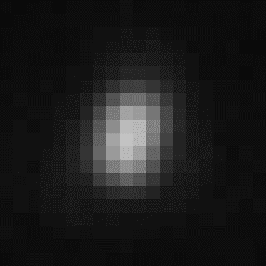
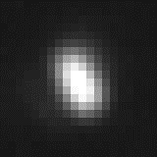
Efficiency evaluation
- First scan: X-ray microscope with sequence mode (Area scan)
& selection of the candidate (Track like)
- Second scan: Optical microscope by pin-point check
& Ellipse fit
X-ray MS
・ 10.83nm / pix
・ 2048 x 2048 pix CCD
281 nm
171 nm
Elli 1.48
Elli 1.68
1.1 μm
1.1 μm

Slide 20
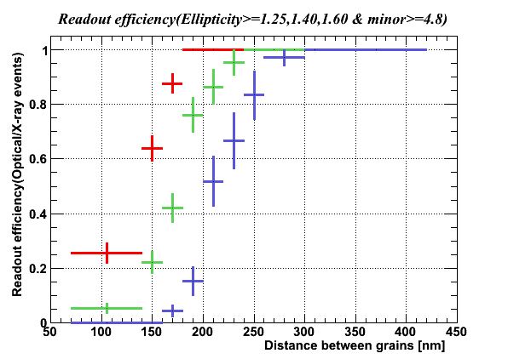
Efficiency evaluation
- 2012 data
- Elli>=1.25
- Track length: 180~340nm
- Grain size ~200nm
- NA1.25 & λ ~ 550nm
- New data
- Elli>=1.25, 1.40, 1.60
- Track length: 50~450nm
- Grain size ~100nm
- NA1.45 & λ ~ 440nm

Slide 21
R&D activity
Optical read-out system
Measurement of sub-micrometric length tracks:
angular resolution and efficiency evaluation
Intrinsic background measurement
External background evaluation
MC simulation
NIT technology
Future?
Notes:
* v. Yoshimoto + Machii (parte finale)

Slide 22
Intrinsic radioactive contamination
Gelatin sample | Contamination [ppb] | Activity [mBQ/kg]
Th | 2.7 | 11
U | 3.9 | 48
Costituent | Mass fraction
AgBrI | 0.813
Gelatin | 0.1253
PVA | 0.0617
PVA | Contamination [ppb] | Activity [mBQ/kg]
Th | <0.5 | <2
U | <0.7 | <9
AgBrI | Contamination [ppb] | Activity [mBQ/kg]
Th | 1 | 4
U | 1.5 | 18
From ²³⁸U: 1.75 ppb (21.6 mBq/kg)
From ²³²Th: 1.18 ppb (4.8 mBq/Kg)
Polystyrene | Contamination [ppb] | Activity [mBQ/kg]
Th | 0.019 | 0.08
U | 0.009 | 0.11
Mass spectrometry measurements
Uncertainty on contamination : 30%
Conversion factors: 1 Bq/Kg(²³²Th) = 246 ppb(²³²Th) ; 1 Bq/Kg(²³⁸U) = 81 ppb(²³⁸U)

Slide 23
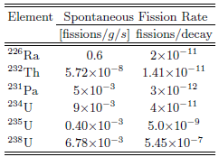
Cross-check with γ spectroscopy
Intrinsic neutron background
1) n from spontaneous fission
The only relevant contribution comes from ²³⁸U
(fission probability/decay negligible for other elements)
2) (α,n) reactions by α from ²³⁸U and ²³²Th chains
Secular equilibrium valid for AgBr-I "potassium free” powder
Evidence for broken secular equilibrium at ²²⁶Ra for Gelatine P6406. The measured activity is ~ 20 times less → to be estimated (conservative assumption)
Emulsion film thickness not enough to stop all α particle; → overestimation of the neutron flux (conservative assumption)

Slide 24
Intrinsic neutron background
Neutron spectrum calculated with SOURCES simulation code
Process | SOURCES calculation (n kg⁻¹ y⁻¹) | calculation by hand (n kg⁻¹ y⁻¹)
Spontaneous fission | 0.745 | 0.768
(α,n) from ²³²Th-chain | 0.109 | 0.100
(α,n) from ²³⁸U-chain | 0.328 | 0.325
Total flux | 1.182 | 1.193

Slide 25
External neutron sources
Neutrons from environmental radioactivity
To be made negligible with appropriate shielding
Cosmic muon-induced neutrons
Preliminary estimation; underground expected to be less than intrinsic radioactive contamination
Differential energy spectrum of neutrons induced by 280 GeV muons
Approximations and assumptions:
Neutron differential spectrum: 10⁻⁵ n/µ/g/cm²/MeV
Material used in the simulation is C_{n}H_{2n}
Muon flux: 1/m²/h
Neutron flux: 0.009 n/kg/y/MeV
Integrating from 0 to 10 MeV → ~ 0.05 n/kg/y
A. Lindote et al., Astroparticle Phys.31 (2009) 366

Slide 26
R&D activity
Optical read-out system
Measurement of sub-micrometric length track:
angular resolution and efficiency evaluation
Intrinsic background measurement
External background evaluation
MC simulation
NIT technology
Future?
Notes:
* v. Yoshimoto + Machii (parte finale)

Slide 27
2014 - 2015 activity
New film production @ LNGS (underground)
Slow Ion implantation @ EU (C ion – 80KeV)
Further studies with neutron source (²⁴¹AmBe) @ LNGS
X-ray microscopy for cross-check and final angular resolution
Measurement of the LNGS underground neutron flux (directionality)
Hardware developments:
High resolution mechanics

Slide 28
backup

Slide 29
Neutron test beam analysis
Development of a new scanning software and a new tracking algorithm:
OPERA algorithm is optimized for the reconstruction of straight and relatively short tracks => efficiency drop for horizontal tracks
Required a new algorithm to reconstruct straight e/o curved tracks originating (or stopping) inside emulsion at any direction
Scanning and track reconstruction performed
Visual inspection of reconstructed tracks:
measurement of length and angle
Comparison between automatic and visual measurement
Comparison between data and Monte Carlo
Evaluation of tracking efficiency
z
OPERA
Dark Matter
y
x

Slide 30
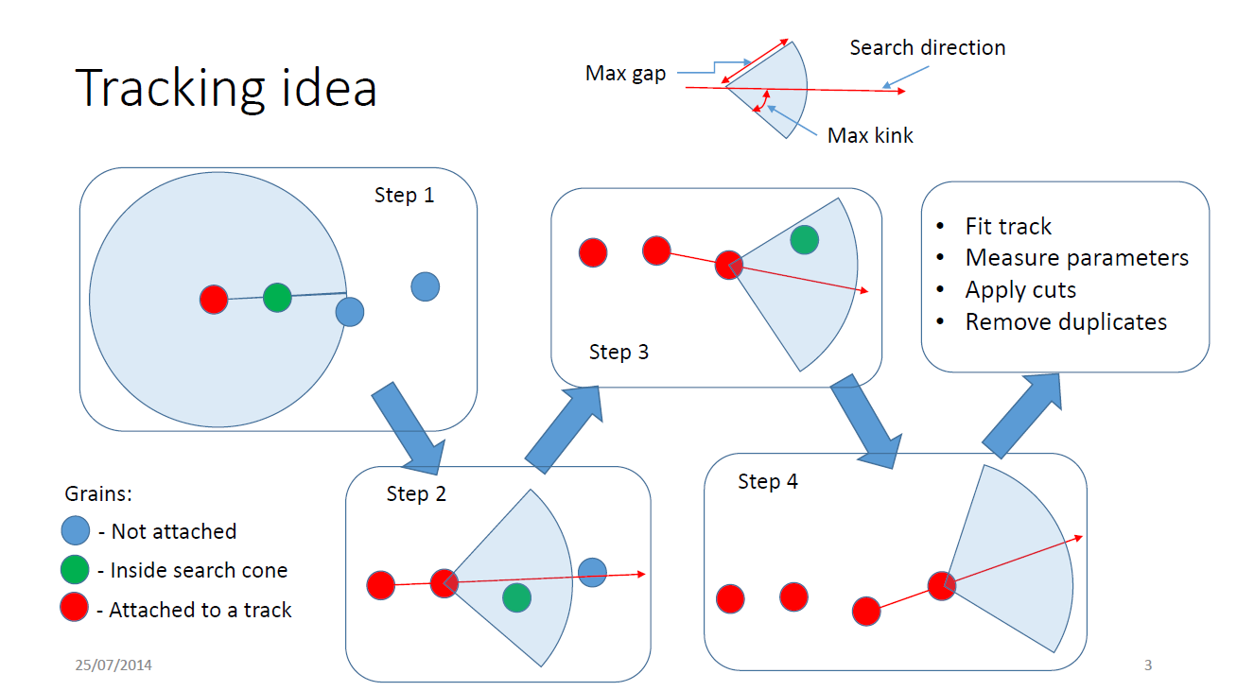
New tracking algorithm for horizontal track detection

Slide 31
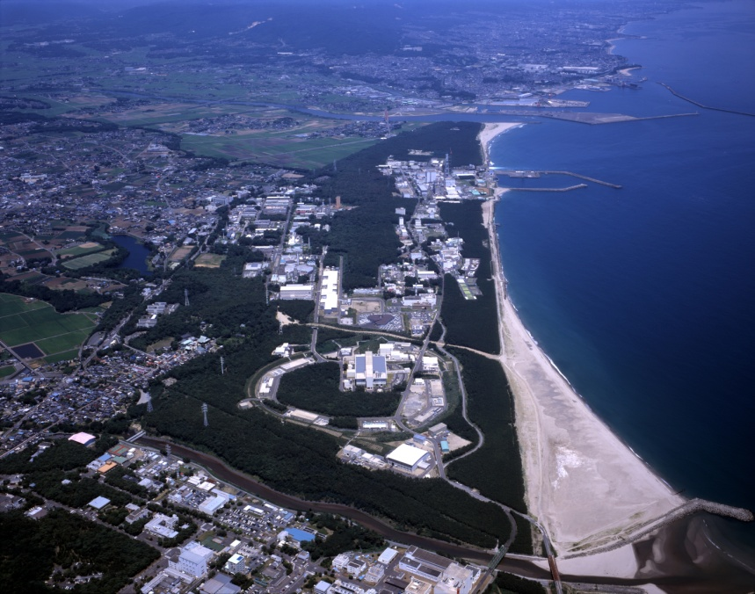
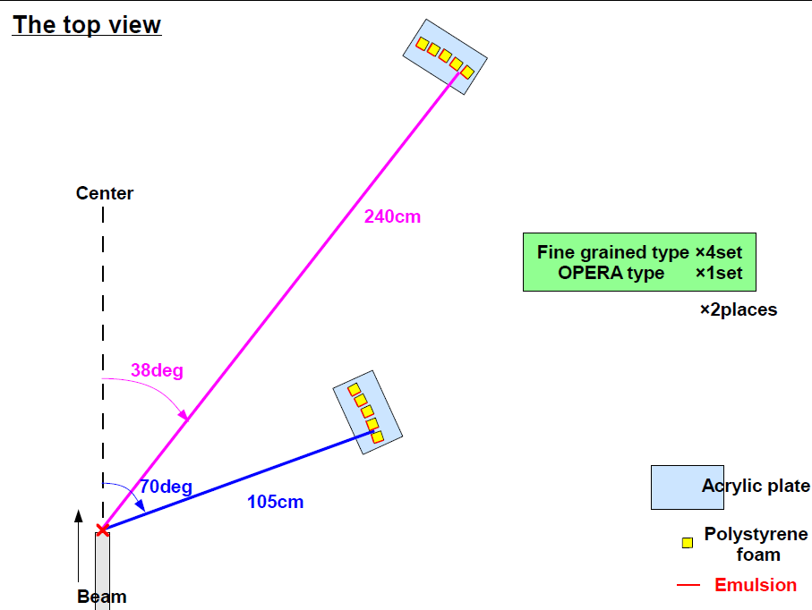
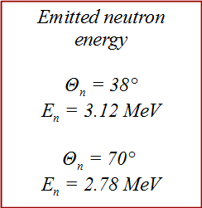
Neutron Test Beam @ FNS
FNS
50 %
³He + n (2.45 MeV)
D + D
50 %
T + p (3.45 MeV)
J-PARK
Emitted neutron energy
E_{D}=1.8MeV(AIST)
E_{D}=350keV(FNS)

Slide 32

10μm
dE/dx
31.3 µm
Ep = 1.55 MeV

Slide 33

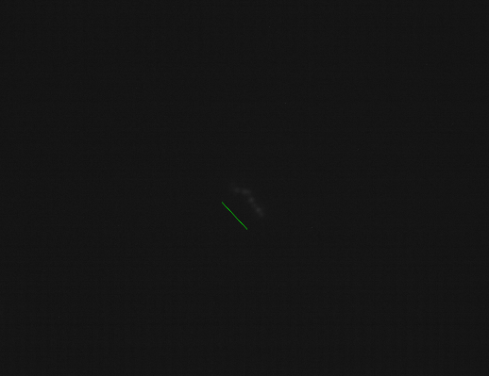
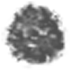
2.2 µm

Slide 34
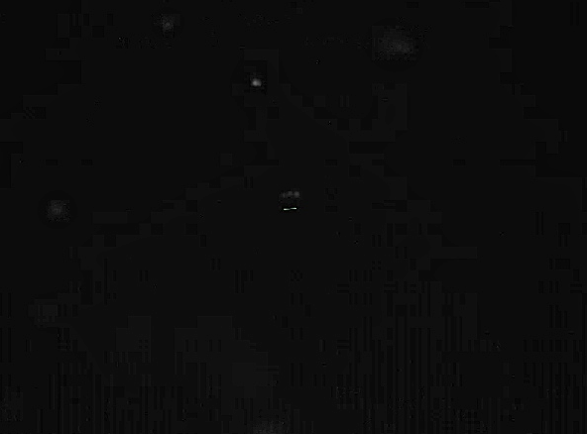
0.89 µm
Ep = 95 keV

Slide 35
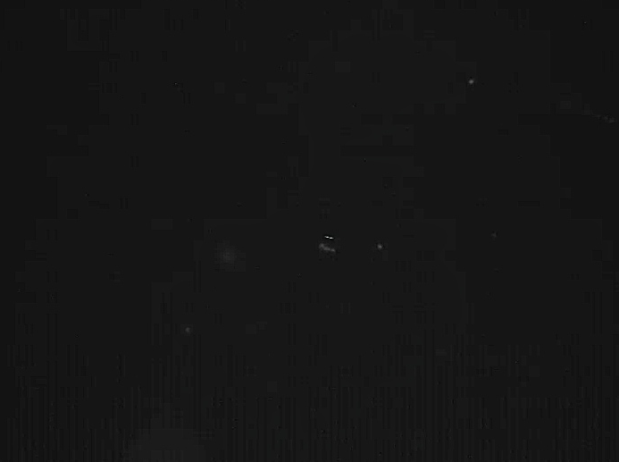
0.65 µm
Ep = 65 keV

Slide 36



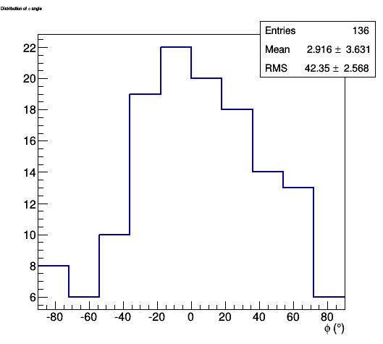
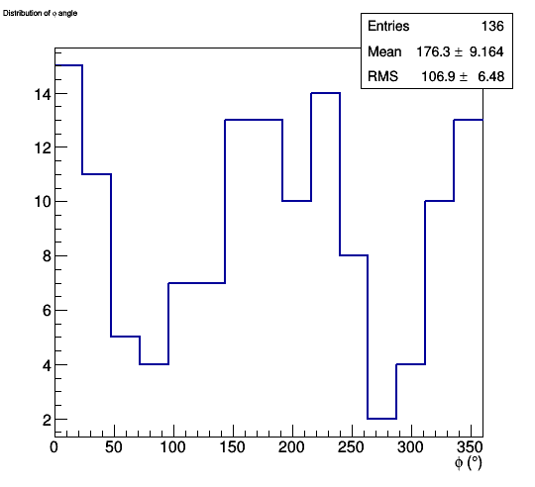







Emission angle and track length
Data
Simulation
Data
Simulation

Slide 37
Neutron energy measurement
Measurement of track length and angle
proton energy using the energy-range relation from SRIM simulation
→ neutron energy
E_{n}= E_{p} / cos²θ
E_{n} = 4.9MeV.

Slide 38

Reconstructed neutron energy (2.8MeV neutron)
2.8
2.5
2.0
1.5
0.8
neutron energy
2.7+-0.3MeV
energy resolution(σ/E)
10%
Notes:
中性子エネルギーにはもともと半値幅で4%程度の広がりがある。

Slide 39

Reconstructed neutron energy (2.8MeV neutron)
2.8
2.5
2.0
1.5
0.8
neutron energy
2.8+-0.2MeV
energy resolution(σ/E)
7%

Slide 40

Reconstructed neutron energy (2.8MeV neutron)
manual measurement
Geant4 simulation
neutron energy
2.78+-0.19MeV
energy resolution(σ/E)
7%
neutron energy
2.80+-0.16MeV
energy resolution(σ/E)
6%

Slide 41


Spatial Resolution E600
E600
PTS
Upgrade
-N.A1.25 Ob.lens
-1M camera (cell size 7.5µm)
-λ 550nm (Green band-path)
-automatic
-N.A1.45 (new!)
-4M camera (cell size 5.5µm)
-λ 440nm (Blue band-path)
-manual
-pixel size: 58nm(measured)
-Spatial resolution:
315nm(measured)
-pixel size: 55nm(measured)
-Spatial resolution:
⇒ next slide

Slide 42




0.8µm
Spatial Resolution E600
Brightness 3D
60nm silver grain
160
140
Brightness
120
×Data
－Fitting
100
80
60
40
20
δ = 232.7 ± 4.2 nm
0
0
2
4
6
8
10
12
Position [pixel], (1pix=55nm)

Slide 43



Track length vs. Ellipticity
Efficiency evaluation
ex) Elli 1.25
Yellow： All events
Red: Elli1.25 cut
Green: Elli1.5
Blue: Elli1.8
523 events
(minor≧4.8)
Pink line: Conventional signal region
ex) Elli 1.25

Slide 44
Efficiency evaluation
Red: Elli1.25 cut
Green: Elli1.40
Blue: Elli1.60
(minor≧4.8)

Slide 45

Underground facility

Slide 46


Underground facility

Slide 47







Hardware upgrades
Matrox Odyssey Xpro SFCL
Matrox Radient eCL SFCL/DFCL
PCI-X interface
up to 680 MB/sec
PCIe 8x interface
up to 1750 MB/sec
SW is ready and tested
Mikrotron MC-1310
Allied Vision Bonito CMC-4000
SFCL interface
1280 x 1024 pixels
1.2 Mpixel @ 376 fps
DFCL interface
2320 x 1726 pixels
4 Mpixel @ 386 fps
SW is ready and tested
Nikon Plan Apo
Nikon CFI Plan Apo Lambda
100X Oil
1.25 NA
100X Oil
1.45 NA
Ordered,
to be tested
PIFOC Pi-726
Piezo nano-positioner
Preliminary tests completed:
very good linearity (0.02%)
high linear speed (up to 2cm/s)
low vibration level

Slide 48

Equatorial telescope
Avalon Instruments
We are measuring the
radioactivity
of the main components

Slide 49
R&D activity
Optical read-out system
Measurement of sub-micrometric length track:
angular resolution and efficiency evaluation
Intrinsic background measurement
External background evaluation
MC simulation
NIT technology
Future?
Notes:
* v. Yoshimoto + Machii (parte finale)

Slide 50



MC Simulation – GEANT4
Phisycal processes involving neutrons activated
Relevant at low energies

Slide 51



MC Simulation – GEANT4
(E_{n}=3.12 MeV)

Slide 52



MC Simulation – GEANT4
E>3.12 MeV

Slide 53





MC Simulation – GEANT4

Slide 54


MC Simulation – GEANT4

Slide 55
2014-2018

Slide 56
2014-2018
PRELIMINARY

Slide 57
2014-2018
PRELIMINARY

