Slide 1


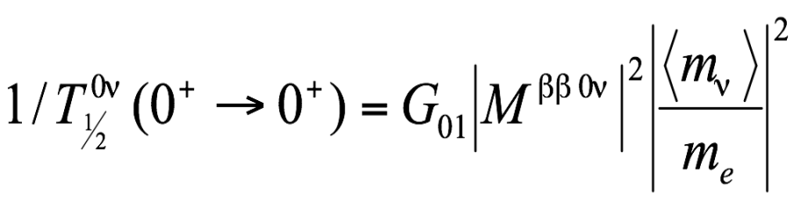
NUMEN@LNS and Neutrinoless Double Beta Decay
Francesco Cappuzzello
What Next LNGS: Prospettive per il ruolo scientifico dei LNGS
LNGS, 15 - 16 ottobre 2014

Slide 2
but requires
Nuclear Matrix Element (NME)!
New physics for the next decades
Calculations (still sizeable uncertainties): QRPA, Large scale shell model, IBM …..
Measurements (still not conclusive for 0νββ):
(π⁺, π⁻)
single charge exchange (³He,t)
electron capture
transfer reactions …
A new experimental tool: heavy-ion Double Charge-Exchange (DCE)
E. Caurier, et al., PRL 100 (2008) 052503
N. L. Vaquero, et al., PRL 111 (2013) 142501
J. Barea, PRC 87 (2013) 014315
T. R. Rodriguez, PLB 719 (2013) 174
F.Simkovic, PRC 77 (2008) 045503.
N. Auerbach, Ann. Of Phys. 192 (1989) 77
S.J. Freeman and J.P. Schiffer JPG 39 (2012) 124004
D.Frekers, Prog. Part. Nucl. Phys. 64 (2010) 281
J.P. Schiffer, et al., PRL 100 (2008) 112501

Slide 3
A new esperimental tool: DCE

Slide 4
Double charge exchange reactions
(¹⁸O,¹⁶O)
⁷⁶Se
⁷⁷Se
⁷⁸Se
(¹⁸O,¹⁸F)
⁷⁶As
(¹⁸O,²⁰Ne)
⁷⁵As
⁷⁷As
(²⁰Ne,¹⁸O)
(π⁺,π⁻), (²⁰Ne,²⁰O), ββ decay
(¹⁸O,¹⁸Ne)
(²⁰Ne,²⁰F)
⁷⁴Ge
⁷⁵Ge
⁷⁶Ge
(²⁰Ne,²²Ne)

Slide 5
Double charge exchange reactions
Abandoned for ββ physics
Pion DCE
(π⁺, π⁻) or (π⁻, π⁺)
Zero spin
Very different mechanism for Gamow-Teller (GT)
K.K. Seth et al., Phys.Rev.Lett. 41 (1978) 1589
Direct mechanism: isospin-flip processes
Heavy Ion DCE
Sequential mechanism: two-proton plus two-neutron transfer or vice-versa
D.R.Bes, O. Dragun, E.E. Maqueda, Nucl. Phys. A 405 (1983) 313.

Slide 6
Heavy-ion DCE
1
Sequential nucleon transfer mechanism 4th order:
Brink’s Kinematical matching conditions
D.M.Brink, et al., Phys. Lett. B 40 (1972) 37
2
Meson exchange mechanism 2nd order:

Slide 7
0νββ vs HI-DCE
Initial and final states: Parent/daughter states of the 0νββ are the same as those of the target/residual nuclei in the DCE;
Spin-Isospin mathematical structure of the transition operator: Fermi, Gamow-Teller and rank-2 tensor together with higher L components are present in both cases;
Large momentum transfer: A linear momentum transfer as high as 100 MeV/c or so is characteristic of both processes;
Non-locality: both processes are characterized by two vertices localized in two valence nucleons. In the ground to ground state transitions in particular a pair of protons/neutrons is converted in a pair of neutrons/protons so the non-locality is affected by basic pairing correlation length;
In-medium processes: both processes happen in the same nuclear medium, thus quenching phenomena are expected to be similar;
Relevant off-shell propagation in the intermediate channel: both processes proceed via the same intermediate nuclei off-energy-shell even up to 100 MeV.

Slide 8
About the reaction mechanism

Slide 9
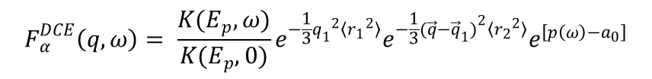


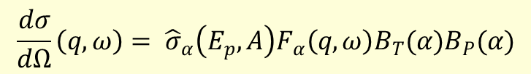
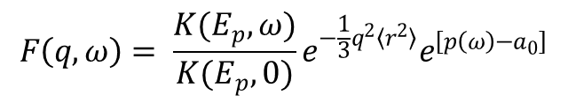
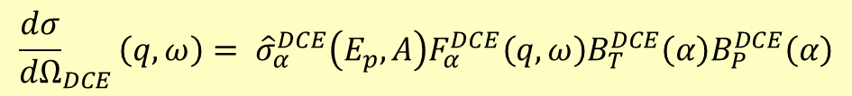
Factorization of the charge exchange cross-section
.
.
.
β-decay transition strengths
(reduced matrix elements)
for single CEX:
$$\frac{dσ}{dΩ}\left(q,ω\right)= {\hat{σ}}_{α}\left(E_{p},A\right)F_{α}\left(q,ω\right)B_{T}(α)B_{P}(α)$$
For small q
$$\hat{σ}\left(E_{p},A\right)=K(E_{p},0){\left|J_{ST}\right|}^{2}N_{ST }^{D}$$
unit cross-section
$$F\left(q,ω\right)= \frac{K(E_{p},ω)}{K(E_{p},0)}e^{−\frac{1}{3}q^{2}〈r^{2}〉}e^{\left[p\left(ω\right)−a_{0}\right]}$$
generalization to DCE:
$${\frac{dσ}{dΩ}}_{DCE}\left(q,ω\right)= {\hat{σ}}_{α}^{DCE}\left(E_{p},A\right)F_{α}^{DCE}\left(q,ω\right)B_{T}^{DCE}\left(α\right)B_{P}^{DCE}\left(α\right)$$
For small q
$${\hat{σ}}_{α}^{DCE}\left(E_{p},A\right)=K(E_{p},0){\left|{J^{′}}_{ST}\right|}^{2}N_{ST }^{D}$$
$$F_{α}^{DCE}\left(q,ω\right)= \frac{K(E_{p},ω)}{K(E_{p},0)}e^{−\frac{1}{3}{q_{1}}^{2}〈{r_{1}}^{2}〉}e^{−\frac{1}{3}{{(\vec{q}−\vec{q}}_{1})}^{2}〈{r_{2}}^{2}〉}e^{\left[p\left(ω\right)−a_{0}\right]}$$

Slide 10
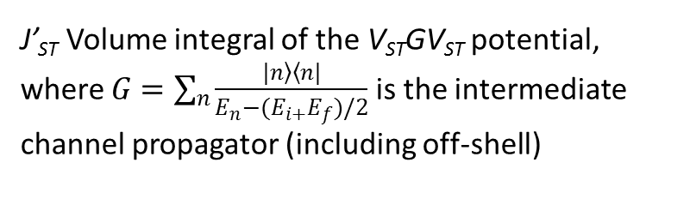



The unit cross section
Single charge-exchange
Double charge-exchange
$$\hat{σ}\left(E_{p},A\right)=K(E_{p},0){\left|J_{ST}\right|}^{2}N_{ST }^{D}$$
$${\hat{σ}}_{α}^{DCE}\left(E_{p},A\right)=K(E_{p},0){\left|{J^{′}}_{ST}\right|}^{2}N_{ST }^{D}$$
J_{ST} Volume integral of the V_{ST} potential
J’_{ST} Volume integral of the V_{ST}GV_{ST} potential, where $G=\sum_{n}{\frac{\left.|n\right\rangle \left\langle n|\right.}{E_{n}−(E_{i+}E_{f})/2}}$ is the intermediate channel propagator (including off-shell)
${\hat{σ}}_{α}^{DCE}\left(E_{p},A\right)$ is the Holy Graal
If known it would allow to determine the NME from DCE cross section measurement, whatever is the strenght fragmentation
This is what happens in single charge exchange
As an example the B(GT;CEX)/B(GT;β-decay) ∼ 1 within a few % especially for the strongest transitions

Slide 11
DCE at LNS

Slide 12
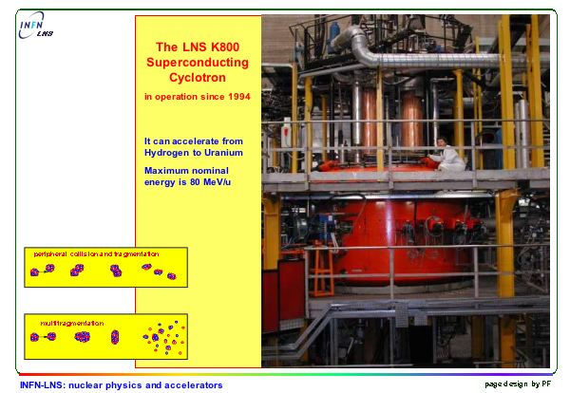
The Superconducting Cyclotron (CS) at LNS

Slide 13
(¹⁸O,¹⁸Ne) DCE reactions at LNS
⁴⁰Ca(¹⁸O,¹⁸Ne)⁴⁰Ar @ 270 MeV
0° < θ_{lab} < 10° Q = -5.9 MeV
¹⁸O and ¹⁸Ne belong to the same multiplet in S and T
Very low polarizability of core ¹⁶O
Sequential transfer processes very mismatched Q_{opt} ∼ 50 MeV
Target T = 0 only T = 2 states of the residual

Slide 14
Experimental Set-up
¹⁸O⁷⁺ beam from Cyclotron at 270 MeV (10 pnA, 330 μC in 10 days)
⁴⁰Ca solid target 300 μg/cm²
Ejectiles detected by the MAGNEX spectrometer
Unique angular setting: -2° < θ_{lab}< 10° corresponding to a momentum transfer range from 0.17 fm⁻¹ to about 2.2 fm⁻¹
Measured
¹⁶O + ⁴²Ca
Not measured
¹⁸O + ⁴⁰Ca
¹⁸F + ⁴⁰K
¹⁸Ne + ⁴⁰Ar
²⁰Ne + ³⁸Ar

Slide 15
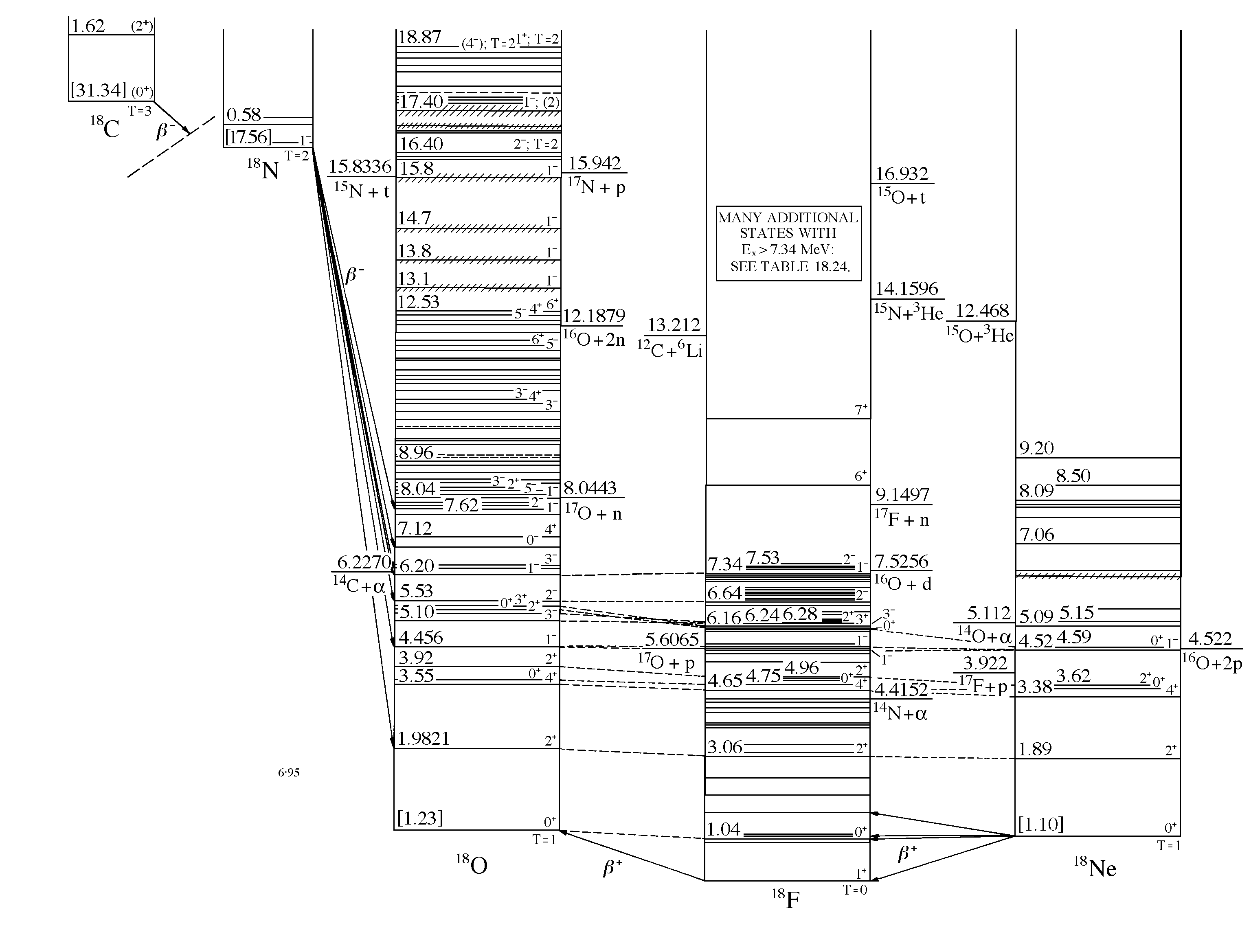
⁴⁰Ca(¹⁸O,¹⁸Ne)⁴⁰Ar
Projectile
¹⁸O
Super-allowed transition
GT strength not fragmented
¹⁸Ne
B(GT) = 3.27
B(GT) = 1.09
¹⁸F
1⁺
2.73
1⁺
g.s.
4⁻
Target
⁴⁰K
B(GT)_{total} < 0.15
B(GT)=0.023
GT strength not much fragmented
B(GT)=0.069(6)
g.s.
0⁺
g.s.
0⁺
⁴⁰Ca
⁴⁰Ar
Y. Fujita, private communication

Slide 16
About ⁴⁰Ca ground state
1f_{5/2}
1f_{7/2}
1d_{3/2}
2s_{1/2}
1d_{5/2}
1p_{1/2}
1p_{3/2}
1s_{1/2}
p
p
n
n
n
p
|⁴⁰Ca_{g.s.}>=0.88|[1d_{3/2}⊗1d_{3/2}]⁰⁺> +0.06 |[1f_{7/2}⊗1f_{7/2}]⁰⁺>+0.06 |[1f_{5/2}⊗1f_{5/2}]⁰⁺>
Pauli blocked

Slide 17
Double Charge Exchange on ⁴⁰Ca ground state
1f_{5/2}
1f_{5/2}
1f_{7/2}
1f_{7/2}
1d_{3/2}
1d_{3/2}
2s_{1/2}
2s_{1/2}
1d_{5/2}
1d_{5/2}
1p_{1/2}
1p_{1/2}
1p_{3/2}
1p_{3/2}
1s_{1/2}
1s_{1/2}
n
p
n
p
n
p
⁴⁰Ca_{g.s.}
⁴⁰K_{g.s.}
⁴⁰Ar_{g.s.}

Slide 18
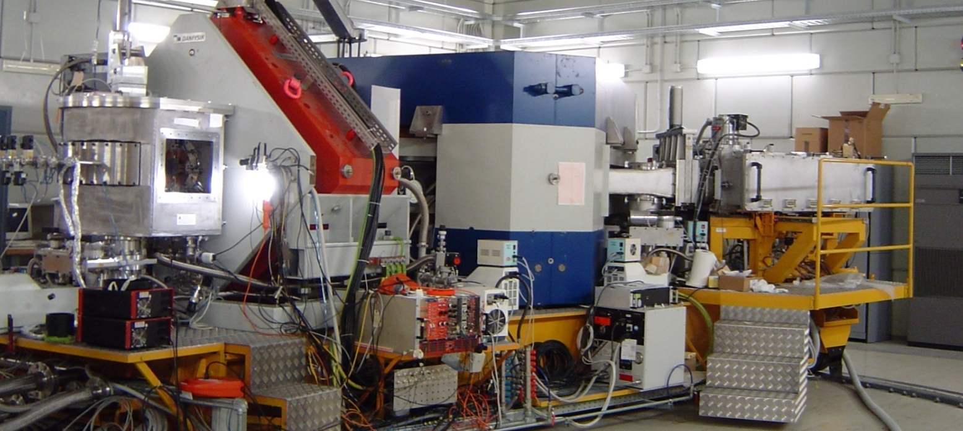
MAGNEX
F. Cappuzzello et al., MAGNEX: an innovative large acceptance spectrometer for nuclear reaction studies, in Magnets: Types, Uses and Safety (Nova Publisher Inc., NY, 2011) pp. 1–63.
Optical characteristics | Measured values
Maximum magnetic rigidity | 1.8 T m
Solid angle | 50 msr
Momentum acceptance | -14.3%, +10.3%
Momentum dispersion for k= - 0.104 (cm/%) | 3.68
Achieved resolution
Energy ΔE/E ∼ 1/1000
Angle Δθ ∼ 0.2°
Mass Δm/m ∼ 1/160
Quadrupole
Dipole
Scattering
Chamber
Focal Plane
Detector

Slide 19
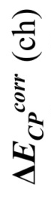

Particle Identification
Z identification
A identification
²²Ne
²¹Ne
²⁰Ne
¹⁹Ne
Na
¹⁸Ne
Ne
F
X_{foc}(m)
E_{resid} (ch)
A. Cunsolo, et al., NIMA484 (2002) 56
A. Cunsolo, et al., NIMA481 (2002) 48
F. Cappuzzello et al., NIMA621 (2010) 419
F. Cappuzzello, et al. NIMA638 (2011) 74
E_{resid} (ch)

Slide 20
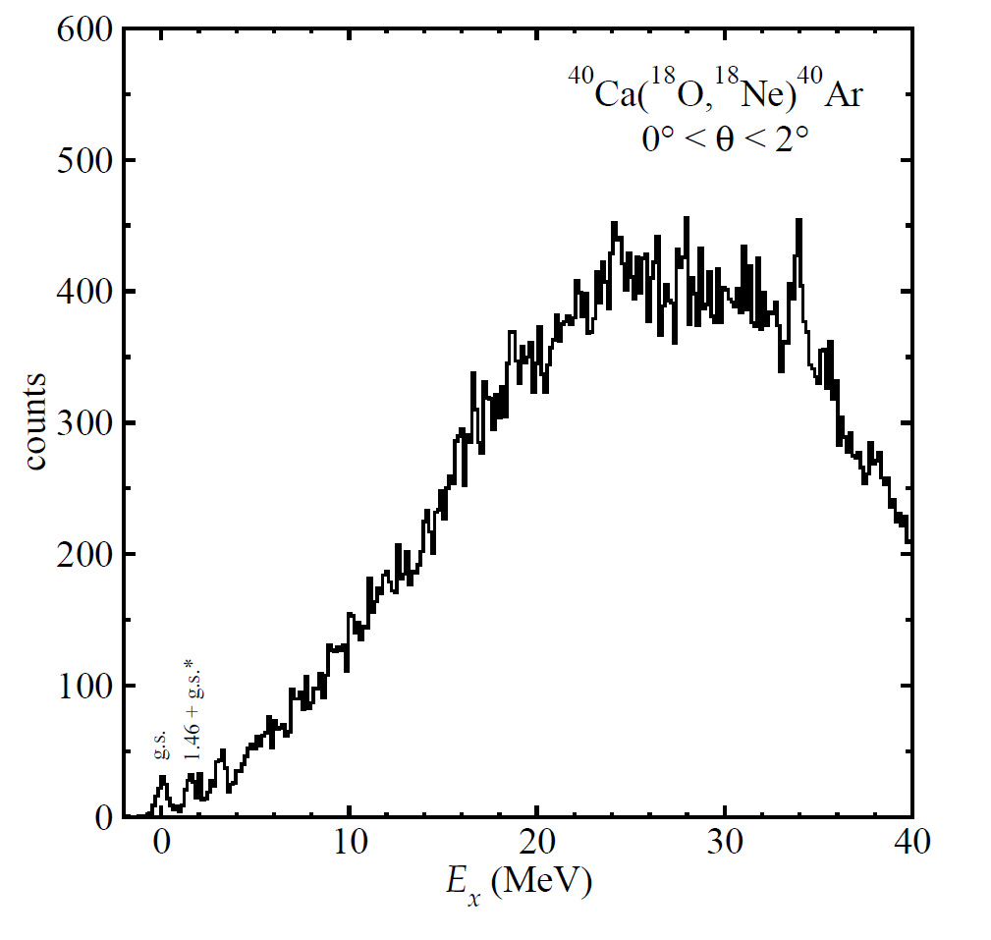
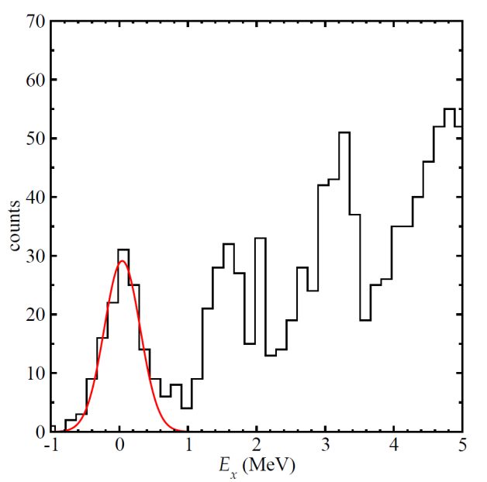
⁴⁰Ca(¹⁸O,¹⁸Ne)⁴⁰Ar @ 270 MeV
The ⁴⁰Ar 0⁺ ground state is well separated from the first excited state 2⁺ at 1.46 MeV
FWHM ~ 0.5 MeV

Slide 21
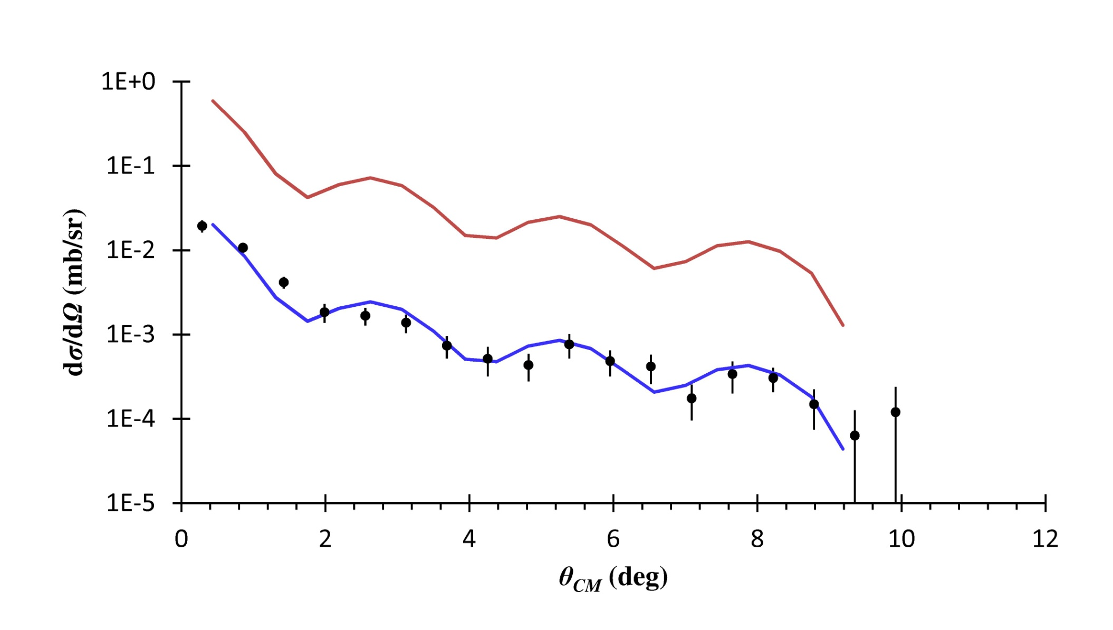



⁴⁰Ca_{g.s.}(0⁺)(¹⁸O,¹⁸Ne)⁴⁰Ar_{g.s.} (0⁺) @ 270 MeV
$${\frac{dσ}{dΩ}}_{DCE}\left(q,ω\right)= {\hat{σ}}_{α}^{DCE}\left(E_{p},A\right)F_{α}^{DCE}\left(q,ω\right)B_{T}^{DCE}\left(α\right)B_{P}^{DCE}\left(α\right)$$
$${\frac{dσ}{dΩ}}_{DCE}\left(q,ω\right)= {\hat{σ}}_{α}^{DCE}\left(E_{p},A\right)F_{α}^{DCE}\left(q,ω\right)$$
$B_{T}^{DCE}\left(GT\right)B_{P}^{DCE}\left(GT\right)$ = 0.17
preliminary

Slide 22
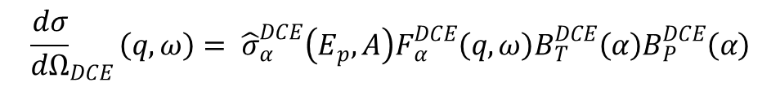
Assuming pure GT
The ⁴⁰Ca(¹⁸O,¹⁸Ne)⁴⁰Ar case:
$${\frac{dσ}{dΩ}}_{DCE}\left(q,ω\right)= {\hat{σ}}_{α}^{DCE}\left(E_{p},A\right)F_{α}^{DCE}\left(q,ω\right)B_{T}^{DCE}\left(α\right)B_{P}^{DCE}\left(α\right)$$
87 μb/sr
0.72
0.17
To be compared to:
B²[GT;¹⁸O_{gs}(0⁺)→ ¹⁸F_{gs}(1⁺)] * B²[GT;⁴⁰Ca_{gs}(0⁺)→ ⁴⁰K_{0-6MeV}(1⁺)]
= 3.56
= 0.0075
Y. Fujita private communication
0.098
D.J.Mercer et al. Phys. Rev. C 49 (1994) 3104

Slide 23
Assuming pure F
The ⁴⁰Ca(¹⁸O,¹⁸Ne)⁴⁰Ar case:
$${\frac{dσ}{dΩ}}_{DCE}\left(q,ω\right)= {\hat{σ}}_{α}^{DCE}\left(E_{p},A\right)F_{α}^{DCE}\left(q,ω\right)B_{T}^{DCE}\left(α\right)B_{P}^{DCE}\left(α\right)$$
39 μb/sr
0.77
0.36
To be compared to:
B²[F;¹⁸O_{gs}(0⁺)→ ¹⁸F_{gs}(1⁺)] * B²[F;⁴⁰Ca_{gs}(0⁺)→ ⁴⁰K_{0-6MeV}(1⁺)]
= 4.00
= 0.138
0.55
Y. Fujita private communication
D.J.Mercer et al. Phys. Rev. C 49 (1994) 3104

Slide 24
Preliminary matrix elements
Pure GT
Pauli blocking about 1/7
Pure F

Slide 25
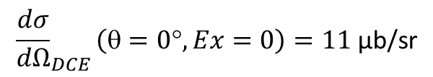
Assuming incoherent sum of F + GT
The ⁴⁰Ca(¹⁸O,¹⁸Ne)⁴⁰Ar case:
${\frac{dσ}{dΩ}}_{DCE}\left(θ=0°,Ex=0\right)= {\hat{σ}}_{F}^{DCE}F_{F}^{DCE}B\left(2F\right)$+ ${\hat{σ}}_{GT}^{DCE}F_{GT}^{DCE}B\left(2GT\right)$= 20 ± 10 μb/sr
13 μb/sr
7 μb/sr
To be compared to:
$${\frac{dσ}{dΩ}}_{DCE}\left(θ=0°,Ex=0\right)=11 \text{μ}\text{b}\text{/}\text{sr}$$

Slide 26
The NUMEN project
Determining the Nuclear Matrix Elements of Neutrinoless Double Beta Decays
by Heavy-Ion Double Charge Exchange Reactions
Proponents: C. Agodi, M. Bondì, V. Branchina, L. Calabretta, F. Cappuzzello, D. Carbone, M. Cavallaro, M. Colonna, A. Cunsolo, G. Cuttone, A. Foti, P. Finocchiaro, V. Greco, L. Pandola, D. Rifuggiato, S. Tudisco
Spokespersons: F. Cappuzzello (cappuzzello@lns.infn.it) and C. Agodi (agodi@lns.infn.it)

Slide 27
Moving towards hot-cases
Caveat
The (¹⁸O,¹⁸Ne) reaction is particularly advantageous, but it is of β⁺β⁺ kind;
None of the reactions of β⁻β⁻ kind looks like as favourable as the (¹⁸O,¹⁸Ne).
(¹⁸Ne,¹⁸O) requires a radioactive beam
(²⁰Ne,²⁰O) or (¹²C,¹²Be) have smaller B(GT)
In some cases gas target will be necessary, e.g. ¹³⁶Xe or ¹³⁰Xe
In some cases the energy resolution is not enough to separate the g.s. from the excited states in the final nucleus → Coincident detection of γ-rays
A strong fragmentation of the double GT strength is known in the nuclei of interest compared to the ⁴⁰Ca.

Slide 28
Major upgrade of LNS facilities
The CS accelerator current upgrade (from 100 W to 5-10 kW);
The MAGNEX focal plane detector will be upgraded from 1 khz to 100 khz
The MAGNEX maximum magnetic rigidity will be increased
An array of detectors for γ-rays measurement in coincidence with MAGNEX will be built
The beam transport line transmission efficiency will be upgraded from about 70% to nearly 100%
The target technology for intense heavy-ion beams will be developed

Slide 29

The unit cross section (an ambitious task)
Studying if the ${\hat{σ}}_{α}^{DCE}\left(E_{p},A\right)$ is a smooth (and thus controllable) function of E_{p} and A is the most ambitious goal of our project
This requires that a systematic set of appropriate data is built, facing the relative experimental challenges connected with the low cross sections and resolution requests
Goal N.1 for NUMEN

Slide 30
Measured DCE cross section and theory
The degree of complexity of DCE cross sections and 0νββ is comparable
The measured DCE cross sections provide a powerful tool for theory in order to give very stringent constraints in the NME estimation
The DCE processes can be artificially generated in the lab! (Few labs. as the LNS)
A new generation of DCE constrained 0νββ NME theoretical calculations can emerge
Promoting this kind of evolution is a main purpose of our project
Goal N.2 for NUMEN

Slide 31
DCE cross sections and sensitivity of 0νββ experiments
Providing relative NME information on hot cases of 0νββ is strongly required by the community in order to compare the sensitivity of different half-life experiments
This could impact in future development of the field
Goal N.3 for NUMEN

Slide 32
The Phases of NUMEN project
LNS
Phase1: The experimental feasibility
Phase2: “hot” cases optimizing the set-up and getting first results
Phase3: The facility Upgrade (Cyclotron, MAGNEX, beam line, …..):
Phase4 : The systematic experimental campaign
Preliminary time table
year | 2013 | 2014 |  | 2015 | 2016 | 2017 |  | 2018 | 2019 |  | 2020
Phase1
Phase2
Phase3
Phase4

Slide 33
Conclusions and Outlooks
The factorization of DCE cross sections is potentially a major source of information about NME for 0νββ
Pioneering experiments at RCNP (Osaka) and LNS (Catania) are showing that the (¹⁸O,¹⁸Ne) cross section can be suitably measured
Magnetic spectrometers are essential, especially with large acceptance
Strong limitation from present available beam current
High beam intensity is the new frontier for these studies
Strong synergy between heavy-ion and neutrino community

Slide 34

The role of LNS
What we put on the table
We have MAGNEX, perhaps the most suitable instrument for these studies
We have a long tradition in heavy-ion physics, experimental and theoretical
We have a solid experience in accelerator physics
What we need to upgrade
We need to carefully explore other targets and reactions as (²⁰Ne,²⁰O) or (¹²C,¹²Be)
We need to have a factor 10-100 more beam current from the accelerator
LNS can realistically compete

Slide 35
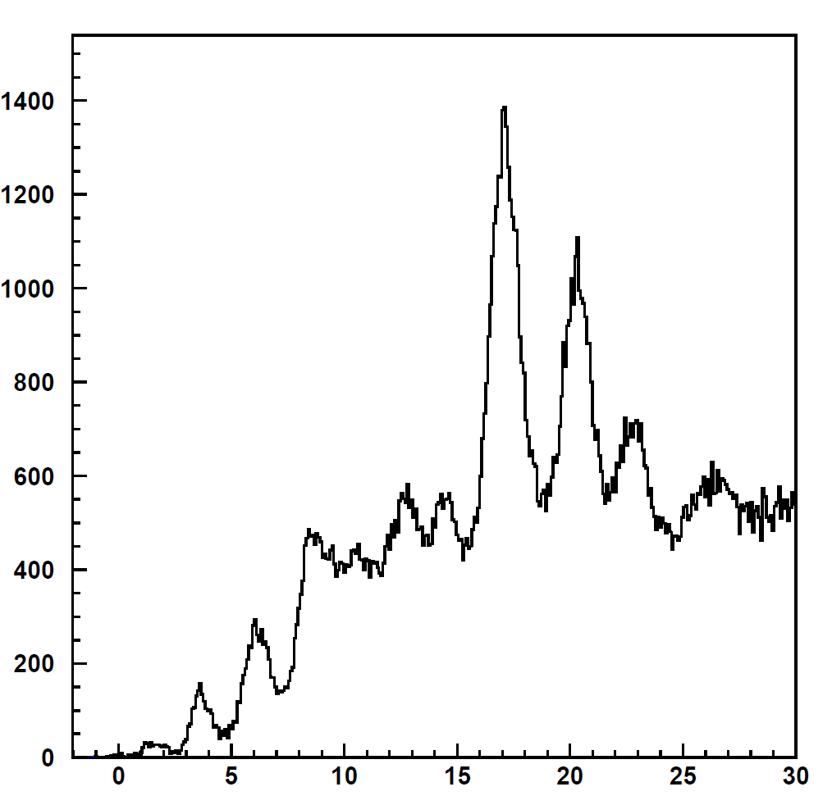
The role of the transfer reactions
⁴⁰Ca(¹⁸O,²⁰Ne)³⁸Ar @ 270 MeV
Suppression of the ⁴⁰Ca(¹⁸O,¹⁶O)⁴²C channel
0°< θ_{lab}<10°
Very weak
⁴⁰Ca
⁴²Ca
counts
³⁸Ar
⁴⁰Ar
dσ/dω(L=0; θ=0°) ∼ 10 μb/sr
l = 8
l = 6
g.s.* + 2.167 l = 2
Suppression of L = 0 in the pair transfer
l = 4
g.s. l = 0
Suppression of L > 0 in the double pair transfer
E* (MeV)

Slide 36
A fundamental property
The complicated many-body heavy-ion scattering problem is largely simplified for direct quasi-elastic reactions
V_{α} (r_{α} ,χ_{α}) = U_{α} (r_{α}) + W_{α}(r_{α} ,χ_{α})
Optical potential
Residual interaction
For charge exchange reactions the W_{α}(r_{α} ,χ_{α}) is ‘small’ and can be treated perturbatively
In addition the reactions are strongly localized at the surface of the colliding systems and consequently large overlap of nuclear densities are avoided
Accurate description in fully quantum approach, eg. Distorted Wave techniques
Microscopic derived double folding potentials are good choices for U_{α} (r_{α})
Microscopic form factors work for charge exchange reactions

Slide 37
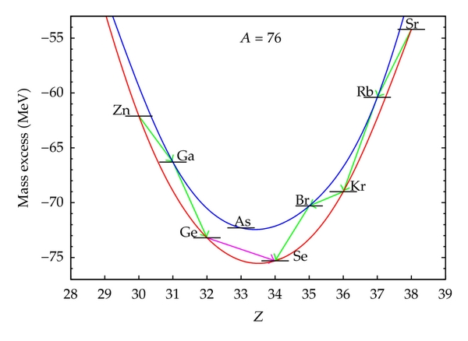
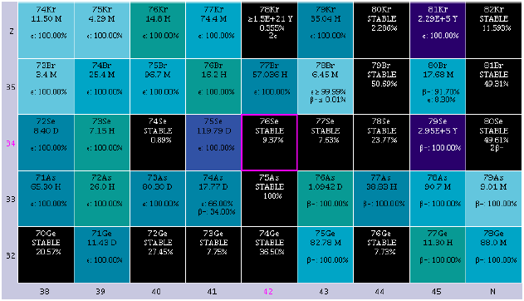

Double β-decay
${{}_{Z}^{A}X}_{N}→$ ${{}_{Z−2}^{A}Y}_{N+2}+{2e}^{−}+\left(2\overline{ν}\right)$
Process mediated by the weak interaction occurring in even-even nuclei where the single β-decay is energetically forbidden
The role of the pairing force

Slide 38
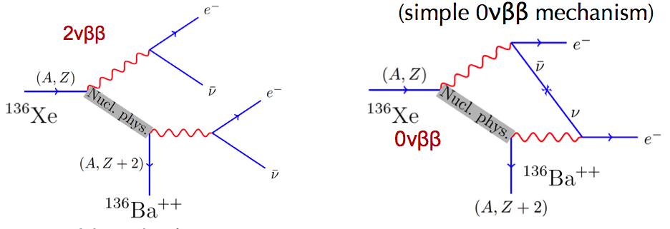
Double β-decay
Great new physics inside
but one should know Nuclear Matrix Element

Slide 39
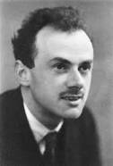

ββ-decay
2ν double β-decay
  Does not distinguish between Dirac and Majorana
  Experimentally observed in several nuclei since 1987
  ν and anti-ν can
  be distinguished
  ν and anti-ν
  are the same
2) 0ν double β-decay
  Neutrino has mass
  Neutrino is Majorana particle
  Violates the leptonic number conservation
  Experimentally not observed
  Beyond the standard model

Slide 40
Matter vs Antimatter
Leptonic number = 0 at Big Bang
All the physics we know does conserve the leptonic number
Why the matter dominates over antimatter?
Majorana neutrinos can explain that since they do not conserve leptonic number!

Slide 41
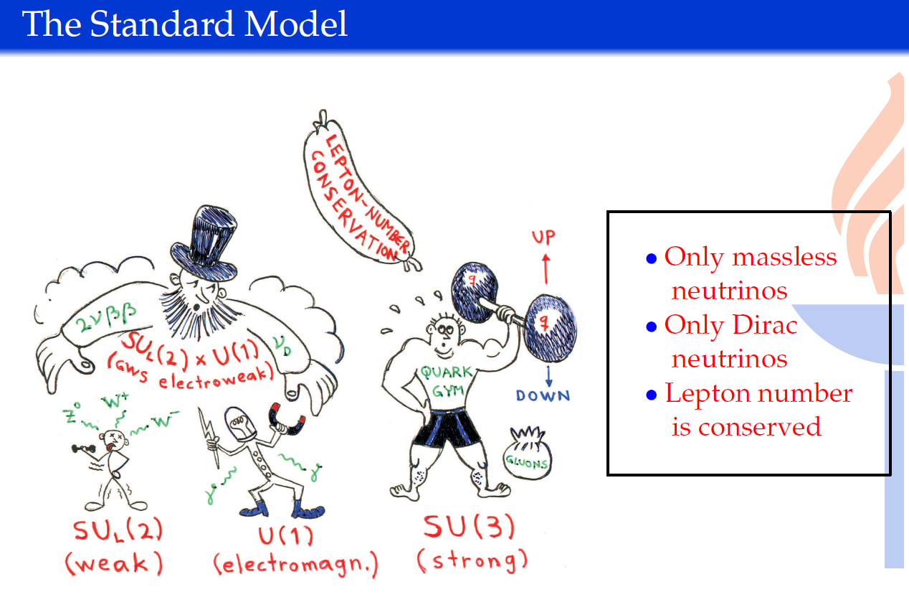
From Jouni Suhonen, JYFL (Finland)

Slide 42
From Jouni Suhonen, JYFL (Finland)

Slide 43

Beyond the standard model
Seesaw mechanism
Dirac mass will be the same order as the others. (0.1~10 GeV)
Right handed Majorana mass will be at GUT scale 10¹⁵ GeV

Slide 44
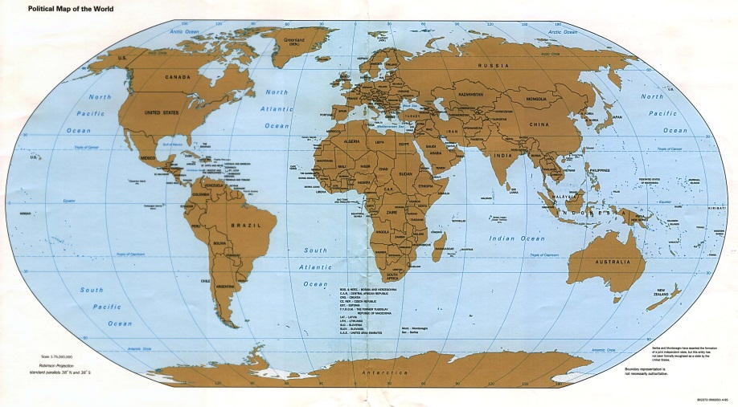
Search for 0νββ decay. A worldwide race
Experiment | Isotope | Lab | Status
GERDA | ⁷⁶Ge | LNGS | Phase I completed Migration to Phase II
CUORE0 /CUORE | ¹³⁰Te | LNGS | Data taking / Construction
Majorana Demonstrator | ⁷⁶Ge | SURF | Construction
SNO+ | ¹³⁰Te | SNOLAB | R&D / Construction
SuperNEMO demonstrator | ⁸²Se (or others) | LSM | R&D / Construction
Candles | ⁴⁸Ca | Kamioka | R&D / Construction
COBRA | ¹¹⁶Cd | LNGS | R&D
Lucifer | ⁸²Se | LNGS | R&D
DCBA | many | [Japan] | R&D
AMoRe | ¹⁰⁰Mo | [Korea] | R&D
MOON | ¹⁰⁰Mo | [Japan] | R&D

Slide 45
More about NME
For L = 0 decays
Gamow-Teller like
Fermi like
Warning: Normally the coupling constants g_{A} and g_{V} are kept out form the matrix element and we talk of reduced matrix elements

Slide 46
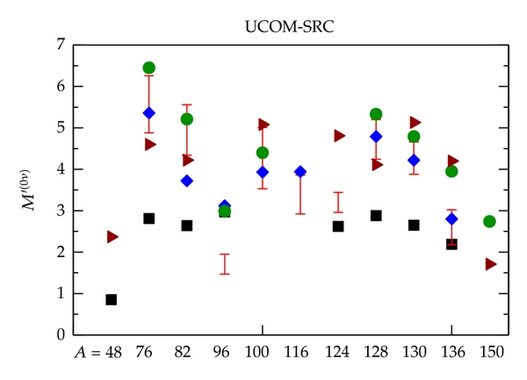
State of the art NME calculations
The neutrinoless double-beta decay; "state-of-the-art" NMEs: QRPA [30] (red bars) and [21, 22] (diamonds), ISM [31] (squares), IBM [25] (circles), and GCM [26] (triangles).
From A. Giuliani and A. Poves Adv. in High En. Phys. 2012 (2012) 857016

Slide 47
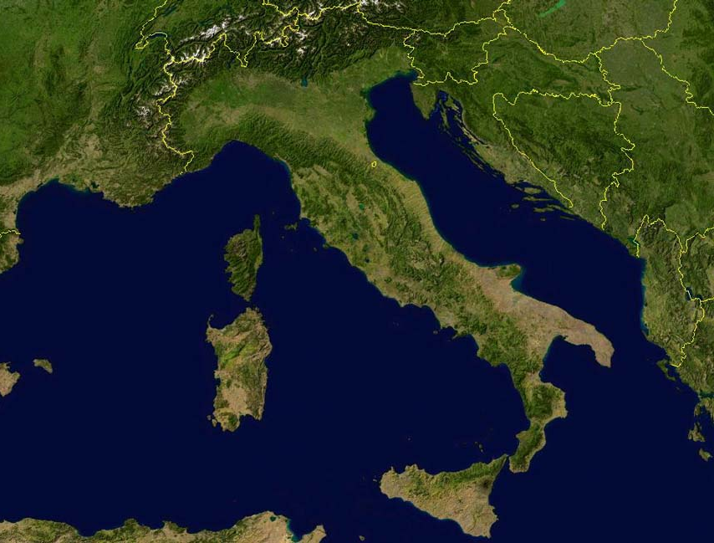
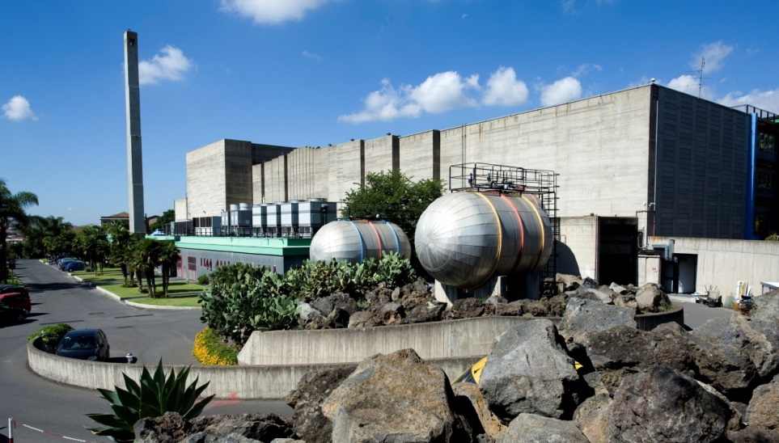
Catania
INFN
Laboratori Nazionali del Sud

Slide 48
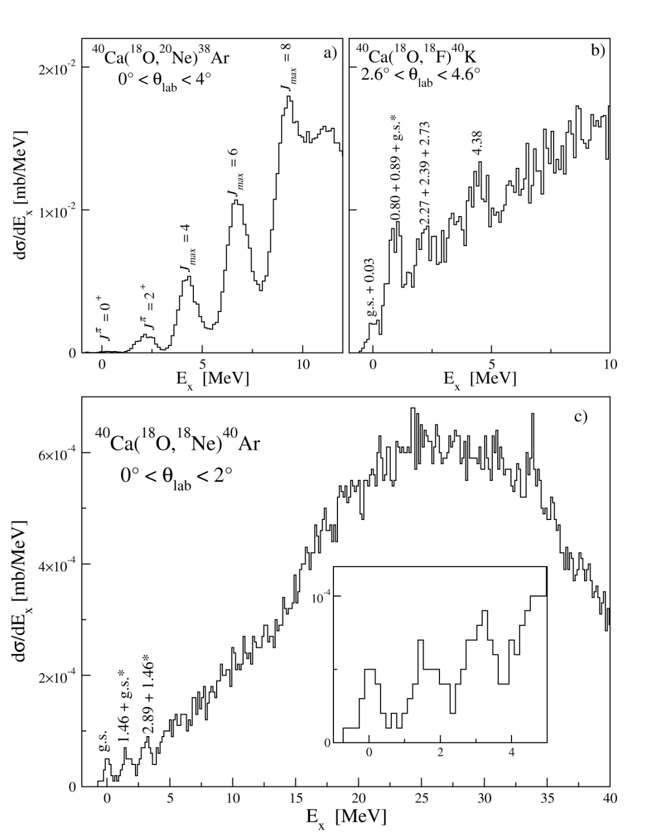
Energy spectra

