Slide 1
Report dal CdGA 4/9/2014

Slide 2
EU-T0 e la calls H2020
Stato attuale di EU-T0
4 Calls sottomesse il 2/9 (quasi 4 M€)
2 Calls da sottomettere il 25/11/2014
1 Call da sottomettere il 14/01/2015
Totale stimato di queste 3, circa 2 M€

Slide 3
EU-T0 (Lucchesi)
Statement of Intent Declaration preparato la settimana scorsa.
Riunione al CERN per preparare un Collaboration Agreement il 16/9
Ingresso di altri partner: INAF,paesi nordici, CEA, NIKHEF
Dopo il 19/9 si discuterà della partecipazione a nuove call H2020

Slide 4
ASTERICS (Bozza)
sottomesso 2/9 in INFRADEV-4
Implementation and operation of cross-cutting services and solutions for clusters of ESFRI and other relevant research infrastructure initiatives
Progetto per Astronomy ESFRI & Research Infrastructure Cluster
data challenge for the research
infrastructures and multi-messenger observations

Slide 5
Packages
WP1 Management, policy and dissemination
WP2 Outreach
WP3 OBELICS (OBservatory E-environments LInked by Common challenges )
WP4 DADI (Data Access, Discovery and Interoperability)
WP5 CLEOPATRA (Connecting Locations of ESFRI Observatories and Partners in Astronomy for Timing and Real-time Alerts)

Slide 6
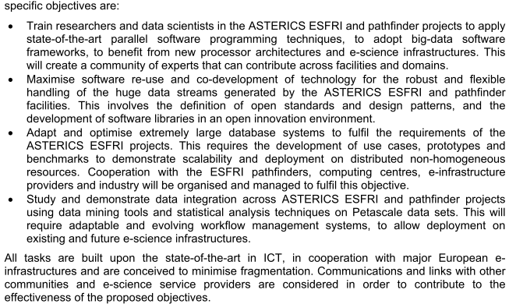
OBELICS
INFN in WP3 (OBELICS):
UniSA/INFN Napoli, LNF, LNS, CNAF (KM3NeT)

Slide 7
Tasks INFN in OBELICS
3.2: Developing new and common data models and high performance formats for data streaming, compatible with interoperability standards beyond the existing FITS, ROOT and HDF5. (INTERESSE SPECIFICO GRUPPI KM3NET – 6 PM)
3.2 Benchmarking low-power computer platforms (including Multicore, MIC, Microservers, GPU, FPGA, ARM) and software technologies/methods for data-driven scalable parallel programming. (INTERESSE SPECIFICO CNAF – 6 PM)
3.3 Managing science data at the Petabyte to Exabyte scale that some of the major ESFRI partners projects will produce. (INTERESSE SPECIFICO CNAF – 6 PM)
3.4 Developing a collection of statistically robust and domain independent open source software libraries for data analysis and data mining on Peta-scale datasets. Statistically robust approaches (Bayesian and likelihood analyses). Effective likelihood reconstruction methods and new graphical processing approaches. (INTERESSE SPECIFICO GRUPPI KM3NeT – 12 PM)
3.4 Establishing a common set of workflow architectures for the orchestration of compute intensive analysis of Peta-scale datasets on distributed computing infrastructures. (INTERESSE SPECIFICO GRUPPI KM3NeT – 6 PM)

Slide 8
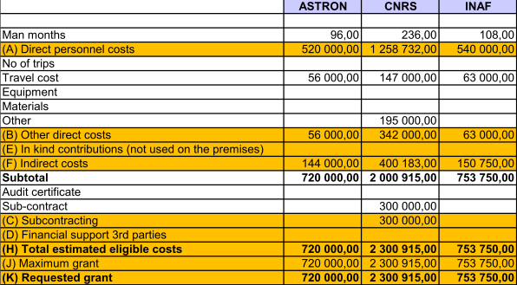
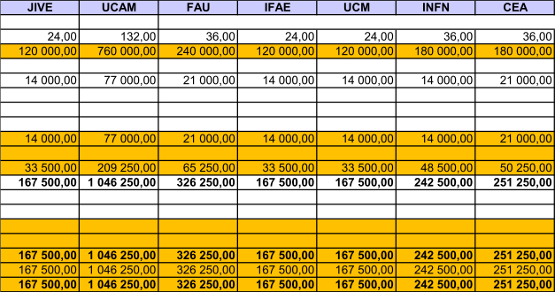
Budget
15 M€ per il progetto
242.5 k€ per l’INFN (36 PM) (1.6% del totale)

Slide 9
Zephyr (Dell’Agnello, Boccali)
sottomesso 2/9 in EINFRA-1 topic 7
Proof of concept and prototypes of data infrastructure-enabling software (e.g. for databases and data mining) for extremely large or highly heterogeneous data sets scaling to zetabytes and trillion of objects. Clean slate approaches to data management targeting 2020+ 'data factory' requirements of research communities and large scale facilities (e.g. ESFRI projects) are encouraged.
CERN, CIEMAT, CNRS, DESY, IFAE, INFN, KIT and STFC
Budget totale 4M in 2 anni

Slide 10
Coinvolgimento progetti - Zephyr
Photon science: E-XFEL, Diamond PanDATA/PanDAAS
Astrophysics: CTA, KM3NET, IceCube, Antares
Cosmology: EUCLID, DES, PAU
Astronomy: SKA
High Energy Physics: HL-LHC
Nuclear Physics: ISIS, ILL

Slide 11
Sustainability - Zephyr
ZEPHYR will provide an openly available blueprint useable for
Facilitating successful data management for H2020+ large scale facilities and ESFRI projects in an efficient, effective, affordable and sustainable manner
Evolving existing e-infrastructures to the Zettabyte- Exascale
Advancing data management capabilities of the partners as major e-infrastructure service providers
Other domains increasingly seeking support from consortium partners
Inter-agency service agreements

Slide 12
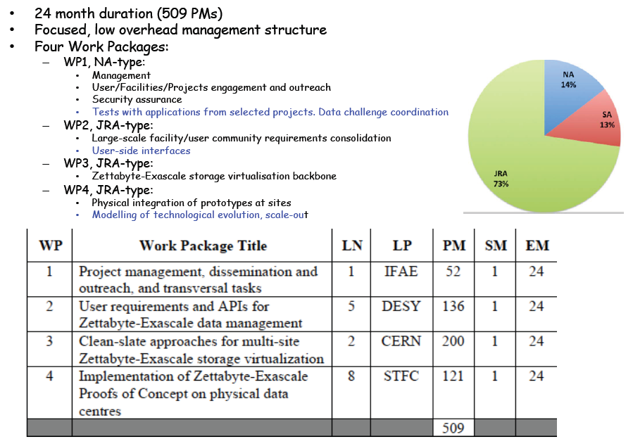
Proposal design - Zephyr

Slide 13
Coinvolgimento INFN - Zephyr
WP1: Proof-of-concept Integration and Test Coordination
Data challenge manager per infrastruttura di testing (sia per feedback, sia come demonstrator)
WP2.3: Definition and development of data handling APIs compliant with user/external needs and storage virtualization internals
in particolare su protocolli di accesso
WP4.3: Modelling of Online Storage at the Zettabyte-Exascale

Slide 14
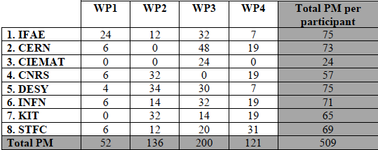
Budget - Zephyr
Richiesta totale 4 M€
Quota INFN 469 k€

Slide 15
EGI-Engage - Gaido
sottomesso 2/9 a EINFRA-1 topic 6
Support to the evolution of EGI (European Grid Infrastructure) towards a flexible compute/data infrastructure capable of federating and enabling the sharing of resources of any kind (public or private, grid or cloud, etc.) in order to offer computing and storage services to the whole European scientific community. The proposal will address operations for supplying services (IaaS, PaaS, SaaS) at European level, engagement of and tailoring of services to new user communities and dissemination activities.
30 mesi, 1161 PM, 43 partner, 8 M€
INFN: 89 PM, 568 k€

Slide 16
Attività INFN
Due ruoli di coordinamento generale (EGI), assegnati all’INFN dopo una call pubblica (persone senior scelte in base al CV):
Profilo “Senior Operations Officer”:
30 PM (1 FTE) per Cristina Aiftimiei
Profilo “Technical Outreach Expert”:
30 PM (1 FTE) per Diego Scardaci
Attività di supporto all’interno dei DCC:
Mobrain: 2+1 (GPGPU) PM
DARIAH 13 PM
Lifewatch: 3 PM
(Distributed Competence Centres)

Slide 17
INDIGO – DataCloud (Salomoni)
sottomesso 2/9 in EINFRA-1 topic 4,5
(4) Large scale virtualisation of data/compute centre resources to achieve on-demand compute capacities, improve flexibility for data analysis and avoid unnecessary costly large data transfers.
(5) Development and adoption of a standards-based computing platform (with open software stack) that can be deployed on different hardware and e-infrastructures (such as clouds providing infrastructure-as-a-service (IaaS), HPC, grid infrastructures…) to abstract application development and execution from available (possibly remote) computing systems. This platform should be capable of federating multiple commercial and/or public cloud resources or services and deliver Platform-as-a-Service (PaaS) adapted to the scientific community with a short learning curve. Adequate coordination and interoperability with existing e-infrastructures (including GÉANT, EGI, PRACE and others) is recommended

Slide 18
Workpackages - INDIGO
INtegrating Distributed data Infrastructures for Global ExplOitation
WP1 (NA): administrative and financial management, project quality assurance and global oversight of activities.
WP2 (NA): Support to Research Communities.
WP3 (SA): Software Management and Pilot Services.
WP4 (JRA): Resource Virtualization.
WP5 (JRA): PaaS Platform DevelopmentWP6 (JRA): Science Gateways, Workflows and Toolkits

Slide 19
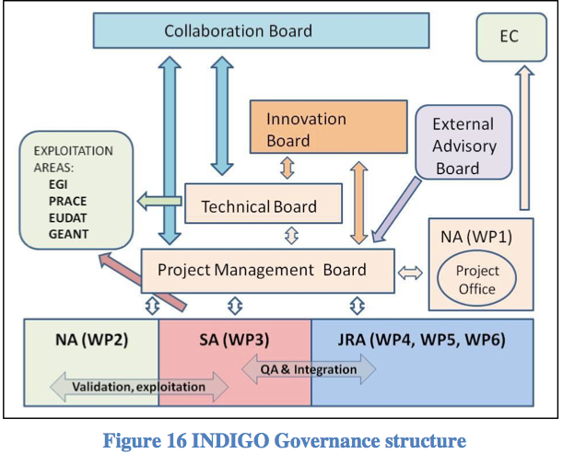
Budget, governance - INDIGO
11 M€ in 30 mesi
INFN partner principale
PI: Salomoni
19% del budget (2M€, 315 PM)
CNAF, PD, TO, BA, CT

Slide 20
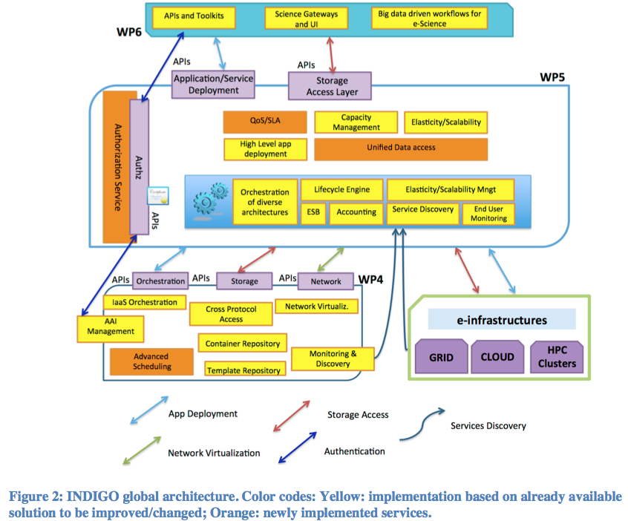
Global architecture - INDIGO
Punti chiave:
scheduling locale (QUACK)
dynamic virtual networks
AuthZ (ma non AuthN fatta da altri progetti)
unified data access

Slide 21
Public survey on Net Innovation for the Work Programme 2016-2017
Entro il 30/9/2014 sarebbe opportuno rispondere al survey:
http://ec.europa.eu/eusurvey/runner/NetInnovation2016
Gruppo di lavoro coordinato da Cristina Vistoli
Contattatela in caso vogliate contribuire

Slide 22
EuroEXA (Vicini)
da sottomettere a FETHPC-1 il 25/11/2014
HPC Core Technologies, Programming Environments and Algorithms for Extreme Parallelism and Extreme Data Applications
Realizzazione di sistema HPC con tecnologia europea
Grande collaborazione con vocazione prettamente industriale
Partner originari: Eurotech (Coordinatore), Nvidia, STM, INFN, UniBo, European top computing centers (BSC, Julich, Cineca,…), Xyratech….
Aggiunti in corso d’opera: ARM, Altera, Fraunhofer, Forth,…

Slide 23
Contributi INFN
Contribute to the definition of the overall structure of the EuroEXA HPC system, using its background in the design of HPC system, and its ability to quickly develop simplified – yet accurate – models of machine performance that allow an early performance assessment and comparison among different architectural options.
Adapt, port, and optimize for performance computing-intensive kernels taken from its large portfolio of HPC codes in areas such as Lattice Gauge Theory, computational fluid dynamics and simulation of complex systems. This work is going to be an important contribution to the validation of the EuroEXA architecture and a strong help in the bring-up phases of development.
Contribute to the design, prototyping and validation of the innovative, hierarchical interconnection structure of the EuroExa computing platform leveraging on INFN proven expertize in design of low latency, high performances Torus network for hybrid clusters optimized for scientific computing;
Contribute to the definition and the implementation of the overall system storage architecture exploiting its experience in designing and handling hierarchical archive systems.

Slide 24
Dettagli tecnici

Slide 25
Design preliminare
Aspetti tecnologici presentano novita’ sostanziali in ambito HPC
Tecnologia d’integrazione modulare, low power e high performance basata su “chiplet”
Microprocessori ARM multi-core ad alta granularita’ Vector computing basato su GPU ARM (e Nvidia??) e FPGA (via openCL)
High-End FPGA generano spazio per test di micro-architetture di calcolo e rete non “tradizionali”
Programming model parallelo basato su paradigmi GAS (PGAS) on RDMA

Slide 26
Budget e outlook
Fra 8 M€ e 20 M€ (massimo)
1 M€ stimato per INFN
Entro fine settembre definiti:
il target tecnologico, applicativo del progetto
La nuova struttura di coordinamento
La composizione della collaborazione
I responsabili della redazione della proposta

Slide 27
EPIC (Tripiccione)
da sottomettere a FETHPC-1 il 25/11/2014
in competizione con EuroEXA
7-8 M€ su 3 anni (INFN: 5%, circa 3 posizioni)
Leadership Juelich + IBM/Nvidia
Ruolo significativo di Bull
Alcuni utilizzatori industriali → Dassault aviation
Alcuni utilizzatori scientifici → INFN / Cyprus Institute

Slide 28
EPIC
Extremely Parallel Interconnected Cores
Realizzare/sperimentare con sistemi di calcolo caratterizzati da:
Alta capicata' di interconnessione
Connessioni cache-coherent
Integrazione di nodi di calcolo con nodi di storage intelligenti
In altre parole:
Imparare a programmare e utilizzare e valutare le performance delle architetture di calcolo HPC che IBM sta comunque sviluppando in risposta a richieste di “grossi” clienti americani....
Architettura basata su Power9+ Nvidia GP100 + Interconnessione stretta con NVLINK + Rete connessa direttamente agli acceleratori

Slide 29
Workpackages - EPIC
Management and scientific coordination
Dissemination, training and exploitation
Applications
System architecture design
Network architecture and technologies
System software architecture
Integration and evaluation

Slide 30
Ruolo INFN - EPIC
Dissemination, training and exploitation
Applications
(System architecture design)
(Network architecture and technologies)
System software architecture
Meeting a Juelich questa settimana per capire “terms & conditions” ….

Slide 31
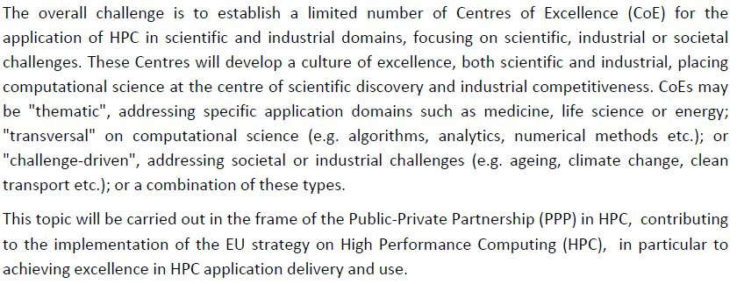
Centres of Excellence for computing applications (Tripiccione)
da sottomettere a EINFRA-5 il 14/1/2015
Centres of Excellence for computing applications

Slide 32
Workpackages - CoE
WP1: community software develop. & data mgmt.
WP2: New algo for large scale simulation & data analitics
WP3: languages/prog. Models/tools
WP4: Science programmes OR Benchmarking OR “nil”
WP5: Hispeed real time data processing
WP6: Dissemination & training
7 M€ su 2 anni, 140 FTE*y (INFN: 15%, circa 10 posizioni)

Slide 33
Ruolo INFN - CoE
In principio un area adatta per un ruolo di significativa Leadership INFN. Punti di forza
capacita' di leadership scientifica
riconosciuta esperienza in area scientifiche HPCintensive
competenza algoritmica architetturale software
ruolo riconosciuto in PRACE
network di conoscenze e di contatti a livello europeo
sinergia con progetti per HPC Core technologies

Slide 34
“Extreme Physics” - CoE
Sviluppo di competenze in aree in cui “fisica estrema richiede computing estremo”
Teorici: LGT e cosmologia computazionale
Sperimentali: LHC e SKA
Partners:
INFN, EPCC, Dirac, DESY, CERN, (CINECA), …
(NVIDIA), (SGI), (INTEL)

