Slide 1
Status of the planar batch ATLAS/CMS
July 29th 2014

Slide 2
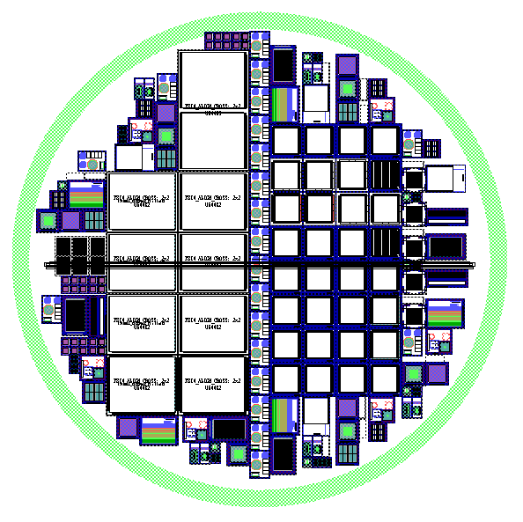
Wafer Layout
CMS
ATLAS
p-type Si-Si wafers
100-,130-μm HR silicon
p-spray & p-stop
.gds ready this week
Test structures for Si-Si qualification

Slide 3
Other GR option
Should we implement these GRs on a pixel sensor or on a test diode?

Slide 4
Test Strip FBK
Same of “Paris EdgeLess”
MOS on p-spray
MOS on p-stop
Capacitances
(for oxide thickness extraction)
Diode
VanDerPauw & Contact Res.
Gated Diode

Slide 5
O2548_C_MOS
Added a p-stop in between the two metals
Larger Passivations

Slide 6
O2548_C_MPD7 (large area diode)
Added p-stop in between Diode and GuardRing
Larger passivations

Slide 7
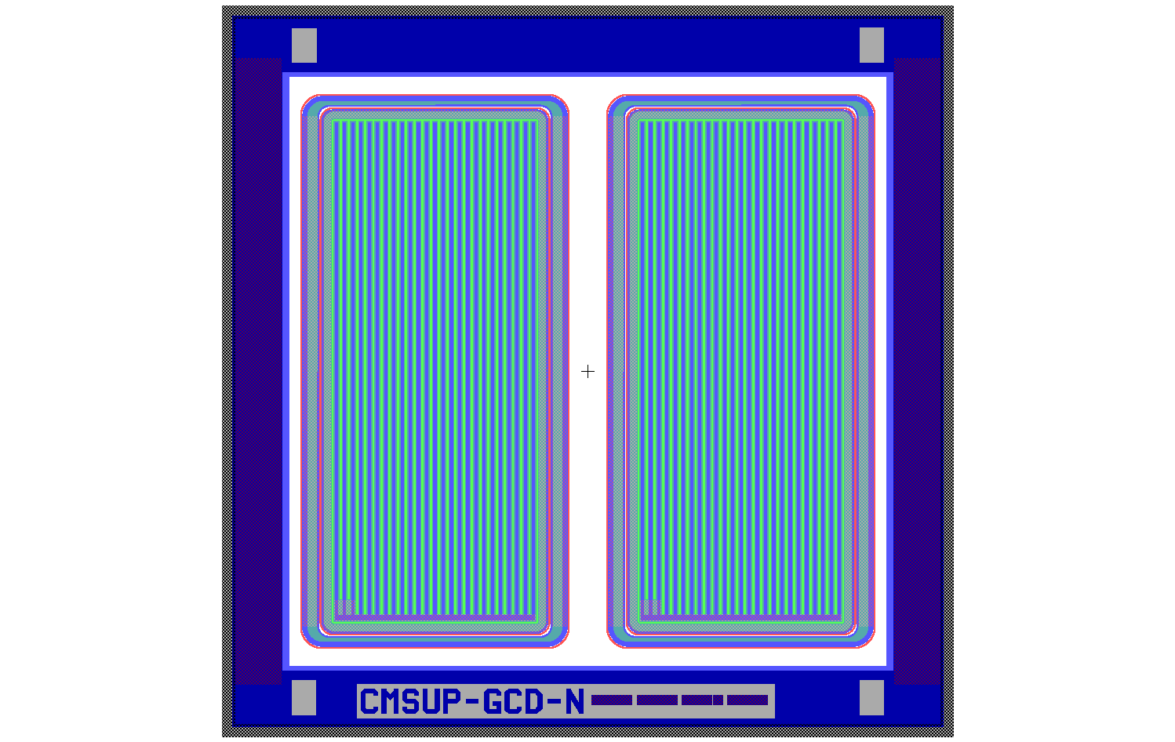
O2548_C_GCD (gated diode)
2 equal Gated Diodes (in the first version, one was with poly→ deleted)
added p-stops
Passivation larger
total width reduced by 460 μm (now it is 7120 μm, like the diode and the MOS)

Slide 8
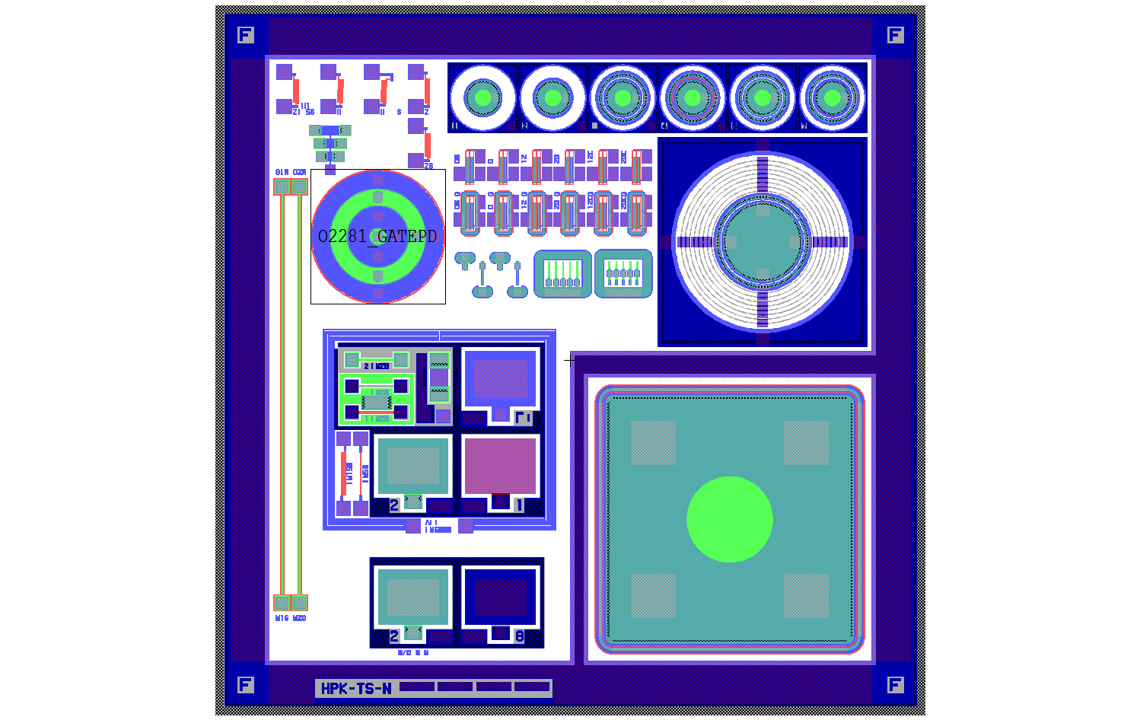
O2548_C_TS (Test Strip)
P-stop added
Larger pass

Slide 9
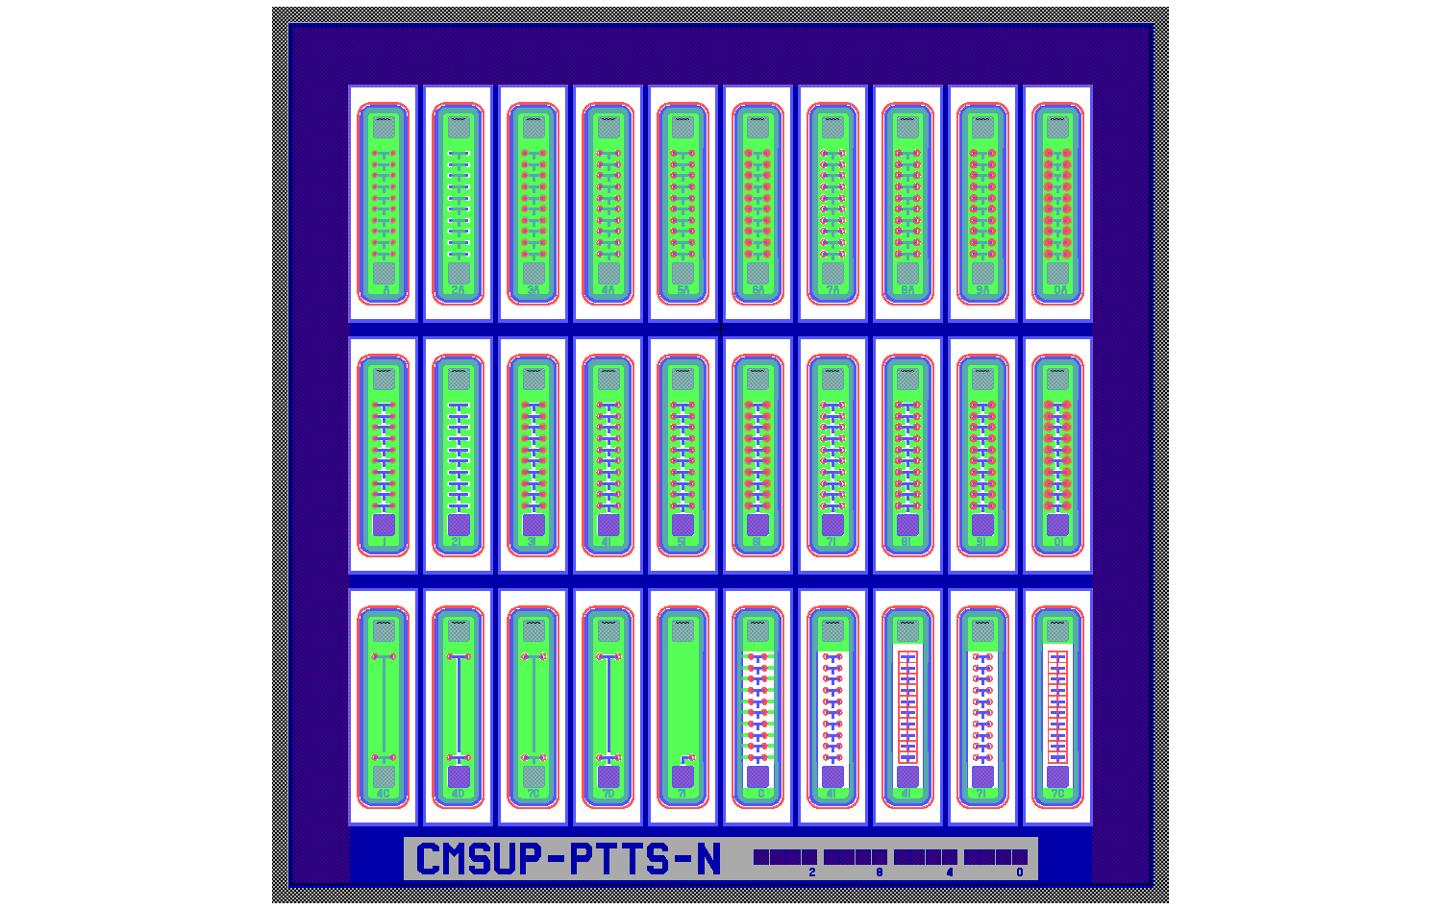
O2548_C_PTTS (PunchThrough Test Strip)
P-stop added
Larger pass

Slide 10
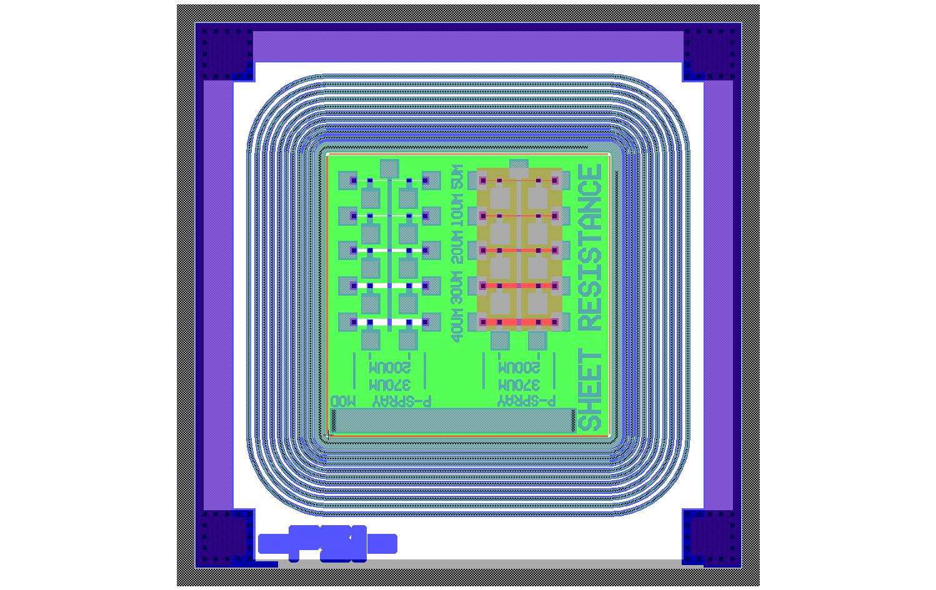
Ts_sheet_p_spray
P-stop added
Larger pass
Lithographic rules relaxed

Slide 11
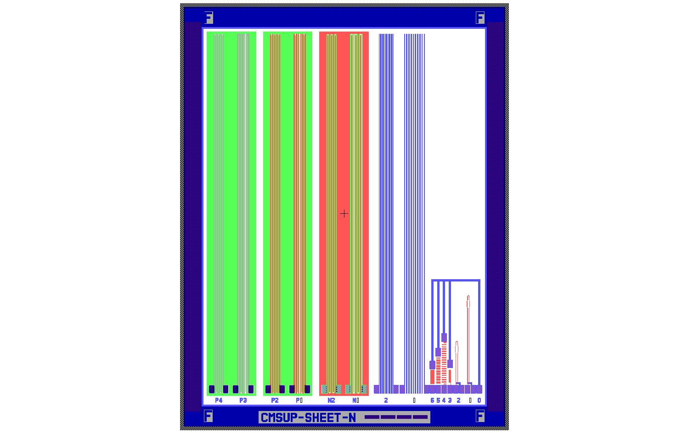
O2548_C_sheet
Larger pass

Slide 12
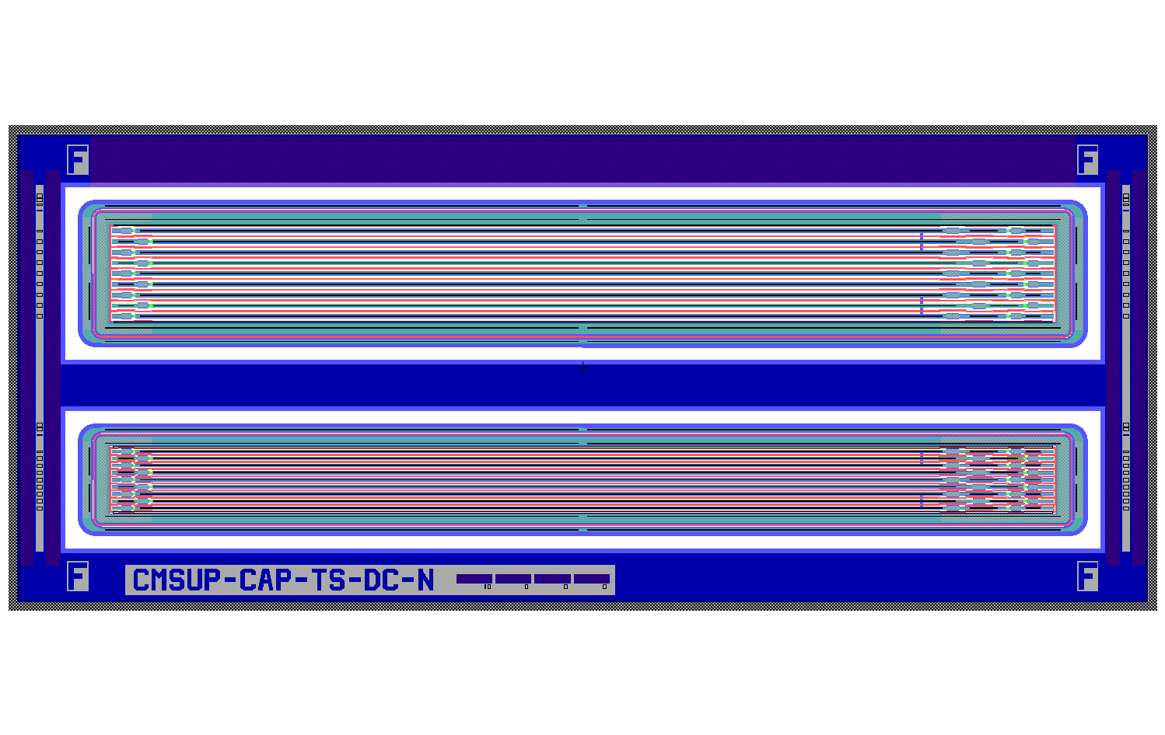
O2548_C_CTDC_P_ind_DC
Larger pass
P-stop added

Slide 13
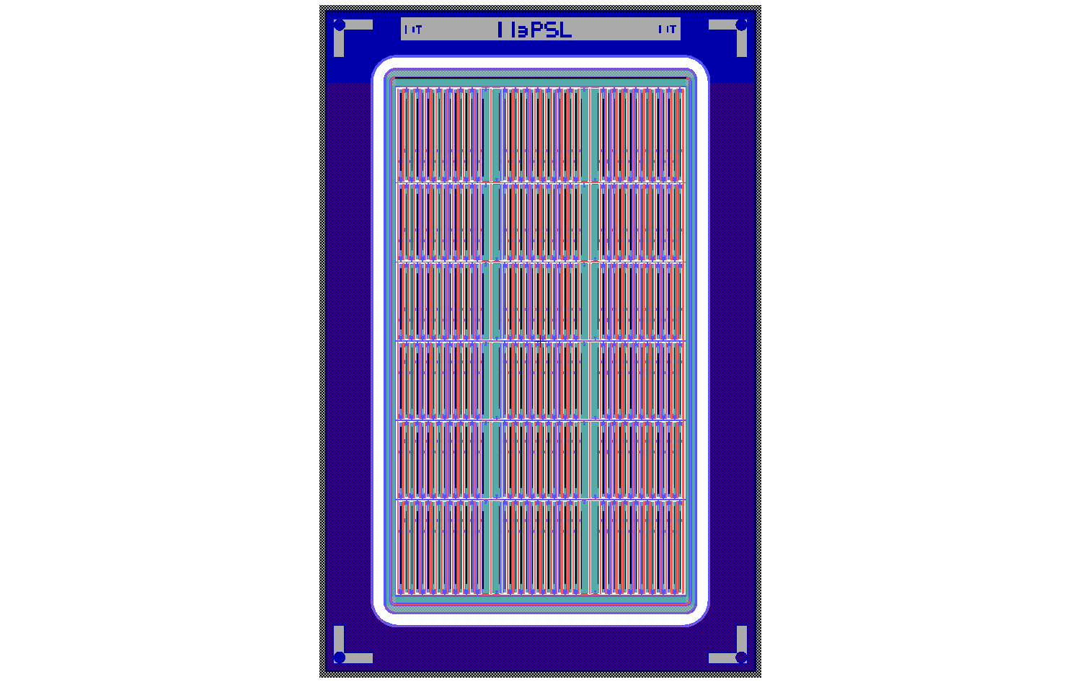
MPIX
Larger pass
P-stop added

Slide 14
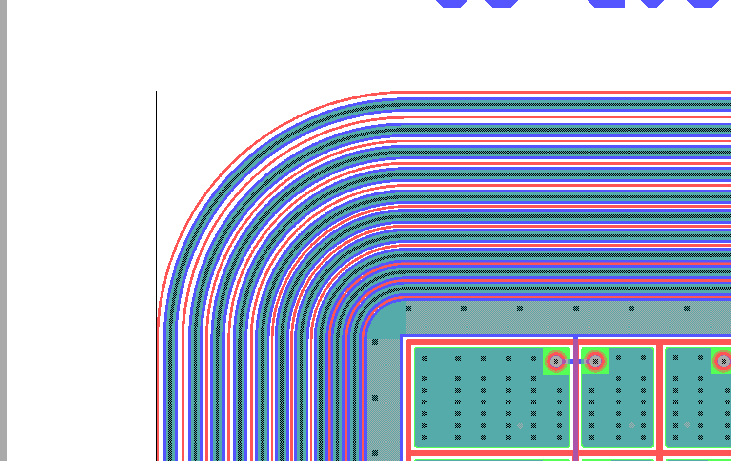
sc_psi46_gap_X
Replaced termination with the (very similar) 10-GR FBK

