Slide 1
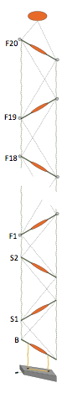
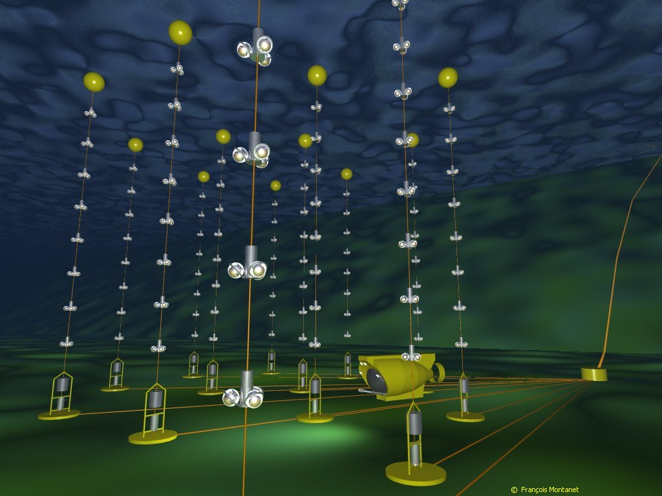
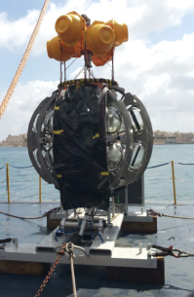
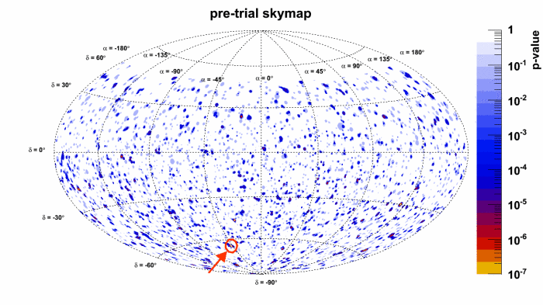
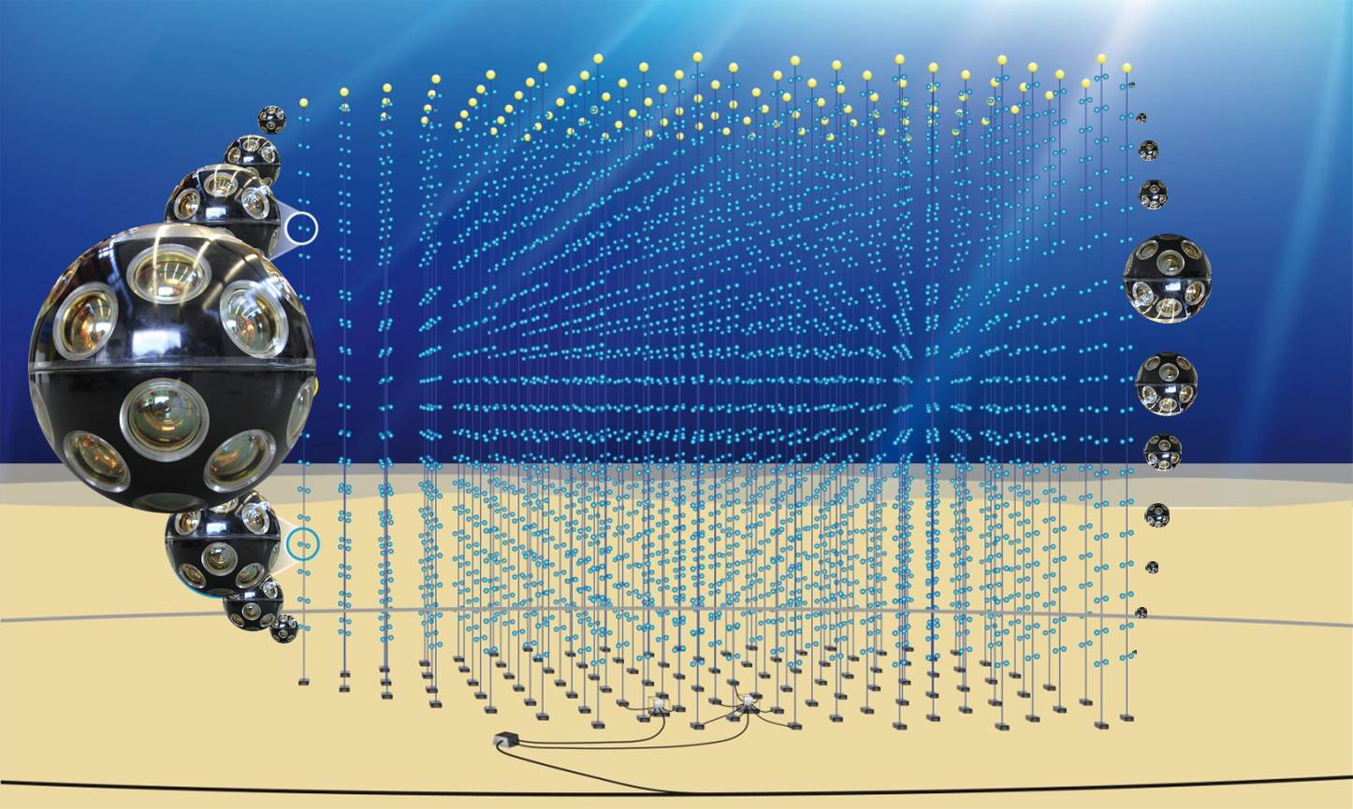
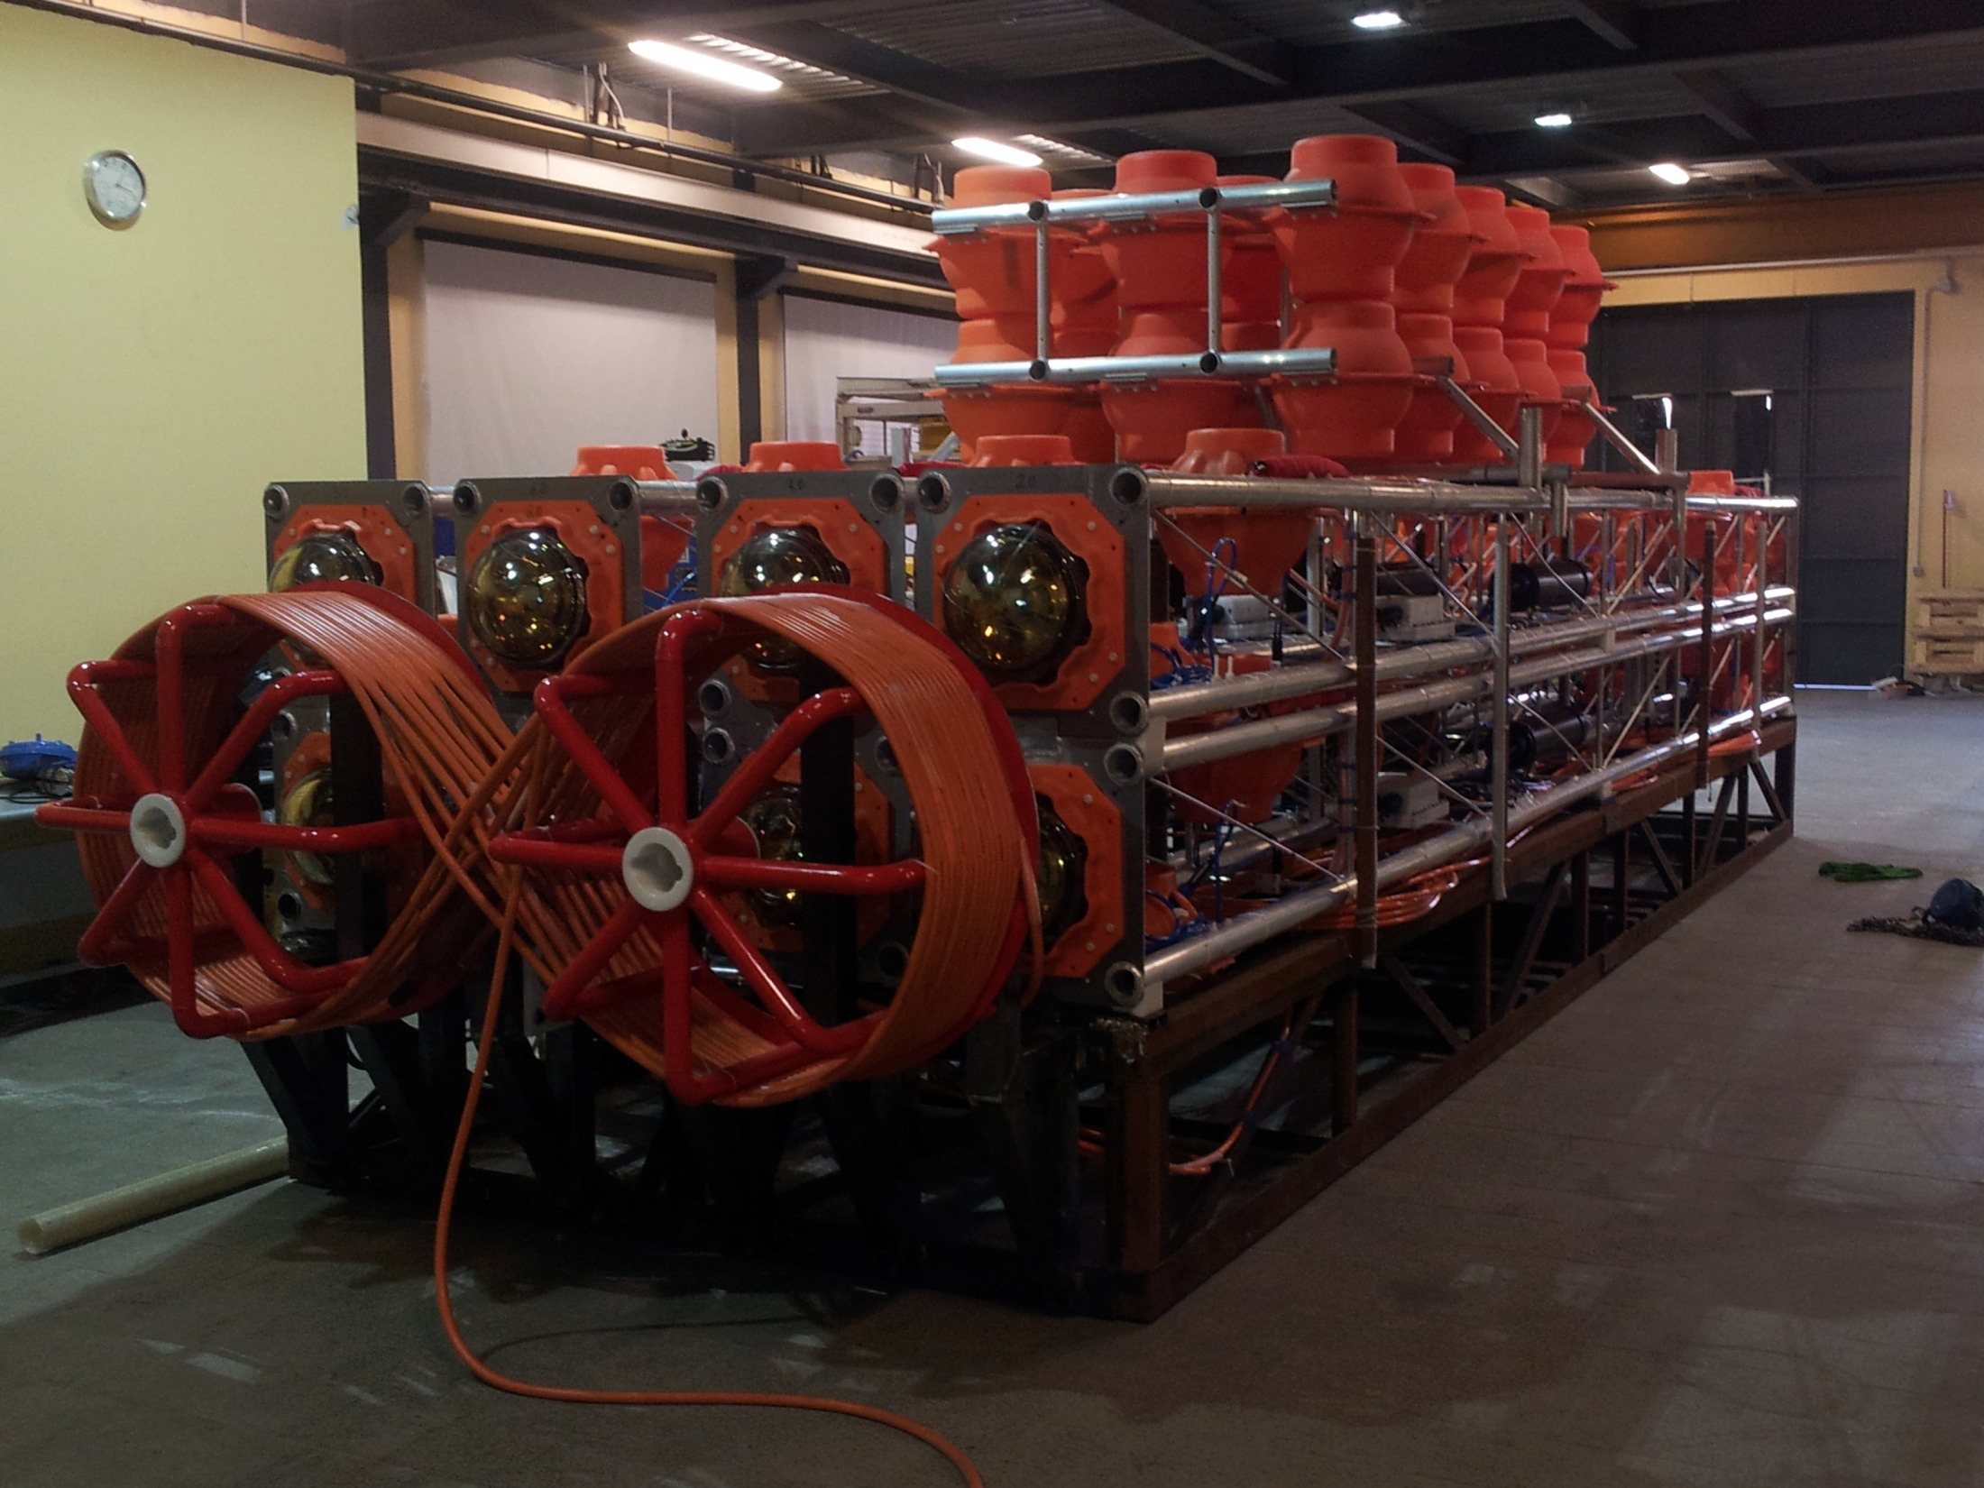
Km3 : astronomia con neutrini astrofisici E_{ν} > TeV
ANTARES
KM3NET-Stringhe
NEMO-Phase2 Tower

Slide 2
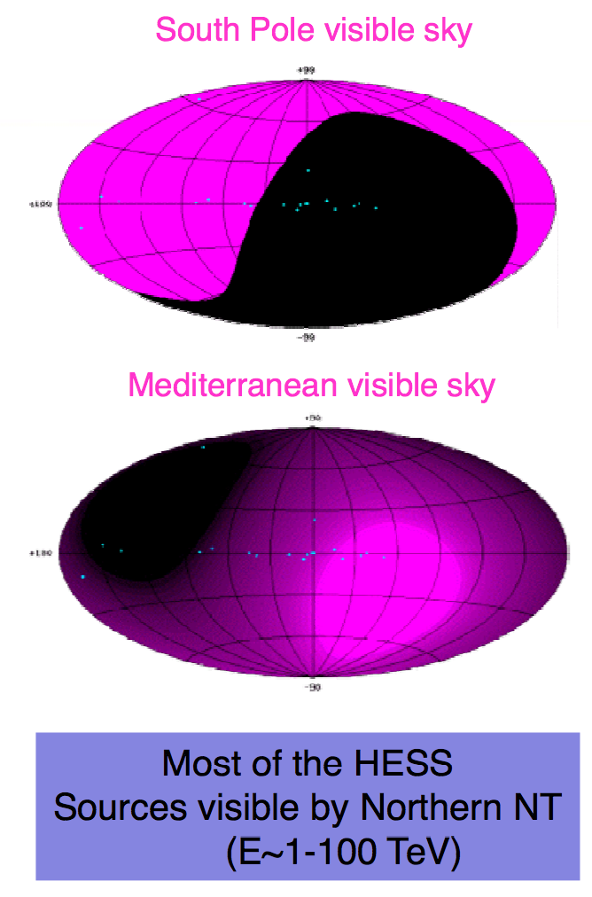
Physics with a Mediterranean Neutrino Telescope
    No doubt HE ν’s are very important messengers (hadronic HECR origin ?, parent's acceleration mechanisms, wider horizon, unexplored territory,…).
    Technical feasibility of HE ν telescopes is proven (under ice, under water).
    Complementarity to the South Pole IceCube detector
    HE ν’s signal observed by IceCube (many events in a region where the visibility is exceedingly good for Med Telescopes).
  Central scientific goals:
      galactic neutrino sources (1< E_{ν} < 100 TeV, point-like)
      high-energy diffuse neutrino flux
      extragalactic sources
      Dark Matter (indirect detection)
      Neutrino properties
      Exotics (monopoles, nuclearites, sterile neutrinos... )
  … and in a multi-messenger approach:
      origin of cosmic rays, internal dynamics of sources and acceleration processes

Slide 3
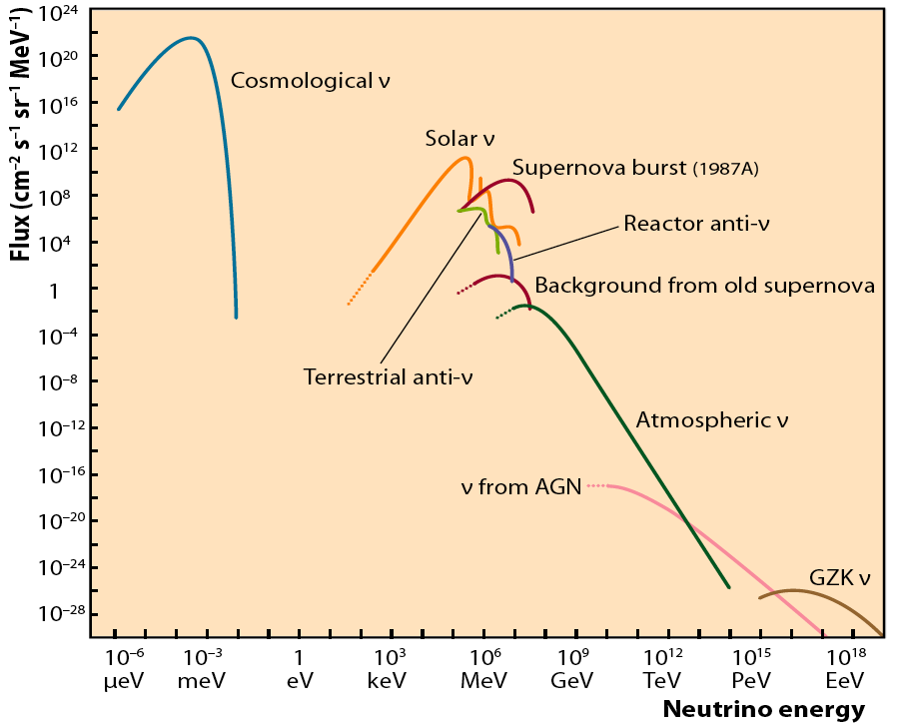
Neutrino fluxes: what do we know/expect ?
This is our region of interest

Slide 4
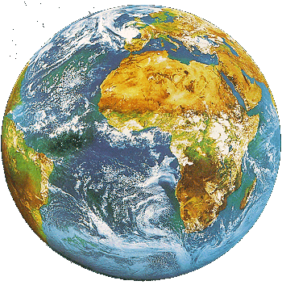
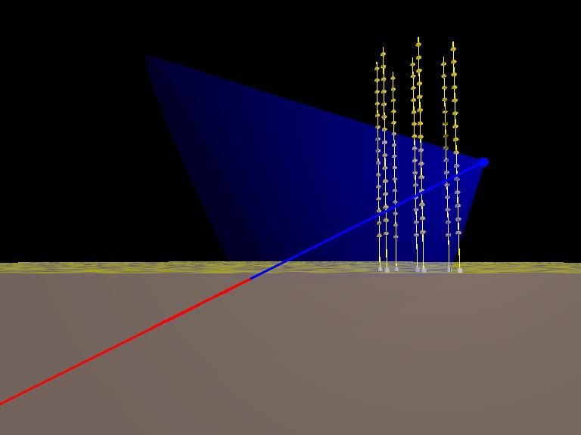
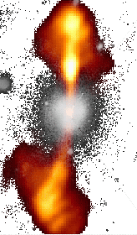
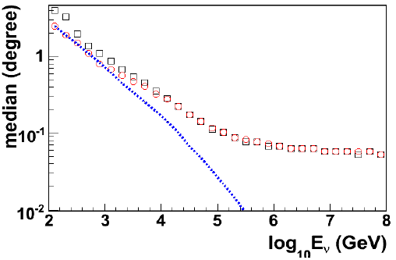
Detection principle
Search for neutrino induced events, mainly , deep underwater
Atmospheric neutrino flux ~ E_{ν}⁻³
Neutrino flux from cosmic sources ~ E_{ν}⁻²
  Search for neutrinos with E_{ν}>1÷10 TeV
~TeV muons propagate in water for several km
before being stopped
  go deep to reduce down-going atmospheric µ backg.
  long µ tracks allow good angular reconstruction
Down-going µ from atm. showers
S/N ~ 10⁻⁶ at 3500m w.e. depth
p, nuclei
µ direction reconstructed from the arrival time of Cherenkov photons on the Optical Modules: needed good measurement of PMT hits, σ(t)~1ns, and good knowledge of PMT positions (σ ~10cm)
Neutrinos from cosmic sources
induce 1-100 muon evts/y
in a km³ Neutrino Telescope
Cherenkov
Neutrino
Telescope
p, nuclei
Up-going µ from neutrinos
generated in atm. showers
S/N ~ 10⁻⁴
< 0.1°
43°
charge current
interactions
µ
water/ice
rock

Slide 5
IceCube discovery: H.E. astrophysical ν observed !
Now 3 years of data analysed (high-energy starting events).
Signal of cosmic neutrinos at >30TeV confirmed, significance now 5.7σ
(Also: Up-going muons now 3.9σ)
Expected backgrounds vs. observation:
Science 342 (2013), 1242856 arXiv:1405.5305
Atmospheric muons 6.0 → 8.4
Atmospheric neutrinos (conv.) 4.6 → 6.6
Overall 10.6 ^{+5.0} _{-3.6} →15.0 ^{+7.2} _{-4.5}
Observed 28 → 37

Slide 6
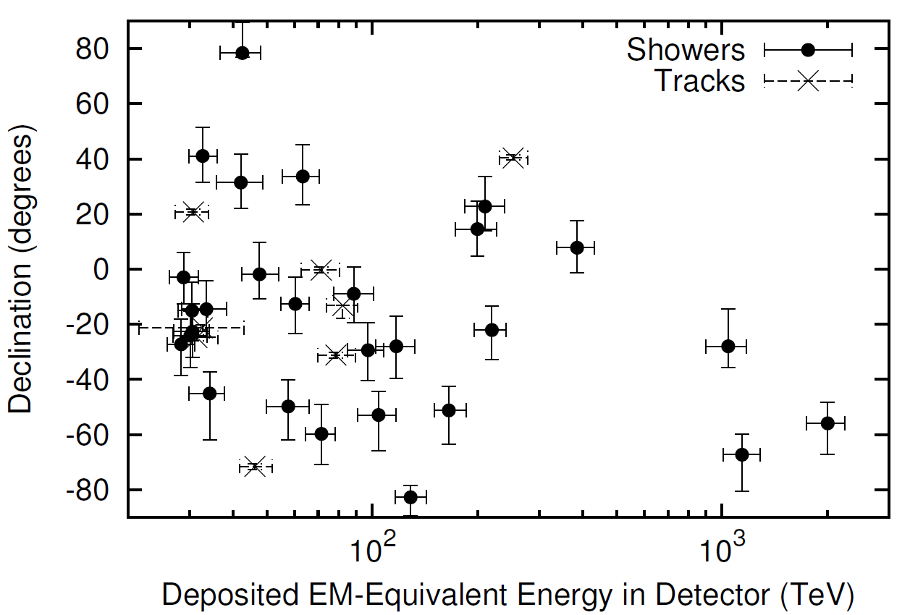
IceCube Signal properties 1
28 cascades, 8 track-like, 1 coincidence of 2 atmospheric muons
Consistent with flavour-symmetric neutrino flux

Slide 7
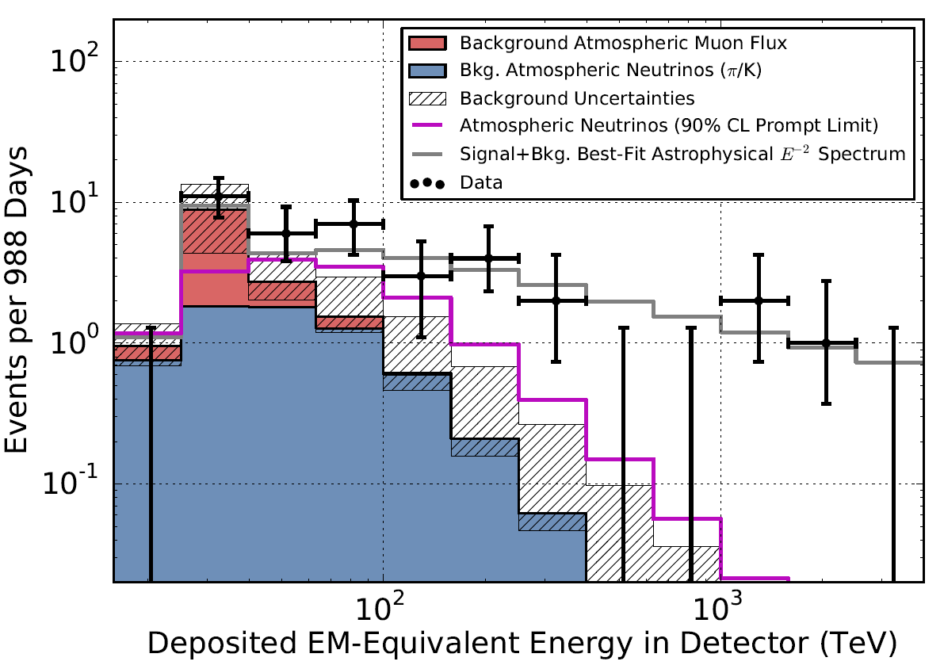
IceCube Signal properties 2
Energy spectrum consistent with power law
Cut-off implied by absence of events from Glashow resonance

Slide 8
Km3 : astronomia con neutrini astrofisici E_{ν} > TeV
ANTARES
Continua la raccolta dei dati sperimentali (fino a fine 2015) e l'analisi dei dati raccolti.
ANTARES sensibile ad un flusso minimo di ν astrofisici (diffusi) maggiore di quello misurato da IceCube, posti limiti superiori a:
  Neutrini da sorgenti puntiformi nella zona del Centro Galattico
  Neutrini da sorgenti diffuse
  Neutrini da "Fermi Bubbles"
  Neutrini in coincidenza con GRB
  Neutrini in coincidenza con GW
  Neutrini da annichilazione di WIMPs nel Sole
  Neutrini in coincidenza con sorgenti "transienti" (ad esempio flares osservati da FERMI)

Slide 9
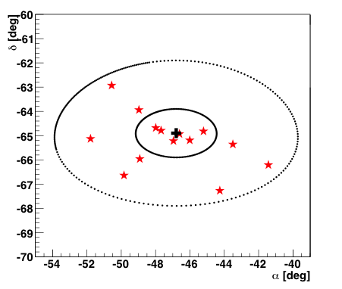
The ANTARES search for point-like ν sources
First time-integrated search with 2007-2010 data (813 days) ApJ. 760:53 (2012)
3058 neutrino candidates (atmospheric + astrophysical ??)
No statistically significant excess
The "best cluster" (-46.5°, -65.0°) compatible with the background hypothesis, p=0.026 (no known source there from ROSAT, Fermi-LAT/HESS)
New search on bigger data sample: 2007-2012 data (1340 days) ApJ-L. 786:L5 (2014)
5516 neutrino candidates (improved angular resolution)
again no statistically significant
excess observed
The same "best cluster" with 6 new events (14 total in 3° search cone)
observed but compatible with background hypothesis (p=2.1%)
90% of events reconstructed with Ψ< 1°
median ~0.4°
cumulative distribution of the angular resolution for selected events assuming E⁻² spectrum
N_{sig}=6.2
p-value =2.7%
signal signif. 2.2 σ
α = -46.8°, δ = -64.9°

Slide 10
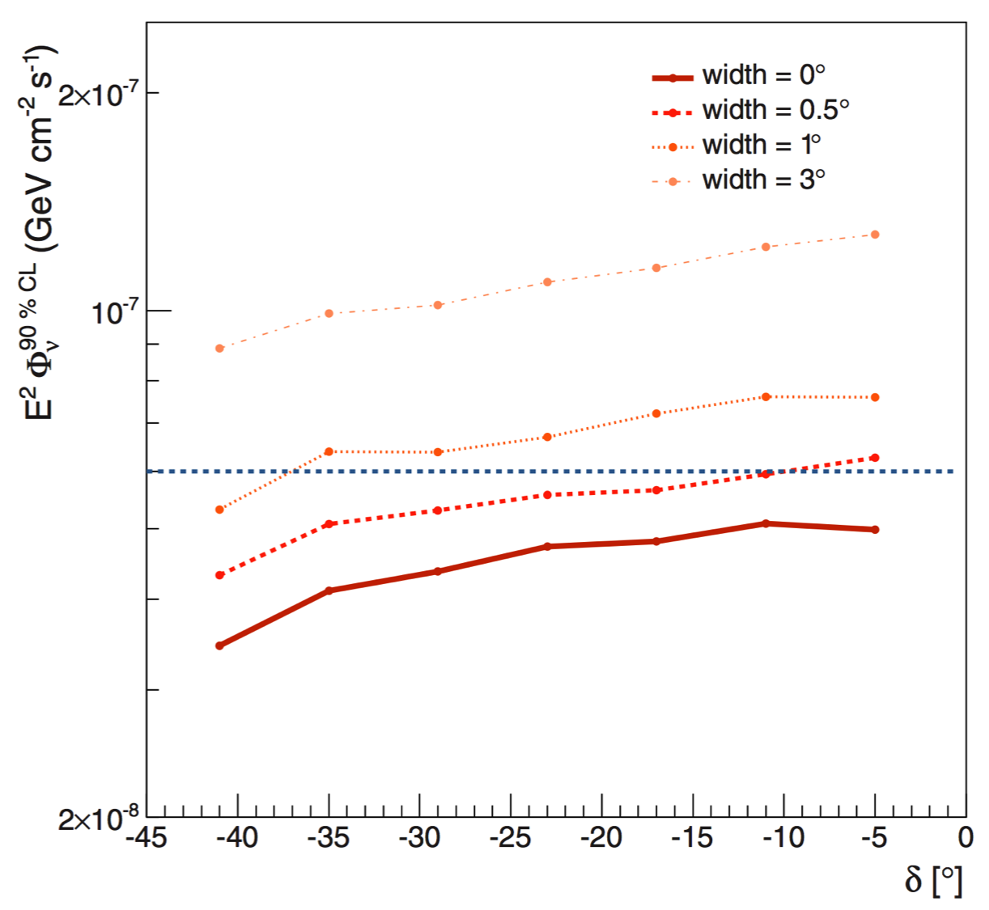
The ANTARES search for ν from known γ sources
Using the 2007-2012 data (1340 days) we counted the number of events in a 20° cone around a list of pre-selected candidates, searching for an excess over the background.
Assuming a neutrino flux from the source like dφ_{ν}/dE_{ν} = Φ₀ E_{ν}⁻² in absence of a statistically significant excess we can put a limit (at 90% C.L.) on Φ₀ . Few examples
x10⁻⁸ GeV cm⁻² s⁻¹
ApJ-L. 786:L5 (2014)
Is there a point-like ν source close to the Galactic Center
(α =-79°, δ =-23°, Gonzalez-Garcia et al. arXiv 1310.7194) such
that could explain the recent IceCube evidence ???
The expected flux should have Φ₀ =6•10⁻⁸ GeV cm⁻² s⁻¹
The point like hypothesis as well as extended Gaussian like
extended (0.5°, 1° and 3°) sources have been tested:
no excess found. No evidence found for a point like-source
that could explain the IceCube results
source α_{s} [°] δ_{s} [°] n_{s} p-value Φ_{ν}^{90% C.L.}

Slide 11
ANTARES search for ν point-like sources
ANTARES data provide the most
stringent limits to flux of neutrinos from point-like sources for a large part of the Southern Sky in the TeV region.
IceCube sensitivity to point-like sources in the Southern Sky improves for E_{ν} > 100 TeV
2014 ApJ 786 L5
δ
horizon
90 % C.L. flux upper limits and sensitivities on the muon neutrino flux for six years of ANTARES data. IceCube results are also shown for comparison.
Notes:
The light-blue markers show the upper limit for any point source located in the ANTARES visible sky in declination bands of 1◦. The solid blue (red) line indicates the ANTARES (IceCube) sensitivity for a point-source with an E−2 spectrum as a function of the declination. The blue (red) squares represent the upper limits for the ANTARES (IceCube) candidate sources. Finally, the dashed dark blue (red) line indicates the ANTARES (IceCube) sensitivity for a point-source and for neutrino energies lower than 100 TeV, which shows that the IceCube sensitivity for sources in the Southern hemisphere is mostly due to events of higher energy. The IceCube results were derived from Aartsen et al. (2013b).

Slide 12
ANTARES: study of the atmospheric spectrum
Atmospheric neutrinos are the irreducible background for the search of the astrophysical neutrino flux: big uncertainty in present spectra parameterizations.
The unfolded spectrum, for 100 GeV < E_{ν} < 200 TeV well described by
Eur. Phys. J. C (2013) 73:2606

Slide 13
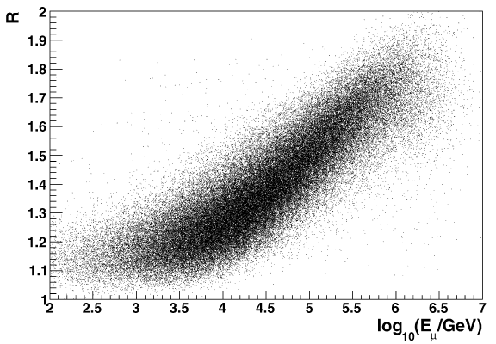
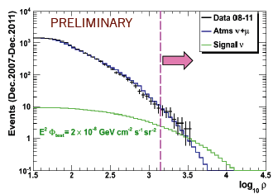
ANTARES: Search for a flux of ν_{μ} astrophysical neutrinos from diffuse sources
Search for an excess in the energy spectrum of up-going tracks with respect to the expected distribution due to atmospheric neutrino.
A good energy estimator is needed.
First search with 2008-2009 data (334 days) Phys. Lett. B 696 (2011) 16-22
  Energy estimator "R": the mean number of hits collected by fired PMTs
  n_{obs} = 9 "candidate" events observed with n_{bkg} =10.7 background for 20 TeV < E_{ν} < 2.5 PeV
  → E_{ν}²Φ(E)_{90%C.L.}= 5.3•10⁻⁸ GeV cm⁻² s⁻¹ sr ⁻¹
New search with 2008-2011 data (885 days)
  Energy estimator: dE/dx
  Reduced atmospheric muon contamination (<0.4%)
  n_{obs} = 8 "candidate" events with n_{bkg} =8.4
  n_{sig} =2.3 for 45 TeV < E_{ν} < 10 PeV
  → E_{ν}²Φ(E)_{90%C.L.}= 4.8•10⁻⁸ GeV cm⁻² s⁻¹ sr ⁻¹

Slide 14
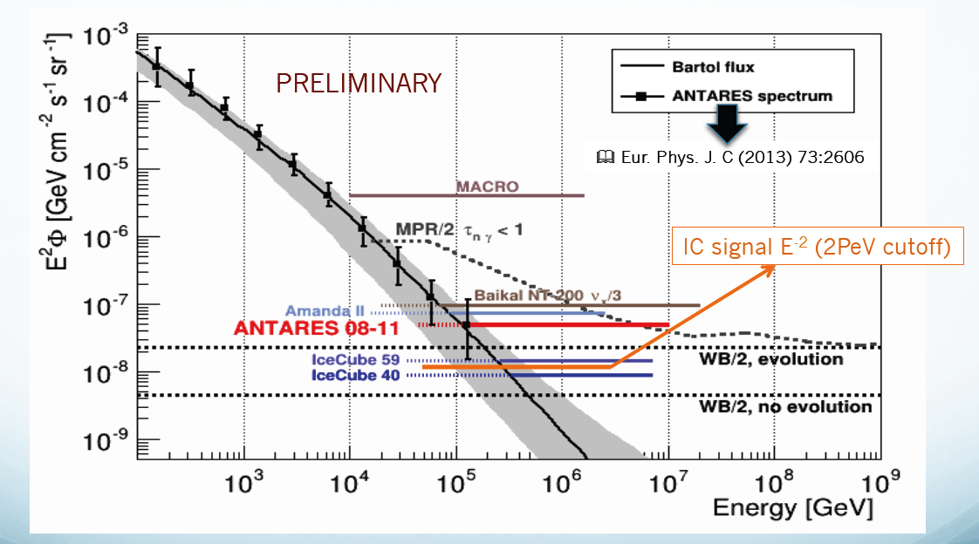
ANTARES: Search for a flux of ν_{μ} astrophysical neutrinos from diffuse sources
E_{ν}²Φ(E)_{90%C.L.}= 4.8•10⁻⁸ GeV cm⁻² s⁻¹ sr ⁻¹
45 TeV < E_{ν} < 10 PeV

Slide 15
Neutrinos from “FERMI Bubbles” ??
Search possible for a Mediterranean Cherenkov ν Telescope
FERMI detected hard γ emission (E⁻²) up to 100 GeV in extended “bubbles” around Galactic Center, hard spectrum not compatible with Inverse Compton mechanism, M.Su et al., Ap.J.724 (2010).
Models involving hadronic processes (e.g. Crocker & Aharonian, PRL 2011) predict significant neutrino fluxes.
Estimates for the neutrino flux:
An exponential energy cut-off could affect the flux
ANTARES, the present Mediterranean ν Telescope, searched for these neutrinos.

Slide 16
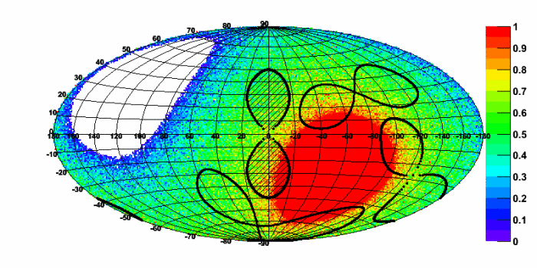
ANTARES: search for diffuse ν_{μ} from "FERMI Bubbles"
Compare the neutrino-like events coming from 3 "off-zones" (with the same size and shape as the Fermi Bubbles "on-zone") with the events coming from the Fermi Bubbles
Events selected as up-going and well reconstructed tracks.
Data sample, in the period 2008-2011, includes 806 days
In the 3 off-zones observed:
n_{bkg} = 9, 12 and 12 events
In the Fermi-Bubble region
n_{obs} = 16 events (1.2σ excess)
No statistically consistent signal observed
Fermi Bubbles "on-zone"
"off-zones"
Eur. Phys. J. C (2014) 74:2701
Data "on-zone"
Data "off-zone" average
bkg simulation
Assuming no cut-off
E²Φ(E)_{90%C.L.}= 5.7•10⁻⁷ GeV cm⁻² s⁻¹ sr ⁻¹
Assuming 500 TeV cut-off
E²Φ(E)_{90%C.L.}= 8.7•10⁻⁷ GeV cm⁻² s⁻¹ sr ⁻¹
Expected signal from Fermi Bubbles:
no cut-off
500 TeV

Slide 17
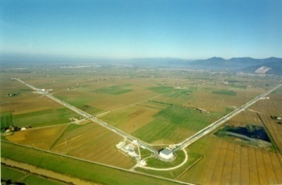


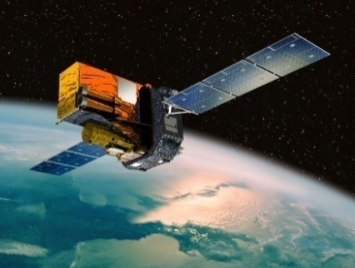
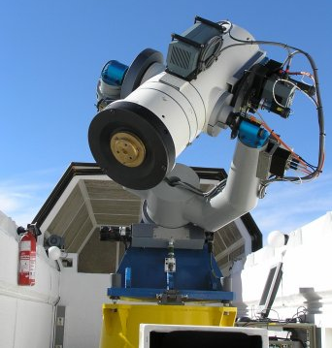
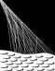
ANTARES - Multi-Messenger Searches
Potential astrophysical sources are predicted to emit very faint neutrino signal. The Multi-Messenger Approach increases the discovery potential, by observing with different probes; the significance, by coincident detection; the efficiency, by relaxed cuts.
Flaring sources
(ν emission from γ-flaring blazars/microquasars)
ANTARES
FERMI SWIFT
RXTE
APP 36 (2012) 204
VIRGO
LIGO
arXiv:1402.1600v1
ANTARES
common working group (GWHEN)
5 Line data
S. Adrián-Martínez et al.,
JCAP 06 (2013) 008
TAToO
(Telescopes – ANTARES Target of Opportunity)
Optical follow-up of neutrino alerts for transient source search (GRBs, SNae).
Analysis in progress!
ANTARES AUGER
GCN
(GRB Coordinat. Network)
Adrian-Martinez et al.,
ApJ 774 (2013) 008
ANTARES
Optical Telescopes
ANTARES GCN
TAROT & ROSTE + more
S. Adrián-Martínez et al., JCAP 1303 (2013) 006
Ageron et al., Astrop.Phys 35 (2012) 530-536

Slide 18
Pubblicazioni ANTARES-NEMO-KM3NeT 2013 - 2014
Deep sea tests of a prototype of the KM3NeT digital optical module, arXiv preprint arXiv:1405.0839, 2014
Searches for Point-like and Extended Neutrino Sources Close to the Galactic Center Using the ANTARES Neutrino Telescope, The Astrophysical Journal Letters 786 (1), L5, 2014
Searches for clustering in the time integrated skymap of the ANTARES neutrino telescope, Journal of Cosmology and Astroparticle Physics 2014 (05), 001
High-frequency internal wave motions at the ANTARES site in the deep Western Mediterranean, Ocean Dynamics 64 (4), 507-517, 2014
Status and first results of the NEMO Phase-2 tower, Journal of Instrumentation 9 (03), C03045, 2014
A Search for Time Dependent Neutrino Emission from Microquasars with the ANTARES Telescope, arXiv preprint arXiv:1402.1600, 2014
A Search for Neutrino Emission from the Fermi Bubbles with the ANTARES Telescope, EUROPEAN PHYSICAL JOURNAL C 74, 2014

Slide 19
Pubblicazioni ANTARES-NEMO-KM3NeT 2013 - 2014
First results on dark matter annihilation in the Sun using the ANTARES neutrino telescope, Journal of Cosmology and Astroparticle Physics 2013 (November 2013), 23
Measurement of the atmospheric ν_{μ} energy spectrum from 100 GeV to 200 TeV with the ANTARES telescope, The European Physical Journal C 73 (10), 1-12, 2013
Search for muon neutrinos from gamma-ray bursts with the ANTARES neutrino telescope using 2008 to 2011 data, Astronomy & Astrophysics 559 (A9), 11, 2013
A first search for coincident gravitational waves and high energy neutrinos using LIGO, Virgo and ANTARES data from 2007
Journal of cosmology and astroparticle physics 2013 (06), 008
Search for a correlation between ANTARES neutrinos and Pierre Auger Observatory UHECRs arrival directions
THE ASTROPHYSICAL JOURNAL 774, 2013
Detection Potential of the KM3NeT Detector for High-Energy Neutrinos from the Fermi Bubbles. ASTROPARTICLE PHYSICS 42, 7 – 14, 2013

Slide 20
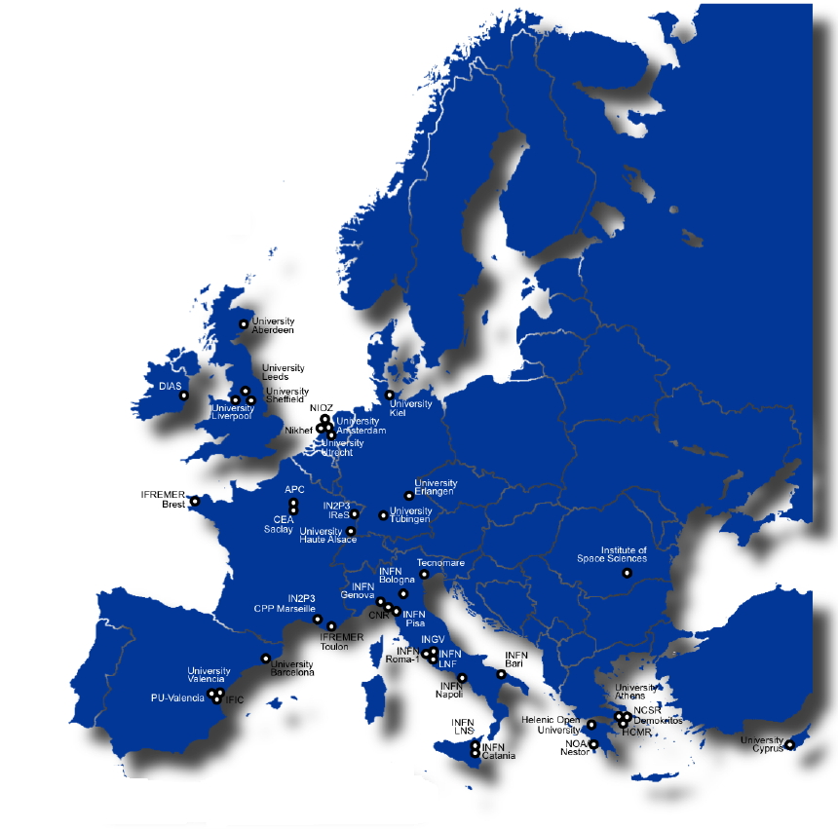
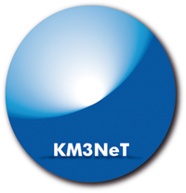
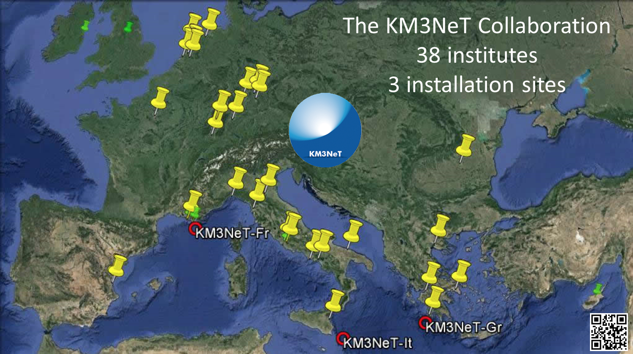
International Collaboration involving 241 scientists from 38 Institutes and 10 EU countries (CY, DE, ES, FR, GR, IE, IT, NL, RO, UK)
KM3NeT
Objective: to build the most sensitive high energy neutrino telescope in the Northern Hemisphere
KM3NeT is on the ESFRI
roadmap since 2006

Slide 21
The KM3NeT Detector
TDR : ISBN 978-90-6488-033-9 (2010)
~ 90 m
KM3NeT
~ 700 m
About 11000 KM3NeT-DOMs (Digital Optical Modules) attached to about 600 KM3NeT Detection Units
Propriety KM3NeT Collaboration
18 optical modules per detection unit Distance between optical modules ~ 36 m
First optical module above seabed ~ 100m

Slide 22
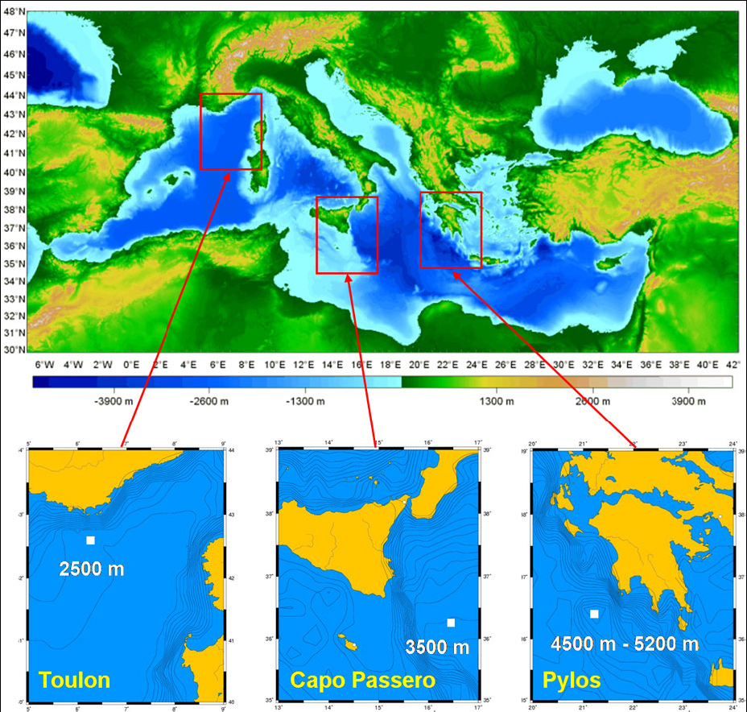
KM3NeT multisite construction
3 detectors, each ~2km³ in 3 sites
KM3NeT-France:
Toulon (depth ~ 2500m)
KM3NeT-Italy:
Capo Passero (depth ~ 3500m)
KM3NeT-Greece:
Pylos (depth ~ 4500m)
Common hardware, data handling and operation control
Centrally managed
Node for marine science at each installation site

Slide 23
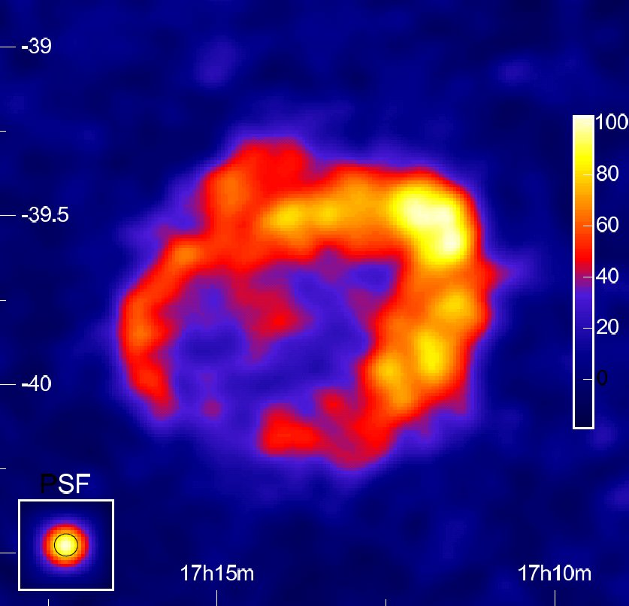
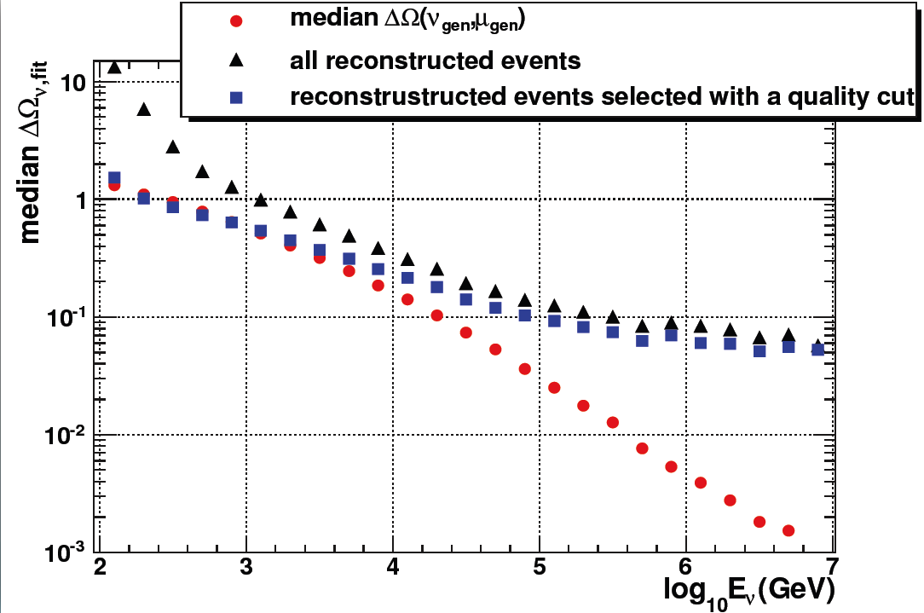
Sensitivity to galactic source for a
Mediterranean ≈5km³ Cherenkov ν Telescope
For the galactic PWN VelaX:
5σ discovery in ~ 3 years (50% prob.)
evidence (3σ 50% prob.) in ~1.2 years
H.E.S.S.: RXJ1713 in gamma-rays
For the galactic Supernova Remnant:
RXJ1713.7-3946
5σ discovery in ~5 years (50% prob.)
evidence (3σ 50% prob.) in 2 years

Slide 24
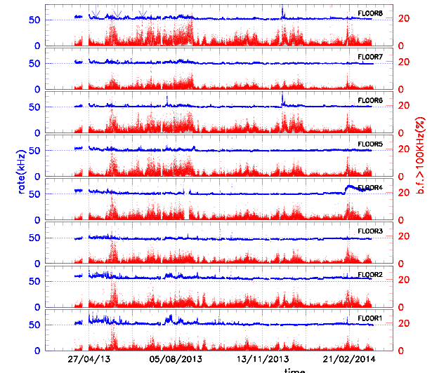
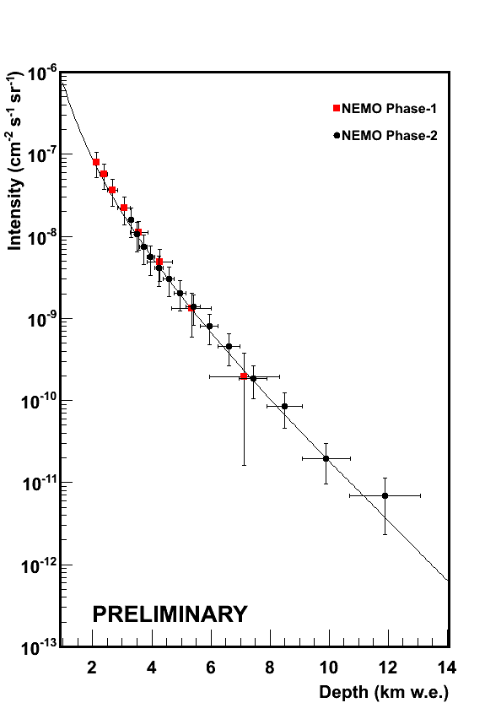
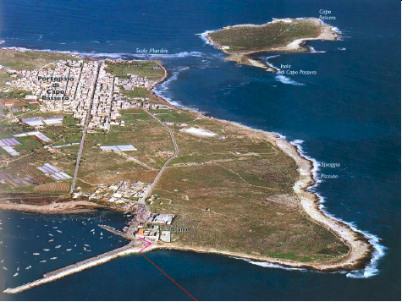
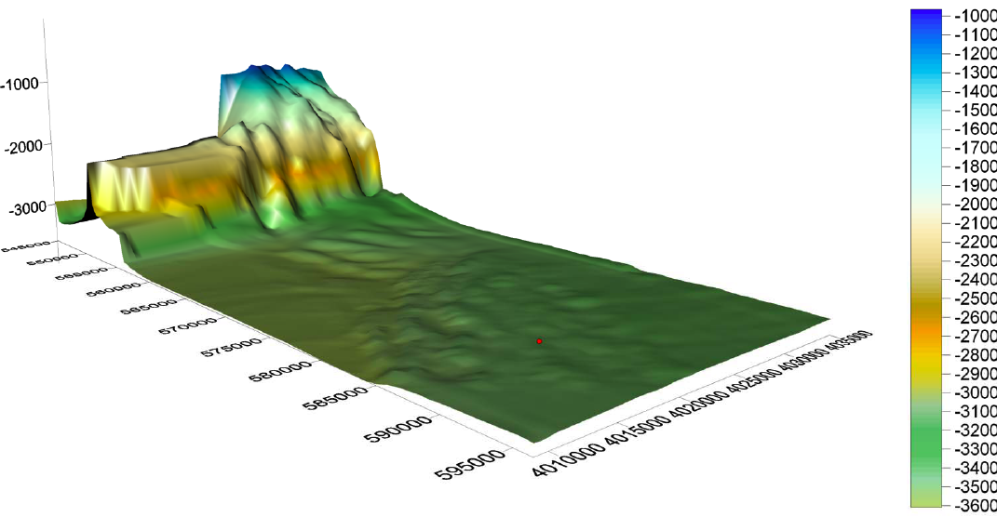
Detectors operational at KM3NeT-It site, May 2014
Since March 2013 the NEMO-Phase2 Tower
Since May 8th 2014: Prototype KM3NeT detection unit with 3 DOMs

Slide 25
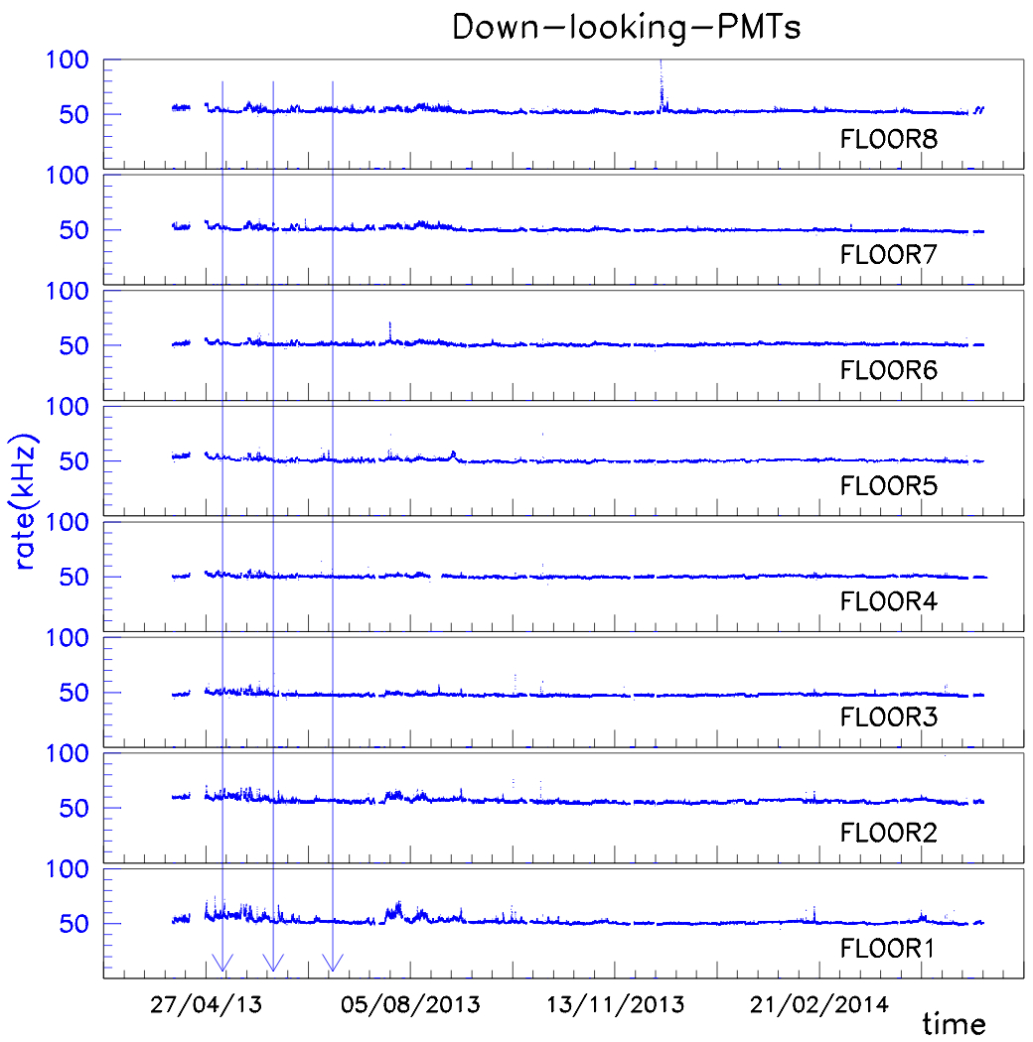
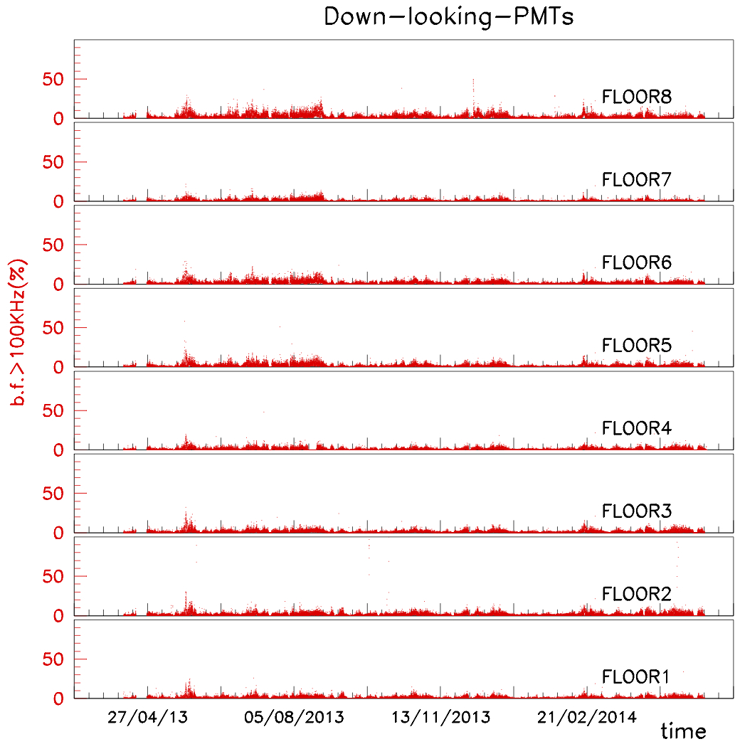
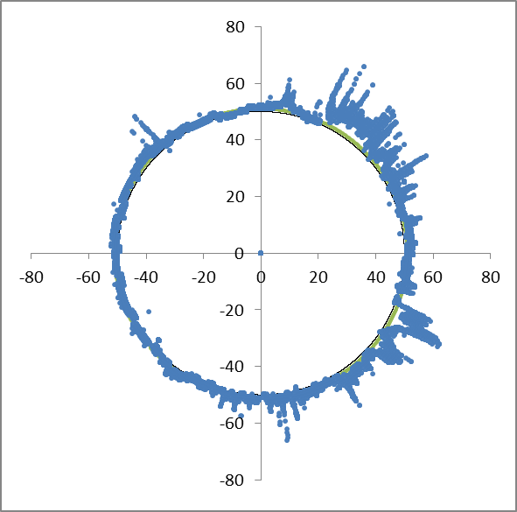
Yearly rates for down-looking PMTs
Yearly behavior
Rate (kHz)
Mar14
Apr13
Feb14
May13
Jan14
Jun13
Dec13
Rate (kHz)
Jul13
Nov13
Aug13
Oct13
Sep13

Slide 26
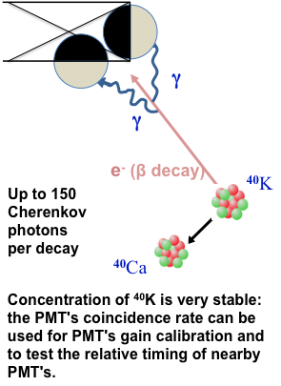
Adjacent PMTs coincidences, due to photons originated by a ⁴⁰K decay, acquired in "minimum bias trigger" 1 ms wide
10" PMT single rate ~ 50kHz, two PMTs coincidence ~ 20 Hz
→ Check of PMTs relative timing and efficiencies.

Slide 27
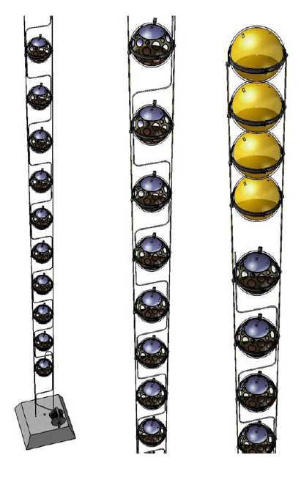
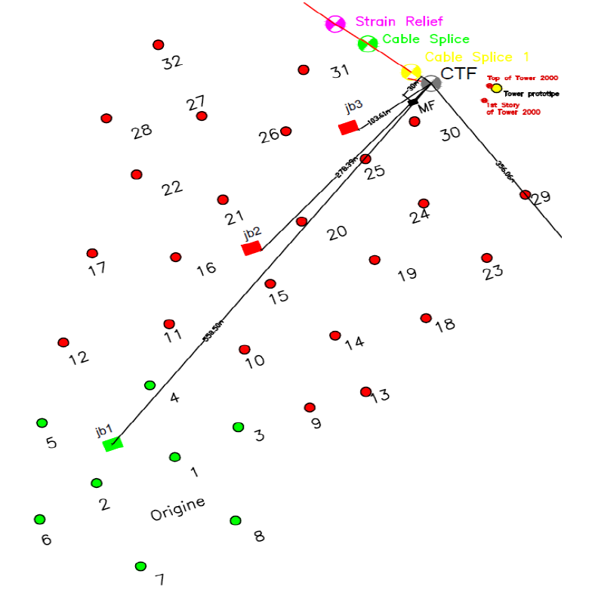
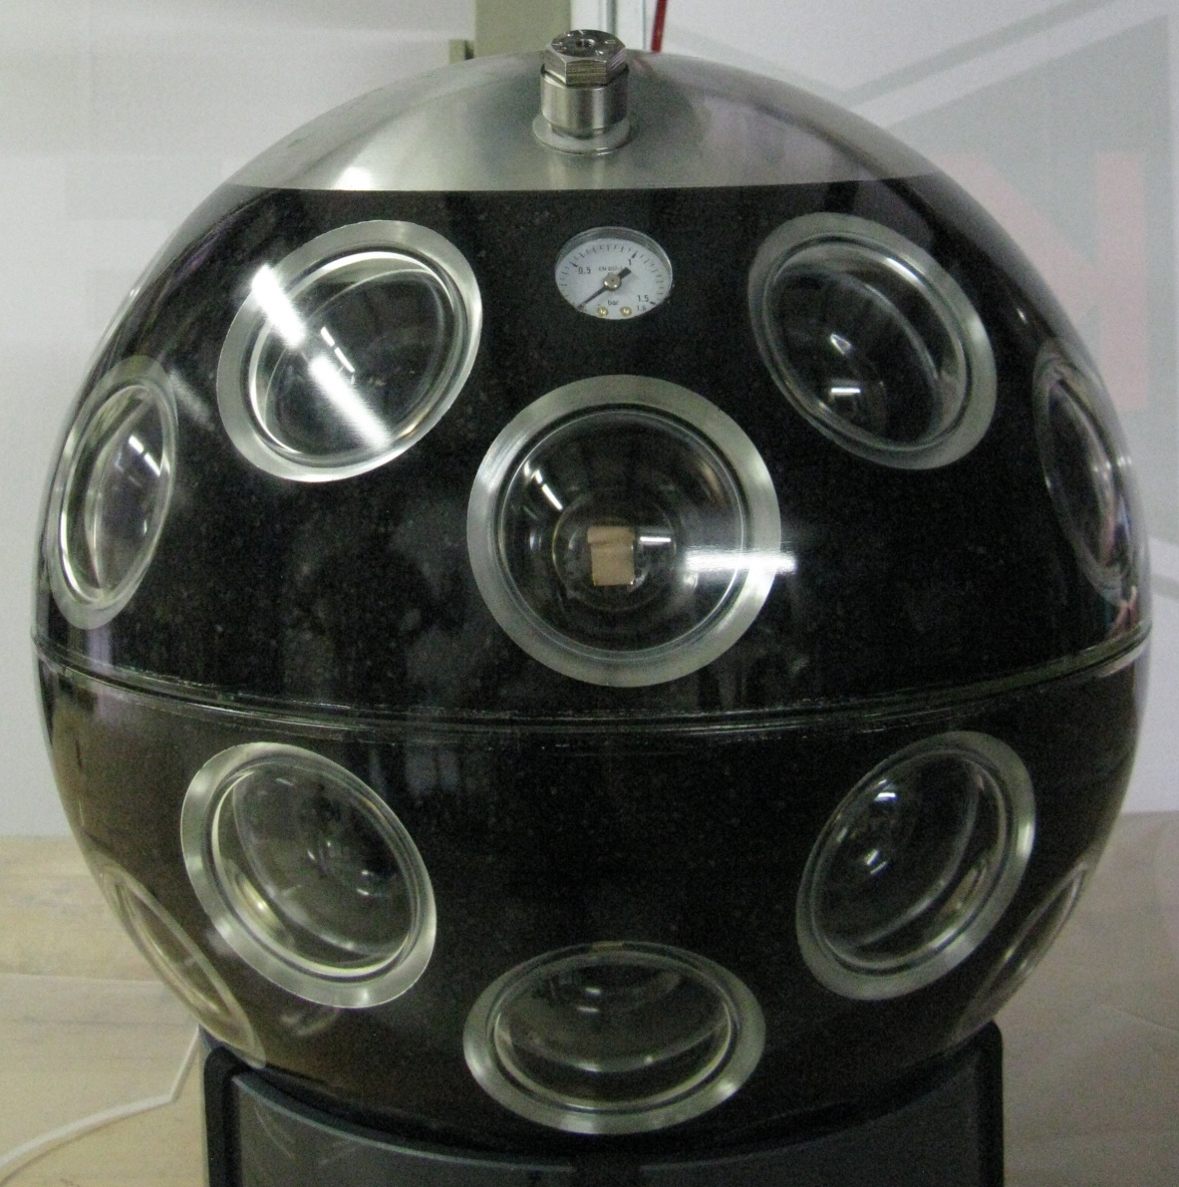
KM3NeT-It Fase-1 @ Capo-Passero: 2014-16
24 Strings with KM3NeT technology: DOMs with 31 3" PMTs
8 Towers like NEMO-Phase2 Tower

Slide 28
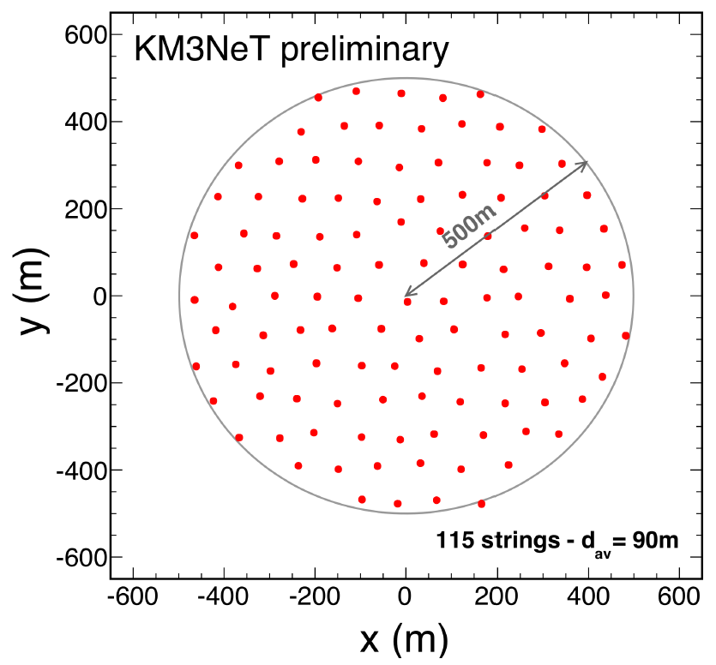
Prossimo obiettivo: fra Fase1 ed il telescopio completo: KM3NeT Phase-1.5 (>2016)
Intermediate phase in staged implementation of KM3NeT
Motivated by, but not restricted to investigation of “IceCube signal”
2 building blocks, 115 strings each;
18 DOMs per string, 31 PMTs per DOM
Standard KM3NeT technology;
no engineering studies
Standard geometry: 90 m string distance,
36m vertical spacing between DOMs
Moderately increased string distance possible (e.g. 120 m)
Cost: 80-90 M€ (including Phase-1)
Building block:
… ancora non finanziato …

Slide 29
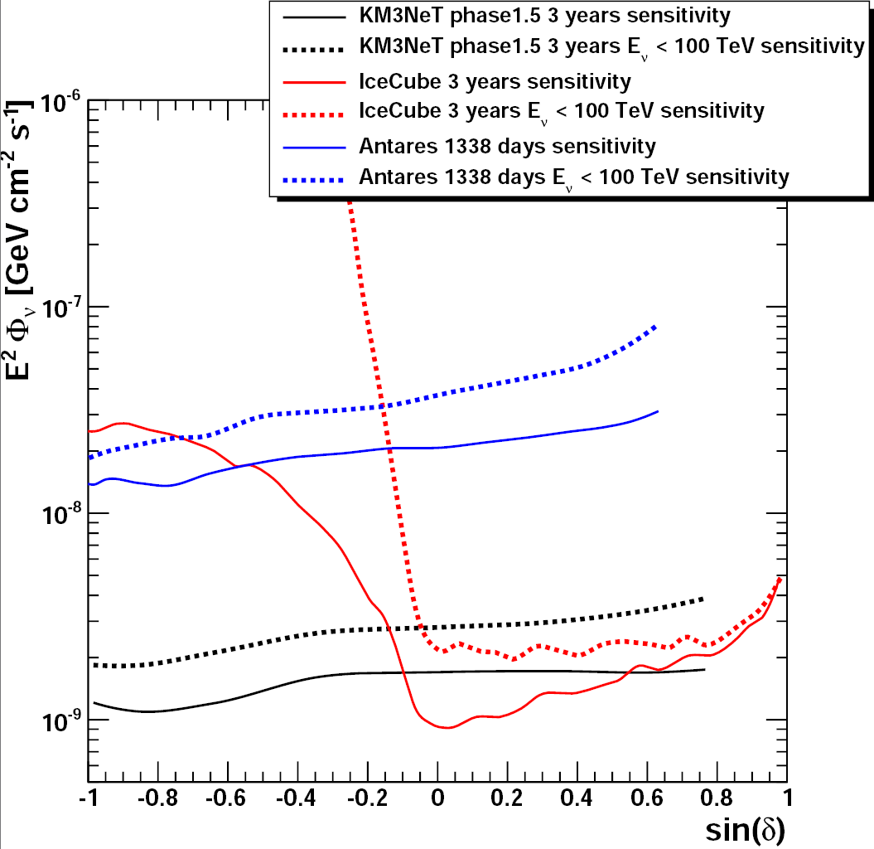
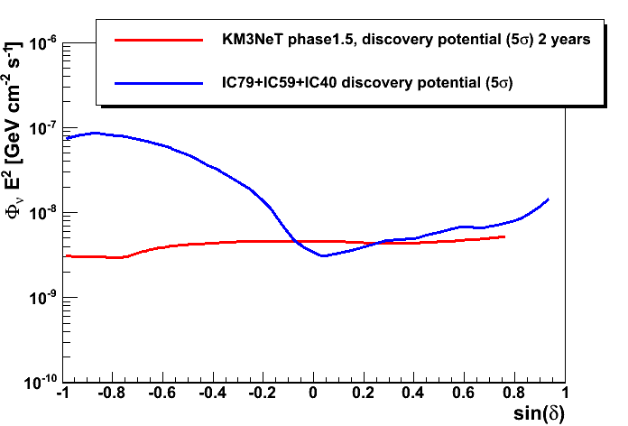
KM3NeT Phase 1.5 point source sensitivity
Muon track reconstruction:
      Angular resolution < 0.2° for E_{ν} > 10 TeV
      Energy estimator (RMS ~0.3 in log₁₀(E_{µ}))
      Quality parameter Λ
Generic assumption: E⁻² spectrum
    Sensitivity as a function of zenith
    Almost full angular coverage
  Specific flux assumption for
  Supernova Remnants (SNR),
  modeled using γ-ray results
  (Kelner et al., Phys.Rev. D74 (2006) 034018 )
    3σ detection in roughly 5 years
Note: KM3NeT Phase-1.5 is a precursor to KM3NeT Phase-2
→ Sensitivity to Phase-2 priority signals is important!

Slide 30
Ieri … oggi e … domani
Torre di NEMO, prototipo delle Torri per KM3NeT-IT
  Data taking da marzo 2013, importante fonte di dati e di verifiche tecnologiche
  Dalla analisi dei dati NEMO-Fase2: atm. μ Depth-Intensity relation, caratteristiche ottiche ed ambientali sito Capo Passero, coincidenze da ⁴⁰K, …
KM3NeT–Torri, programma di lavoro 2014-15
  Produzione e test dei componenti, integrazione e deployment delle Torri, messa in acquisizione dati a KM3NeT-It (Capo Passero): 2 Torri < dicembre 2014, 6 Torri < giugno 2015
KM3NeT-Stringhe
  PMTs ordinati per 24 Stringhe, integrazione dei DOMs in fase di avvio
  Prima Stringa con 18 DOMs pronta < novembre 2014 da installare < giugno 2015
  4 Stringhe installate a KM3NeT-It < ottobre 2015
  Completamento costruzione DOMs per 24 Stringhe < dicembre 2015
Adeguamento della infrastruttura di fondo per KM3NeT-It (8 Torri + 24 Stringhe)
  Adeguata ad accogliere due Torri < dicembre 2014, adeguata per 8 Torri + 24 Stringhe < dicembre 2015

Slide 31
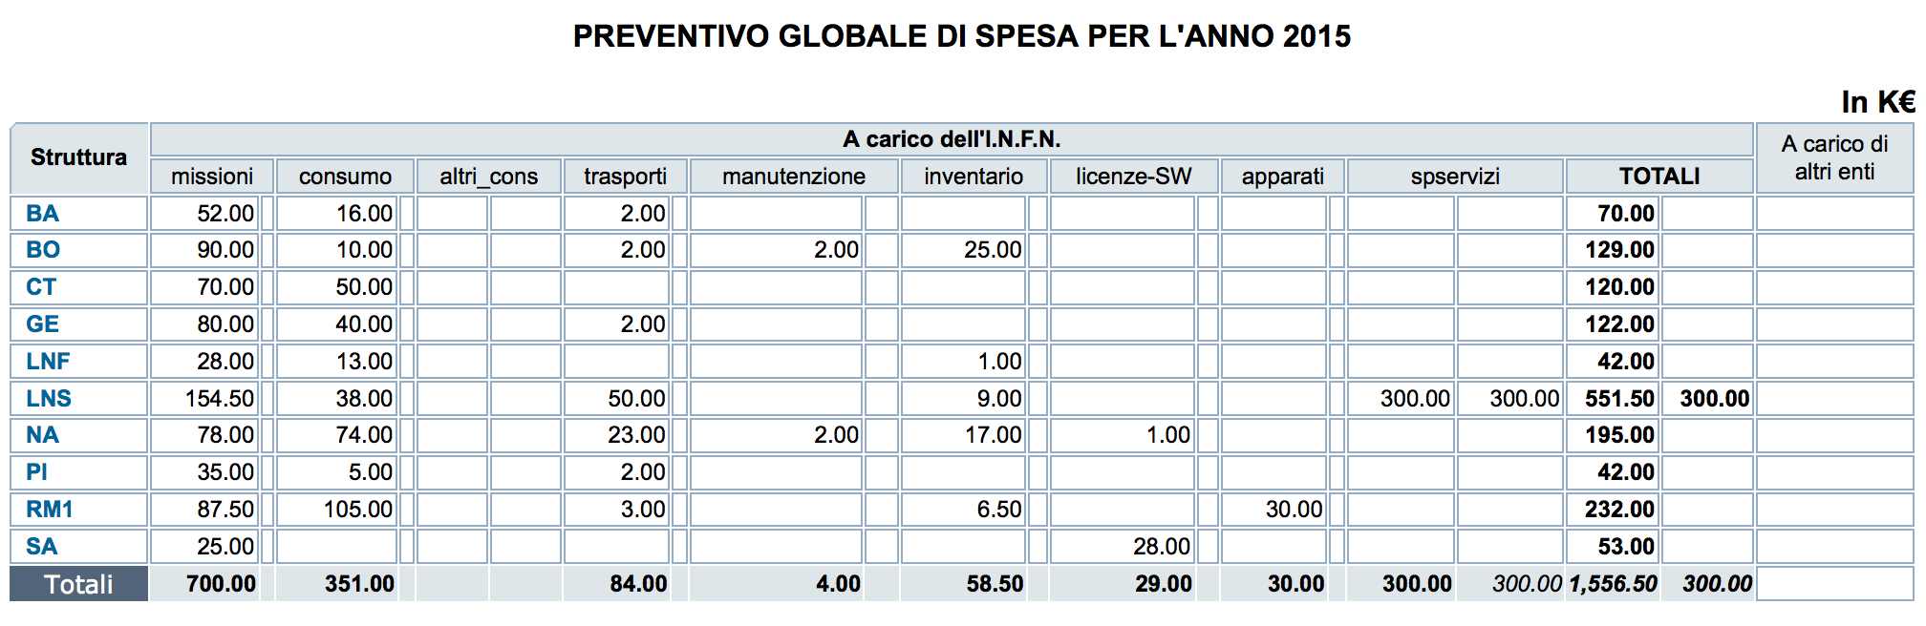

Slide 32
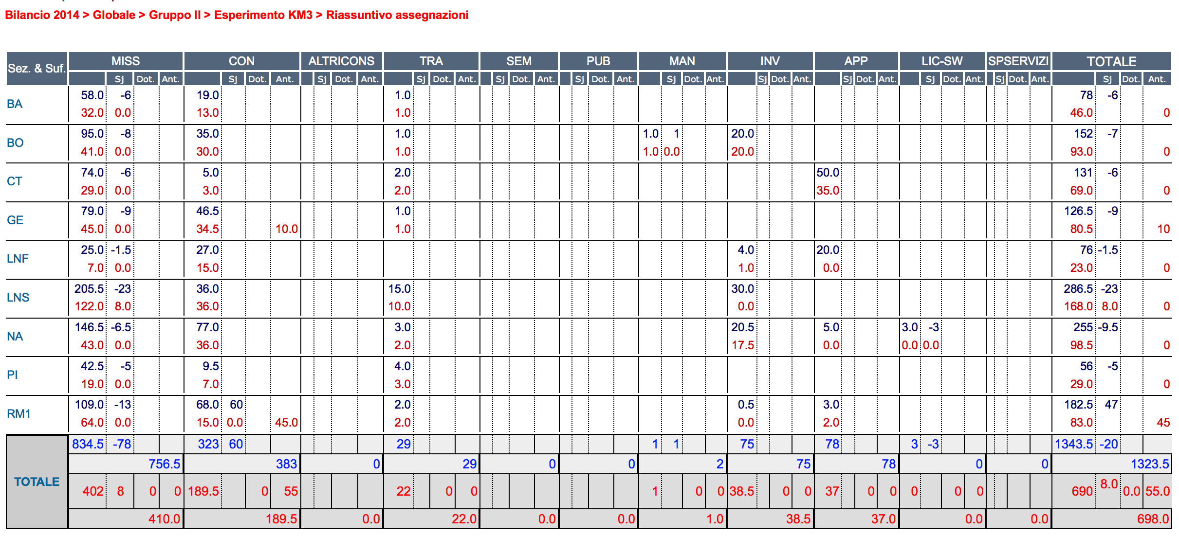

Slide 33
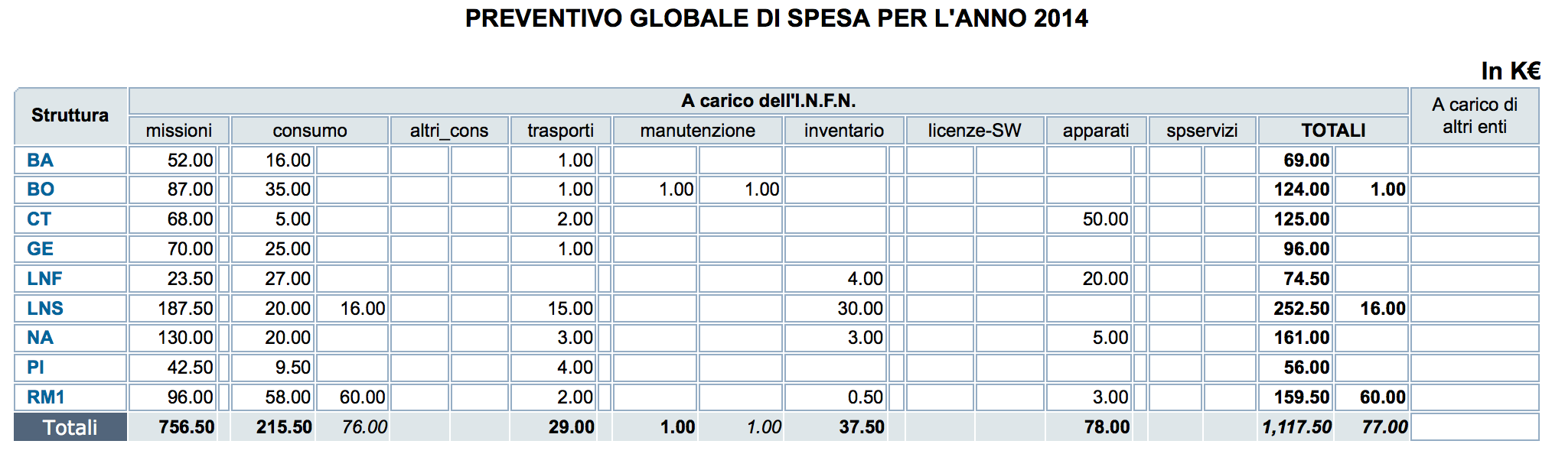

Slide 34
KM3NeT technology
Multi-PMT Digital Optical Module (DOM)
31 3” PMTs in 17-inch glass sphere (cathode area~ 3x10” PMTs)
  19 in lower, 12 in upper hemisphere
  Light collection rings (20-40% gain)
31 PMT bases (total ~140 mW) (D)
Front-end electronics (B,C)
  FPGA readout
  Sub-ns time stamping
  Gb/s speed
Al cooling shield and stem (A)
Single penetrator
Calibration:
  LED and piezo inside sphere
Advantage:
  large segmented photocathode area
  1-vs-2 photo-electron separation:
  sensitivity to coincidences
  directionality
A
B
C
C
D
PMT

Slide 35
KM3NeT Detection Unit
String-like vertical structure with 18 KM3NeT-DOMs
Mooring line:
  Buoys for string tensioning
  2 Dyneema© ropes
  18 storeys (one OM each),
  36m distance, first DOM 100 m above the Seabed
  DOMs connected via electro-optical cable: 1 fibre+2 copper wires
  Break out box with fuses at each storey
  DWDM with 80 wavelengths
    GB/s readout
    all data to shore

