Slide 1
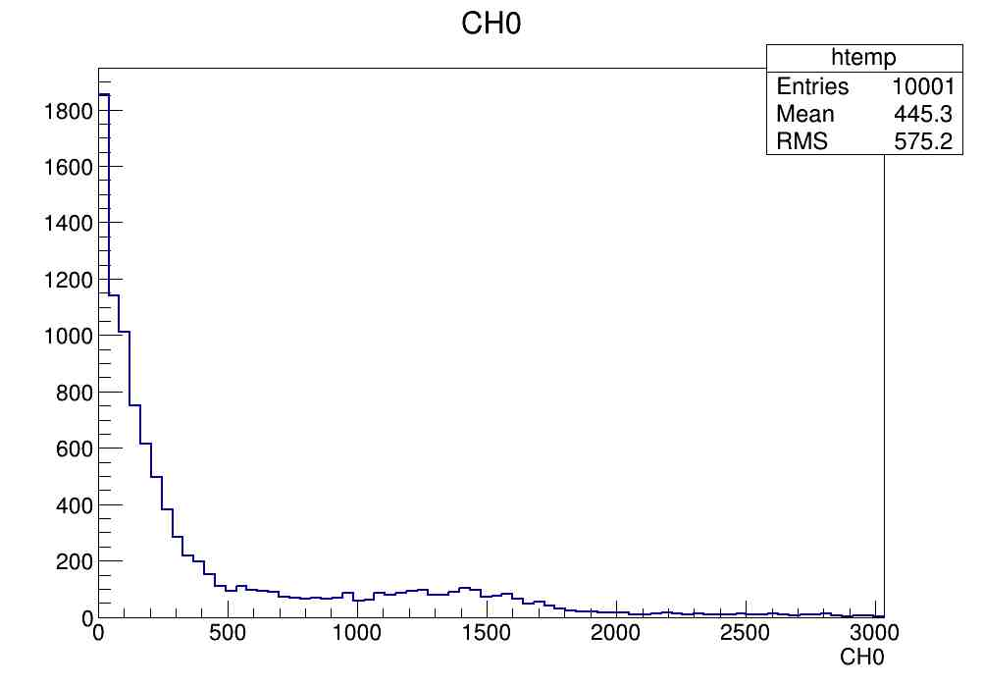
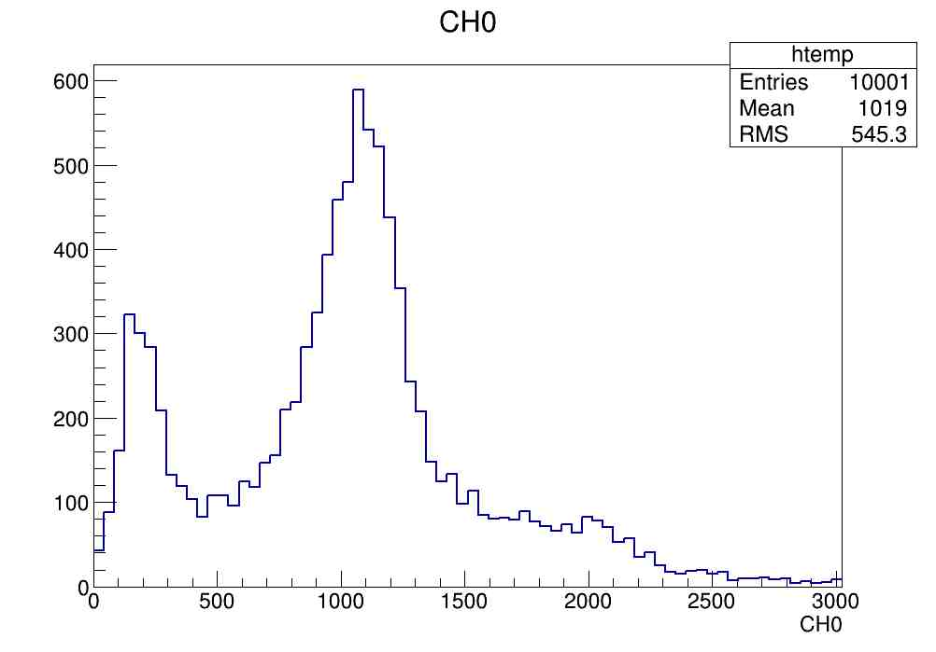
137Cs LY on CsI:Tl Amcrys 005 sample
AM005
PRE-irradiation
after 21 Gy
after 67 Gy
after 67 Gy and 1 day
after 67 Gy and 11 days

Slide 2
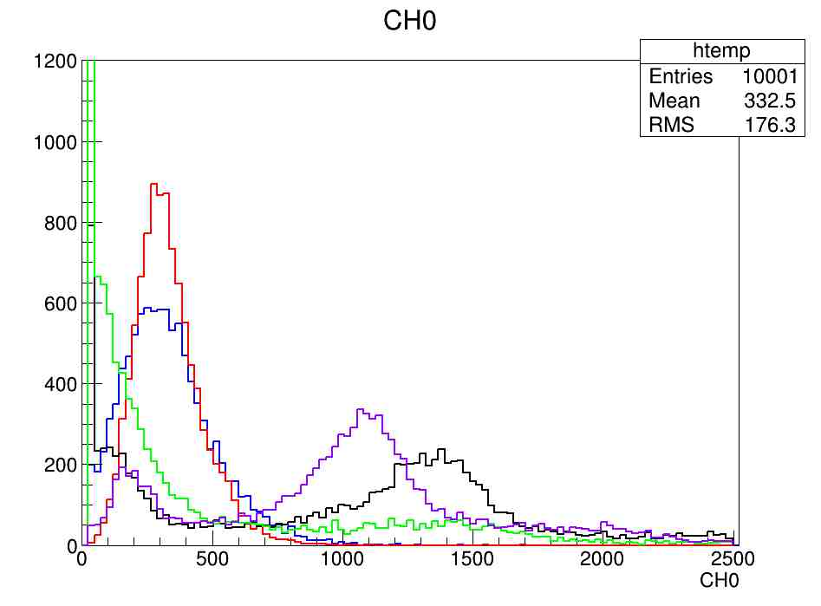
137Cs LY on CsI:Tl Amcrys 005 sample
Before irr
21 Gy
67 Gy
67 Gy and 1 day
67 Gy and 11 days

Slide 3
137Cs LY on CsI:Tl Amcrys 006 sample
AM006
PRE-irradiation
after 20 Gy
after 142 Gy
after 142 Gy and 3 h
after 142 Gy and 6 h
after 142 Gy and 24 h
662 keV photopeak recovering
662 keV photopeak recovering
High rate luminescence causes a shift on signal baseline (AC coupling): qualitative spectra until luminescense is strongly reduced

Slide 4
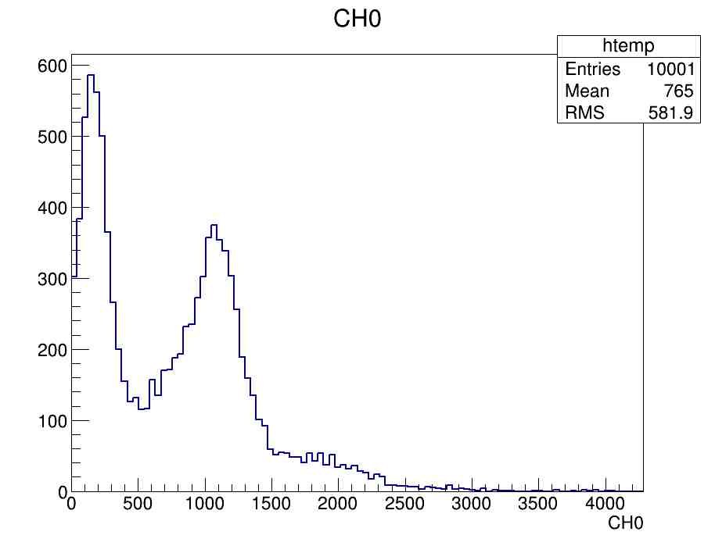
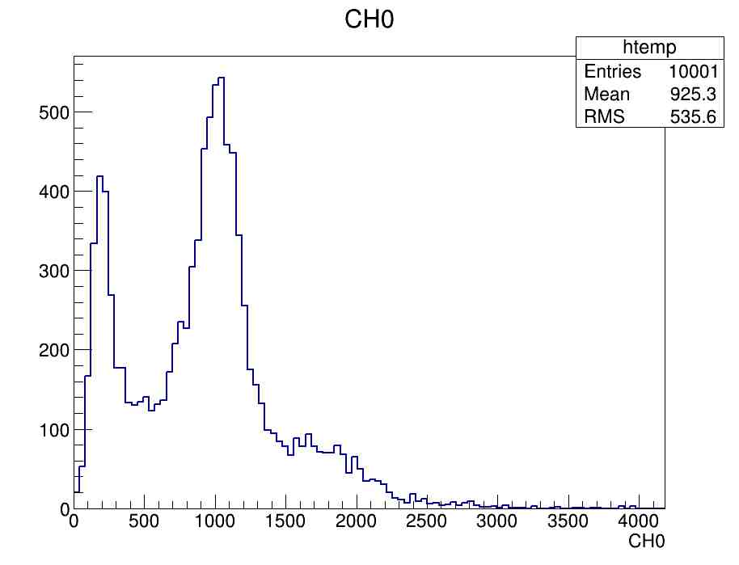
LY recovery on CsI:Tl AM006
after 142 Gy and 2 days
after 142 Gy and 12 days
662 keV photopeak recovering
662 keV photopeak recovering

Slide 5
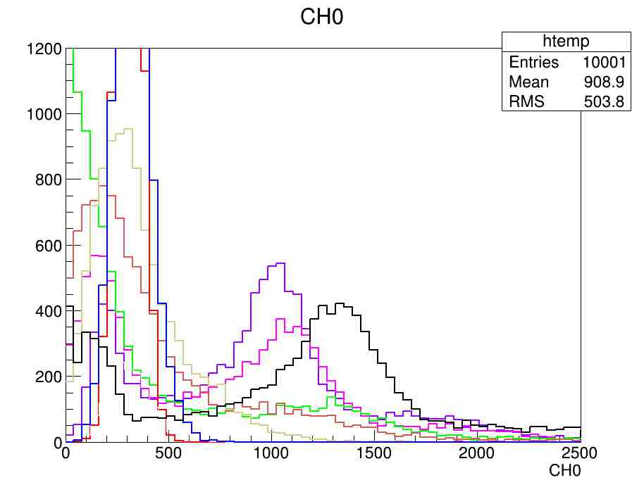
137Cs LY on CsI:Tl Amcrys 006 sample
Before irr
20 Gy
142 Gy
142 Gy and 3 h
142 Gy and 6 h
142 Gy and 1 day
142 Gy and 2 days
142 Gy and 12 days

Slide 6
Transmittance spectra of CsI:Tl AM005 and AM006
after irradiation:
transmittance decreases in the whole range
absence of Tl absorption peaks (300-600 nm)

Slide 7
Transmittance recovery of CsI:Tl AM006
no recovery after irradiation

