Slide 1
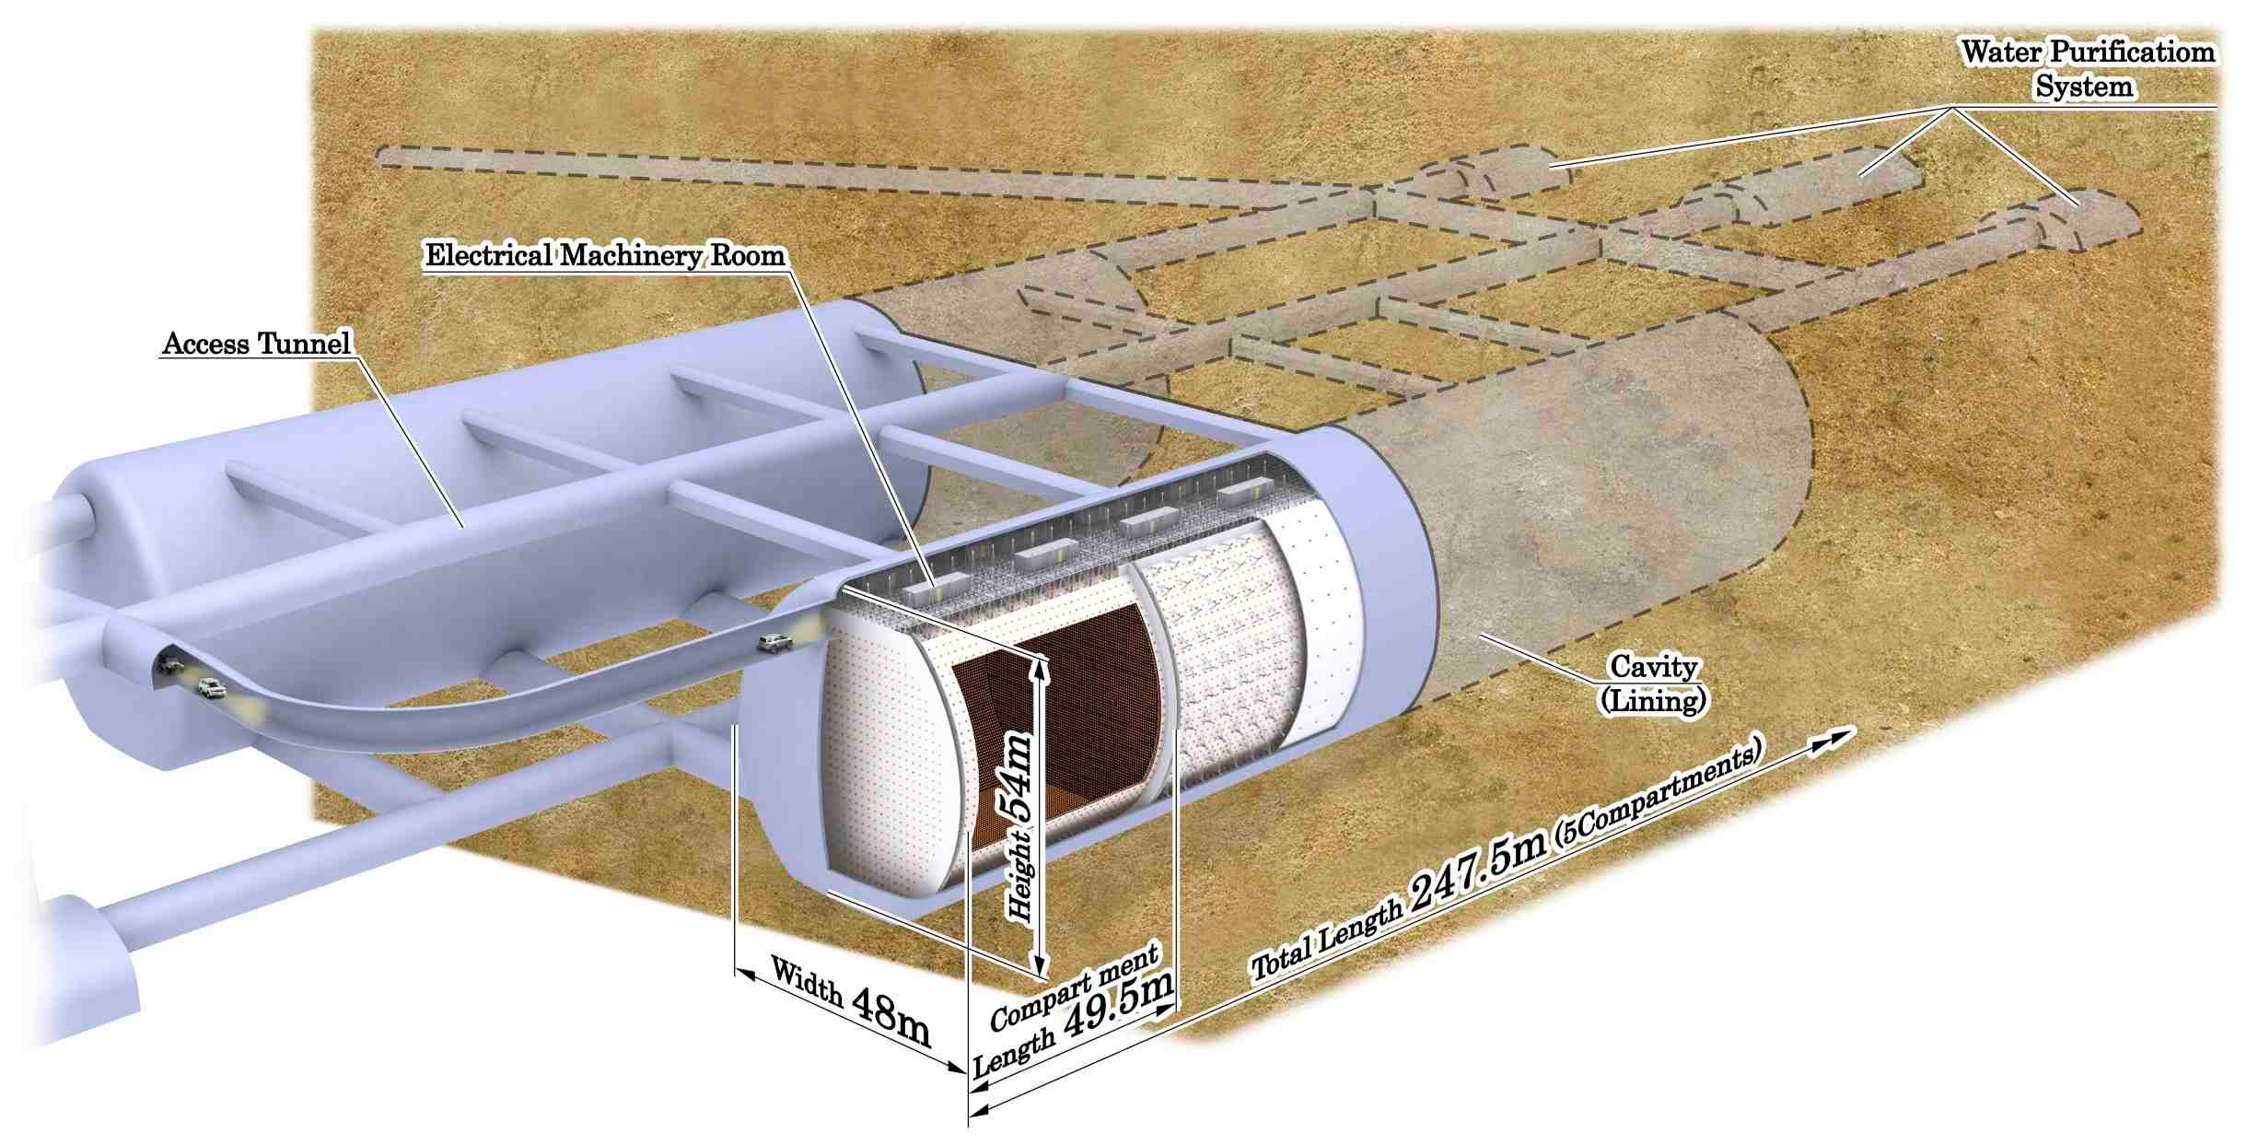
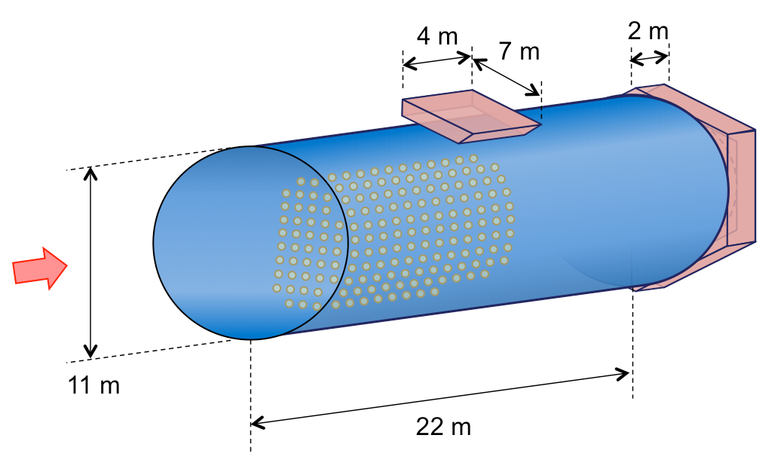
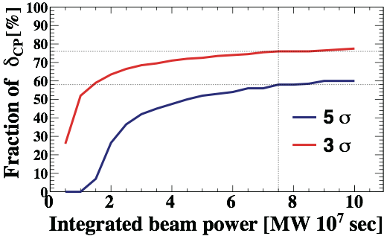
TITUS : An Intermediate Detector for the Hyper-K Experiment
Tokai-to-Hyper-K Experiment
TITUS Detector Concept
Megaton scale Water Cherenkov detector
x25 larger fiducial volume than Super-K.
A proposed Water Cherenkov Near Detector
Main features:
2km from the neutrino beam source to match the far detector flux.
Identical target nucleus and detector technologies as the far detector to maximise the cancelation of systematic uncertainties.
Neutron tagging by capture on Gadolinium.
Magnetised Muon Range detector for sign selection and measure escaping muons.
Leptonic CP violation can be established at 3σ (5σ) for 76% (58%) of δCP space.
New near detectors are needed to maximise physics potential of the T2HK beam programme.

Slide 2
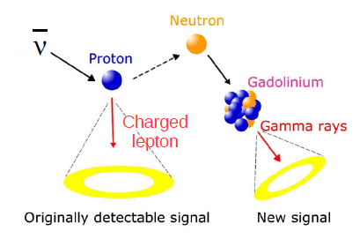
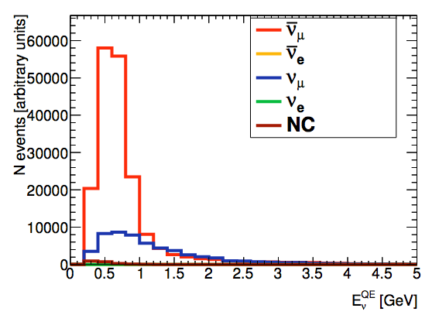
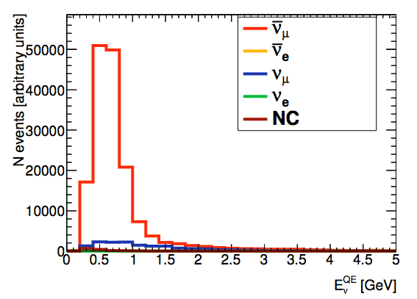
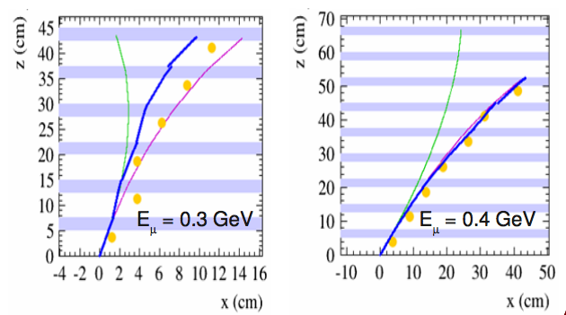
TITUS : An Intermediate Detector for the Hyper-K Experiment
Neutron Tagging
Muon Range Detector
Please find my poster if you would like to know more!
A magnetised iron-scintillator sandwich
measure momentum of escaping muons.
allows sign-selection.
in-situ validation of the neutron capture technique.
Neutron capture on Gd produces visible gamma signal.
Neutron tagging allows neutrino-anti-neutrino discrimination.
No neutron selection
With neutron selection
David Hadley on behalf
of the TITUS working group

