Slide 1
The RD53 effort towards the development of a 65 nm CMOS pixel readout chip for extreme data rates and radiation environments
Valerio Re (INFN-Pavia) on behalf of the RD53 collaboratios
RD53 was organized to tackle the extreme and diverse challenges associated with the design of pixel readout chips for the innermost layers of particle trackers at future high energy physics experiments (LHC – phase II upgrade of ATLAS and CMS, CLIC)
ATLAS and CMS Phase 2
Pixel Detector Requirements:
Small pixels: 50x50 μm² (or 25x100 μm²)
Large chips: > 2cm x 2cm ( ~1 billion transistors)
Hit rates: ~3 GHz/cm²
Radiation: 1 Grad, 10¹⁶ n/cm² (unprecedented)
Trigger: 1 MHz, 10 μs (~100x buffering and readout)
Total power budget: ≤ 1 W/cm²
Minimum threshold: 1000 electrons
RD53 institutions
ATLAS: CERN, Bonn, CPPM, LBNL, LPNHE Paris, Milano, NIKHEF, New Mexico, Prague, RAL, UC Santa Cruz.
CMS: Bari, Bergamo-Pavia, CERN, Fermilab, Padova, Perugia, Pisa, PSI, RAL, Sevilla, Torino.

Slide 2
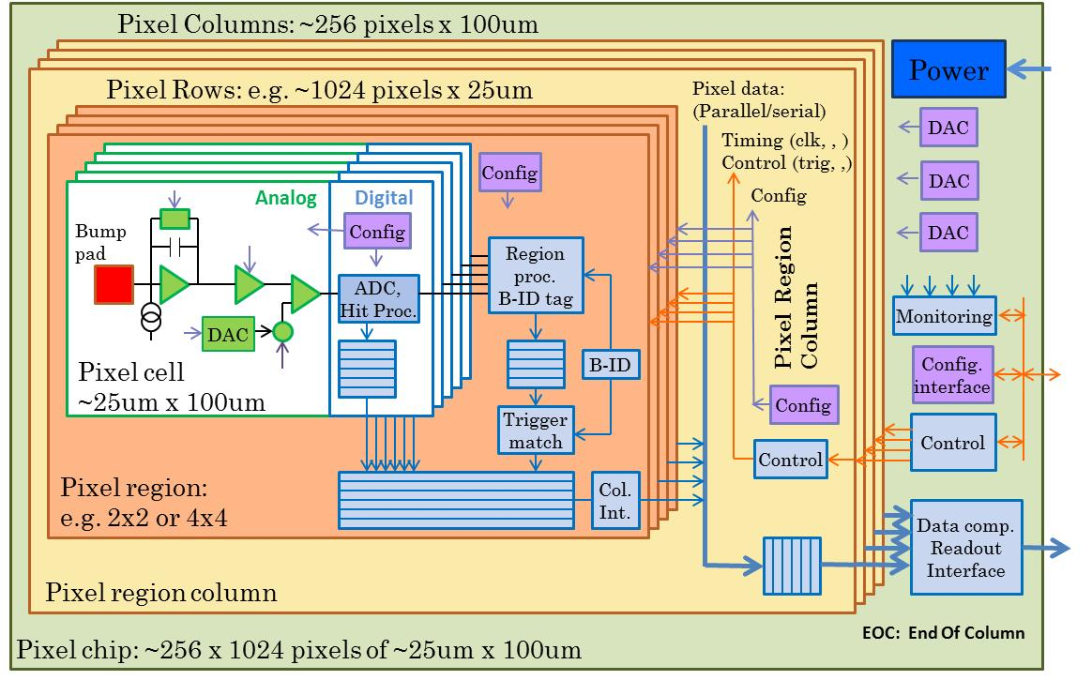
New challenges of the RD53 collaboration
65 nm CMOS is the candidate technology to address the RD53 requirements for the ATLAS/CMS pixel readout chip
Global architecture of the chip
RD53 Goals
Detailed understanding of radiation effects in 65 nm
Development of a simulation and verification framework with realistic hit generation
Design and test of small/medium size pixel readout chip prototypes
Design of a shared rad-hard IPs library
Design, characterization and test beam of a full sized pixel array chip > 1cm² from a common engineering run
95% digital, Charge digitization
~256k pixel channels per chip
Pixel regions with buffering
Data compression in End Of Column
Chip must work with large pixels for outer layers

