Slide 1
IHEP and Perspectives
Gang Chen
Institute of High Energy Physics
May 26, 2015

Slide 2
Main research Disciplines
Particle Physics
HEP Exp. Based on Accelerators
Particle Astrophysics & Neutrino Exp.
Particle Detection and Electronics
Particle Physics Theory
Science
Accelerator Physics and Technologies
Technology
High Luminosity Electron Accelerator
High Intensity Proton Accelerator
Applied Research and Technology Transfer
Radiation Technologies and Applications
Synchrotron Radiation Techs & Applications
Neutron Scattering Techs & Applications
Nuclear Analytical Techs & Applications
Scientific infrastructure for multi-disciplinary studies

Slide 3
Large science facilities
IHEP serves as the backbone of China’s large science facilities
In operation
  Beijing Electron Positron Collider (BEPCII)
  Beijing Spectrometer (BESIII)
  Beijing Synchrotron Radiation Facility (BSRF)
  Yangbajing Cosmic Ray Observatory: ASγ & ARGO
  Daya Bay Neutrino Experiment
Under construction
  China Spallation Neutron Source (CSNS)
  Hard X-ray Modulation Telescope (HXMT)
  Accelerator-driven Sub-critical System (ADS)
  Jiangmen Neutrino Underground Observatory (JUNO)
Under planning
  HEPS, LHAASO, HERD, XTP, …

Slide 4
IHEP Timeline
Daya Bay
JUNO
JUNO
BESIII
CEPC
CEPC
SppC
SppC
ASγ
LHAASO
LHAASO
HXMT
HXMT
HERD
HERD
Construction
XTP
XTP
Operation
SCNS
ADS
HEPS
Future Light Sources（FEL，ERL）？
2020
2030
2040
2050

Slide 5
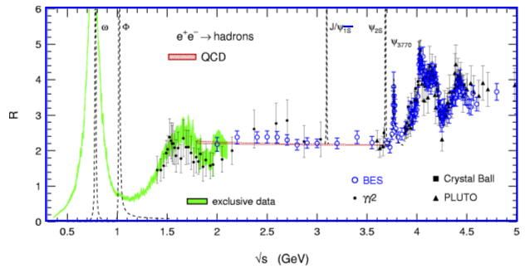
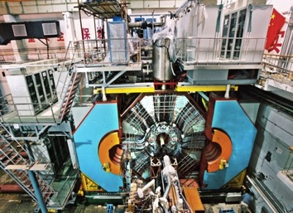
BESIII Data Taking Status & Plan
 | Previous Data set | BESIII now | Plan
J/psi | BESII: 58M | 1.2 B | 10B
Psi’ | CLEO：28 M | 0.5 B | 1B
Psi” | CLEO：0.8 /fb | 3.5/fb | 20 /fb
y(4040)/y(4160)/X(4260) etc. | CLEO：0.6/fb @ y(4160) | 0.4/fb y(4040); 2.0/fb X(4260), 0.5/fb X(4360) 1/fb X(4600) | Upon requests
R scan & Tau | BESII: | 0.8 /fb for E>3.8 GeV | 100K evts/point
BESIII will continue for the next 8-10 years: Unique in the world

Slide 6
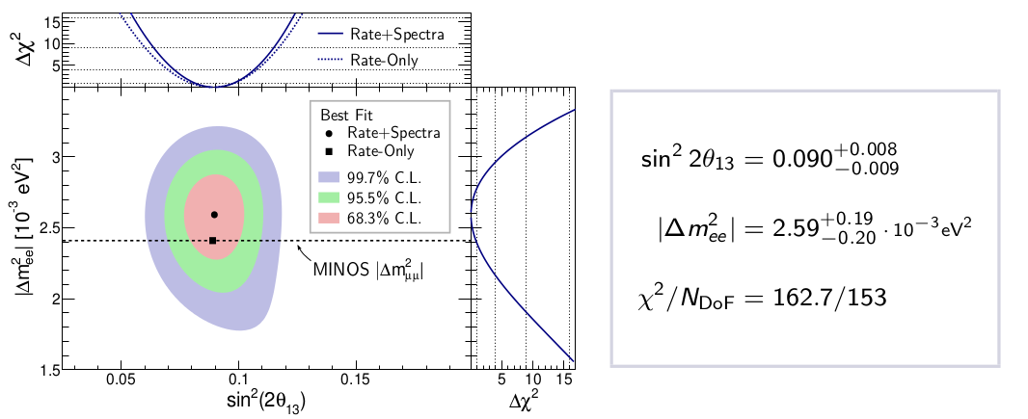
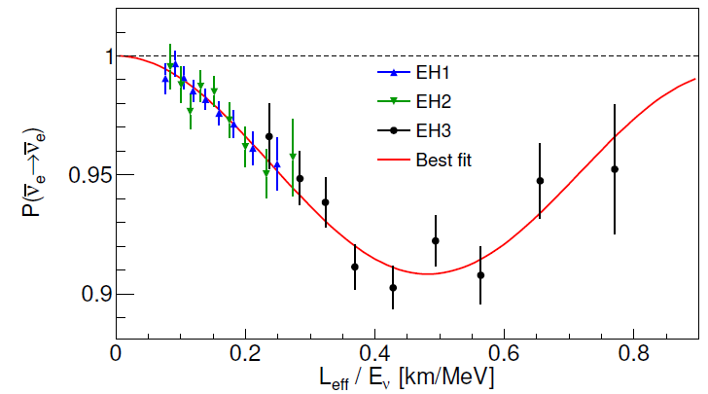


Daya Bay latest results：Rate+Spectra
arXiv:1310.6732

Slide 7
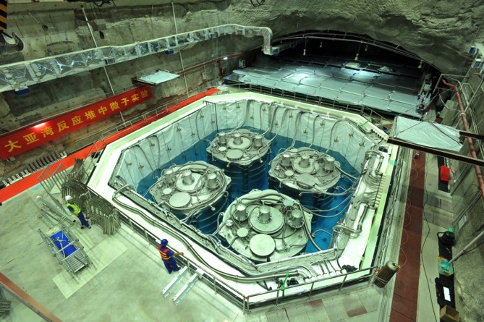
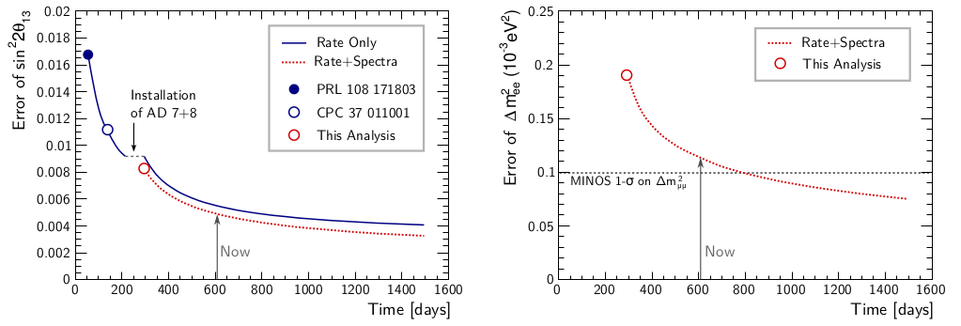
Daya Bay: Futue Plan
Maintenance & calibration completed
Results in three years: D(sin²2θ₁₃) ~ 3-4%
The most precise measurement of sin²2θ₁₃ in the next decades.
Data taking will continue until about 2017

Slide 8
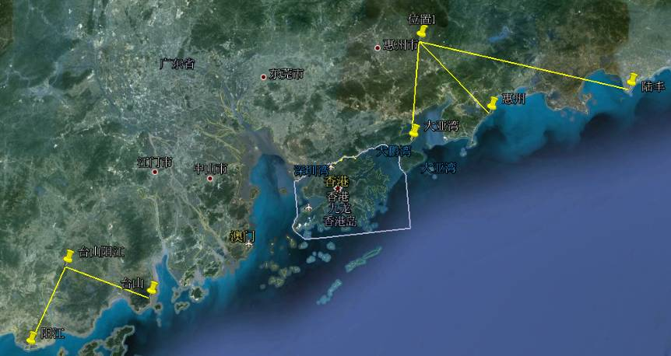
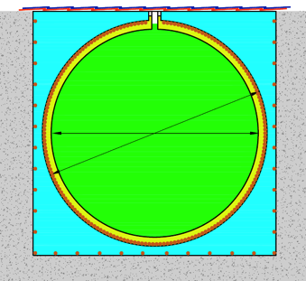
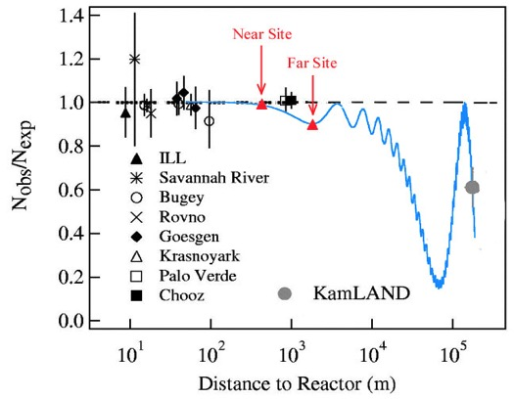
JUNO for Mass Hierarchy
Daya Bay
60 km JUNO
Previous site
20 kt LS
Lufeng
Huizhou
Daya Bay
Mass hierarchy
Precision mixing parameters
Supernova neutrinos
Geoneutrinos
Sterile neutrinos
…
JUNO site
Hong Kong
Yangjiang
Taishan
The only one based on reactor: independent of CP phase

Slide 9
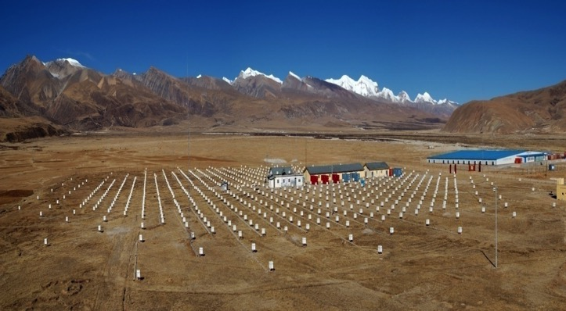
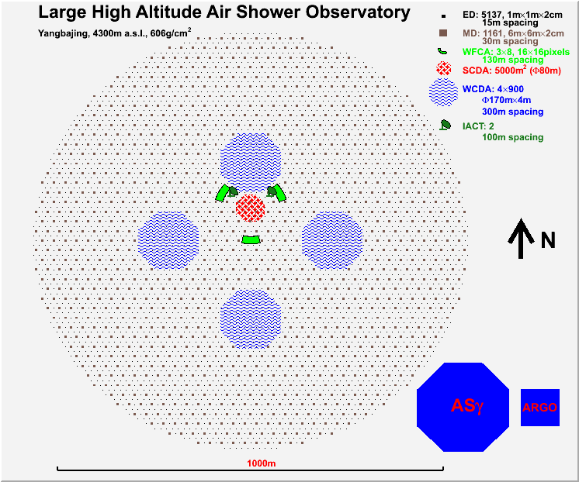
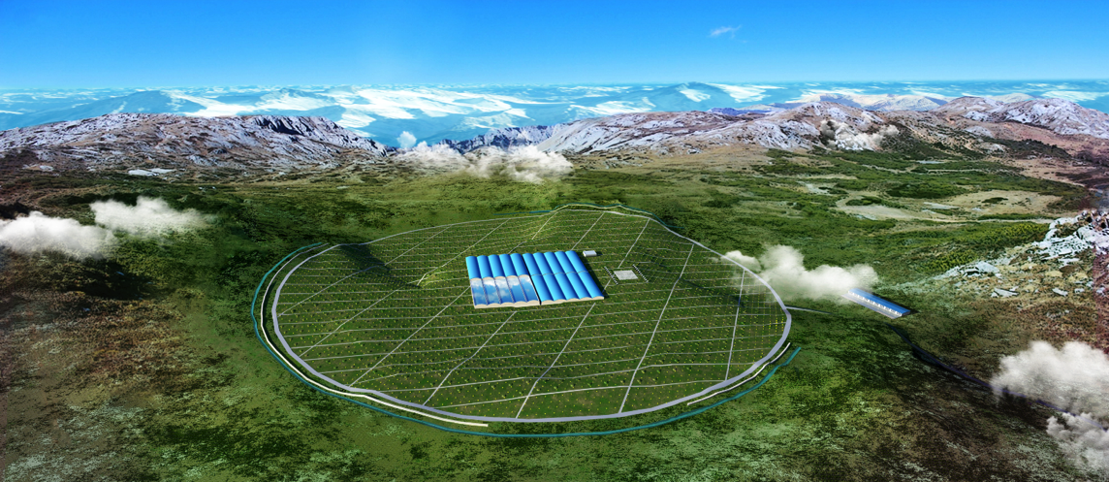
From ASγ/ARGO to LHAASO
ASγ/ARGO were in Yangbajing of Tibet
LHAASO (Large High Altitude Air Shower Observatory) in Sichuan, Altitude ~ 4400 m
  CR spectra of individual spices over two knees
  Start construction: 2015 ？
  International collaboration: China, Italy, France, …

Slide 10
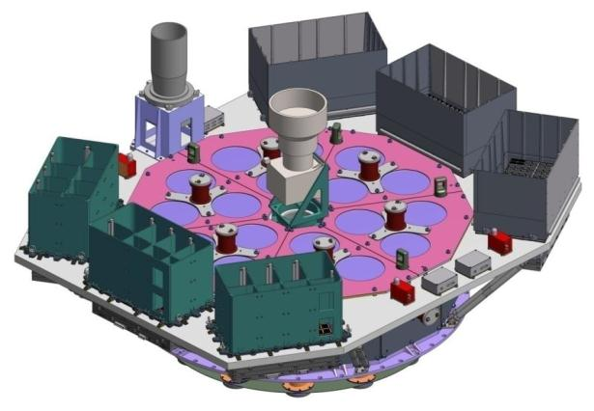
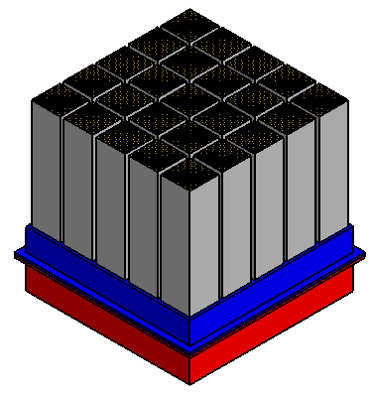
Current Space Programs
Hard X-ray modulated telescope (HXMT):
  Total mass：1021kg; Power: 350 W
  to be launched in 2015
Gamma-ray burst polarization (POLAR):
  onboard China’s Spacelab: TG-2
  An international collaboration: China, Switzerland, France, Poland
  To be Launched ~ 2015
SVOM
  Redefined program: On board Chinese spacecraft
  A collaboration of China and France
  to be launched in 2017-2018
ME
LE
HE

Slide 11
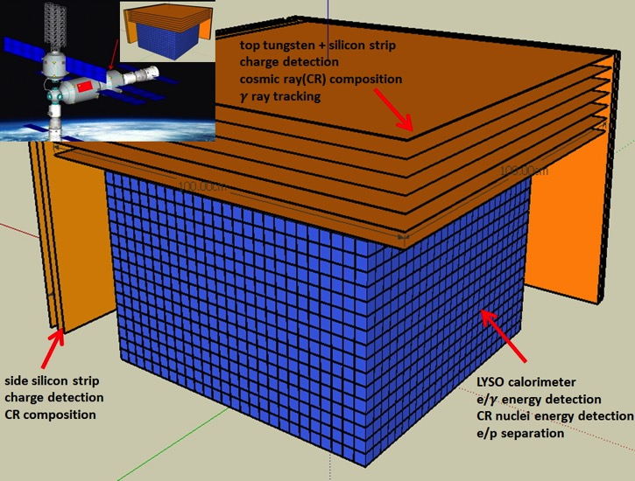
High Energy cosmic Radiation Detection (HERD)
Science
  Dark matter search: γ from 0.1 – 10,000 GeV
  Spectral and composition measurements of CRs between 300 GeV to PeV
  Complementary to LHAASO: directly measured composition & spectrum in space
Status
  Mission concept selected
  Design concept reviewed
  Technical review for mission selection soon
  Groups from China，Italy，Switzerland，Sweden,…
  Launch in ~2020 (?)
Notes:
11

Slide 12
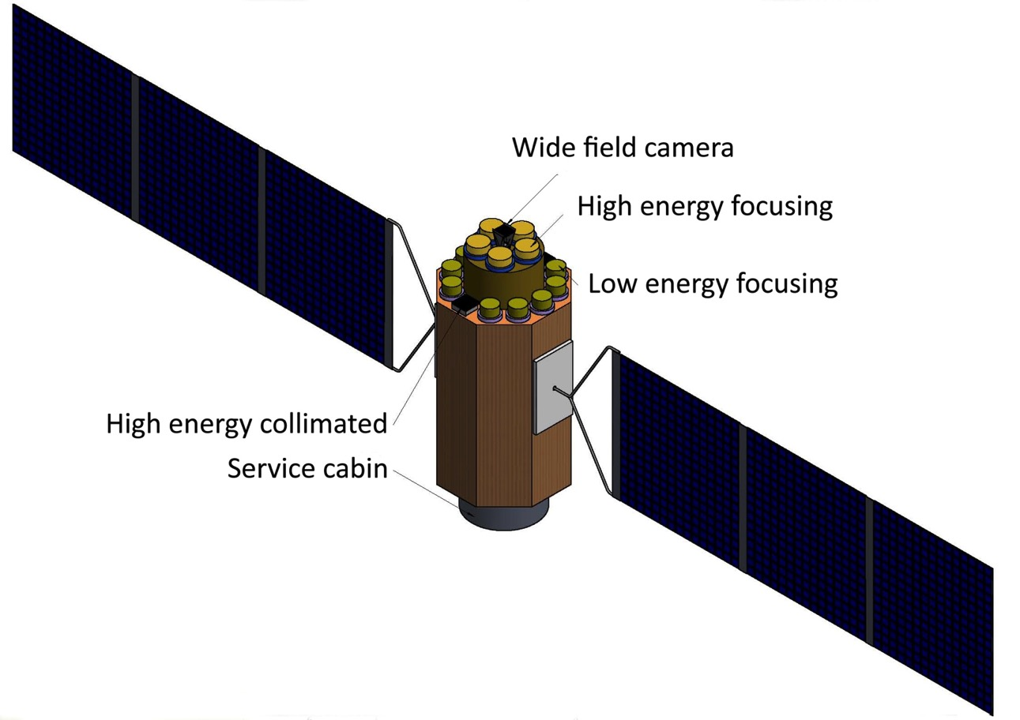
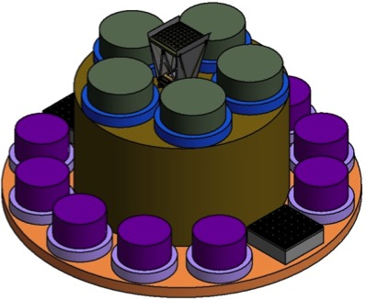
X-ray Timing and Polarization (XTP) satellite
Expected launch in 2020.
  The most sensitive light curve with good energy resolution and polarization at 1-30 keV → from faint X-ray binaries to bright AGNs

Slide 13
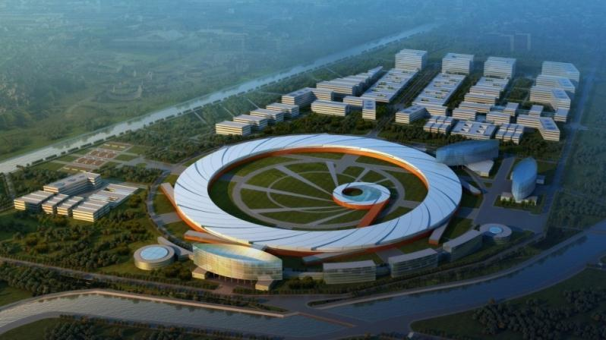
High Energy Photon Source (HEPS)
Beijing High Energy Photon Source (HEPS)
  Build of Test Facility Started in end of April 2015.
  HEPS to be built in 2017
X-ray Free Electron Laser
  EXFEL collaboration: Cryo-module
  and Undulator prototypes R&D
  9-cell RF cavity
  Photo-cathode electron gun.
  Protein structure characterization by XFEL
X-ray Energy Recovery LINAC
  Preparing a proposal for the test facility at IHEP.

Slide 14
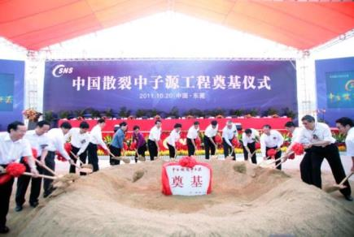
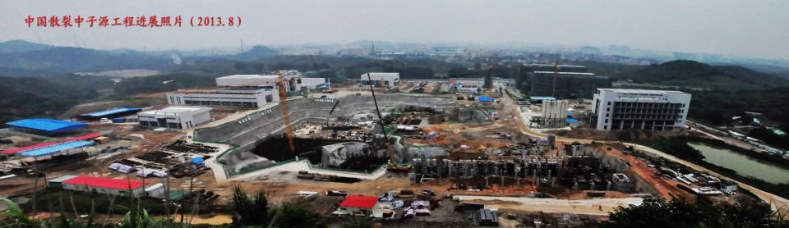
CSNS
Phase I： 100 kW
Phase II： 500 kW
Start Construction: 2011
Completion: 2017

Slide 15
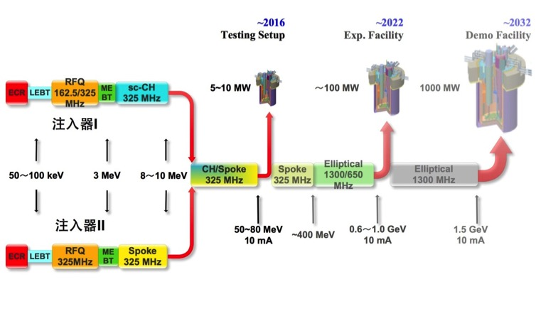
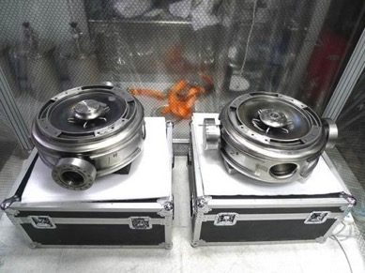
Accelerator Driven Subcritical System
ADS program in China
  Nuclear waste is a bottleneck for nuclear power development in China.
  ADS has been recognized as a good option for nuclear waste transmutation, but never established for test in the world , many challenges faced.
  As a long-term program, ADS R&D has been supported by CAS.

Slide 16
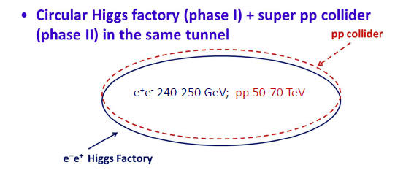
CEPC+SppC
For about 9 years, we have been talking about “What can be done after BEPCII in China”
Thanks to the discovery of the low mass Higgs boson, and stimulated by ideas of Circular Higgs Factories, CEPC+SppC configuration was proposed in Sep. 2012
A 50-70 km tunnel is very affordable in China NOW

Slide 17
Collaborations
Long Histry of international collaborations
    Got great helps to domestic HEP related projects, training of scientists, ...
We have been an active partner of LHC for long time
Collaborations with other projects
  AMS, ILC,
  Neutrino, Dark matter, ...

Slide 18
Thanks

