Slide 1

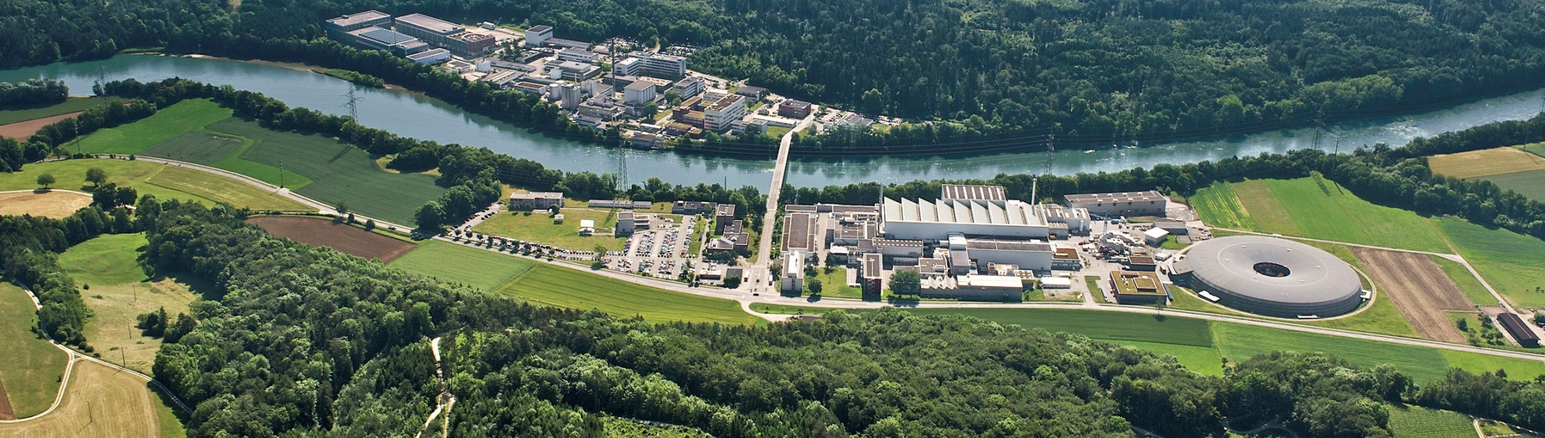
Paul Scherrer Institute
M. Hildebrandt
Synergies and Complementarity among Laboratories – Input for the Round Table Discussion
Frontier Detectors for Frontier Physics
13th Pisa Meeting on Advanced Detectors
La Biodola, Isola d’Elba, 24th - 30th May 2015

Slide 2
Paul Scherrer Institute
The Paul Scherrer Institute is the largest Swiss research institute (1900 employees).
Research Committee
DIRECTORATE
Human Resources
Large Project SwissFEL
Safety
CCEM-CH
Communications
Center for Proton Therapy
Technology Transfer
Research
Department
Research
with
Neutrons
and Muons
Research
Department
Synchrotron
Radiation
and Nano-
technology
Research
Department
General
Energy
Research
Department
Nuclear
Energy and
Safety
Research
Department
Biology
and
Chemistry
Department
Large
Research
Facilities
Department
Logistics
Laboratories:
• Particle Physics
• Neutron Scattering and Imaging
• Muon Spin Spectroscopy
• Developments and Methods
operation of accelerators

Slide 3
Science
Science synergies and complementarities
  • High intensity vs. high energy accelerator
  • Complementarity vs. competition

Slide 4
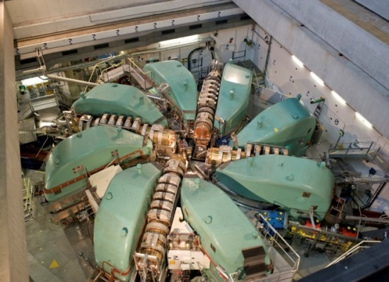
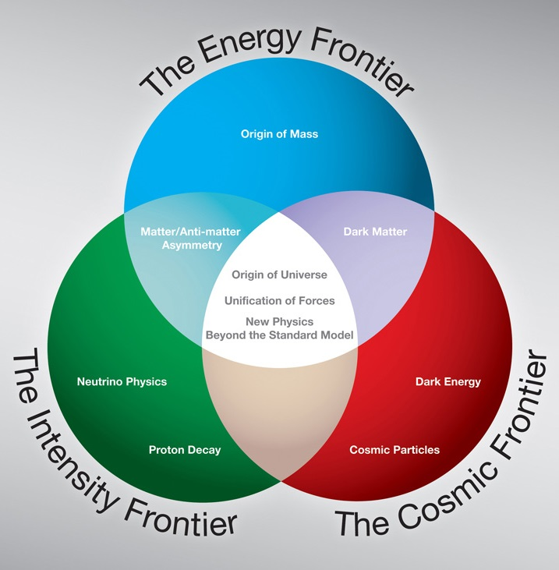
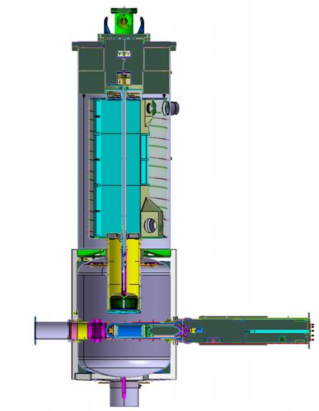
The Intensity Frontier
proton ring cyclotron
• continuous source
• I_{p} = 2.2 mA
• E_{kin} = 590 MeV
→ highest intensity secondary beams
▪ up to 10⁸ μ/s (surface muons)
▪ up to 10¹⁰ π/s
→ P = 1.3 MW
→ most intense p-cyclotron
nEDM
Lepton Flavour Violation
(e.g. rare μ decays)
ultra cold neutron source
• 1% duty cycle
• one of the most intense sources
• nEDM experiment
based on: FNAL

Slide 5
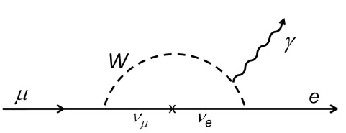
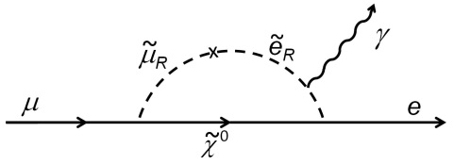
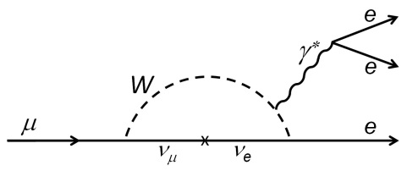
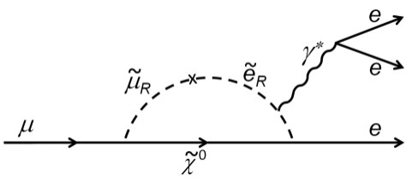
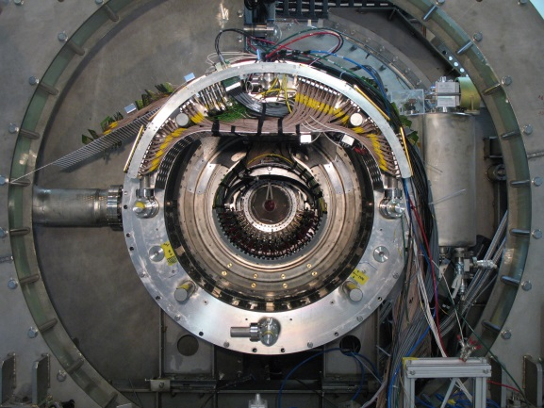
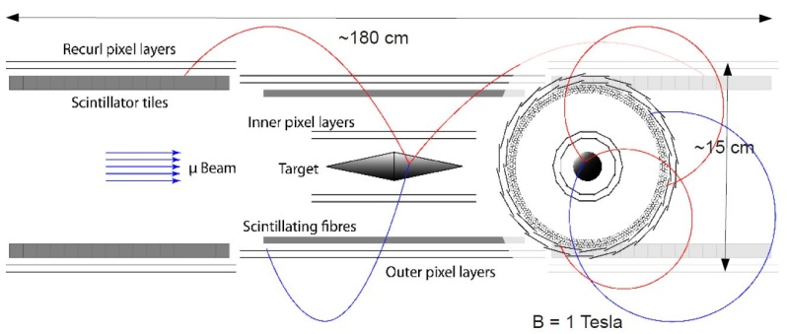
The Precision Frontier
search for decay μ → e γ
search for decay μ → e e e
BR(μ→eγ ) < 10⁻⁵⁰
BR(μ→eγ ) ≈ 10⁻¹⁴ -10⁻¹²
BR(μ→eγ ) << 10⁻⁵⁰
BR(μ→eγ )
≈ 0.006
BR(μ→eee )
→ observation of μ→eγ is ”physics beyond SM”
→ sensitivity for new particles on TeV scale
→ upper limit: constraints for new theories
→ → continuous μ -source preferable
SINDRUM
(1980 - 88)
BR(μ→eee ) < 1.0∙10⁻¹²
Nucl.Phys. B299 1 (1988)
→ still most stringent limit
MEG
(1998 - 2013)
BR(μ→eγ ) < 5.7∙10⁻¹³
PRL 110, 201801 (2013)
→ most stringent limit
→ final result: 2015
Mu3e
(2012 - …)
→ staged approach
→ expected final sensitivity: 10⁻¹⁶
MEG-II
(2013 - 18)
→ new / improved subdetectors:
e.g. DC, scint + SiPM, LXe + PMT & SiPM
→ improved resolutions, larger acceptance, higher rate
→ expected sensitivity: 5∙10⁻¹⁴

Slide 6





The Precision Frontier
search for decay μ → e γ
search for decay μ → e e e
BR(μ→eγ ) < 10⁻⁵⁰
BR(μ→eγ ) ≈ 10⁻¹⁴ -10⁻¹²
BR(μ→eγ ) << 10⁻⁵⁰
BR(μ→eγ )
≈ 0.006
BR(μ→eee )
→ observation of μ→eγ is ”physics beyond SM”
→ sensitivity for new particels on TeV scale
→ upper limit: constraints for new theories
→ → continuous μ -source preferable
SINDRUM
(1980 - 88)
BR(μ→eee ) < 1.0∙10⁻¹²
Nucl.Phys. B299 1 (1988)
→ still most stringent limit
MEG
(1998 - 2013)
BR(μ→eγ ) < 5.7∙10⁻¹³
PRL 110, 201801 (2013)
→ most stringent limit
→ final result: 2015
MEG
(1998 - 2013)
BR(μ→eγ ) < 5.7∙10⁻¹³
PRL 110, 201801 (2013)
→ most stringent limit
→ final result: 2015
MEG
(1998 - 2013)
BR(μ→eγ ) < 5.7∙10⁻¹³
PRL 110, 201801 (2013)
→ most stringent limit
→ final result: 2015
MEG / MEG-II
international collaboration
~70 authors
Mu3e
(2012 - …)
→ staged approach
→ expected final sensitivity: 10⁻¹⁶
MEG-II
(2013 - 18)
→ new / improved subdetectors:
e.g. DC, scint + SiPM, LXe + PMT & SiPM
→ improved resolutions, larger acceptance, higher rate
→ expected sensitivity: 5∙10⁻¹⁴
→ 11 contributions by MEG-II collaborators

Slide 7
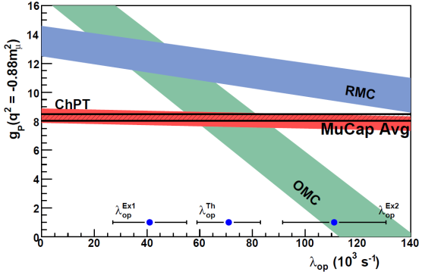
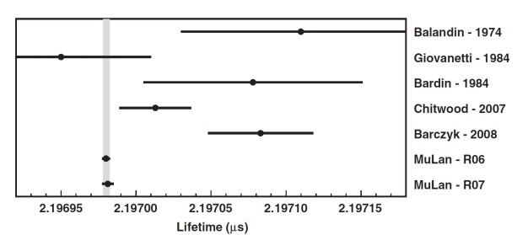
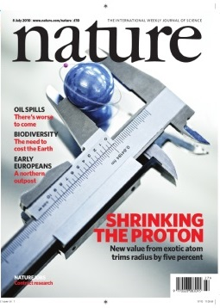
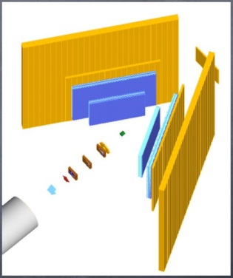
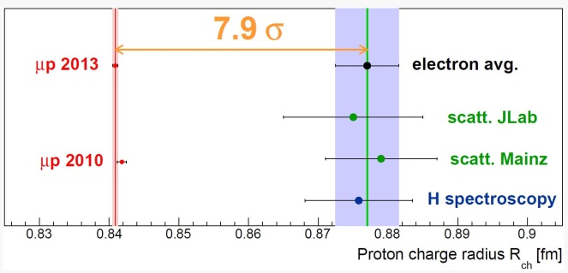
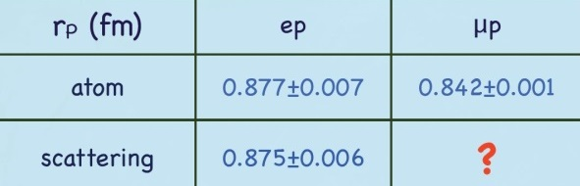
Unique Muon Science at PSI
MuLan (1999 - 2011)
• measurement of muon lifetime τ_{μ} to 1ppm
• high intensity, low momentum μ, 2∙10¹² μ decays
• τ_{μ} = 2 196 980.3 (2.2) ps
→ Fermi constant
G_{F} = 1.166 378 8(7) ∙ 10⁻⁵ GeV⁻² ↔ 0.6 ppm
MuCap (1997 - 2013)
• measurement of capture rate Λ_{S} of p+μ→n+ν_{μ} to 1%
• high intensity, low momentum μ, ≥ 10¹⁰ μ decays
• Λ_{S} = (714±7.4) s⁻¹
→ pseudoscalar
coupling constant
g_{P} = 8.06±0.55 (7%)
→ long standing
descrapency solved!
→ MuSun: d+μ→n+ν_{μ} (2008…)
-
PRL 110, 012505 (2013)
-
PRL 106, 041803 (2011)
Laser spectroscopy in μH (1998 - 2010)
• high intensity, low mometum μ
plus ”ultra-low-energy-μ-beam” (5keV)
• measurement of ΔE(2S-2P)
→ proton radius
r_{p} = 0.840 87 (39) fm
→ discrepancy
with
e-p scattering
and hydrogen
spectroscopy
MUSE (2012 - …)
• μp elastic scattering experiment to study the
”proton radius puzzle”
• μ±p, e±p scattering
• p_{inc} = 115, 153, 210 MeV/c
• ambitious experimental goal:
→ Δr_{p} : 0.01 fm for μ⁻p, e±p
0.015 fm for μ⁺p
Nature 466, 213 (2010)
Gilman, PSI Open User Meeting (2012)

Slide 8
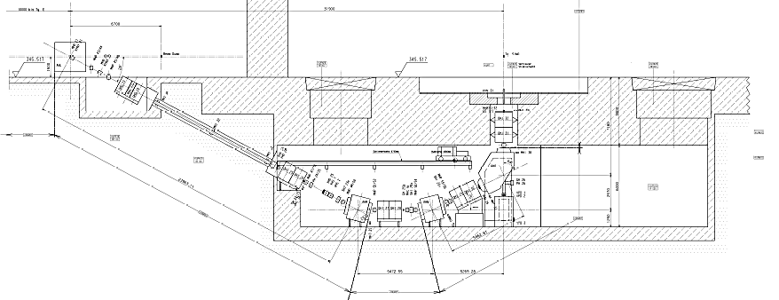
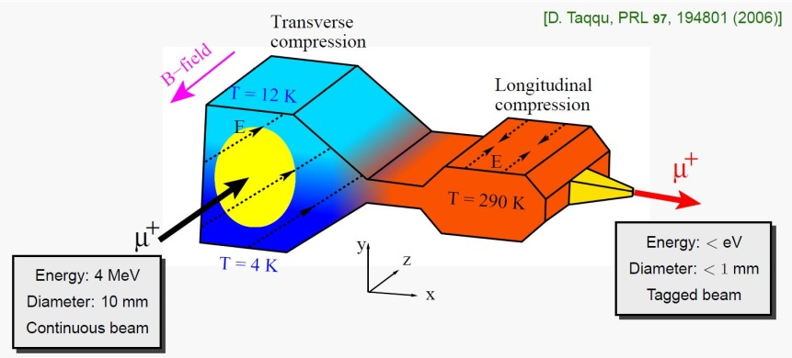
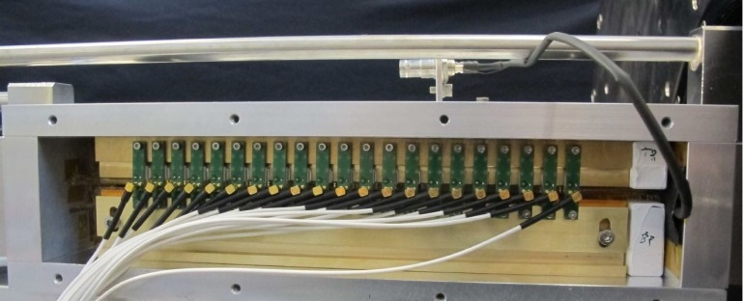
High-intensity Muon Beams
high intensity surface muon beam
• feasibility study for a ”next generation” high-
intensity muon beam
• goals: ▪ μ rates ≥10¹⁰ Hz
▪ multi-port facility (particle physics, μSR)
• main motivation: Mu3e experiment (phase 2)
• approaches:
1) use of SINQ target (”p beam dump”) as μ source
→ modification of SINQ moderator necessary
high-brightness ultra-cold muon beam
• new development of a tertiary beam line for a
ultra-brightness μ⁺ beam in eV-range
• starting from a standard secondary μ beam line
• reduction of phase space of up to 10¹⁰ with
overall efficiency of 10⁻³
• applications: ▪ new physics searches, e.g. μEDM
▪ muonium spectroscopy
▪ next generation μSR applications
• status: longitudinal compression succesfully tested
p
SINQ
target
PRL 97, 194801 (2006)
PRL 112, 224801 (2014)
μ
2) modification of meson production targets
↔ constraints: ▪ no increase of beam losses
▪ preserve proton footprint and
energy on SINQ
▪ preserve total material budget
seen by p-beam
→ promissing results from intensive simulations !
A. Antognini (PSI / ETHZ)

Slide 9
Technology
Technology synergies and complementarities
  • Accelerator elements development
  • Detector development
  • Test infrastructures
  • Industry connections

Slide 10
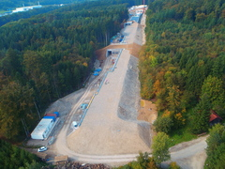
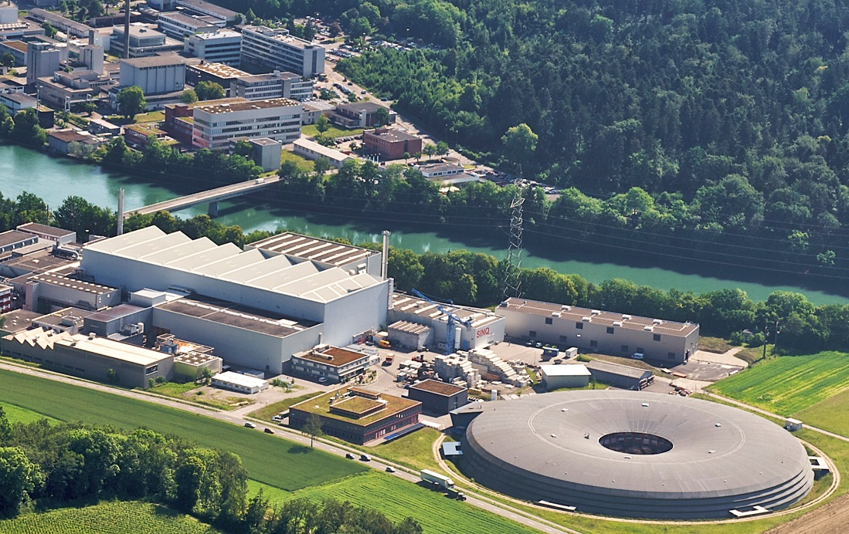
Facilities
PSI is a multi large-scale-facility research and user laboratory.
SwissFEL
proton cyclotron
neutron spallation source
ultra cold neutron source
medical proton cyclotron
synchrotron light source

Slide 11
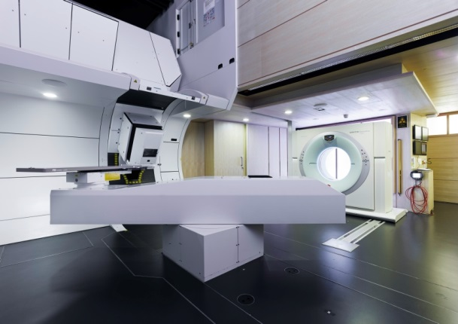
Accelerator Development
research institute
technology transfer & company
High energy and high intensity frontiers, neutron spallation sources
• CERN: CLIC high gradient structures, FCC magnets and magnetic measurements
• ESS: possible in-kind contributions on experiments, control systems, diagnostics, RF, target expertise
Medical applications of accelerators, proton therapy
• LBL and Varian: gantry R&D
Free Electron Lasers and synchrotron light sources
• EuroXFEL / DESY: Swiss in-kind contribution to the European X-ray Free Electron Laser:
Development of beam position monitor (BPM) and transverse intra-bunch-train
feedback (IBFB) systems
• STFC / ASTeC: SwissFEL, UK FEL and SLS, DIAMOND, storage rings upgrades (magnets, vacuum)
• ELETTRA and FERMI (Trieste): FEL science, seeding schemes, feedbacks
• LCLS / SLAC: FEL experiments, short pulses diagnostics and generation
• SACLA / Riken-SPring8: FEL experiments, short pulses diagnostics
• Ampegon: solid-state RF sources TT and R&D
based on L. Rivkin (PSI / EPFL)

Slide 12
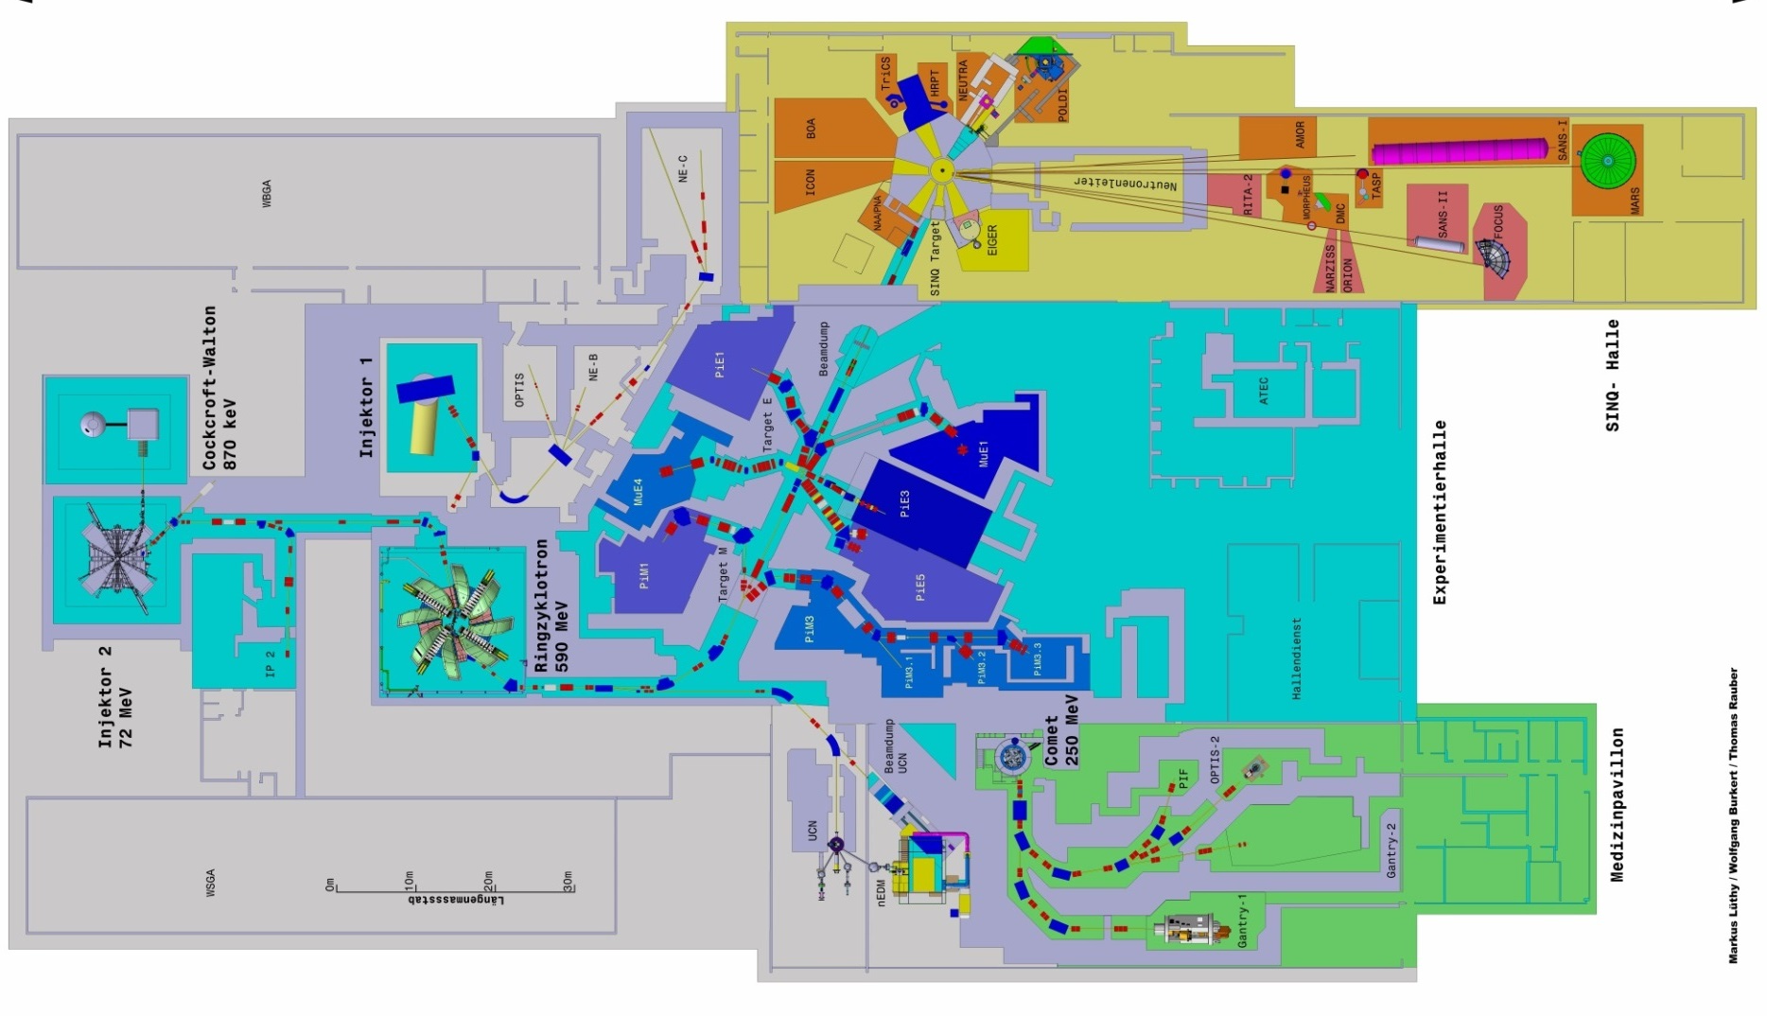
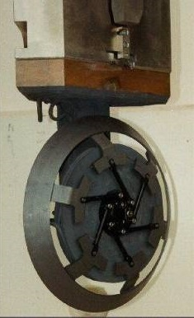

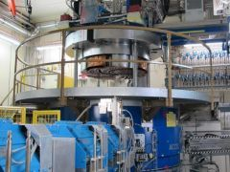
Test Facilities for Detectors & Electronics
high intensity π and μ beams
• rates up to 10⁸ e/s
up to 10⁸ μ/s
up to 10¹⁰ π/s
• momenta up to several
hundred MeV/c
• particle physics, μSR
• detector tests (e.g. πM1, πE1)
neutron spallation source SINQ
• I_{proton} = 1.5 mA → P = 0.9 MW
• cold, thermal neutrons
• n beams for scattering, imaging and tests
proton irradiation facility
• energy range 6 – 230 MeV
• up to 2∙10⁹ p/s/cm² and I_{max} = 2 nA
• ”space-like” proton spectra
• electronics and detector tests
proton ring cyclotron
• continuous source
• I_{proton} = 2.2 mA
• E_{kin} = 590 MeV
medical proton cyclotron
• I_{proton} = 1 - 850 nA
• E_{kin} = 250 MeV

Slide 13
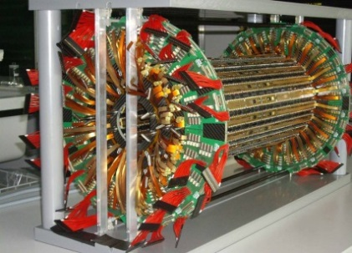
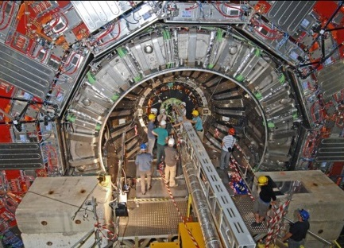

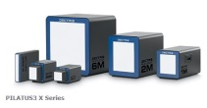
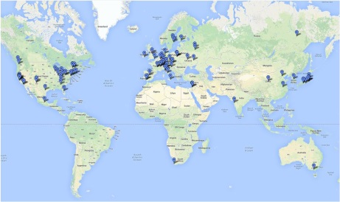
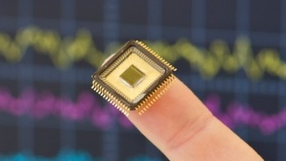
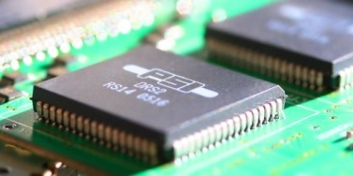

Technology Developments & Synergies
Silicon Pixel Detector (BPIX) of CMS experiment
• R&D, design and construction time at PSI ~12 years:
readout chip, sensor, bump bonding, module production
and integration
• BPIX tracking points crucial for all CMS
physics analyses, e.g. H→4μ, B_{s,d}→μμ
Feb 2008
BPIX @ PSI
Jul 2008
BPIX in CMS
Chip Design Core Team of LTP (PSI)
• embedded in electronics group of LTP
• keeps chip design knowledge and maintains
infrastructure working on own projects
• interested groups can ”plug-in” to get help with
basic start up, support and guidance
Spin-Off
• 2006 founded, 2015 ~63 employees
• delivers advanced pixel x-ray
detectors to all major research
synchrotron labs in world
→ poster by R. Dinapoli
DRS – Domino Ring Sampling chip
• full custom Integrated Circuit developed at PSI (started 2001)
• fast digitization and high accuracy allows waveform analysis
• developed for MEG experiment
• used in applications around the world
→ talk by S. Ritt
MIDAS – Maximum Integrated
Data Aquisition System
• versatile Data Aquisition System for
medium scale experiments
• developing effort of PSI and TRIUMF
• discussion forum ELog
• running on multiple platforms
(e.g. Linux, Windows, iOS)

Slide 14
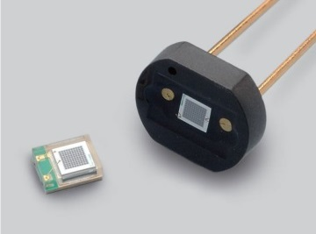

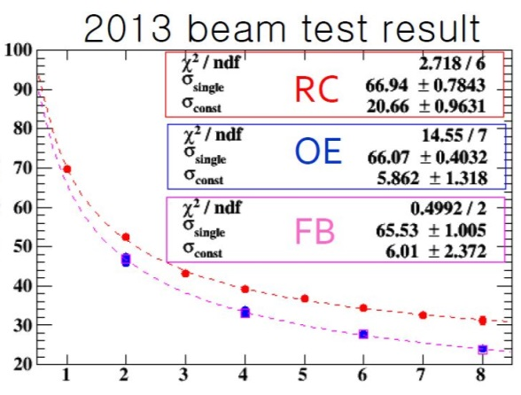

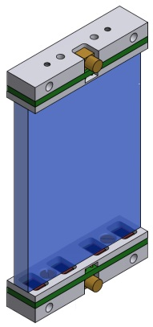

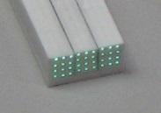
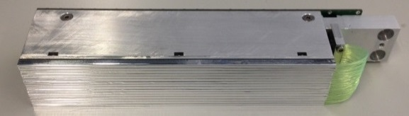
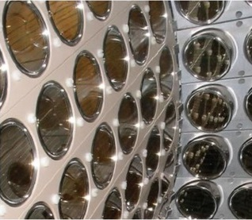
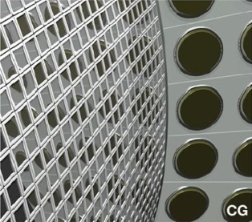
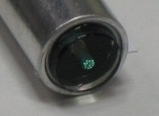
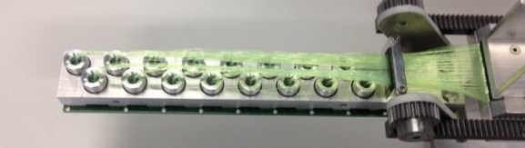
Detector Developments & Synergies
μSR instrumentation, pixelated TC for MEG-II
• very high timing resolution
• operation in high B-field and He environment
• flexible shape and orientation
MEG-II test beam results 2013
SiPM, MPPC, G-APD
• opto-semiconductor device with excellent
single photon counting capability
• high gain, low operation voltage
• fast response, very good time resolution
• insensitive to magnetic fields, compact
σ (ps)
number of hit counters
LXe calorimeter for MEG-II (1000 l LXe)
• 216 (of 846) 2’’ PMTs → 4092 (12×12) mm² MPPCs
→ improved position and energy resolution
• cryogenic application
• VUV light detection: no epoxy protection layer,
optimised reflection / refraction index of sensor layer
Neutron detector for POLDI @ SINQ
• new approach: ZnS:Ag/⁶LiF, WLS fibres, SiPM
• individual readout of each channel → no coding
• compact, allows high B-field sample environment

Slide 15
Social
Social synergies and complementarities
  • Social effects of developments
  • Technology transfer and industry
  • Young researcher formation and opportunities
  • How to make best use of available resources
  • How to best support our science in front of the government

Slide 16
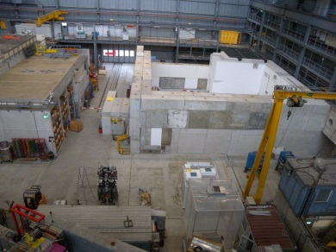
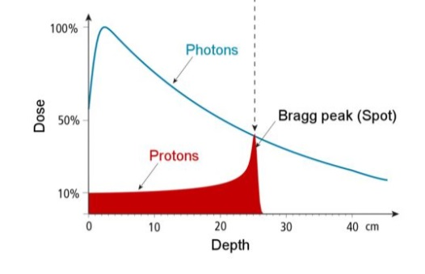
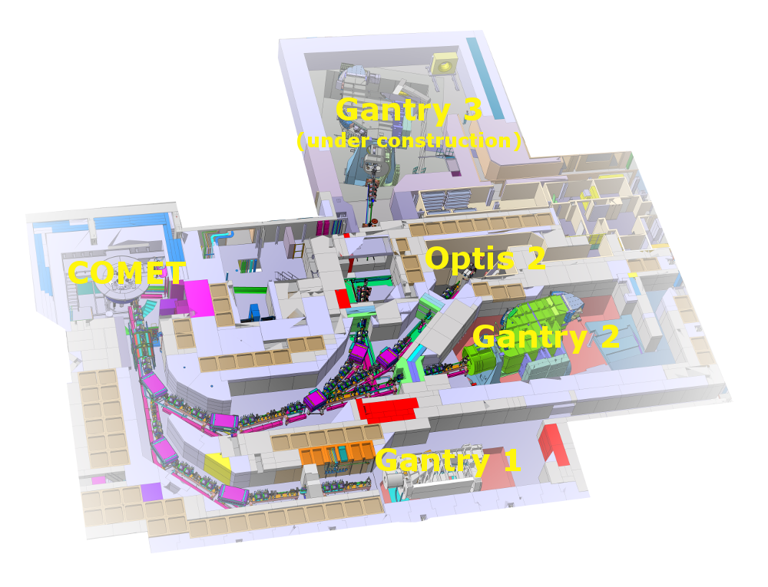
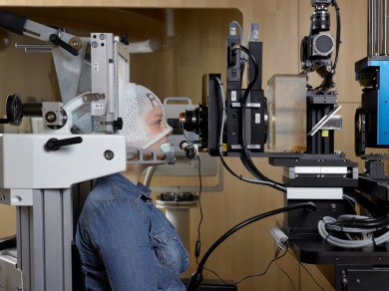

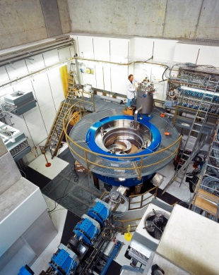
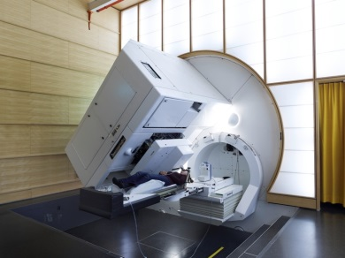
Medical Application
Gantry 3
• under construction
• research collaboration with
Varian Medical Systems
• start in 2016
Center for Proton Therapy (CPT)
• treatment with protons (deap-seated & ocular tumors)
• spot scanning technique
COMET
• superconducting medical
proton cyclotron
• I_{proton} = 1 - 850 nA
• E_{kin} = 250 MeV
• in operation since 2007
Optis
• Optis 1 1984-2010
• Optis 2 since 2010
• more than 6000 patients
Gantry 1
• in clinical service since 1996
• first facility with spot-scanning
technique
• more than 900 patients,
incl. ~300 children
Gantry 2
• in clinical service
since November 2013

Slide 17


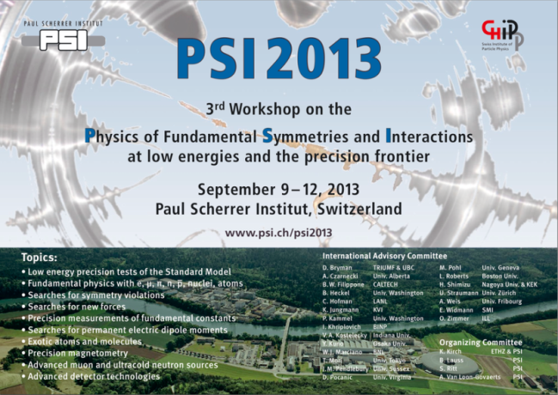
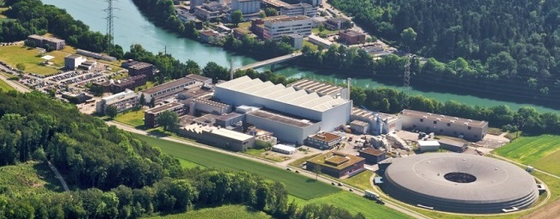

Schools, Conferences
Laboratory for Particle Physics is organisor and host:
• PSI Particle Summer School
(”Zuoz Summer School”)
▪ every 2 years, 1 week duration,
Zuoz in Grisons (CH)
▪ lectures on theory and experiment
by international experts (8-10 lecturers)
▪ ~70-80 worldwide participants
▪ lectures covering recent topics in physics at
”energy” and ”intensity / precision” frontiers
• International Workshop on the Physics of
fundamental Symmetries and I nteractions
at low energies and the precision frontier
▪ every 3 years, ~4 days duration,
Paul Scherrer Institut (CH)
▪ ~75 oral presentations, ~50 posters
(5% theoretical, ~95% experimental)
▪ ~160-180 worldwide participants
▪ low energy precision tests of standard model,
fundamental physics with μ, π, n and atoms,
searches for symmetry violations or permanent
electric dipole moments, etc.
PSI 2016
4th
September 2016
www.psi.ch/ltp/
23rd Summer School
August 2016

Slide 18

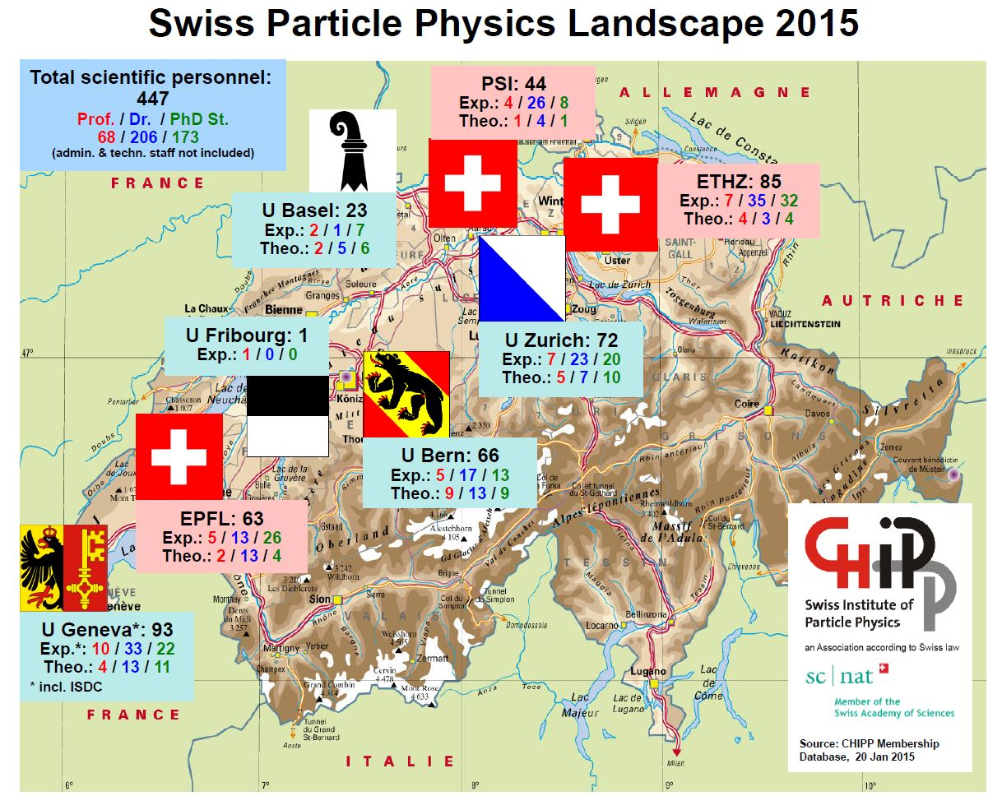
National Association
CHIPP – the Swiss (CH) Institut of Particle Physics
• units researchers active in particle, astroparticle and nuclear physics in Switzerland
→ PSI is member of CHIPP
• association according to Swiss Law
• member of Swiss Academy of Science (SCNAT)
organisation:
• plenary, board, executive board, chairman
• subcommittees: outreach, computing
• representatives in SPS, CERN Council, ECFA,
NuPECC, ApPEC
goals:
• to strengthen particle, astroparticle and nuclear
physics in Switzerland
• to coordinate and strengthen the participation
in international projects and committees
• to coordinate research, funding requests and
teaching activities
• to act as common contact for funding agencies
and politics
• to promote public awareness
activities: • PhD prize, PhD school, topical workshops

Slide 19
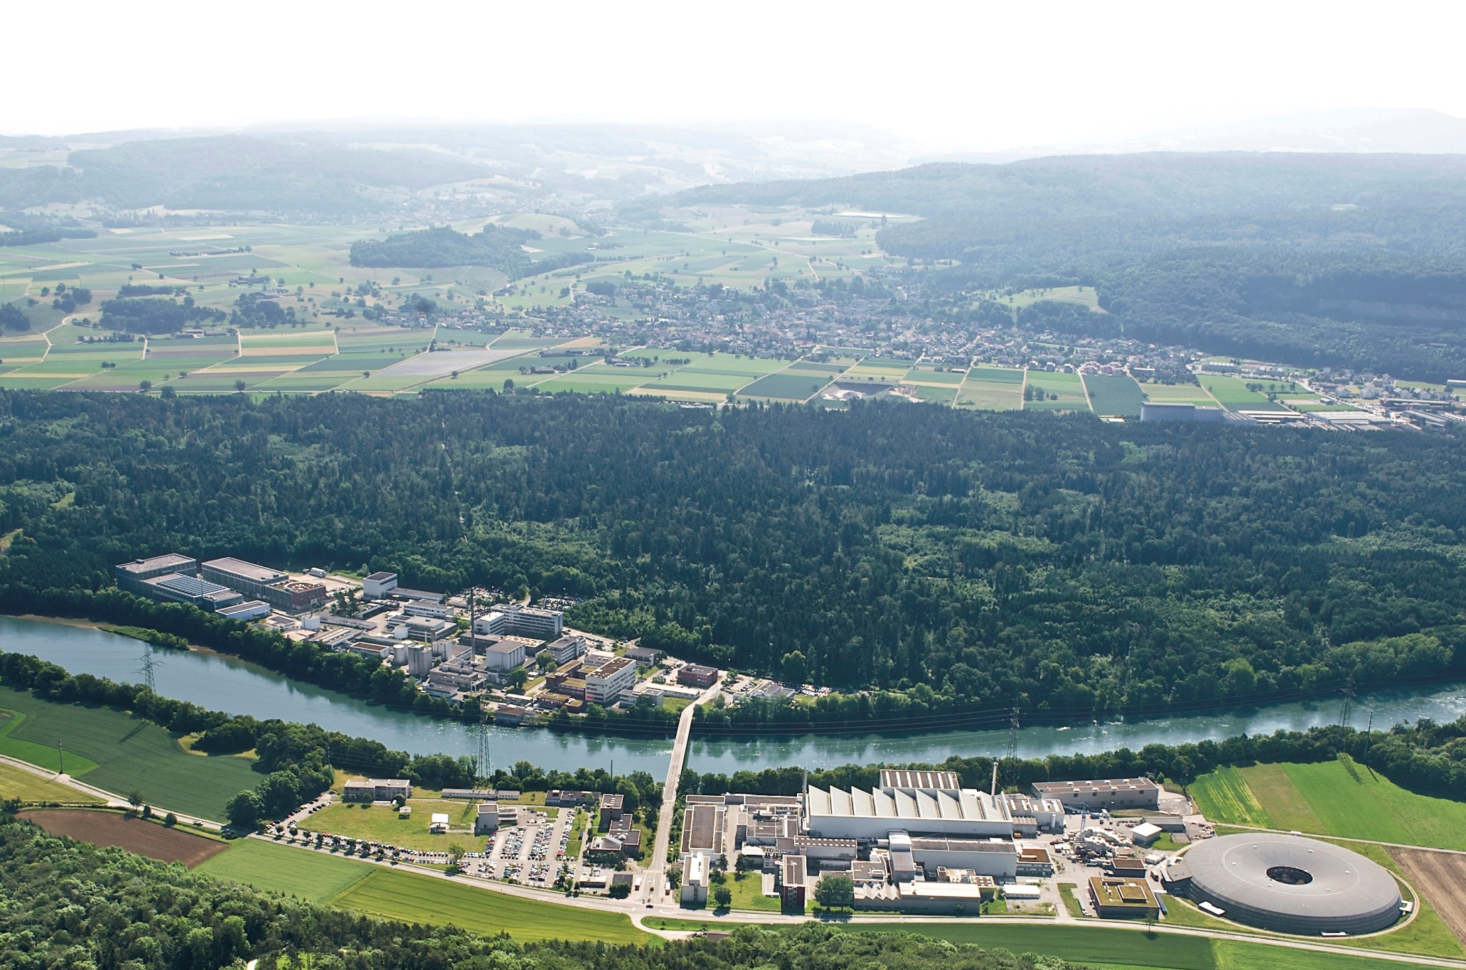
Summary
• The Paul Scherrer Institute addresses the open questions in particle physics
▪ with experiments at PSI at the ”high intensity and high precision frontiers”, and
▪ with its involvement in CMS at the ”high energy frontier”.
• The institute operates the most powerful proton cyclotron, highest intensity secondary
π and μ beam lines and a world-leading source of ultra-cold neutrons.
The institute offers unique possibilities for precision experiments and
test facilities for detectors and electronics.
• The institute pursues and collaborates on accelerator & detector technology and
software developments and transfers expertise in science and technology to industry.
• The institute plays an important role in the education of young researchers.

