Slide 1
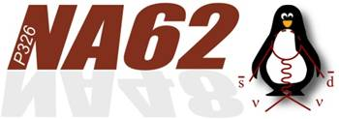
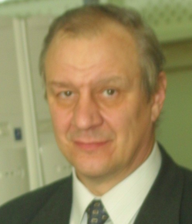
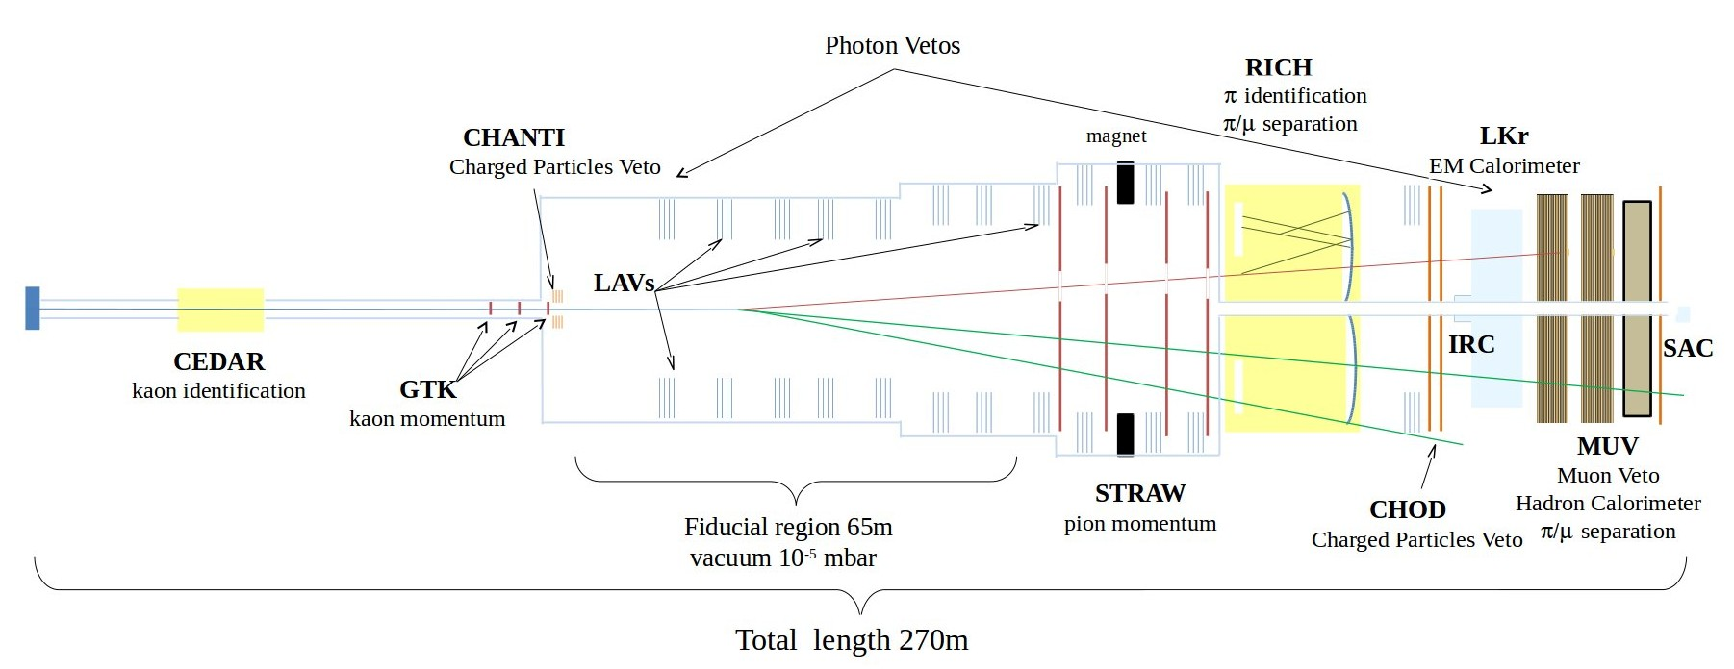
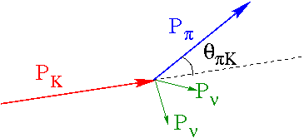
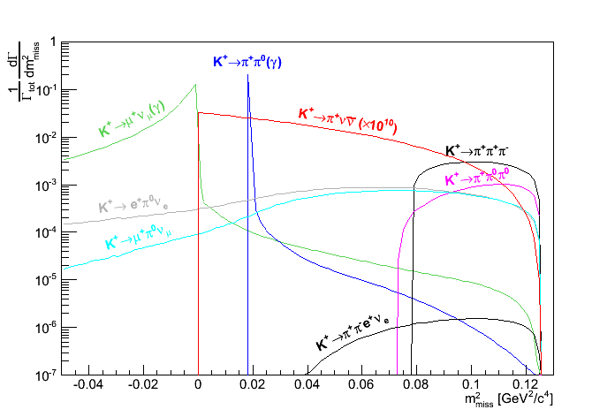
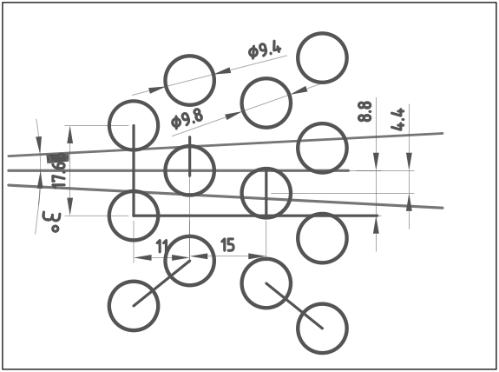
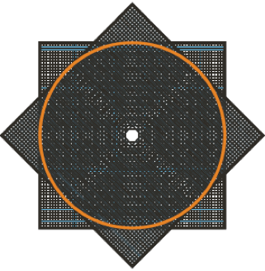
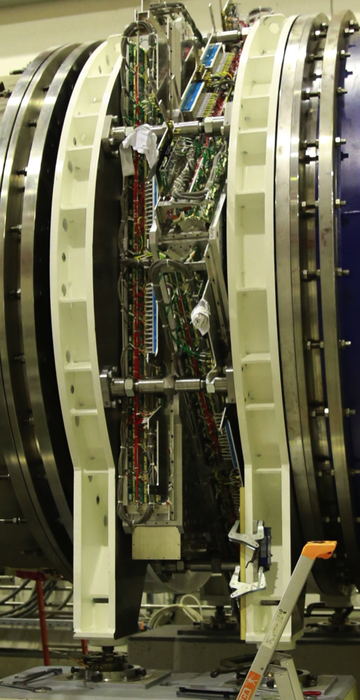
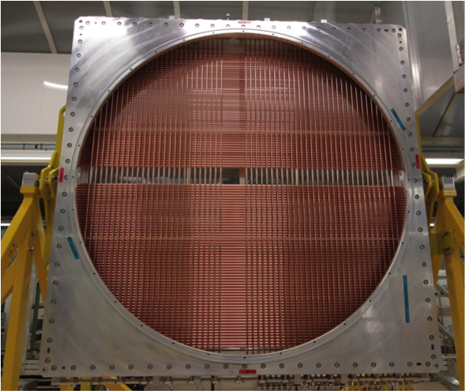
The drift chamber with a new type of straws for operation in vacuum
Yu. POTREBENIKOV on behalf of CERN-JINR straw working group of the NA62 Collaboration
NA62 main goal: measuring K⁺→π⁺νν,
∼100 events with 10% precision
in 3 year of data taking
BR x 10¹⁰ | SM prediction | Experiment
K⁺ → π⁺νν | 0.781 ± 0.075 ± 0.029 | 1.73 ± 1.10
K_{L} → π⁰νν | 0.243 ± 0.039 ± 0.006 | < 260
signal signature : one K⁺ track, one π⁺ track
kinematic variable : m²_{miss} = (P_{K} – P_{π} )²
momentum measurement + particle
identification + veto
ΔP_{π}/P_{π} ≤ 1%; Δθ_{Κπ} ≤ 60 μrad
Spatial resolution 130 mm per coordinate, 80 mm per space point
≤ 0.5% of a radiation length (X₀) for each chamber
Working in vacuum (P=10⁻⁵ mbar) with minimum gas load for the vacuum system 10⁻¹ mbar l/s
Operation in high rate environment (up to 500 kHz/channel) with a mean rate 60 kHz/channel
Region II
_{Region I}
Region I: 0 < m²_{miss} < 0.01 GeV²/c⁴
Region II: 0.026 < m²_{miss} < 0.068 GeV²/c⁴
Design of straw
view
Straw chamber (2 straw modules)
2 independent pairs of layers, each for registration of min 1 hit of particle with up to 3º angle;
< 15% more material than in 2 closed layers (< 5% for straws with effective Ø= 9.4 mm);
All tracks with 2 or more hits in effective (Ø= 9.4 mm) straw volume;
Up to 35% track with 3 hits in a view
Design
Chamber
Straw module

Slide 2
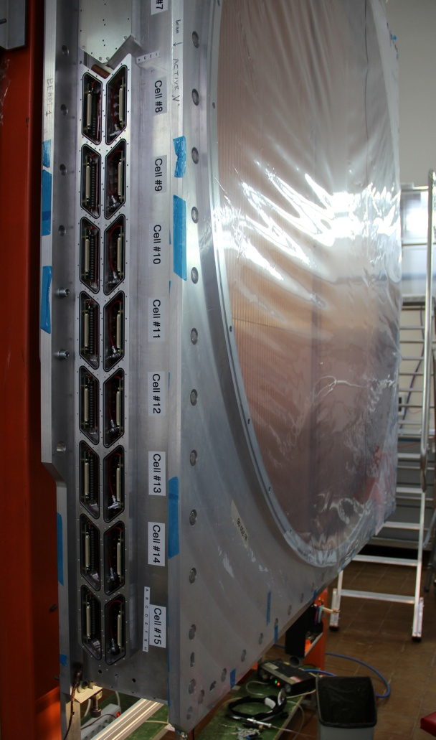
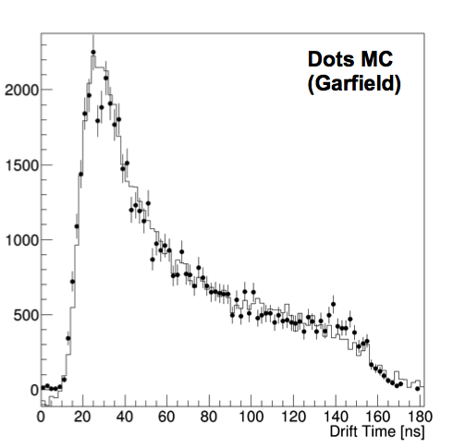
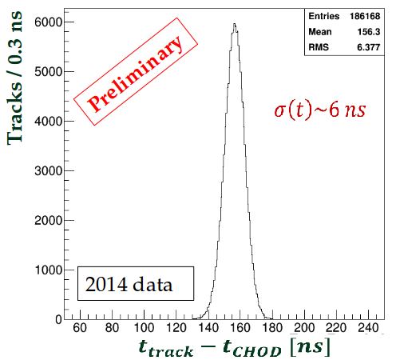
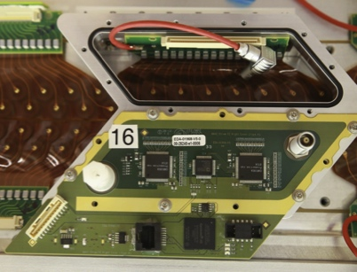
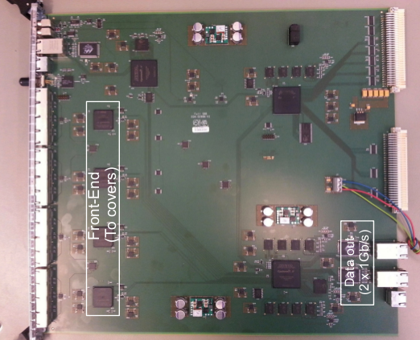
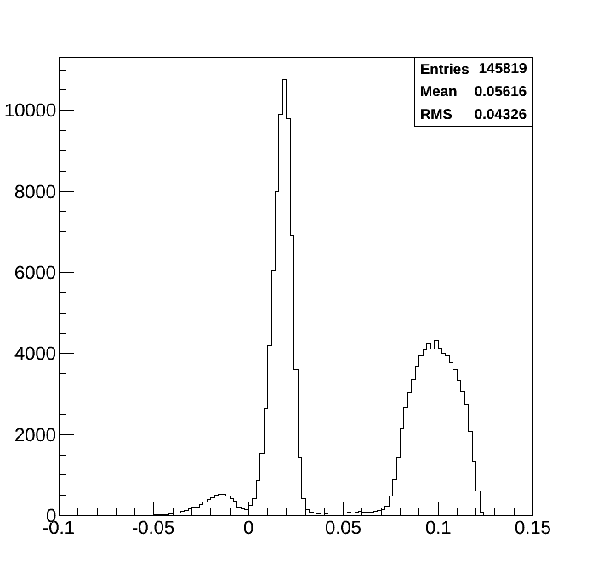
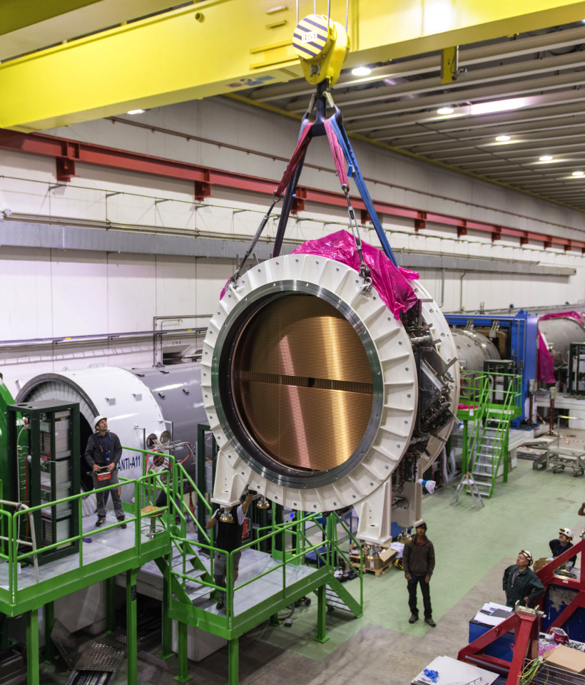
New type of straws for operation in vacuum
2.7 m long tube with a diameter of 9.8 mm
The base material is Poly Ethylene Terephthalate (PET) or Mylar (Hostaphan), 36 μm thickness
Over 8000 straws have been produced
(more than 20 km of ultrasonic welded tubes).
97.58% straws are good after all quality tests
36 μm PET
20 nm Au
50 nm Cu
Straw module assembling
First results
module sealing;
straw support by 2 spacers;
straw gluing with a pretension 1.8 kg;
wire crimping with 90 g tension;
electrical connection (HV and signal, 16 straw granularity) by flexible circuit board (WEB);
gas manifold covers by front-end electronics board – 2 CARIOCA+ALTERA chips;
2 straw read-out board (SRB) per module
straw position test by optical rangefinder – ±100 μm from the nominal (17.6 mm)
distance between straws;
straw pretension test - 1.6 ÷ 2.1 kg;
wire position test by “visible light” -
±35 μm from the nominal position;
vacuum test - < 0.8 mbar l/min CO₂ per module;
gas used - Ar(70%) CO₂(30%);
and test
Hit time distribution
Kaon selected in time with CHOD and Spectrometer track + geometrical acceptance
Vertex in fiducial region
15 < P < 35 GeV/c
π⁺π⁰
Preliminary
3π
Resolution
of the π⁺π⁰ peak
5*10⁻³ GeV²/c⁴
( vs. 3*10⁻³ GeV²/c⁴
in MC)
μν
Integration of the straw chamber Into NA62 setup
m²_{miss} = (P_{K} – P_{π} )²

