Slide 1
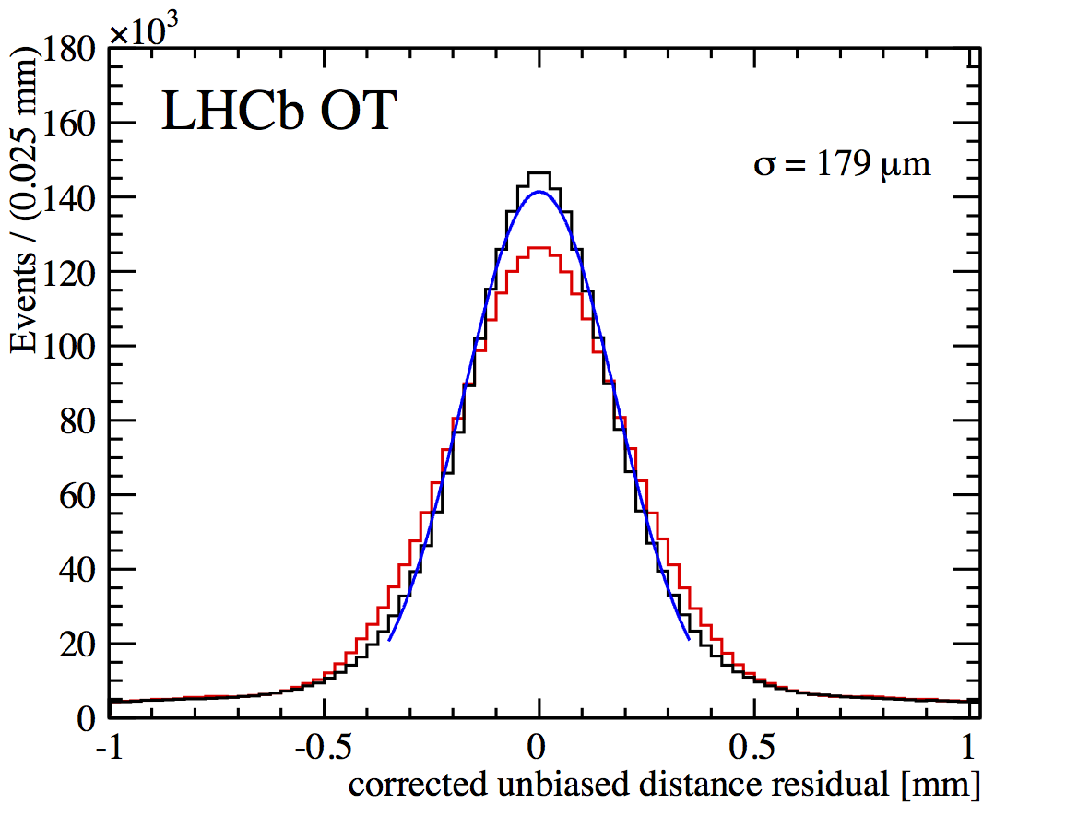
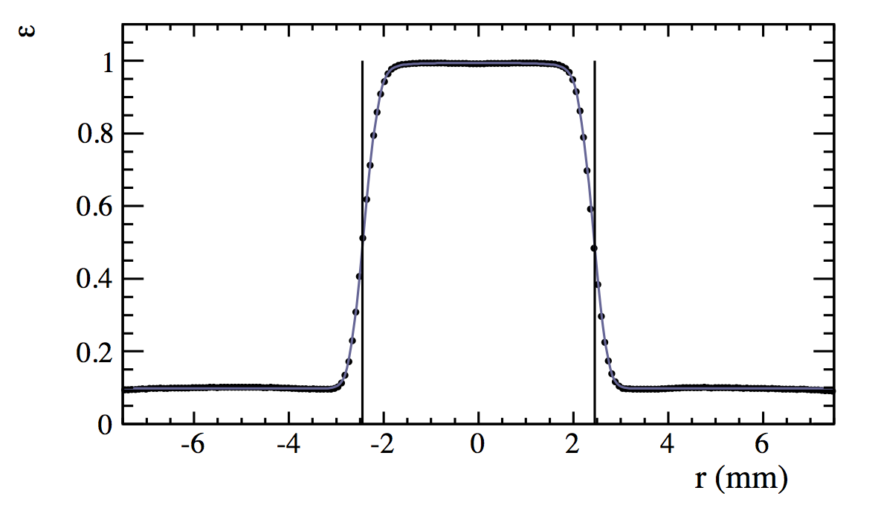
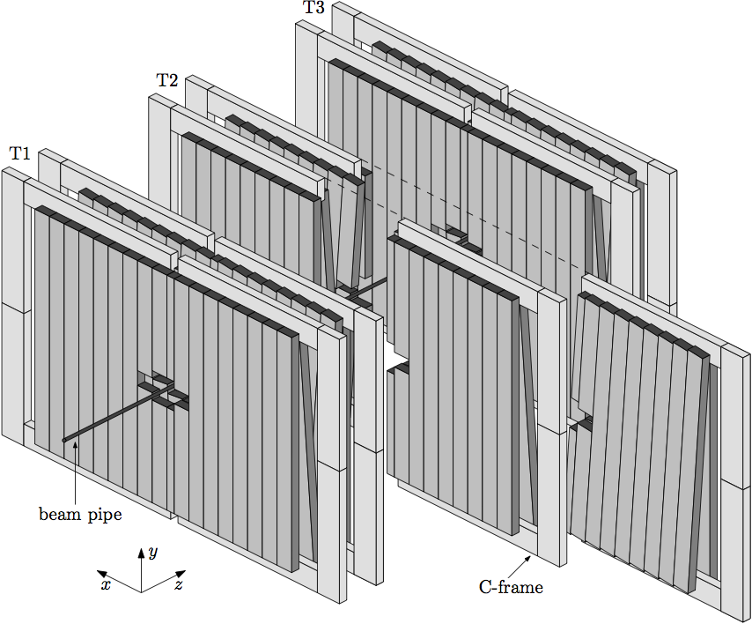
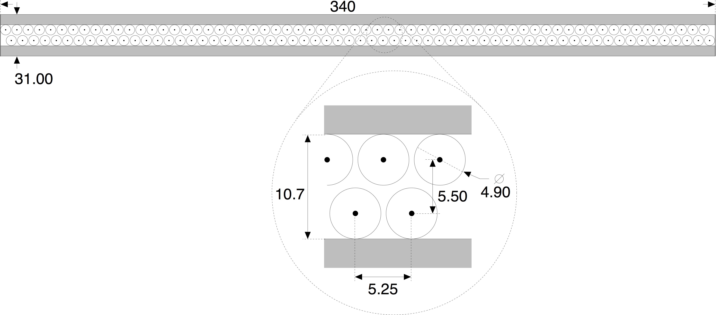
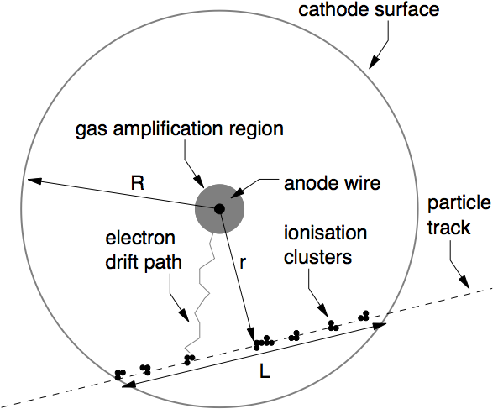
The Outer Tracker Detector at LHCb Prepared by Niels Tuning, presented by Mark Tobin
Gaseous straw tube detector.
12 detection layers (~ 6 x 5 m²).
53760 straw tubes (2.4 m long, 4.9 mm diameter).
Gas mixture: Ar/CO₂/O₂ (70%/28.5%/1.5%).
Nominal operating voltage is 1550 V.
Hit resolution ≈ 200 μm.
Single hit efficiency = 99.3% for r < 1.25 mm.
Detector geometry:
Twelve module layers.
Module cross-section:
2 × 64 straws.
Charged particles
traversing the straw:
Ionisation of the gas.

Slide 2
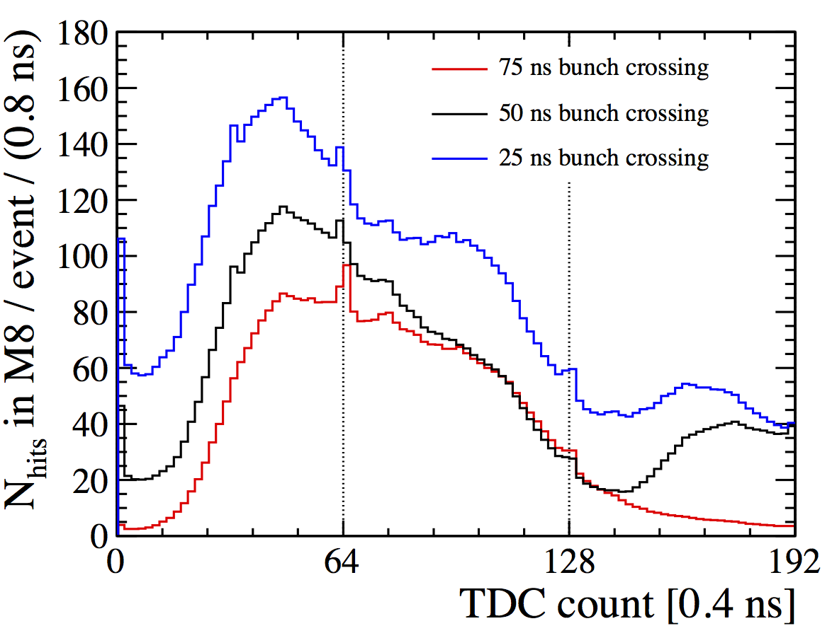
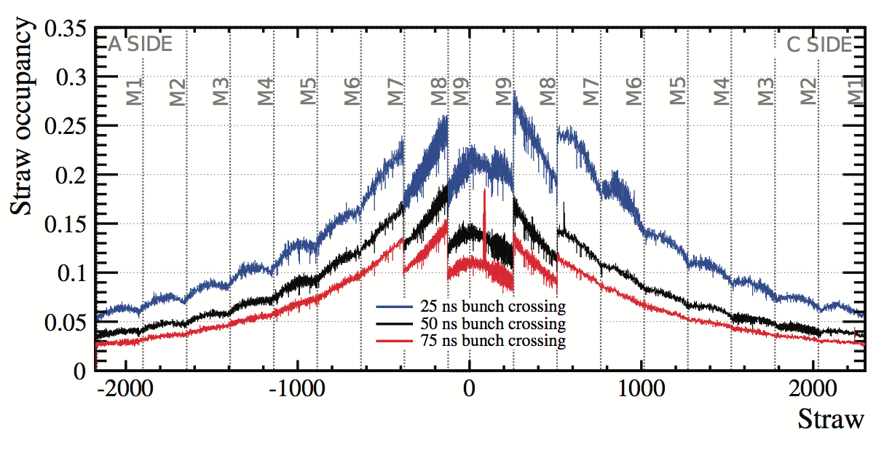
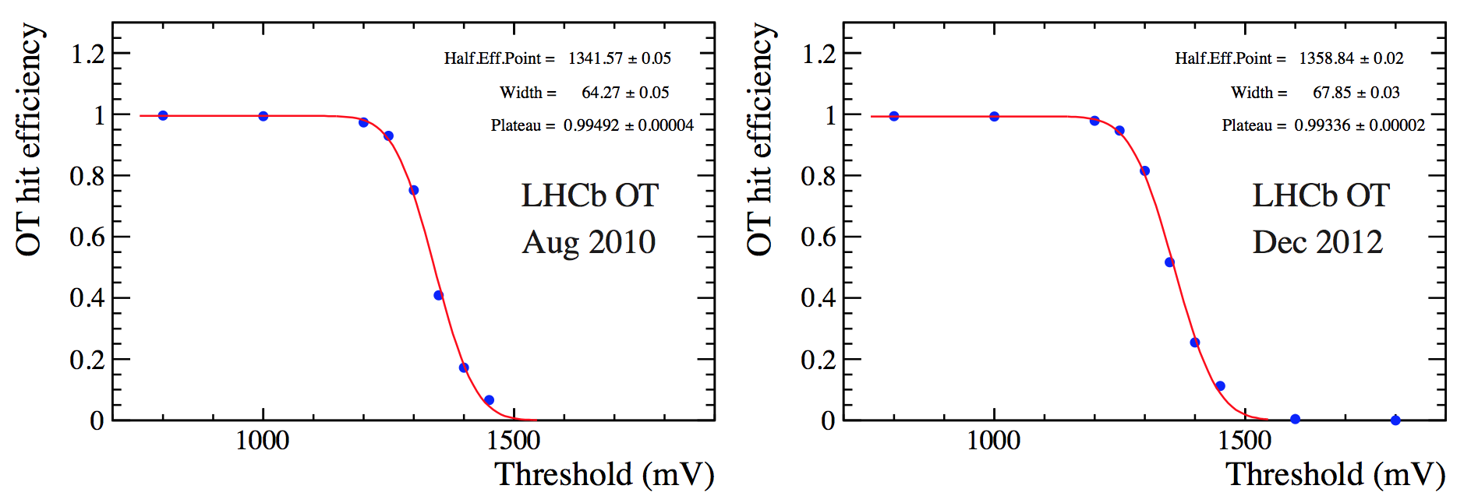
Expectations for Run-2
LHC will collide bunches with 25 ns spacing in 2015.
Spill-over from neighbouring bunches.
Higher straw occupancy.
Plastifier di- isopropyl-naphthalene in glue, can form insulating layer on wire after irradiation.
Hit efficiency as function of amplifier threshold unchanged from 2010 to 2012.
No reduction in pulse-height due to irradiation.

