Slide 1
Cylindrical Micromegas
An innovative solution for central trackers.
PISA Meeting – elba island
May 2015
Maxence Vandenbroucke – CEA saclay - IRFU

Slide 2
Overview
Micromegas Principle, Bulk
Cylindrical Micromegas
Large radius resistive cylindrical Micromegas for CLAS12
  Overview
  Performances
  Resistive technology features
Small Radius detectors : The ASACUSA Micromegas Tracker
Future project at an Electron Ion Collider

Slide 3
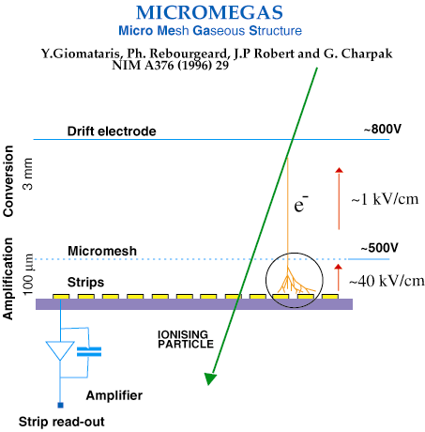
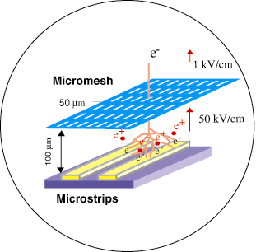
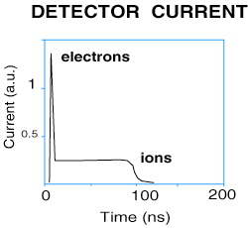
Micromegas Principle
Fast ions collection
~100 μm
thin gap

Slide 4
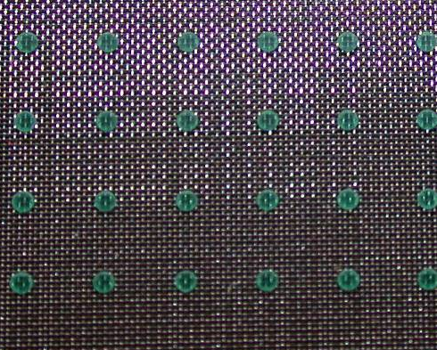
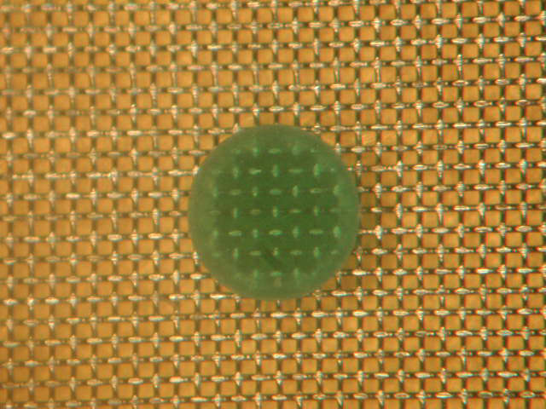
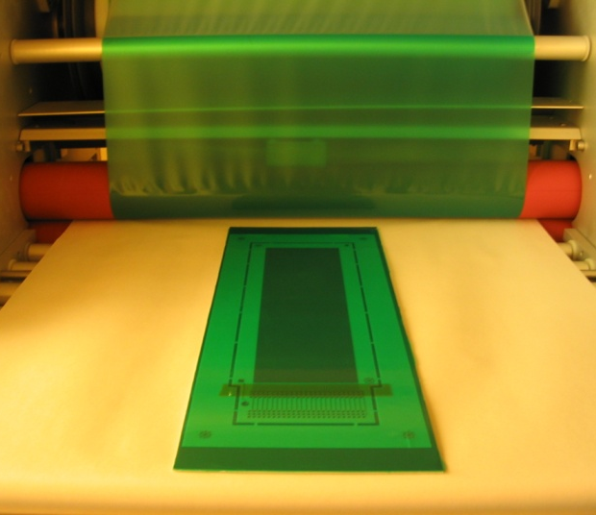
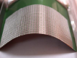
Bulk Technology (2006)
Embedded of the MicroMesh on the readout electrode
Goal : Make the Production of Micromegas an Industrial process
Robust, Cheap
Simplified and light mechanical structure
Ability to use thin PCBs and produce different shapes (cylindrical detectors !)
Notes:
ToDo add transition toward Barrel

Slide 5
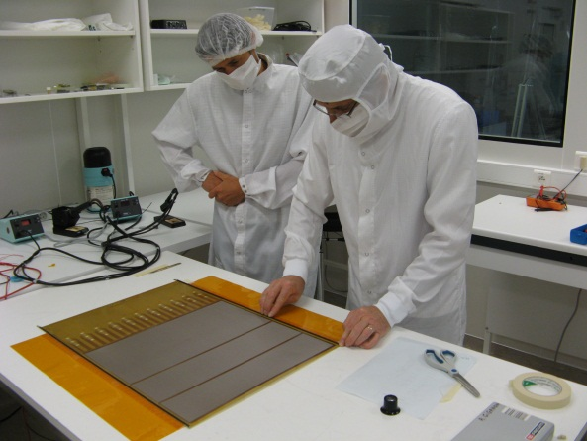
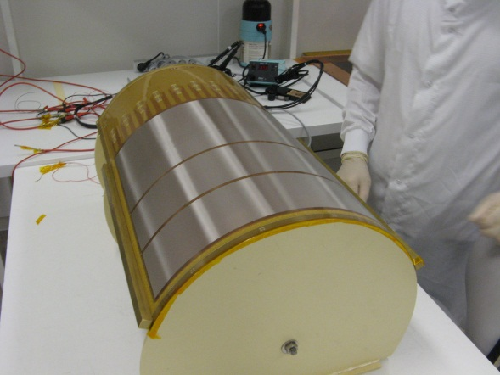
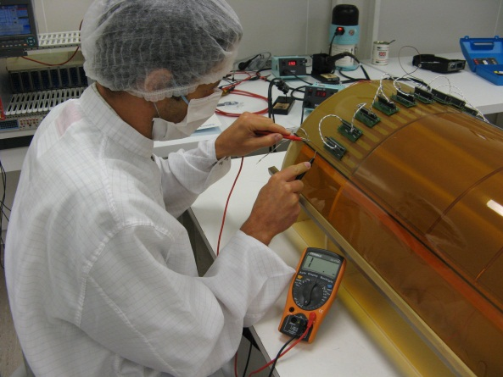
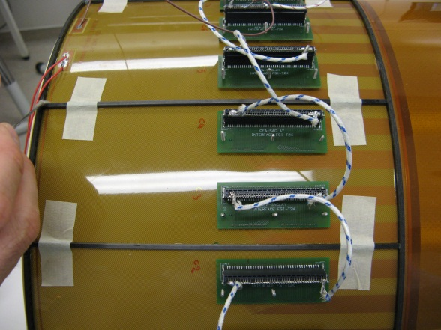
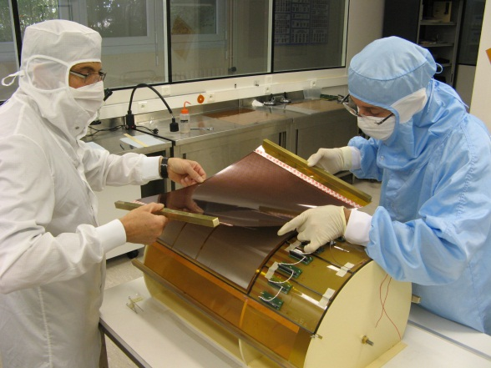
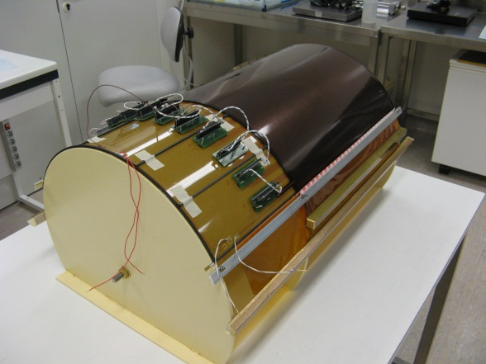
Cylindrical Micromegas
Segmentation and preparation
Gluing of the side carbon ribs on circular shape
Electric leak test
Gluing of additional ribs
Setting drift plane
Gluing of the drift plane

Slide 6
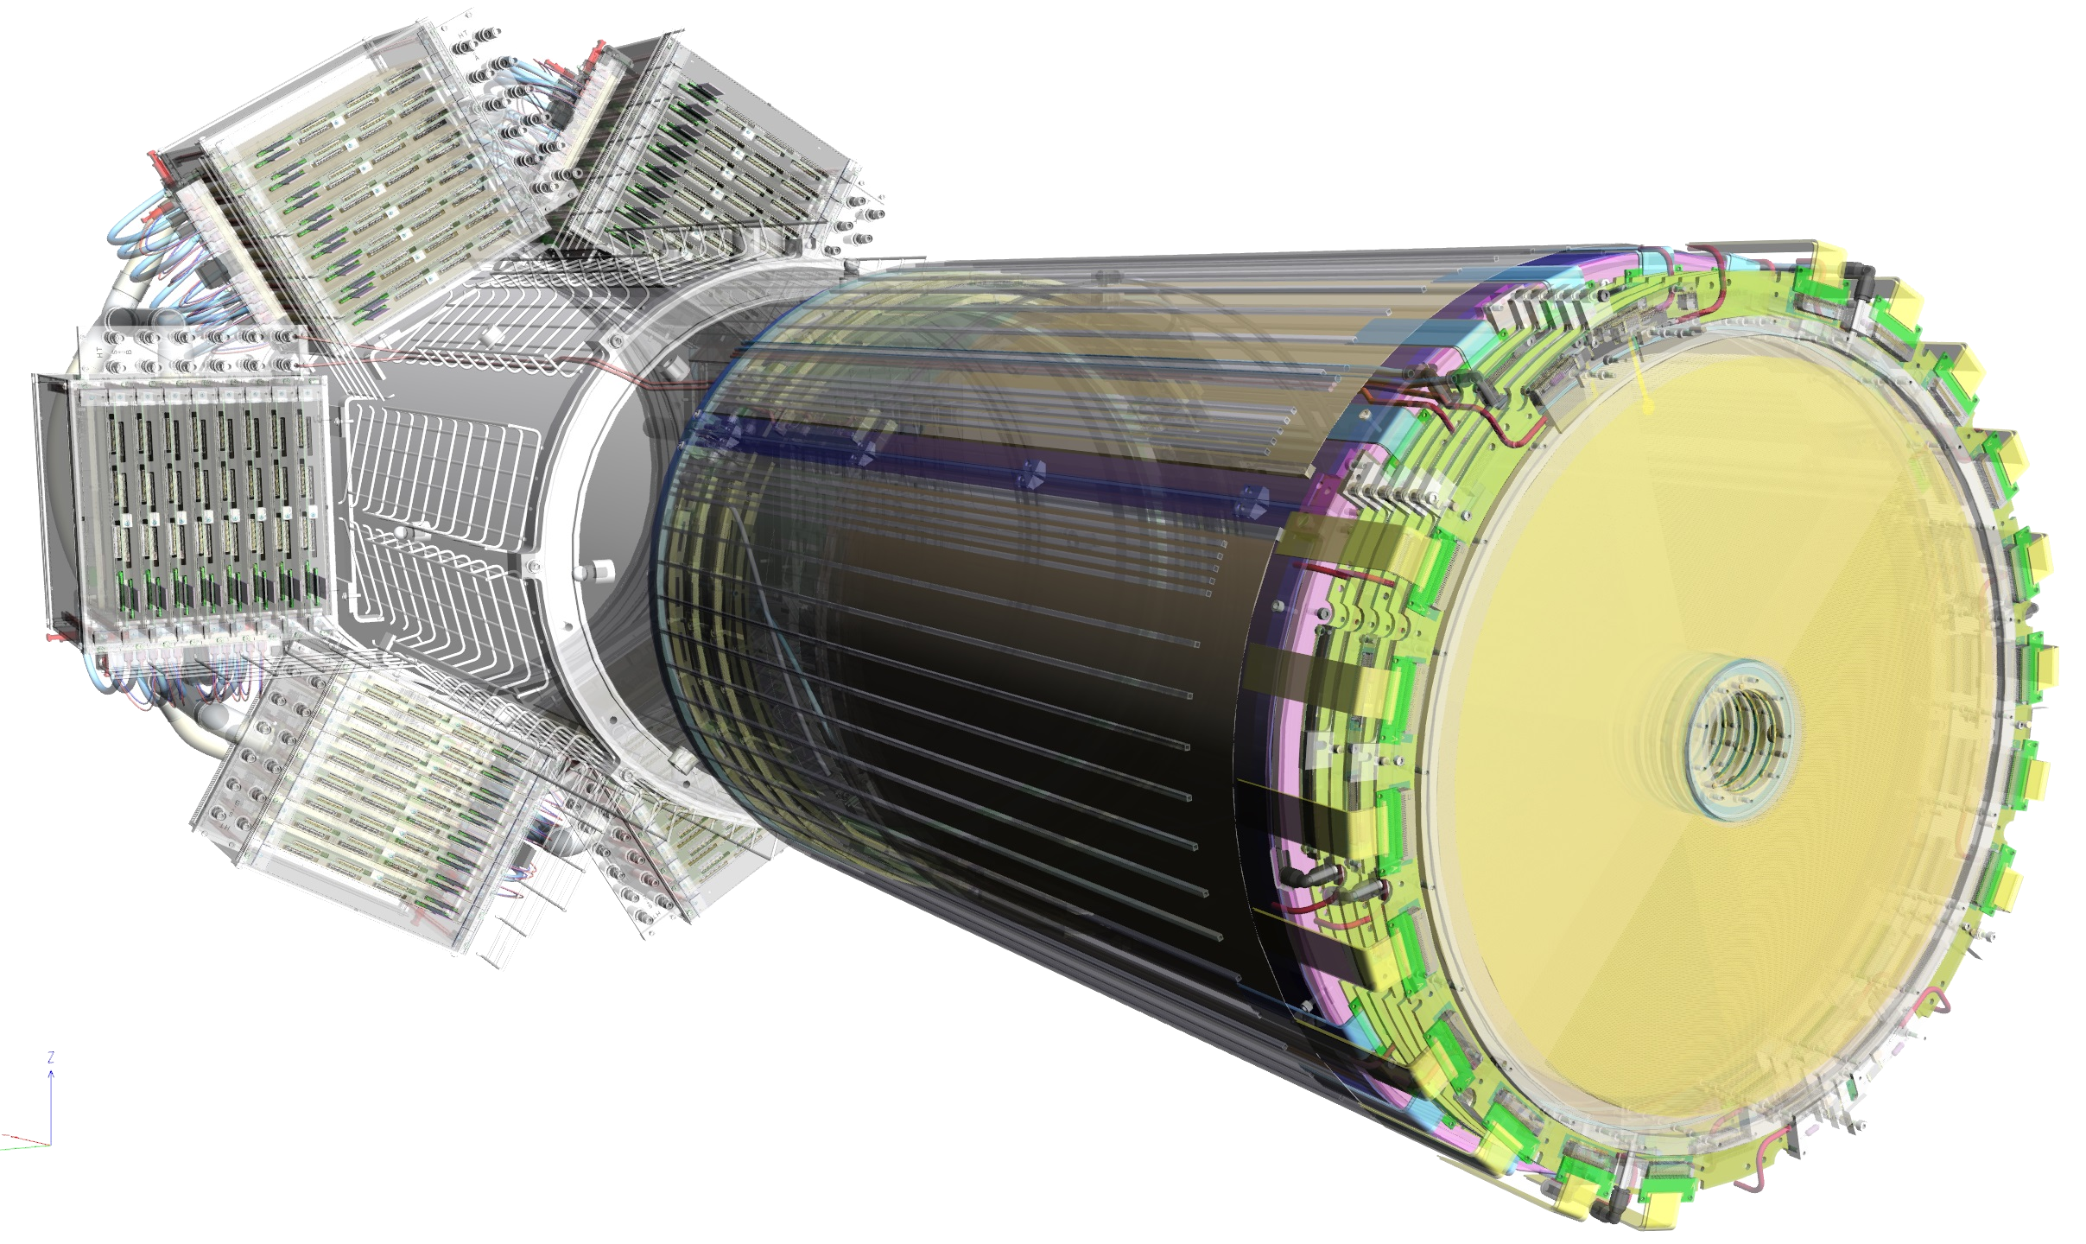
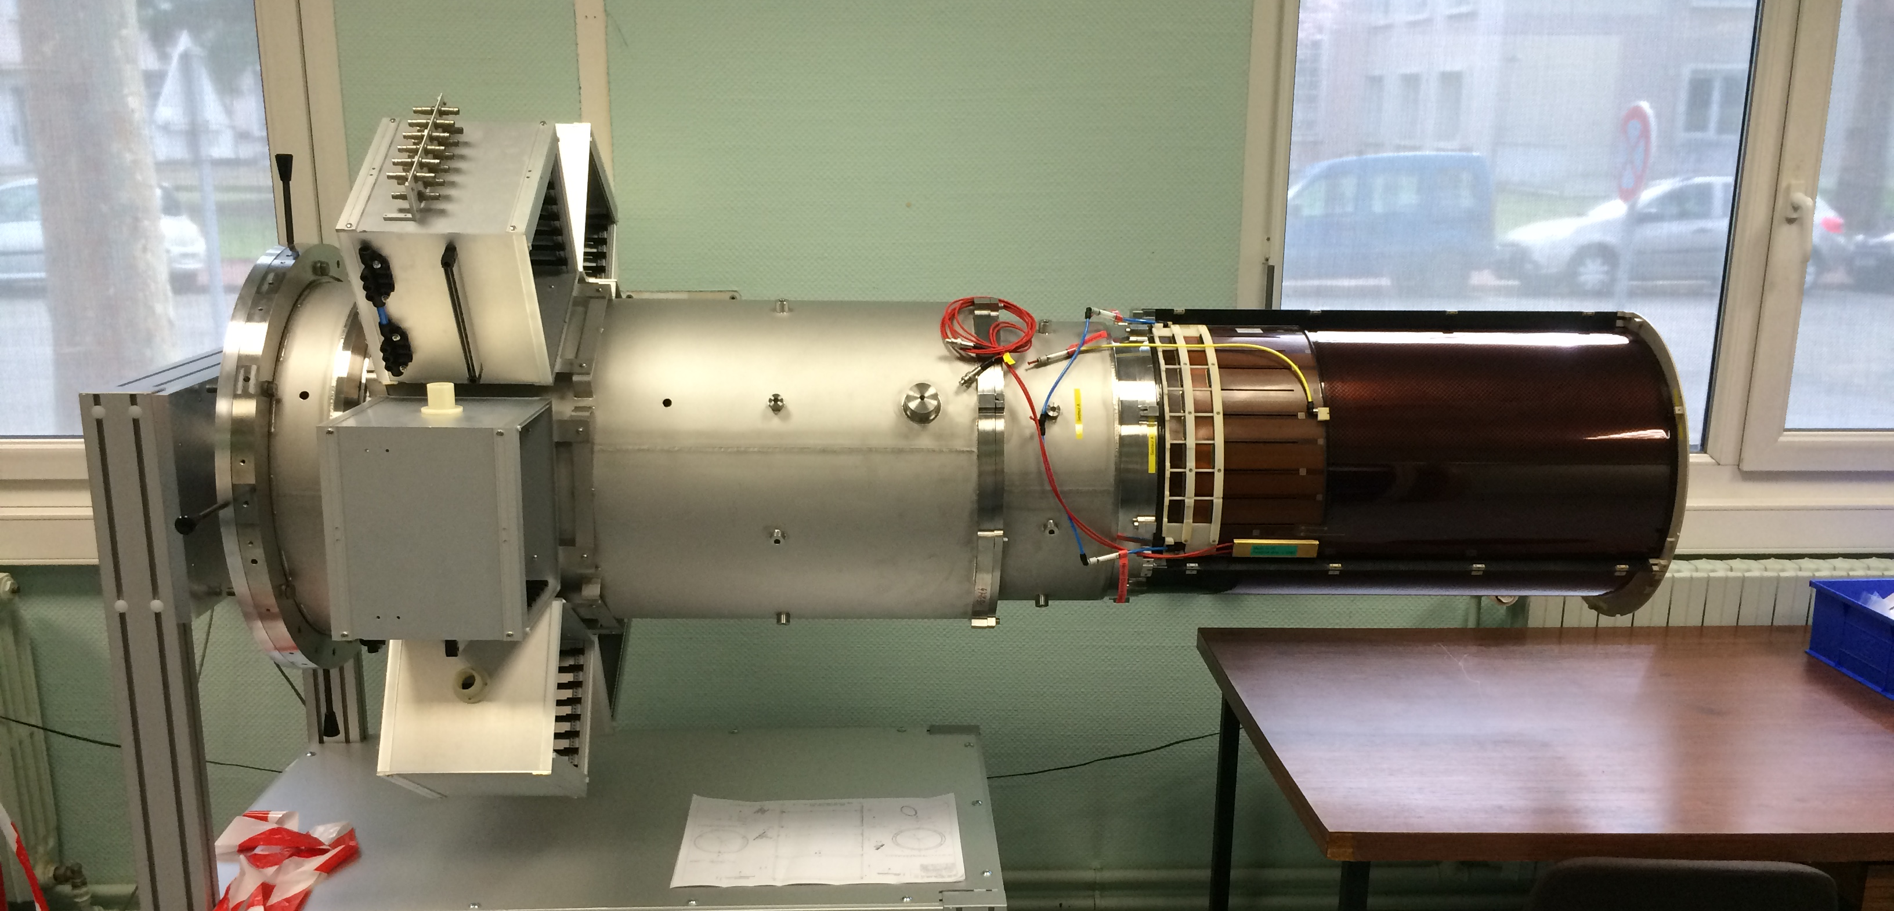
CLAS12 Central Tracker
CLAS12 experiment at J-LAB
High Rate 10 MHz
High magnetic field (5 T)
Deported electronics
6 Disks after the target (Forward Det.)
  Resistive strips divided in 2 zone inner/outer
  1024 strips, pitch 525 µm
  Dimensions: 430 mm diameter disk with a 50 mm diameter hole at the center
Cylindrical Barrel
  Resistive Detectors
  Phase 1 : 2 Layers (6 Det. Of 120º)
  Phase 2 : 6 Layers (18 Det.)
Notes:
ToDo Barrel intro + CLAS12 logo + dream

Slide 7
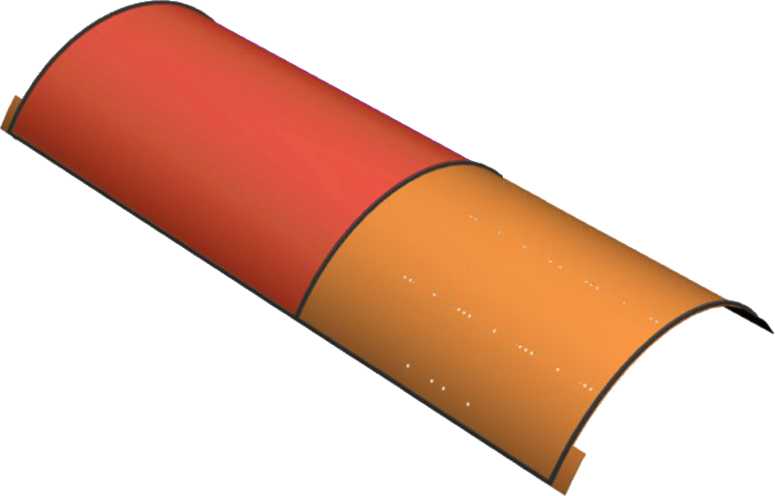
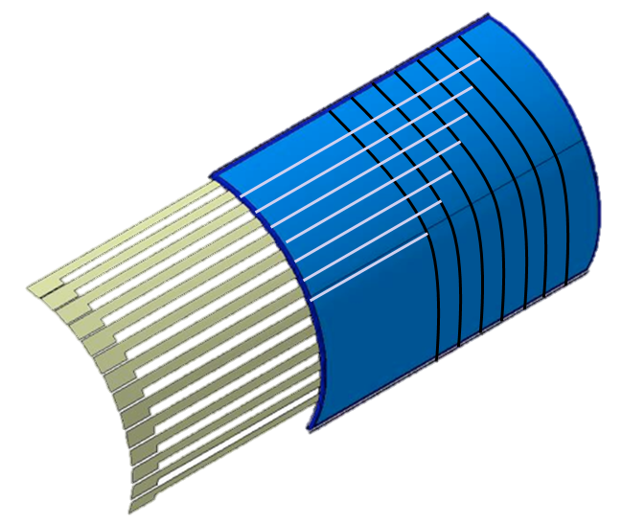
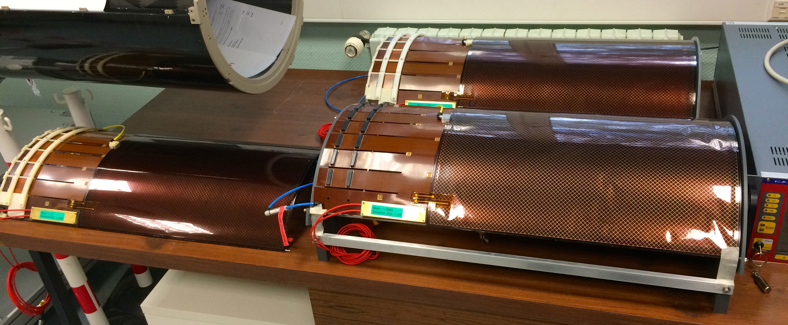
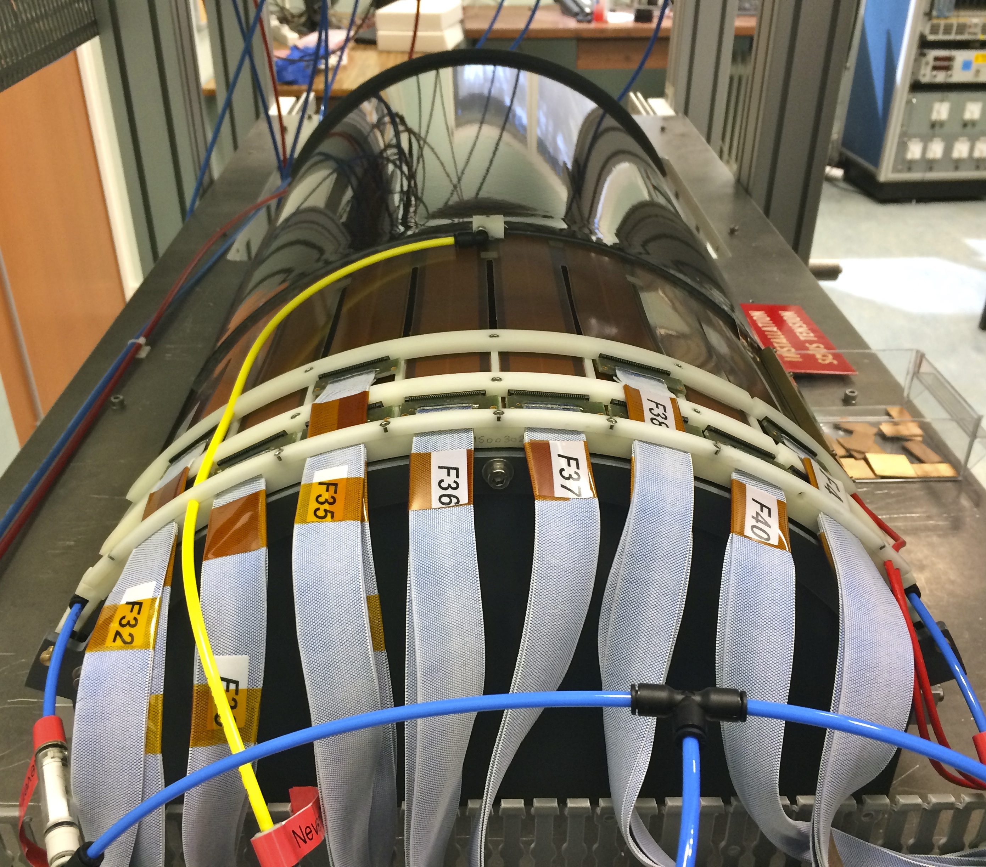
CLAS12 Barrel Detectors
1152 “C” strips
221 mm radius
Pitch from 0.67 to 0.33 mm
PCB thickness 100 µm, Drift thickness 250 µm
0.3% of X0
Drift Field 2.4kV on 3 mm gap
Resistive strips technology
768 “Z” strips
225 mm radius
0.529 mm pitch
PCB thickness 200 µm, Drift thickness 250 µm
0.37% of X0
Drift Field 2.4kV on 3 mm gap
Resistive strips technology
“Z” Barrel
“C” Barrel
“Z” Barrel
“C” Barrel
Notes:
To do reoder bullets to have symetry

Slide 8
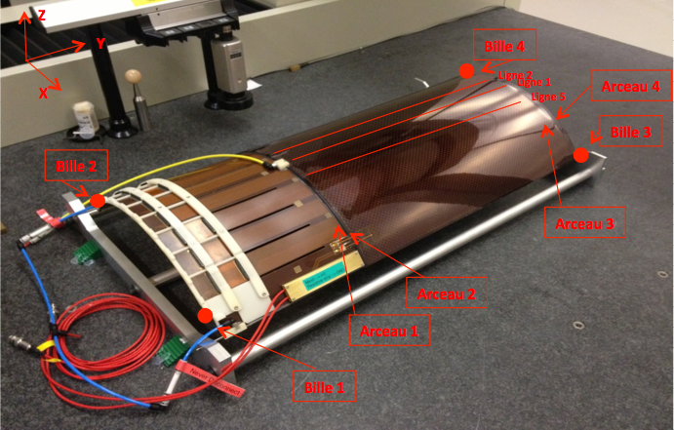
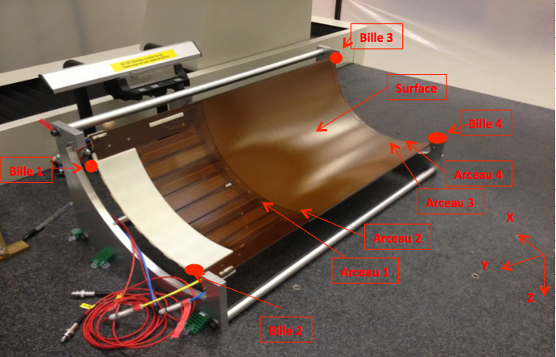
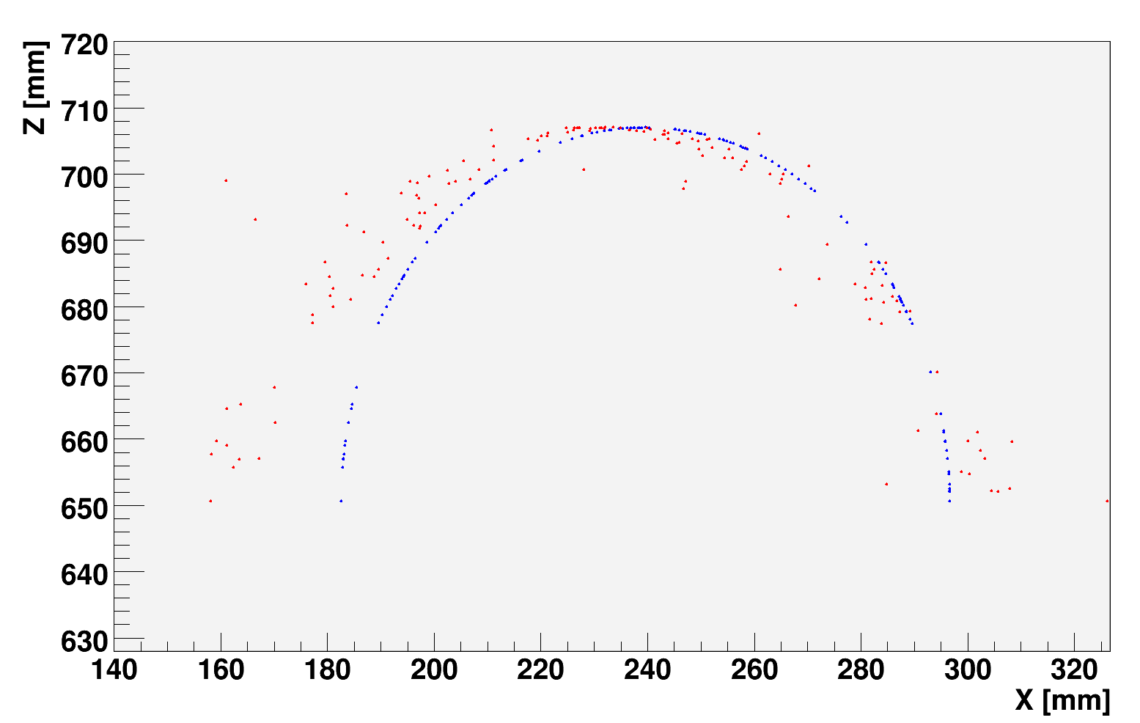
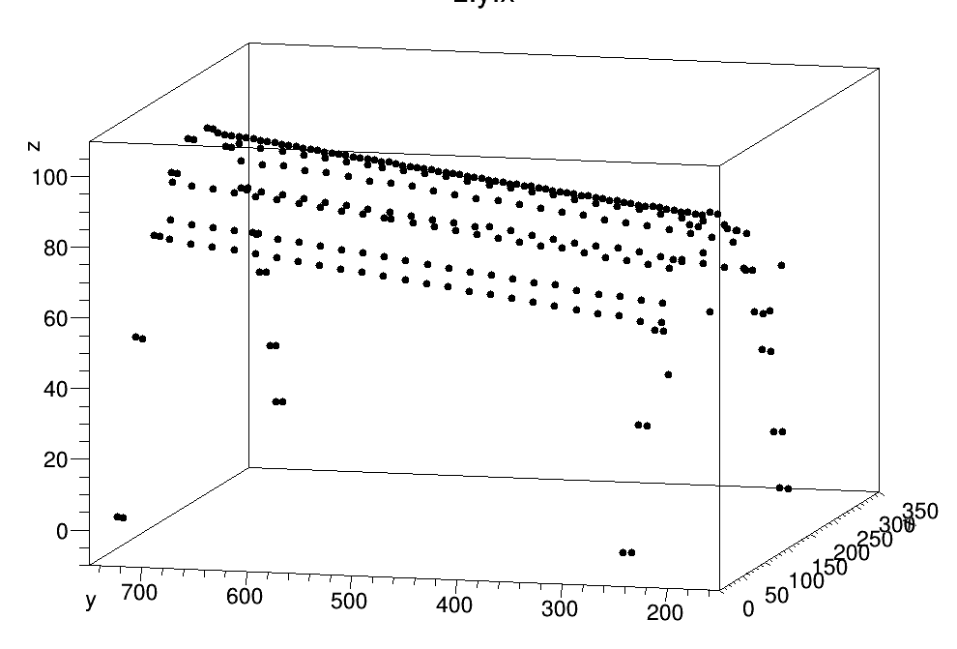
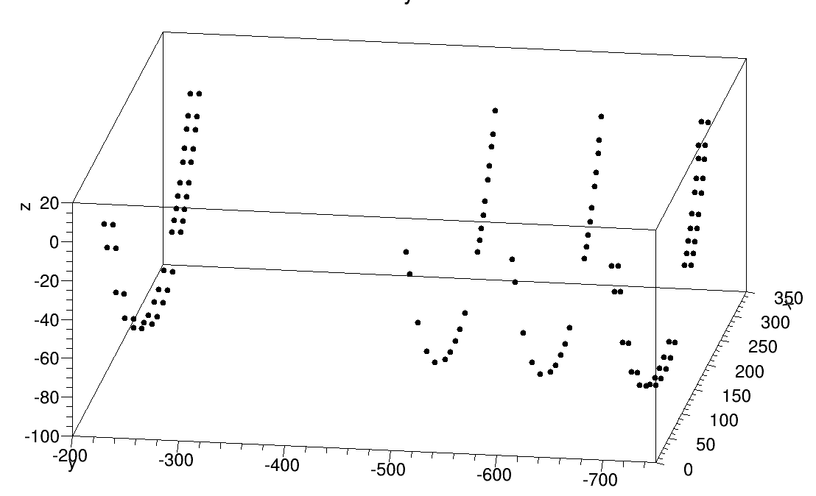
CLAS12 Barrel : Geometry
How well a self support cylindrical MM hold its shape ?
Minimal mechanical support
3D probing machine measuring points :
  270 points on top (drift side)
  120 points under (readout side)
List of measured points
 | X | Y | Z
PT-Arceau1_1 | -3.588 | 231.995 | -0.005
PT-Arceau1_2 | 28.993 | 231.995 | 33.071
PT-Arceau1_3 | 64.992 | 231.994 | 57.126
…
Crosscheck using cosmic ray data reconstruction
Mechanical precision up to ~2mm in radius (only one measurement)
Notes:
Motivation + self supporting + 0.40 % of x0 + “Frist time mm, don’t know

Slide 9
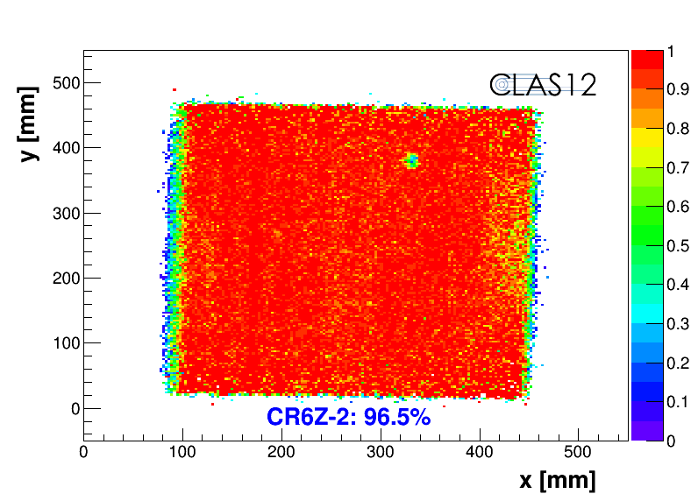
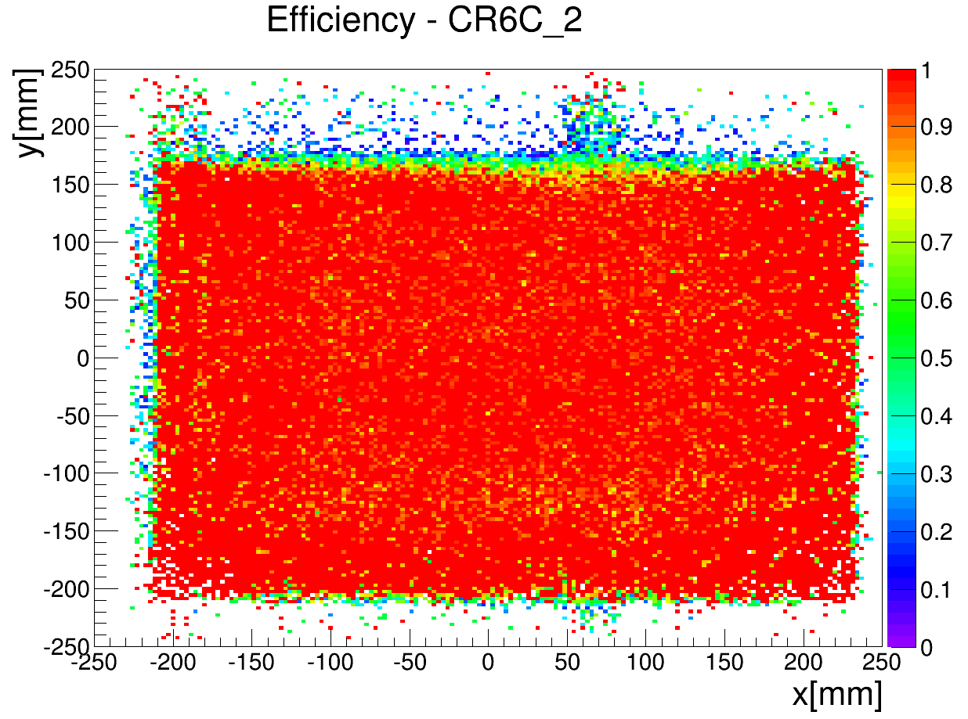
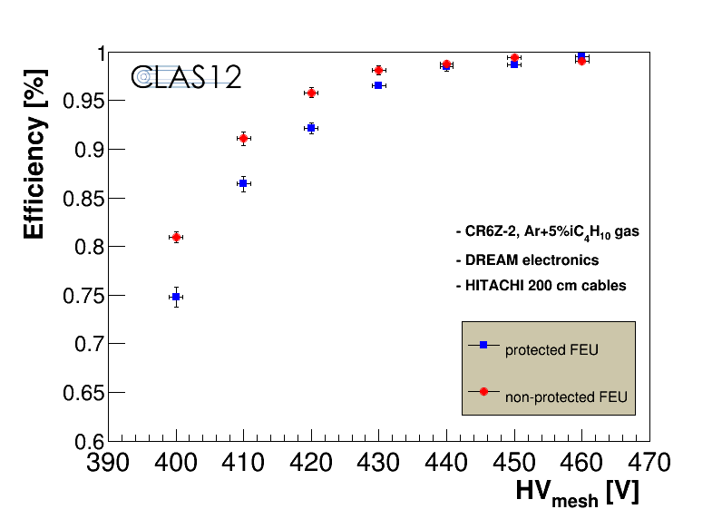
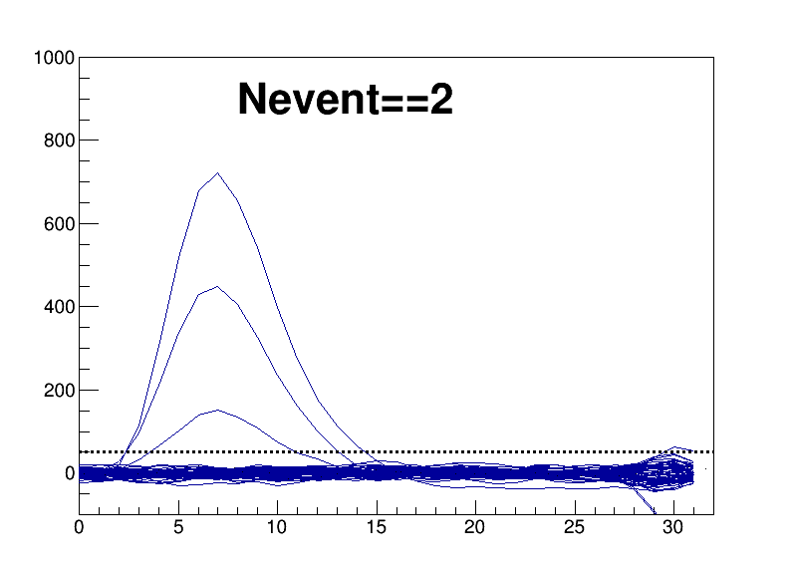
CLAS12 Barrel : Performances
Cosmic rays characterization at Saclay
Barrel efficiency >98% :
Z Barrel Efficiency Map
C Barrel Efficiency Map
Resistive Barrel Nominal performances :
  Great signal to noise
  Fully efficient
  2500V on drift electrode ok
  ~200µm spatial resolution
  (limited by track resolution)
  ~25ns time resolution
Efficiency Plateau
Typical event

Slide 10
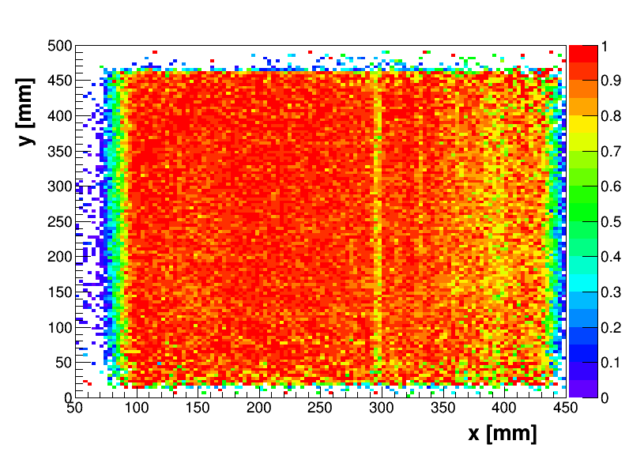
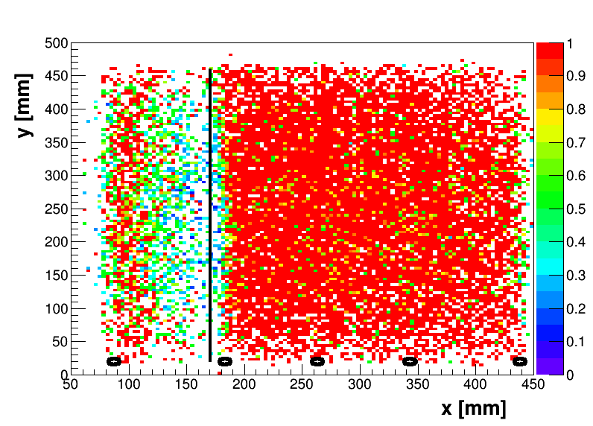
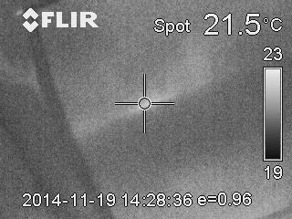
High current on resistive detectors
Happens when a default enters in the amplification gap
Not possible to burn using sparks
Not a barrel related issue, also observed in the forward detectors
Large problem when the current flows over the detector surface to the nearest ground
without current
with current
position of the noisy strip
position of resistive contacts
Efficiency Map
Solutions :
  No resistive interconnection (ladders)
  Aluminum frame at the gas inlet
  More ground connections
    “C” Barrel detectors had no problem !
  Fixing is possible by filing the area with a drop of polymer
Zoom on a part of the CLAS12 Barrel pre-series #2 with thermal cam, with HV on and current of about 300 μA

Slide 11
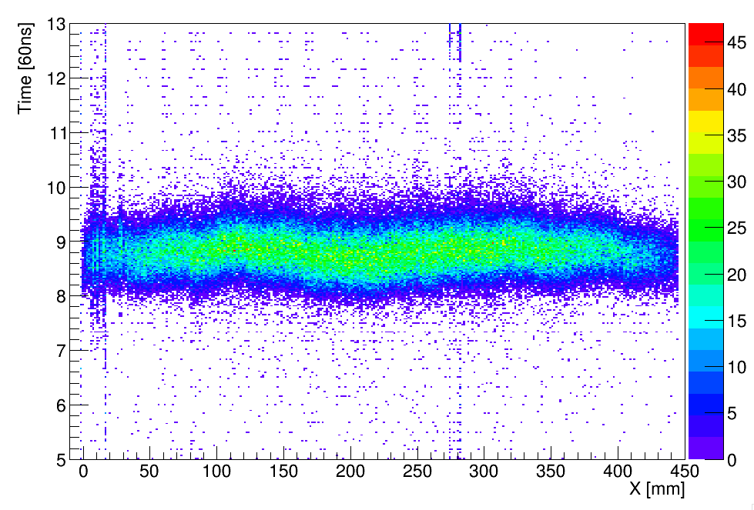
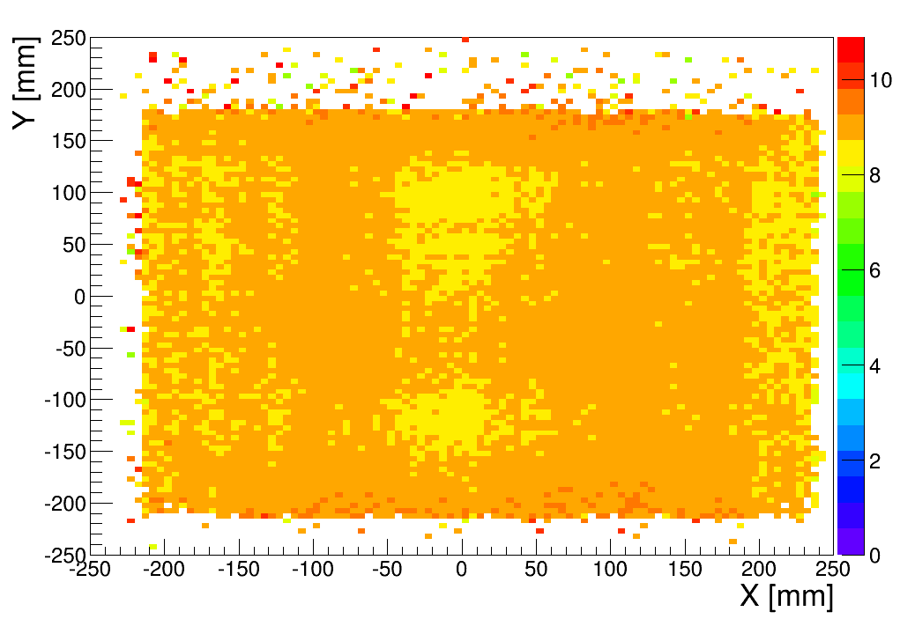
Time resolution
Time Resolution with resistive detectors is ~25ns instead of ~15ns (depending on the conditions)
Inhomogeneities over the detector surface observed
Time Vs Det. X
2D Time distribution
Solutions :
  Electronic parameters optimization (~3ns)
  1D (2D?) corrections under investigation (~5ns)
  Currently under investigation

Slide 12
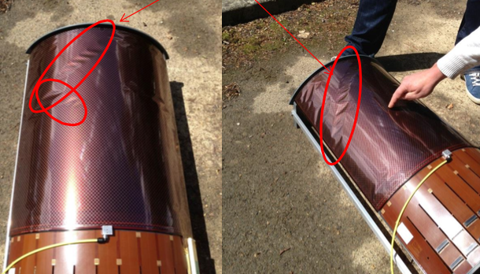
CLAS12 Barrel - Status
4 Full scale prototype detectors assembled and tested
“Z” pre-series CLAS12 Detectors :
  CR6Z-1 -> High current, sent back to CERN
  CR6Z-2 -> Fixed ! OK !
“C” pre-series CLAS12 Detectors
  Drift electrode to be changed (production issue)
  CR6C-1 -> missing channels (to be repaired soon) 92% efficiency
  CR6C-2 -> OK !
All problems found a solution and we are ready for production for this summer !
Drift Electrodes not thermally treated

Slide 13
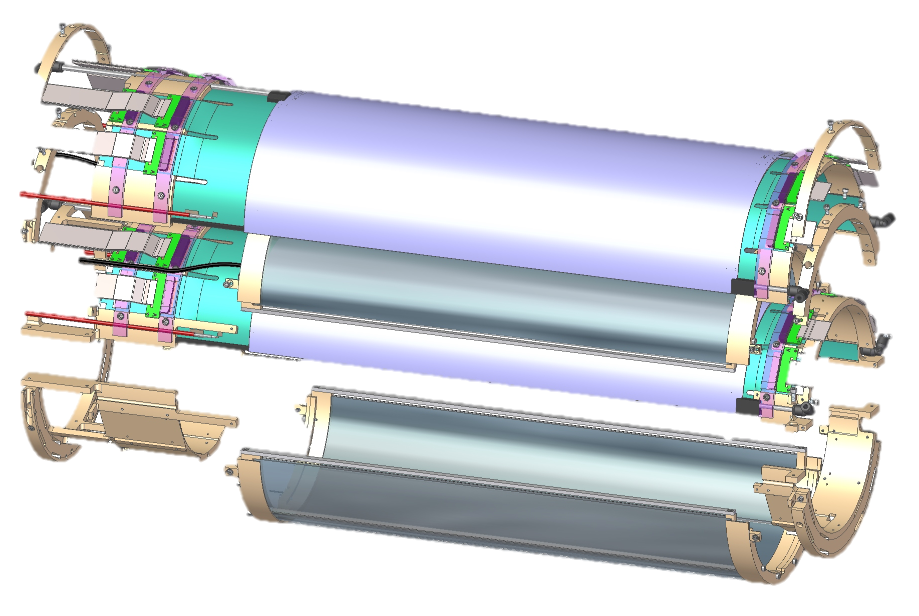
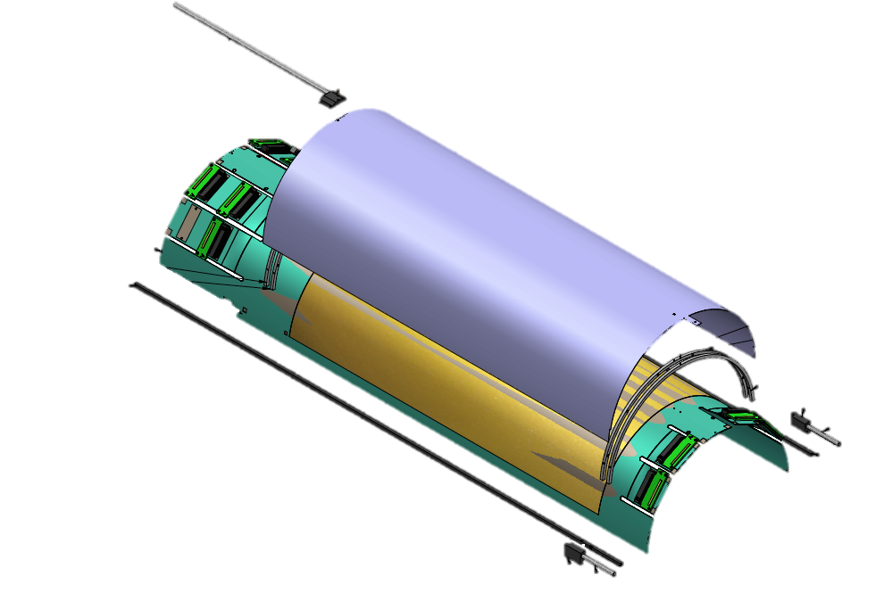
The ASACUSA Micromegas Tracker
ASACUSA experiment : spectroscopy of anti-H at the Anti-Proton Decelerator (AD) at CERN
Goal : Vertex reconstruction inside the EM trap where the anti-H is produced with ~1cm resolution
Overall thickness of the full system limited to ~2.5cm
4T magnetic field (from -2T to 4T in the active area)
Annihilation rate: ~10-50 kHz
2 Cylindrical layers = 4 MM with 2D readout
Magnet Trap

Slide 14
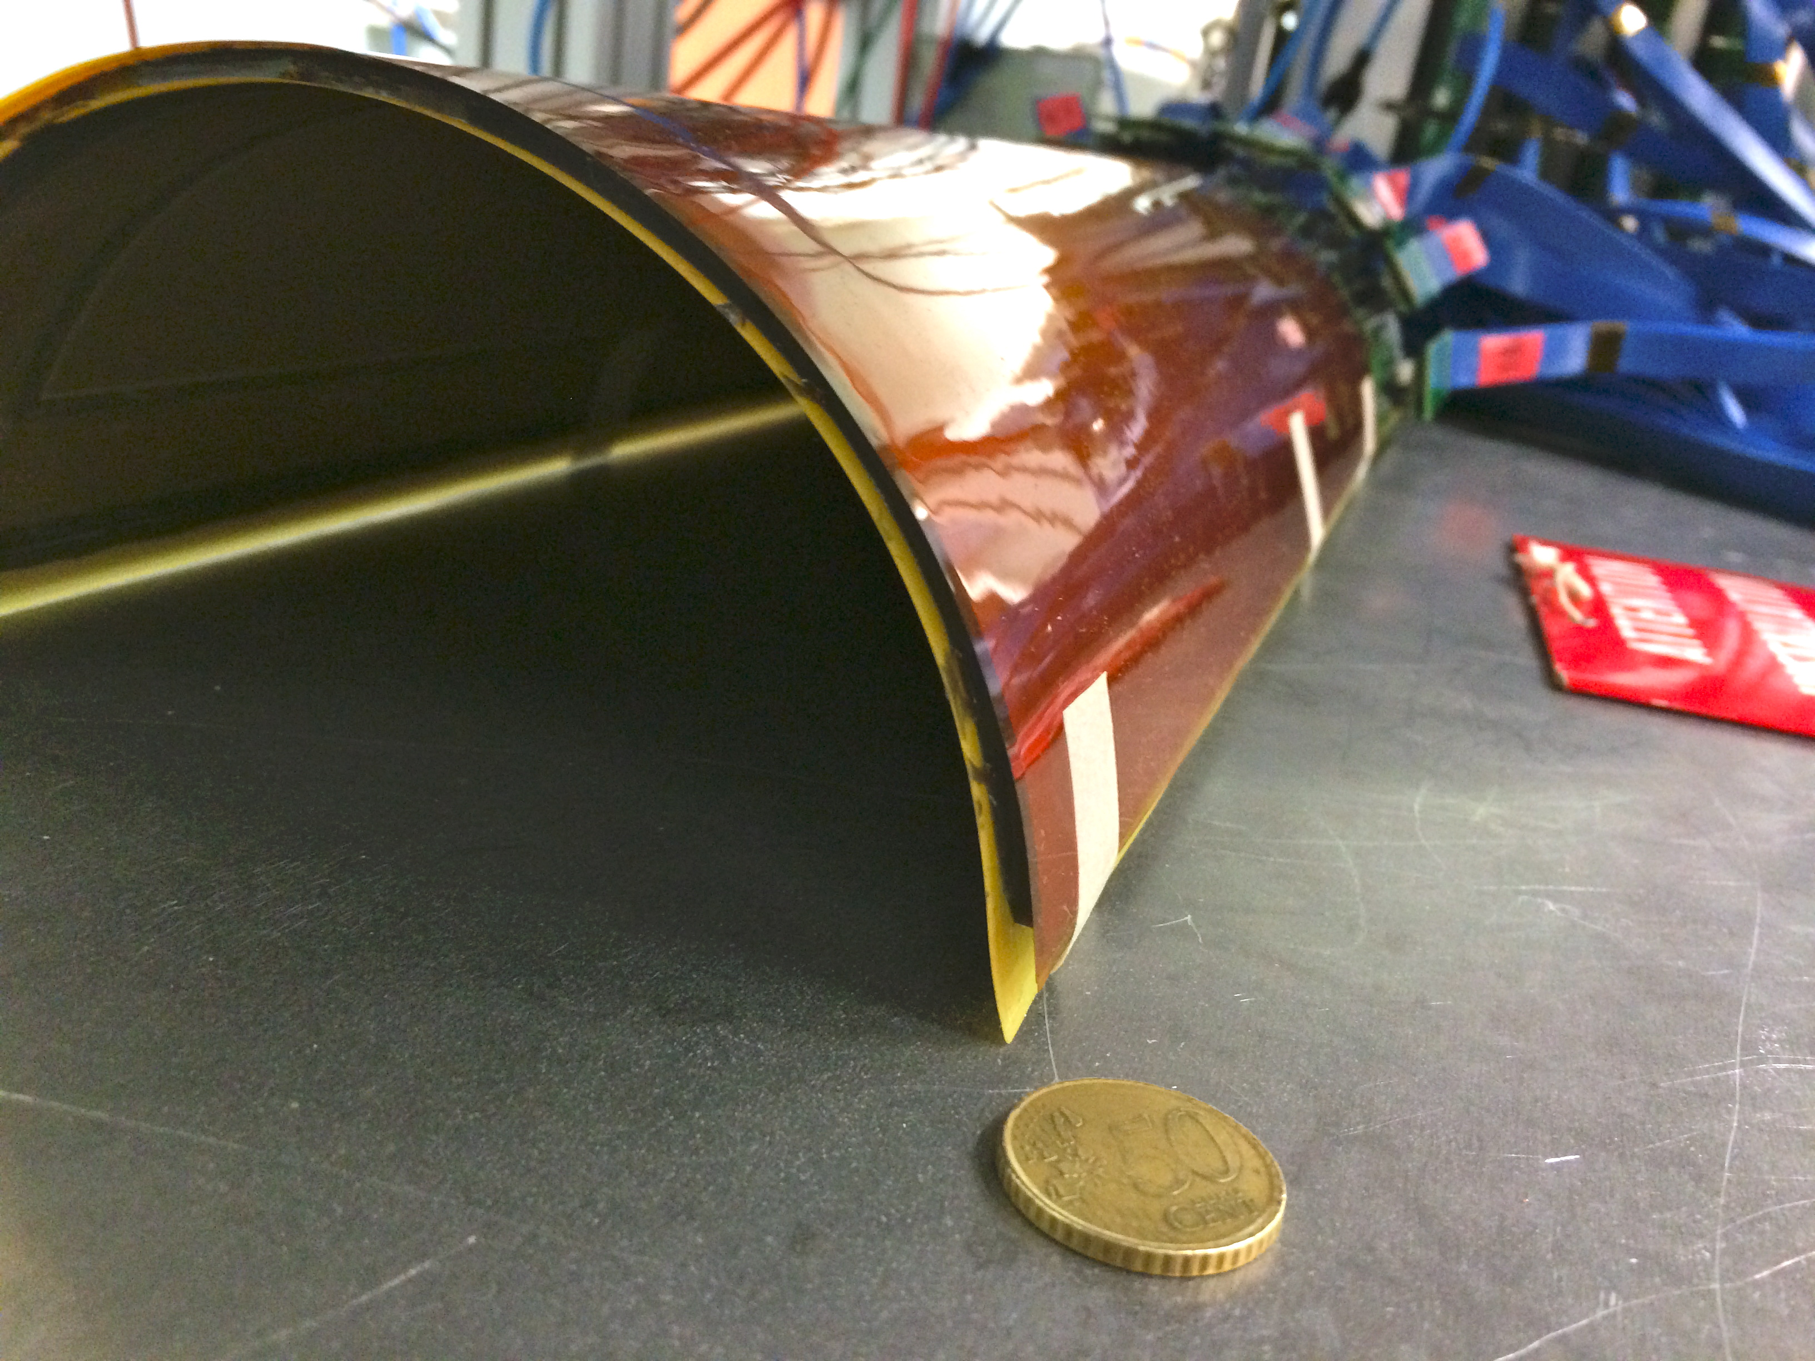
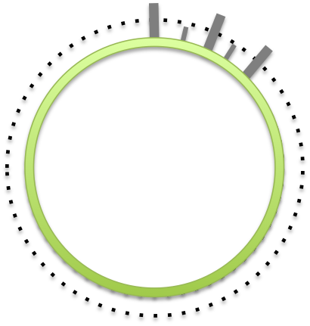
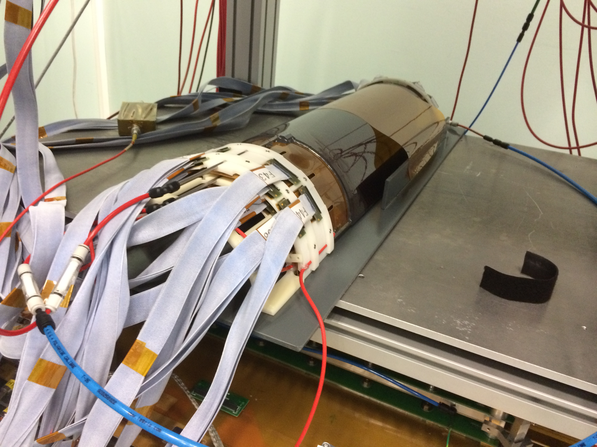
The ASACUSA Micromegas Tracker
Phase I : Half Cylinder Instrumented (2 MM)
2D metallic Micromegas “C” – “Z” pattern
Internal Layer R_{MIN} : 60cm x 85 mm radius
External Layer R_{MAX} : 60cm x 95 mm radius
Intermediate support pillars
DREAM electronics using 2m Hitachi cables from CLAS12 R&D
3D printed structure (white)
Cutout flaps for a better deformation at the connector level
Gas distribution through aluminum frame
0.87mm pitch: 250 longitudinal Z strips, 500 circulars C strips
“C” strip
“Z” strip
Readout pattern (top)
Readout pattern (bot)

Slide 15
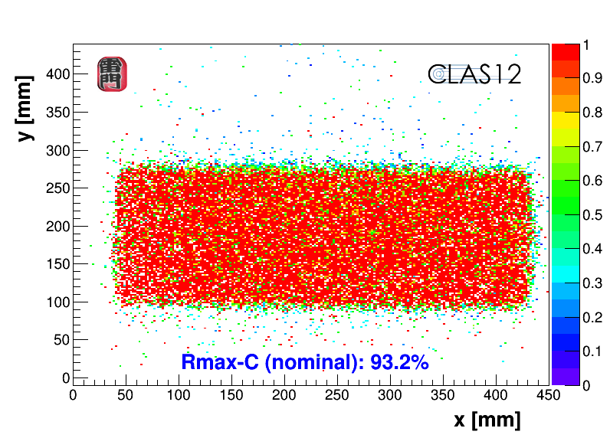
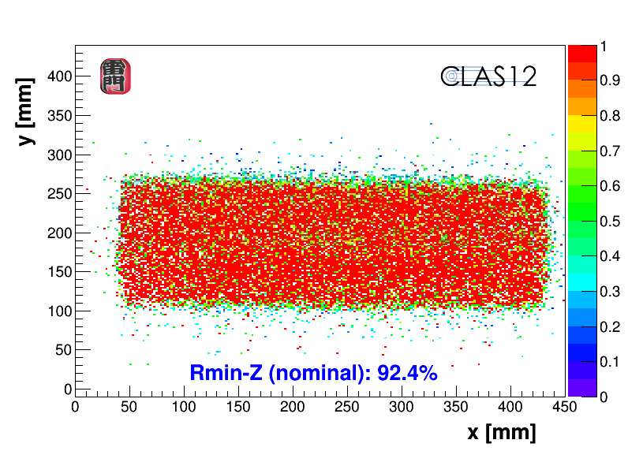
The ASACUSA Micromegas Tracker
Characterization at Saclay :
6 Months of smooth data taking ! (technical paper submitted)
Effect of the magnetic field (80º Lorentz angle at low drift field)
B Field OFF
B Field ON
Notes:
Small plateau – Review of scientific instruments – pictures todo - Can’t show physics data - > micro tpc

Slide 16
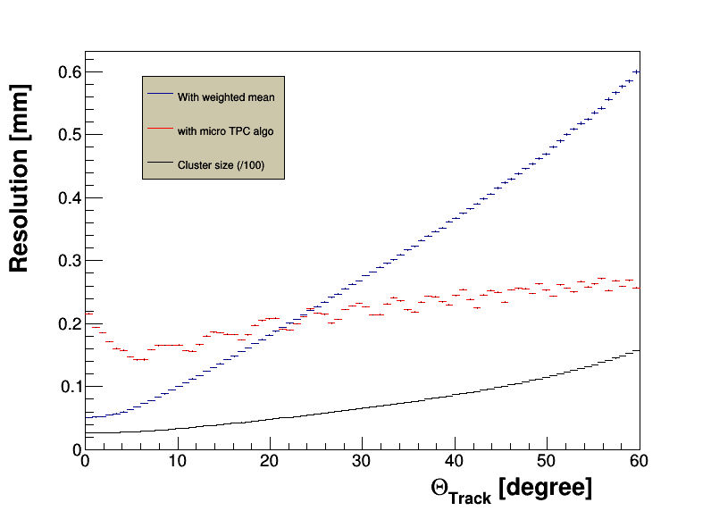
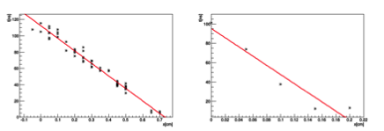
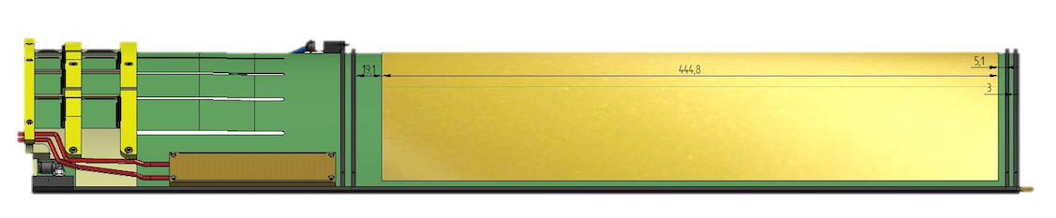
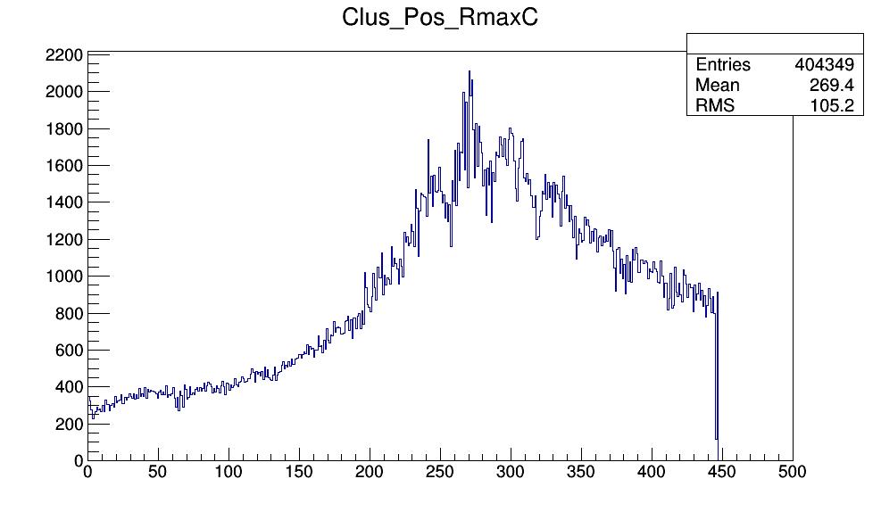
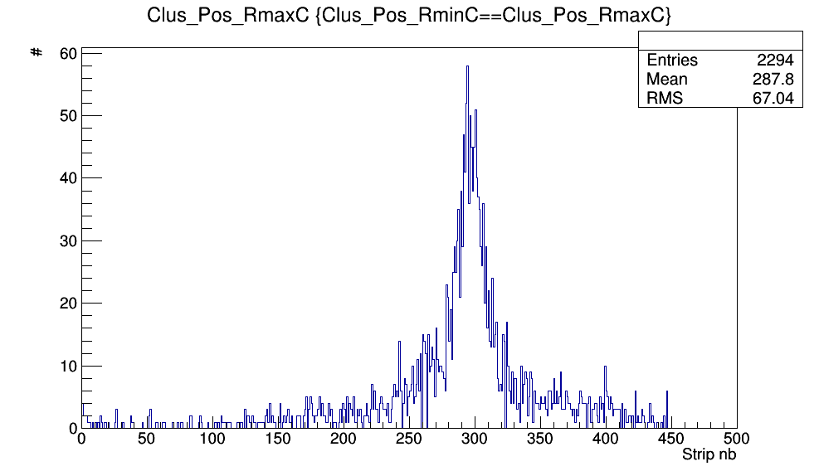
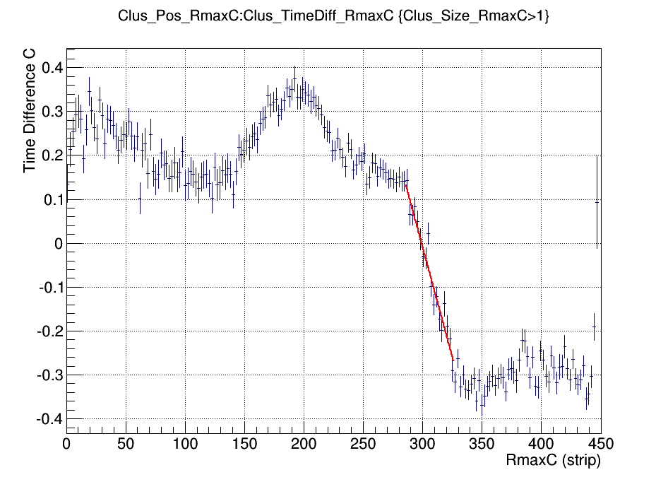
AMT – MicroTPC Algorithm
The MicroTPC algorithm uses the time information on multi-strip clusters to extrapolate the track angle :
time
space
Fitted signal in the drift space
Resolution Vs Track Angle
MicroTPC algo on anti-p data :
Cut
µTPC
Antiproton distribution
(calibration data)
Track angle from a single layer barrel
Filtered distribution
Notes:
TO REDO WHILE SPPEAKING 3mm drift, only only one layer

Slide 17
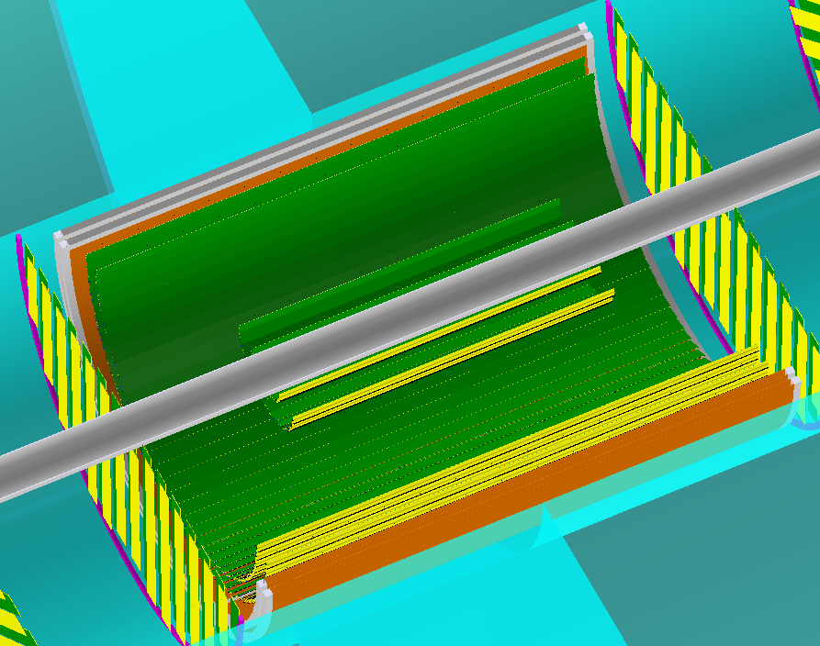
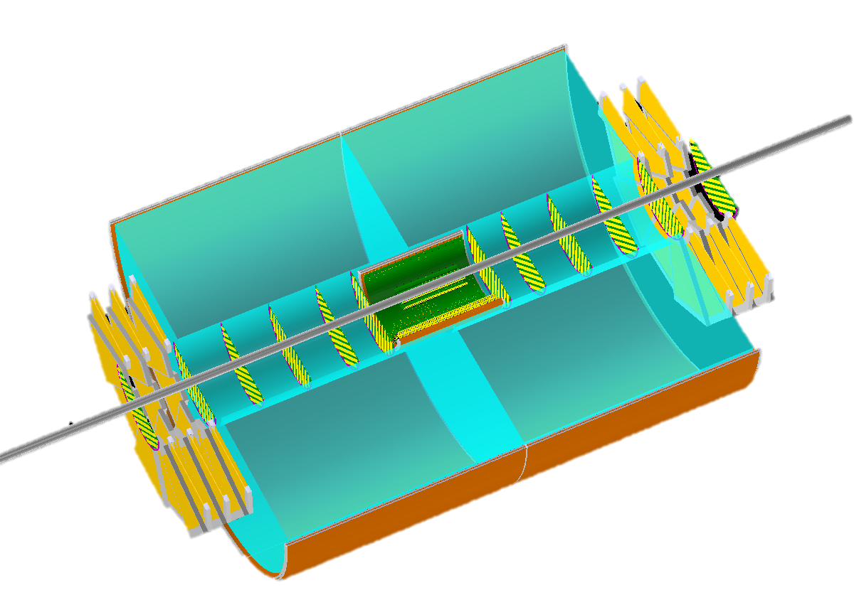
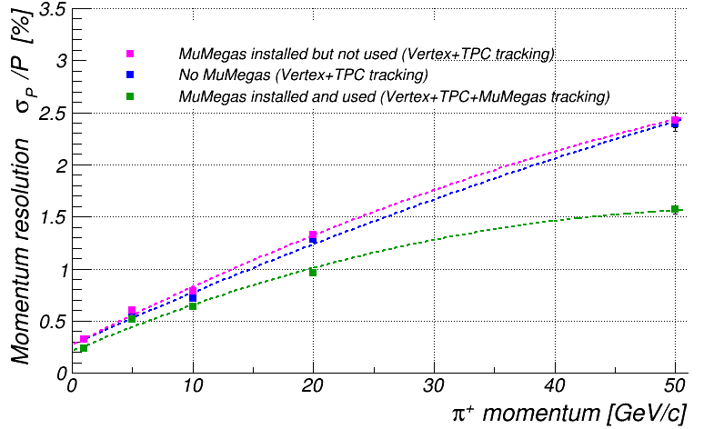
Barrel Micromegas for an
Electron-Ion Collider (EIC)
A solution based on a TPC + Barrel detectors is considered for an EIC detector
Internal (~20cm) and external (~2m radius) 2D cylindrical layers
Establish <100 µm spatial resolution in a 3T field
Deliver reliable “vector” measurement
Fast measurement layer between MAPS and the TPC
Minimized material budget
Internal layers
EIC GEMs : See B. Surrow Poster
External layers
Notes:
Bernd –posrter’s

Slide 18
Outlook
Large Cylindrical Micromegas has been developed thanks to the bulk technology for the CLAS12 experiment after a long R&D
Cylindrical Micromegas allows fast and precise measurements on light weight layers
4 full scale CLAS12 Barrels using resistive technology have been produced and tested
Pre-series production issues understood, ready for production !
Great performances measured on the barrel CLAS12 detectors
  Full efficiency
  0.3% of X0
  Below 200µm spatial resolution
  20 to 25 ns time resolution in Ar/iC4H10 95/5
First use of small radius cylindrical detectors in the ASACUSA experiment
4x2D AMT operational det. produced, 2 used for data taking
Vector measurements with a single layer successfully tested in experimental conditions
R&D for an EIC started for a mixed Si/TPC/Cylindrical MM tracker

Slide 19

CLAS12 TEAM AT SACLAY
D. Attie, S. Aune, J. Giraud, R. Granelli, C. Lahonde-Hamdoun, I. Mandjavidze, O. Meunier, S. Procureur, M. Riallot, J-Y Rousse, F. Sabatie, M. Vandenbroucke

Slide 20
Spares

Slide 21



Detector characterization at Saclay : The Cosmic Test Bench
Scintillator
Top reference
detectors
Coincidence
module
Prototype
to the
trigger
Down reference
detectors
Setup to characterize in 2D the prototypes
Tracking detectors : MultiGen 2D x4 (8 Connectors)
Fully equipped with DREAM FEE
24 Positive + 24 Negative HV
Gas mixing system + pre-mixed bottles
Trigger control module, trigger time resolution below 3 ns, Projected track resolution of ~100 µm
6 Hz trigger rate, >90% track reconstruction efficiency
1h to get one efficiency point

Slide 22

The ASACUSA Experiment
Antimatter spectroscopy at CERN
ASACUSA Micromegas Tracker

Slide 23
CLAS12 Operating Conditions

Slide 24

Material Budget

Slide 25

CLAS12 Barrel : Geometry
Using cosmic ray data reconstruction
OUTER (4 ribs)
R= 211.3 +/- 1.8
INNER(4 ribs)
R= 207.3+/- 2.1
=> Mechanical precision up to ~2mm in radius (only one measurements)
Notes:
Maybe suppress X0 to avoid Q?

Slide 26



Forward disk for CLAS12: issue with resistive ladders
2 pre-production detector tested, One not ok :
  High current due to a contact in the active area (can’t burn it with sparks)
  Large impacted zone due to ladders
  Drift electrode glued
Production detectors
  No ladders
  Re-openable design with screws
Before the current appaered
With current

Slide 27


Investigation of the cause of the short
Some defects observed with the Mitutoyo along a noisy strip.
The defect has not been identified
Observation of the current with infra-red camera made
Zoom on a part of the CLAS12 Barrel pre-series #2 with thermal cam, with HV on and current of about 300 μA

Slide 28


List of detectors tested
10 CLAS12 & M-Cube detectors were tested in our cosmic bench
→ 9 resistive + 1 non resistive
Detector | experiment | resistive | Active area | manufacturer | year | Drift frame
Forward prototype | CLAS12 | Hand, no ladder | R=20 cm | ELVIA | 2013 | Epoxy
Forward preserie | CLAS12 | Screen printing, ladders every 2 cm | R=18.5 cm | CERN | 2014 | ?
Barrel preserie (x2) | CLAS12 | Screen printing, ladders every 8 cm | 45x37 cm² | CERN | 2014 | Carbon ribs
Forward Tagger prototype | CLAS12 | no | R=14.6 cm | CERN | 2013 | Epoxy
MultiGen 2D (4x) | M-Cube | Screen printing with ladders | 50x50 cm² | CERN | 2014 | Aluminum
MultiGen 2D | M-Cube | Screen printing with ladders | 50x50 cm² | CERN+ELVIA | 2014 | Aluminum
→ Detectors without current between resistive strips and mesh are perfectly fine…
M-Cube
talk by S. Bouteille

