Slide 1







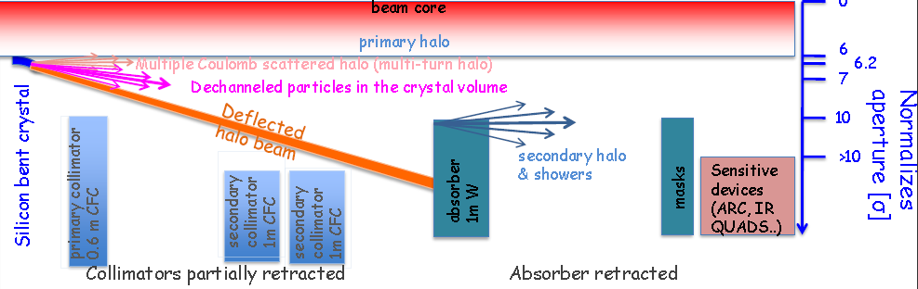
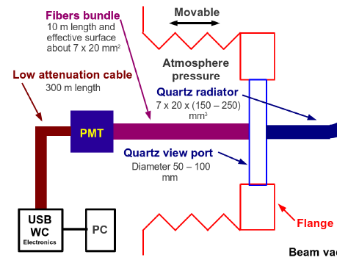
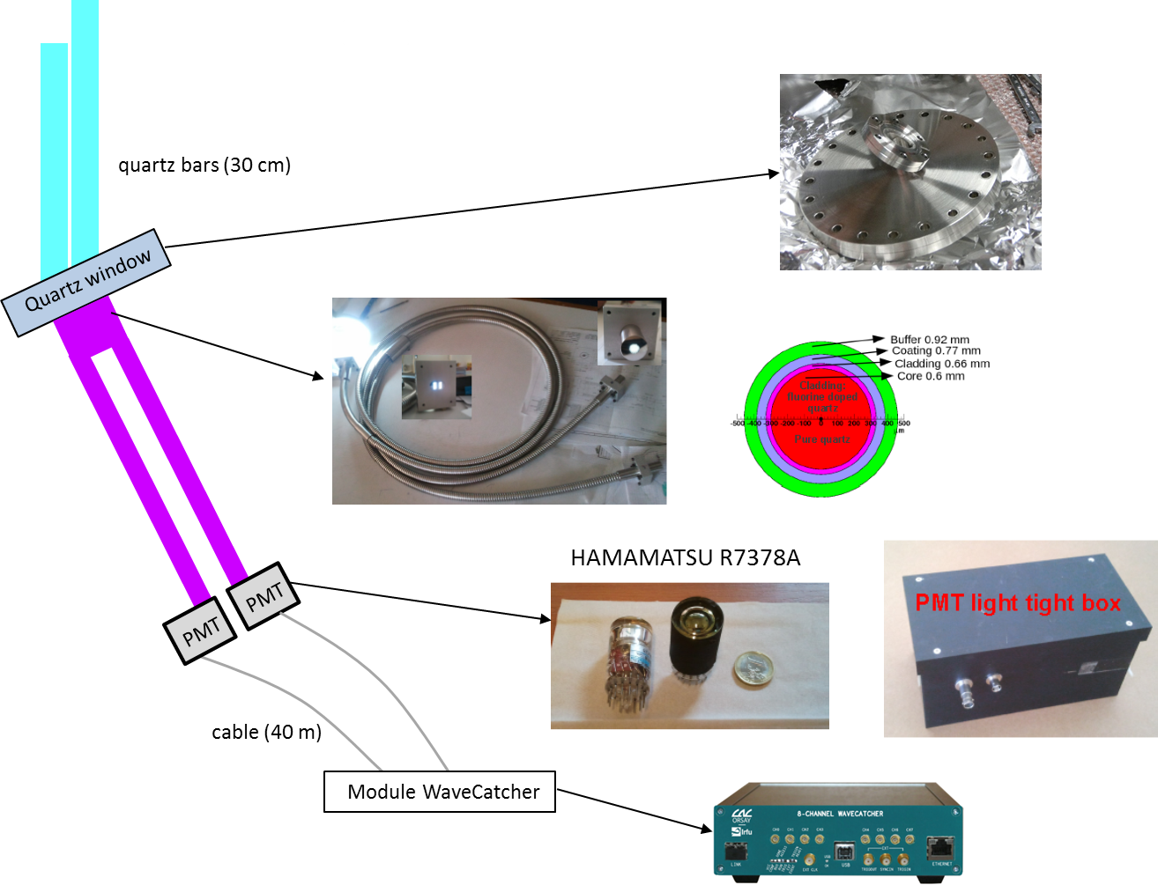
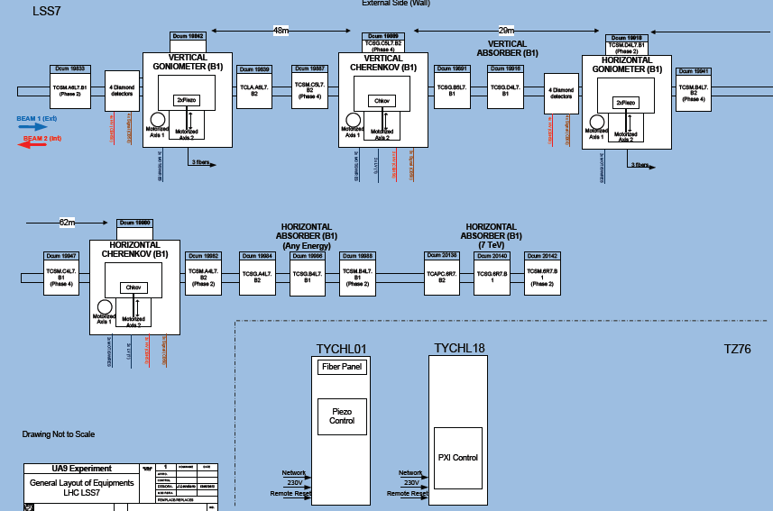
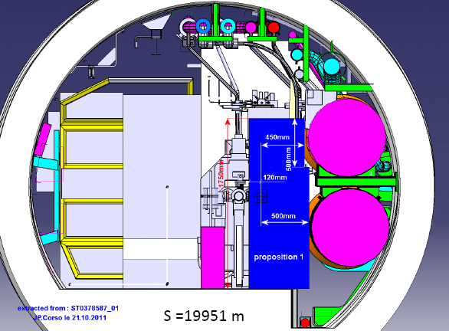
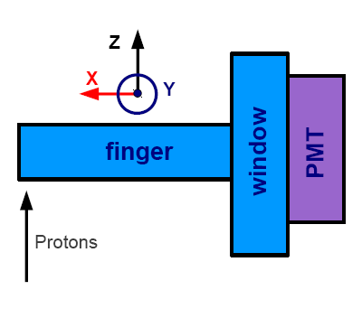
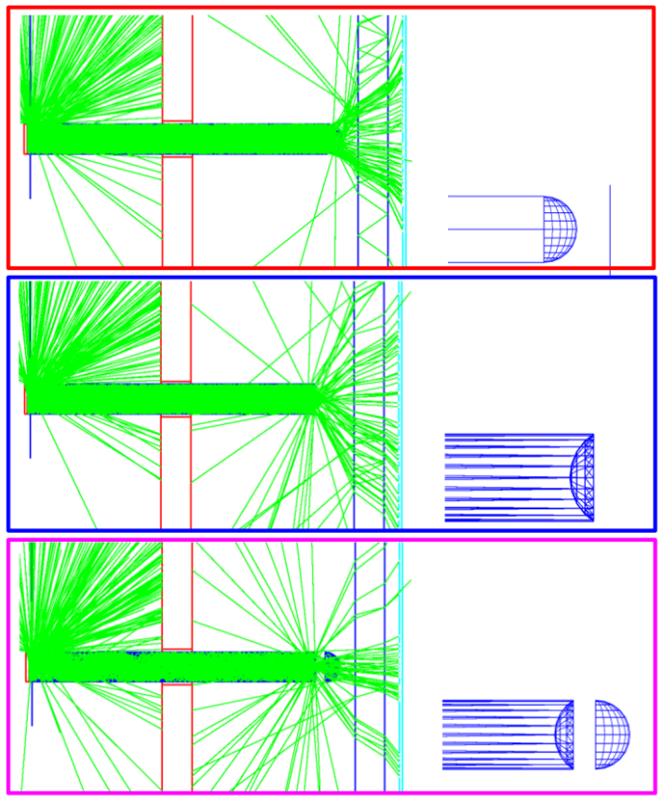
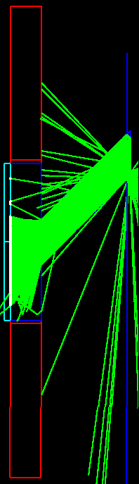
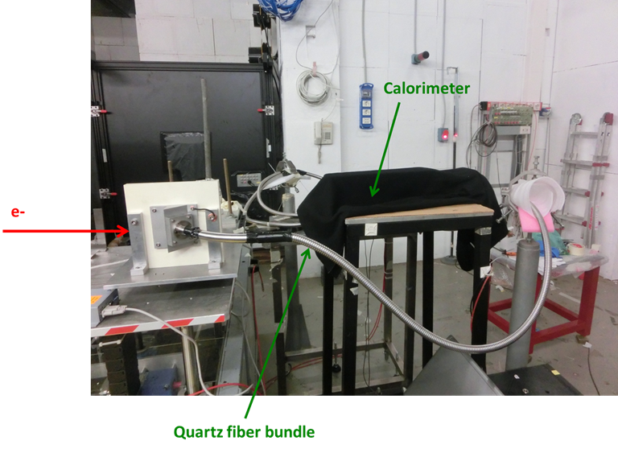
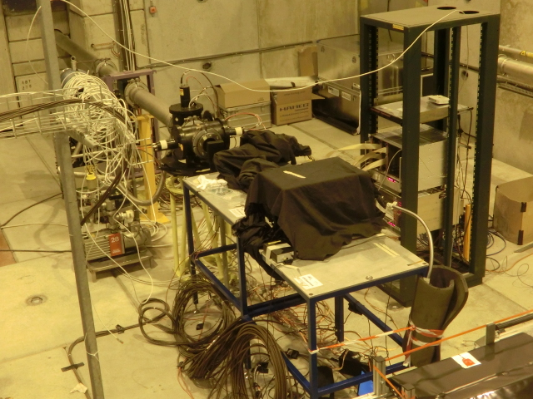
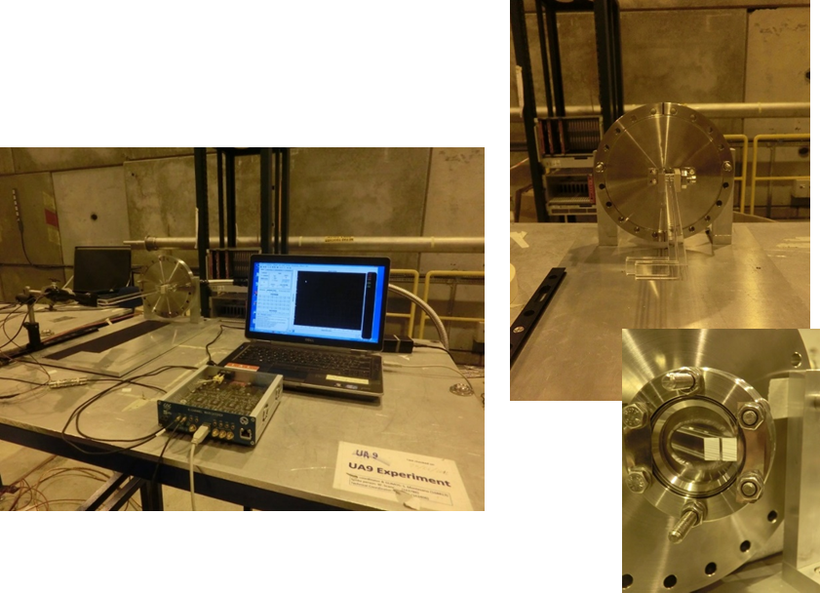
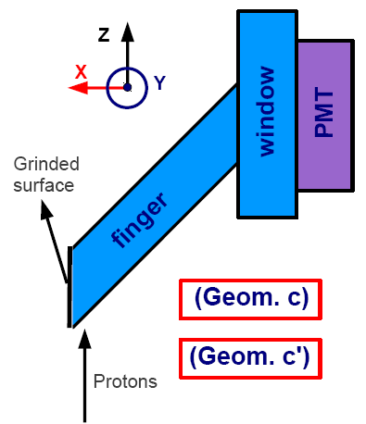
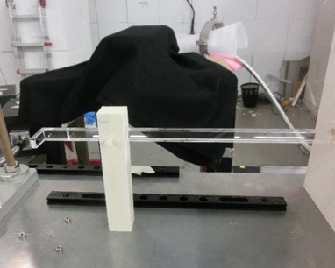
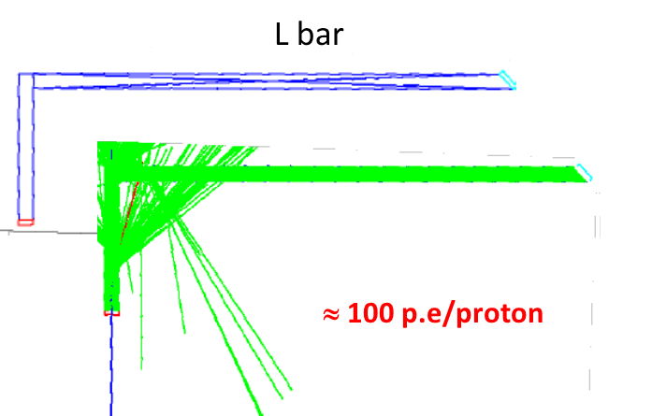
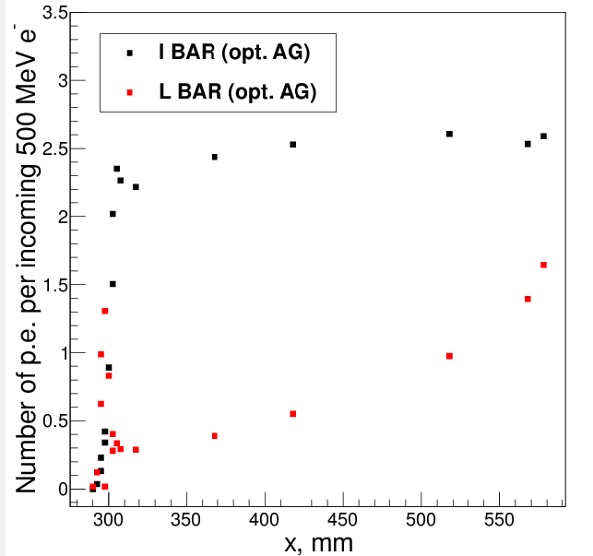
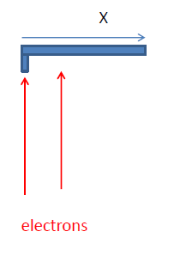
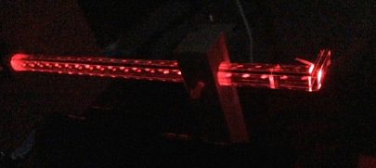
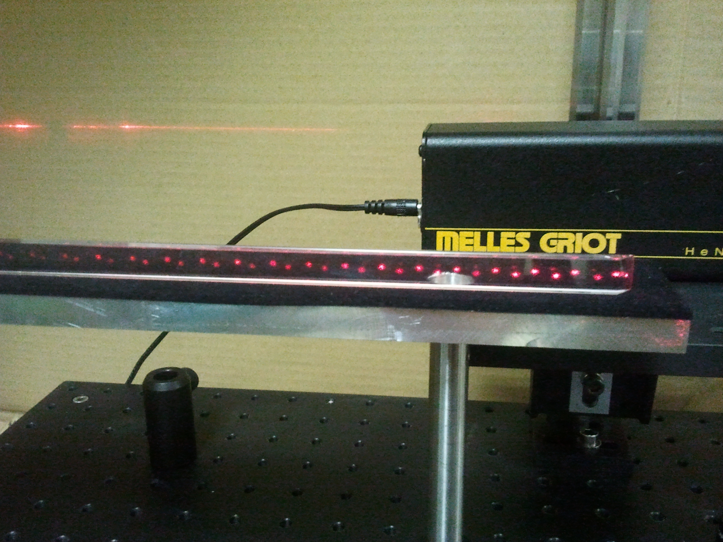
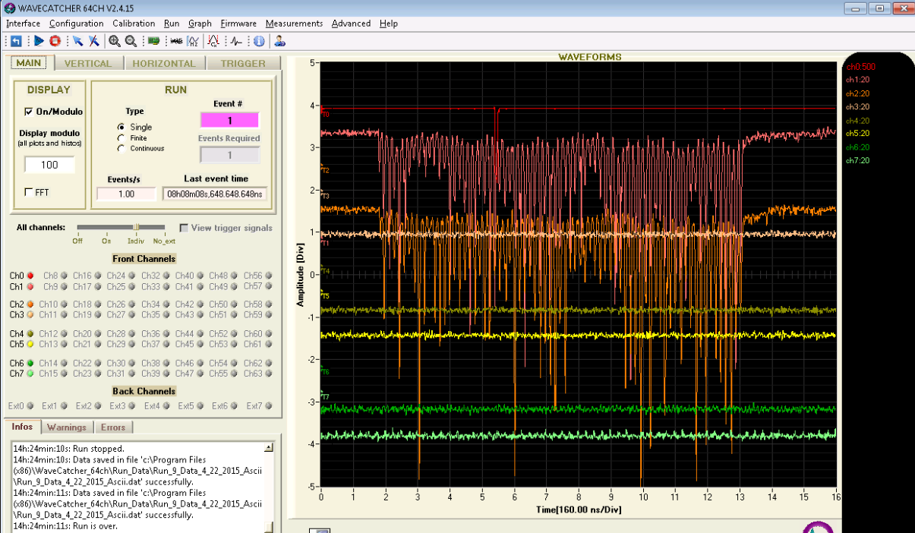
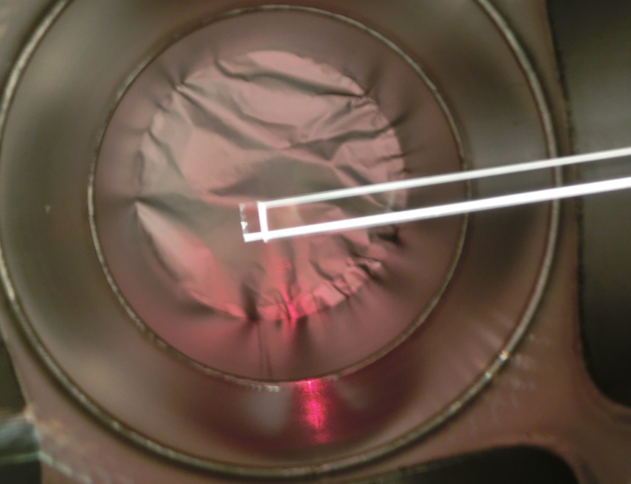
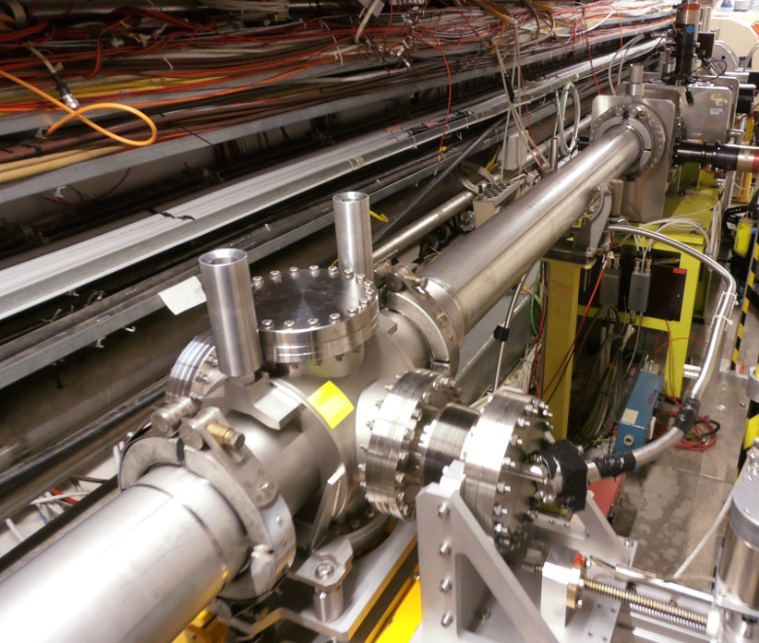
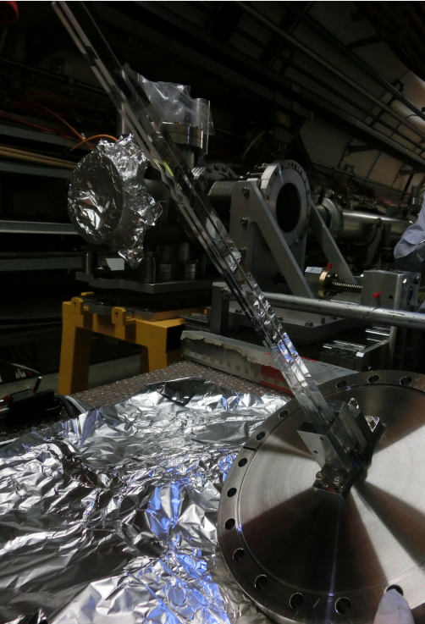
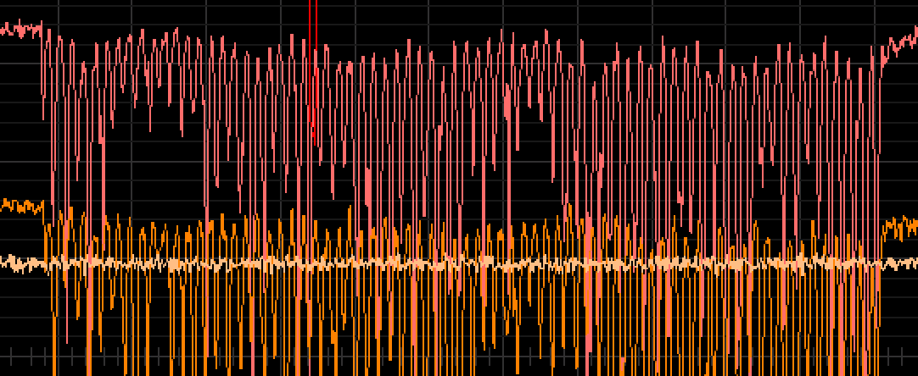
Frontier Detectors for Frontier Physics, Elba, Italy, May 2015
13th Pisa Meeting on Advanced Detectors
UA9 a device for crystal assisted collimation in large hadron colliders
W. Scandale³, D. Breton¹, L. Burmistrov¹, F. Campos¹, G. Cavoto², S. Conforti¹, V. Chaumat¹, M. Garattini ³, Y. Gavrykov ⁴, F. Iacoangeli ², J. Jeglot¹, J. Maalmi¹, S. Montesano ³, V. Puill¹, R. Rossi ², A. Stocchi¹, J.F Vagnucci¹
¹ LAL, Univ Paris-Sud, CNRS/IN2P3, Orsay, France
² INFN Roma, Piazzale A.Moro, 2 00185 Roma Italy
³ CERN - European Organization for Nuclear Research, CH-1211 Geneva 23, Switzerland
⁴ Petersburg Nuclear Physics Institute,188300 Gatchina,Leningrad Region,Russia
Introduction UA9
The use of bent crystals for beam manipulation in particle accelerators is a well-assessed concept rapidly evolving into practical application. Charged particles interacting with a bent crystal can be trapped in channeling states and deflected by the atomic planes of the crystal lattice. One of the possible applications is “smart” collimation system for particle accelerators. The experiments of the UA9 Collaboration at the CERN-SPS have played a key role for a quantitative understanding of channeling and volume reflection mechanisms. The extension of previous experiment to the Large Hadron Collider has received full support from CERN. Investigation of the channeling process close to a circulating beam ideally requires in vacuum detectors resolving the single particle, which should be located inside the vacuum pipe itself. We designed a detection chain, the CpFM (Cherenkov detector for proton Flux Measurement) composed by a fused silica radiator, a long quartz fibers bundle and a photomultiplier readout by the WaveCatcher electronics. All the components except for the electronics have to withstand very high rate of radiation. The layout of the UA9 detectors in the SPS and LHC, both including CpFM detectors, will be presented and the key tests demonstrating crystal assisted collimation concept thoroughly discussed.
Aim: count the number of deflected protons with a precision of about 5% in the LHC environment (mean value over several bunches)
Constraints at the LHC:
inside the primary vacuum → no degassing materials
very hostile radioactive environment → radiation hardness of the detection chain → readout electronics at 300 m
small space available → compact radiator inside the beam pipe
→ small footprint of the photodetector + cables + …. Inside the tunnel
Our proposal:
Radiator: quartz
Photodetector: PMT
Readout electronics: WaveCatcher
CpFM
Cherenkov detector for proton flux measurements
proton
LHC tunnel
Beam vacuum
Location of CpFM inside the LHC
Simulation (Geant4) of the CpFM
Beam tests of the CpFM at BTF (Frascati, Italy) at CERN (H8 line)
π⁺ 180 GeV/c
e- 500 MeV/c
1 < beam intensity< 2000 e-
∼ 22 p.e/p
∼ 42 p.e
Test of “L and I shape” quartz bar
Calibration of the CpFM
Charge histogram of the CpFM1 & CpFM2
Best results with “L shape” quartz bar
p.e number as a function of the position
Signal loss factors
The amount of the detected light is low for the L bar
bad quality of the polishing
CpFM1
CpFM2
Measurements of the attenuation of the signal due to the optical coupling or the long coaxial cable
Internal reflexion of the light inside the quartz bar
Part of the detection chain | Factor of loss
Passage through the Quartz window | 50 %
Fibers bundle and Optical couplings | 20 – 30 %
40 m coaxial cable | 20 %
Good linearity of the chain
Good homogeneity of the response with the impact point on the bar
Quartz L bars not enough polished → using of I bar
All events
Events detected by CpFM
Calibration : 0.2 p.e/incident particle
The CpFM in the SPS
Conclusion
CpFM detector has been successfully tested at the Beam Test Facility at Frascati with electrons of 449 MeV.
Measured resolution of about 15 % can be significantly improved by changing the I-like geometry of the radiator by a L-like. Particle will penetrate thicker radiator hence will produce more light.
Potential problem of this geometry is its polishing quality.
Initial test in the SPS are encouraging. Exploitable signals are provided that allow evaluating the halo flux intercepting the radiator.
Alignment of the quartz bar
with the SPS beam
tank
bellow to put the CpFM in garage position when not in operation
Quartz viewport
Quartz fiber bundle
Background induced by a set of 25 ns spaced bunches circulating in the SPS

