Slide 1
A Compact, High Density Gamma-Detection Module for Time-of-Flight Measurements in PET Applications
I. Sacco, P. Fischer, M. Ritzert
Institute for Computer Engineering, Heidelberg University
A. Gola, C. Piemonte
Fondazione Bruno Kessler
R. Dohle
Micro System Engineering
Pisa Meeting 2015
Isola d’Elba, 24-30 May 2015
Notes:
1

Slide 2
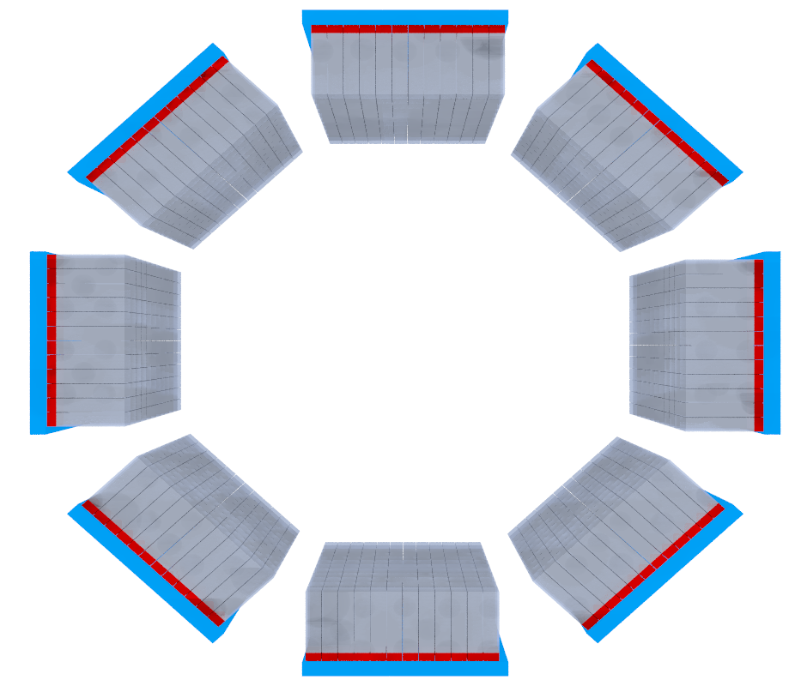
Positron Emission Tomography
Clinical Application
Time of Flight
1:1 coupling LYSO – SiPM
High density channel
detector
Compact and MR
compatible
Ɣ
Ɣ
Pre- clinical Application
Sub-millimeter LYSO
array identification
Light spreader and
neighbor logic
ns-CRT sufficient
Compact and MR
compatible
spatial resolution

Slide 3
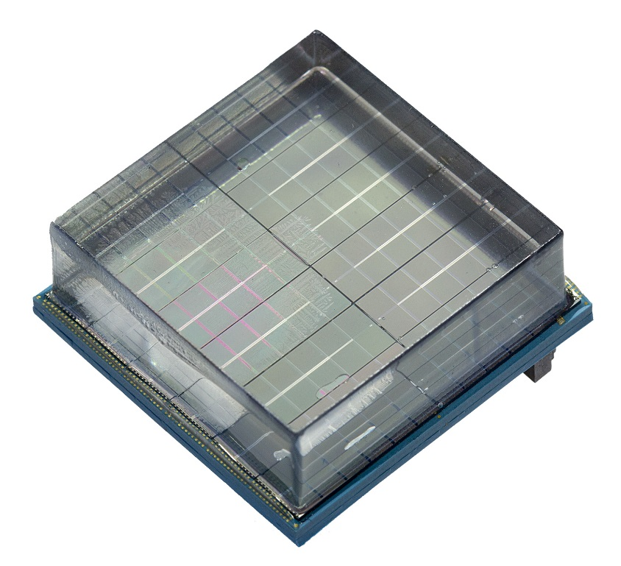
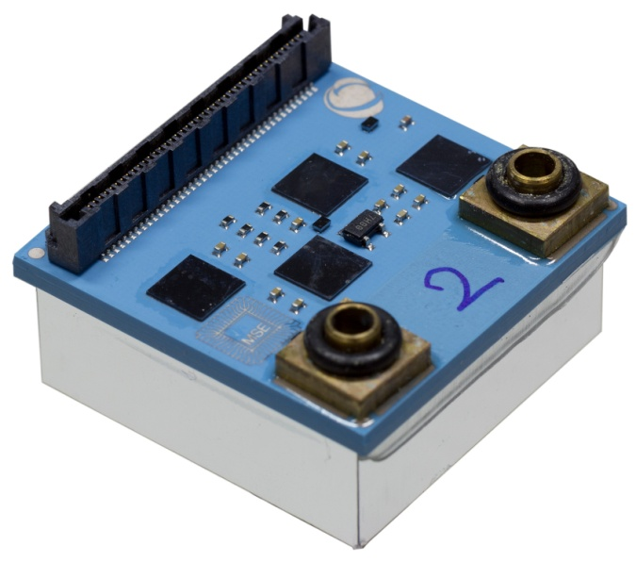
One-layer Detector Module
18mm
30 mm
30 mm
Single Low Temperature Co-fired Ceramic (LTCC)
12×12 SiPM array – 2.5×2.5mm² pitch
Four PETA5 flip-chip mounted – 144 Readout Channels
Integrated liquid cooling within the LTCC
Directly connected to the main readout PCB

Slide 4
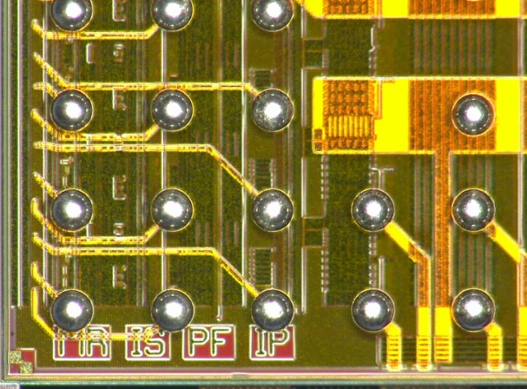
PETA5 Design: Features
Position Energy Timing Asic family
5thASIC generation specialized for SiPM
readout
5 × 5mm² in UMC 180nm technology
bump-bonded with 292µm pitch
36 channels single/differential ended
configuration and control scheme shared up to
4 chips with very few wires
PLL & VCO integrated on chip at reference frequency 622.5MHz
TDC with 50.2 ps bin width from a 16 stage ring differential oscillator
Four groups of neighbor logic fully programmable per half chip
Veto mechanism for low energy events and zero suppression

Slide 5
PETA5 Design: Single-Ended Channel
Inject
Low Impedance
Front-End
Charge Integrator & ADC
gain
Inject
DAC
Input
V_{REF}
Finite State Machine
I_{Ramp}
Initial Condition
SiPM
Discriminator
- HV
Input impedance < 10Ω
Adjustable input DC potential ± 0.4V
Trim Threshold per channel
Power Consumption ~20mW per channel
Th_{N}
V_{CM}
x 4
Th_{P}

Slide 6
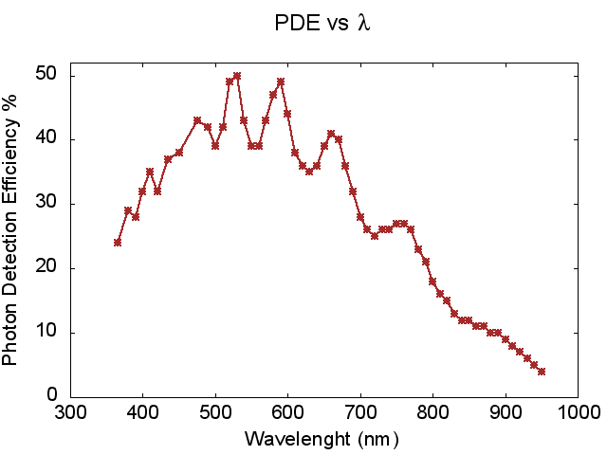
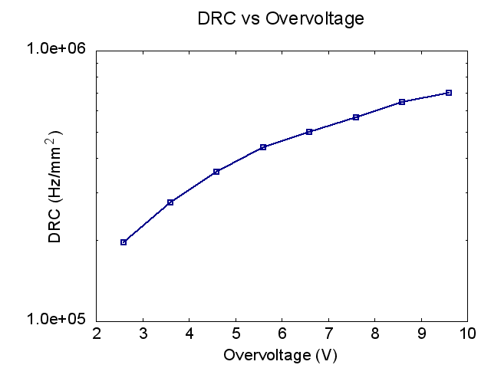
SiPM Design: RGB-HD Technology
Technology developed at Fondazione Bruno Kessler, Trento, Italy
Cell size 25×25µm²
72% of geometrical fill factor
Peak PDE @ 450-600 nm
Breakdown voltage uniformity on the wafer ≤ 0.2V
OV = 8.92V
@ 20°C

Slide 7
144-Channels Module: SiPM Array
Rectangular SiPM dies in a 2×6 geometry – active area 2.25 × 2.25 mm²
Wire-bonding pads at the external edge → no gaps in the active region
Tracks resistance is adjusted depending on SiPM position
5mm
15mm
Regular 2.5mm pitch all over the array
LYSO Array with
ESR + Al+ ESR
reflector for better light collection

Slide 8
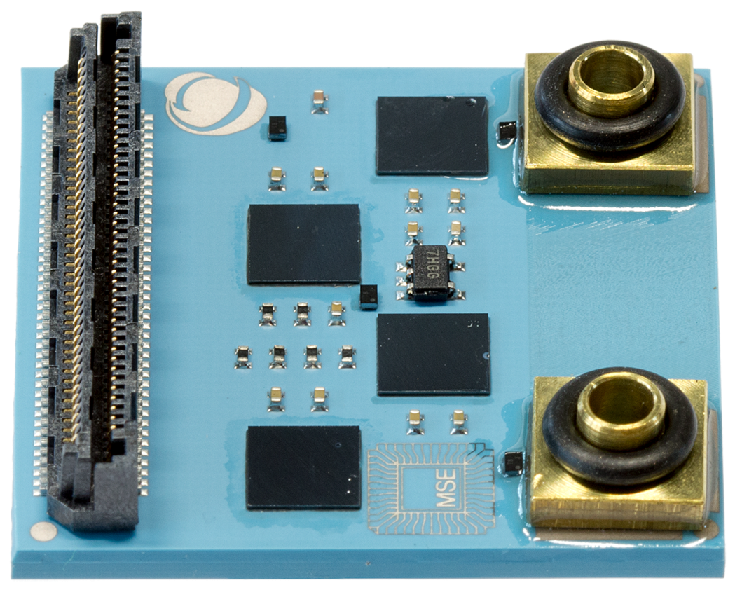
144-Channels Module: Readout and Control
Four PETA5 flip-chip mounted and controlled in parallel
Almost no external component needed
80-pins connectors is sufficient
Inlet/outlet for the internal liquid cooling
temperature I²C sensors
EEPROM memory for configuration
storage
30 mm
termination resistors and decoupling capacitors
30 mm

Slide 9
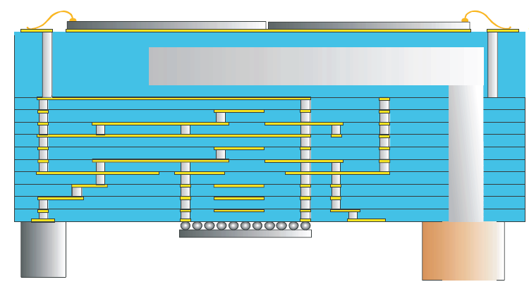
144-Channels Module: Internal Liquid Cooling
Fabricated at Micro System Engineering, Berg, Germany
Cooling channel just below the SiPM array
ΔT ~ 3 K
Room temperature water
Water flow rate ~ 10 ml/sec
Stabilize more than four times
faster than external cooling

Slide 10
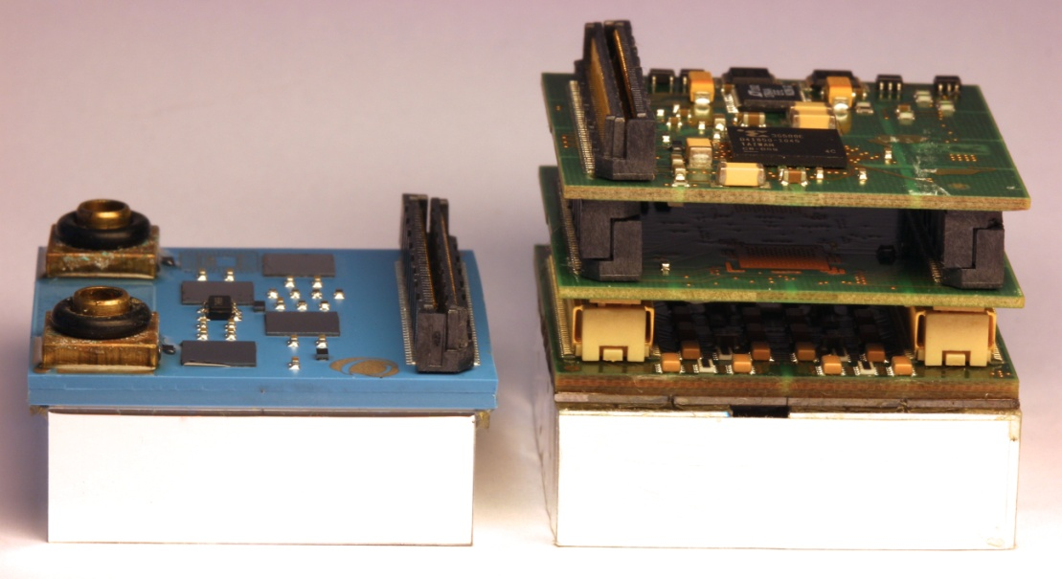
Sublima Detector Module
Sublima Project
HyperImage Project
One LTCC layer
4 flip-chip mounted ASICs
144 Channels
SiPM pitch 2.5×2.5mm²
Internal liquid cooling
Three PCB layers
2 wire-bonded ASICs
64 Channels
SiPM pitch 4×4mm²
External liquid cooling with
copper pipes

Slide 11
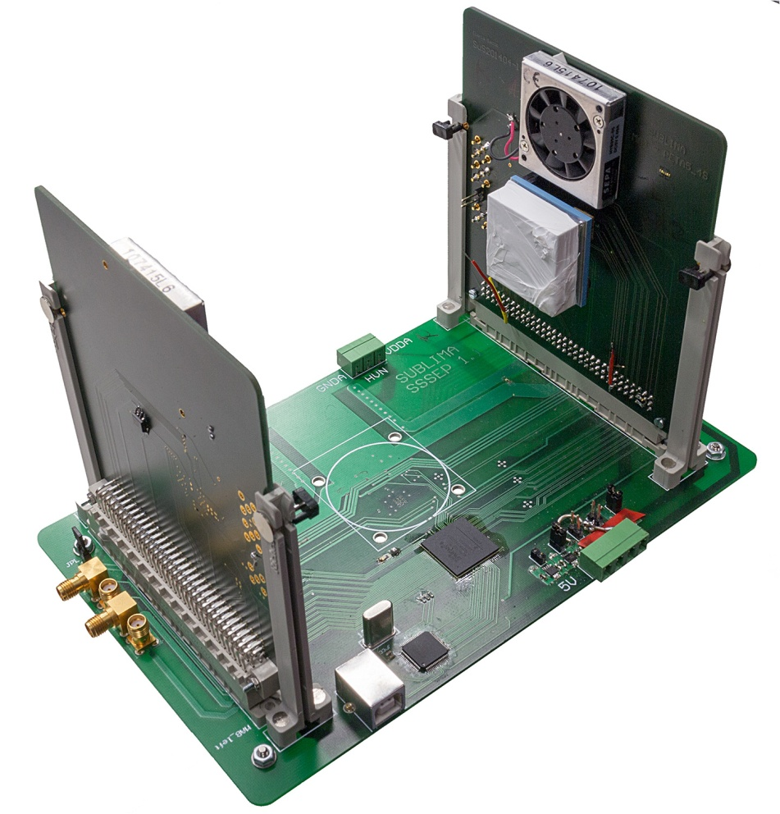
Back-to-Back Setup
Readout main board for two
modules
Synchronized clock from main
board @ 622.5 MHz
Spartan6 FPGA process data
from 8 PETA5 (288 channels)
Rotational stage to emulate
phantom
Distance between tiles ~ 140mm
Full readout
(main PCB + LTCC)
< 10 mm

Slide 12
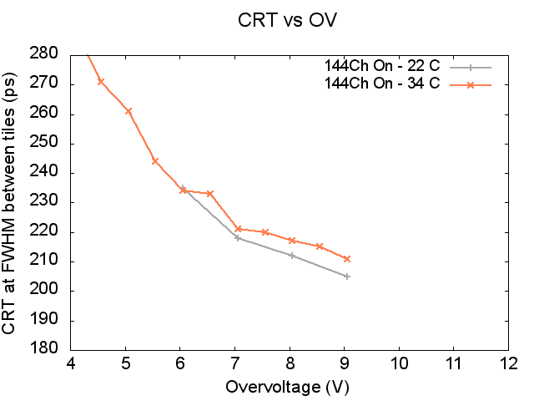
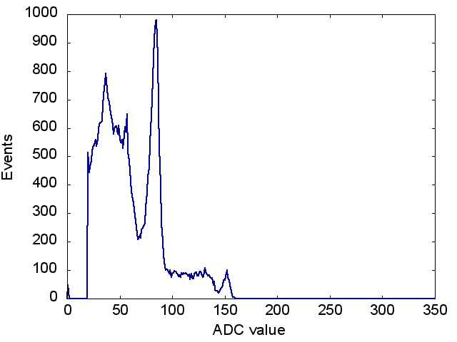
Timing & Energy Resolution
Timing Resolution
144 channels biased per tile
One channel readout per tile
Measurements at 22/34°C
Energy Resolution
Gain per-channel working as
expected
Non-linearity in ADC for large signals
CRT ~ 205 ps @ FWHM
dE/E ~ 14% @ FWHM

Slide 13
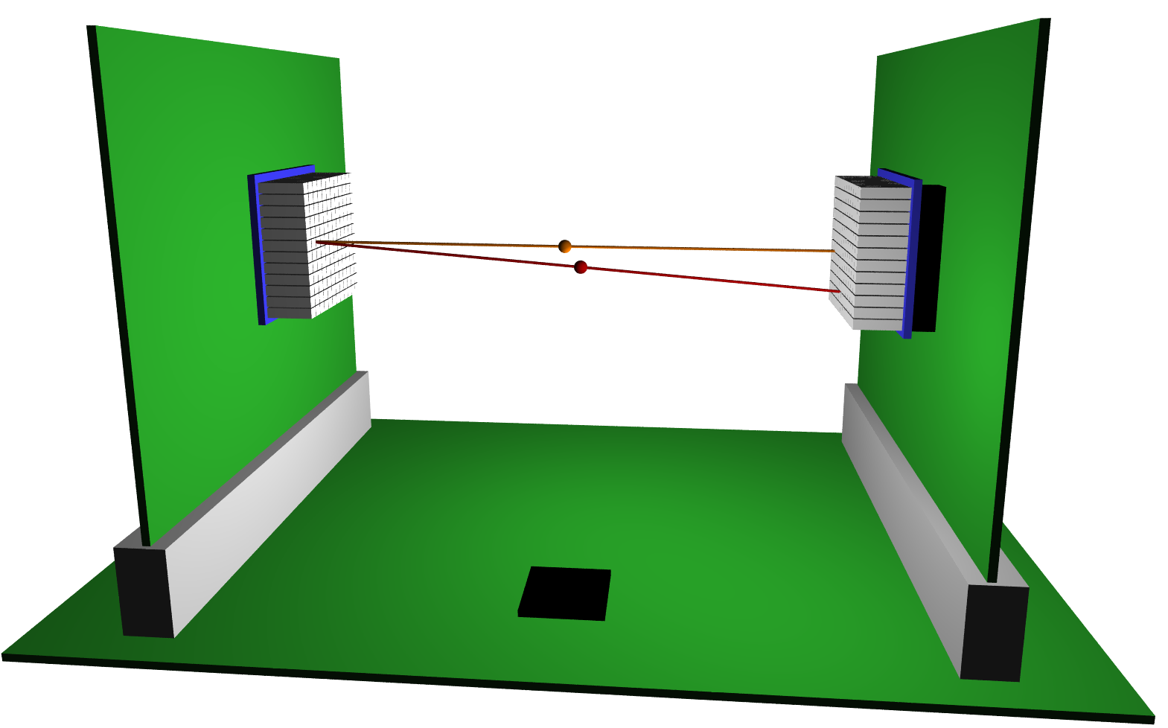
Timing Resolution between Tiles
Timing Resolution between channels on two tiles
The channel-pair that detects a coincidence depends on the source position
B8
A1
B1
B1
A1
A8
A8
B8
Select an area of 18 channels per tile
Move the source to get all the possible correlations

Slide 14
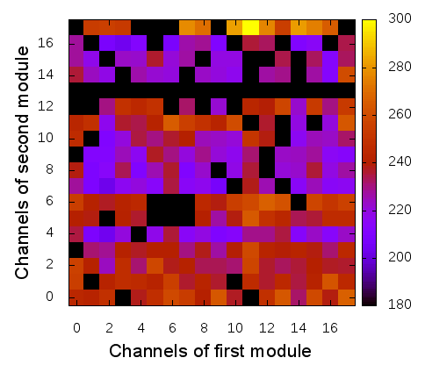
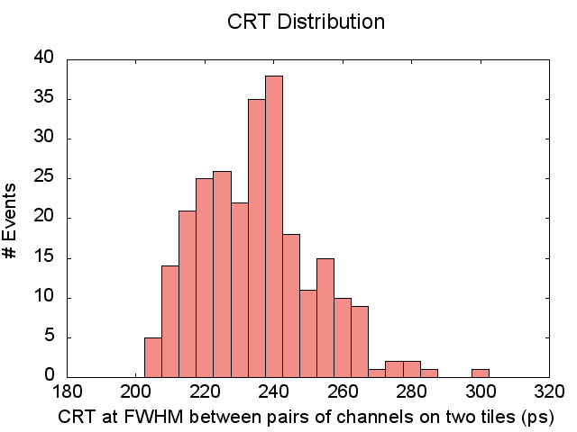
Timing Resolution between Tiles
Timing Resolution between channels on two tiles
The channel-pair that detects a coincidence depends on the source position
not working channel
µ ~ 232 ps
SiPMs with long traces
source position missing

Slide 15
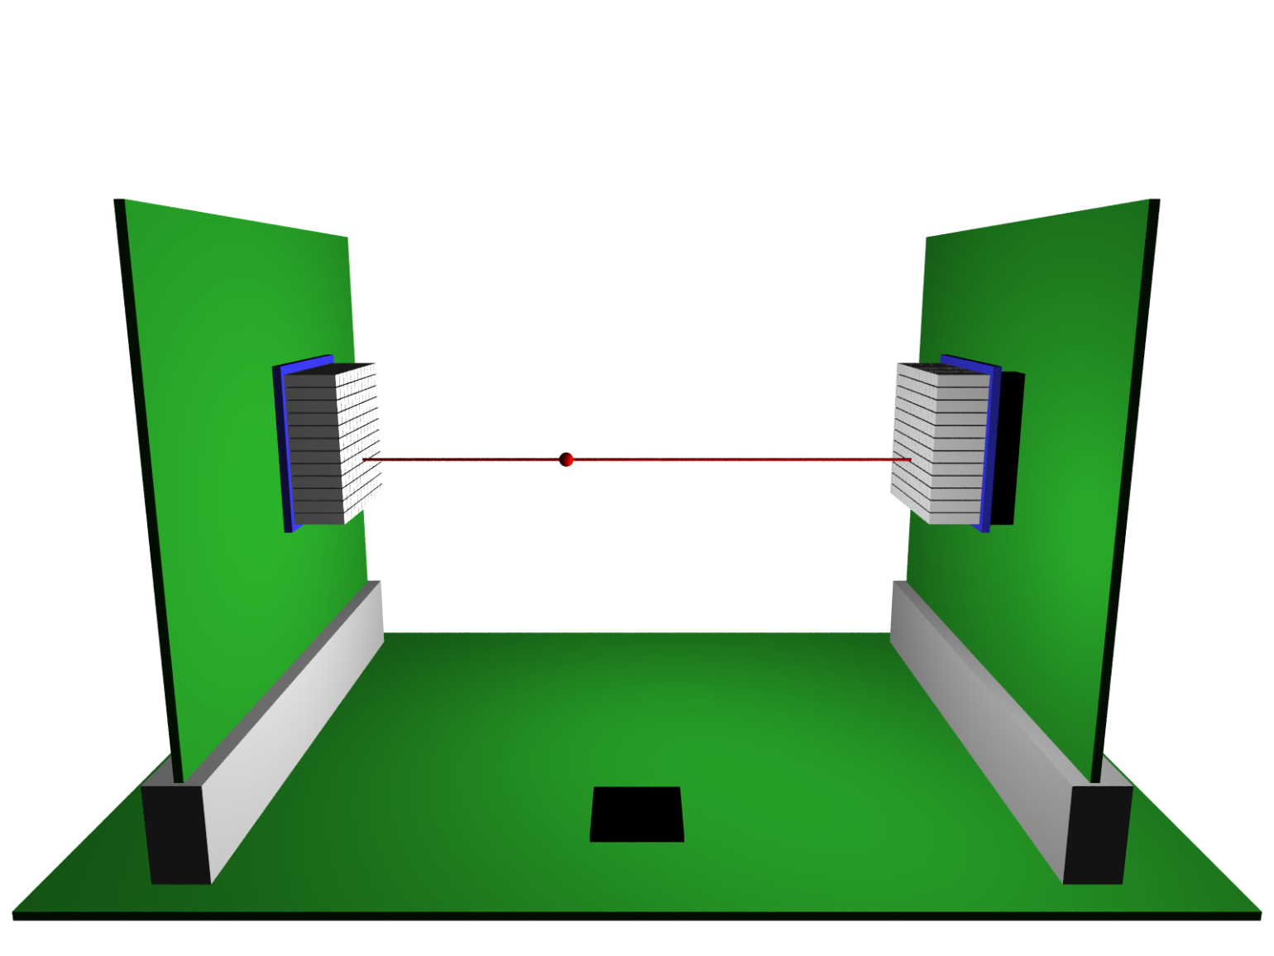
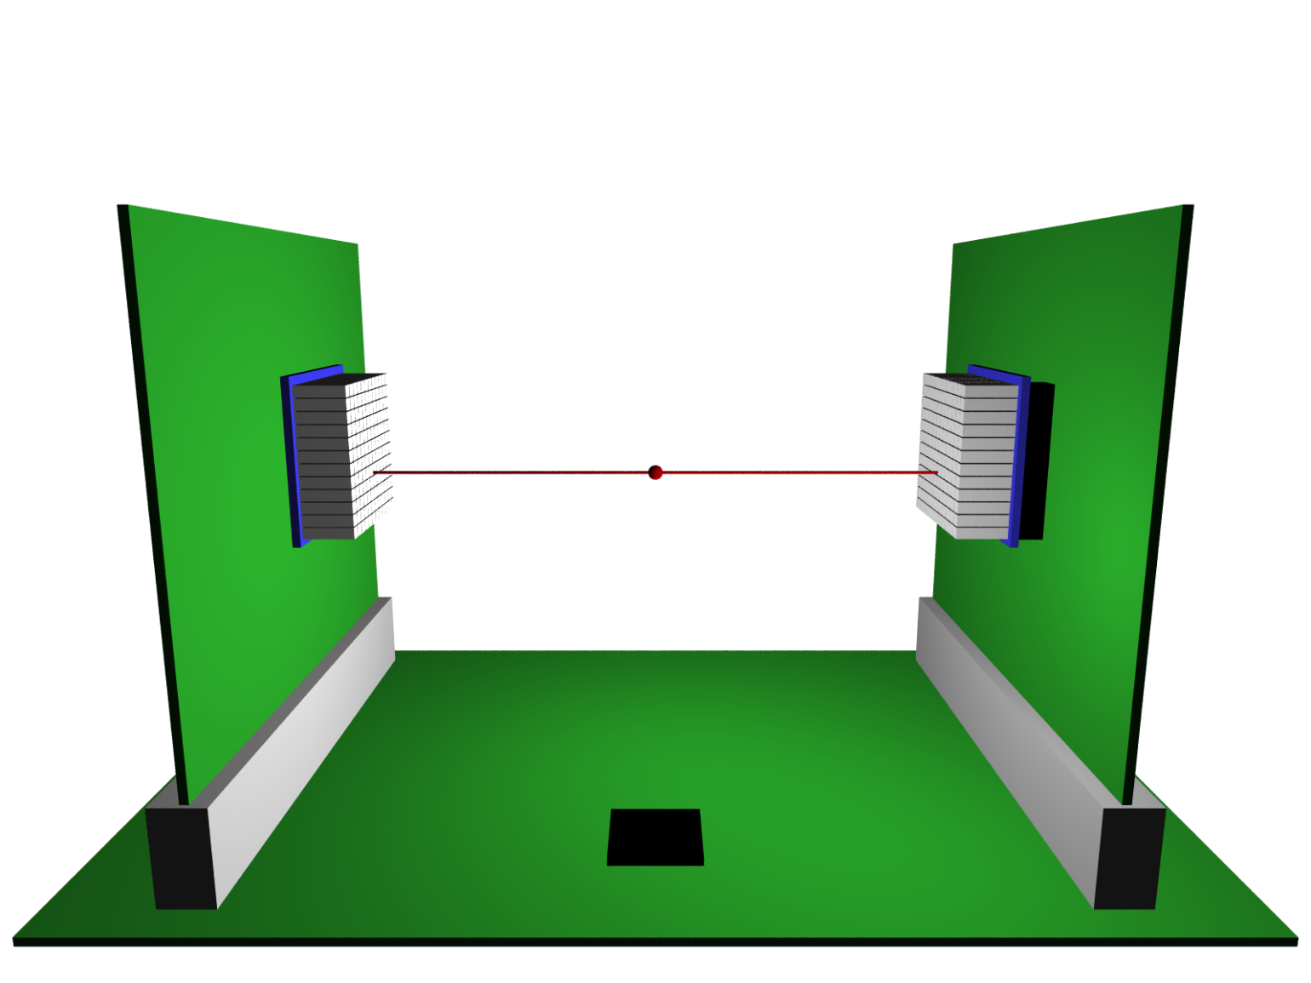
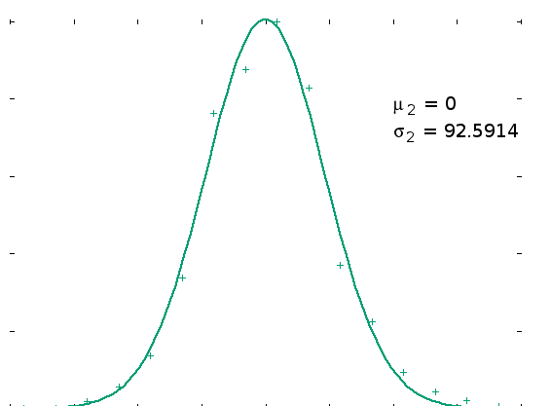
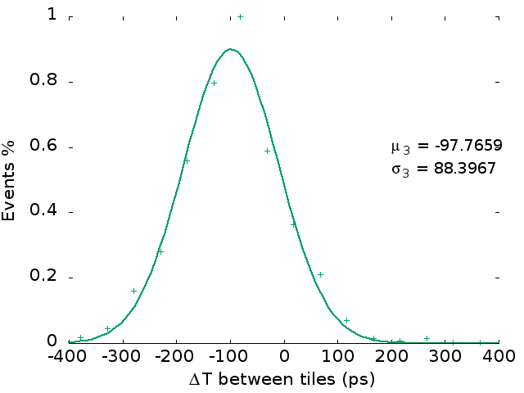
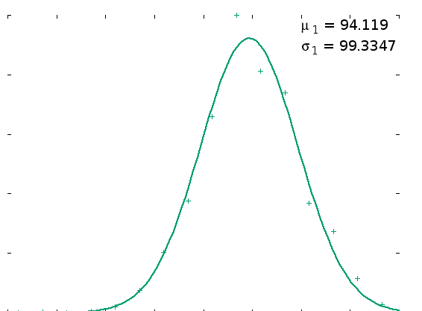
Time-of-Flight Measurements
Using only one channel per tile→ moving the source along the line between them
15mm 15mm
Δx = 0.5 × ΔT× c
100ps 100ps

Slide 16
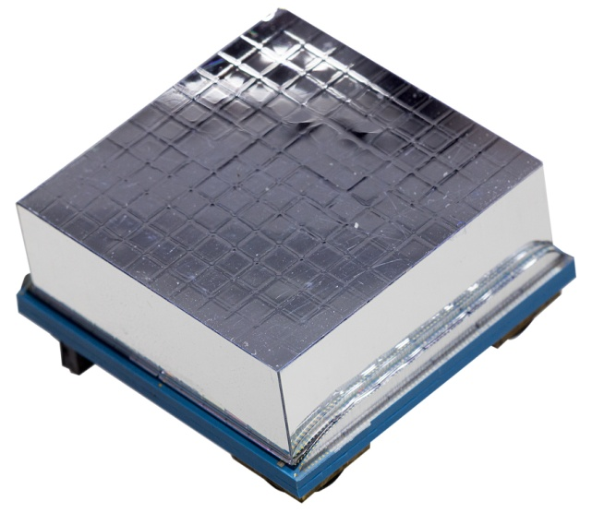
What next?
Goal: module for both humans and small-animals PET applications
Clinical Detector
Preclinical Detectors
LYSO array with 0.8×0.8mm² pitch
1:1 coupling LYSO – SiPM
2.5 mm pitch
ToF
High density channels
Small LYSO pitch
+ Light spreader
High resolution
Neighbor logic
Small LYSO pitch
+ Interpolating SiPMs
High resolution
Simplified neighbor logic
Assembled and working with ToF performance
Measurements ongoing
Assembly in the next weeks

Slide 17
Conclusions
Successfully operated a very compact gamma-detection module
The module contains ALL functionalities for a MR compatible PET
readout: SiPMs, ADCs, TDCs, Cooling
The modules have excellent timing performance of 230 ps CRT at room
temperature providing good ToF performance
The latest generation of FBK SiPMs should provide even better timing
The spatial granularity is only 2.5mm, smaller than typical clinical systems
We expect very high spatial resolutions with light spreader readout
and with specialized SiPMs as well

Slide 18
Thank you!
This work has been supported by the European Union under the 7th framework program Grant Agreement #24171
Notes:
18

