Slide 1
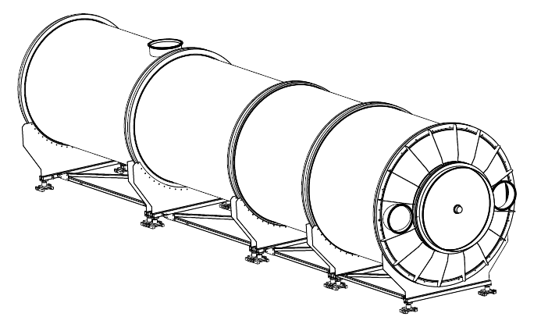
Performances of the NA62 RICH detector
Francesca Bucci
INFN, Sezione di Firenze
on behalf of the NA62 collaboration
RICH Working Group:
CERN, Firenze INFN and University, Perugia INFN and University

Slide 2
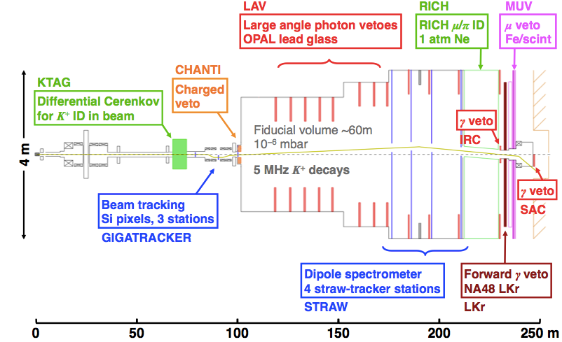
The NA62 Experiment
Fixed target experiment at the CERN Super Proton Synchrotron
NA62 primary goal: Measure BR(K⁺→π⁺νν) with 10% accuracy by collecting O(100) SM events in 3 years of data taking
One of the theoretically cleanest channel in flavor physics
BR(K⁺→π⁺νν) = (7.81± 0.75 ± 0.29)×10⁻¹¹ [Phys. Rev. D83 (2011) 034030]
2012-2014: Detector Installation
October 2014: NA62 Pilot Run
2015-2016-2017: Physics Runs

Slide 3
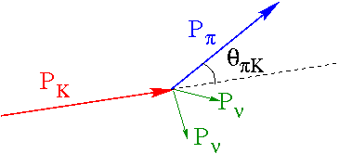
The NA62 Challenge
Suppression of decay channels with BR ≥ 10¹⁰ BR(K⁺→π⁺νν)
and similar experimental signature: BR(K⁺→μ⁺ν)=63.4%
Need good kinematic rejection: 10⁻⁵ (GTK+STRAW)
Need good PID: muon veto 10⁻⁵ (MUV), pion identification with muon contamination <10⁻² (RICH)
Need precise timing: 100 ps both upstream (GTK) and downstream (RICH) the decay region

Slide 4
RICH Requirements
Suppress the μ contamination in the π sample by a factor of at least 100 between 15 and 35 GeV/c momentum
Measure the pion crossing time with a resolution of about 100 ps
Produce the L0 trigger for a charged track

Slide 5
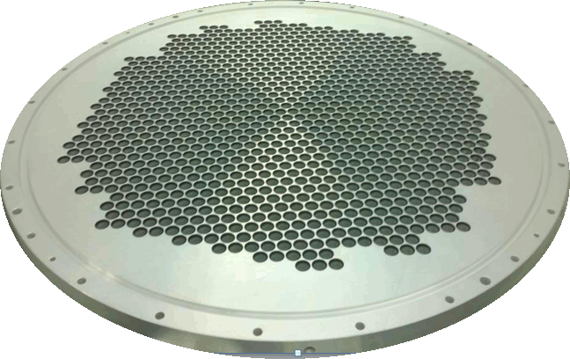
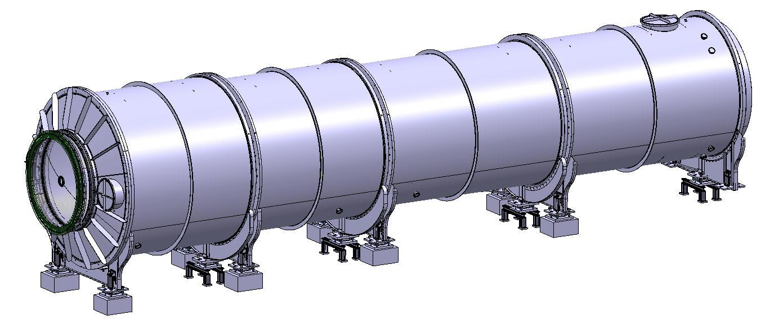
The Rich Layout
2 × ∼1000 PMTs
Mirror Mosaic (17m focal length)
Beam
Beam Pipe
Vessel: ∼17 m long

Slide 6
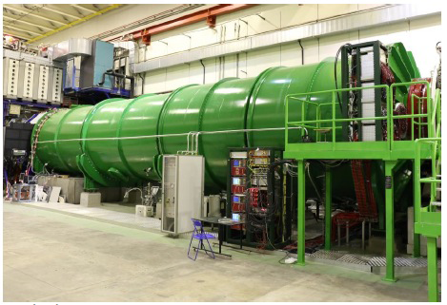
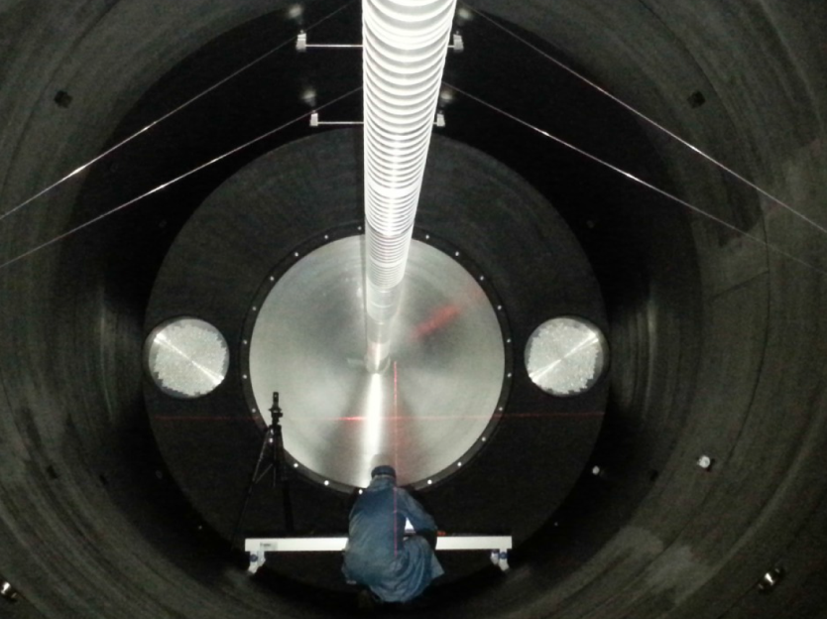
RICH Vessel
Vacuum proof tank
17 m long made of structural steel
subdivided into 4 cylindrical sections of decreasing diameter (4→3.4 m) and different lenghts
beam pipe (∅ 168 mm) going through
thin Al entrance and exit windows

Slide 7
RICH Radiator
RICH vessel has an overall volume of 200 m³
Neon slightly above atmospheric pressure at room temperature
(n-1) = 62.8×10⁻⁶ at λ = 300 nm
p_{threshold} = m/√ (n² -1) = 12.5 GeV/c for π
Good light trasparency in visible and near UV, low chromatic dispersion
RICH performances rather immune to impurities
operated with a sealed gas volume without gas renewal
During the pilot run the leak rate was much smaller than 0.1 mbar l/s

Slide 8
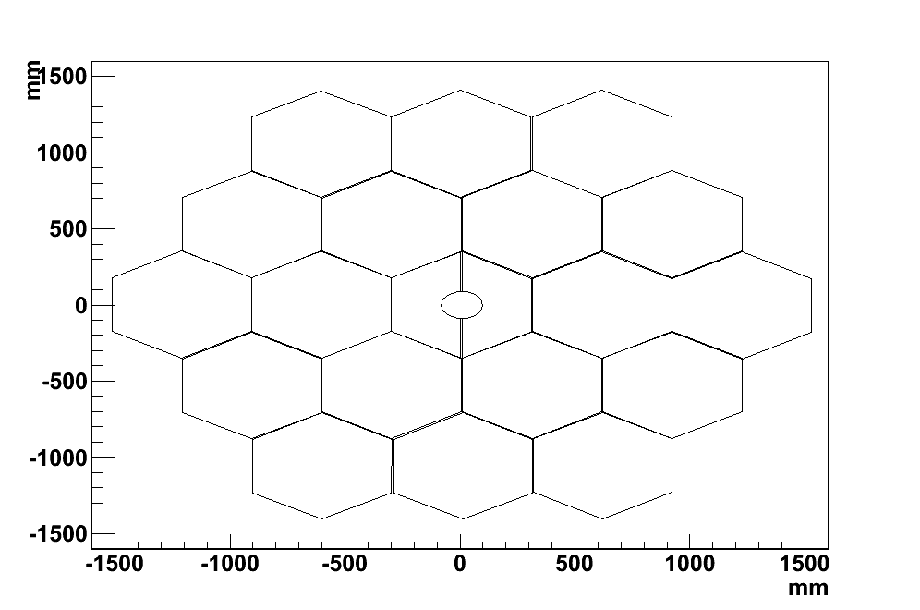
RICH Mirror
A mosaic of 20 spherical mirrors used to reflect the Cherenkov light
18 hexagonal mirrors (35 cm side)
2 semi-hex with pipe hole
2.5 cm thick glass coated with Al
Thin dielectric film added
Optical parameters
R=(34.0±0.2) m
Average reflectivity > 90% (195-650 nm)
D₀ ≤ 4 mm

Slide 9
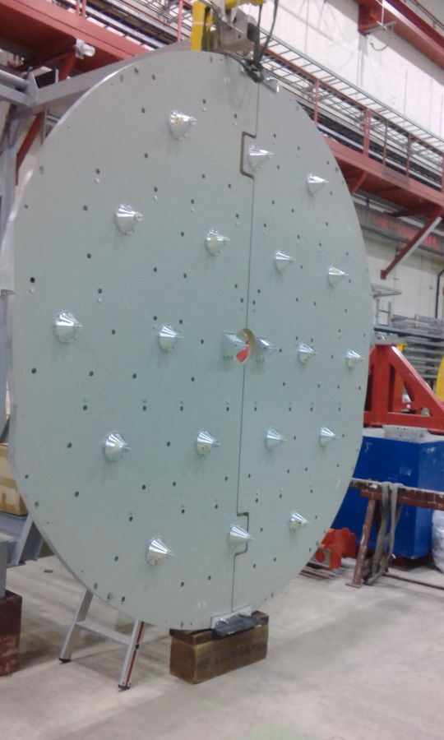
Mirrors Support
Al honeycomb structure, 5 cm thick, chosen as mirror support panel
Mirrors are supported by a dowel inserted in the back and connected to the panel
Two thin aluminium ribbons keep the mirror in equilibrium and allow its orientation
A third vertical ribbon is used to avoid mirror rotations
The semi-hexagonal mirrors have two holes and a single ribbon
Piezo motors, out of the acceptance, allow a remotely controlled orientation
Preliminary mirrors alignment by using laser

Slide 10
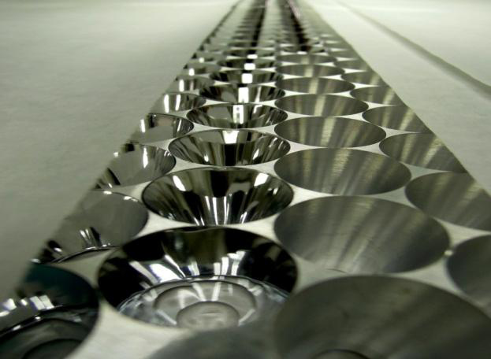
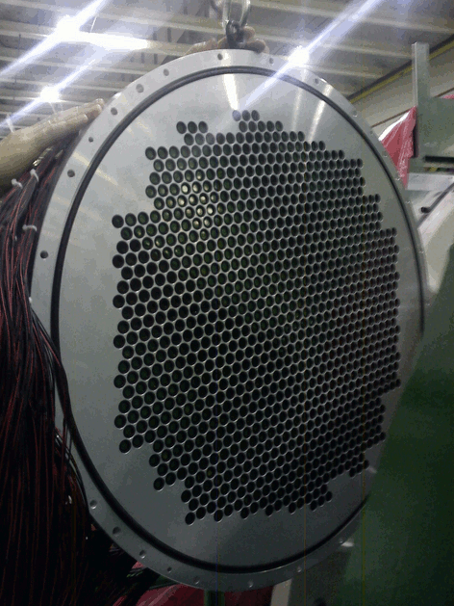
RICH Photo-Detection System
The reflected light is collected by 1952 PMTs with 18 mm pixel size
The PMTs are assembled in a compact hexagonal packing into 2 aluminium disks placed at the upstream endcap
Light is collected by means of Winston cones with aluminized mylar foil
Quartz windows to separate neon from air

Slide 11
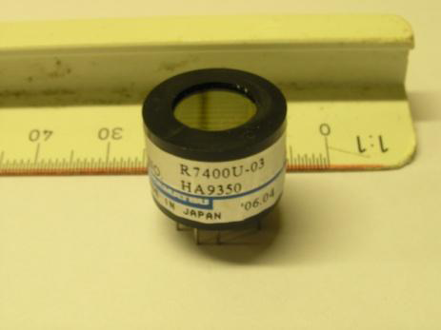
RICH PMTs
Hamamatsu R7400U-03
UV glass window, 16 mm ∅ (8 mm active ∅)
Custom made HV divider
Sensitivity range 185-650 nm (420 nm peak)
Gain 1.5×10⁶ at 900 V
Q.E. ∼ 20% at peak
280 ps time jitter (FWHM)

Slide 12
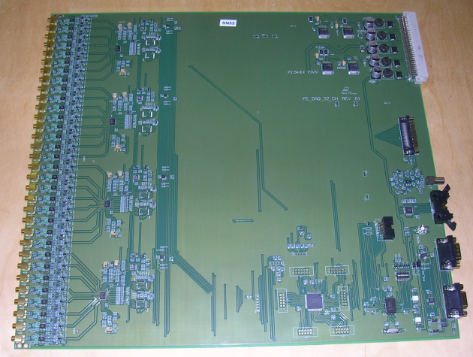
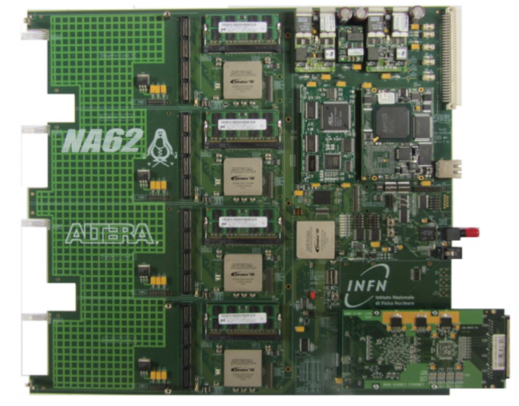
RICH Front-End and Read-Out System
RICH front-end
Custom-made current amplifiers with differential output
NINO chips used as discriminators
64 boards
Each boards has 32 channels
RICH read-out:
128 channels TDC daughter Boards (TDCB), each one housing 4 CERN HPTDC (High Performance TDC)
5 TEL62 mother boards (4 for the 2000 PMTs, 1 for the multiplicity read-out used to produce the L0 trigger), each one housing 4 TDCBs

Slide 13
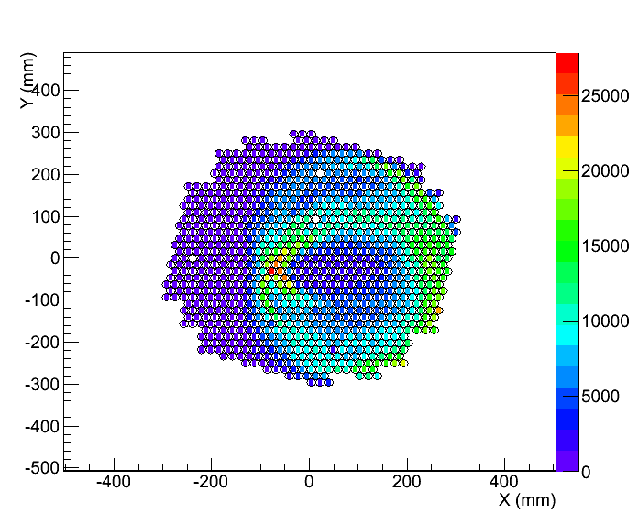
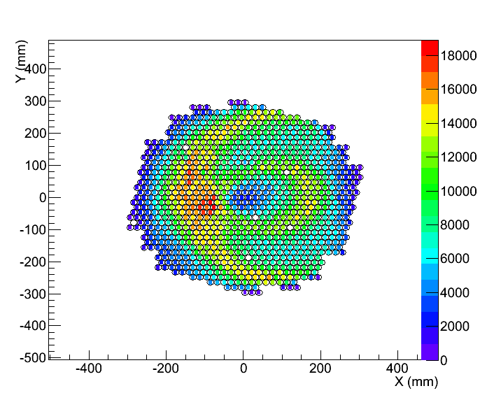
RICH Commissioning
RICH installation completed at the beginning of NA62 Pilot Run in 2014:
Two-months first physics data taking with (almost) full setup(*)
Commissioning of hardware and readout with particles at 5% of beam intensity
Select π⁺sample from K⁺→π⁺π⁰decays reconstructing the π⁰ from LKr information
Jura
Saleve
(*) GTK, STRAW and MUV detectors partially equipped

Slide 14
Tests and Results
In 2014 Pilot Run STRAW detector partially equipped
(STRAW data not available during the RUN)
The RICH remote alignment plan could not be fulfilled
Select K⁺→π⁺π⁰ decay using only LKr information
Extrapolate the selected charged tracks to the RICH mirror
Compare the predicted position of the ring center with the one from the fit
Try and raise one mirror in Y with piezomotors
Mirror | Δx (cm) (before) | Δx (cm) (after) | Δy (cm) (before) | Δy (cm) (after)
20 | -0.8±0.2 | -1.0±0.1 | -0.7±0.1 | 1.4±0.1
Movement of mirror 20 in y : 2.1±0.1 cm as expected

Slide 15
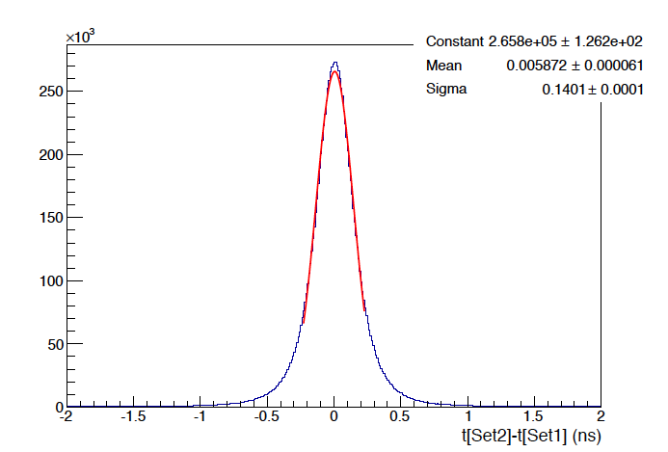
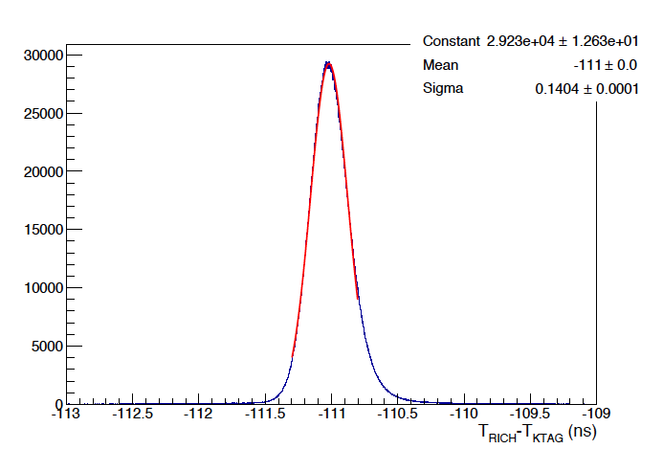
Tests and Results
The RICH event time resolution is about 70 ps
σ = 140 ps = 2 * event time resolution
Event time resolution measured by splitting the hits of a Cherenkov ring in two halves and computing the difference of the average times
Difference between the average time of a Cherenkov ring and the KTAG time

Slide 16
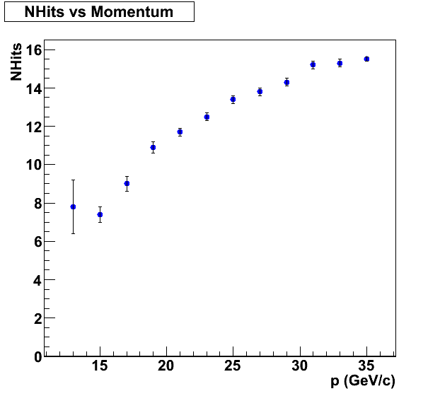
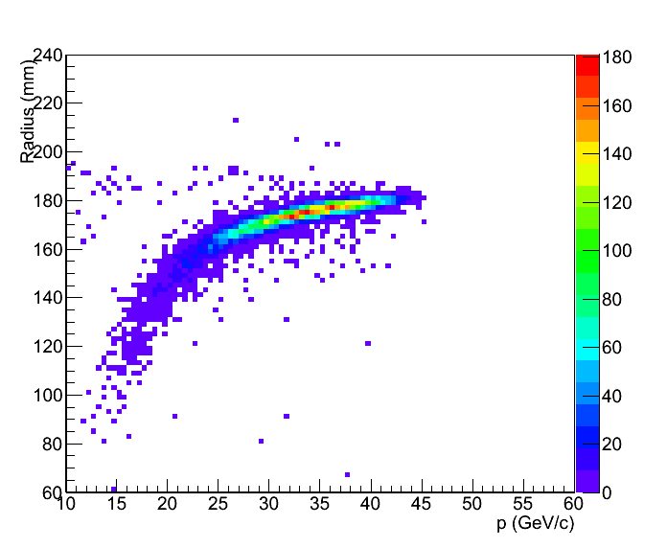
Tests and Results
π⁺ sample from K⁺→π⁺π⁰ decays selected without spectrometer information
Nhits vs Momentum
Radius vs Momentum

Slide 17
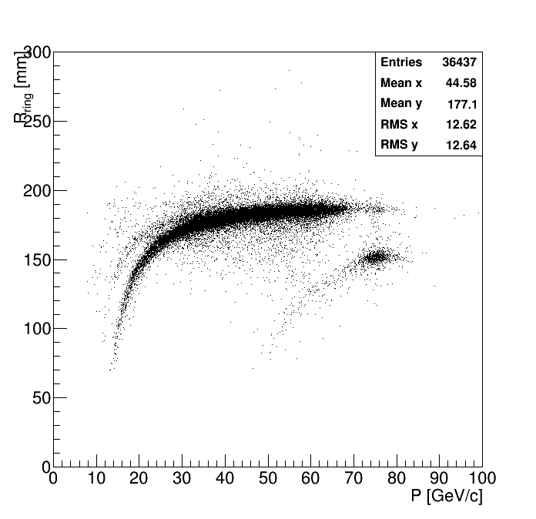
Tests and Results
Only recently we had access to the spectrometer information
Radius vs Momentum
μ⁺
π⁺
K⁺
A small fraction of the beam entered the detector during the 2014 run

Slide 18
Conclusions
NA62 beam line ready
Detector installation completed
2014 Pilot Physics Run
RICH fully commissioned
Preliminary results show that RICH is performing as expected
The 2015 Run will allow to understand better the RICH performances
RICH will provide the necessary information for the 2015 physics analysis

