Slide 1
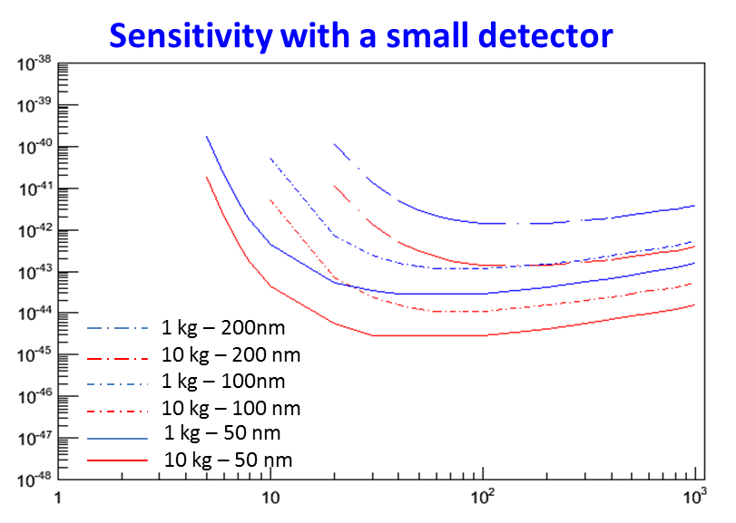
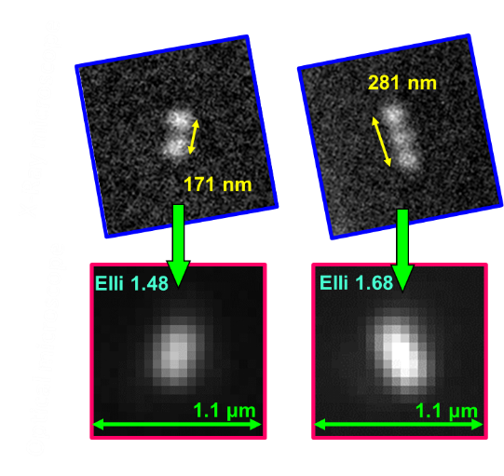
Development of a super-resolution optical microscope for directional Dark Matter search experiment Andrey Alexandrov (INFN-Napoli) on behalf of the NEWS collaboration
NEWS – Nuclear Emulsion Wimp Search experiment will use a novel technique for DM search with a capability of detecting the directionality of recoils
Nuclear emulsion advantages:
High density, ~4 g/cm³ (acts both as a target and a tracking detector)
Extreme spatial resolution (limited by a crystal size, few tens of nm)
No electronics is required in target area during the exposure
Nano Imaging Tracker (NIT) - new emulsion type available:
Extremely low fog level (the number of thermally excited crystals)
Not sensitive to electrons
20 nm crystal size, ~29 crystals/µm – under testing
The goal of the presented R&D is to build a microscope capable of detecting 100nm-long recoil tracks in NIT emulsions and measuring their direction
Problem: resolution of optical microscopes is limited by diffraction (to approx. 200 nm) –> Grains are not resolved and a track is seen as a single spot (a cluster)
Cross Section [cm²]
WIMP Mass [GeV/c²]
Detector mass
Track length threshold

Slide 2
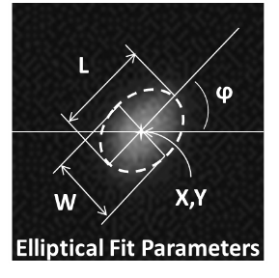
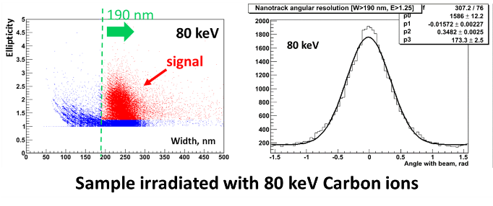
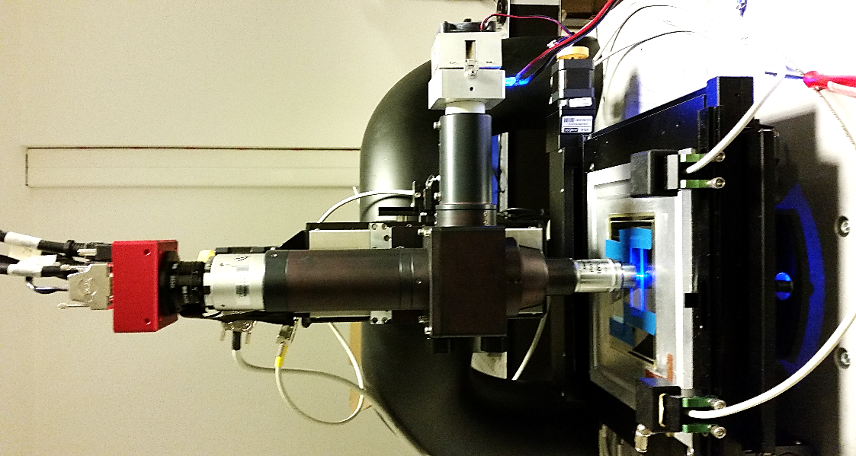
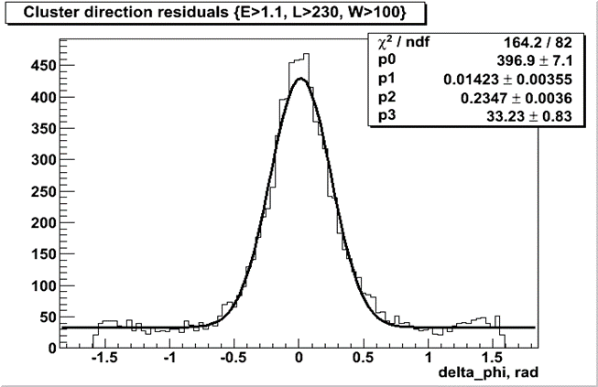
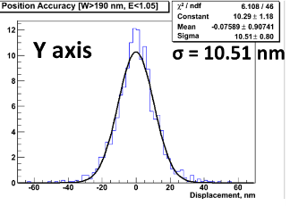
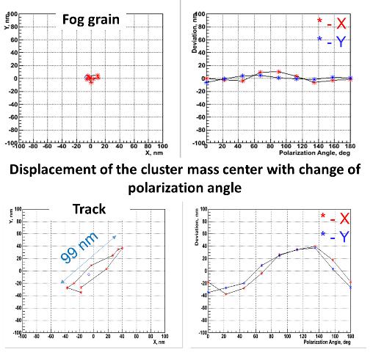
Development of a super-resolution optical microscope for directional Dark Matter search experiment Andrey Alexandrov (INFN-Napoli) on behalf of the NEWS collaboration
Though the individual grains are not resolved the track’s shape becomes elliptical while images of fog grains remain circular
Use elliptical fit to detect direction and select track candidates
Angular resolution by elliptical fit = 235 mrad = 13°
Developed Ag grains are not spherical -> scattered light is polarized -> grain brightness changes with polarizer rotation
Position accuracy = 10.5 nm
By analyzing images of one and the same track under different polarization angles it is possible not only distinguish tracks from fog grains but also to isolate individual grains inside the track!
With the use of Elliptical Fit and Polarization Analysis the detection of 100nm-long tracks is possible!
Bonito CL/CMC-4000
CMOS Camera
4 Mpix
Rotatable Polarizer
Magnifying lens,
Nikon VM C-2.5x
UV LED λ=406 nm
Nikon Oil Objective
100x, 1.45 N.A., Plan Apo
Optical resolution: 207 nm
Dig. resolution: 27 nm/pixel
View Size: 65 x 48 µm

