Slide 1




Poster Review
“Solid State Detectors” or
26 posters in 20 minutes
Anthony Affolder
University of Liverpool
Frank Hartmann
Karlsruhe Institute of Technology

Slide 2
Overview
Lots of great posters- go check them out!!

Slide 3
Current Systems
BCMs
Luminosity Monitors

Slide 4
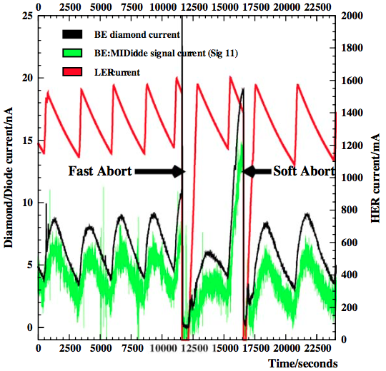
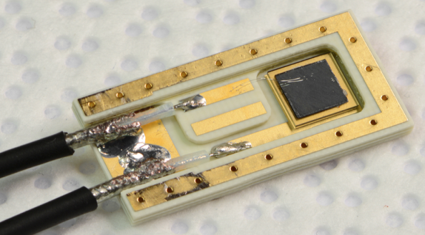
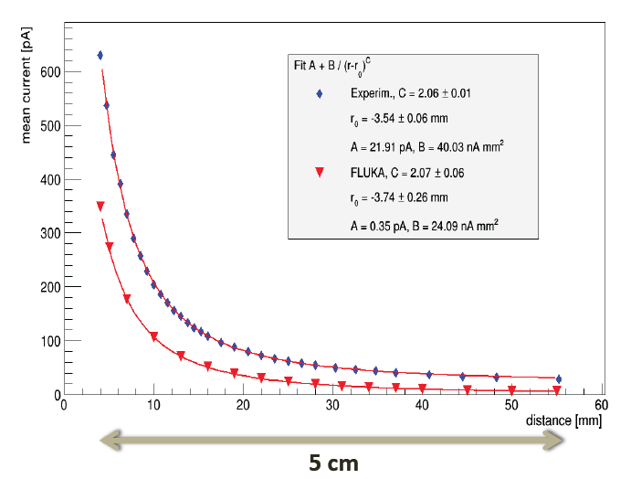
Belle-II VXD radiation monitoring and beam abort with sCVD diamond sensors
Lorenzo Vitale, Belle-II SVD collaboration INFN and Univ. Trieste, ITALY
Requirements
  Measurement of instantaneous dose rates & integrated doses
    sensitivity O(1 mrad/s = 10 μGy/s), sampling rate O(100 KHz)
  Beam Abort for excessive beam losses affecting PXD, SVD
    “Fast” (10-100 μs) “slow” (ms), “very slow” (> 1s) Beam Abort triggers
    Programmable “intelligent” thresholds, depending on accelerator conditions
Conceptual design
  Diamond sensor measures currents
    Typical pCVD sensor (10 × 10 × 0.5) mm³: 1 nA = 7 mrad/s = 70 μGy/s
  4 + 4 sensors near PXD
  6 + 6 sensors near SVD
Current I vs distance d of ⁹⁰Sr β source
measurement
Prototypes progressing to system
Diamonds: State of the art for beam monitoring
simulation
4

Slide 5
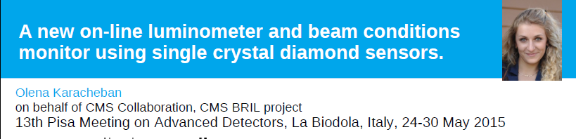
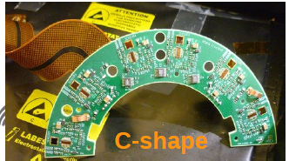
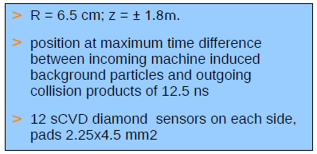
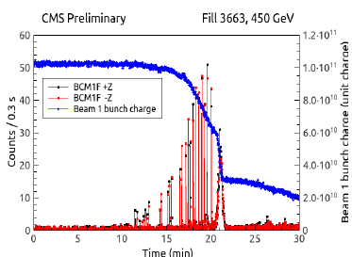
System ongoing commissioning
First measurements already made with beam

Slide 6


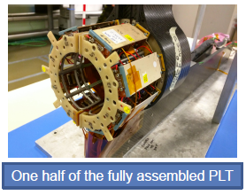
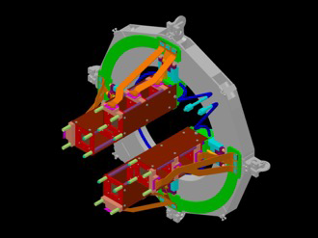
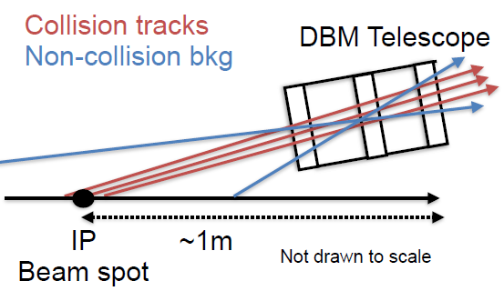
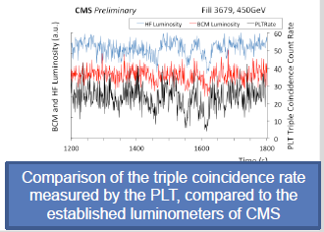
Telescopes for Luminosity Measurements
The CMS Pixel Luminosity Telescope
The ATLAS Diamond Beam Monitor
Andreas Kornmayer
Doug Schaefer
4 tracking telescopes per side with 3 pixels sensors
3 diamond, 1 Si
8 tracking telescopes per side with 3 Si pixels sensors
Both measure luminosity bunch-by-bunch by track counting
See next Pisa meeting to see which technology choice is optimal

Slide 7
Future Silicon Systems
CBM
Belle Upgrade
HL-LHC Upgrades
CLIC

Slide 8
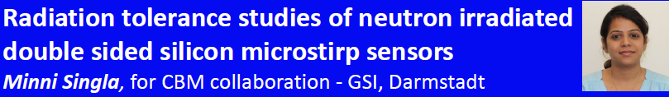
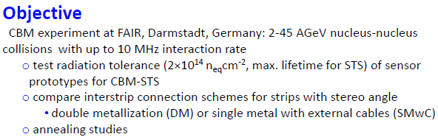
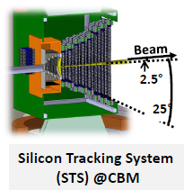
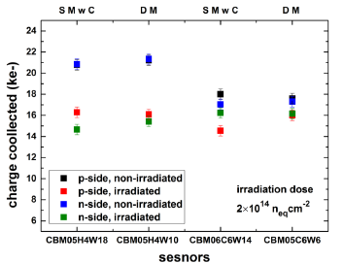
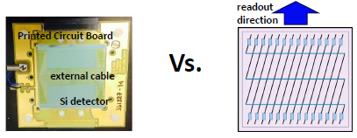
Tried and tested technologies finding new uses

Slide 9
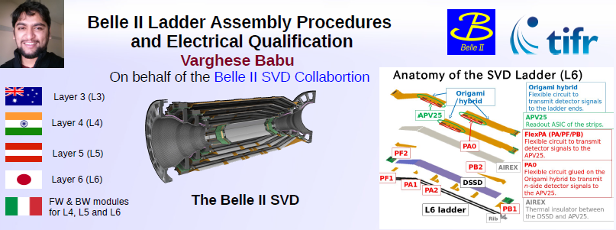
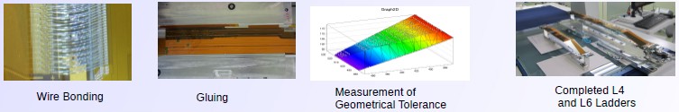
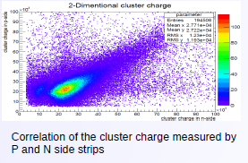
Standard double-sided modules pushed to the extreme in material reduction

Slide 10
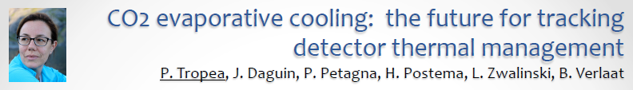
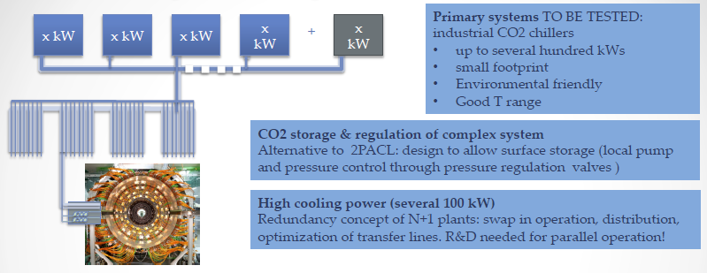
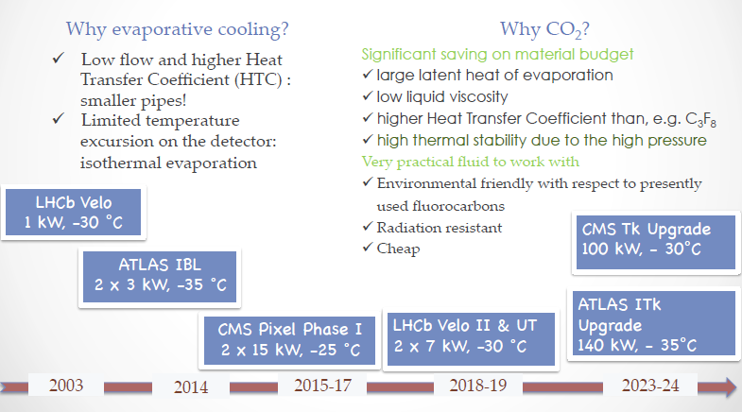
These three are already built
CO2 cooling is the baseline for LHC upgrades
Expertize exists. Just need to upscale to 100s of KW ☺
CERN becoming a CO₂ plant factory

Slide 11


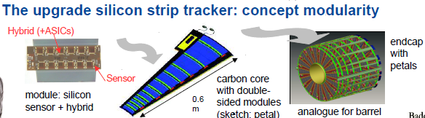
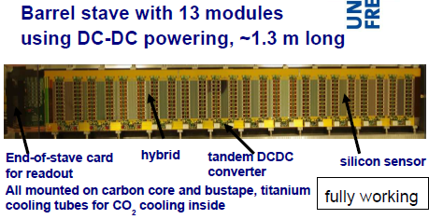
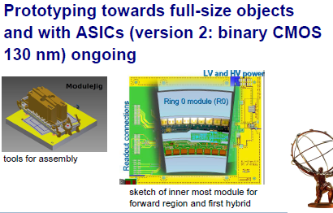
~200 m² of silicon
~5x segmentation of LHC
Less material, more power
Prototyping well underway. Solutions for powering and cooling understood. Extremely integrated and designed for production.

Slide 12

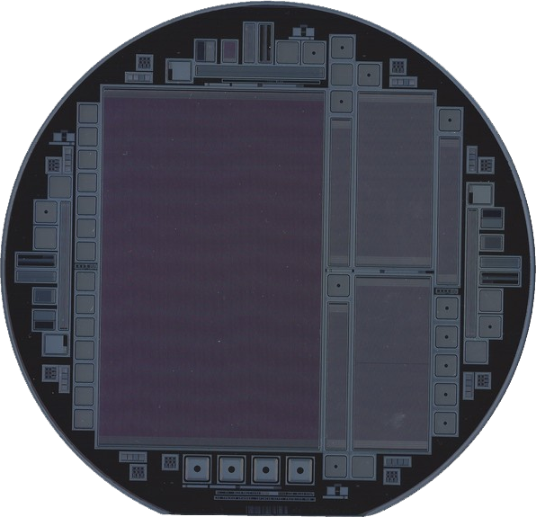
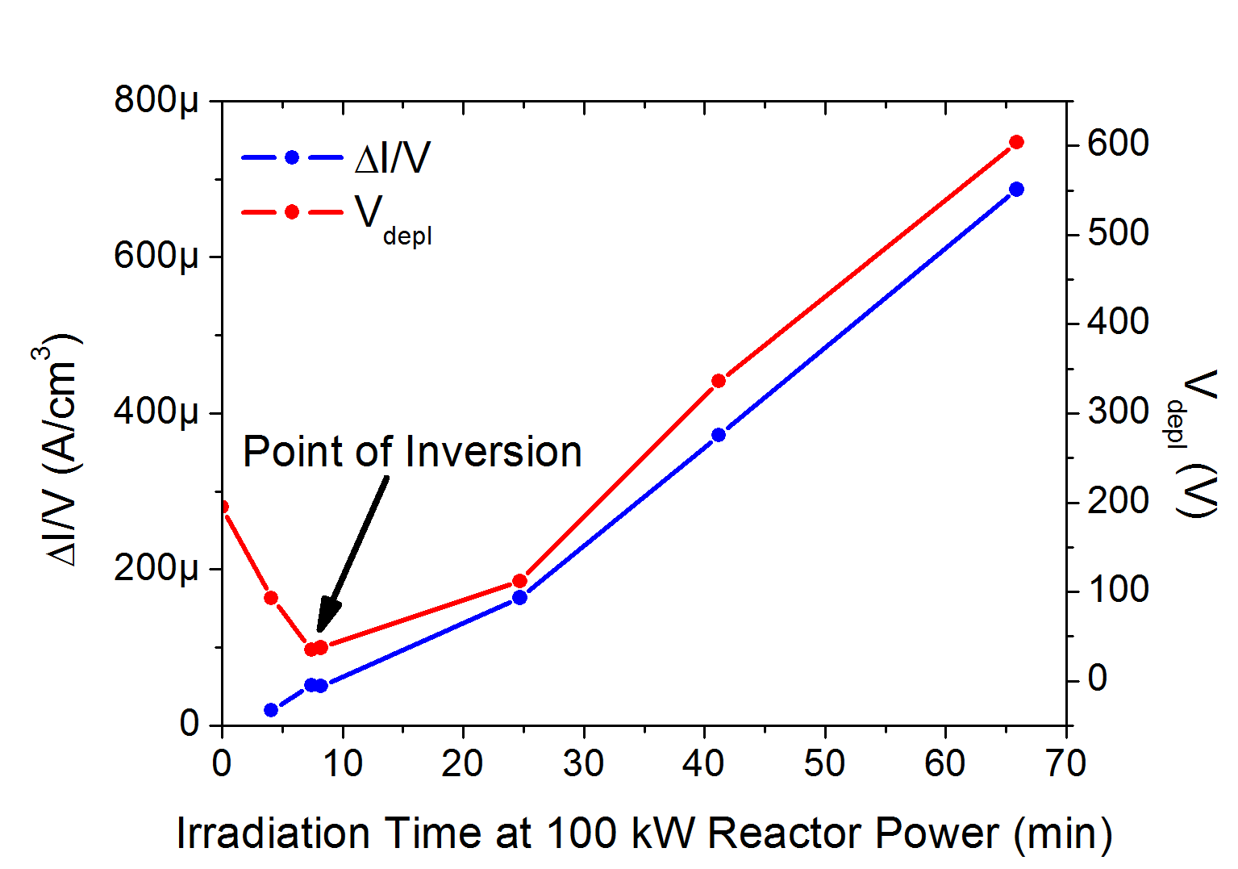
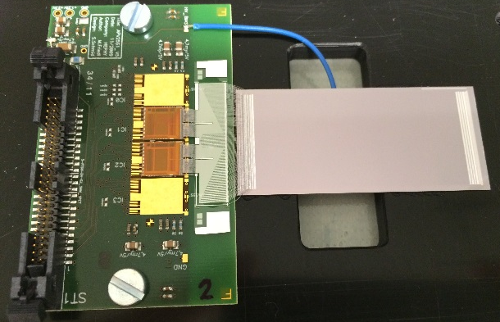
Developing Silicon Strip Detectors with a large-scale commercial foundry
A. König, T. Bergauer, M. Dragicevic, W. Treberspurg
We are developing a production process for planar 6 inch p-on-n Silicon Strip Sensors with the European semiconductor manufacturer Infineon Technologies
More than 40 wafers each comprising 6 different sensors were delivered and characterized
Beam Test
Irradiation
Finding/developing additional large-scale vendors critical to HL-LHC upgrades
First n-in-p sensors (and 8”) of great interest

Slide 13

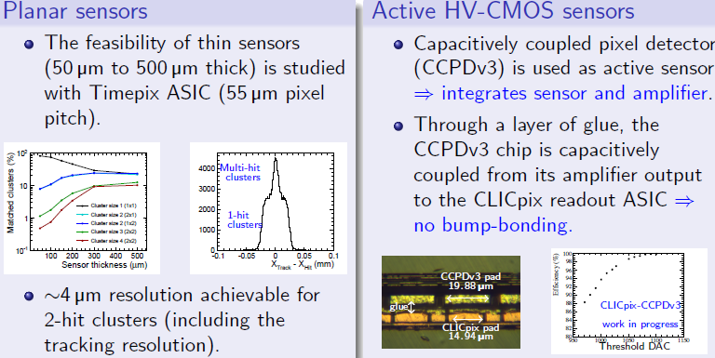
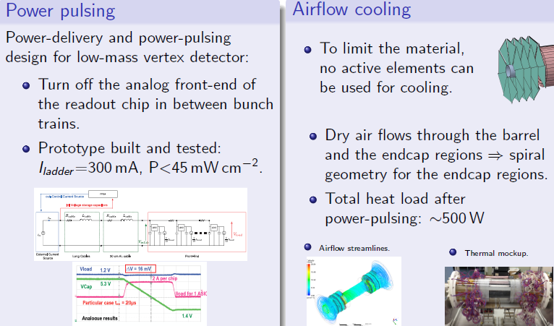
Niloufar Alipour Tehrani
Requirements:
Single point resolution of 3 μm: 25 μm pixels with analogue readout
Time slicing to ~10 ns
Material budget of <0.2% X₀ per layer -> 50 μm thick sensors and ASICs
Extremely challenging to meet these requirements with a hybrid pixel detector of this size
Time-scales allow time for development of this (and others e.g. full-MAPs) technologies

Slide 14
Evaluation/Simulations
Device Characterization
Device simulation for layout
Device simulation for evolution

Slide 15
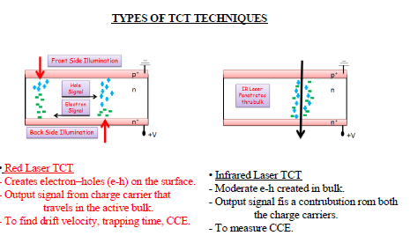
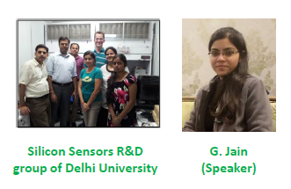
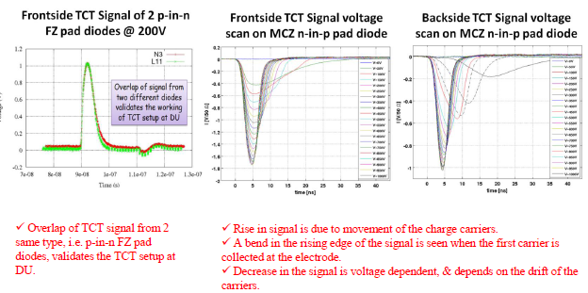
Past specialist tools are becoming the standard for quality control.
Allows for more direct understanding of fields/drift velocities within device.
Directly applicable to simulation.

Slide 16

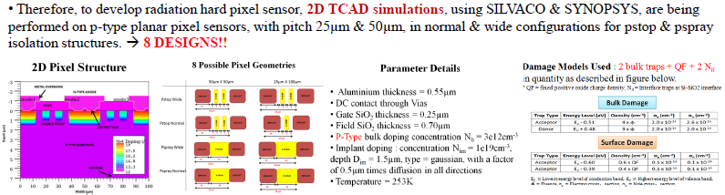
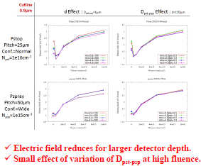
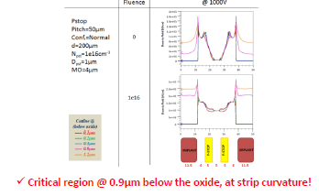
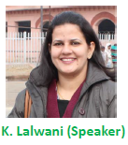
Using simulation of drive design choices

Slide 17
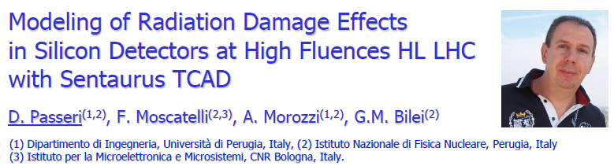
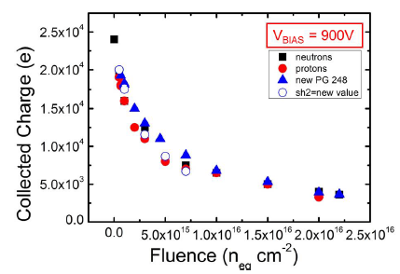
Extending prediction to HL-LHC radiation damage level
Based on 3 deep traps, oxide/interface trap states and physical models for charge multiplication
First simulation with quantitative agreement with experimental data covering full HL-LHC lifetime!!
Needs to be cross-checked with additional data (different device thicknesses)
Can be hugely powerful for optimization for HL-LHC pixel layouts

Slide 18
Silicon Drift Devices
Device Simulation
X-ray fluoresence spectrography
SIDDHARTA

Slide 19
Generalization of the One Dimensional Modeling and Design Considerations of Spiral Si Drift Detectors: Flat (Straight) Drift Channels and Constant Drift Fields
Manwen Liu and Zheng Li*
School of Materials Science and Engineering,Xiangtan University, Xiangtan 411105, China
A Spiral SDD in square shape
Optimum drift path gives a minimum drift time
of carriers from point S₁ to point S₂
Calculus of variations is used to find surface E-field profiles that gives
the best drift path: a straight line (“flat”) with constant drift field

Slide 20
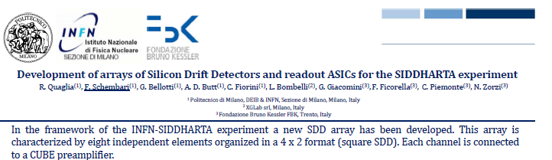
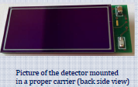
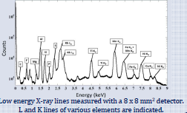
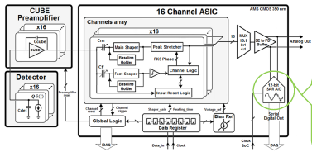
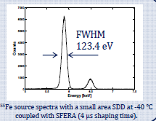
Silicon Drift Detectors finding new areas (X-ray spectroscopy of kaonic atom transitions)

Slide 21
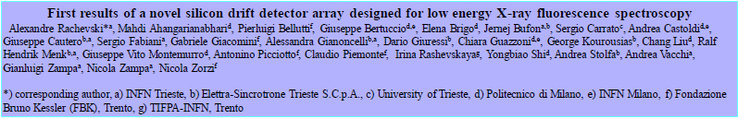
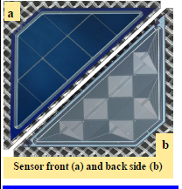
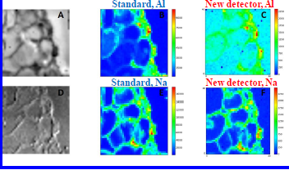
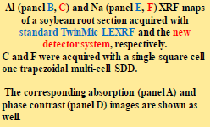
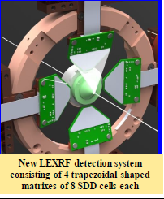
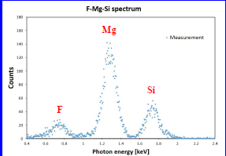

Silicon Drift Detectors finding new areas (X-ray fluorescence spectroscopy)

Slide 22
3d Device Development
Active edges
3d Sensors

Slide 23








Design and TCAD simulation of planar p-on-n active-edge pixel sensors for the next generation of FELs
Gian-Franco Dalla Betta, on behalf of the PixFEL Collaboration (UniPI, UniPV, UniTN, INFN)
Wafer layout
Active edge sensor
STRUCTURE & LAYOUT
high density interconnects
low density peripheral TSVs
Bond pads
bump bonding
low density bump bond
high density TSVs
Readout chip
Active edge sensor
front-end + ADC
memory + digital readout
Four-side buttable module for the assembly of large area detectors
Rectangular Slim Edge trenches
Columnar Slim Edge trenches
Scribe Line
Scribe Line
Layouts for different border terminations
Scribe Line
Scribe Line
Contact holes
Trenches
Columns
GR4
GR4
GR4
Active Edge
GR3
GR3
GR3
GR2
Trench
GR2
GR2
GR1
GR1
GR1
4 Guardring structure
6 Guardring structure
Active edges are finding niche uses. ~150 μm inactive edges achievable.
Costs/yields needs to be improved to be used more widely
8 Guardring structure
10 Guardring structure

Slide 24








Thin 3D Si Radiation Sensors for HL-LHC
M. Boscardin^{1,3} ; G.-F. Dalla Betta^{2,3}; R. Mendicino^{2,3}; D M S Sultan^{2,3}; S. Ronchin¹; N. Zorzi^{1,3}; G. Darbo⁴; M. Meschini⁵; A. Messineo^{6, 7}
¹FBK, Italy; ²UniTN Italy; ³TIFPA-INFN, Trento; ⁴INFN Genova; ⁵INFN Firenze; ⁶INFN Pisa; ⁷University of Pisa, Italy
Proposed fabrication approach
First wafer layout
(ready for fabrication)
Simulated Signal Efficiency
L
L
3d silicon is still be targeted for inner regions of HL-LHC detectors.
Some tension between column diameter and depth with smaller pixel size
Costs/yields needs to be improved to be used more widely.

Slide 25
CMOS/MAPs
HR CMOS active sensors
HV CMOS active sensors
SOI active sensors
MAPs

Slide 26
CMOS Overview
CMOS sensors (MAPs) are viewed as the future for our field
  Could easily have a full conference on just this topic
Developing on two tracks (active sensors with standard CMOS ROCs and full MAPs)
  Impressive progress on the understanding for signal development and radiation tolerance
Company | Technology Size | HV/HR | Stitching
AMS | 350 nm | HV | No
Tower Jazz | 180 nm | HR | Yes
AMS | 180 nm | HV | No
XFAB SOI | 180 nm | HV | No
Tosiba | 130 nm | HR | ??
Technology nodes under study in poster session

Slide 27







(Sadly NO) First results from the Over-depleted CMOS Monolithic Active Pixel Sensor project (OverMOS)
No HV Standard
Jens Dopke
High resistivity (HR) CMOS sensor with low doped epitaxial layers allowing full depletion of the sensor (bias of ~6-30 V)
  TowerJazz HR 180 nm CMOS
Should collect all charge through drift, faster than previous high resistivity approaches
Submitted with different geometries for active cell, to evaluate implementations for pixel- and strip-like detector and evaluate timing vs. fill-factors
  P-epi on P substrate (electrons)
  P-epi on N substrate (holes)
Preparing for a second submission with a full active sensor implementation
<0ns
0ns
15ns
Study of “Imaging” technology with stitching
Radiation tolerance still need to be demonstrated
27

Slide 28





No HV Standard
First tests are promising.
Needs further development to show radiation tolerance and systems potential

Slide 29


HVCMOS Detectors – Overview
Ivan Peric
High-voltage CMOS (HVCMOS) pixel sensors are depleted active pixel sensors implemented in standard CMOS processes.
Applications
  Mu3e:developed a 4 mm x 4 mm large detector prototype MuPix (monolithic HVCMOS detector) in AMS 180 nm technology.
  ATLAS pixels: Five TS in 180 nm and two in 350 nm AMS technology. Smart HVCMOS sensor readout with the pixel readout ASIC FEI4. Capacitive signal transmission used instead bump bonds.
  ATLAS strips:HVCMOS sensors (AMS 350nm technology)
  CLIC: HVCMOS active sensor capacitively coupled to CLICPIX ASIC – 25µm x 25µm pixels.
Within HVCMOS, we are planning several engineering runs in 350nm and 180nm technologies with increased substrate resistivity (20 Ω cm standard vs. 80 Ωcm – 2 kΩcm)
Strontium-90 signal after proton irradiation to 2 x 10¹⁵n_{eq}/cm² ~ 3600e. Signal to noise ratio after proton irradiation ~ 20.
HV Standard
HVCMOS detector is based on the triple-well structure: A deep n-well in p-substrate is used as charge-collecting electrode.The entire CMOS pixel electronics are placed inside the deep n-well.
Irradiated to 10¹⁵ n_{eq}/cm² with neutrons
HVCMOS has (almost) demonstrated radiation hardness
Huge potential for future detectors
Important open questions are: how much digital functionality can be include and how best to make large systems (10s-100s m²)

Slide 30








Radiation-hard CMOS: XFAB SOI Monolithic
Heinz Pernegger
Monolithic test chip in XFAB 180nm SOI process: Electronics isolated from substrate through oxide (BOX)
Small collection well (capacitance!) and no competing wells in p-substrate with 100 Ω cm CZ (1 kΩ cm possible)
HV up to 300V
Irradiated up to 700Mrad TID and 5x10¹⁴ neq
No back-gate effect observed in irradiation: electronics isolated from substrate
Only very small V_thr shifts (<80mV)
Substrate bias possible >300V
n-irradiated
Charge [e-] vs (Voltage)^{1/2}
SOI with 300 V HV demonstrated
XFAB SOI has a large potential for radiation tolerance due to high bias potential
Potential of digital circuitry needs to be explored
Needs to be developed into larger devices with costs and yields demonstrated
XTB01 - No P-stop
DPW (P-Stop) reduces leakage and leads to high breakdown voltage >300V
XTB02 – With P-stop

Slide 31






One of first systems using AMS 180 HVCMOS.
Huge potential for understanding the process and its evolution

Slide 32
Future Materials
Graphene
Sapphire

Slide 33




Potential cost-effective replacement of diamond.
Charge collection efficiency and uniformity needs to improve greatly.
Polarization effects may become an issue for high rate experiments

Slide 34





Graphene-based Field Effect Transistors as Radiation Sensors
Just beginning… stay tuned for results in the future

