Slide 1
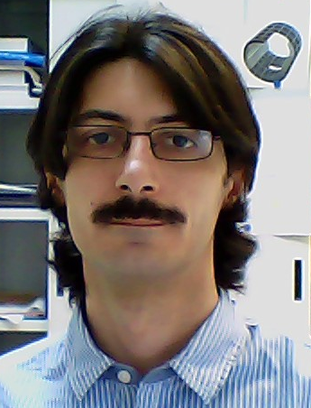
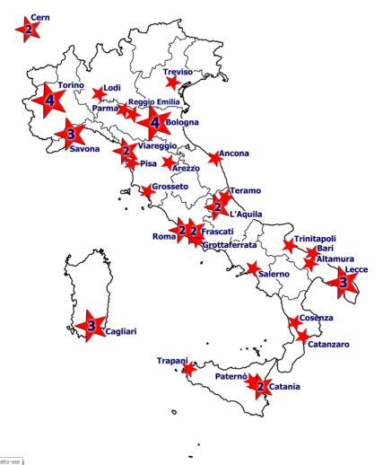
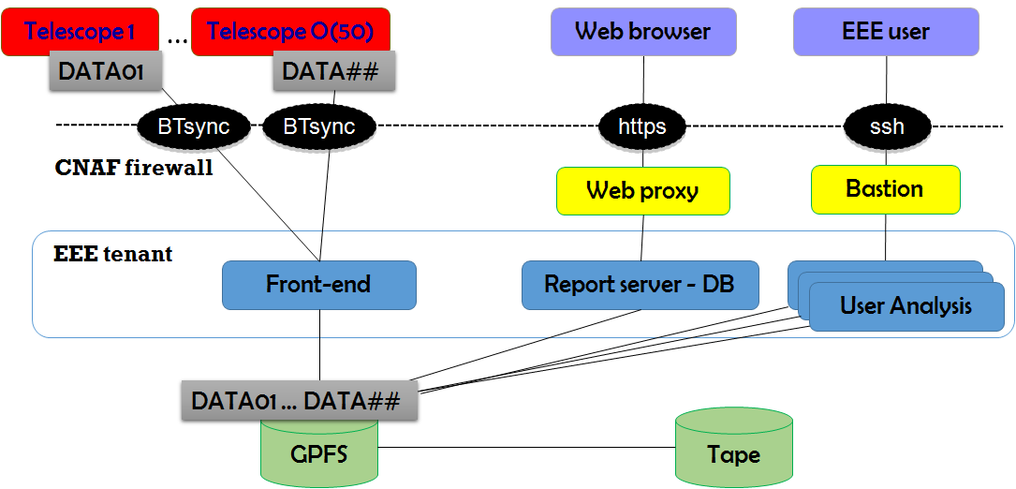
The computing and data infrastructure to interconnect EEE stations
F. Noferini on behalf of the EEE Collaboration
The Extreme Energy Event (EEE) experiment is devoted to the search of high-energy cosmic rays through a network of telescopes installed in about fifty high schools distributed throughout the Italian territory. One of the main goals of the project is to involve young students in a high-level scientific enterprise. Therefore the setup of the experiment is very peculiar and requires new solutions for the data management.
Data are collected (all schools → CNAF) and automatically reconstructed.

Slide 2
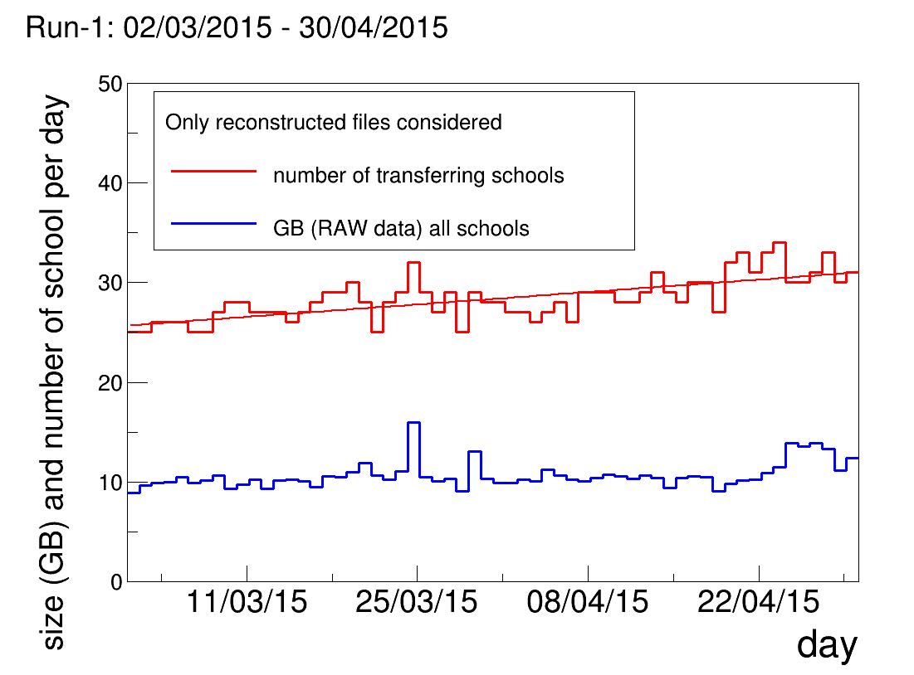
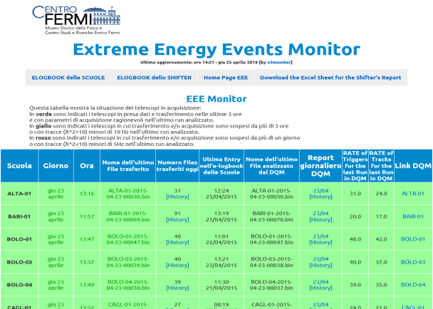
Data Transfers and Run-1 stats
We have so far 35 schools connected at CNAF and transferring data using bittorent sync
A CNAF front-end is dedicated to receive all the data with a required bandwidth of 300 kB/s
A btsync client is installed in each school (Win OS)
5-10 TB per year are expected
Full statistics from pilot run* to Run-1*: ∼2.4 TB (raw: ∼2 TB, reco: ∼0.4 TB) corresponding to ∼7 billion cosmic rays (+3 TB from past years)
Run-1 day-by-day statistics.
*Pilot run from 27-10-2014 to 14-11-2014
Run-1 from 02-03-2015 to 30-04-2015
Additional infos in the poster presented by M. P. Panetta
EEE monitor with information in real time https://www.cnaf.infn.it/eee/monitor/

Slide 3
Telescope 1
…
Telescope O(50)
Web browser
EEE user
DATA01
DATA##
BTsync
BTsync
https
ssh
CNAF firewall
Web proxy
Bastion
EEE tenant
Front-end
Report server - DB
User Analysis
User Analysis
User Analysis
DATA01 … DATA##
GPFS
Tape

