Slide 1
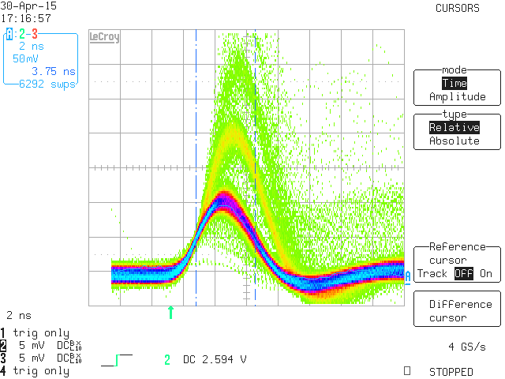
Detection Method of Signals from Silicon Photomultipliers Using Fully Differential Charge to Time Converter and Fast Shaper
The front-end electronics consists of fast and slow path.
The pulse width of the Charge to Time Converter (slow path) depends on the number of photons. In wide range its response is nonlinear. Nevertheless with the varicap diode good linearity can be achieved for signals above the 8 photoelectrons. For diode number 5 r-squared is equal to 0.998 and time per photoelectron 0.9 ns/ph (fig.2)
The fast shaper (fast path) generates unipolar pulse. The peaking time for single photoelectron is equal to 3.6ns and the FWHM is 3.8ns
Fig.2 relationship between the output pulse width and number of photoelectrons.

