Slide 1



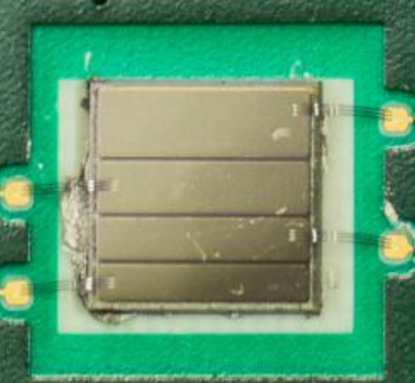
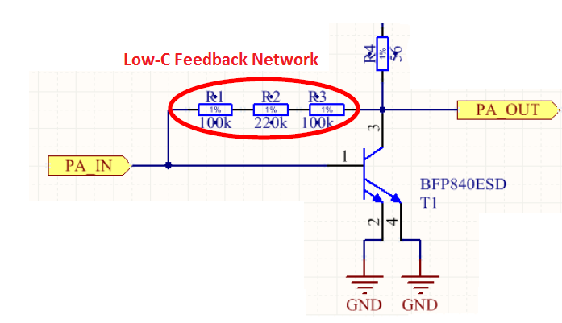
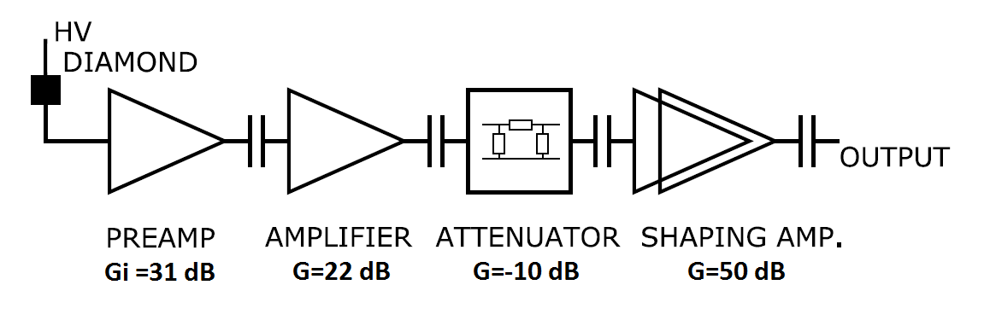
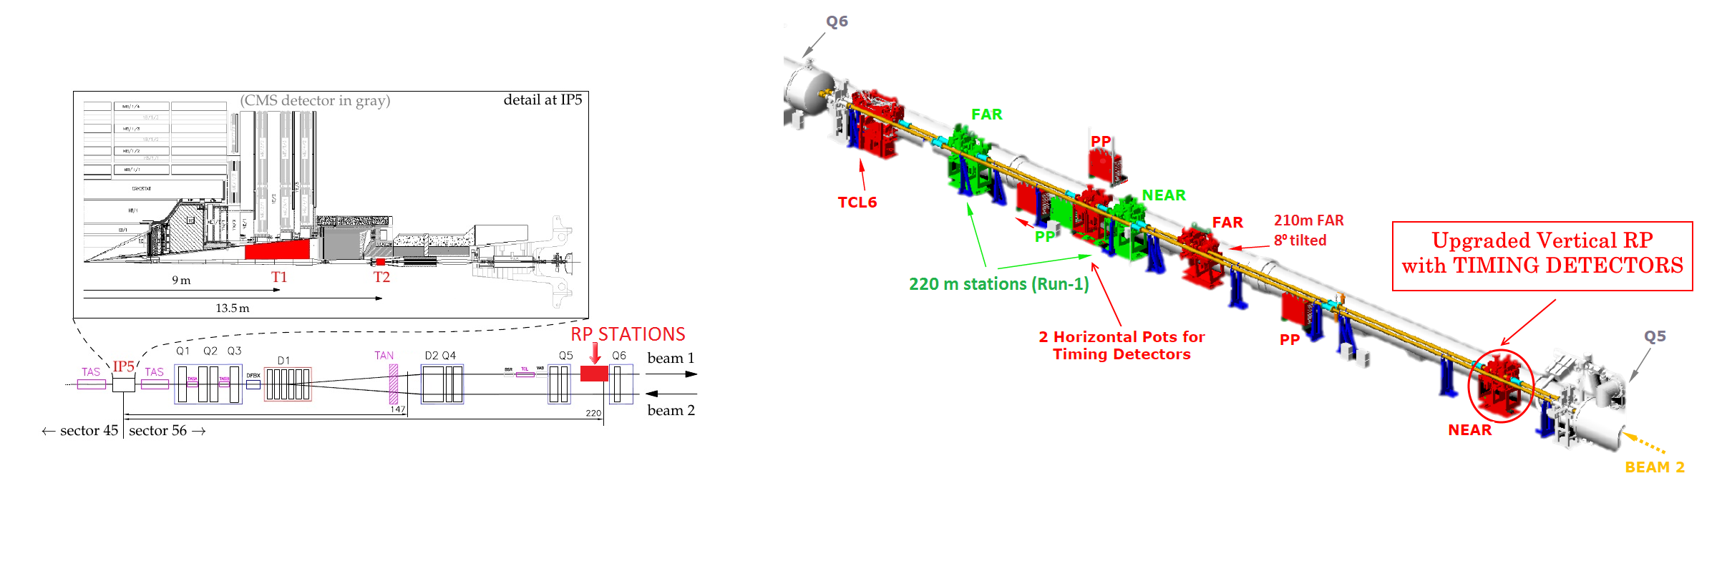
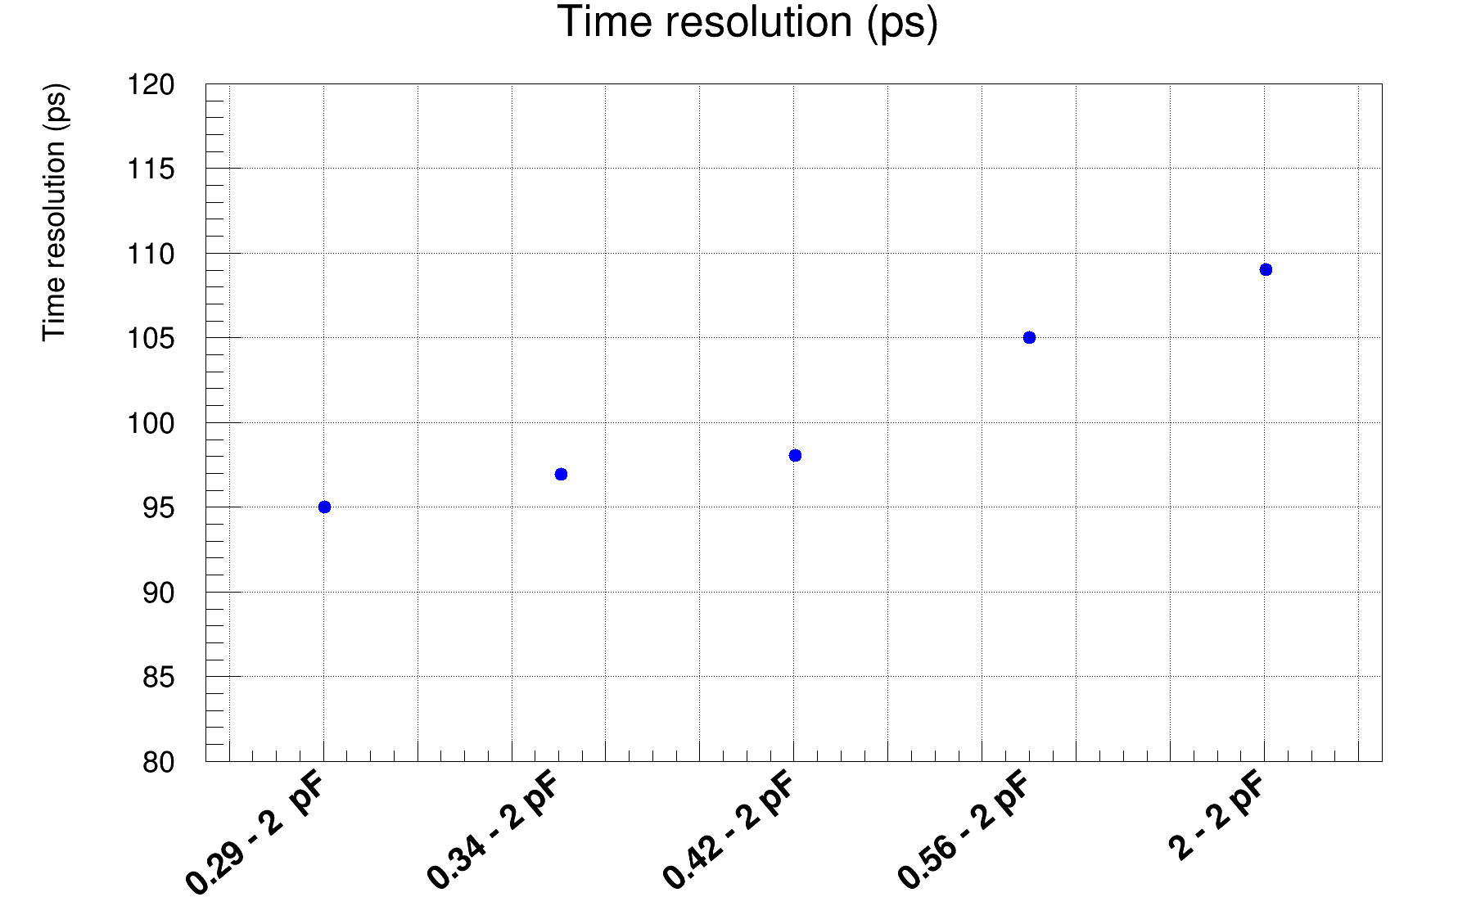
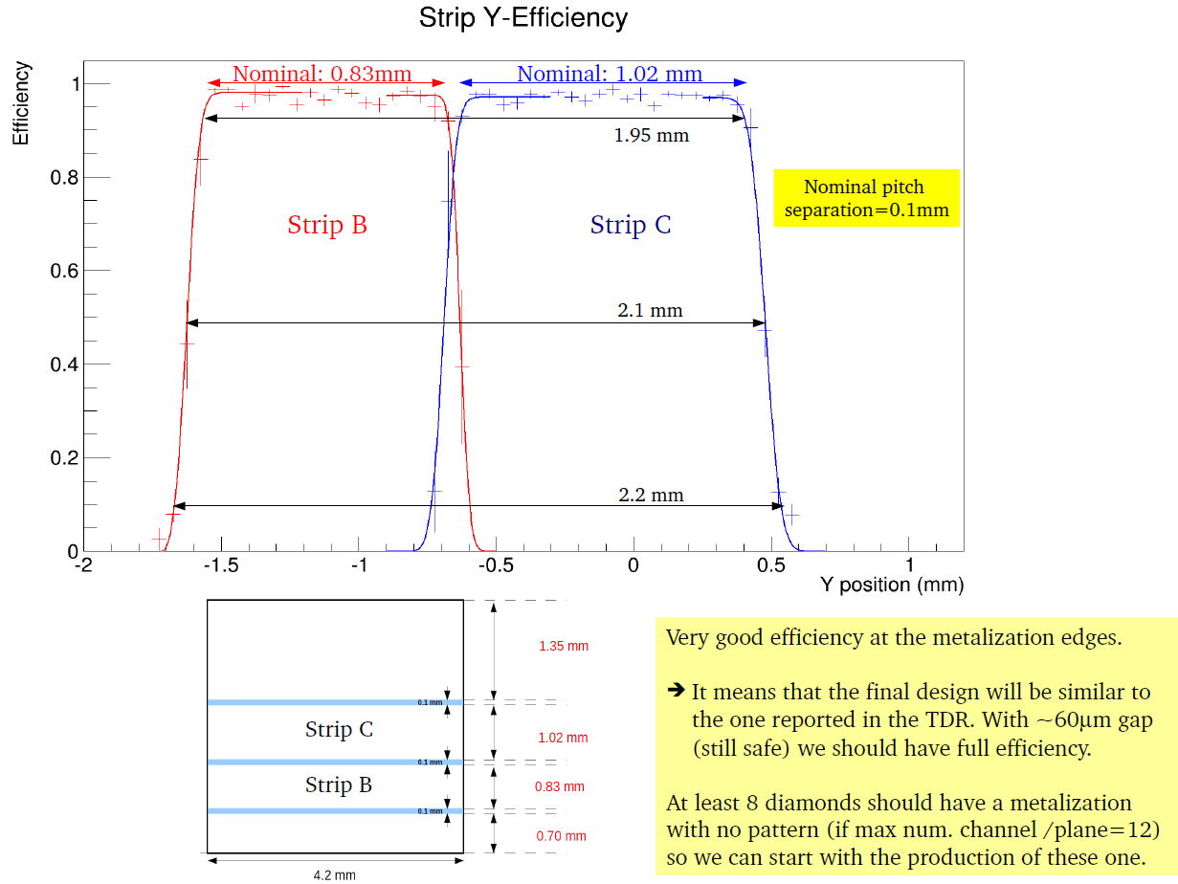
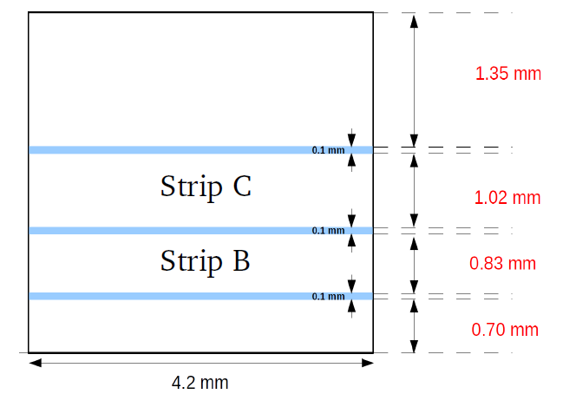
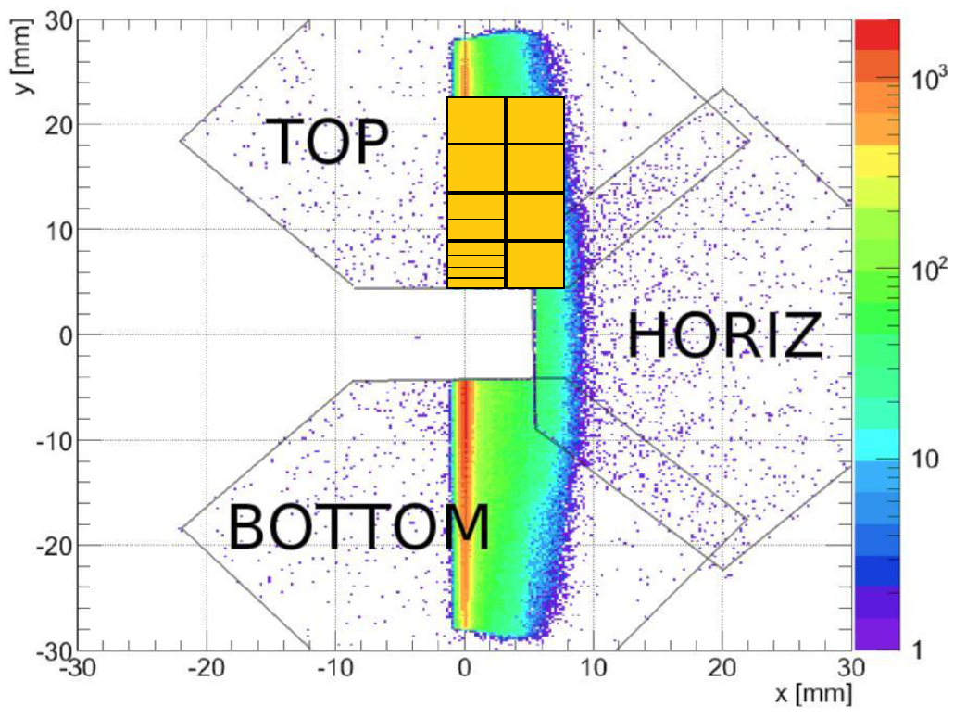
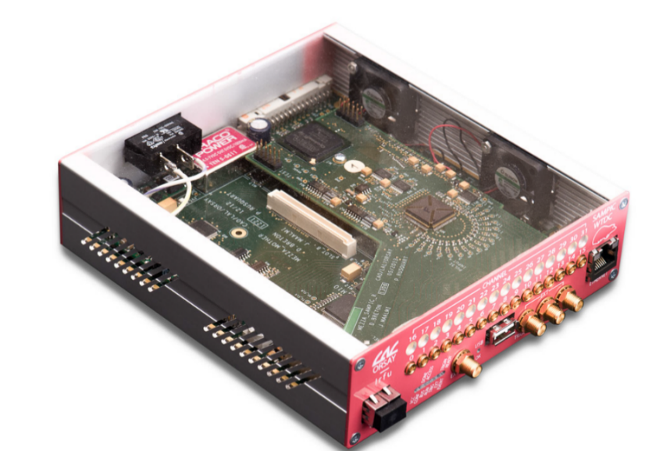
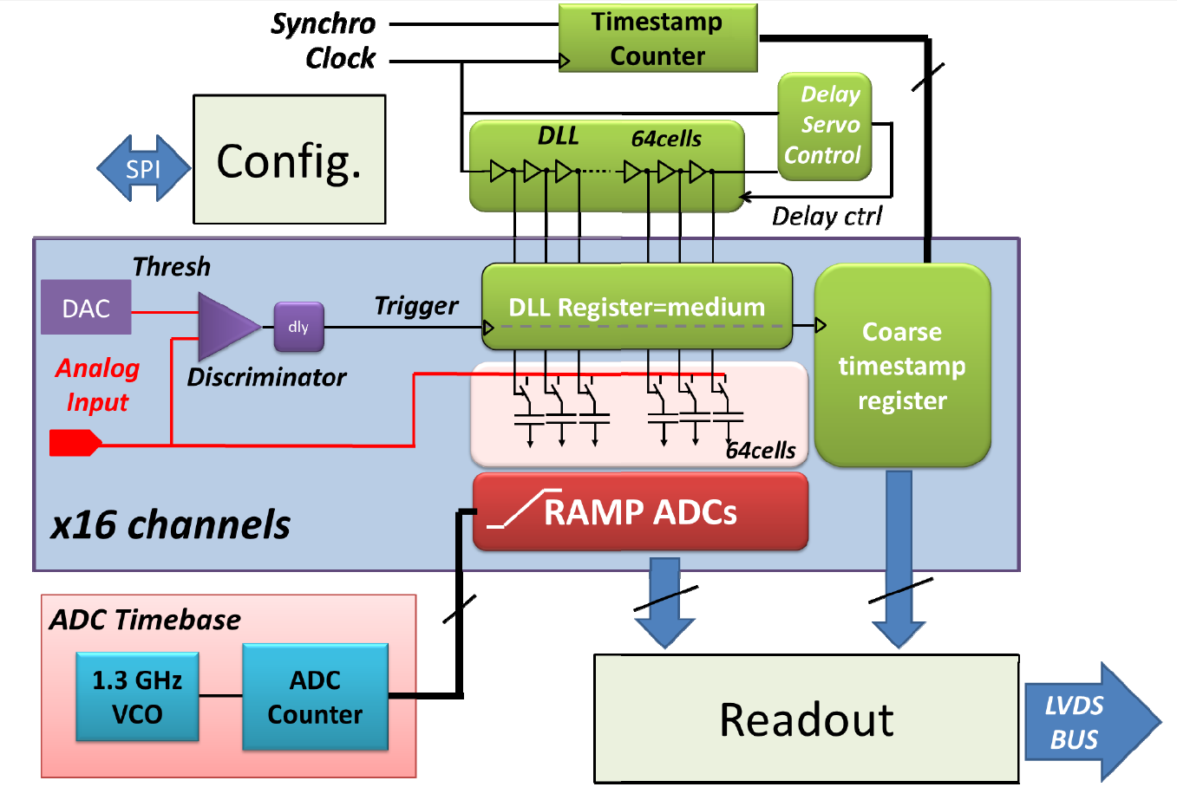
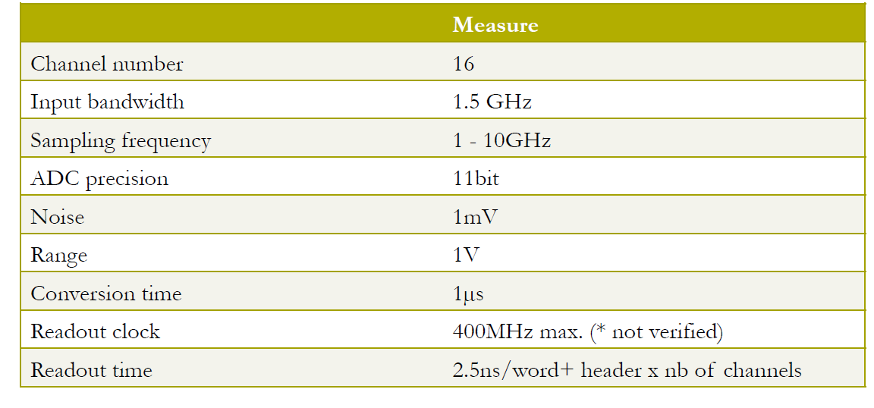
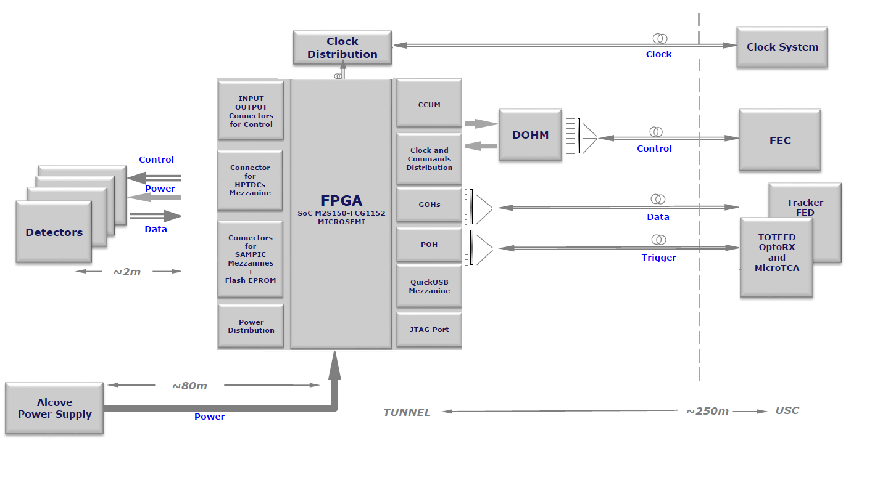
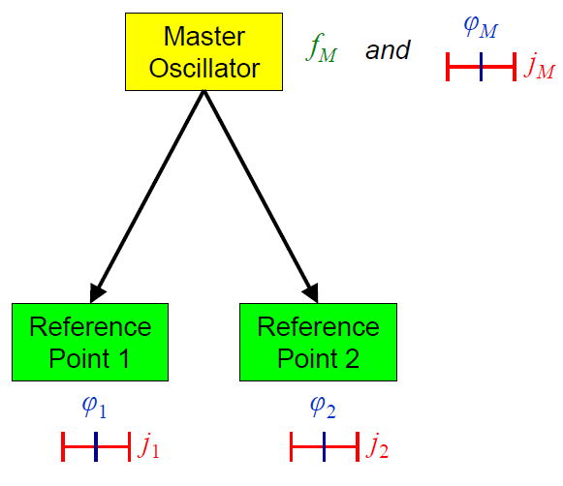
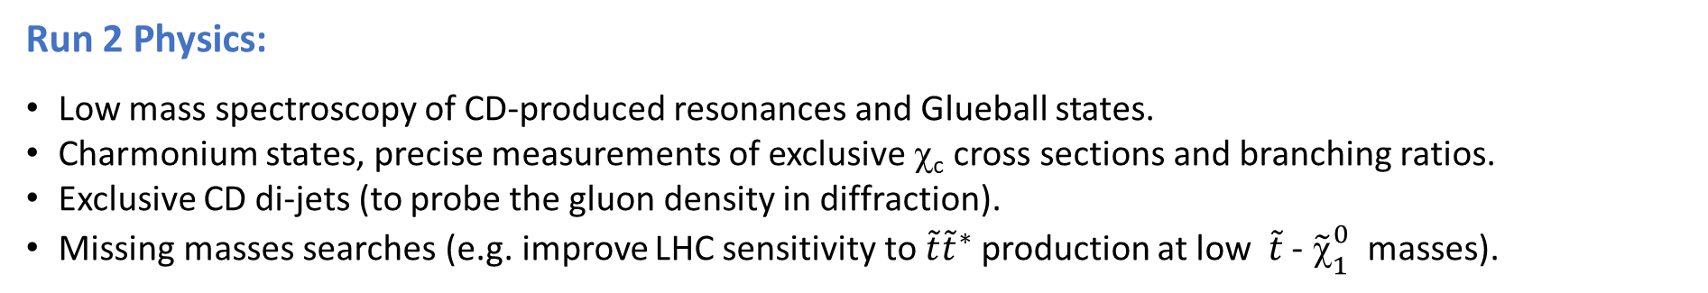
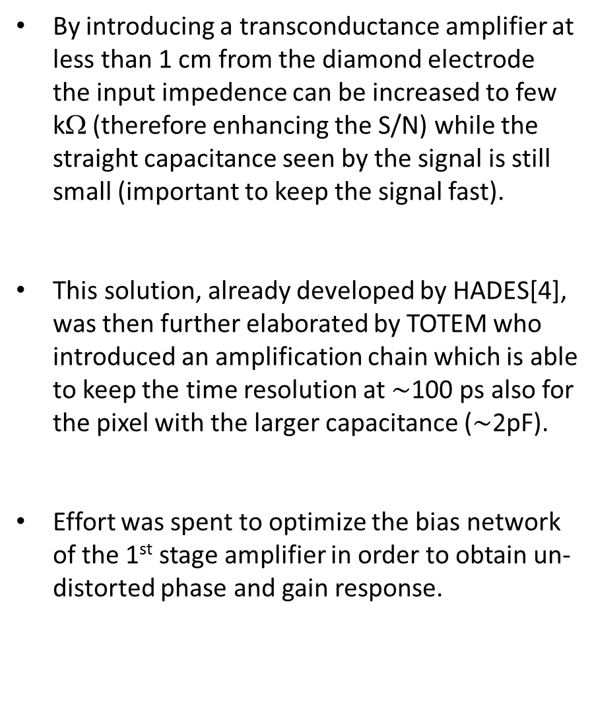
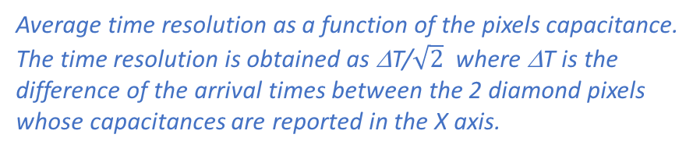

Mirko Berretti
(CERN and INFN)
On behalf of the TOTEM Collaboration
13th Pisa meeting on Advanced Detectors
24-30 May 2015
TOTEM R&D on diamond detector
The measurement of the protons TOF with 50 ps time resolution requires the development of several challenging technological solutions. Indeed, while diamond sensors have the advantage of higher radiation hardness, lower noise and faster signal than silicon sensors, the amount of charge released in the medium is lower.
The timing upgrade project of the TOTEM Roman Pot detectors
By introducing a transconductance amplifier at less than 1 cm from the diamond electrode the input impedence can be increased to few kΩ (therefore enhancing the S/N) while the straight capacitance seen by the signal is still small (important to keep the signal fast).
This solution, already developed by HADES[4], was then further elaborated by TOTEM who introduced an amplification chain which is able to keep the time resolution at $\sim$100 ps also for the pixel with the larger capacitance ($\sim$2pF).
Effort was spent to optimize the bias network of the 1st stage amplifier in order to obtain un-distorted phase and gain response.
The Totem RPs upgrade and its Physics motivation
Top:
A diamond Pixel with 4 strips and the preamplifier layout
Left:
The expected primary current from a MIP
Bottom:
The full amplification chain
The TOTEM upgrade programme [1],[2] focuses on improving the experiment’s capability to explore and measure new physics in Central Diffractive (CD) processes: p+p -> p + X + p. The installation of proton Time-Of-Flight (TOF) detectors in the TOTEM Roman Pots allows to reconstruct the longitudinal vertex position and thus to assign the proton vertex to the proper vertex reconstructed by the CMS tracker, even in presence of event pileup.
Common CMS-TOTEM data taking are foreseen during the LHC Run 2, with a special LHC-optics configuration for which the proton acceptance is optimal (all ξ=Δp/p for |t|>0.04 GeV²). Ultimately, 100 fb⁻¹ can be collected in runs with a μ=50% pileup.
TOTEM in Run2:
Only electronic graded scCVD sensors (bought from Element6) provided enough efficiency and time resolution. Both metallizations Cr-50nm + Au-150nm and TiW-100nm have been successfully tested.
Detector performance with MIP particles
Experimental advantages of CD:
Exclusive CD: quantum number filter on J _{(Z)}^{PC}.
Presence of rapidity forbidden/allowed regions.
The CMS/TOTEM P_{T} balance further increases the experimental sensitivity in exclusive events.
Production from a high-purity gluonic system (exclusive dijets or low mass resonances).
M²_{pp}= ξ₁ξ₂s vs M²_{CMS} comparison allows missing mass searches.
Run 2 Physics:
Low mass spectroscopy of CD-produced resonances and Glueball states.
Charmonium states, precise measurements of exclusive χ_{c} cross sections and branching ratios.
Exclusive CD di-jets (to probe the gluon density in diffraction).
Missing masses searches (e.g. improve LHC sensitivity to $\tilde{t}{\tilde{t}}^{∗}$ production at low$\tilde{t}$ - ${\tilde{\text{c}}}_{1}^{0}$ masses).
A diamond TOF detector:
Average time resolution as a function of the pixels capacitance. The time resolution is obtained as ΔT/$\sqrt{2}$ where ΔT is the difference of the arrival times between the 2 diamond pixels whose capacitances are reported in the X axis.
Detection efficiency as a function of the particle position. The efficiency is found >98% in the bulk of the crystal with a negligible effect introduced by the unmetallized area between the strips.
Test performed at DESY, with the DATURA telescope.
Diamond detectors have been chosen due to their:
Proven radiation hardness and fast response (best S/N in solid state detectors).
Small and safe enough to be placed inside a RP.
After an extensive R&D on the FE electronics a time resolution < 100 ps has been proved.
4 diamond planes per arm -> 50 ps per arm will be achieved (σ_{Z} $\sim$1 cm).
To minimize the pileup probability in the same diamond pixel the design has been optimized in order to guarantee an uniform occupancy [3].
Waveform digitization with the SAMPIC
Waveform TDC developed in Saclay[5], used to acquire the full waveform shape of the detector signal, by sampling it through a 64 cell Delay Line Loop (DLL) based TDC and an ultrafast analog memory for fine timing extraction.
Sparse mode self-triggering (only the triggering channels will send data).
Track distribution in the 220F RP, for events with 2 protons in the final state. The golden picture on the TOP shows the diamond detector surface. The diamond detector in the BOTTOM RP is not reported for clarity.
Background Reduction:
The measurement of the protons TOF adds an independent variable (Z_{VTX} = cΔt/2) that can be used in together with the track-based variables to reduce the background.
For exclusive events, the TOF information is used to better understand the background (S/B enhancement)
For inclusive events, or events with missing momentum the association of the proton to the CMS vertex by using only the tracking variables is more problematic. Here timing detectors are even more crucial.
IN GENERAL, an additional factor 5 on the CD sample purity can be obtained from the installation of a timing detector in the RP with 50 ps time resolution per arm.
Test Beam measurements confirmed a negligible worsening of the time resolution due to the SAMPIC.
Clock distribution
DAQ
The crucial problem to be solved is to provide a common time reference between detectors which are ~220m distant from a common source.
The same “Timing Motherboard” with radiation Tolerant FPGA will be used both for TOTEM and for the CT-PPS project
Initially TOTEM will not trigger on the timing detectors. The board have to be interfaced to the same hardware used for the data transmission of the silicon detectors
Expected trigger rate <100 KHz
The start and clock signal should arrive simultaneously in the two arms. In general this is not true due to different delays, additive noise in signal transmission etc..
TOTEM clock distribution is adapted from the “Universal Picosecond Timing System”, developed for FAIR at GSI [6].
Simplified working principle:
TDC clock and start signals are modulated with different wavelength and optically sent from the CR to the detector.
Another modulation is added on the same fiber and reflected back from the detector to a measuring unit in the CR.
The delays of the two arms is therefore measured and a correction can be applied.
[1],[2] The Totem Collaboration: CERN-LHCC-2014-020, CERN-LHCC-2014-024
[3] M. Berretti: CERN-TOTEM-NOTE-2014-001
[4] M. Ciobanu et al: IEEE TRANSACTIONS ON NUCLEAR SCIENCE, VOL. 58, NO. 4, AUGUST 2011
[5] E. Delagnes et al: 2014 IEEE NSS/MIC; in2p3-01082061; http://hal.in2p3.fr/in2p3-01082061
[6] M. Bousonville and J. Rausch: Phys. Rev. ST Accel. Beams 12 (2009) 042801
References

