Slide 1
Performances of the SDHCAL technological prototype for future lepton collider experiments
Imad Laktineh
IPN de Lyon
On behalf of the SDHCAL groups of the CALICE collaboration

Slide 2
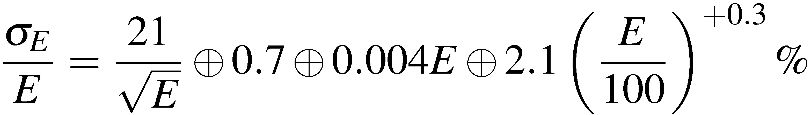
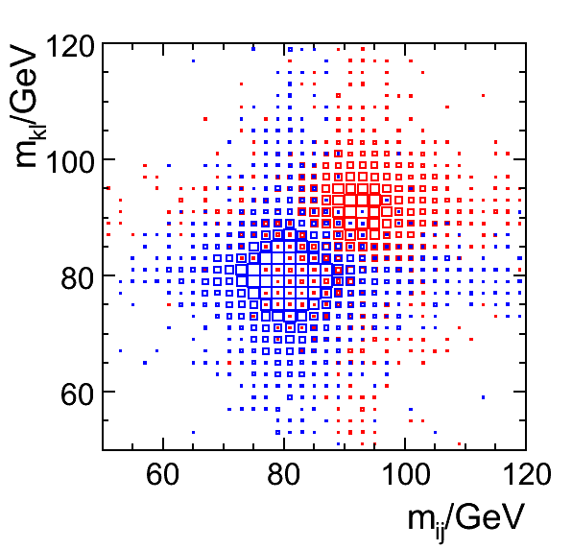
Motivations
For future colliders, jet energy resolution will be a determinant factor of
understanding high energy physics.
Exemples:
→Trilinear Higgs self coupling measurement
→WW scattering measurement
Resolution
Tracking
Leakage
Confusion
To improve on the jet energy resolution
PFA is a promising solution to reduce the
confusion term.
But PFA needs high granularity Calorimeters
30%/√E
Different solutions of such calorimeters are being followed within the
CALICE international collaboration. The option we are investigating is the
Digital and Semi-Digital Hadronic CALorimeter using GRPC as sensitive medium

Slide 3
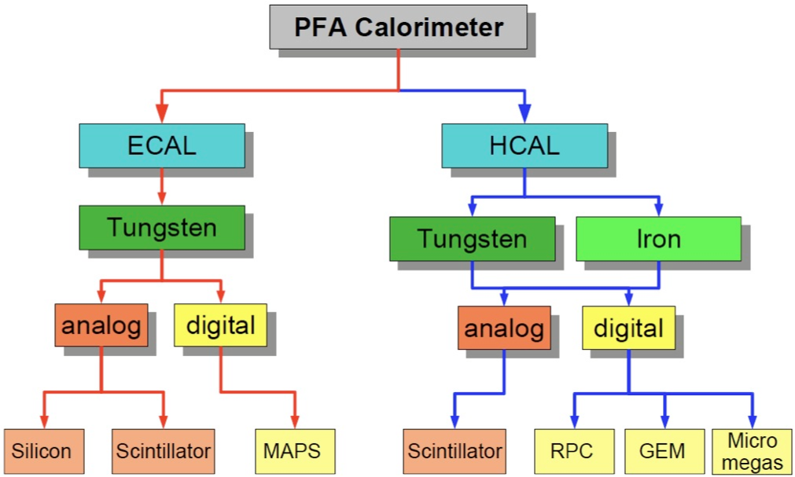

Calice calorimeters
Several R&D on calorimeters are followed within the CALICE collaboration in order to
apply successfully particle flow analysis.
High granularity but also compactness and hermeticity are the key words of this development.

Slide 4
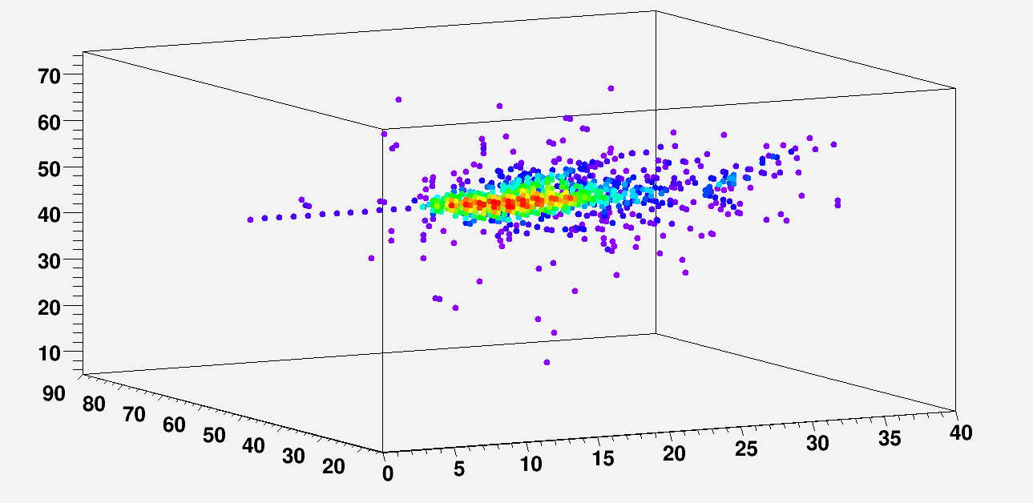
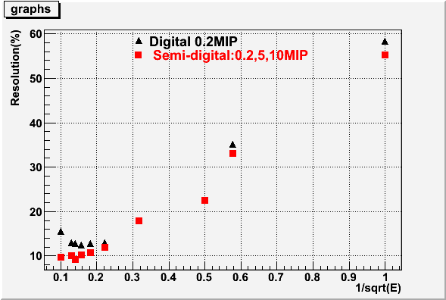
SDHCAL concept
1- Detector choice
Gaseous detectors: homogenous, cost-effective and highly transverse and longitudinal granular.
GRPC : is an adequate candidate for ILC.
2- Electronics readout choice
At high energy the shower core is very dense
→ Simple binary readout will suffer saturation effect
→ Semi-digital readout (2-bit) can improve the energy
resolution.
Avalanches
30 GeV
1 cm² pad
Simulation

Slide 5
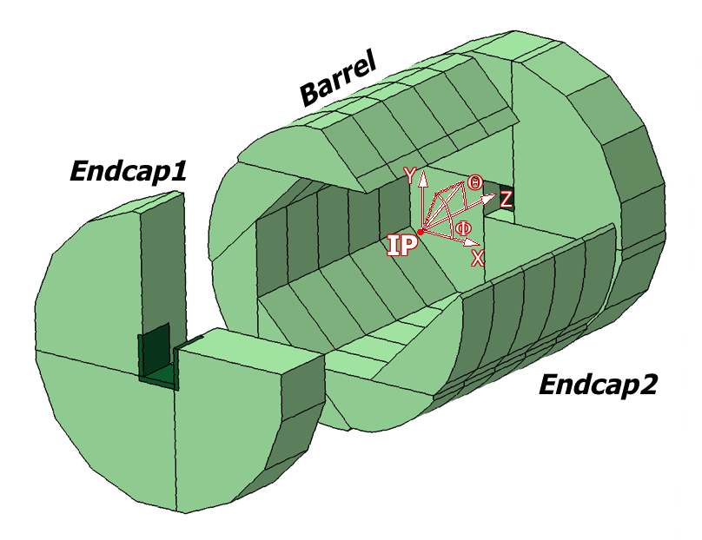
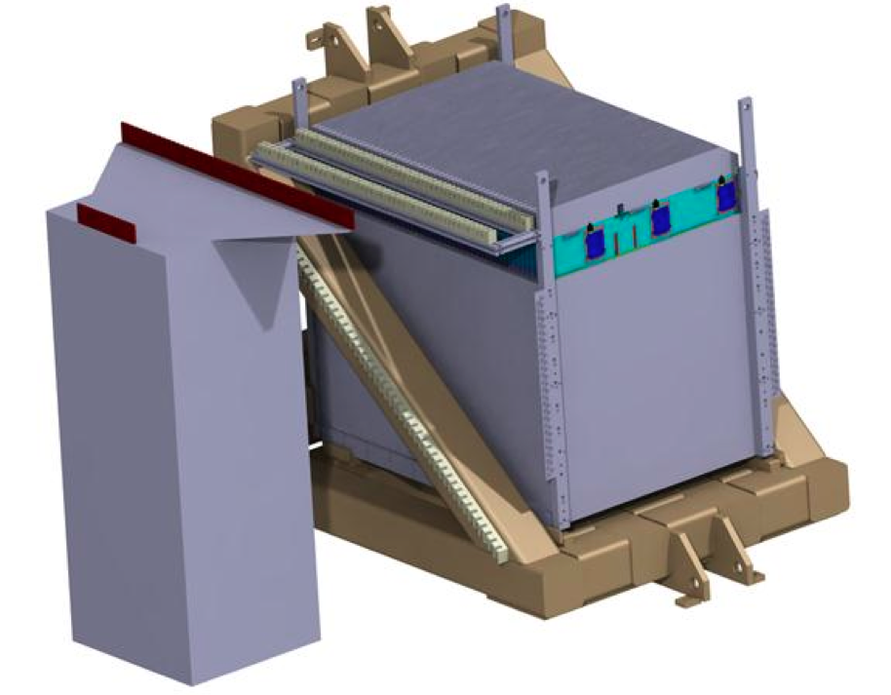
SDHCAL for ILD
The SDHCAL-GRPC is one of the two HCAL options proposed
in the ILD Letter Of Intention (LOI). Modules are made of
48 RPC chambers (6λ_{I}) equipped with
power-pulsing electronics readout.
The structure proposed for the SDHCAL-ILD :
Is self-supporting
Has negligible dead zones
Eliminates projective cracks
Minimizes barrel / endcap separation
(services leaving from the outer radius)
SDHCAL Prototype
- Come as close as possible to the ILD module
and be able to study hadronic showers
-48 units (active layer + absorber)
fulfilling the ILD requirements.
Challenges
-Homogeneity for large surfaces
-Thickness of only few mms
-Services from one side
-Embedded power-cycled electronics
-Self-supporting mechanical structure

Slide 6
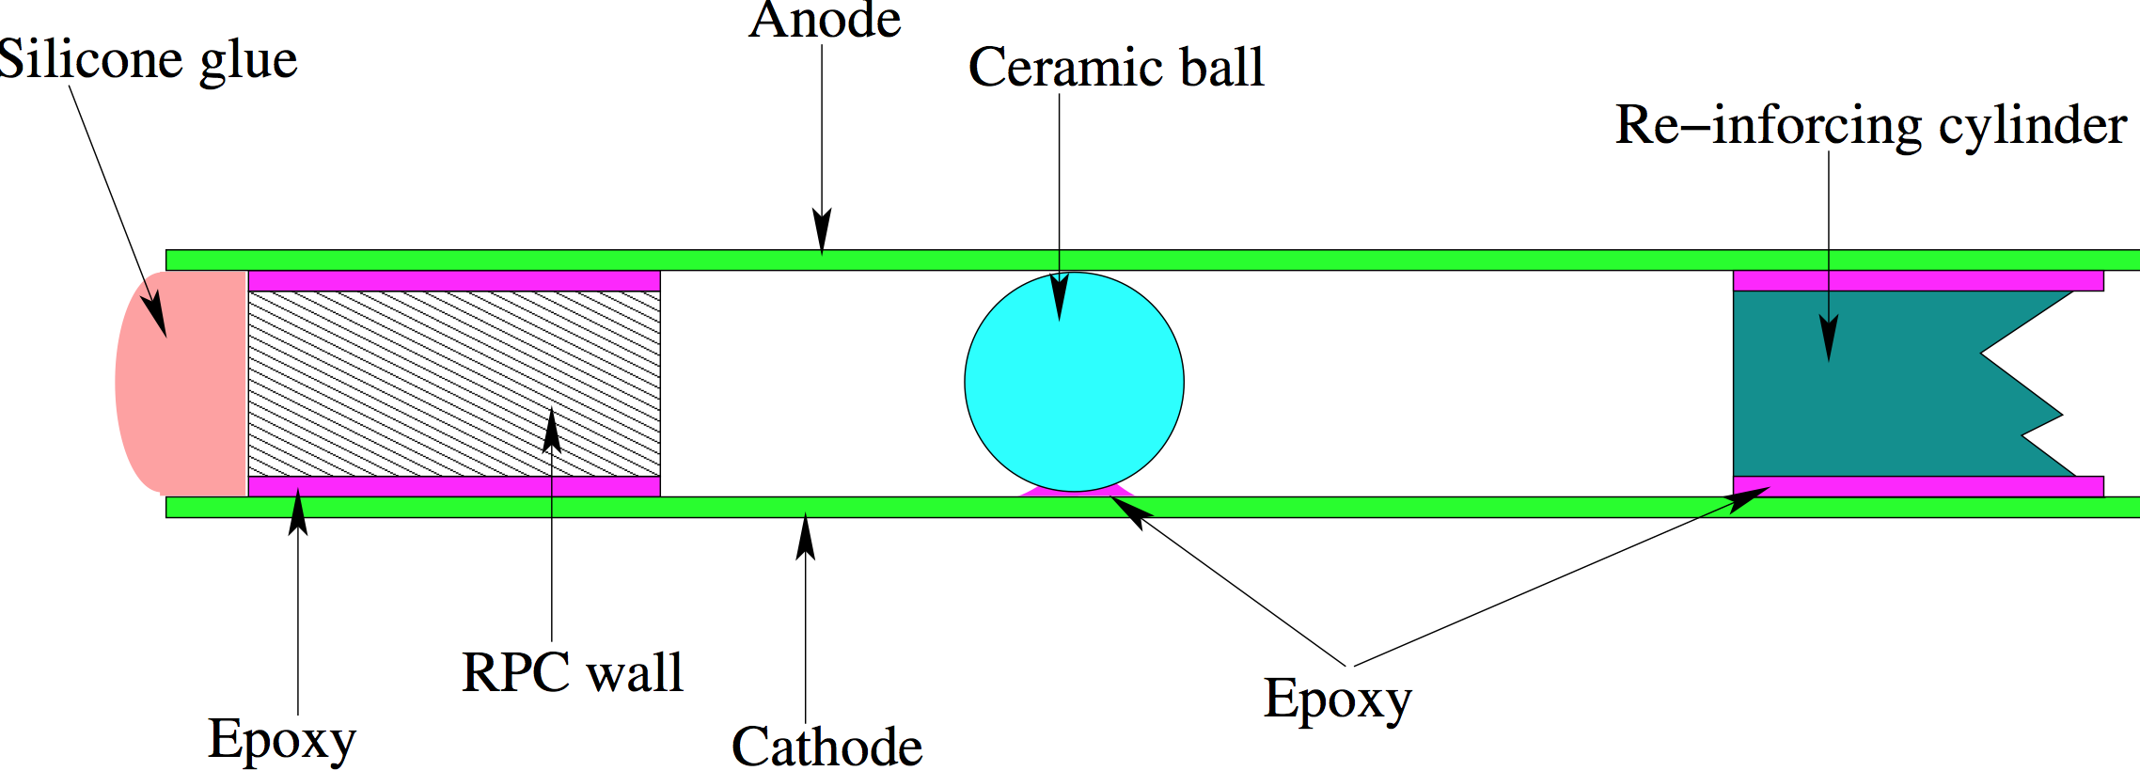
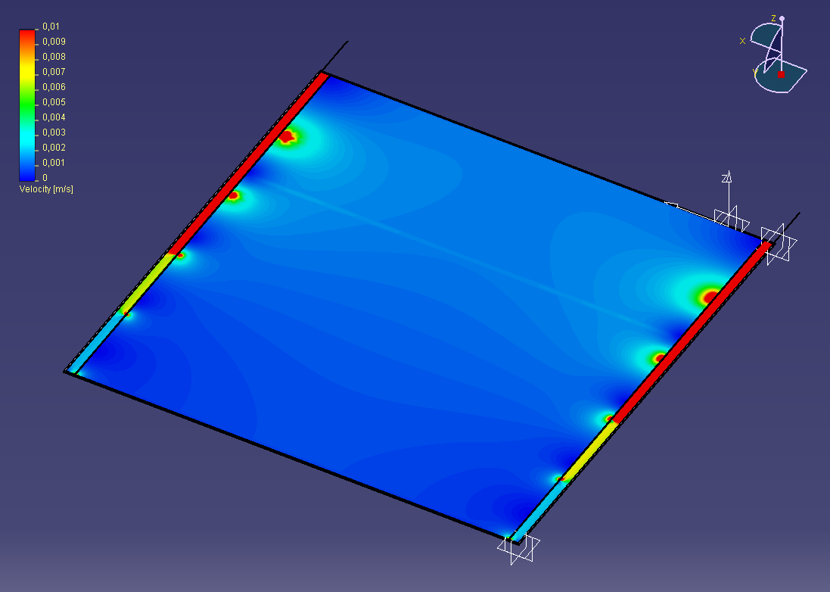
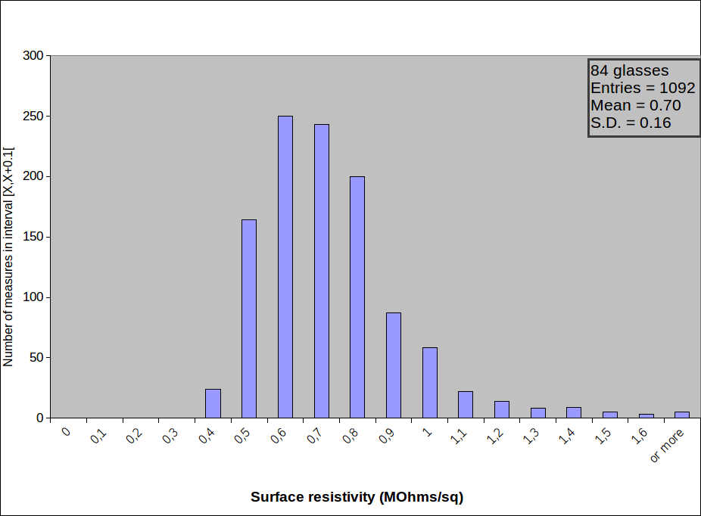
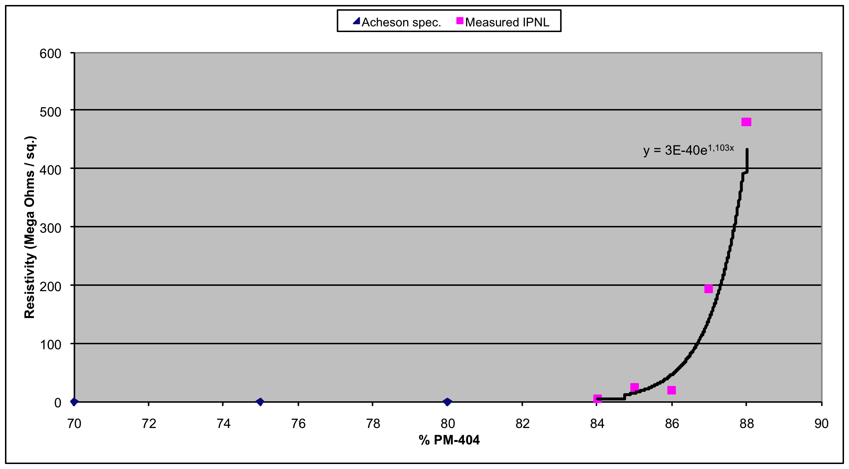
GRPC development
Max. deformation: 44μ
Deformation studies
Dead zones minimized
New resistive painting was developed
Genuine gas distribution

Slide 7
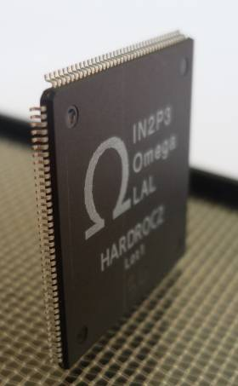
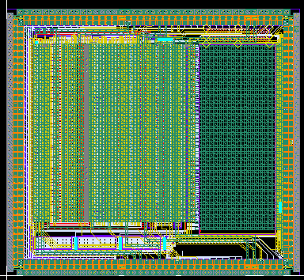
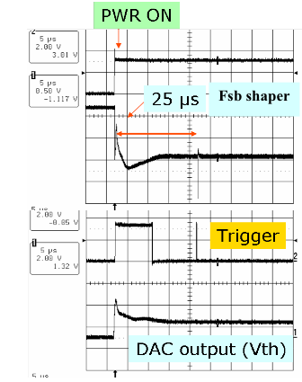
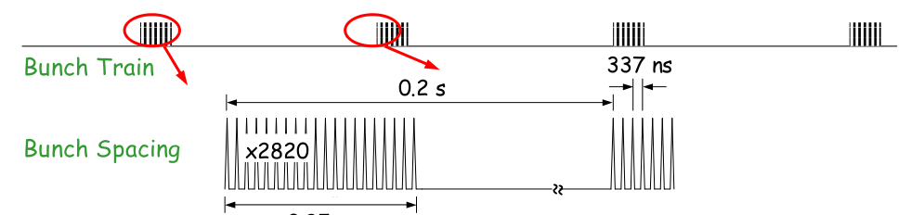
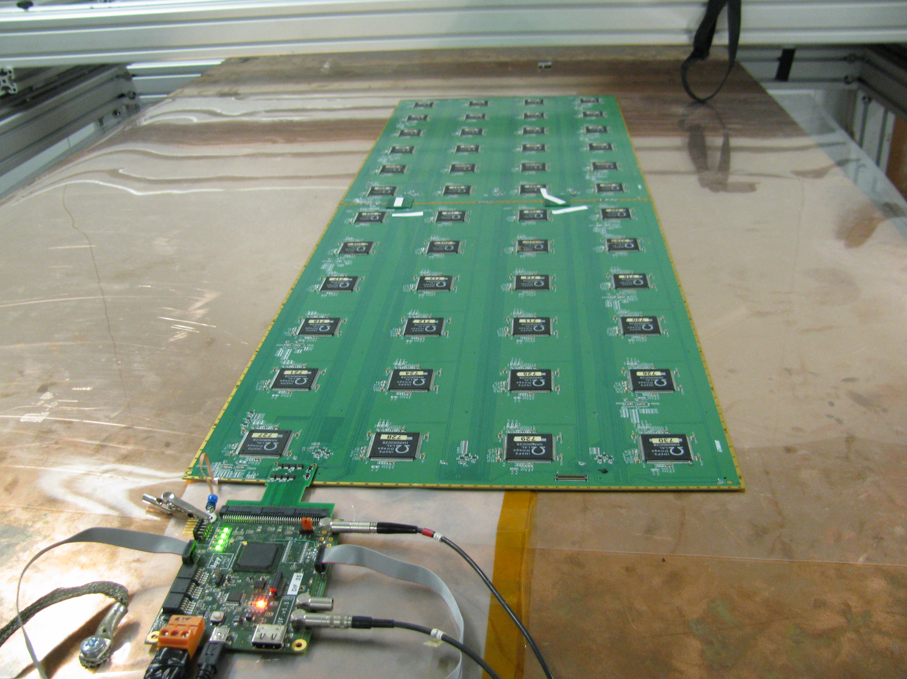
Electronics readout development
4.7 mm
ASIC: HARDROC
64 channels, trigger less mode, memory depth:
127 events
2-bit readout : 3 thresholds
Dynamic range: 10 fC-15 pC
Gain correction → uniformity
Power-pulsed → reduced power consumption
4.3mm
Printed Circuit Boards (PCB) were designed to reduce the x-talk with 8-layer structure and buried vias.
Tiny connectors were used to connect the PCB two by two (the 24X2 ASIC are daisy-chained).
DAQ board (DIF) was developed to transmit fast commands and data to/from ASICs.
6mm(active area) + 5mm(steel) =
11 mm thickness

Slide 8
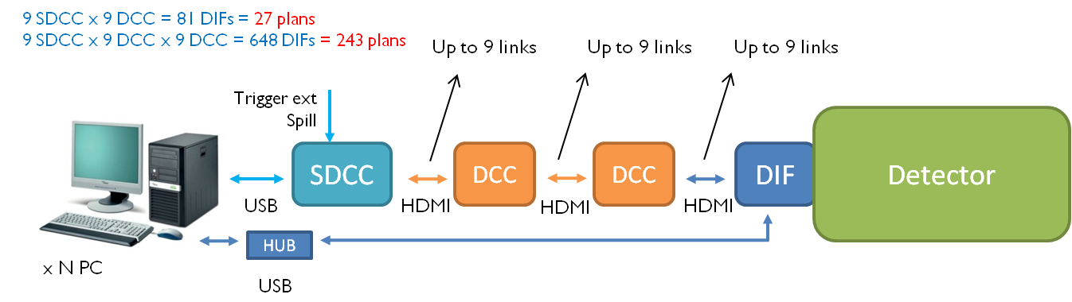
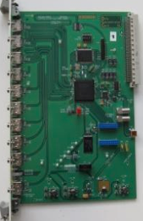
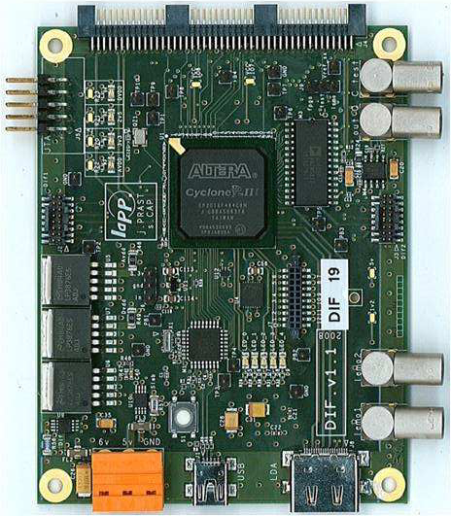
SDHCAL acquisition system
Acquisition software was developed to deal with the output of large
number of electronics channels (> 460 000).
Oracle database used for ASIC configurations and slow control.
→ CMS Xdaq used to provide the DAQ framework.

Slide 9
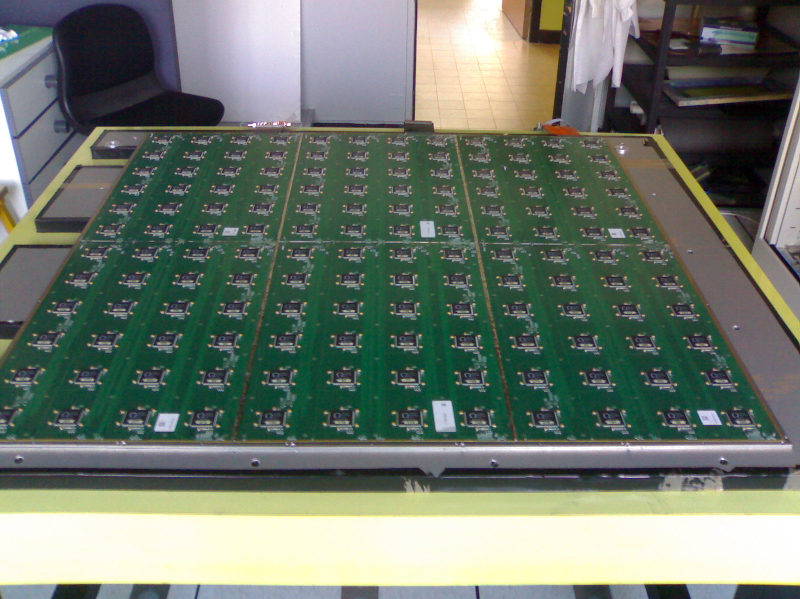
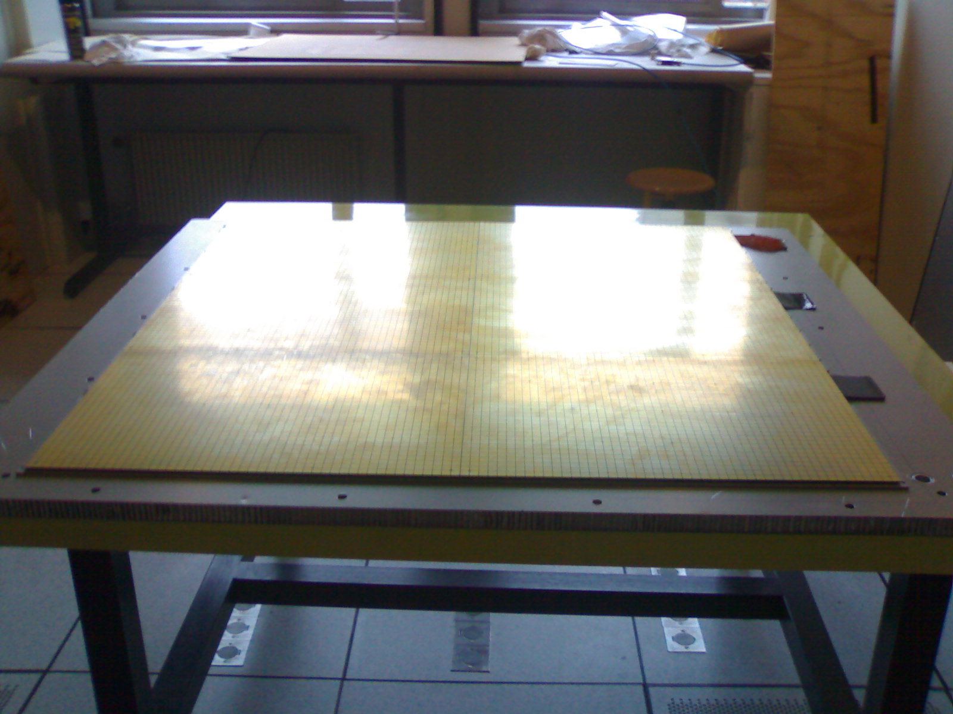
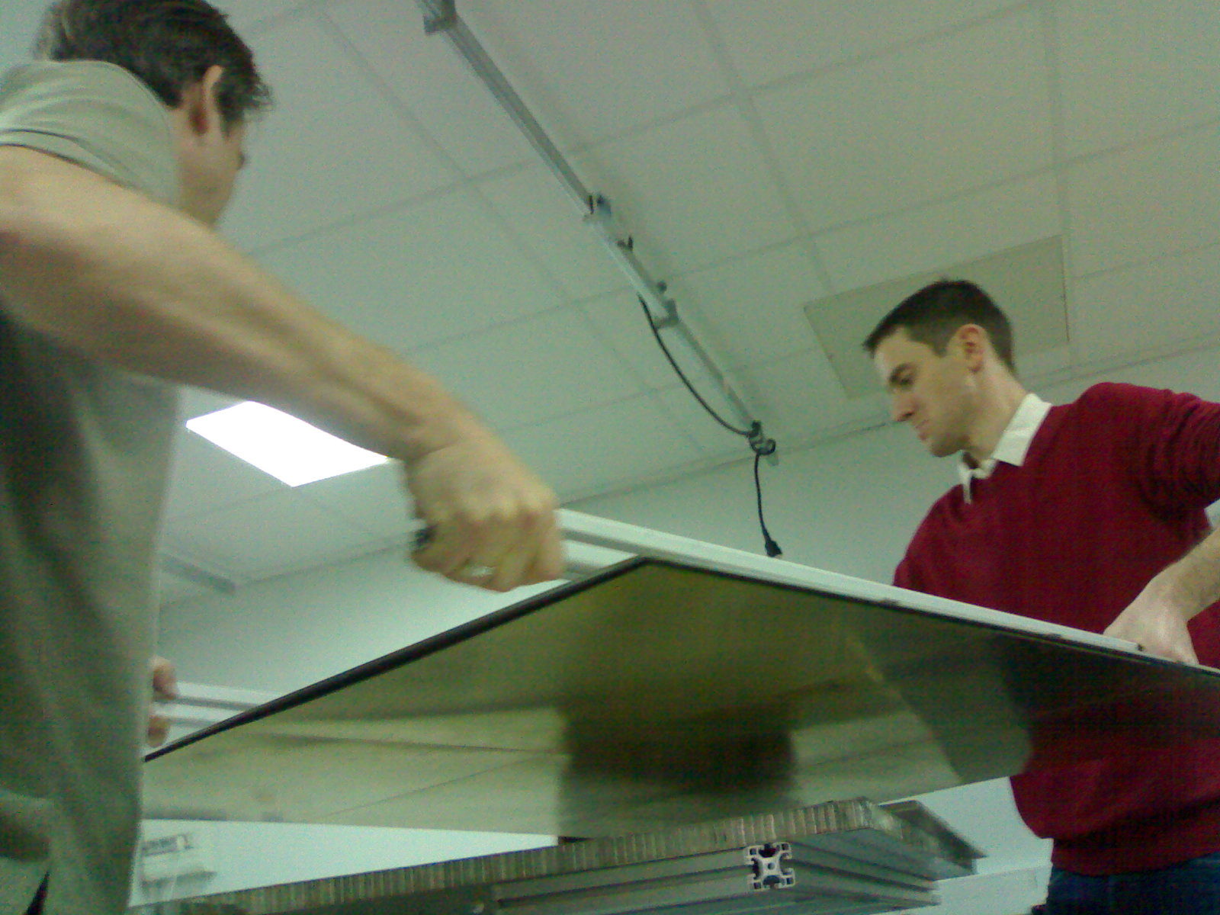
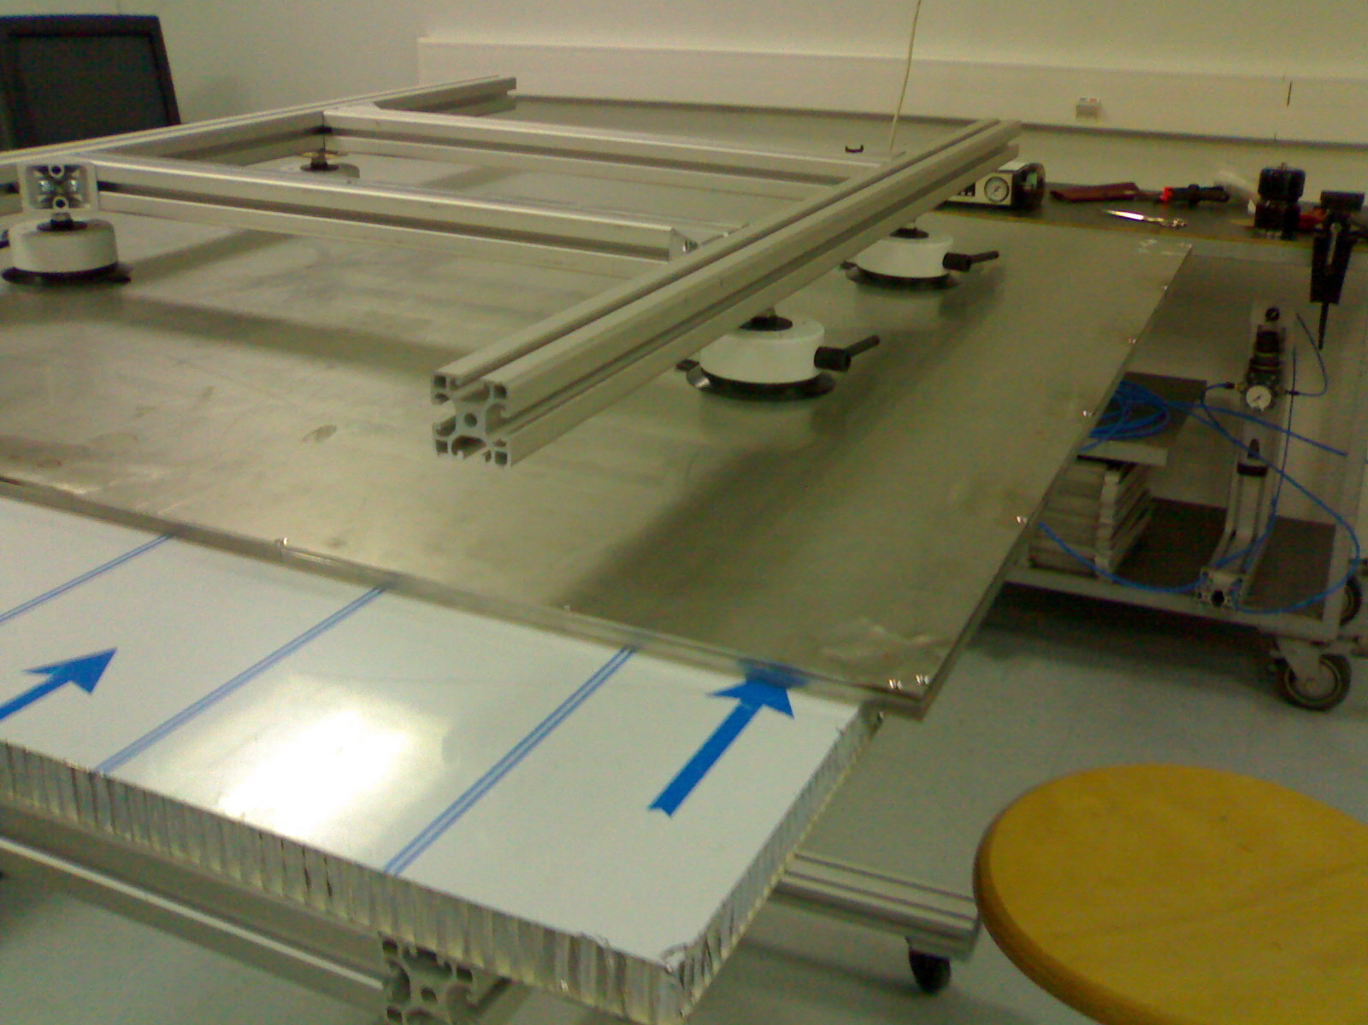
Cassette development
→ To provide a robust structure.
→ To maintain good contact
between the readout electronics
and the GRPC.
→ To be part of the absorber.
→ It allows to replace detectors
and electronics boards easily.
144 ASICs= 9216 channels/1m²
6mm(active ara) + 5mm(steel) =
11 mm thickness
The cassettes are built of no-magnetic stainless steel walls 2.5 mm thick each → Total cassette thickness = 6mm (active layer)+5 mm (steel) = 11 mm

Slide 10
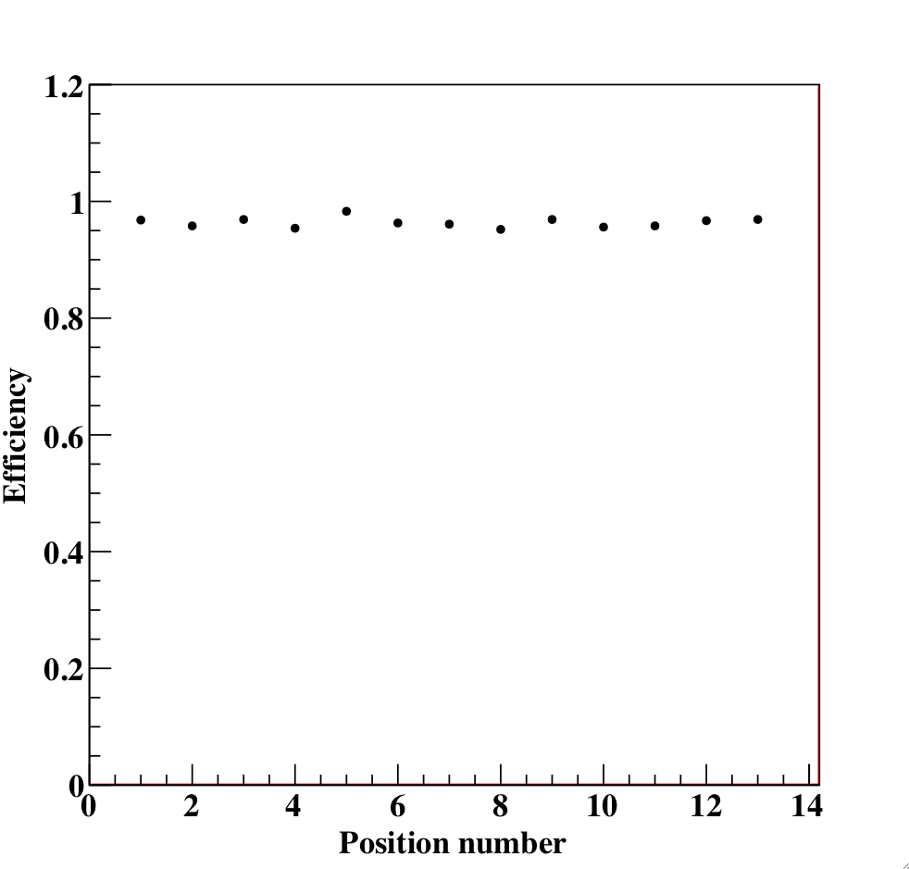
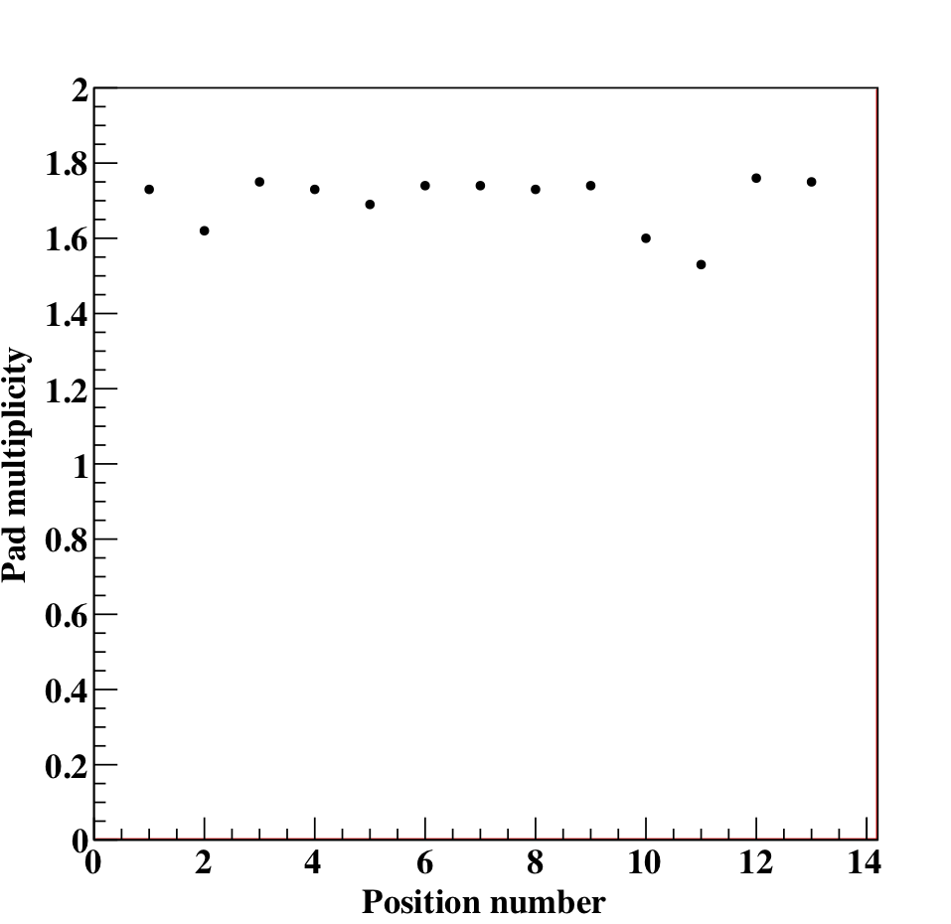
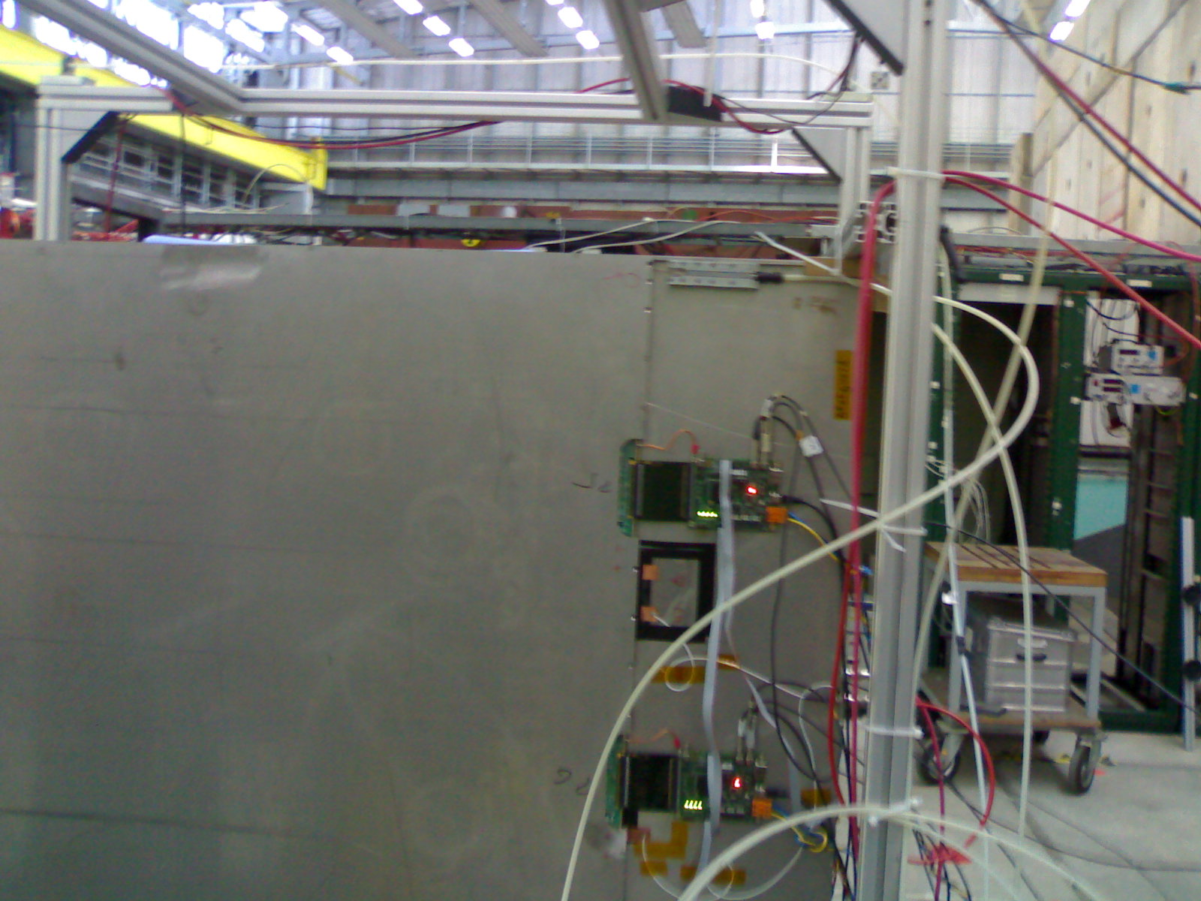
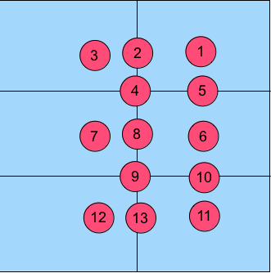
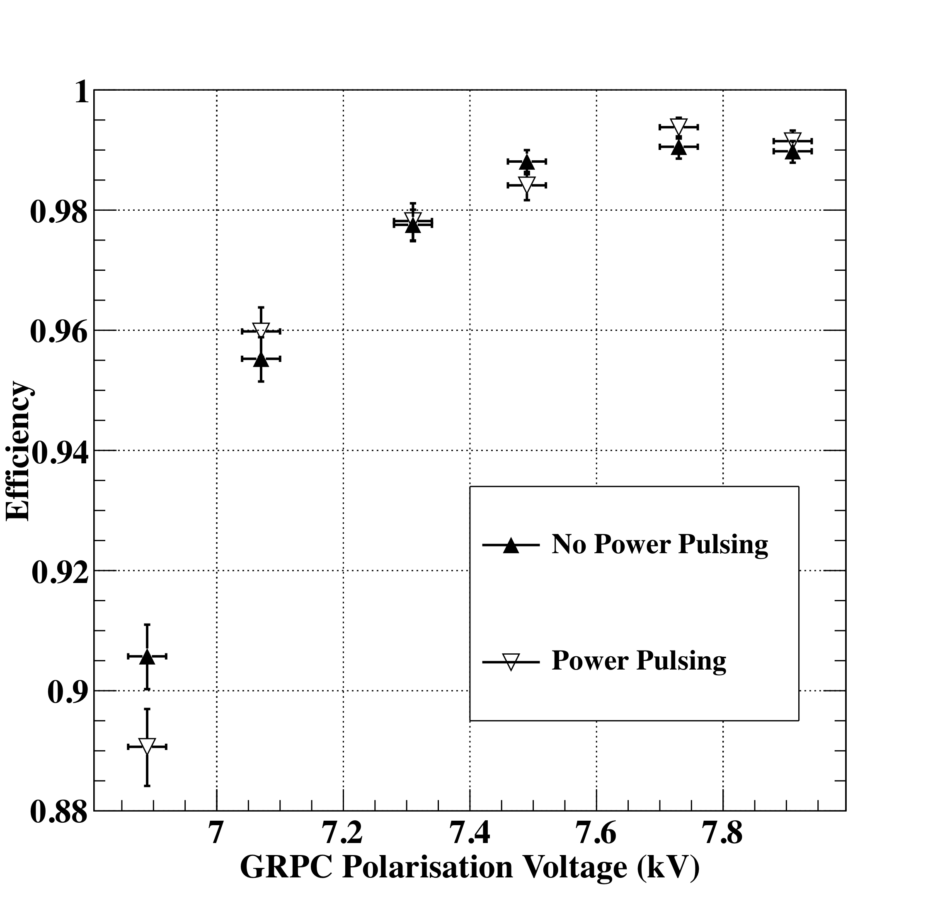
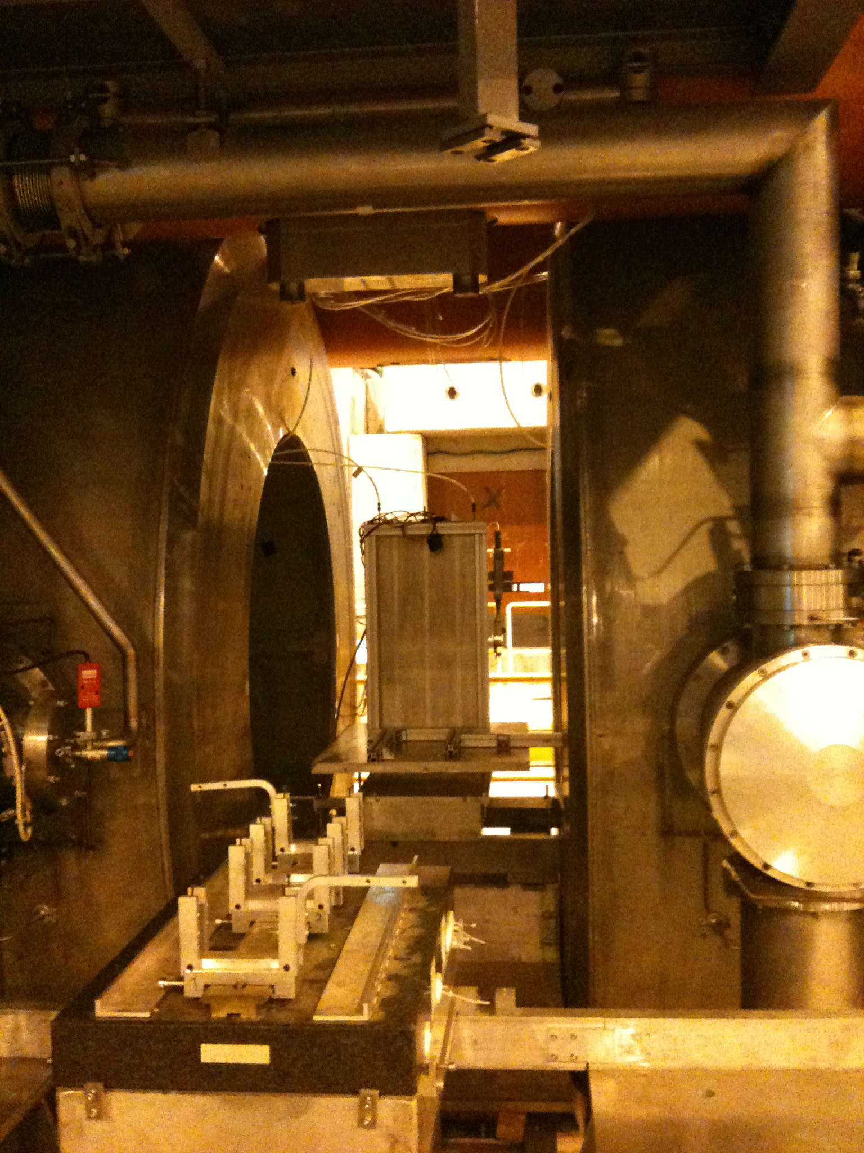
Test Beam validation
The homogeneity of the detector and its readout electronics were studied
HV : 7.4 kV
Beam spot position
Efficiency
Multiplicity
Power-Pulsing mode was tested in a magnetic field of 3 Tesla
The Power-Pulsing mode was
applied on a GRPC in a 3 Tesla
field at H2-CERN
(2 ms every 10 ms)
No effect on the detector
performance
10
Notes:
10
10

Slide 11
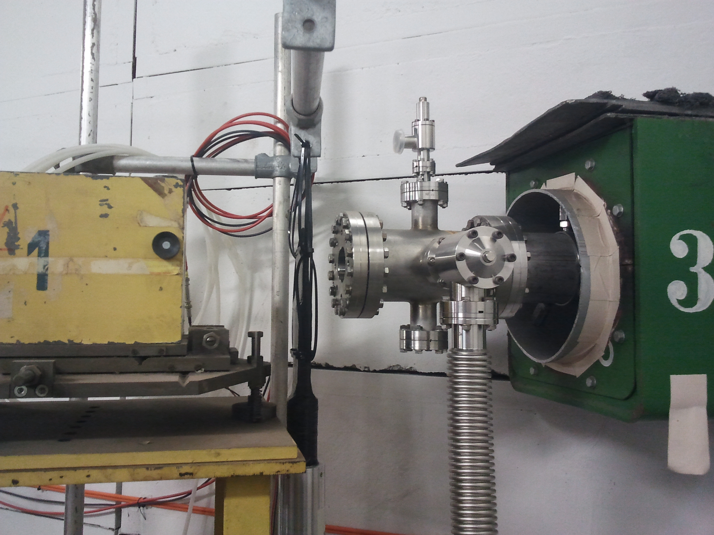
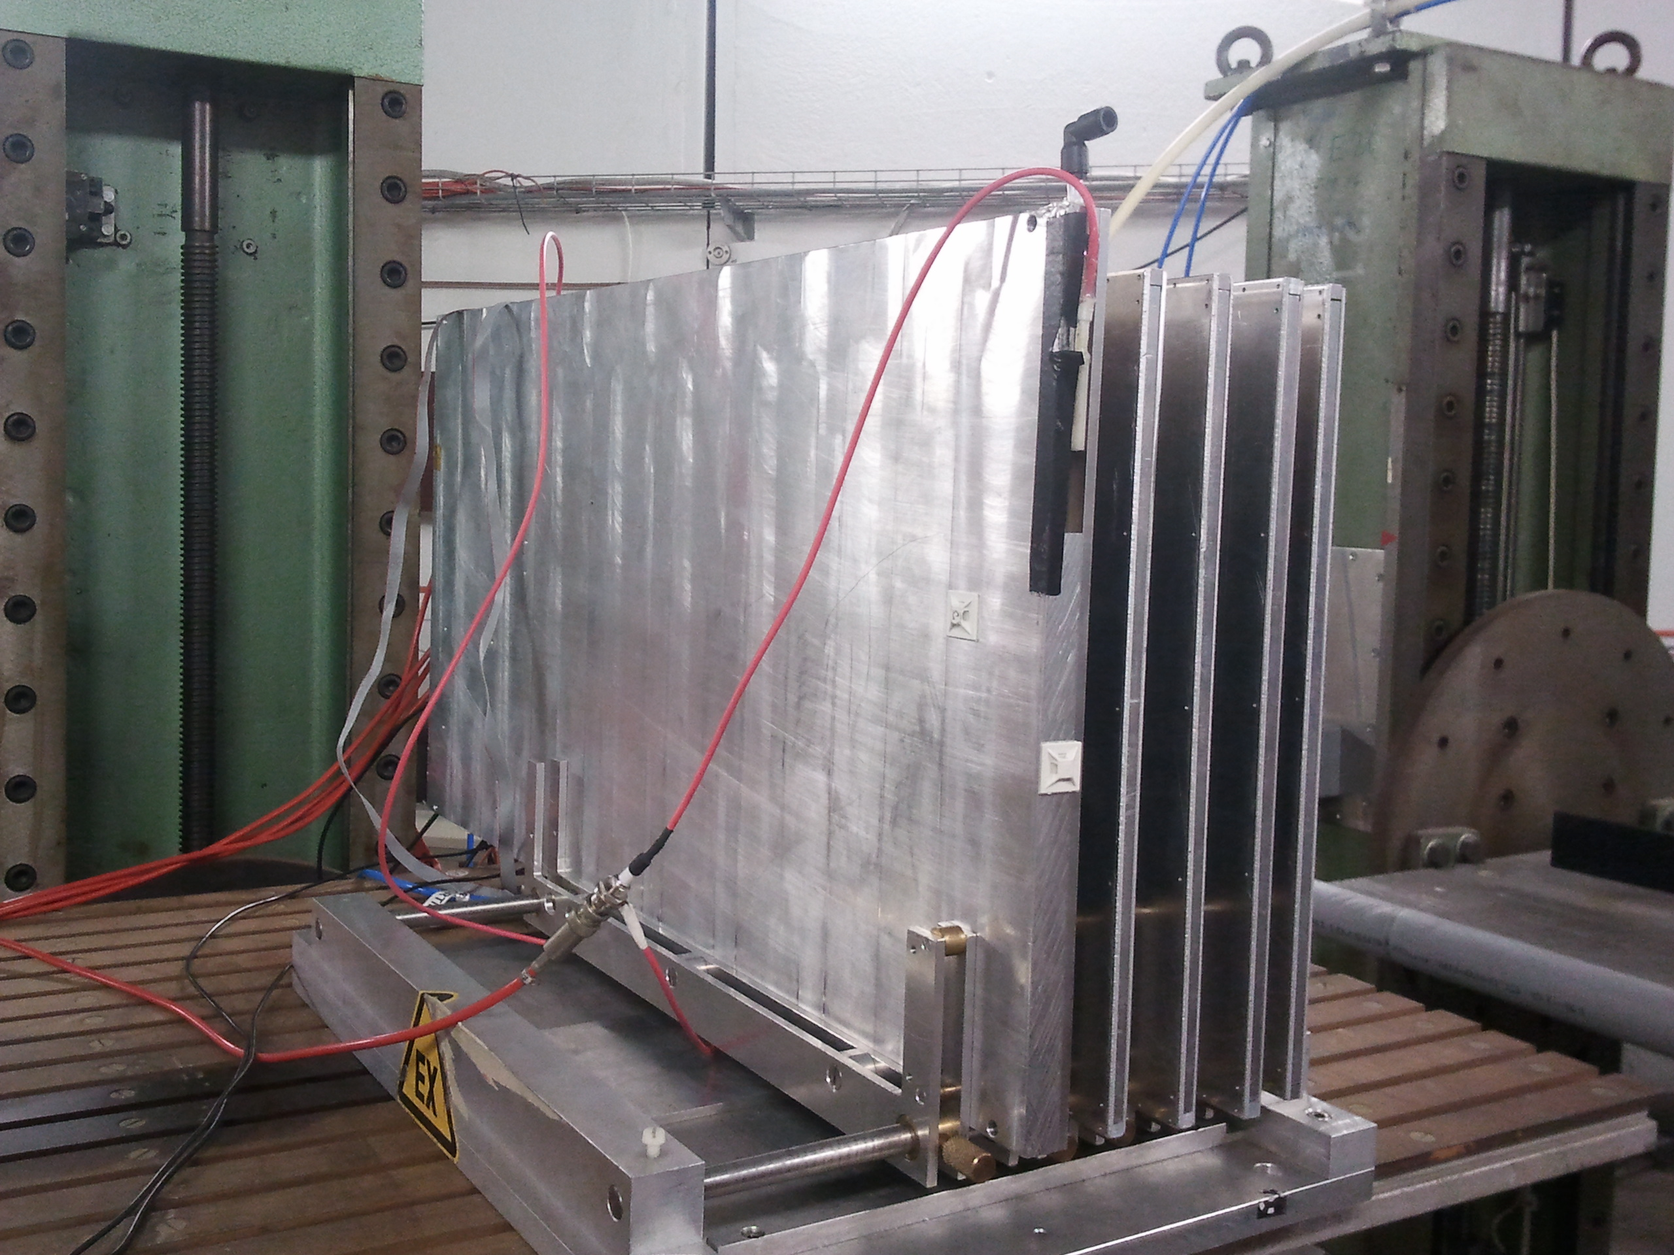
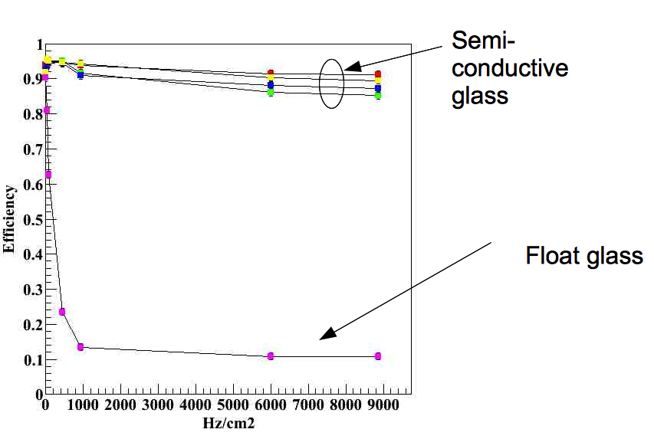
High-Rate GRPC
High-Rate GRPC may be
needed in the very forward
region
Semi-conductive glass (10¹⁰ Ω.cm)
produced by our collaborators
from Tsinghua University was
used to build few chambers.
4 chambers were tested
at DESY as well as standard
GRPC (float glass)
Performance is found to be excellent at high rate
for GRPCs with the semi-conductive glass and can be used in the very forward of ILD region if the rate exceeds 100 Hz/cm² in future ILD upgrades

Slide 12
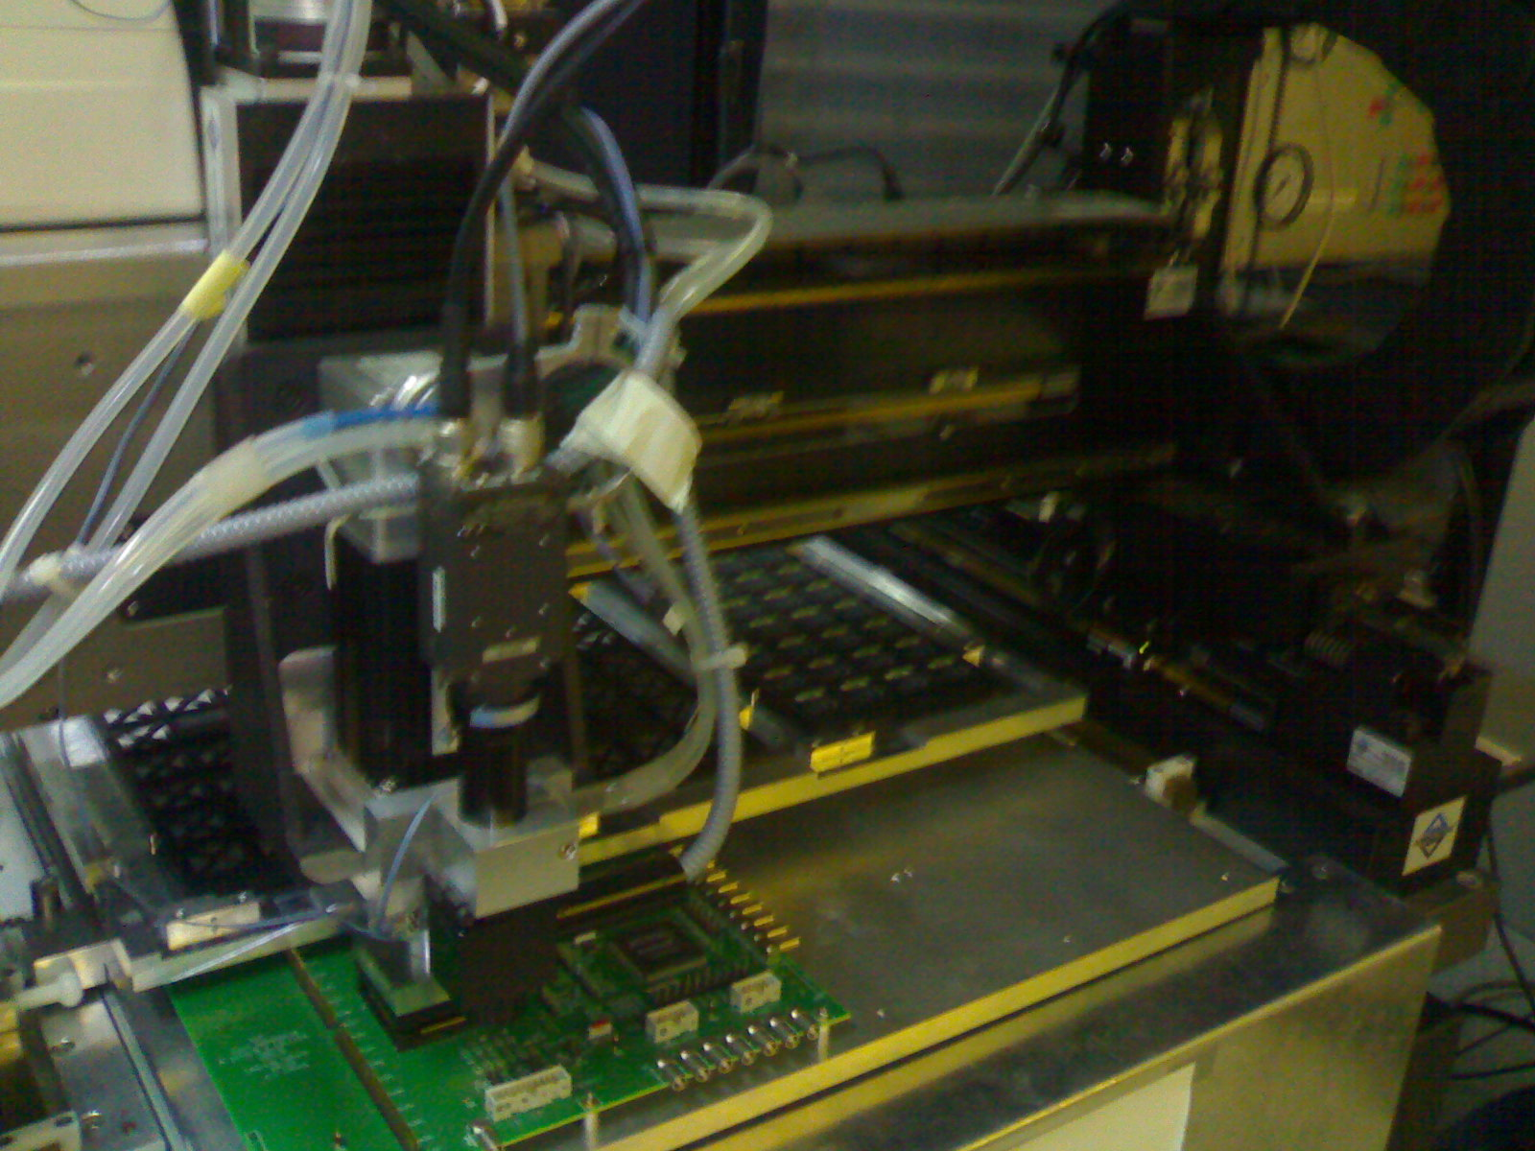
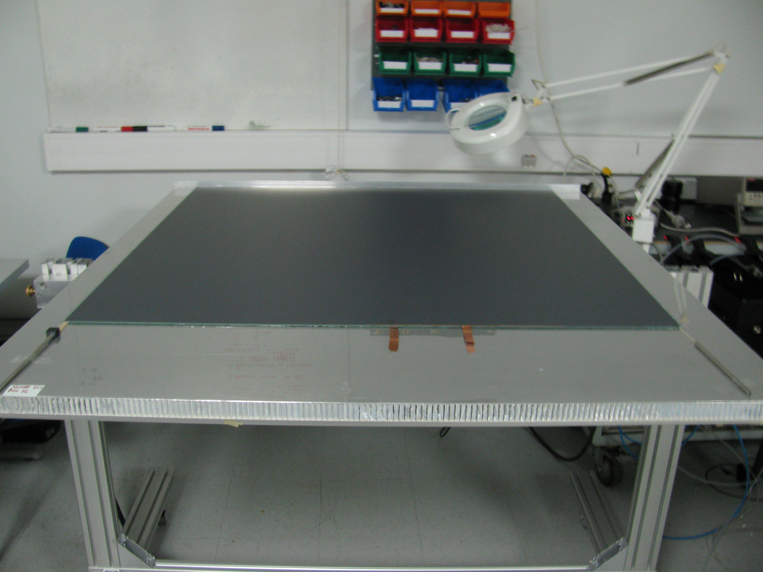
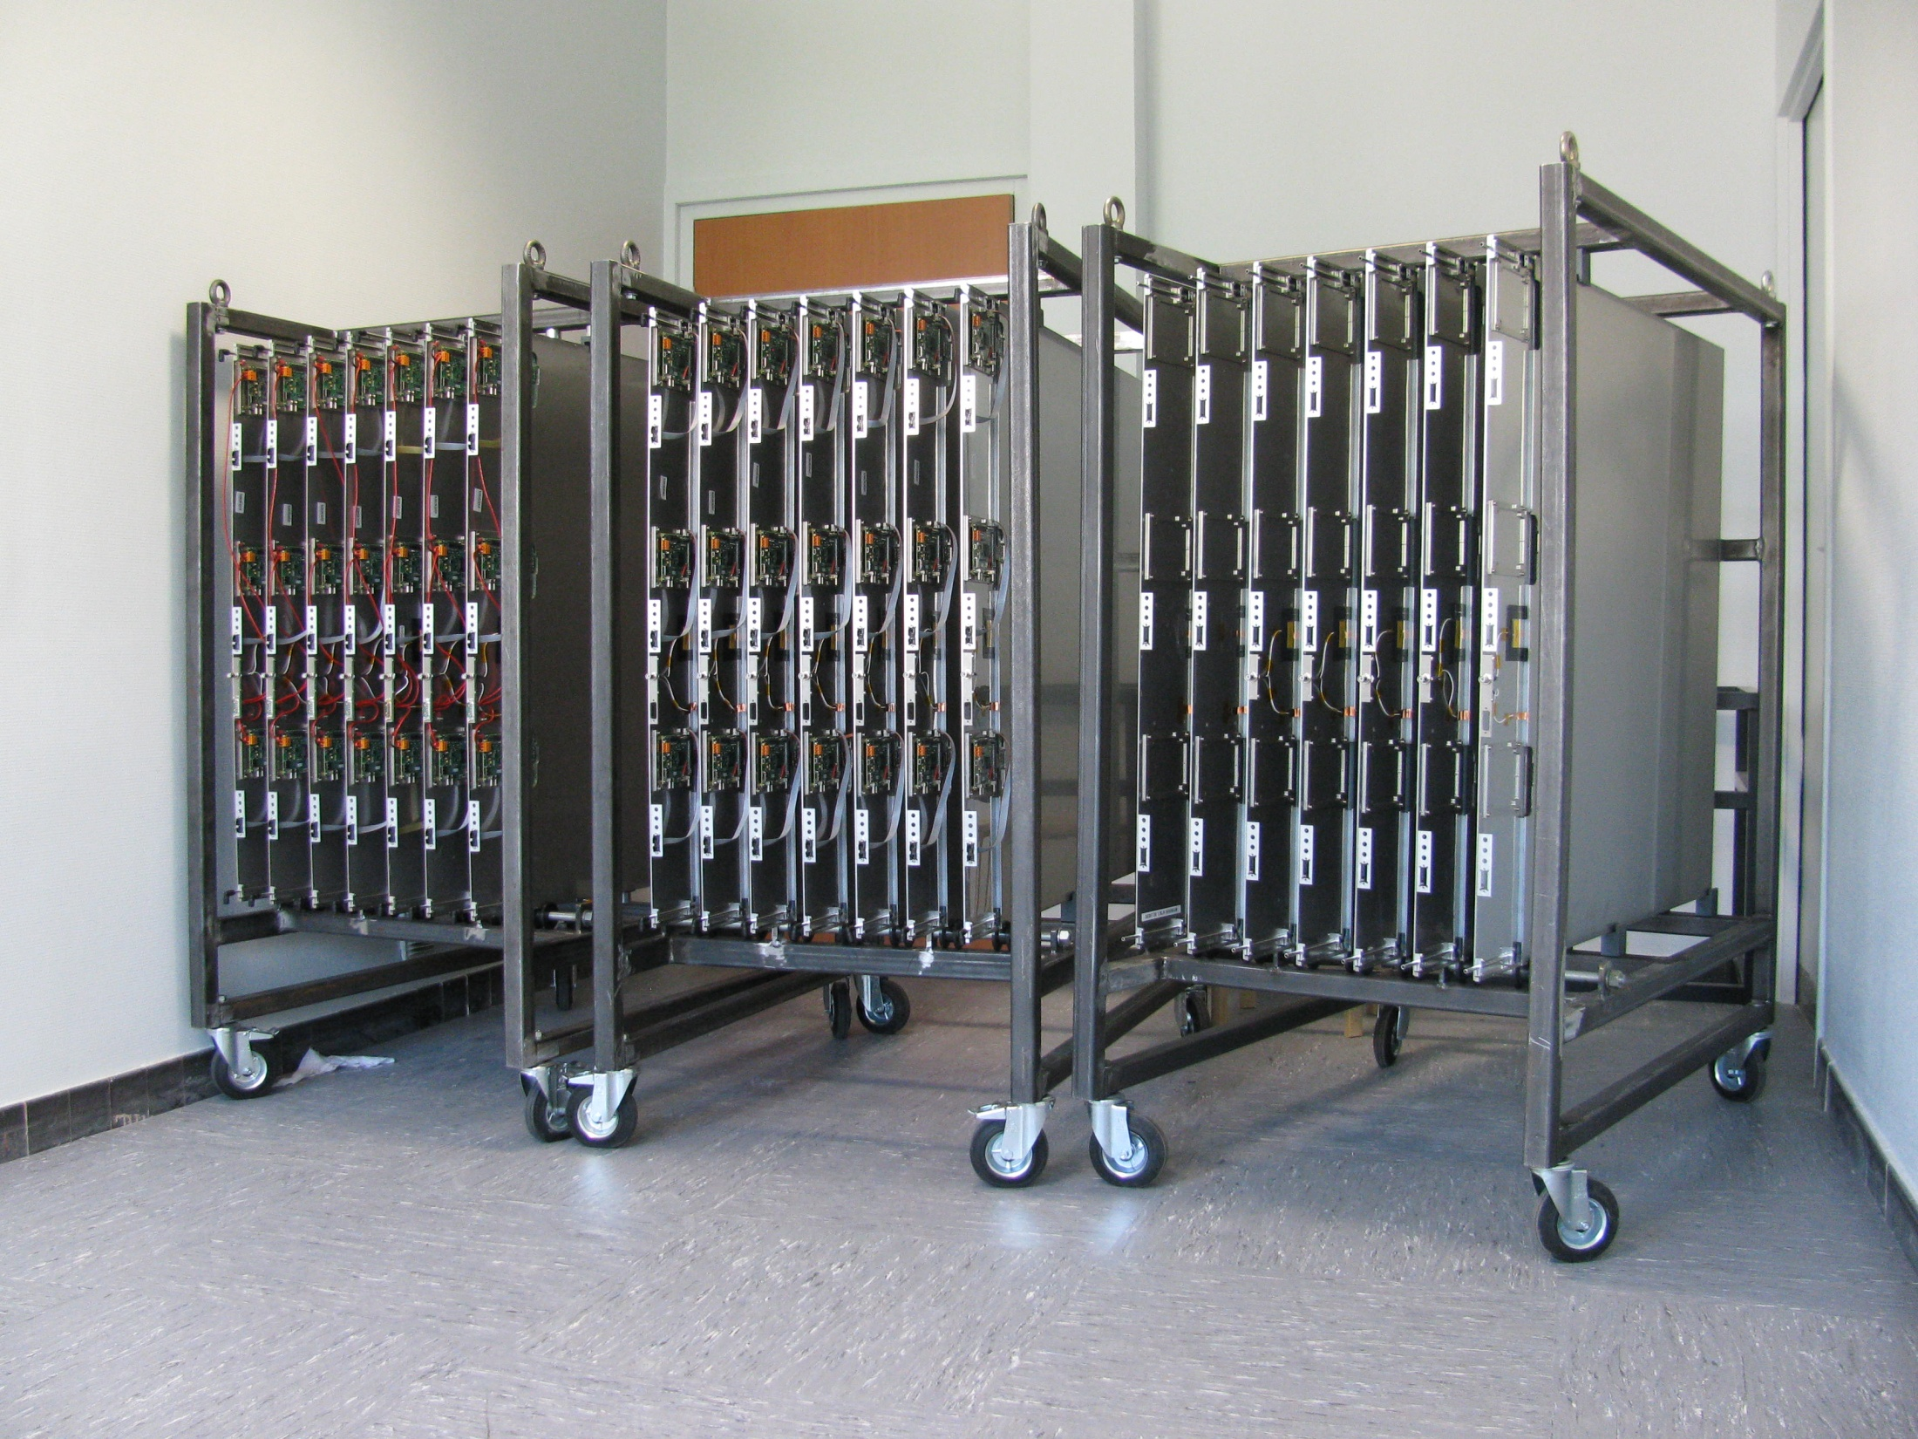
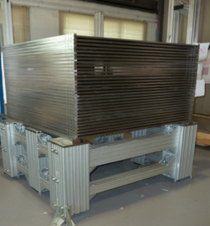
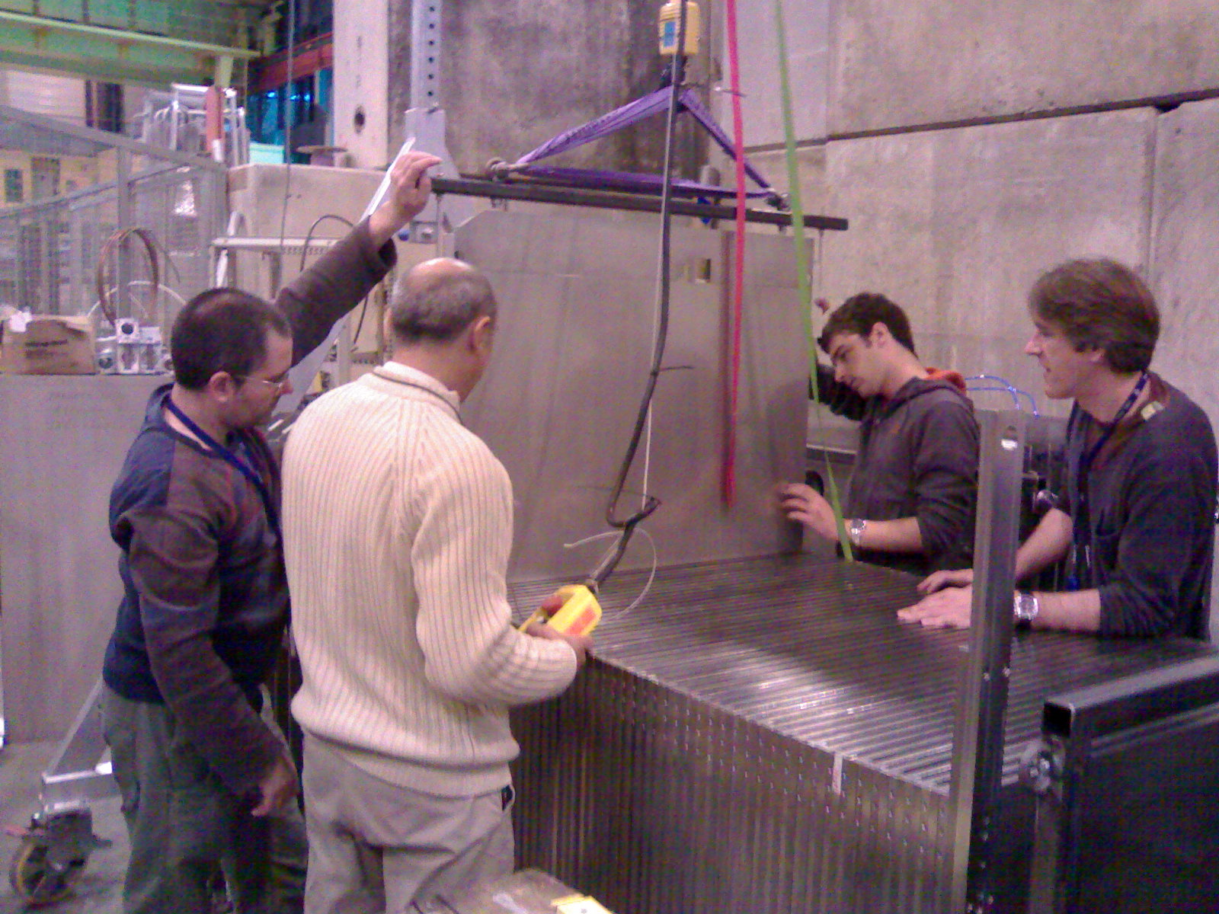
SDHCAL prototype construction
10500 ASIC were tested and calibrated using a
dedicated robot that was used by CMS (IPNL, OMEGA)
(ASICs layout : 93% ).
310 PCBs were produced, cabled and tested (IPNL).
They were assembled by sets of six to make 1m²
ASUs
170 DIF(LAPP), 20 DCC(LLR) were built and tested.
50 detectors were built and assembled with
their electronics into cassettes. Cassettes were tested
by sets of 6 using a cosmic test bench (IPNL).
The mechanical structure was built in CIEMAT.
HV, cooling services were built by UCL, Gent.
Full assembly took place at CERN.

Slide 13
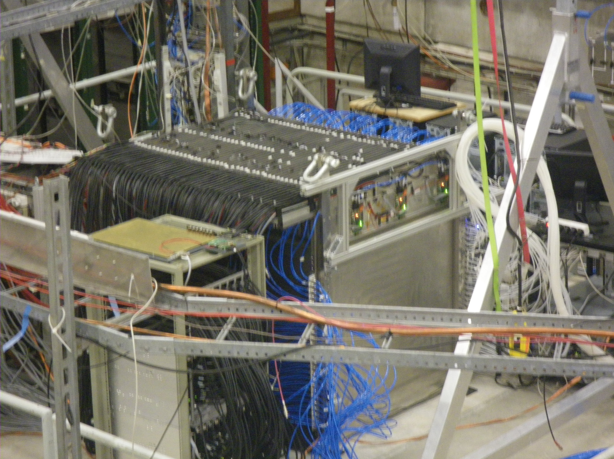
Prototype @TB
TB in 2012, 2014 and 2015 (6 weeks)
Thresholds choice
optimization;
Muons run calibration;
→ Pion, electron runs
to study EM and
hadronic showers;
No particle identification detector was used.
Power-Pulsing Triggerless modes

Slide 14
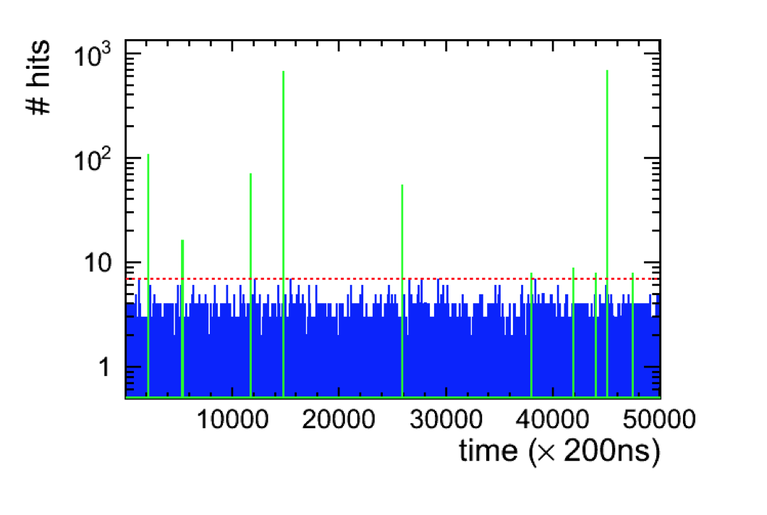
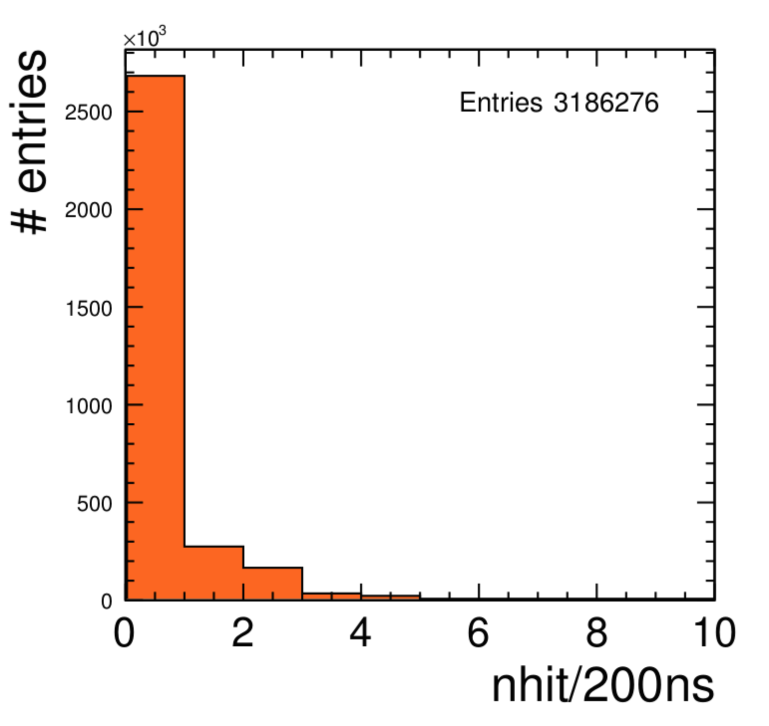
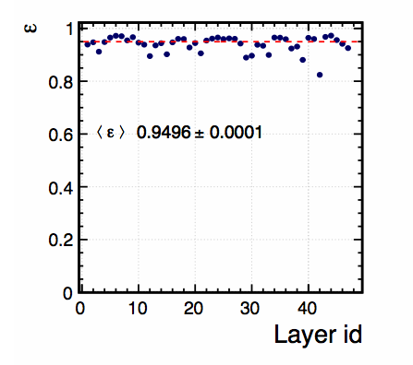
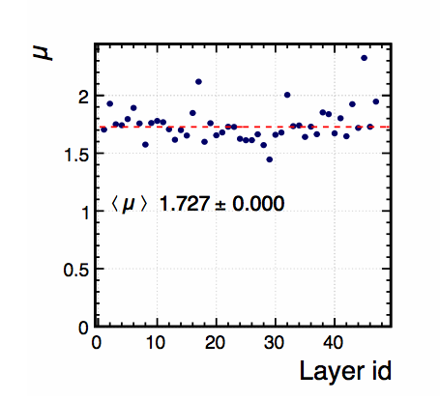
Data collection
All hits of all sorts are recorded while the power-pulsing is on ( during the spill duration)
Mean : 0.76 hits
RMS : 0.70 hits
Efficiency
Pad multiplicity

Slide 15
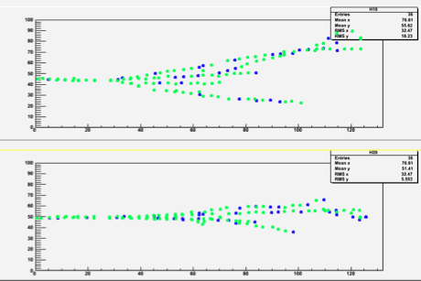
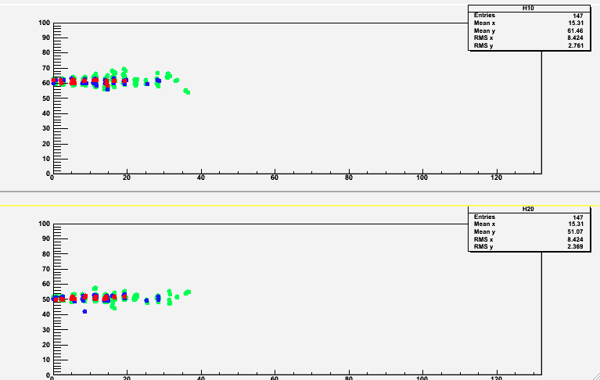
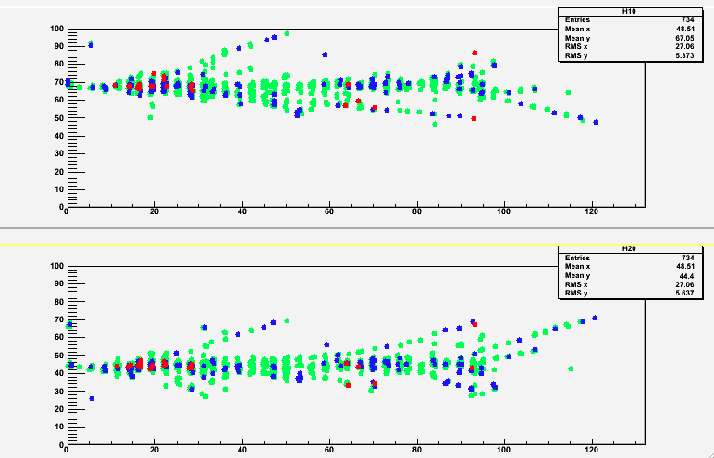
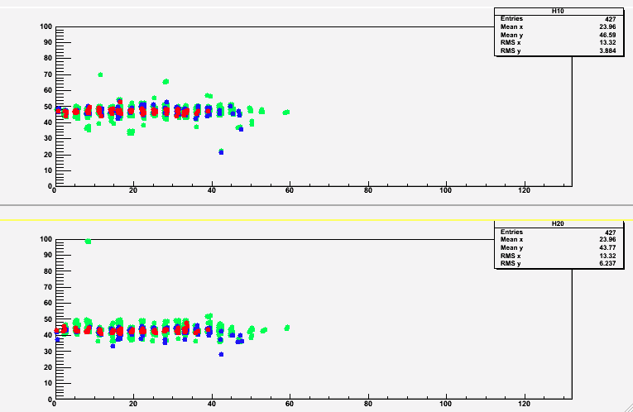
Event display
10 GeV pion
10 GeV electron
X
Z
Z
Y
Z
Z
TriggerLess
Power-Pulsed
units in cm
X
50 GeV pion
50 GeV electron
Z
Z
Y
Z
Z
Colours correspond to the three thresholds: Green (100 fC), Blue (5 pC), Red (15 pC)
Raw data, no treatment except time hit clustering

Slide 16
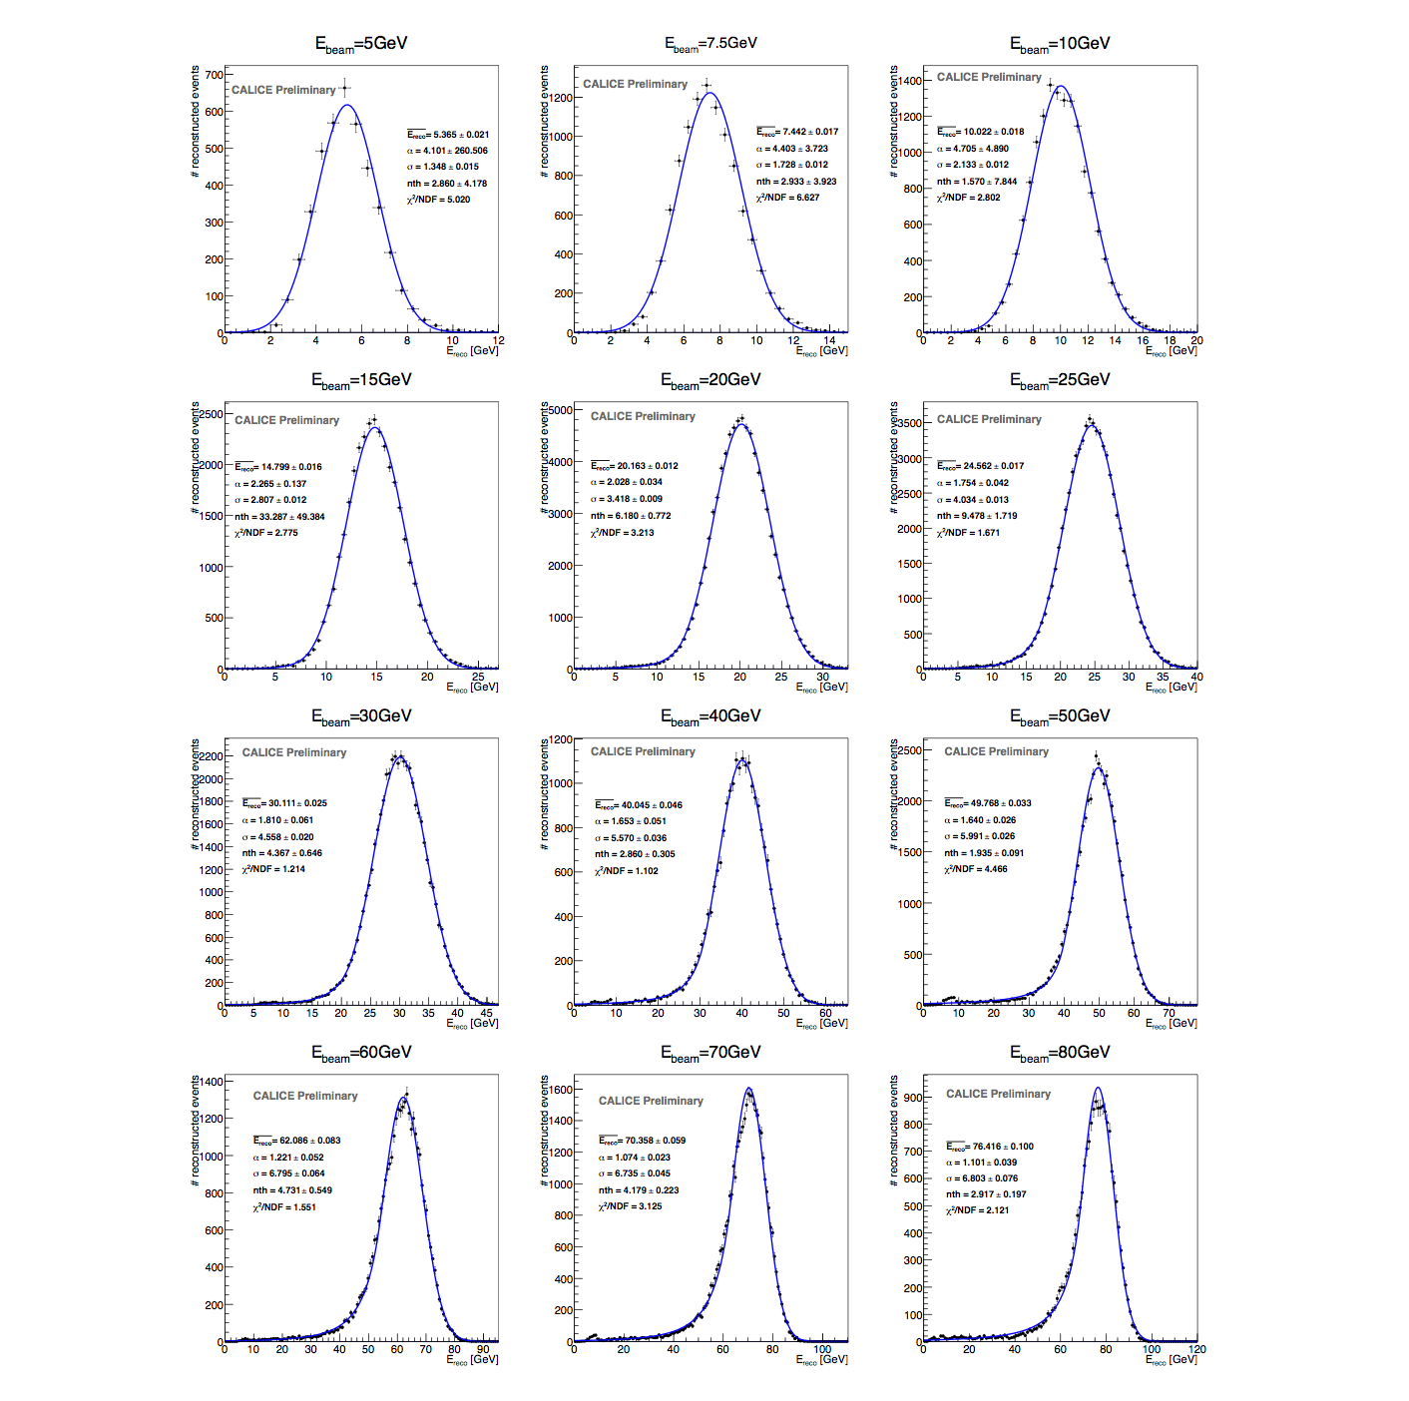

Slide 17
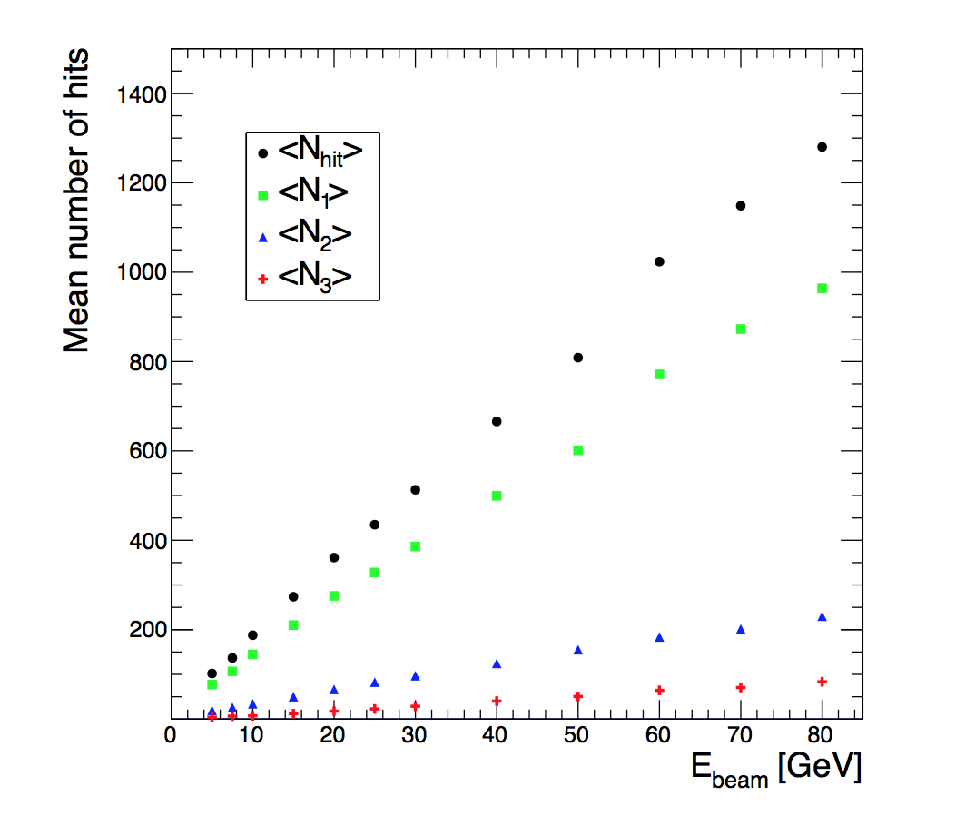
Mean number of hits for each threshold versus energy

Slide 18
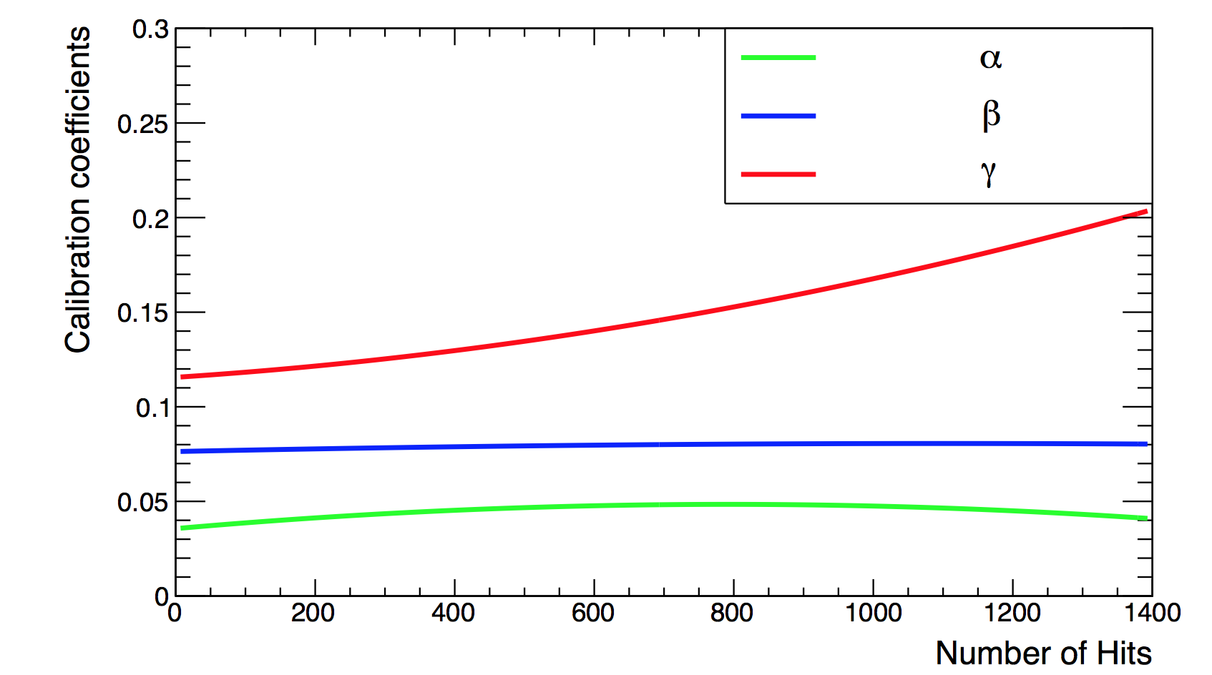
Energy estimation
The thresholds weight evolution with the total number of hits obtained by minimizing a χ²
Χ² = (E_{beam}-E_{rec})²/E_{beam}
E_{rec =} α (N_{tot}) N₁ + β(N_{tot}) N₂ + γ(N_{tot}) N₃
N₁,N₂ and N₃ : exclusive number of hits associated to first, second and third threshold.
α, β, γ are quadratic functions of the total number of hits (N_{tot})
For instance α = α₀ + α₁ N_{tot} +α₂ N²_{tot}
Events of September runs corresponding to energies : 5, 10, 30 , 60 and 80 GeV were used to fit the 9 parameters. This represents more than 50 k events.

Slide 19
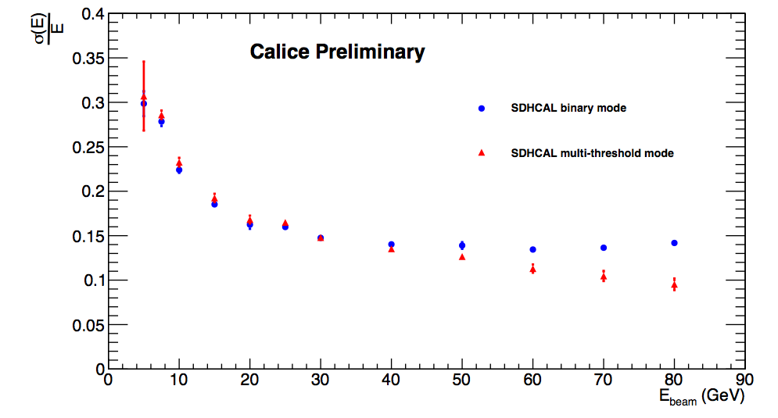
Semi-digital improvement with respect to the binary version.
Calice note CAN-037

Slide 20
SPS-H6
SPS-H2
SPS-H6
SPS-H2

Slide 21



High-granularity impact
Hough Transform is an example to extract tracks
within hadronic showers and to use them to control
the calorimeter in situ
ρ_{xz} = z sin(θ) + x cos(θ)
Excellent agreement with results obtained from direct methods

Slide 22
Improvement of energy resolution

Slide 23

Raw data
Pion
Selection
Overlay
Shower separation
Excellent separation down to 10 cm of distance between 2 close-by h.showers
Comparison
E1 – E3 ?
E2 – E4 ?

Slide 24
Road map in the 2-3 coming years
Build few very large GRPC detectors (2-3 m2) : gas circulation system, thickness…;
Test the new version of electronics (I2C, roll mode..) ;
Design a new ASU capable to read the large GRPC (up to 3 m²);
Develop a new DIF ( low consumption, reduced size, new functionalities);
Build a small mechanical prototype to host the few large chambers and test it.

Slide 25

New version of the readout electronics
New features in
the DAQ boards
RJ-45 (Data)
External Network chip
RJ-45 (TTC)
TTC electrical layer
(ADN2814)
ASU
connectors
Fiber/copper
(future use)
SFP cages
Spare I/Os
Clock in/out
Power out
FPGA
Large enough to embed processor if needed
The new version brings improvements on the previous one:
Independent channels and
zero suppression
Independent ASICs (I2C)
Better dynamic range
(up to 50 pC).
successfully tested;
600 ASIC have been produced
Micro USB
USB2
WatchDog
Temp
Power in
Power supply
DIF and ASU
Goldcaps to handle power pulsing ?
Current/voltage monitoring
Only one DIF per plane. For the maximum
length plane (1x3m) the DIF will handle
432 HR3 chips;
Slow control through the new HR3 I2C bus;
→ Data transmission to DAQ by Ethernet using commercial switches for concentration;
Clock and synchronization by TTC;
Synergy with R&D on fast links R&D of LHC (GBT)
Funded essentially by CIEMAT
New ASU design for large detectors under study

Slide 26





Detector improvement : to achieve same performances with very large GRPCs
Prototype circulation system
New circulation system
inlet
outlet
2 m
1 m
Mechanical structure : to be built with EBW techniques and to host few large detectors GRPCs

Slide 27
Conclusion and prospects
-The SDHCAL prototype is the first and up-to-now the unique technological
calorimeter prototype built for ILC future experiments.
-SDHCAL with its fine granularity is an excellent tool to develop and exploit
PFA algorithms;
-Fine granularity is also an excellent tool to study hadronic shower;
-The project has led to several spin-offs (TOMUVOL, CMS,..);
-Work on complete validation of the SDHCAL concept is on-going.
-Adapting the SDHCAL to CEPC, FCCee are also on-going (active cooloing, timing….)

