Slide 1
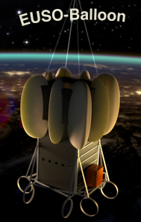
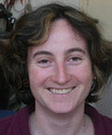

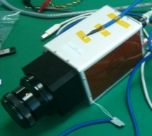
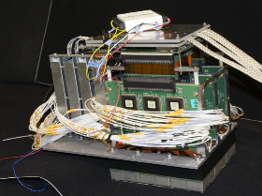
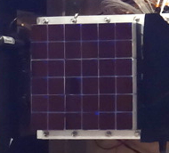
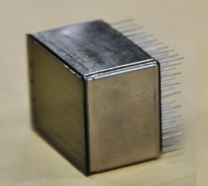
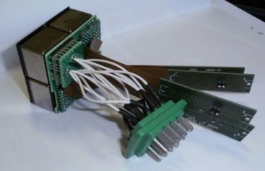
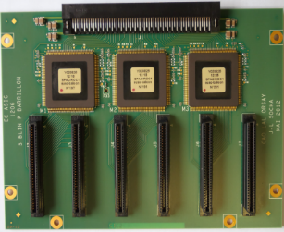
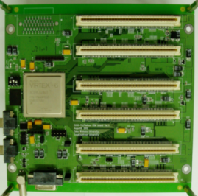
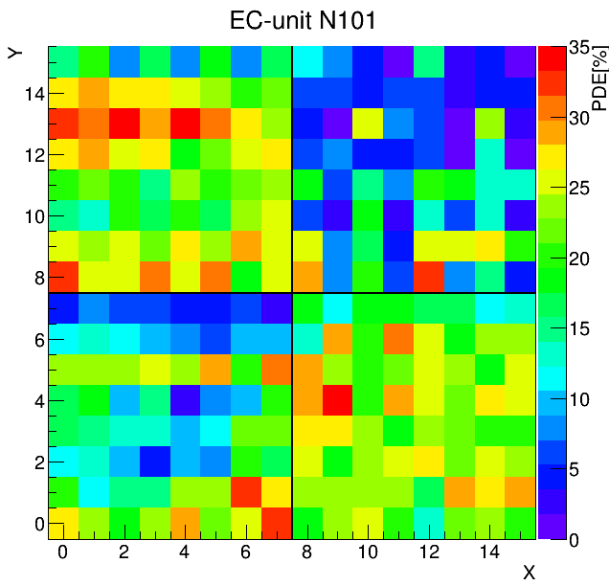
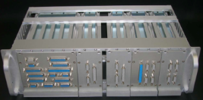
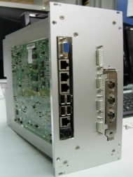
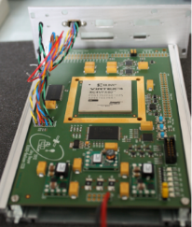
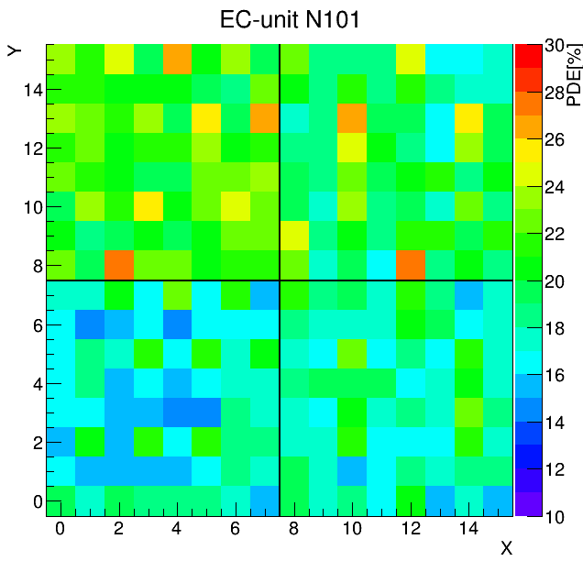





EUSO-BALLOON: Readout electronics performances
Sylvie Blin, Simon Bacholle, Pierre Barrillon, Sylvie Dagoret, Christophe de la Taille, Frédéric Dulucq, Andreas Ebersolt, Philippe Gorodetzky, Aera Jung , Hiroko Miyamoto, Camille Moretto, Guillaume Prévôt, Julio Arturo Rabanal for the JEM-EUSO Collaboration
EUSO-BALLOON: UV camera with 2304 pixels launched in August 2014.
IR camera
Poster presents the Photo Detector Module
Sensor (photodetector)
Front-end (FE) electronics
PMT
• Hamamatsu 64-ch MAPMT
• BG3 filter
EC-Unit
• 4 PMTs (256-ch)
readout cables
• HV board
• potting
EC-ASIC
• 6 x ASICs
• readout
• counter
PDM-Board
• Slow control
• Level 1 (L1, track) trigger
167 mm
167 mm
Efficiency of 4 MAPMT pixels: Without ASIC gain adjustment
HK, LVPS
Data Processing (DP)
CPU
• Run control, config. FE electronics
• Console & GUI, remote access, etc.
• Data processing
• managing Mass Memory for data storage
CCB
(Cluster Control Board)
• Receive data
from 9 PDMs
Efficiency of 4 MAPMT pixels: With ASIC gain adjustment
FRONTIER DETECTORS FOR FRONTIER PHYSICS – 13th Pisa Meeting on Advanced Detectors

