Slide 1
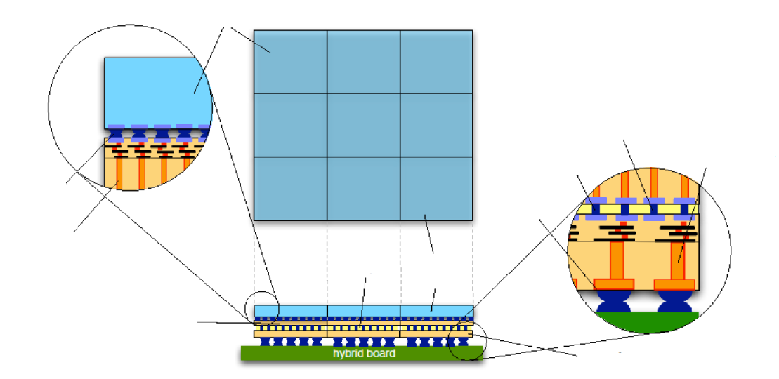
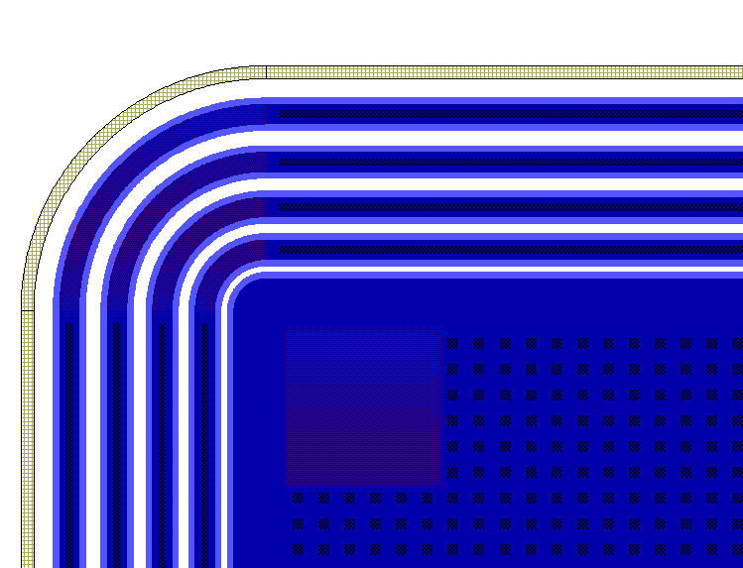
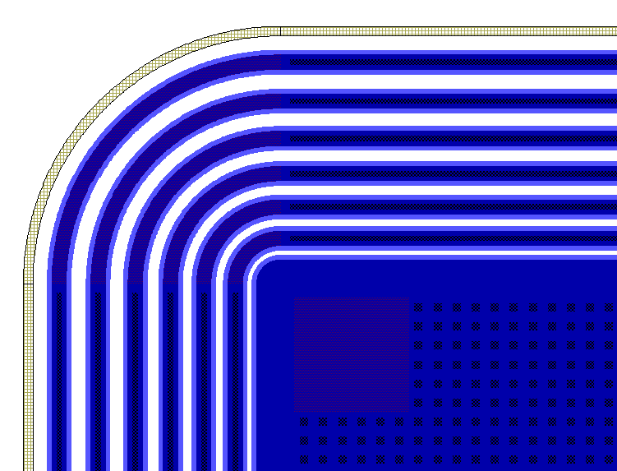
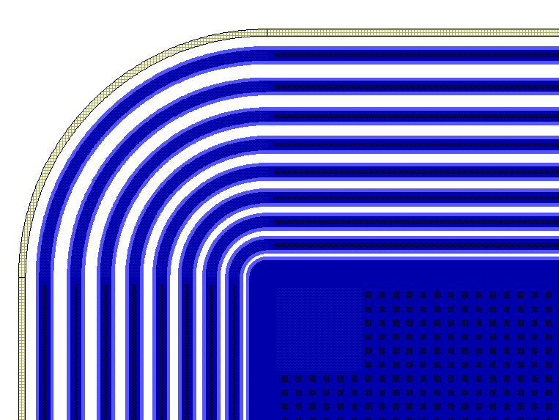
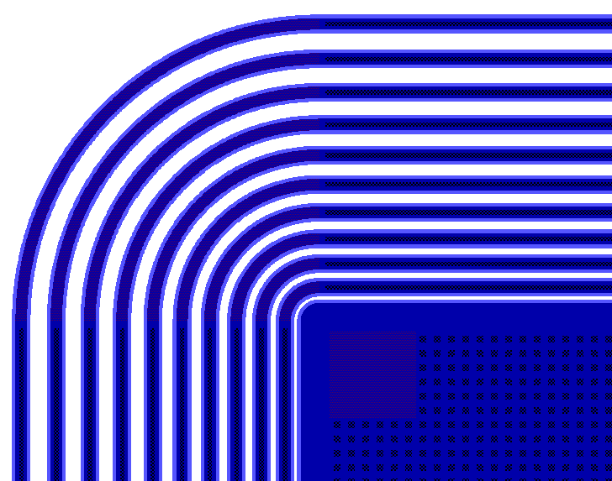
Design and TCAD simulation of planar p-on-n active-edge pixel sensors for the next generation of FELs
Gian-Franco Dalla Betta, on behalf of the PixFEL Collaboration (UniPI, UniPV, UniTN, INFN)
PARAMETER OPTIMIZATION
Active edge sensor
STRUCTURE & LAYOUT
high density interconnects
low density peripheral TSVs
Bond pads
bump bonding
low density bump bond
high density TSVs
Readout chip
Active edge sensor
front-end + ADC
memory + digital readout
Four-side buttable module for the assembly of large area detectors
Aim: Optimization with TCAD simulation
in order to find best trade-off between edge region size and breakdown voltage.
Breakdown voltage versus the oxide thickness in a 4-GR edge termination with different oxide charge densities and Junction Depths
Layouts for different border terminations
Contact holes
GR4
Active Edge
GR3
GR2
Trench
GR1
Best trade-off with 4 GRs, oxide thickness, t_{ox} ~ 300nm, Field-plate width, l_{FP} ~ 5µm, and Junction depth X_{j}=2,4µm
It allows for V_{BD} > 400V at all radiation doses within ~155 μm
4 Guardring structure
6 Guardring structure
8 Guardring structure
10 Guardring structure
Breakdown voltage versus the oxide charge density for different edge terminations

Slide 2
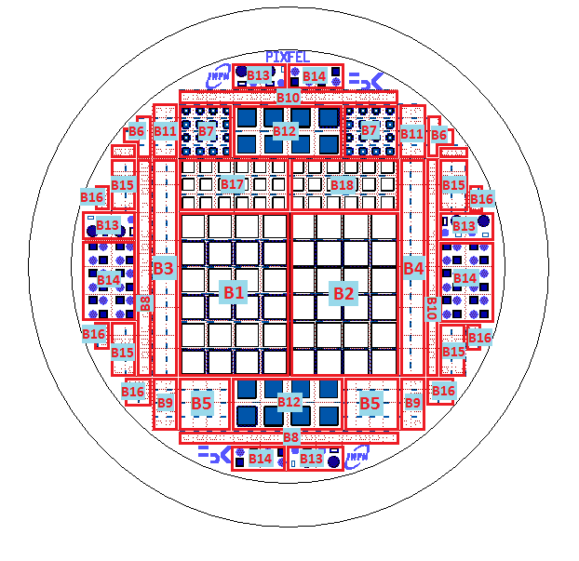
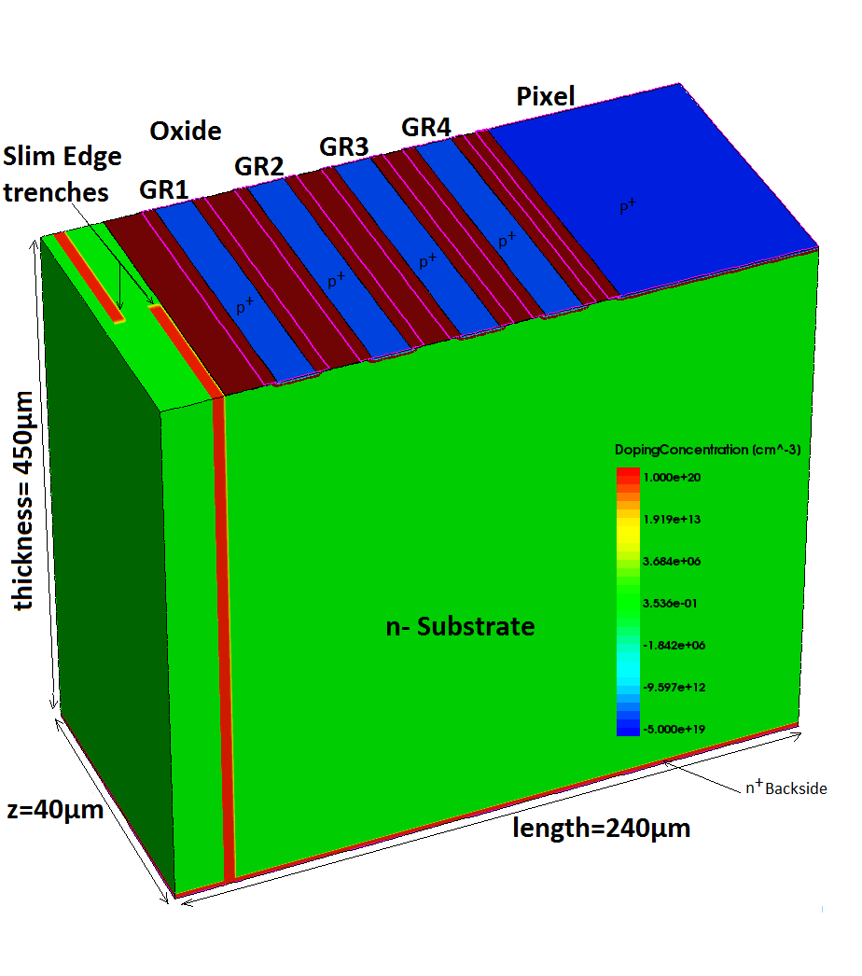
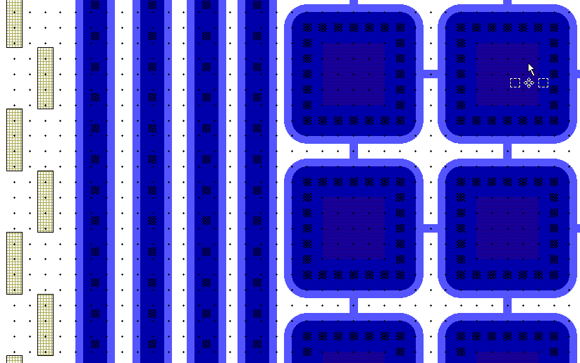
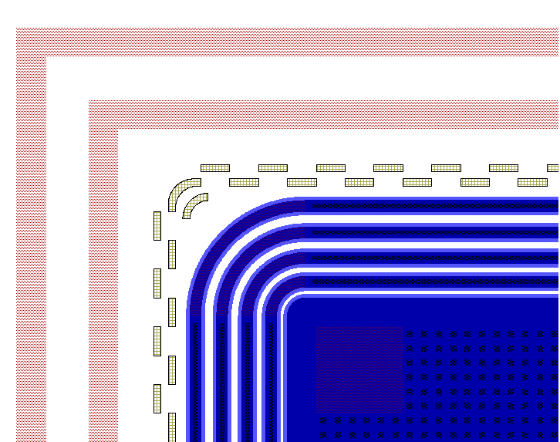
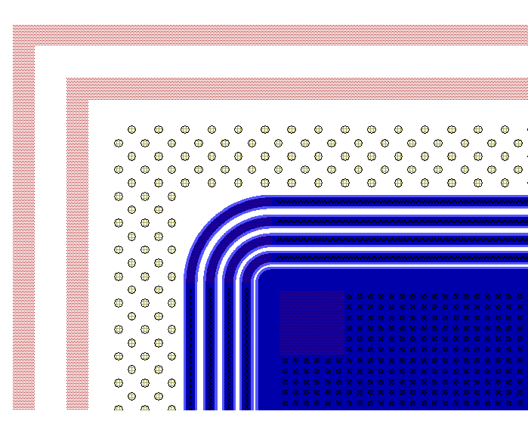
An alternative design with slim edge
DASHED TRENCH APPROACH
Advantages:
Get rid of the support wafer (simpler technology)
Entrance window at low energy can be optimized
Disadvantages and risks
Reduction of V_{BD}
More dead space on border
Wafer layout
TCAD 3D structure
Structure Layout
Structures in the layout:
- Standard test structures
- Pixel-cap extraction structures
- Large diodes with different border
terminations
- Strip sensors with different border
terminations
- The 8x8 Pixel arrays
- The 32x32 Pixel arrays
- The 64x64 Pixel arrays
Structure layout and simulation domain to investigate the Slim Edge approach with TCAD
Final layout of a 6-inch wafer including active edge and slim edge pixel sensors under fabrication at FBK (Trento, Italy)
Rectangular Slim Edge trenches
Columnar Slim Edge trenches
Scribe Line
Scribe Line
Scribe Line
Scribe Line
Trenches
Columns
GR4
GR4
GR3
GR3
GR2
GR2
GR1
GR1
IV-curves of a 4-GR edge termination with Slim Edge for different oxide charge densities

