Slide 1




The WaveDAQ System for the MEG II Upgrade
Stefan Ritt, Paul Scherrer Institute, Switzerland
Luca Galli, Fabio Morsani, Donato Nicolò, INFN Pisa, Italy

Slide 2
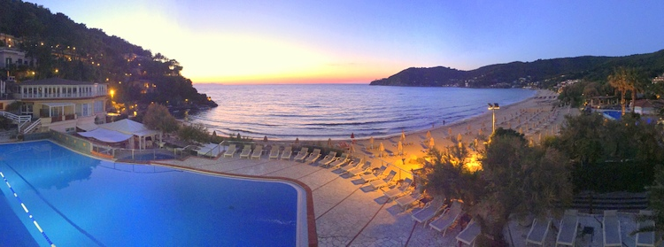
The WaveDAQ System for the MEG II Upgrade
Stefan Ritt, Paul Scherrer Institute, Switzerland
Luca Galli, Fabio Morsani, Donato Nicolò, INFN Pisa, Italy

Slide 3
DRS4 Chip
0.2-2 ns
Inverter “Domino” ring chain
IN
Storage
capacitors
Out
FADC
33 MHz
Clock
Shift Register
Switched Capacitor Array (Analog Memory) developed at PSI
5 GSPS / 11.5 bits SNR, 9 channels on 5 mm x 5 mm chip, 40 mW / chn.
Used at ~200 locations worldwide
2012: “Gigahertz Waveform Sampling: An Overview and Outlook”
Pile-up rejection O(~10 ns)
Time measurement O(10 ps)
Charge measurement O(0.1%)

Slide 4
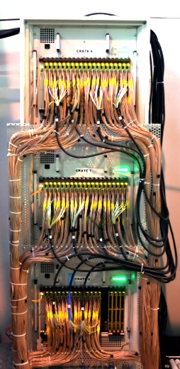
MEG & MEG II
MEG Experiment 1999-2013
Separated DAQ & Trigger
3000 Channels DRS4
(0.8 GSPS / 1.6 GSPS)
1000 Channels Trigger
(100 MSPS)
5 Racks
Power
Trigger
Active
Splitter
Clock distribution
PMT
Trigger Bus
DRS
DAQ
HV
MEG II Experiment 2014-
9000 Channels
Same rack space
➔Combine
DAQ & Trigger
TDAQ
SiPM
S2: M. de Gerone: An extreme high resolution Timing Counter for the MEG II Experiment
S2P: M. Simonetta: Test and characterization of SiPMs intended as detector for the MEG timing counter
S5P: D. Nicolò: An FPGA-based trigger for the MEG II Experiment
S5P: A. Pepino: A high performance Front End Electronics for Drift Chamber readout in the MEG II Experiment
S7P: M. Grassi: A new cylindrical drift chamber for the MEG II Experiment
S7P: G. Rutar: A Dedicated Calibration Tool for the MEG and MEG II Positron Spectrometer
S7P: L. Galli: MEG II drift chamber prototype characterization with the silicon based cosmic ray tracker at INFN Pisa
S7P: M. Venturini: Ageing tests for the MEG II drift chamber
S9P: D. Nicolò: A liquid hydrogen target for the calibration of the MEG and MEG II liquid xenon calorimeter
S9P: K. Ieki: Upgrade of the MEG liquid xenon calorimeter with VUV-light sensitive large area SiPMs

Slide 5
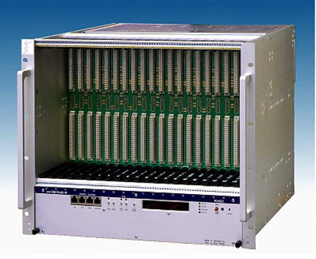
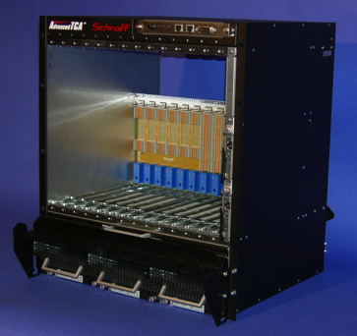
Crate Options
Feature | VME | ATCA | ???
Transfer speed O(100 MB/s) | ✔ | ✔ | ✔
Dual-Star Topology with Gbit links | ✗ | ✔ | ✔
Shelf management | ✗ | ✔ | ✔
Fast trigger distribution | ✗ | ✗ | ✔
Low-jitter precision clock O(ps) | ✗ | ✗ | ✔
200 V SiPM biasing | ✗ | ✗ | ✔
< 2000 EUR per crate including power | ✗ | ✗ | ✔

Slide 6
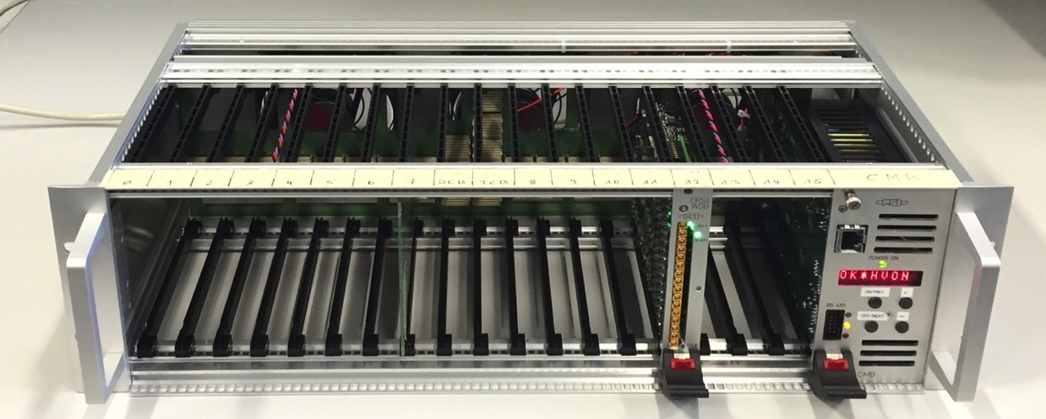
WaveDAQ System
Fans blow from back to front
Crate Management Board
Power supply 24V / 300W
Fan / Temp. control
Power cycle each slot
FPGA Firmware upload
Ethernet remote control
Data Concentrator Board
Trigger Concentrator Board
16 WaveDREAM boards (256 channels)

Slide 7
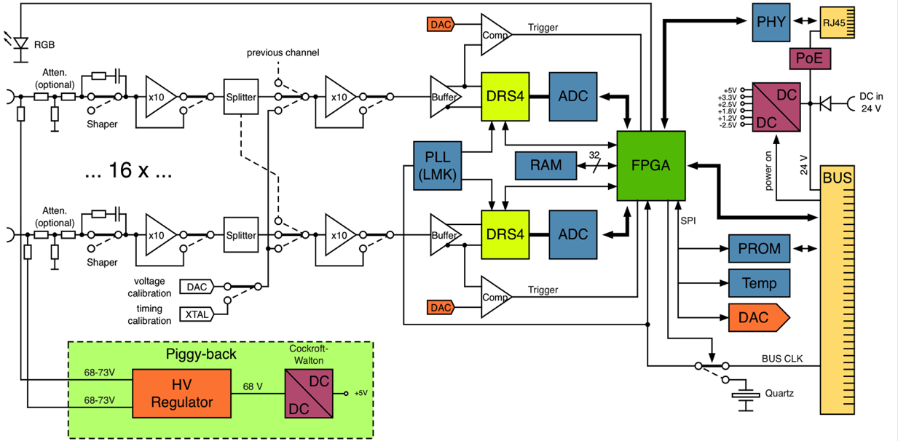
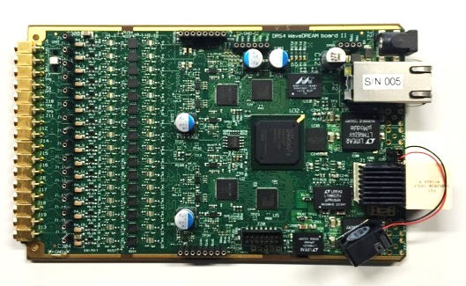
WaveDREAM Board (WDB)
Spartan 6
Drs4 based REAdout Module

Slide 8
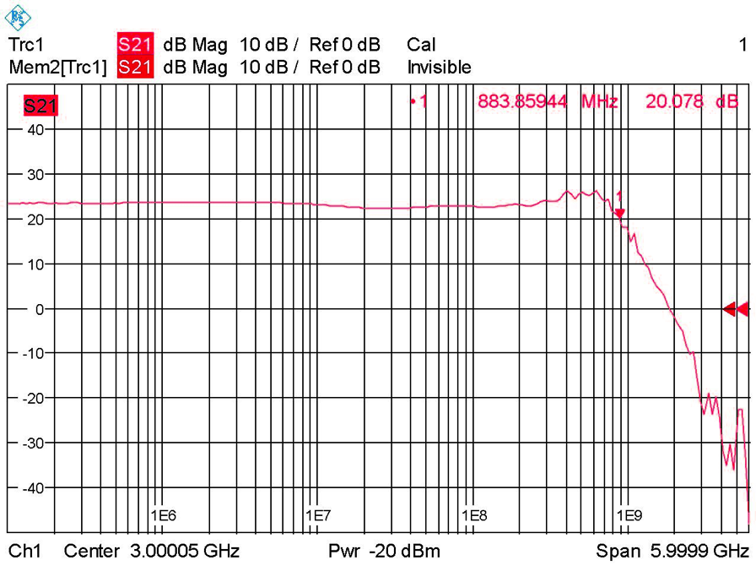
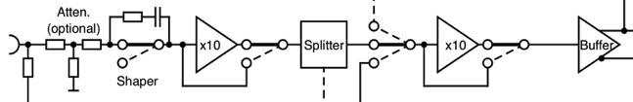
Preamp
Gain | BW_{3db} (MHz) | Noise (mV)
1 | 940 | 0.37
10 | 880 | 0.40
100 | 300 | 1.2
100 | 500 | 1.7
100 | 800 | 3.3
Different compensations
LMH6629
LMH6629
LTC6409
3.3 mV at output =
33 μV at input
PE4215
ADC904
PE4215

Slide 9
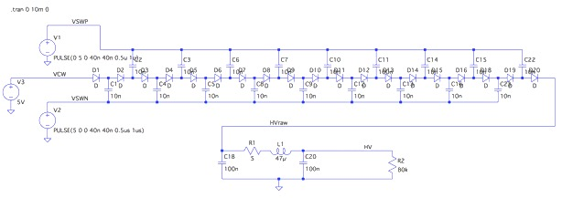
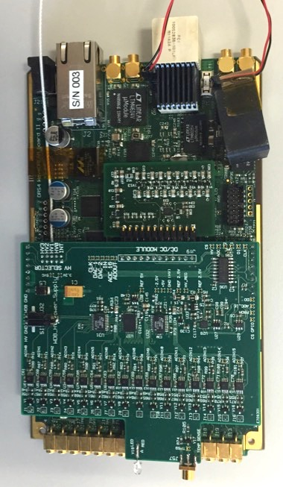
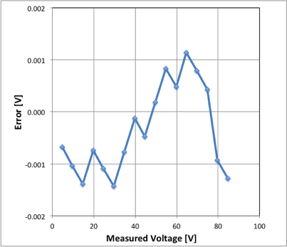
WaveDREAM2 HV
Microblaze @
Spartan
~ 5 EUR / channel
+/- 1mV
Ripple < 10 μV

Slide 10
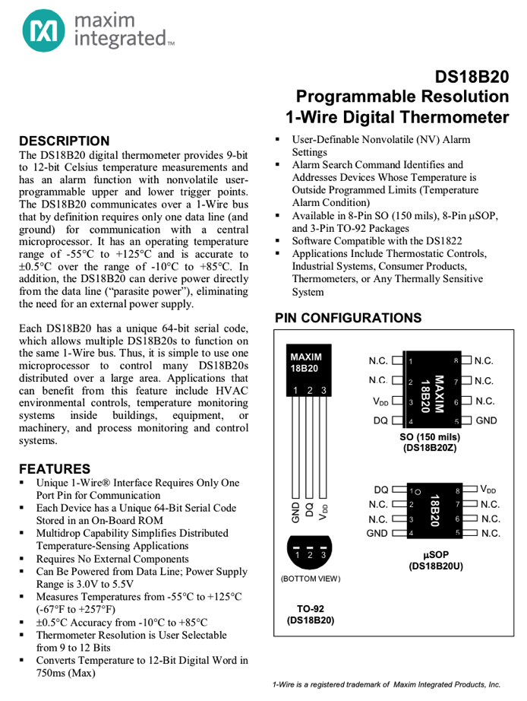
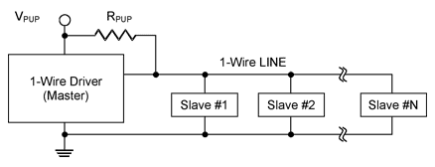
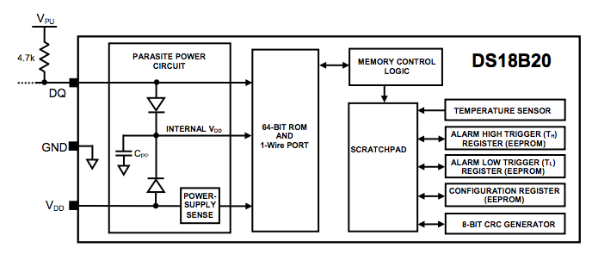
Temperature Sensor Extension
accuracy ±0.5∘, 3 EUR / sensor
1-16 sensors per WD2 board with
only one coaxial cable
Automatic HV adjustments with
temperature changes

Slide 11
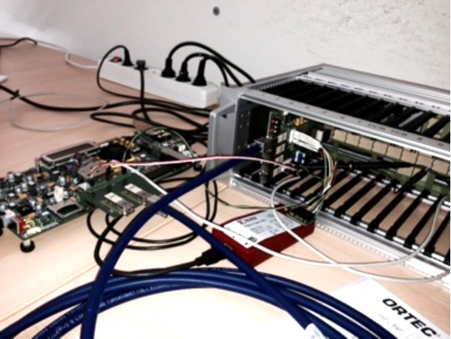
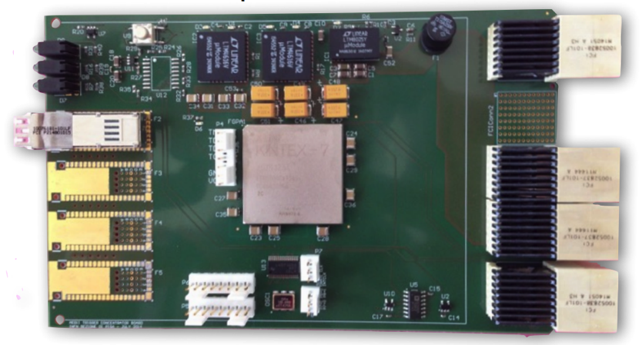
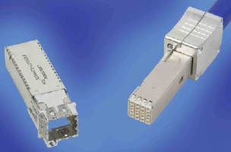
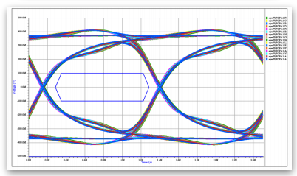
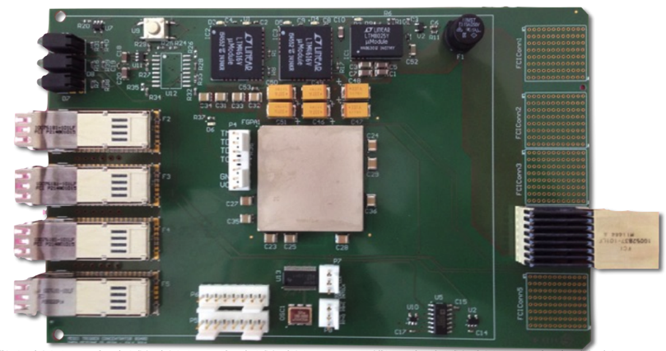
Trigger Concentrator Board (TCB)
Crate local trigger
KINTEX 7
Global trigger
Receives serial links (SERDES) from WD boards
Computes crate local trigger
Send trigger via serial links to global trigger in dedicated
crate
FCI Densishield cables
KINTEX 7

Slide 12
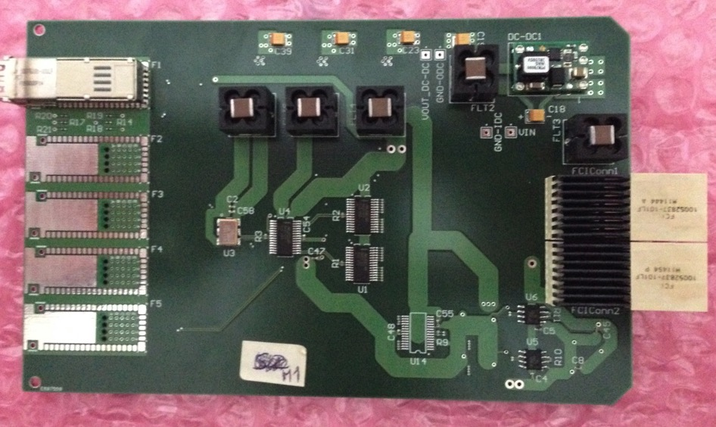
Ancillary system
Contains master clock
Distribute clock
(jitter < 12 ps measured)
Distribute trigger
4 diff. pairs for
  Clock
  Trigger
  Busy
  (Sync)

Slide 13
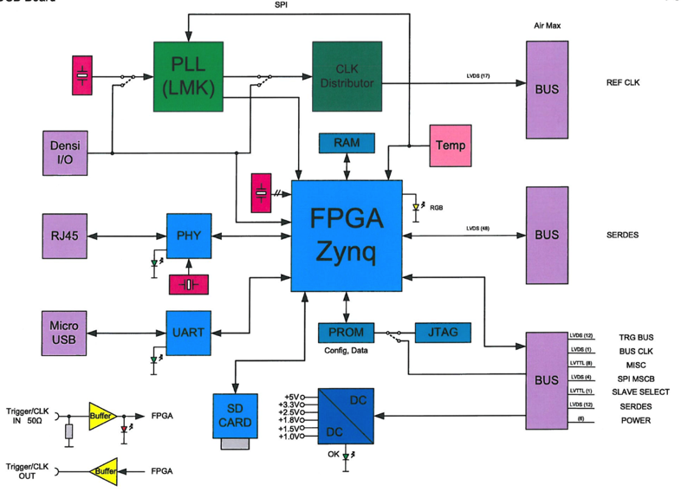
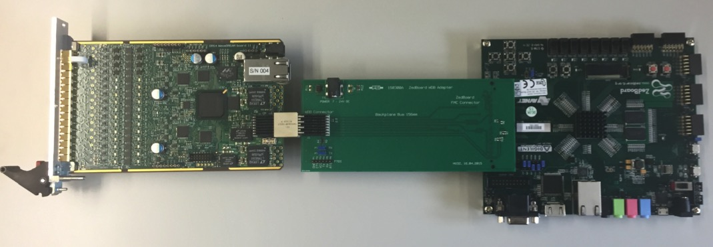
DAQ Concentrator Board (DCB)
Receive Gbit links from WDB
Use SERDES instead GTX (lower latency)
Waveform preprocessing in Zynq CPU
Output via Gbit Ethernet (10 Gbit optional)
Board under design
Tests with Zed-Board and “Backplane Simulator”

Slide 14
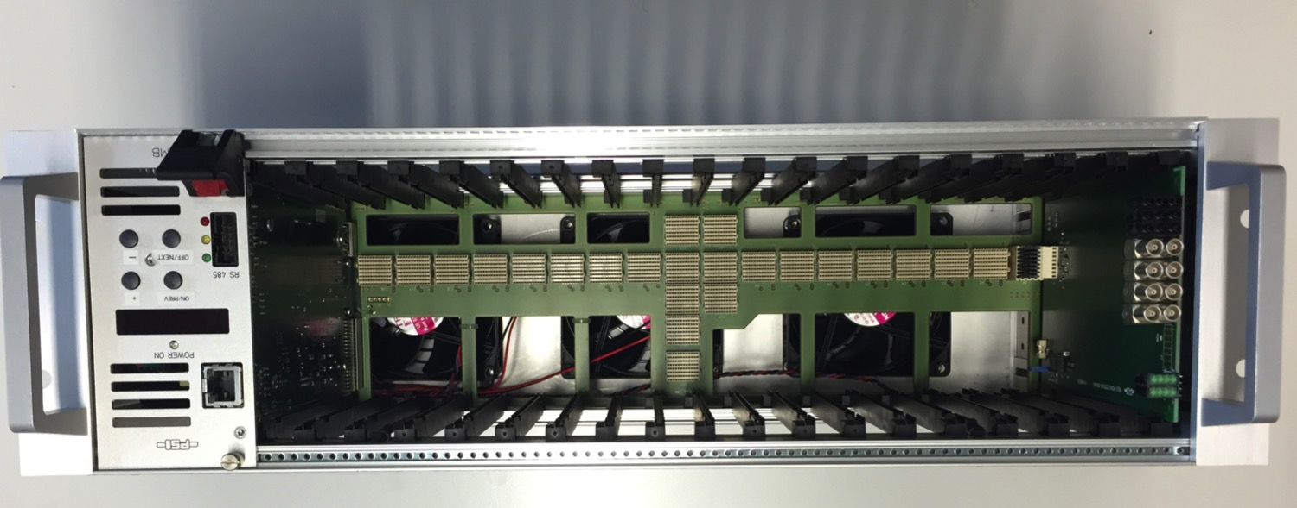
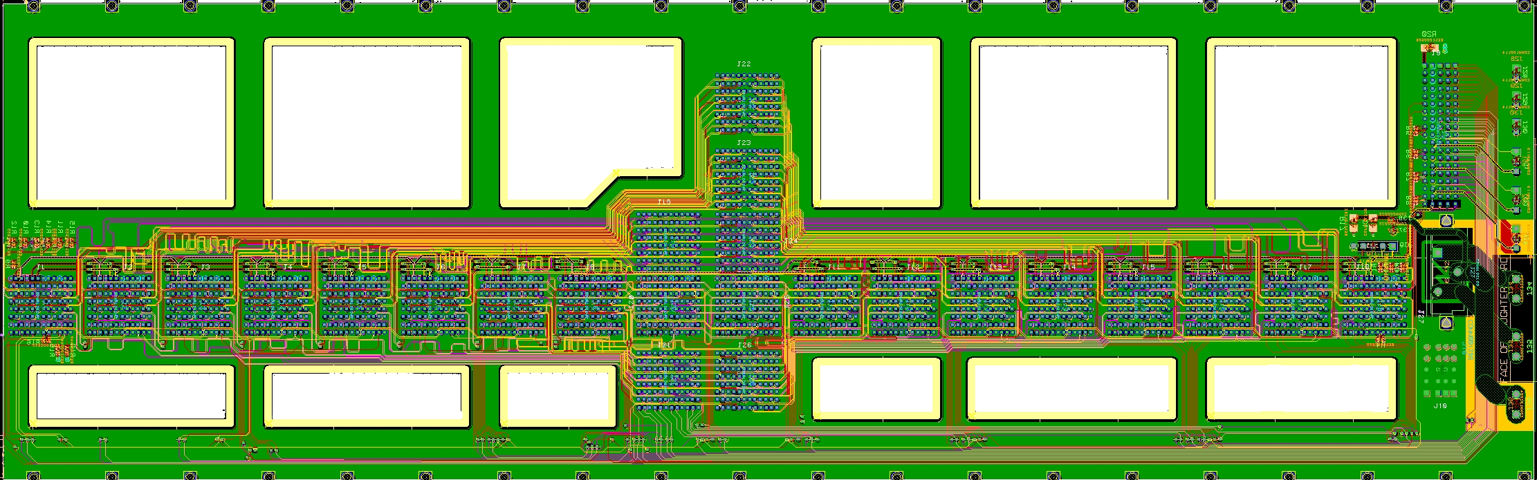
Half Height Backplane

Slide 15
SPI configuration

Slide 16
Gbit links for DAQ & Trigger
Event Builder PC
Global Trigger

Slide 17
Trigger Bus & HV

Slide 18
Clock Distribution

Slide 19
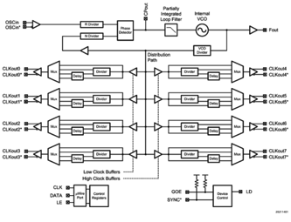
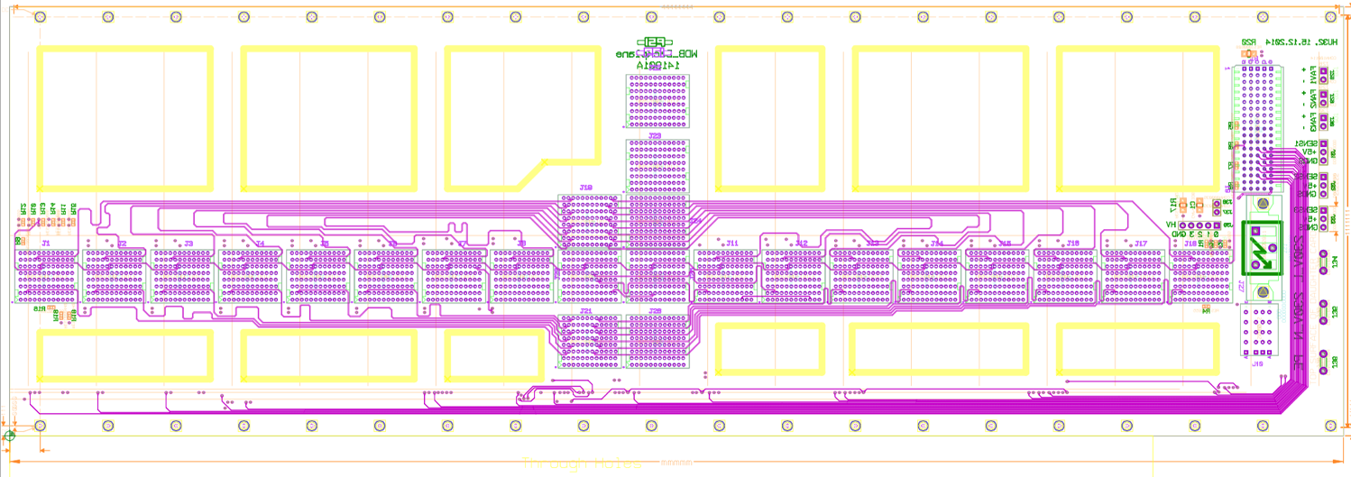
WaveDAQ Clock Distribution
DCB
WD
WD
WD
WD
master clock
Crate
LMK03000 Jitter Cleaner
FCI Densishield Cable
Goal: < 5 ps clock jitter at system level

Slide 20
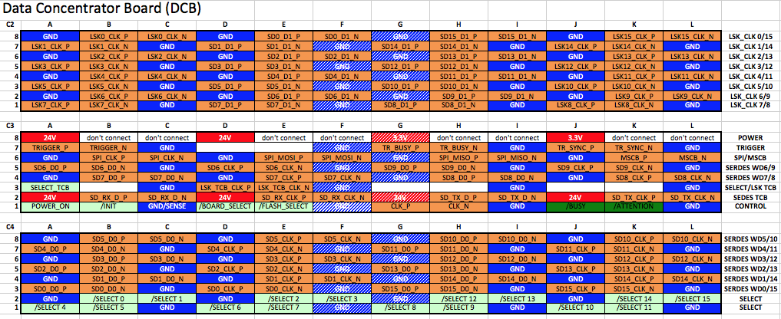
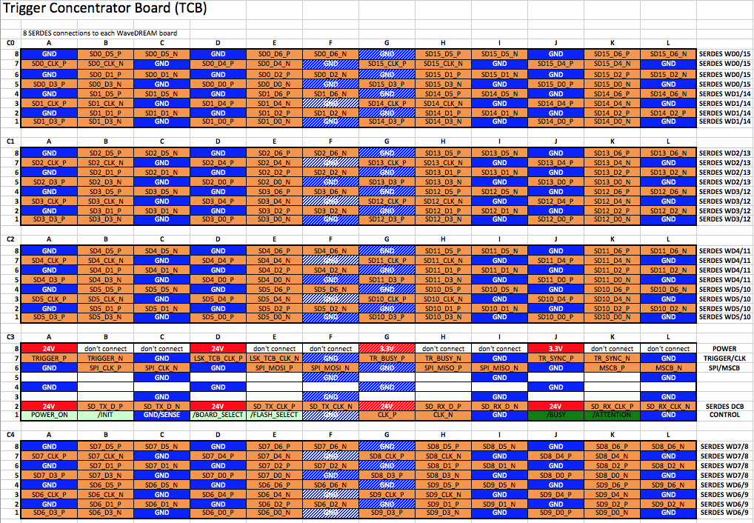
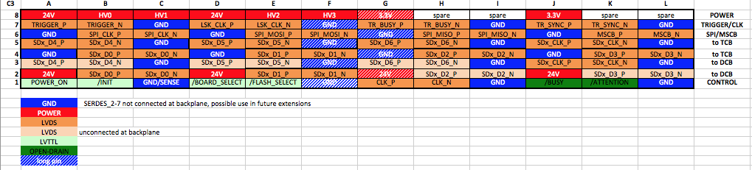

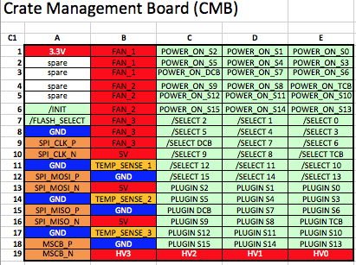
Pin Assignment

Slide 21
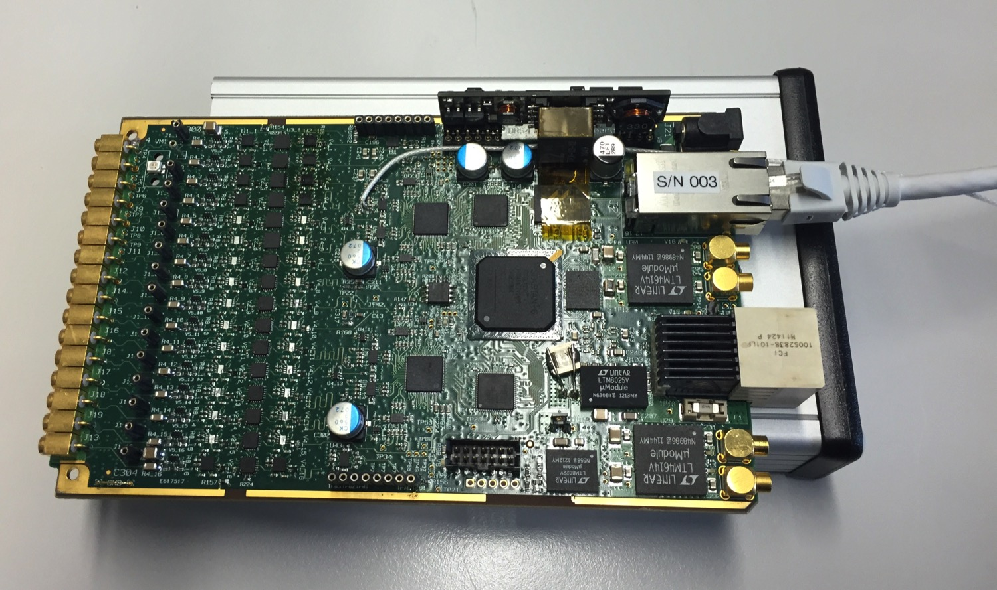
Minimal System
Power-over-Ethernet

Slide 22
One-crate system
Up to 256 Channels
Detector
Gbit Ethernet
220 V

Slide 23

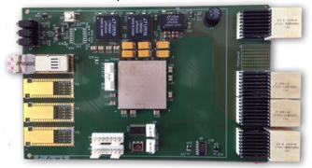

MEG II System
35 crates
x 256 channels
= 9000 channels
. . .

Slide 24
WaveDAQ Performance
Trigger resolution 10 ns (100 MHz clock)
Trigger bandwidth 8 Gbit / s
Trigger latency <380 ns *) (9000 channels)
DAQ bandwidth 2 Gbit / s
DAQ time measurement 10 ps *)
DAQ dead time 3 - 35 μs / event
MEG II: 7 x 10⁷ μ/s, DAQ eff. > 95% @ 30 Hz *)
*) projected

Slide 25
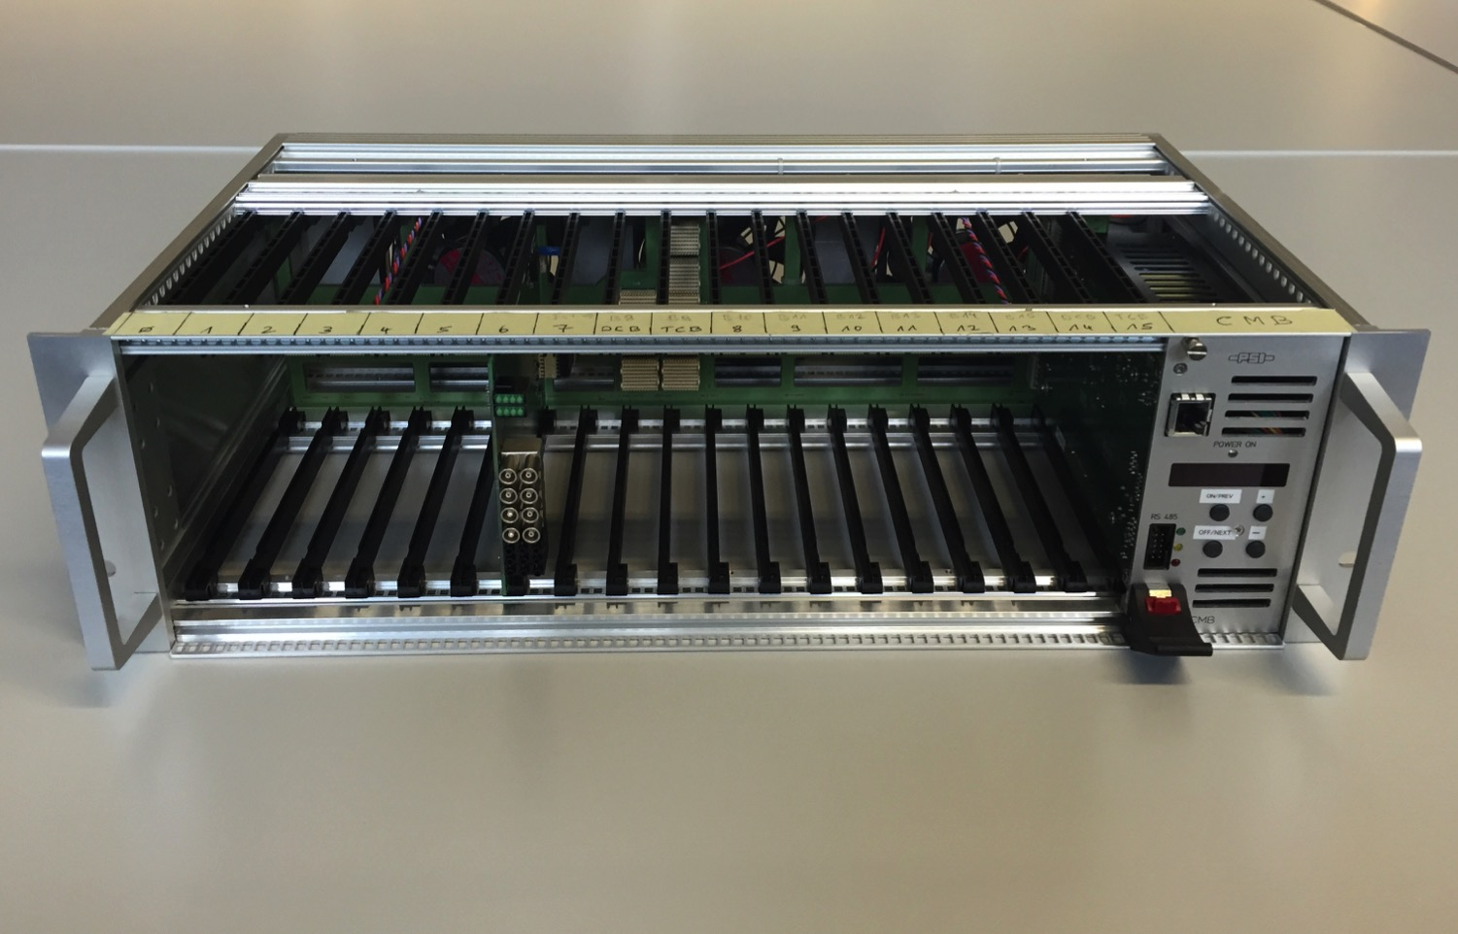
Conclusions
WaveDAQ system has been designed to fulfill needs of MEG II experiment
System has huge potential for many others
(costs: ~130 EUR / channel)
Status: Crate fully working, trigger board and WaveDREAM board successfully tested, firmware to be finished, DCB under design
First full crate test end of 2015,
full system (35 crates) in 2016
DRS5 chip (no dead-time) planned for 2017+

