Slide 1
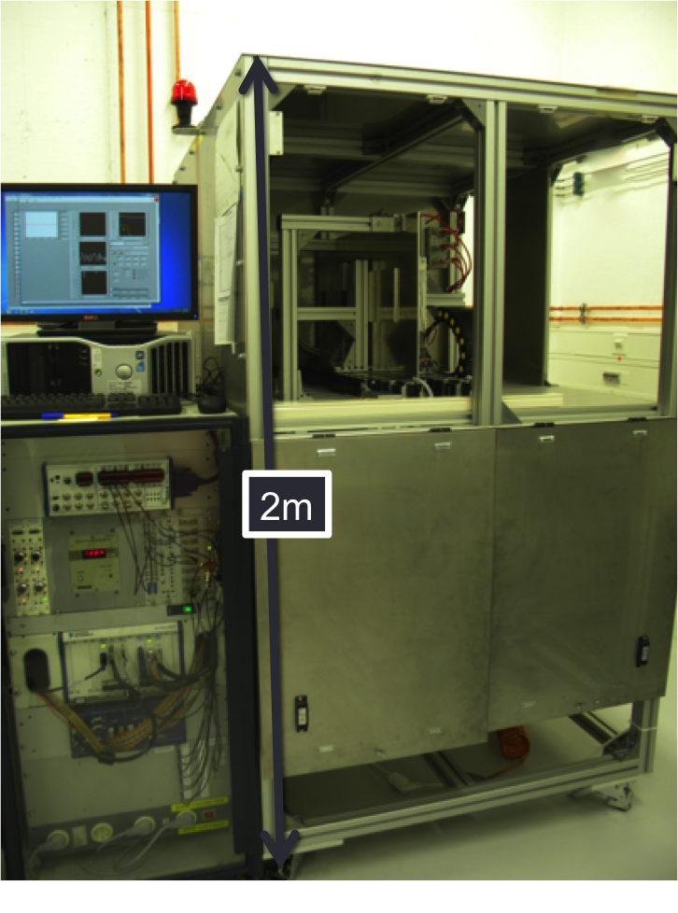
Building and Commissioning of a Setup to Study Ageing Phenomena in Gaseous Detectors
A fully automated system for gaseous detector ageing studies has been constructed and commissioned in the detector lab of GSI, Germany.
This system is able to observe the onset of ageing in MWPC
Gain variation in the order of 0.3% peak-to-peak has been achieved, thus, the ageing investigations can be carried out at a current density that matches with the real experiments.
This setup is ready to do ageing studies for construction materials of gaseous detectors employed in FAIR experiments.
It can also be used for monitoring the performances of gaseous detectors, in particular those used in CBM.
DAQ and control system

Slide 2
Material tests
Al-tape (Gerband 705) and RTV-3145 glue have been tested in parallel. They reveals dangerous effect in terms of ageing on a MWPC during exposure to X-ray.
Chamber | Radiation type | Particle rate density (kHz/cm) | Accumulated charge (mC/cm) | Ageing rate (%/mC/cm) | Resolution loss (%)
Ch-1 (Gerband) | X-ray | 22 | 42 | 0.3 | 4
Ch-2 (RTV-3145) | X-ray | 15 | 12 | 3 | 1.5
Normalized Gain [a.u.]
Resolution [%]
Accumulated charge [mC/cm]
Accumulated charge [mC/cm]
Notes:
-In the end, ageing test for two materials have been carried out.
-TRV is a well known glue causes ageing used to test setup ability to test ageing.
-Conductive Al-tape (Gerband 705) has been tested and showed ageing with rate of 0.3%/C/cm after accumulating 42 mC/cm.

