Slide 1



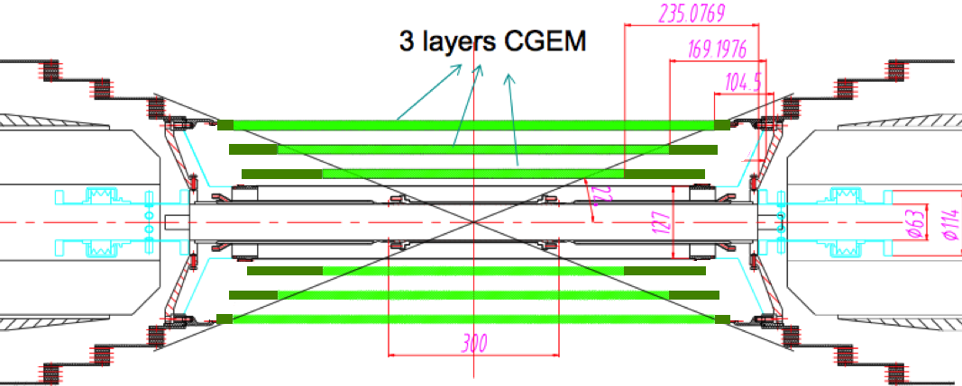
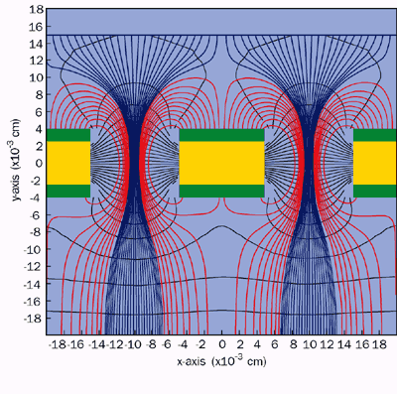
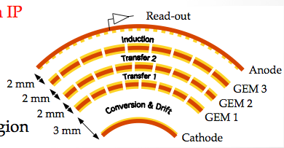
A Cylindrical GEM Detector with Analog Readout for the
Experiment
Detector requirements
3 layers CGEM
Rate capability: ~10⁴ Hz/cm²
Spatial resolution: σ_{xy} =~120 μm : σ_{z}=~1 mm
Momentum resolution:: σpt/Pt =~0.5% @1 GeV
Efficiency = ~98%
Material budget ≤ 1.5% of X₀ for all layers
Coverage: 93% 4π
Operation duration ~ 5 years
beam-pipe
each CGEM layer composed by a triple GEM detector with cylindrical shape
Detector peculiarities and innovations
Rohacell will be used in the cathode and anode structure with a substantial reduction of the thickness of the detector.
Analogue readout to reach the required spatial resolution with a reasonable number of channels. A dedicated ASIC chip will be developed.
Anode plane with jagged strips to limit the parasitic capacitance
The BESIII CGEM group: INFN-Ferrara, University of Ferrara, LNF-INFN, INFN and University of Perugia, INFN-Turin, University of Turin, Institute of High Energy Physics (Beijing), Upsala University, University of Mainz.

Slide 2
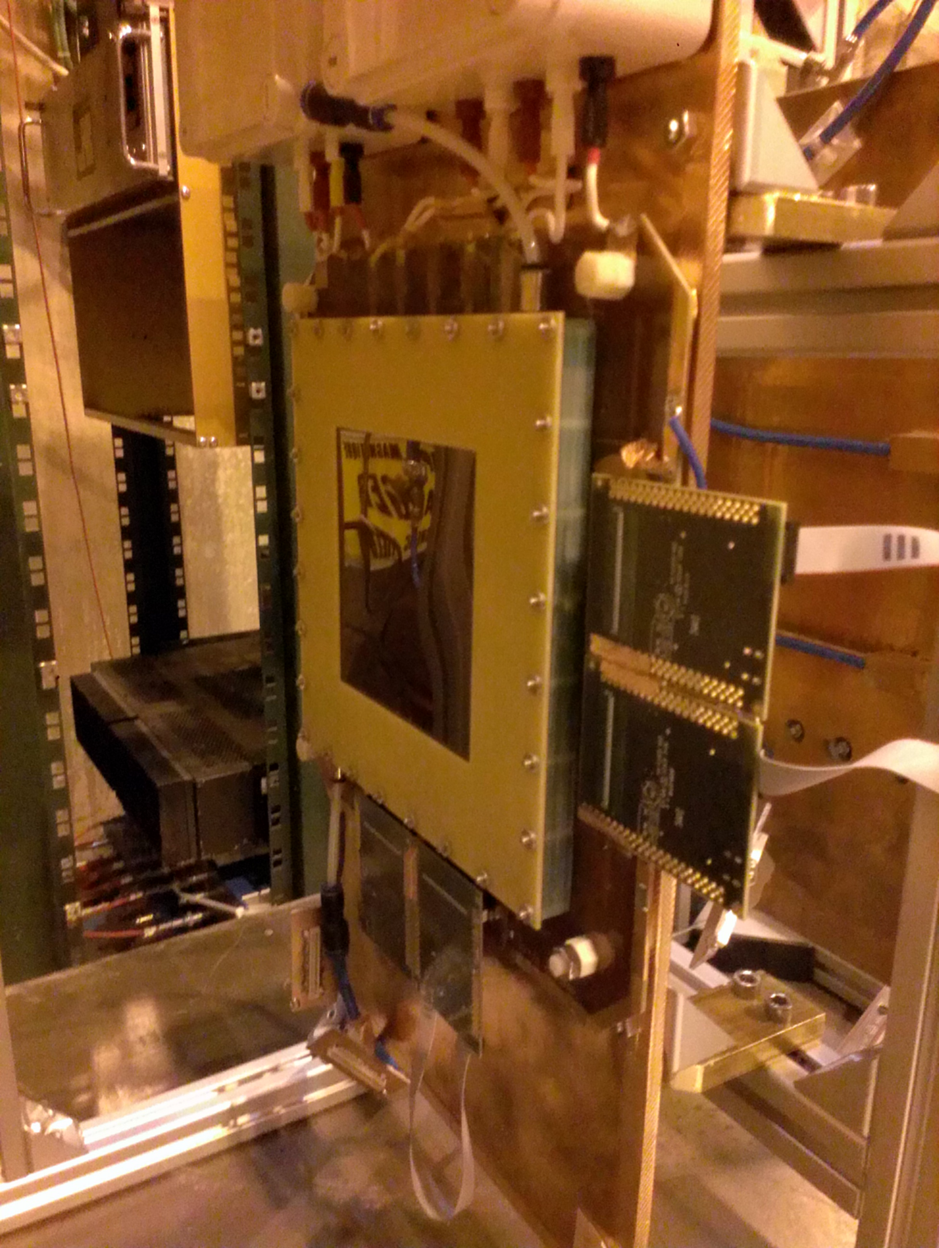
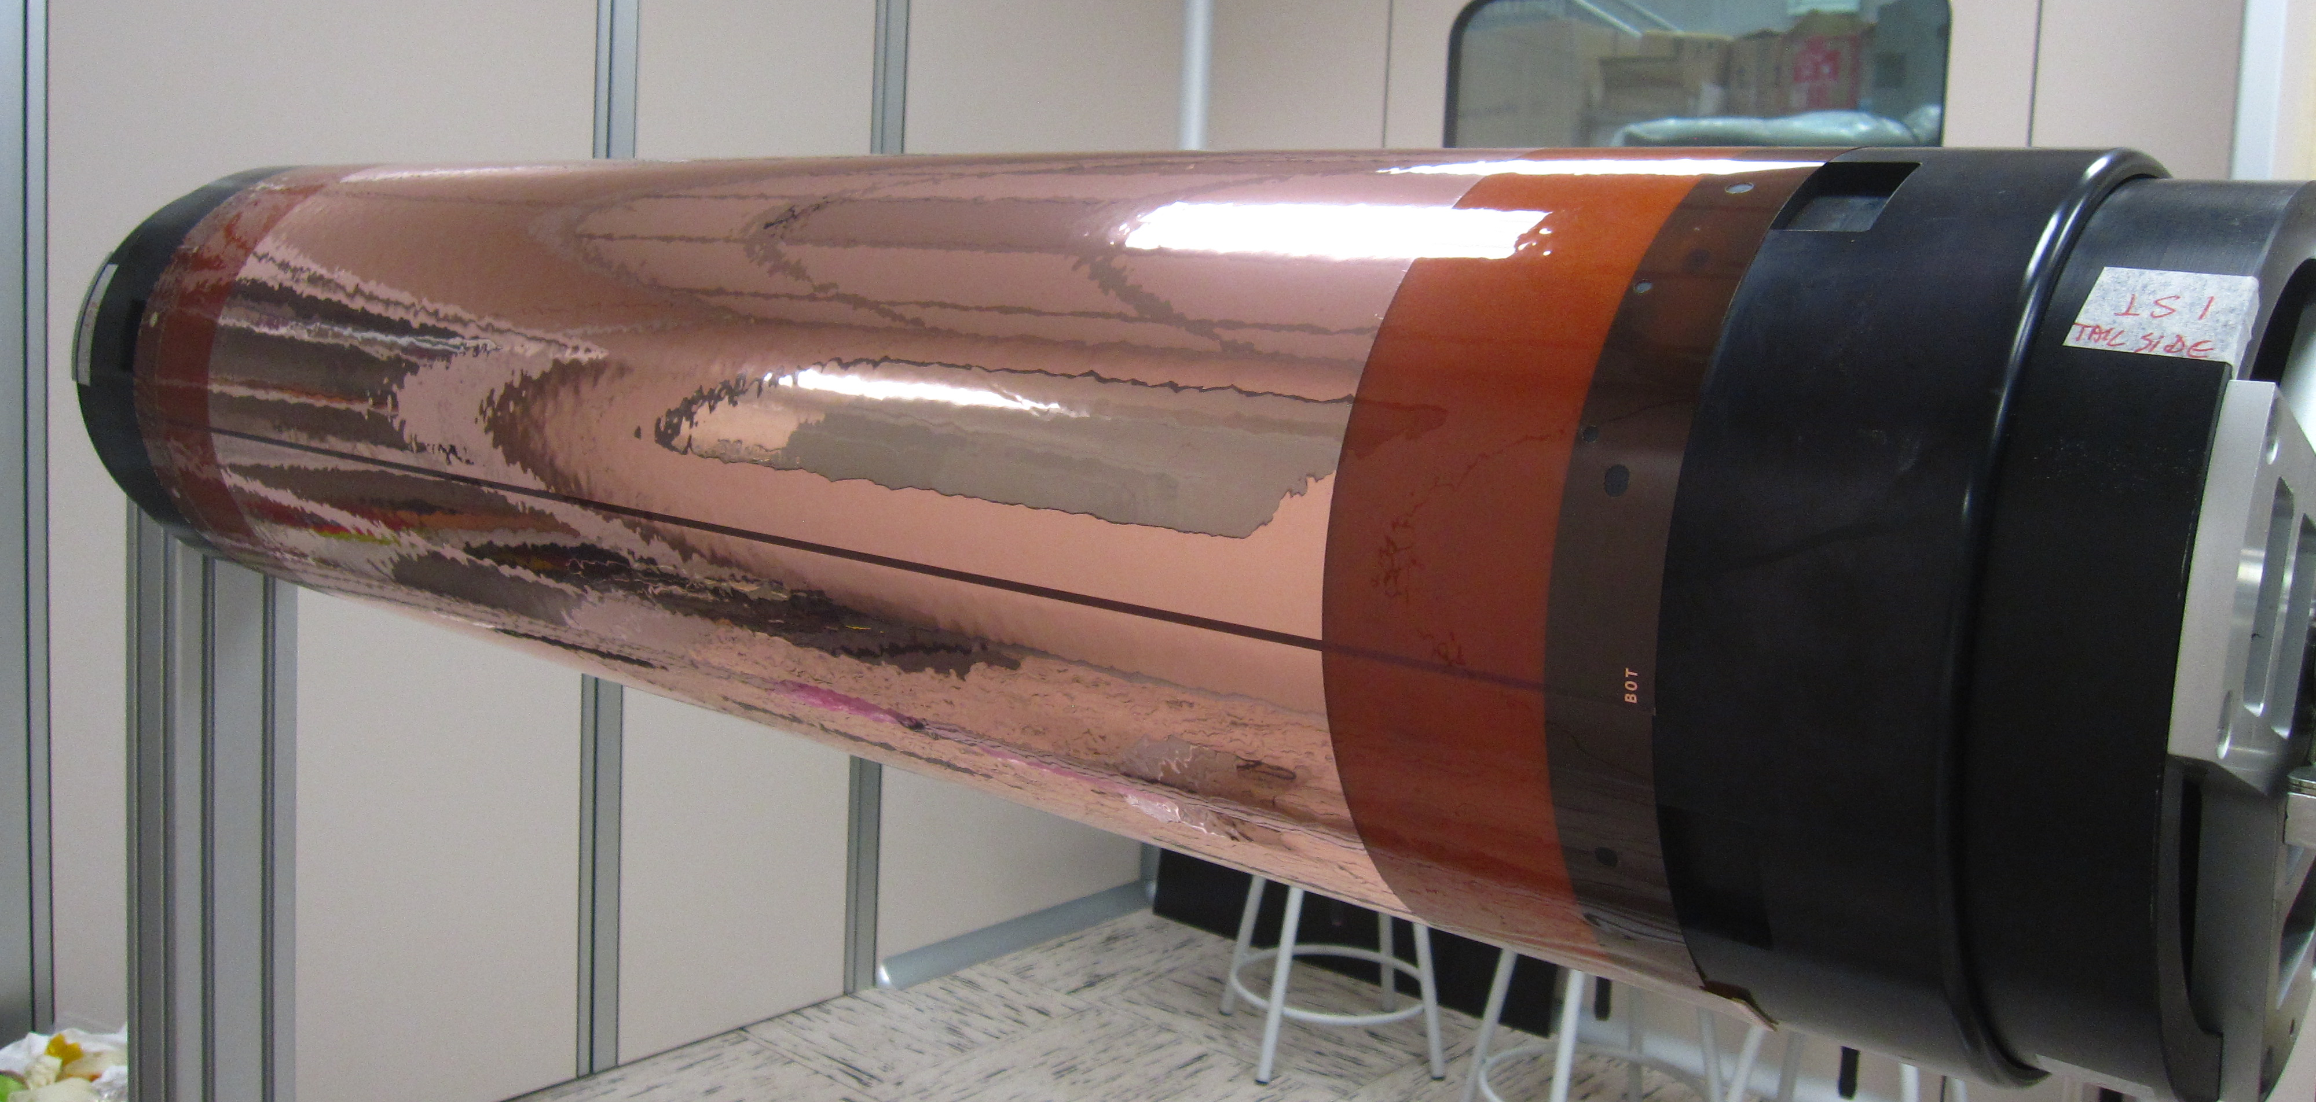
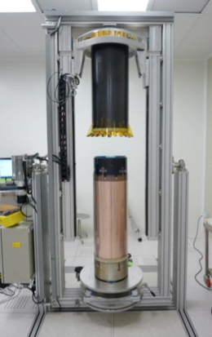

A Cylindrical GEM Detector with Analog Readout for the
Experiment
Test Beam @ CERN
gas mixture Ar/Isobutane - 90/10
2-dimensional efficiency ~97%
Spatial resolution ~90 μm
Spatial resolution vs Gain
Efficiency vs Gain
X View
Y View
resolution (μm)
X View
Y View
X AND Y
Efficiency (%)
preliminary
preliminary
Gain
Gain
Status of the project
Cathode and three GEM layers of the first cylindrical prototype have been assembled. Final prototype assembly expected by September.
Final Inner Tracker design will be finalized by 2015.
Full detector production, assembly and test by 2016.
Installation and commissioning in 2017.
External funding
Design, construction and test of a CGEM prototype and readout electronics funded by the Foreign Affairs Ministry agreement of scientific cooperation for a Joint laboratory “INFN-IHEP”.
The BESIIICGEM project has been recently selected as one of the project funded by the European Commission within the call H2020-MSCA-RISE-2014.

