Slide 1

Accelerator Division Activities
Andrea Ghigo on behalf of
INFN-LNF Accelerator Division

Slide 2
Accelerator Division Main Projects
  KLOE
  Beam Test Facility
  Synchrotron Radiation
DAΦNE
SPARC-LAB
SPARC-Premiale
CHAOS-Premiale
ELI-NP (Romania) / STAR (Cosenza)
Collaborations: LC/CLIC, HL-LHC, FCC, ESRF, CNAO…
FP7 European projects
  FEL
  Plasma acceleration
  Thomson Scattering
  FLAME
  TeraHertz
!

Slide 3
Dipendenti:
38 Laureati
48 Tecnici
2 Coll.Amm.
+ 3 Ass.Ric
+3 borse diplom.
+ Dottorandi
9 Servizi
16 Reparti
24 TD

Slide 4
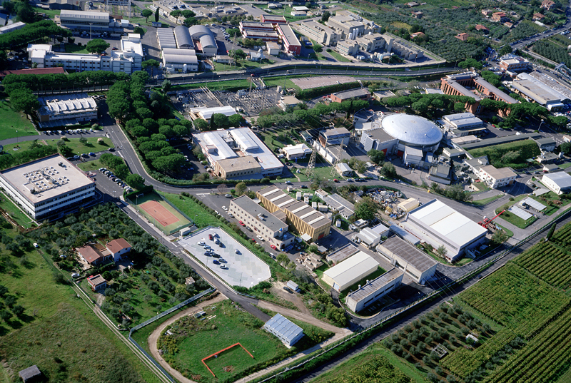
LNF
DAFNE-light
DAFNE
LINAC
BTF
The DAΦNE Φ-Factory complex

Slide 5
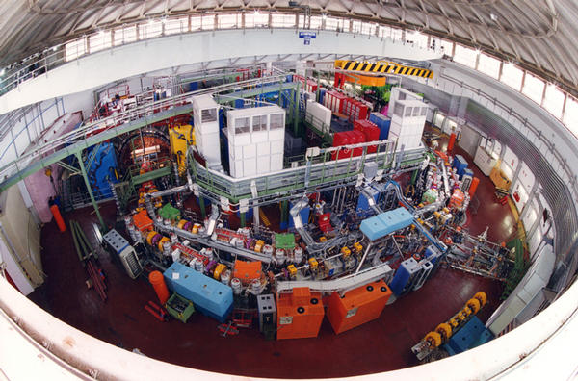
DAΦNE – LNF - FRASCATI
e+ e-
Ecm = 1.02 GeV
L = 1.5 10³² cm⁻² sec⁻¹

Slide 6
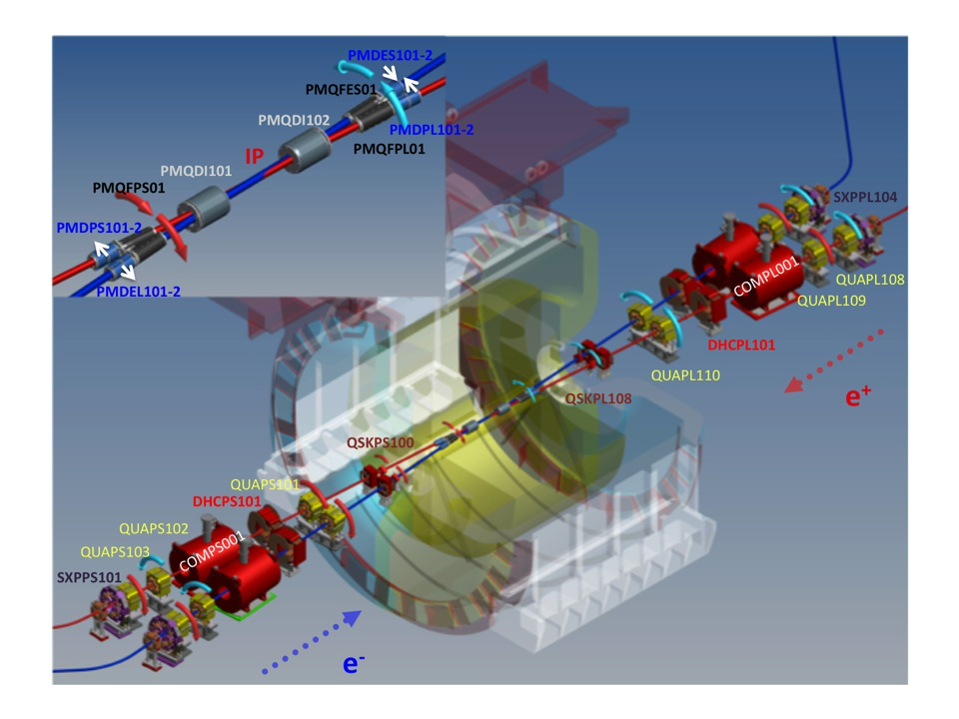
DAΦNE IR for the KLOE-2 run

Slide 7
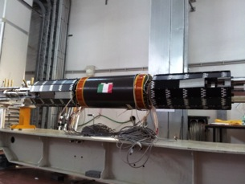
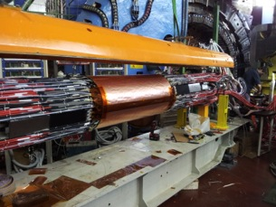
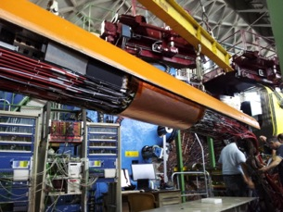
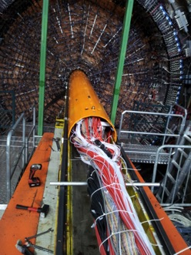
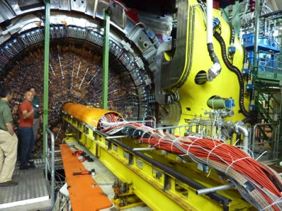
The new KLOE detector layers have been wired
Whole structure has been inserted inside the experimental apparatus

Slide 8
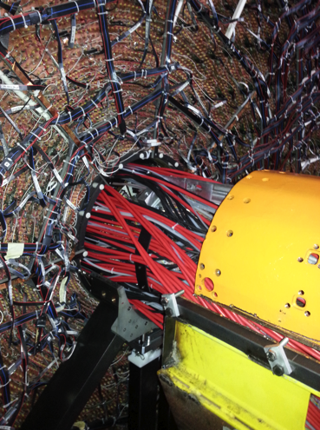
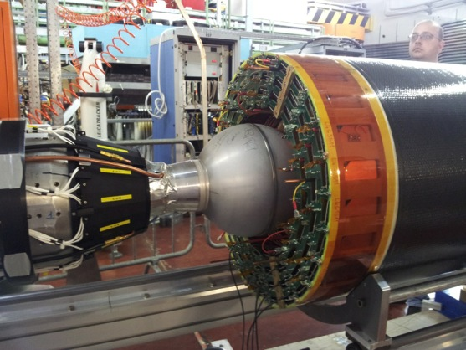
New KLOE vertex detector

Slide 9
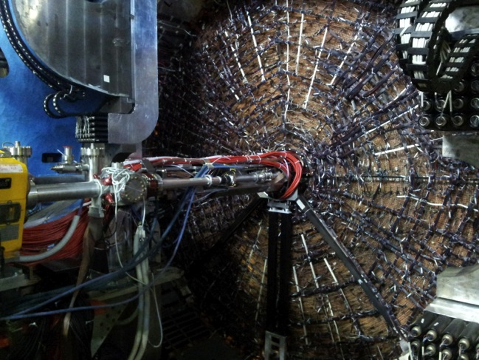
Third carbon fiber support installed
IR branches outside the detector reassembled and aligned
Shut-down activities completed by mid July

Slide 10
DAΦNE Consolidation Activities
DAΦNE shut-down was intended mainly to upgrade the experimental detector (KLOE became KLOE-2), and it has been very useful to consolidate the entire collider.
December 16th 2012 ÷ mid July 2013
Activities involved almost all the components of the DAΦNE accelerator complex:
  IR mechanical structure and IP vacuum chamber
  auxiliaries’ automation and control system
  Control system
  Vacuum installation (windows, scrapers)
  Cooling system
  Cryogenic plant
  Magnets and power supplies
  Modification of the LLRF controllers
  Linac
  E-cloud electrode power supplies
  new horizontal kicker for the MRe feedback
  Additional BPMs and improved tools for beam profile measurements

Slide 11
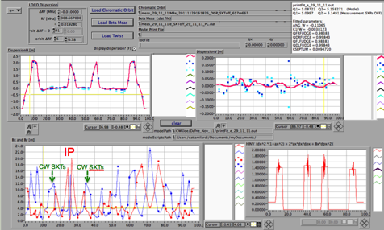
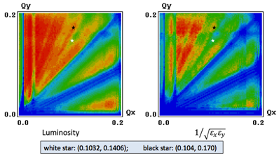
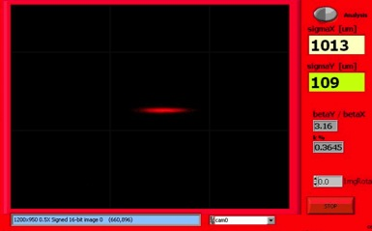
Commissioning
Commissioning started mainly by the end of January 2014, but it has been severely slowed down by 3 main interruptions due to external circumstances causing, in total, two and half months of inactivity.
working points adopted
  ν_{x}⁻ = 5.098 ν_{y}⁻ = 5.164
  ν_{x}⁺ = 5.102 ν_{y}⁺ = 5.139
according LIFETRAC simulations should provide good luminosity
e⁻ ring optics
Transverse betatron coupling all skew QUADs off:
  κ⁺ ~ 0.4%
  κ⁻ not yet optimal
Tuning the skew QUADs:
  0.2% < κ < 0.3% (both beams)

Slide 12
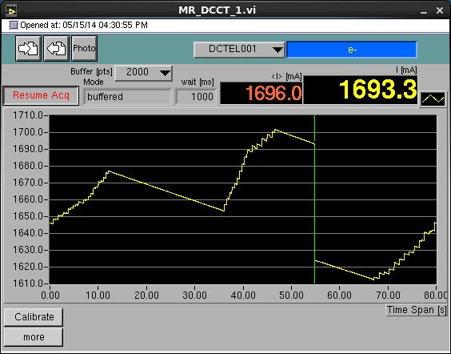
Beam Dynamics
Highest currents stored, so far, in 98 bunches spaced by 2.7 ns are:
I⁻ = 1.7 A I⁺ = 1.15 A
These currents are the highest ever achieved after installing the new IR for the KLOE-2 detector, based on the Crab-Waist collision scheme.
The three independent bunch-by-bunch feedback systems installed on each ring are essential for high current multi-bunch operations.
The e⁺ vertical feedback is now using a new ultra-low noise front-end module, designed in collaboration with the SuperKEKB feedback team, aimed at reducing the noise contribution to the transverse vertical beam size in collision.

Slide 13
e⁺ Beam Dynamics
Beam dynamics in the e⁺ ring is dominated by the e-cloud induced instabilities which are kept under control by:
  powerful bunch-by-bunch transverse feedback systems
  solenoids wound all around the straight sections
  electrodes installed inside dipole and wiggler vacuum chambers.
Electrodes effectiveness has been already proved in 2012 polarizing the stripline with a positive voltage in the range 0÷250 V
Simulations indicate that a factor two higher voltage is required to completely neutralize the e-cloud density due to a e⁺ current of the order of 1 A

Slide 14
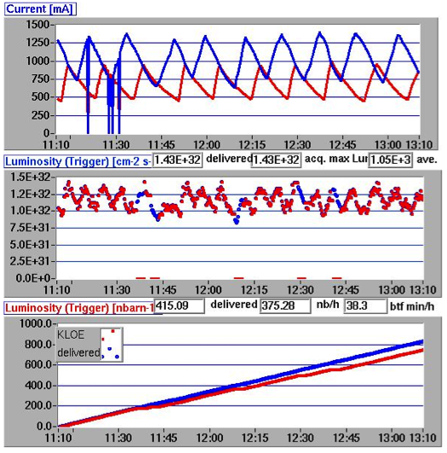
Integrated luminosity
L_{∫1 hour} = 0.415 pb⁻¹
L_{∫day} ≈ 10. pb⁻¹
KLOE is taking data
Acquired and delivered L are comparable
L_{∫1 hour} is the highest measured with KLOE-2
27/11/2012

Slide 15
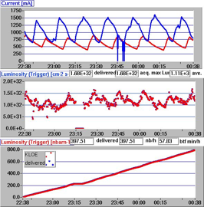
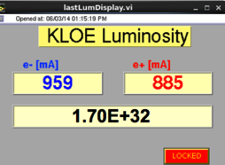
Peak Luminosity
100 bunches
L_{∫1 hour} = 0.4 pb⁻¹
moderate injection regime
 | DAΦNE CW upgrade SIDDHARTA (2009) | DAΦNE KLOE (2005) | DAΦNE (CW) KLOE (2012) | DAΦNE (CW) KLOE-2 (2014)
L_{peak} [cm⁻²s⁻¹] | 4.53•10³² | 1.50•10³² | 1.52•10³² | 1.70•10³²
I⁻ [A] | 1.52 | 1.4 | 0.93 | 0.96
I⁺ [A] | 1.0 | 1.2 | 0.72 | 0.89
N_{bunches} | 105 | 111 | 100 | 100
L_{peak} exceeds by a 13% the best luminosity ever achieved, at DAΦNE, during operations for an experimental apparatus including high field detector solenoid.
Background presently has been reduced to levels almost compatible with the detector data-taking

Slide 16
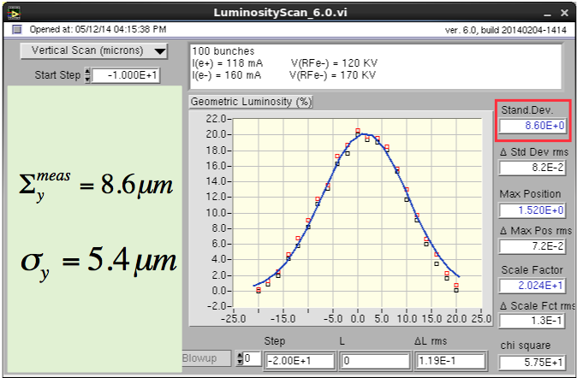
Vertical beam-beam Luminosity scan
Σ^{meas}_{y} is still considerably high since the transverse betatron coupling in the e⁻ ring is not yet properly corrected

Slide 17
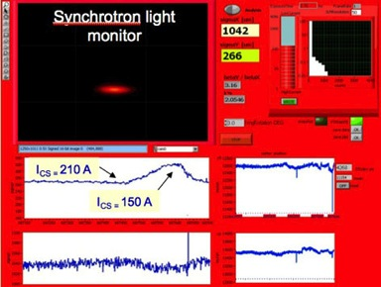
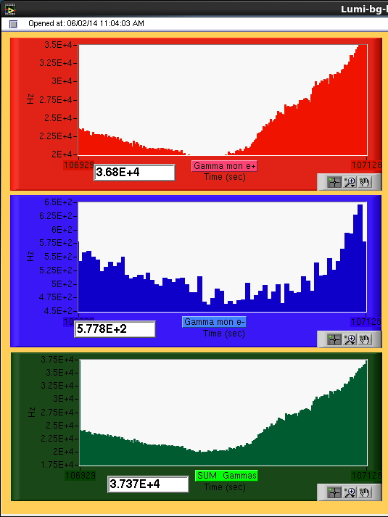
Crab-Waist Sextupoles
Crab-Waist Sextupoles effectiveness has been tested on the e⁺ ring
DAΦNE luminosity monitor
Crab-Waist Sextupoles strengths are 30% and 50% lower than the nominal ones for e⁺ and e⁻ respectively.
I_{CS} = 210 A
I_{CS} = 150 A

Slide 18
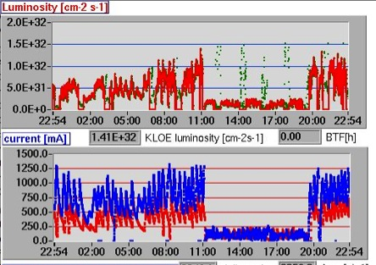
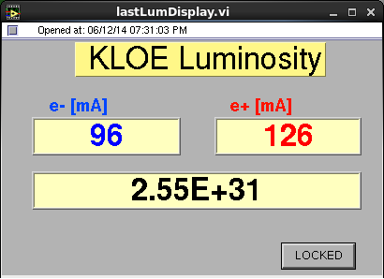
10 Bunches Luminosity
Aiming at minimizing the impact of collective effects on L
L_{peak} ~ 2.5 10³² cm⁻² s⁻¹ might be achieved by using 100 bunches
  Beam-beam is not a limiting factor
  Crab-Waist Sextupoles work (even at lower strength)
This result can be improved by:
  optimizing dynamical vacuum
  perfecting colliding beams parameters
  tuning multi-bunch and high current operations

Slide 19
Pushing luminosity further
Higher luminosity might be attained by:
  Improving the transverse betatron coupling correction in the e⁻ ring
  optimizing the present rings optics and working point
  Setting the CW-Sextupoles to the nominal values
  improving dynamic vacuum
  Increasing stored currents and number of colliding bunches

Slide 20
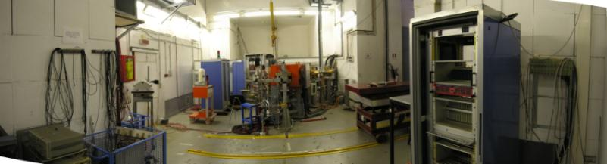
Beam Test Facility (BTF) Infrastructure
@DAFNE Linac
The Frascati Beam Test Facility infrastructure is a beam extraction line optimized to produce electrons, positrons, photons and neutrons mainly for HEP detector calibration purposes. The quality of the beam, energy and intensity is also of interest for experiments (~ 20% of the users) studying the electromagnetic interaction with matter

Slide 21

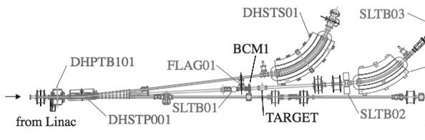
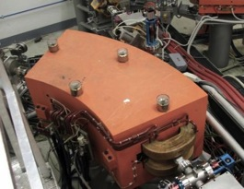
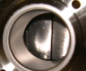
BTF LAYOUT – Primary beam
PRIMARY
TO BTF
PRIM conditioned
Positron Beam
6×10⁹ e⁺/bunch
4x single-axes SCRAPERS
Forward Magnetic Line
LINAC Energy is conserved
Electron Beam
3×10¹⁰ e⁻/bunch

Slide 22
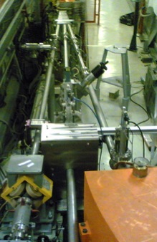
BTF LAYOUT - Secondary Beam
PRIMARY
TO BTF
SECONDARY
Positron Beam
4×10⁹ e⁺/bunch
Electron Beam
3×10¹⁰ e⁻/bunch

Slide 23
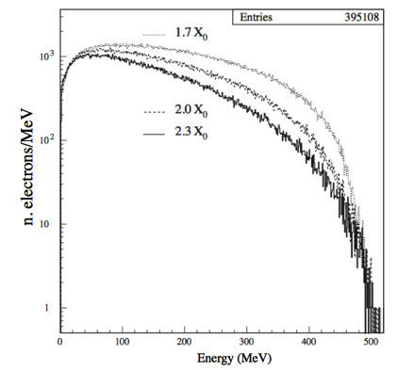
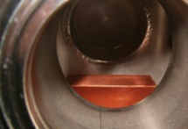
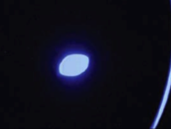
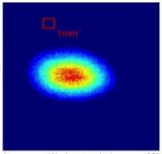
BTF LAYOUT - Secondary Beam
3-selectable thickness Copper Showering TARGET (Targhettone…)
1.7, 2.0 or 2.3 radiation lengths
Mult
Mult
10¹⁰
∫∫
For 10^8 e^{+/}e⁻ primary particles
∫∫
510
Energy [MeV]
Primary Beam
YAG:Ce FLAG
Secondary Beam
2cm² MEDIPIX

Slide 24
LNF
The SPARC-LAB complex
FLAME
SPARC-LAB

Slide 25
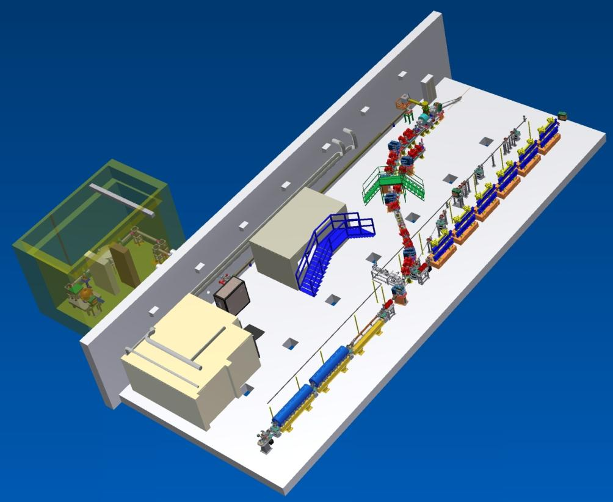
SPARC_LAB
Sources for Plasma Accelerators and Radiation Compton with Lasers And Beams
Thomson X-ray
EOS
EXIN
FLAME
FEL
(2colors)
COMB
THz Source

Slide 26
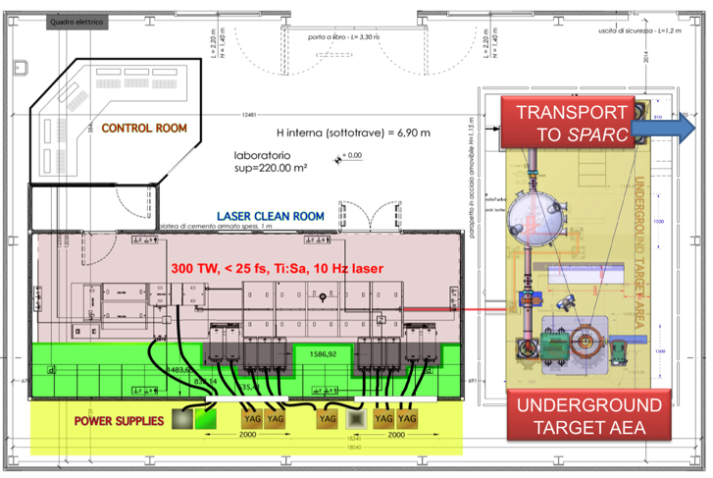
Ti:Sa FLAME laser
Stretcher
Amplifiers
Compressor
LWFA
Electron Self Injection
And
Protons

Slide 27
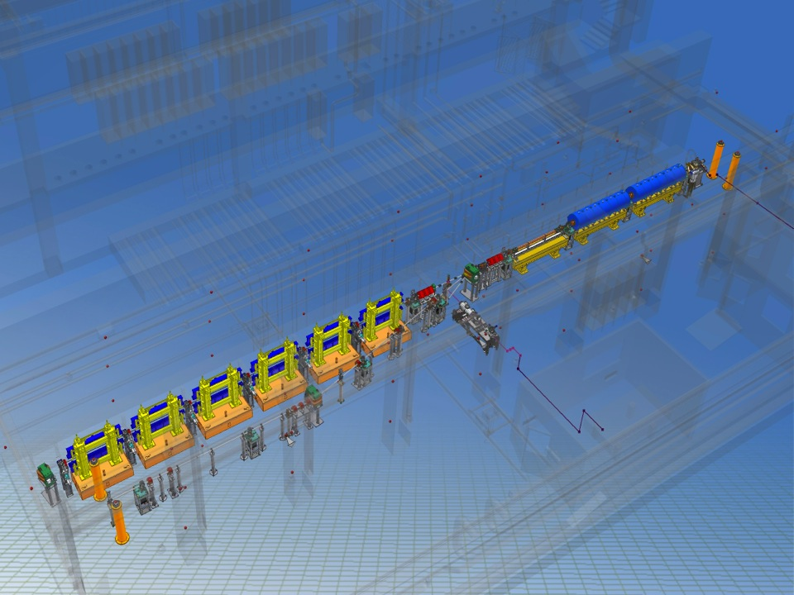




Linac and FEL
150 MeV S-band linac
Velocity Bunching
Diagnostic and Matching
Undulators
λ_{u} = 2.8 cm
K_{max} = 2.2
λ_{r} = 500 nm
12 m
Long Solenoids
S-band Gun
15 m
Seeding
Spectrometer

Slide 28
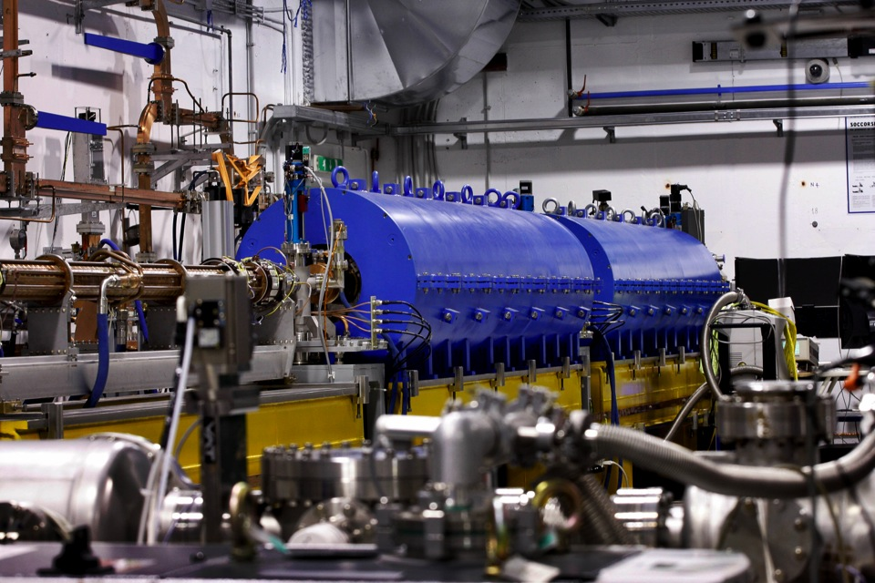
HB photo- injector with Velocity Bunching

Slide 29
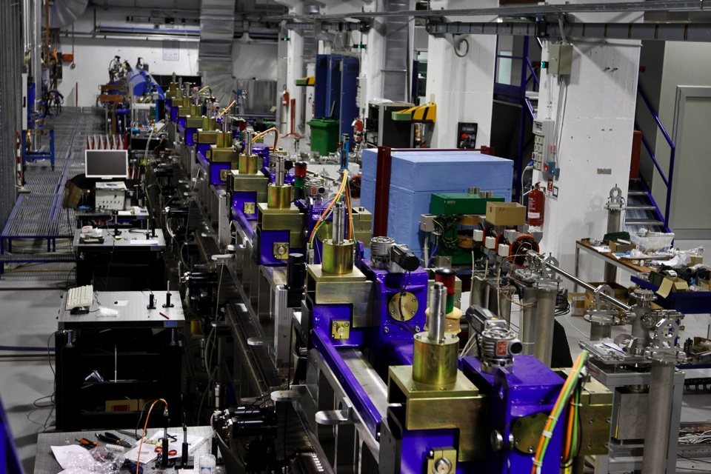
Free Electron Laser

Slide 30
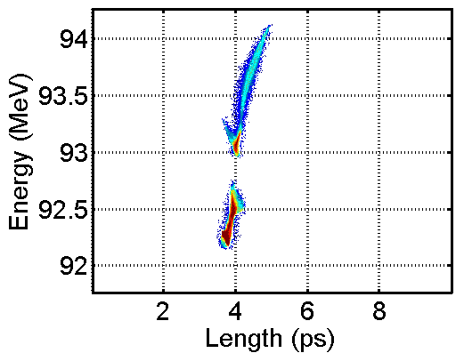
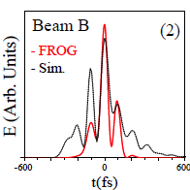
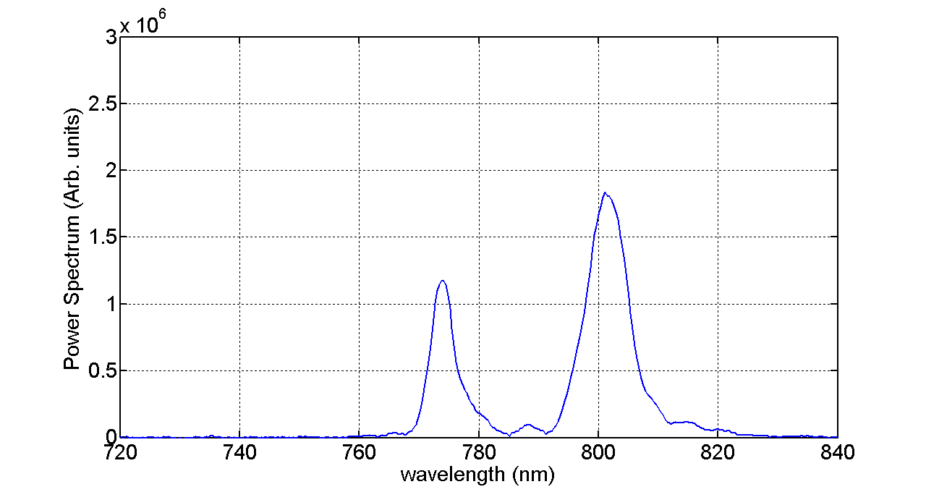
TWO COLORS SASE FEL
two bunches with
a two-level energy distribution
and time overlap (Laser COMB tech.)
1 MeV
produce two wavelength SASE –FEL radiation
with time modulation
110 fs
18 nm

Slide 31

Tunable X-ray radiation source based on Thomson Scattering

Slide 32
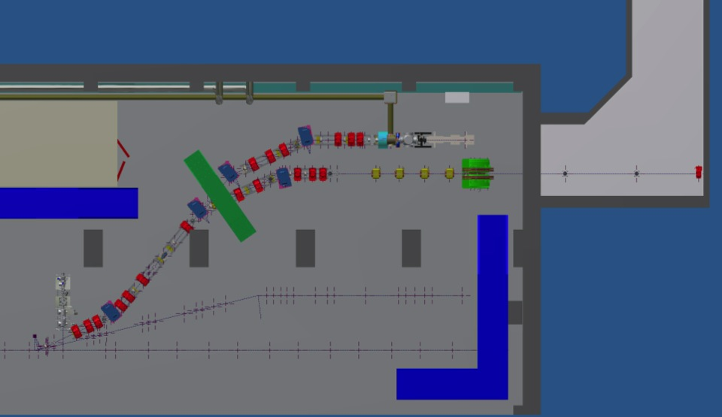
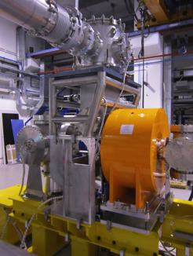
SL-Thomson Source at SPARCLAB
FLAME
SPARC

Slide 33
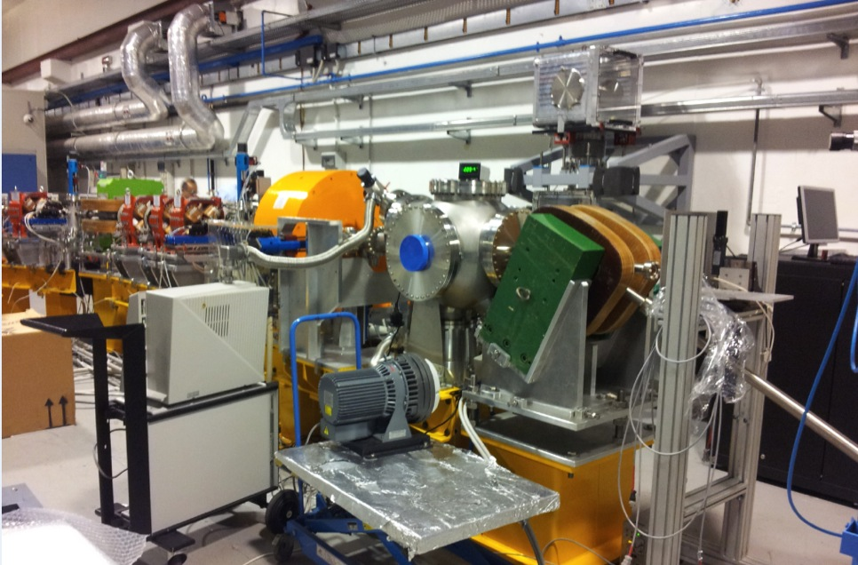
Thomson back-scattering source

Slide 34
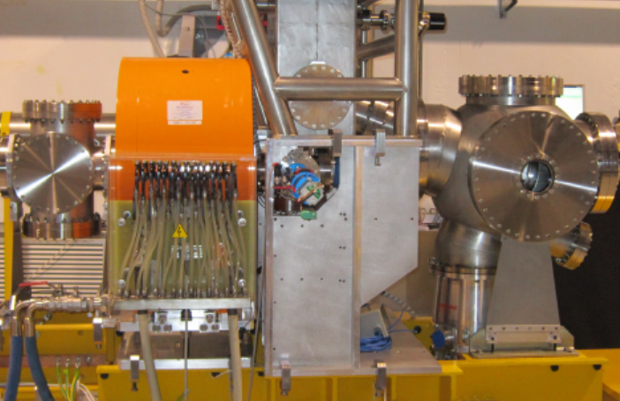
Thomson back-scattering source

Slide 35
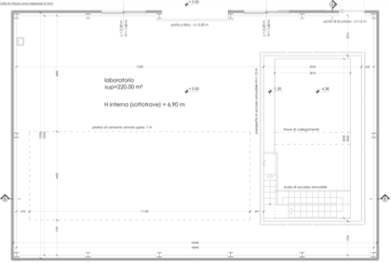
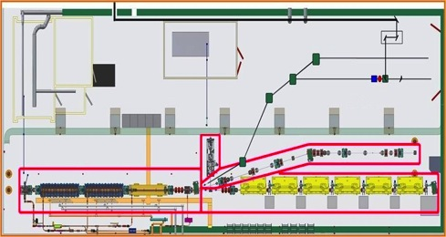
SPARC_LAB synchronization system
FLAME AREA
Main RF Reference oscillator
  RF system and laser oscillators locked to the reference through PLL
  Electrical signal distributed through coaxial cable
  Single sub-system VS reference time jitter <50fs_{RMS}
  Interaction laser VS electrons time jitter (estimated) <200fs_{RMS}
FLAME oscillator
In 2856MHz
Out 79.33MHz
PC laser
Oscillator
79.33MHz
SPARC HALL
RF reference
2856MHz

Slide 36
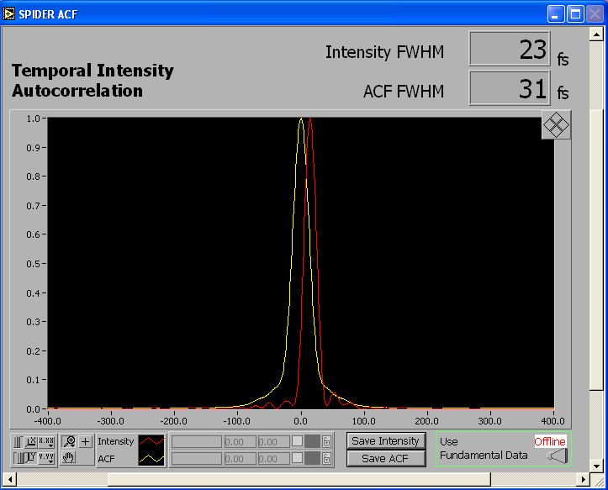
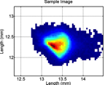
Electron Beam Experimental Studies
Thomson backscattering experiments
  Flame transport
e⁻ beam at IP
σ_{x}=0.16±0.01 mm
σ_{y}=0.24±0.01 mm
Max energy: 7J
Max energy on target: ̴ 5J
Min bunch duration: 23 fs
Wavelength: 800 nm
Bandwidth: 60/80 nm
Spot-size @ focus: 10 µm
Max power: ̴ 300 TW
Contrast ratio: 10¹⁰

Slide 37
Resonant plasma excitation by a Train of Bunches
Weak blowout regime with resonant amplification of plasma wave by a train of high Brightness electron bunches produced by Laser Comb technique?
Ramped bunch train configuration to enhance tranformer ratio?
High quality bunch preservation during acceleration and transport?

Slide 38
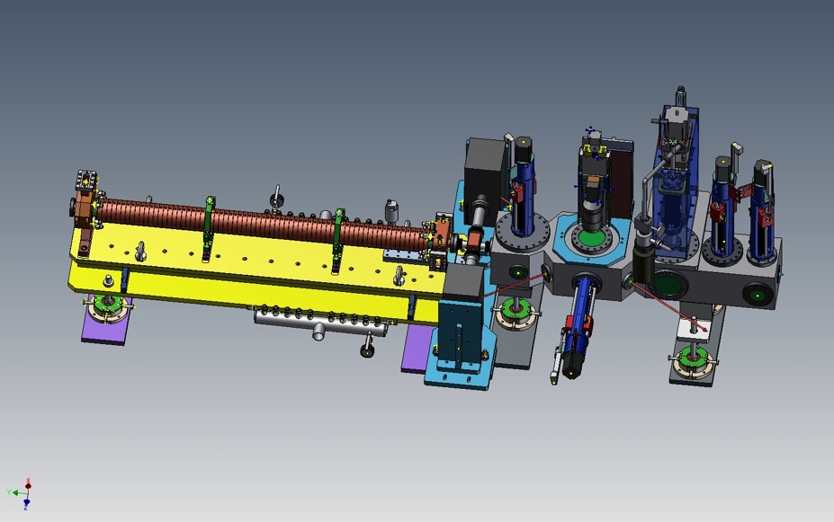
COMB plasma interaction chamber
Camera interazione e
Sistemi ancillari di pompaggio e iniezione gas
Gruppo Pompe Vuoto
Sezione Banda C
YAG/OTR actuator
Permanent magnet actuator
YAG/OTR/EOS crystal actuator

Slide 39
LWFA acceleration of externally injected electrons in a gas-jet plasma

Slide 40
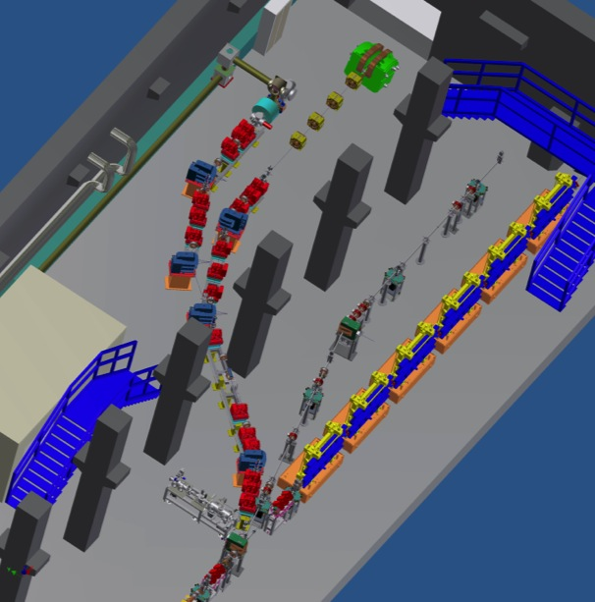

Slide 41

Interaction Layout
Gas: Hydrogen
Gas cell and/or capillary
e-beam
Interaction chamber
EOS chamber
CL - Preventivi Frascati, 1 Luglio 2014

Slide 42



The SPARC_LAB THz beam lines
Linac-based source: Coherent Radiation from an aluminum-coated silicon screen (Coherent Transition Radiation, CTR) and from a rectangular aperture in the metallic screen (Coherent Diffraction Radiation, CDR).
CTR and CDR sources
YAG:Ce screen
Si-Al screen (CTR)
5 mm slit (CDR)
3 mm slit (CDR)
CTR source

Slide 43


Broad-band THz radiation: Measurements
Frequency cut limited by the vacuum window quartz
Diamond window to be installed
Intensity (arb. units)
Electron beam parameters
Energy (MeV) | 100
Charge (pC) | 260
RMS bunch length (fs) | 260
Frequency (THz)

Slide 44




Narrow-band THz radiation:
2-bunches train measurements
Measured Longitudinal Phase Space (LPS)
Current profile as measured at the end of the linac
Electron beam parameters
Energy (MeV) | 122
Charge/bunch (pC) | 80
RMS bunch 1 length (fs) | 150
RMS bunch 2 length (fs) | 165
Time distance (ps) | 0.91 (0.019)
Autocorrelation measurement
of CTR with
a Michelson interferometer
0.9 ps
40%

Slide 45
Achieved THz Performances
Electron beam parameters | Single bunch (VB mode: max compression) | 4-bunches per train (VB mode + laser comb)
Charge/bunch (pC) | 300 | 50
Energy (MeV) | 130 | 100
Bunch length (fs) | 160 | 200
Rep. Rate (Hz) | 10
Radiation parameters | SPARC (single bunch) | SPARC (4-bunches/train)
Energy per pulse (J) | 40 10⁻⁶ | 0.6 10⁻⁶ (@ 1 THz)
Peak power (MW) | > 100 | 3 (@ 1 THz)
Average power (W) | 1.8 10⁻⁴ | 6 10⁻⁶
Electric field (kV/cm) | 500 | > 10
Pulse duration (fs) | 160 | < 100
Bandwidth (%) | broadband | < 25

Slide 46



ELI-NP proposal
INFN – CNRS – STFC – ALBA
+European High Tech firms

Slide 49

Laser Optical multipass ricirculator
LAL-Orsay

Slide 51
Thanks for your attention

