Slide 1
CHIPIX65
F. Palla
CALL CSN5 – Responsabile Nazionale: L. Demaria (To)

Slide 2
Challenges for CHIPIX65
Design of innovative electronics in strategic area of INFN, using the “novel” CMOS 65nm technology, with a large participation of INFN community
INFN is one of founding members of RD53, an international collaboration for the R&D phase of an innovative chip for the pixel detector of ATLAS and CMS at HL_LHC, and the goals of RD53 are the main focus of CHIPIX65 milestones:
  Small pixels: 50x50um² (25x100um²)
  Large chips: >2cm x 2cm ( ~1 billion transistors)
  Hit rates: ~2 GHz/cm²
  Radiation: 1Grad, 10¹⁶ neu/cm² (unprecedented)
  Trigger: 1MHz, 10us (~100x buffering and readout)
  Low power - Low mass systems

Slide 3
CHIPIX65 CALL Project Proposal 2013 – CSN5
Sezioni partecipanti
Bari (CMS), Milano (ATLAS), Padova (CMS), Pavia (CMS), Perugia (CMS), Pisa (CMS) e Torino (CMS)
35 membri, di cui 20 progettisti elettronici. 9.85 FTE
Work Packages:
  Radiation Hardness – P. Giubilato (Pd)
  Digital Electronics – R. Beccherle (Pi)
  Analog Electronics - A. Rivetti (To)
  Chip Integration - V. Re (Pv), V. Liberali (Mi)
International Collaborations / supports: RD53, ATLAS, CMS – All wrote support letters
Funding: ~700 kEuro for a three year project, subject to yearly peer review (milestones achieved).
    Mainly consumables and foundry submissions, no man power.

Slide 4
RD53: the international context for CHIPIX65
~ 100 members, 19 Institutes (2 new institutes have joined)
  Bari, Bergamo-Pavia, Bonn, CERN, CPPM, Fermilab, LBNL, LPNHE Paris, Milano, NIKHEF, New Mexico, Padova, Perugia, Pisa, Prague IP/FNSPE-CTU, PSI, RAL, Torino, UC Santa Cruz.
    2 institutes requesting to join: LAL/OMEGA, Seville
Spokes persons: Maurice Garcia-Sciveres, LBNL (ATLAS), Jorgen Christiansen, CERN (CMS) [2 year terms]
Institute Board (IB chair: Lino Demaria, Torino)
  Regular IB meetings
  MOU drafted and ready to be signed
Management board: Spokes persons, IB chair, WG conveners
  Monthly meetings
Technical Working Groups have started
  WG conveners
  Regular WG meetings
News: TSMC NDA with IMEC ready to be signed by interested Institutions.
  Pisa contact F. Morsani

Slide 5
Main CHIPIX65 contributions to RD53
Radiation WG (Padova):
  Irradiation campaign at Legnaro with low energy protons (TDD studies)
  foreseen also irradiation with x-ray machine (TID)
Analog WG (Pavia, Torino)
  Design of Very Front end chain, low power, low threshold (<1000e-) with synchronous and asynchronous comparators
IP-block WG (Bari, Milano, Pavia, Padova, Pisa, Torino)
  16 out of 34 IP-block under INFN responsibility
Simulation WG (Perugia)
  Main contributor to the development of the simulation and verification framework
Top Level WG:
  Activity is at a preliminary stage. Contribution mainly from LBNL (USA)
IO WG:
  Activity will start during the second half of 2014. Convener being identified now (Roberto Beccherle – Pisa)

Slide 6
CHIPIX65 Milestones
2014:
  disegno, sottomissione, test di IP blocks analogici e digitali
  risultati sull’irraggiamento di strutture di test di base
2015:
  qualifica radiation hardness della tecnologia
  design methodology and verification of high dense IC
  ottimizzazione architettura digitale: globale, regionale, della cella pixel
  architetture del very fron end analogico
2016:
  integrazione el.analogica nel chip; power distribution, clock distribution
  primo prototipo chip, con architetettura digitale e readout semplificati

Slide 7
Radiation WG
Qualifica per radiazioni fino a 1 Grad e 10¹⁶ neq/cm²
^{WG convener m. barbero (CPPM)}
CERN, CPPM, Fermilab, LBNL, New mexico, Padova
Activities and Status:
  Defining radiation testing procedure
  Test of 65nm transistors to 1Grad
    NMOS: Acceptable degradation
    PMOS: Severe radiation damage above 300Mrad (next slide)
      Not yet a clear understanding of effects seen at these unprecedented radiation levels
      ESD damage from manipulation and test systems ?
    Systematic radiation/annealing studies required to be verified with pixel detector operation
  Test of circuits to 1Grad
    Ring oscillators, Pixel chips ( CERN, LBNL)
    Digital circuits remains operational up to 1Grad (better than indicated by tests of individual transistors)
  Critical to confirm if 65nm is OK for inner layers of pixel detectors
    Alternative technologies / Replacement of inner layers after a few years ?
Plans
  Systematic radiation and annealing studies of 65nm basic devices and circuits
  Hadron/neutron radiation tests for NIEL effects
  Radiation test of basic transistors/structures in alternative technologies (for comparison/understanding)
  Simulation models of radiation degraded transistors (if possible)

Slide 8
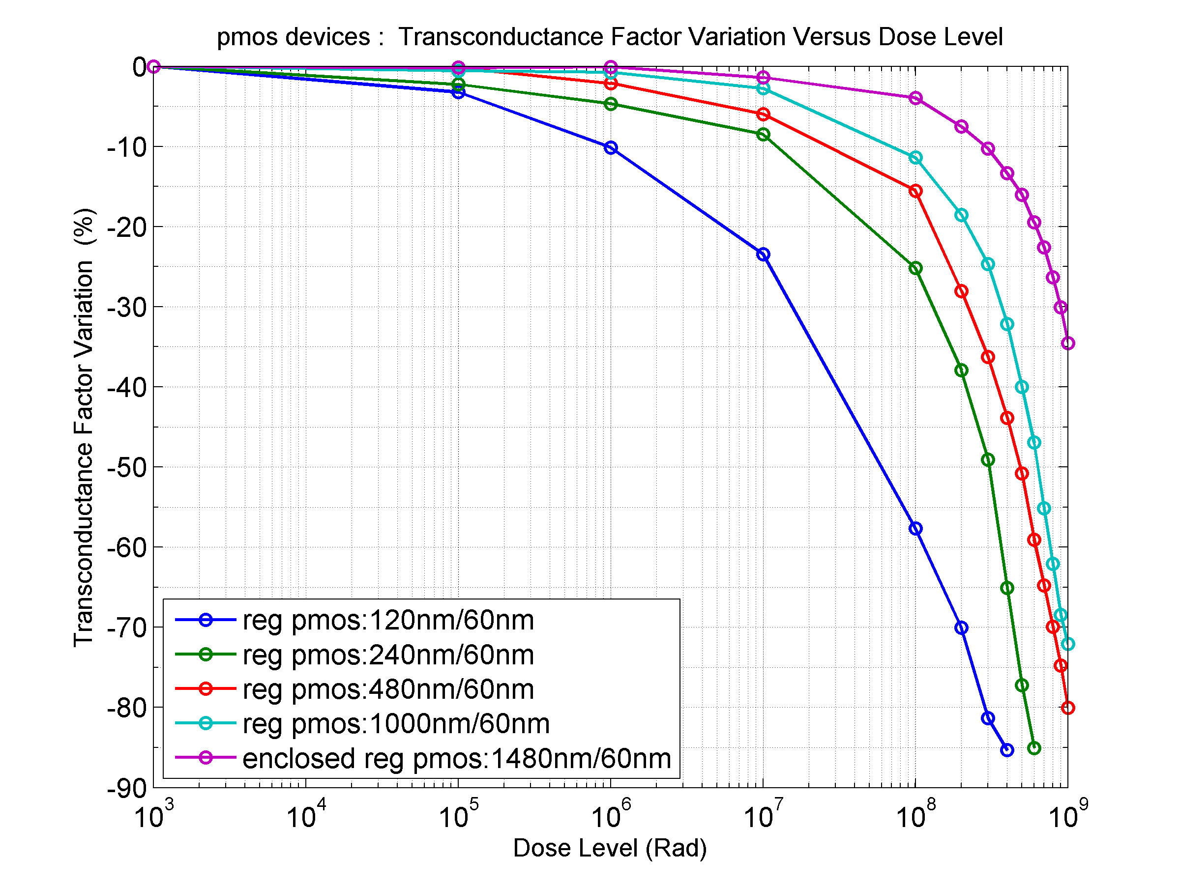
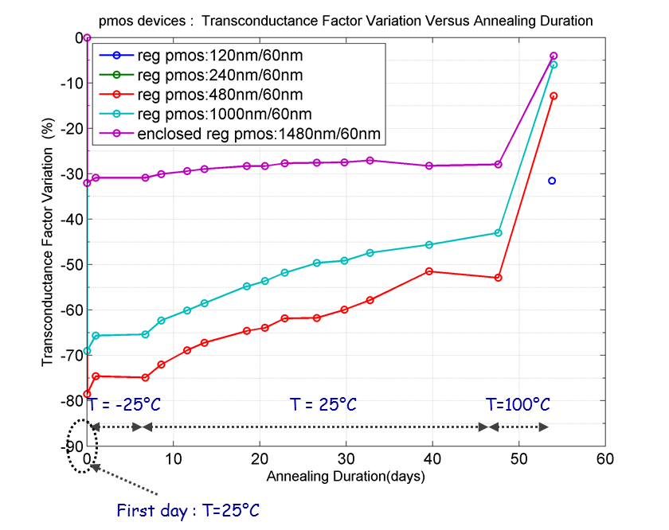
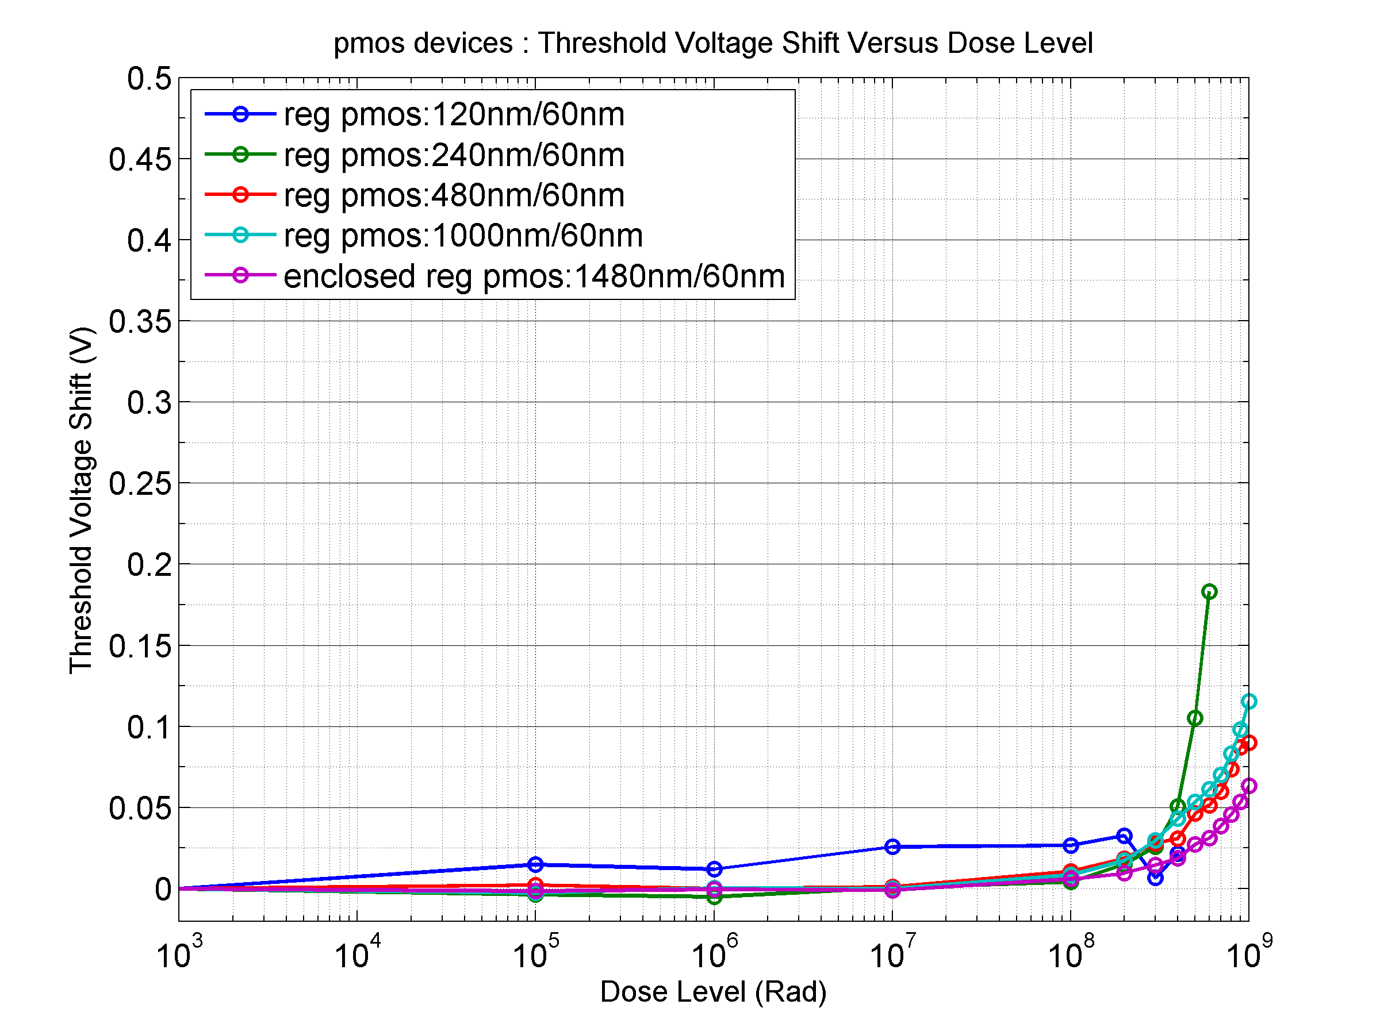
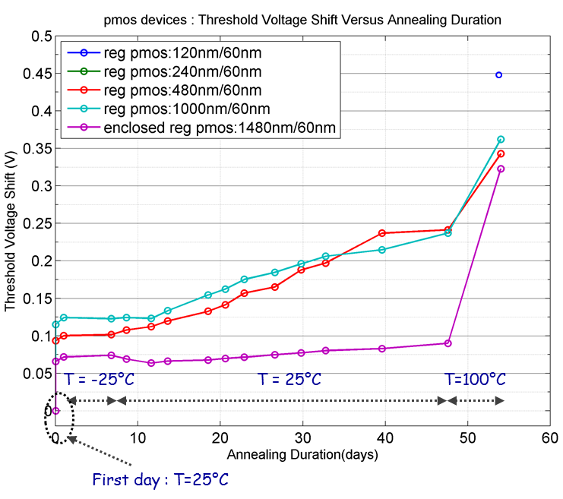
PMOS Radiation effects 65nm
Transconductance
Vt shift

Slide 9
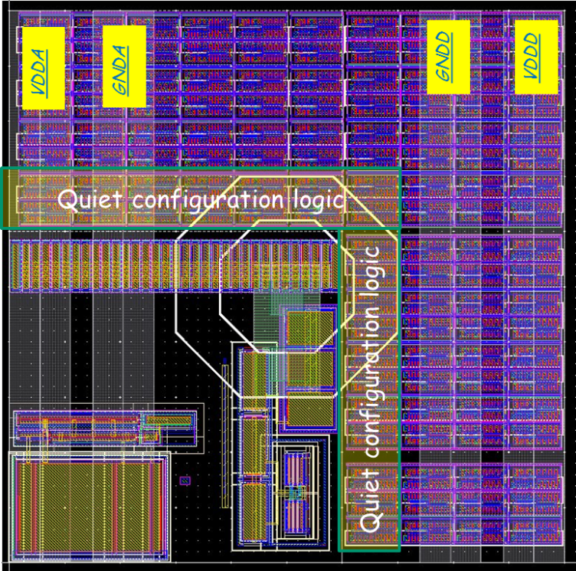
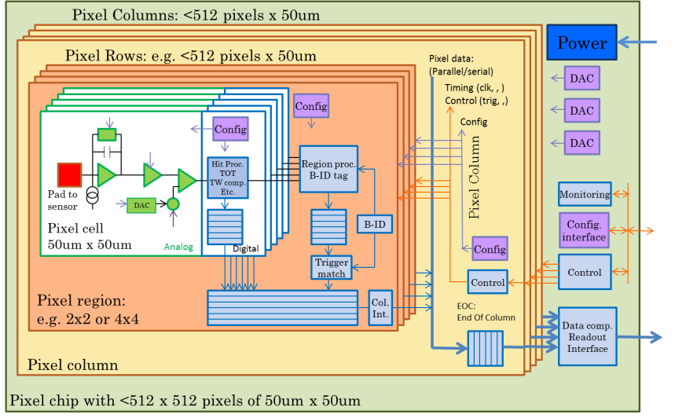
Top level WG
Global architecture and floor-plan issues for large mixed signal pixel chip - Convener: Maurice Garcia-Sciveres, LBNL
Activities and status
  Global floorplan issues for pixel matrix
    50x50um² – 25x100um² pixels with same pixel chip
      ATLAS – CMS has agreed to initially aim for this
    Global floor-plan with analog and digital regions
  Appropriate design flow
  Column bus versus serial links
  Simplified matrix structure for initial pixel array test chips
Plans
  Submission of common simplified pixel matrix test chips
  Evaluation of different pixel chip (digital) architectures
    Using simulation frameworks from simulation WG.
  Final integration of full pixel chip
Bonn, LBNL, , , ,

Slide 10
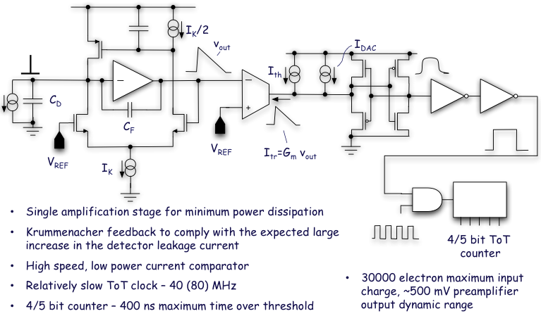
Analog WG
Evaluation, design and test of appropriate low power analog pixel Front-Ends
Convener: Valerio Re, Bergamo/Pavia
Activities and status
  Analog front-end specifications
    Planar, 3D sensors, capacitance, threshold, charge resolution, noise, deadtime, ,
  Alternative architectures –implementations to be compared, designed and tested by different groups
    TOT, ADC, Synchronous, Asynchronous, Threshold adjust, Auto zeroing, etc.
  Design / prototyping of FE’s ongoing
Plans
  Prototyping and test (with radiation) different FEs
    Some FEs have already been prototyped
    Others will be prototyped after the summer
  Test, comparison and choice of most appropriate FE(s)
Bergamo-Pavia, Bonn, CERN, CPPM, Fermilab, LBNL, Prague IP/FNSPE-CTU, Torino.
Krummenacher – TOT examples

Slide 11
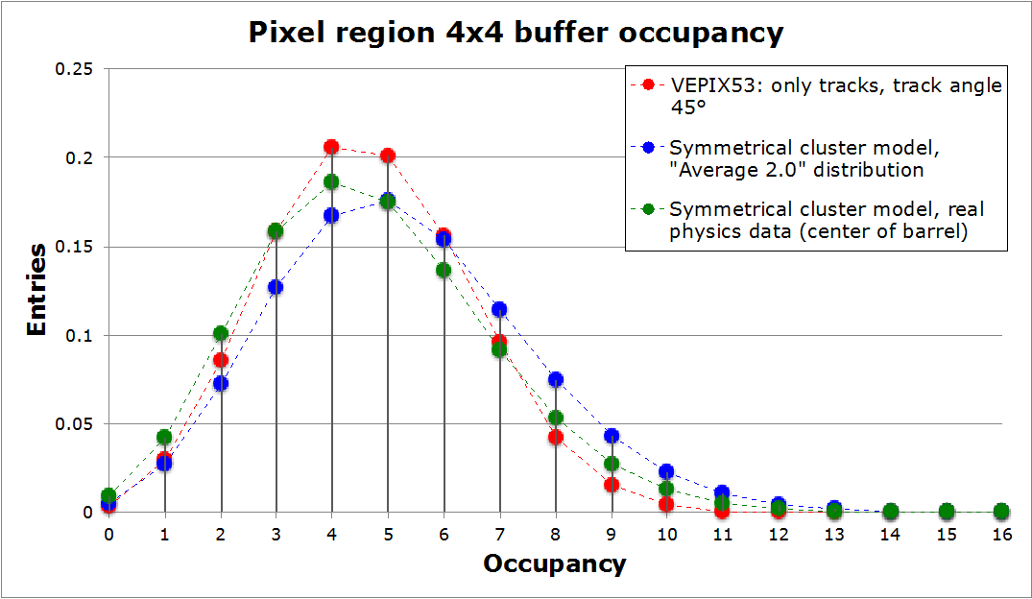
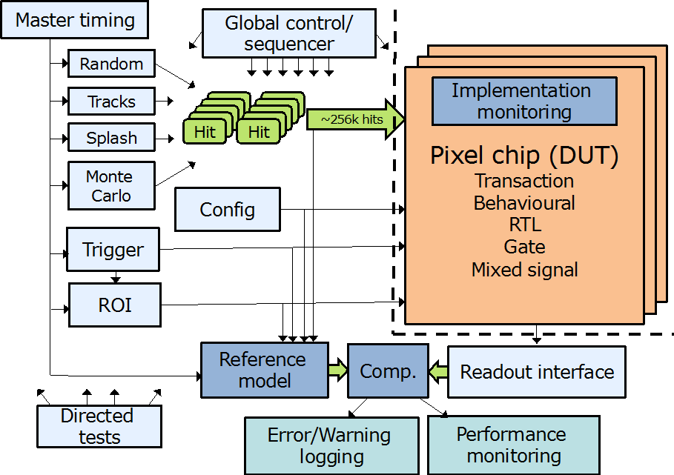
Simulation/verification WG
Simulation and verification framework for complex pixel chips
Convener: Tomasz Hemperek, Bonn
Activities and status
  Simulation framework based on system Verilog and UVM
  (industry standard for ASIC design and verification)
    High abstraction level down to detailed gate/transistor level
    Benchmarked using FEI4 design
  First basic version of framework available on common repository
    Internal generation of appropriate hit patterns
    Used for initial study of buffering architectures in pixel array
  Integration with ROOT to import hits
  from detector simulations and for
  monitoring and analysing results.
Plans
  Refine/finalize framework with detailed
  reference model of pixel chip
  Import pixel hit patterns from
  detector Monte-Carlo simulation
  Modelling of different pixel chip
  architectures and optimization
  Verification of final pixel chip
Bonn, CERN, Perugia
Buffer occupancy comparison between
simulation and analytical statistical model

Slide 12
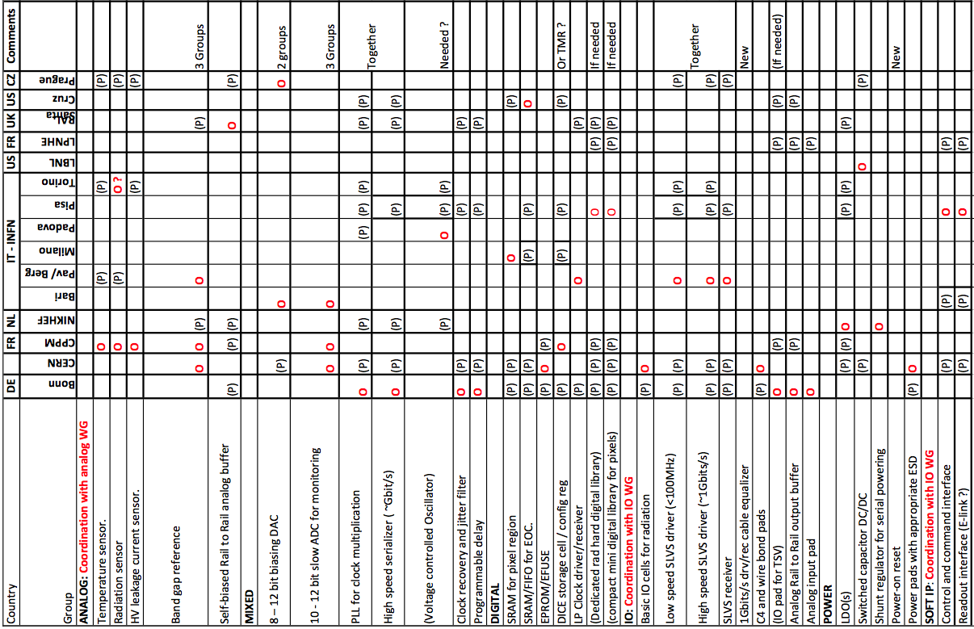
IP WG convener: Jorgen christiansen (CERN)
Out of 34 IP-block identified in RD53, INFN has proposed to contribute at ~16 of them
Job shared with some institutes Organizing the work, others to Participate.
Pisa organizes/participate: VCO, SLVS drivers/receivers, (+ Dedicated radhard/compact digital library)

Slide 13
CHIPIX65 2014 submissions
IP-block submission (2x2 mm²)- October 2014:
  SLVDS (Pavia)
  Band-Gap (Pavia, Milano)
  SRAM (Milano)
  DAC (Bari)
Analog Very Front End submission (2x2 mm²)- October 2014
  Synchronous, Auto-zeroing, FAST ToT analog front end (Torino)
  Asynchronous analog front end (Pavia)
  Analog readout: max (12x12) pixels + Matrix: (12x32) pixel
In the pipeline
  IP blocks:
    ADC (Bari), Serialiser (Pisa), Digital Logic RAdHard (Milano)
  Pixel-Matrix with complex synthetized digital logic (pixel and readout) [Torino, Pisa, Pavia, Milano]

Slide 14
IO WG
Newly defined WG. No work yet done.
Defining and implementing readout and control interfaces
Convener: Roberto Beccherle (Pisa)
  TBA this Thursday
Plans
  Defining readout and control protocols
  Implement/verify IO blocks for pixel chip
  Standardized pixel test systems

Slide 15
Attività 2013-14 a Pisa
Studio di un trigger self-seeded di primo livello con i pixel
  K. Androsov, M. T. Grippo, A. Rizzi, S. Donato, M. A. Ciocci, F. Palla, G. Bagliesi
Logica nel pixel per la prima sottomissione
  F. Morsani
Disegno di alcuni IP cores
  G. Magazzù – M. Miller (UCSB)
Disegno di una logica di clustering sul chip
  M. Minuti, G. Magazzù, F. Palla
Attività di acquisizione dati (DAQ)
  F. Morsani, M. Minuti

Slide 16
Tau to 3 prongs
M. T. Grippo, K. Androsov et al.
Identify triplets in a pixel chip of compatible cluster size in first two layers (using beam spot as a third point is in effect a p_{T} cut)
Look for compatible triplets in the third layer and form all track combinations, requiring ≥2 GeV track p_{T}.
Estimate tau decay vertex position in both R-Z and R-Phi planes.
L1 rate 300 kHz and 75% efficiency with L1-tracks
Or factor 4 reduction of L1 Calo Trigger at 40 GeV

Slide 17
Tau to 3 pro: Data rate

Slide 18
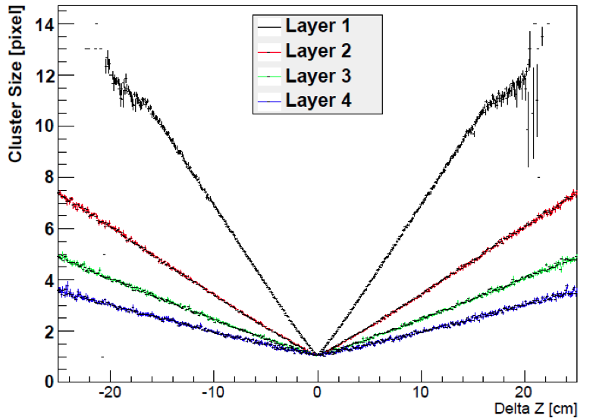
Jets primary vertex reconstruction
A. Rizzi, S. Donato

Slide 19
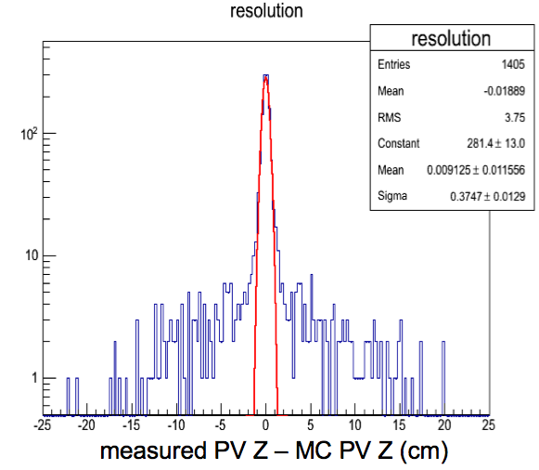
Jets primary vertex reconstruction
Algorithm uses pixel cluster information only from chips in the line-of-sight of jets
  Read full pixel information for a subset of the detector (reduction x 5-10) only for Calo-jets with some threshold as L0-trigger (and if latency allows)
  Performance depends on Jet ET. Typical reduction factors ~5 with ~90% efficiency.
    HOWEVER: does not do better than L1 Tracks
~4 mm resolution (RMS)
Similar resolution with L1-Tracks

Slide 20
Logica nel pixel per la prima sottomissione
F. Morsani
Lavoro a Pisa (F. Morsani) e Torino
  Misura del ToT con un clock generato internamente al pixel
  Simulazione e ottimizzazione delle celle
  Layout con il DK TSMC
  Realizzazione della matrice
  Test bench e sviluppo del firmware
    Riutilizzo e riadattamento scheda M. Minuti
Lavoro fatto ad oggi
  disegno del circuito funzionante in ToT e binary (registrazione del solo hit) mode
  setup simulazione mixed-mode (Verilog-Spectre): stimoli digitali e readout in Verilog, circuito dei pixel in Spectre (analog simulator)
  simulazione e debugging del singolo pixel

Slide 21
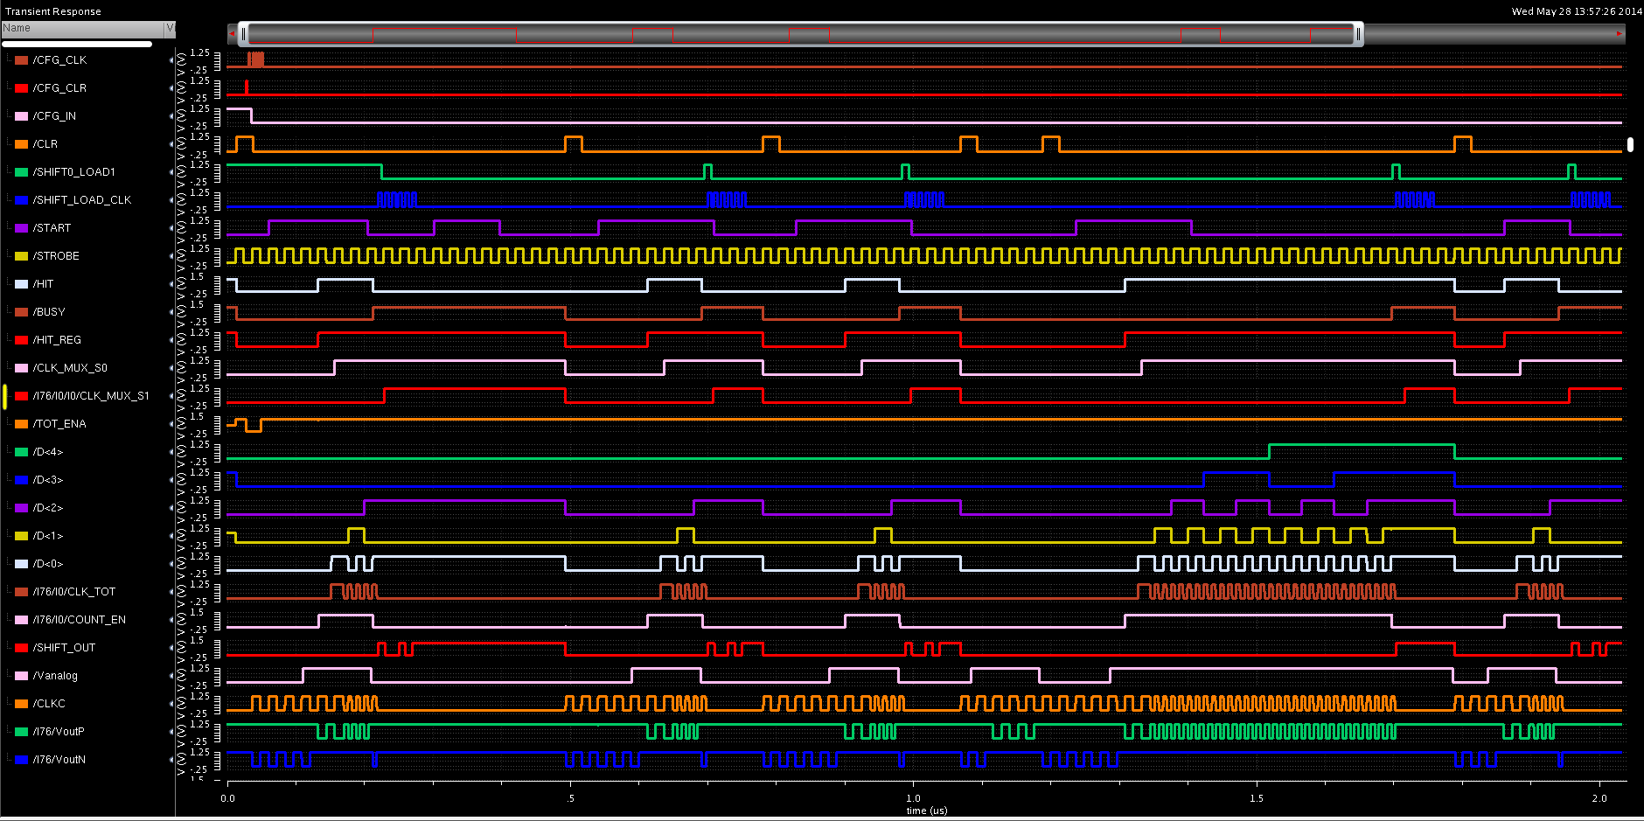
Simulazione, 5 eventi singolo pixel in vari casi, si vede bene il clock del ToT e il caso di timeout nel conteggio del ToT
CHIPIX65

Slide 22
Cosa c’e’ da fare
circuito da definire nei dettagli: ulteriori bit di configurazione, decisioni finali sul metodo di readout, buffering di segnali globali, organizzazione della matrice, ecc.
finire simulazioni con circuito attuale e quello finale, con singolo e doppio pixel (test intercomunicazione e readout)
layout pixel e matrice
validazione globale e generazione files per l’integrazione
DAQ: in base alla lista dei segnali necessari vedere cosa c’e’ da modificare in cio’ che e’ disponibile; sharing con PIXfel che intende usare lo stesso sistema.

Slide 23
Pixel clustering on chip
M. Minuti – G. Magazzù
Estimate the reduction in data rate if a clusterization is performed in some Macro-regions before shipping data to the periphery
  Clear gain in data volume reduction (up to 70% in some regions)
  Currently evaluating the clusterization logic and the power, to compare with default option
Macro Region size (m X n) | Baricenter spatial Accuracy | Total bits/cluster | Totalbits/Firedpixel | DVR* Mean | DVR* StdDev
8 X 8 | 1/4 P | 34 | 20 | 0.58 | 0.39
8 X 8 | 1/6 P | 38 | 20 | 0.65 | 0.44
16 X 16 | 1/4 P | 38 | 42 | 0.31 | 0.21
16 X 16 | 1/6 P | 42 | 42 | 0.34 | 0.23

Slide 24
IP-cores for high speed links
G. Magazzù – M. Miller
Standard Cell based SER/DES in CMOS 65nm
Ready for the CHIPIX65 submission in fall 2014
  RTL preliminary synthesis completed
    SER @ 2GHz
      Worst 1.4 mW
      Best 1.6 mW
    DES @2GHz
      Worst 6.0 mW
      Best 8.3 mW
High speed TX & RX differential pads in CMOS 65nm (M. Miller @ UCSB)
  Ready for the UCFF4 submission before the end of the year
  Electrical simulations ok – Layout to be started in August
Total dose (CERN) and SEU test (US) on UCFF2 & UCFF3 before the end of the year

Slide 25
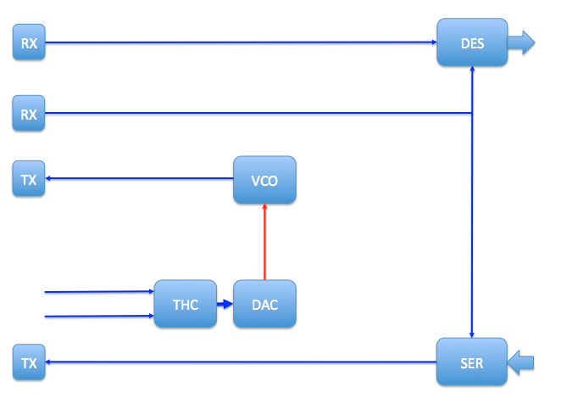
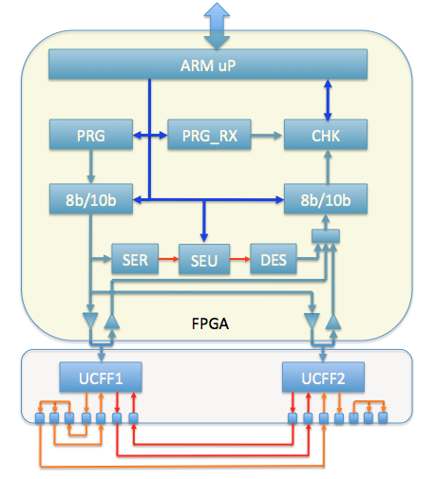
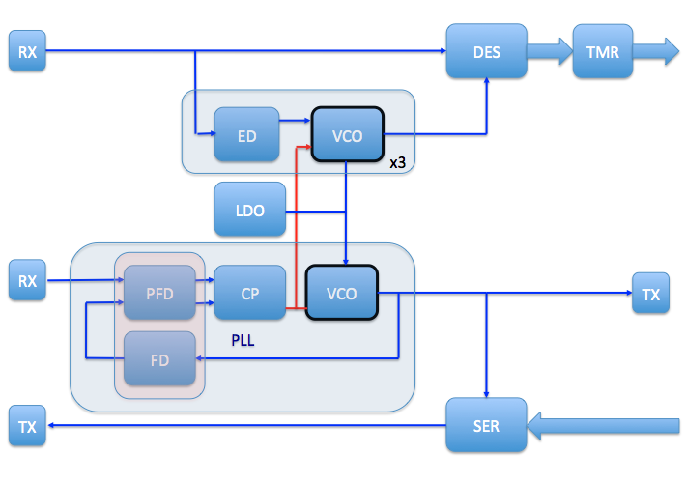
IP-cores for high speed links
UCFF1
UCFF test bench => Zed-Board (Xilinx Artix-7) + custom test board with 2 DUTs
UCFF2

Slide 26
I/O group
Responsabile R. Beccherle
1) I/O: Evaluation and definition of I/O protocols supporting 2Gbps or higher serial links, command based triggering up to 1MHz rate and minimum dead-time.
  - 80Mbps or higher serial input, with command decoder to configure and operate the chip. Evaluation of a slow control protocol.
  Command and Clock should be encoded on a single line.
  - 2Gbps Serial Output links will require to evaluate different output data formats and compression alternatives.
  - A duplex solution where all I/O takes place on a single serial connection should be considered. Investigation of link redundancy schemes to be eventually used on less data demanding layers.
2) Interfaces: Evaluation of compatibility with defined interfaces such as LPGBT.
3) IP blocks related to I/O: interface driver, clock recovery, clock multiplier methods, LVDS driver and receivers. [Work to be shared with the IP group]
4) Off chip connectivity: Calculation, Simulation and Test of transmission performance with realistic interconnects. I/O should not stop at the chip pads but extend to the system immediately outside the chip. High speed cables and protocols and even test interfaces. Therefore we should develop a specification for the system around it and a test setup.

Slide 27
CHIPIX 65 Activities for 2015
Details under discussion:
1 full INFN IP-block submission
1 full INFN pixel matrix submission
Participation to RD53 shared IP-block submission(s)
Participation to RD53 shared pixel matrix submission(s)

Slide 28
Attività 2015 a pisa
Sviluppo test board, carrier e firmware per il test della prima sottomissione e test dei primi prototipi
  F. Morsani, M. Minuti
Inizio delle attività I/O
  Q3, Q4: integrazione logica di I/O sul chip
    SER/DES 2Gbps e Tx/Rx 3GHz

Slide 29
Personale
Nomi | Percentuale
F. Palla | 20%
M.T. Grippo | 10%
R. Beccherle | 30%
G. Magazzù | 30%
F. Morsani | 25%
M. Minuti
Attività di sviluppo per R&D di CMS per HL-LHC

Slide 30
BACKUP SLIDES

Slide 31
Tau to 3 prongs
One “solution” using pixel-stand alone “tracking” at 40 MHz. (results presented here)
M. T. Grippo, K. Androsov et al.

Slide 32
RD53 Global Schedule as today
2014:
  Release of CERN 65nm design kit: Very soon !
  Detailed understanding of radiation effects in 65nm
    Radiation test of few alternative technologies (backup solution).
  IP block responsibilities defined and appearance of first FE and IP designs/prototypes
  Simulation framework with realistic hit generation and auto-verification.
  Alternative architectures defined and efforts to simulate and compare these defined
  Common MPW submission 1: First versions of IP blocks and analog FEs
2015:
  Common MPW submission 2: Near final versions of IP blocks and FEs.
  Final versions of IP blocks and FEs: Tested prototypes, documentation, simulation, etc.
  IO interface of pixel chip defined in detail
  Global architecture defined and extensively simulated
  Common MPW submission 3: Final IPs and Fes, Small pixel array(s)
2016:
  Common engineering run: Full sized pixel array chip.
  Pixel chip tests, radiation tests, beam tests , ,
2017:
  Separate or common ATLAS – CMS final pixel chip submissions.

Slide 33
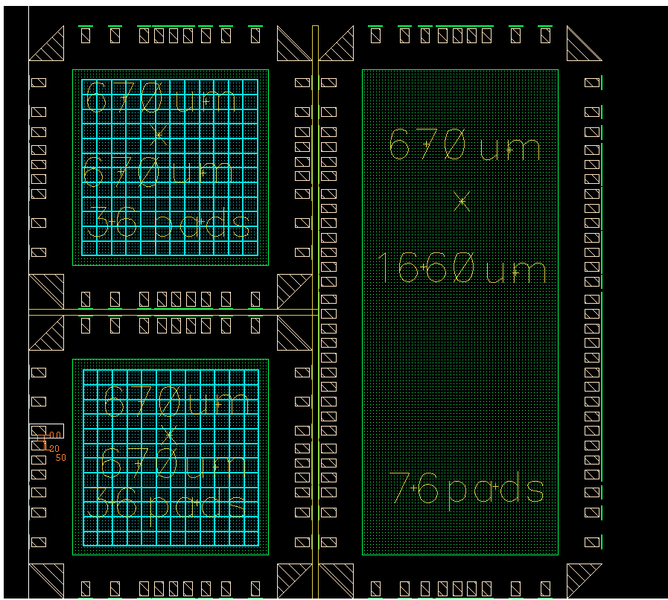
Floor Plan October

Slide 34
Read out semplificato per prima sottomissione
Piano
  implementazione della misura del ToT tramite un clock generato internamente al pixel usando il comparatore del tipo strobed messo in feedback con se stesso
  implementazione dei registri di configurazione del pixel
  simulazione mixed-mode e debugging dei circuiti implementati, singolo pixel e coppia di pixel
  ottimizzazione dal punto di vista dei consumi (p. es. oscillatore attivo solo durante la misura del ToT)
  layout delle singole celle e del circuito: attesa DK via CERN -> Adesso OK
  realizzazione della matrice e sua simulazione, fornitura del progetto a chi dovra’ fare l’integrazione per la sottomissione
  pensare al sistema di test dei prototipi

