Slide 1

Communicating
EU Research & Innovation
A guide
for project
participants

Slide 2
OUTLINE
Communication, why?
What is formally required?
Build your own communication strategy – a checklist
Good practices from projects like our
How can we help you?
Sources and resources

Slide 3
1. Communication, why?
Bring our research to the attention of as many relevant people as possible.
Communication about European research projects should demonstrate the ways in which research is contributing to a European ‘Innovation Union’
Should account for public spending by providing tangible proofs

Slide 4
What we should show
how European collaboration has achieved more than would have otherwise been possible, in achieving scientific excellence, contributing to competitiveness and solving societal challenges
how the outcomes are relevant to our everyday lives, by creating jobs, introducing novel technologies, or making our lives more comfortable
making better use of the results: are they taken up by decision-makers to influence policy-making and by industry and the scientific community to ensure follow-up?

Slide 5
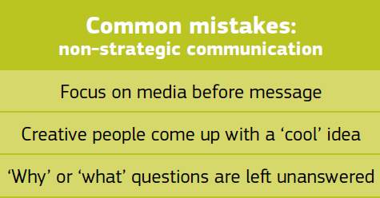
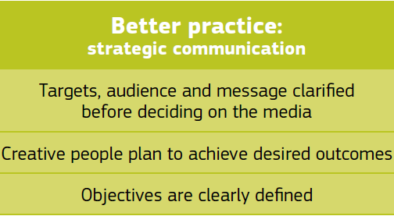
Enormous difference between communication strategically planned with these objectives in mind and ad hoc efforts for the sake of meeting contractual requirements

Slide 6
HOW we will profit? A good communication and dissemination plan will:
Increase the success rate of our proposal;
Attract the interest of potential partners;
Draw the attention of national, regional authorities and other public and private funding sources;
Encourage talented students and scientists to join your partner institutes and enterprises;
Enhance our reputation and visibility at local,
national and international level;
Help the search for financial backers, licensees or industrial implementers to exploit your results;
Generate market demand for the products or services developed

Slide 7
2. What is formally required?
Submitting and negotiating a proposal: impact resulting from communication & dissemination activities counts for evaluation.
During the project:
Grant Agreement, Annex II.4. Reports and deliverables and Guidance Notes on Project Reporting – Provide (a) periodic reports that include a publishable summary; (b) a website to be up to date, published on the Commission’s website.
Grant Agreement, Annex II.12. Information and communication – (a) Beneficiaries have to engage with the public and the media about the project and to highlight the European Union’s financial support. (b) The Commission is authorised to publish information on the project.
At the end of the project:
Grant Agreement, Annex II.30. Dissemination - (a) Each beneficiary is to ensure that their foreground is disseminated as swiftly as possible. If it fails to do so, the Commission may disseminate that foreground.
Grant Agreement, Annex II.4. Reports and deliverables and Guidance Notes on Project Reporting – (a) The consortium has to provide a final publishable report including a publishable summary. It includes information on the expected final results and their wider societal implications. (b) In final report should be a plan for the use and dissemination of foreground: list of all scientific (peer reviewed) publications relating to the foreground of the project, a list of all dissemination activities (e.g. conferences, flyers, articles published in the popular press, videos), a list of the applications for patents, trademarks, registered designs, etc., a list of exploitable foreground and a report on societal implications.

Slide 8
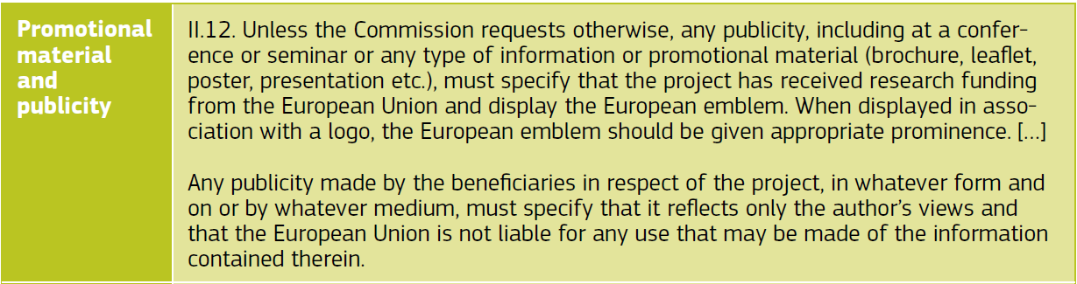
What formal references do we have to make?
High-resolution emblems can be found here (update: see recent email): http://europa.eu/about-eu/basic-information/symbols/flag/
More informationcan be found at the following link (notably p.3):
http:// ec.europa.eu/research/pdf/eu_emblem_rules_2012.pdf
The following written formulas are taken from Annex II to the Grant Agreement:

Slide 9
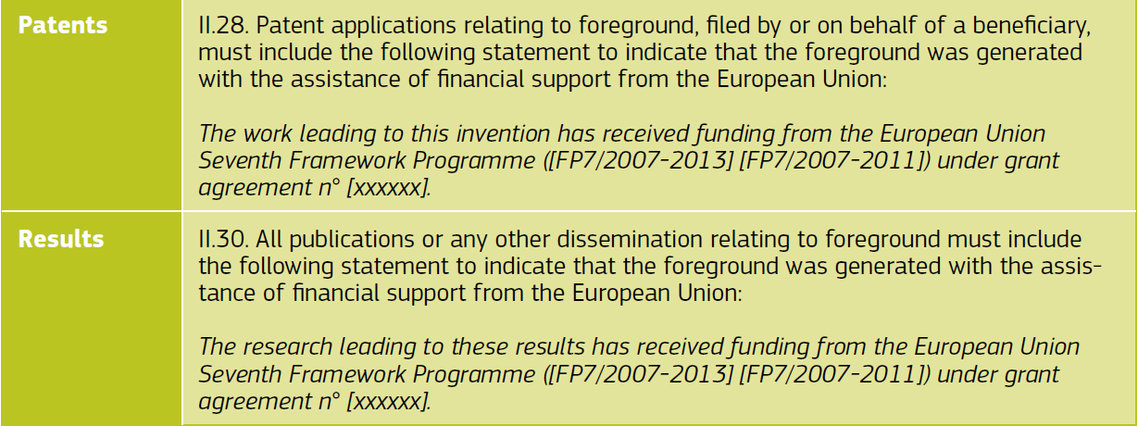
See recent e-mail for update

Slide 10
3. Build your communication strategy – a checklist
A - Ensure good management:
Have resources been allocated (time and money)?
  Does proposal include a work package on communication? A dissemination & communication strategy & timeline right from the beginning?
  Does the communication element of the project involve all consortium partners (staff, including researchers)?
  Is there awareness that communication is a continuous process, not a one-time effort when the project ends?
  ready for the unexpected? how to respond effectively to such things as publication in high-ranking journals or a sudden new event related to the project’s theme?
Are professional communicators involved?
  Have resources been allocated to professional assistance: drafting of press releases, graphic design, website maintenance …. ?
  Have you considered taking any training in the field of communication or including a communication expert in your team?
Is continuity ensured?
  Arrangements to ensure information will not be lost once the project comes to an end?
  Any feedback loops back to the European Commission to amplifying the message, i.e. by notifying an event, or before publishing a press release?

Slide 11
B - Define your goals and objectives:
Are there any goals and objectives?
  Are final and intermediate communication project goals specified? what impact, what reaction or change is expected from audience?
  Receiving feedback or engaging in dialogue
  Influencing the attitudes of decision-makers
  Having people make a decision or take action
  Ensuring that the project outcomes will be taken into production
Are your goals and objectives neither too ambitious nor too weak?
  Is there a deadline by which the goals should be achieved, taking into account different stages of the research and possible intermediary outcomes?
  Are the objectives specific and measurable, rather than vague? Does the project envisage ways of measuring its communication efforts and impact? For example:
    Evidence of debates in the media
    Evidence of new funders for your area
    Evidence of transference of research into practice (patents, prototypes, licenses)
    Number and turnover of new products, practices or procedures developed, based on your research outcomes
    Number of articles in the press
    Number of people asking for feedback or more information
    Number of references in scientific publications
    Participation in project events and seminars
    Speaker evaluations from conferences
    presentations
    Survey of end-users
    Trends in website visits

Slide 12
C. Pick your audience
1. Is your audience well defined?
  Is each target audience a relatively homogenous group of people (not: ‘the public at large’ or ‘all stakeholders’)?
  Can the indicated audiences be further specified? For example: from ‘the general public’ to ‘female citizens commuting by train to work in one of the EU-10 countries’ or from ‘decision-makers’ to ‘Europarliamentarians involved in the design of the new transport policy 2013’.
2. Does it include all relevant target groups?
  Can your audience help you reach your objectives?
    Who has an interest in your research?
    Who can contribute to your work?
    Who would be interested in learning about the project’s findings?
    Who could or will be affected directly by the outcomes of the research?
    Who are not directly involved, but could have influence elsewhere?
  Does the project aim to address both a direct audience and intermediaries to reach more people?
  What about the possibility of audiences at local, regional, national and European level?
  Is the audience external (not restricted to consortium partners)?
For each audience, you should work on a distinct strategy using targeted messages, means and language

Slide 13
D. Choose your message
1. Is it news?
  Why do we need to know? What will change? What solutions are you offering? What makes the issue urgent? What are the consequences if no actions is taken?
  Have you tried to stir your audience’s imagination and emotions?
  How does your work relate to everyday life? Does it link to any broader societal issue? Is your project research positioned within a broader socio-economic & policy context, so that it is easier to explain the results and their relevance to policymakers and citizens?
2. Are you connecting to what your audience wants to know?
See through your audience’s eyes:
  What do they already know about the topic?
  What do they think about it?
  Do they need information and/or persuasion?
  Have you tested your message?
Are you considering a FAQ on potentially controversial or sensitive issues?
3. Are you connecting to your own communication objectives?
Tell a story, don’t just list facts. A story is an effective way to make people remember your message. Why not tell one to disseminate your results? You have forgotten how to tell a story? Just search for ‘storytelling’ on the internet.

Slide 14
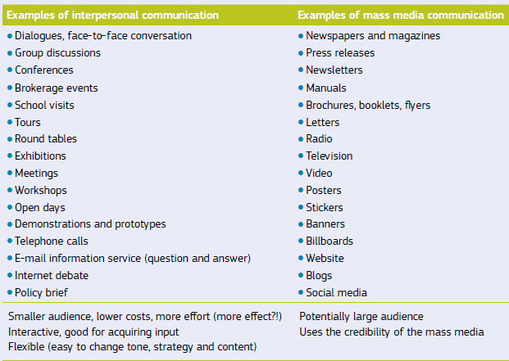
E. Use the right medium and means
1. Do they reach the audience?
  Are you working at the right level (local, regional, national)?
  Are you using dissemination partners and multipliers to amplify and multiply a message?
2. Do they go beyond the obvious?
  If input or contributions are needed, are there mechanisms in place to make communication interactive so as to obtain responses?
  Are you taking into account the different ways to communicate?

Slide 15
Good practices from projects like yours
F. Evaluate your efforts
Go back to your goals and objectives. Have they been reached? What lessons have you learned?
See the attached File with examples
How can we help you?
Whether your project is organising a public event or press demonstration, or has just delivered a set of exciting results: the European Commission may be able to help you spread the word. Inform your project officer about interesting topics, news and events
several freely accessible tools follow in the next pages

Slide 16
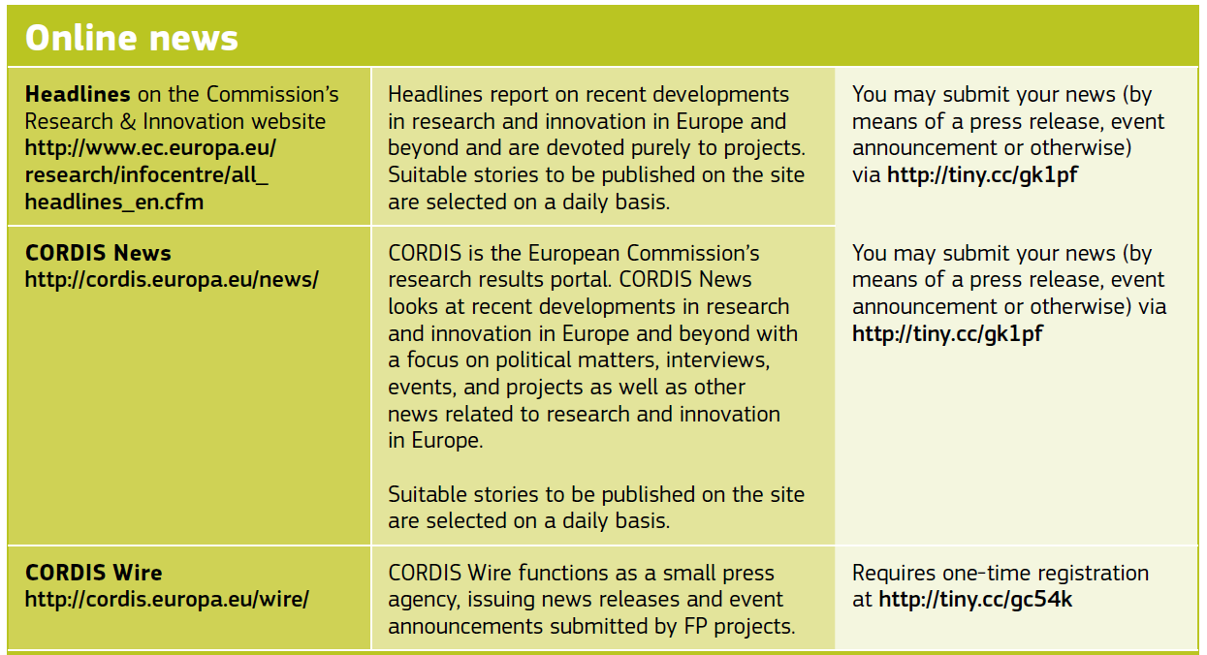

Slide 17
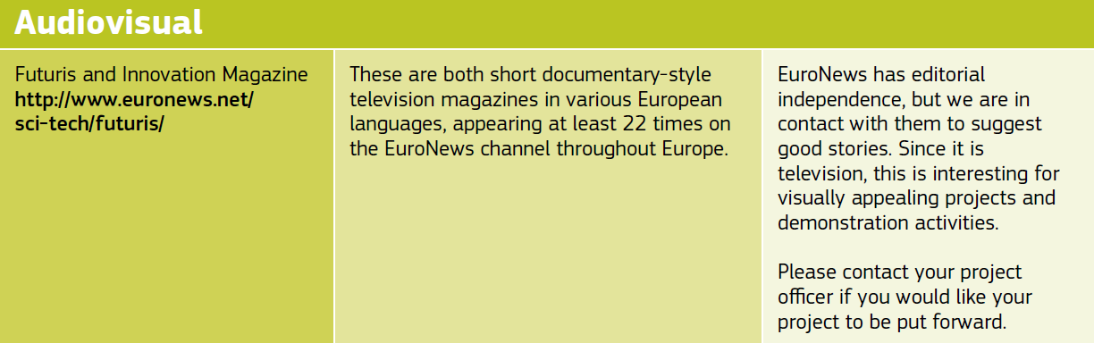

Slide 18
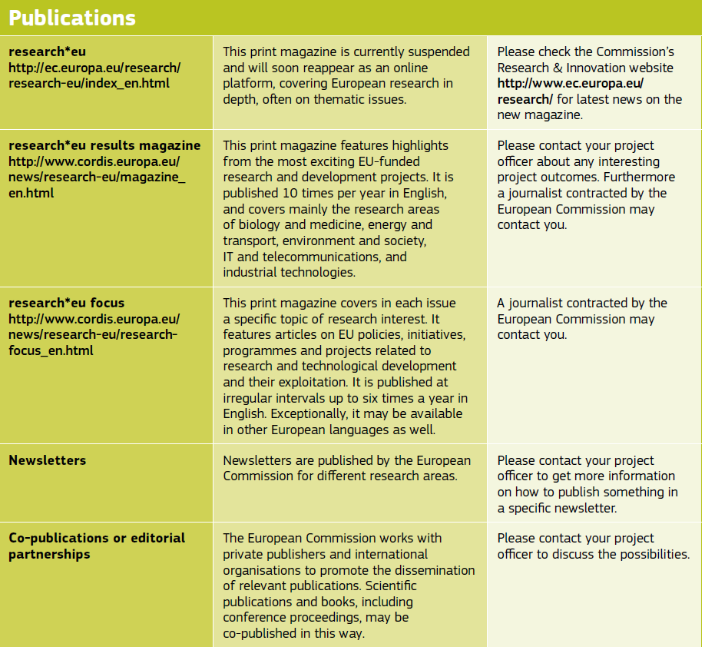

Slide 19
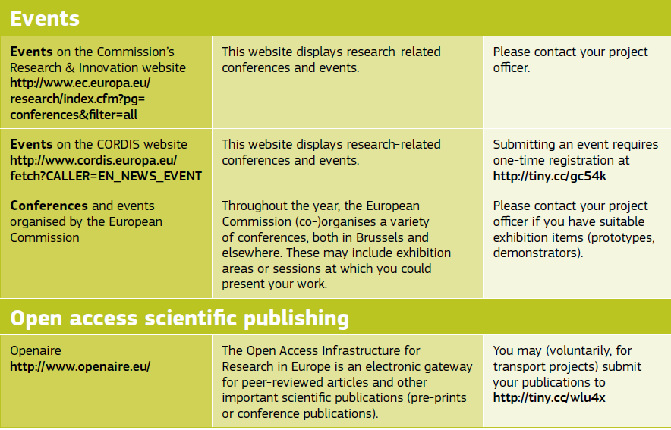

Slide 20
Sources and resources
AAAS (American Association for the Advancement of Science) http://communicatingscience.aaas.org/ Communicating Science: Tools for Scientists and Engineers includes learning the basics of communication, how-to tips for working with reporters, strategies for using online media effectively, and more.
British Science Association ‘Collective Memory’ http://collectivememory.britishscienceassociation.org/ The Collective Memory is a database of evaluations of a diverse range of science communication initiatives.
Carrada, Giovanni (2006), A Scientist’s Survival Kit; Communicating Science. EU Publications Office, Luxembourg.
European Commission (2004), European Research - A guide to successful communications. EU Publications Office, Luxembourg.
European Commission (2008). Scientific evidence for policymaking. Publications Office, Luxembourg.
European Commission (2010). Communicating research for evidence-based policymaking. A practical guide in socio-economic sciences and humanities. Publications Office, Luxembourg.
European Science Events Association (Eusea) http://www.euscea.org The European association for organisations for European Science Communication Events (SCE).
Story Collider http://storycollider.org (podcasts) Science is everywhere in our lives. We all have a story about science, and at The Story Collider, we want to hear those stories.
UK Royal Society (2006). Communicating the results of new scientific research to the public –Science & the public interest. The ins & outs of communicating about risk & probability.
Voice of Young Science (2006). Standing up for science. A guide to the media for early career scientists. Sense about Science, London.

Slide 21
Many web sites on skills, examples
Communication Skills: Speaking and Listening
http://www.kent.ac.uk/careers/sk/communicating.htm
Also see:
Teamworking skills Interactive exercise and tips for group work exercises in assessment centres.
Making a presentation
Persuading, influencing and negotiating skills
Leadership skills including a leadership styles exercise
Interview skills
Telephone interviews
Competency-based interviews
Body language in interviews Quiz on non-verbal communication.
Assertiveness in interviews
150 common interview questions and how to answer them
Practice interviews
Online Communication Skills Training http://www.youtube.com/user/PowerDiversity

