Slide 2
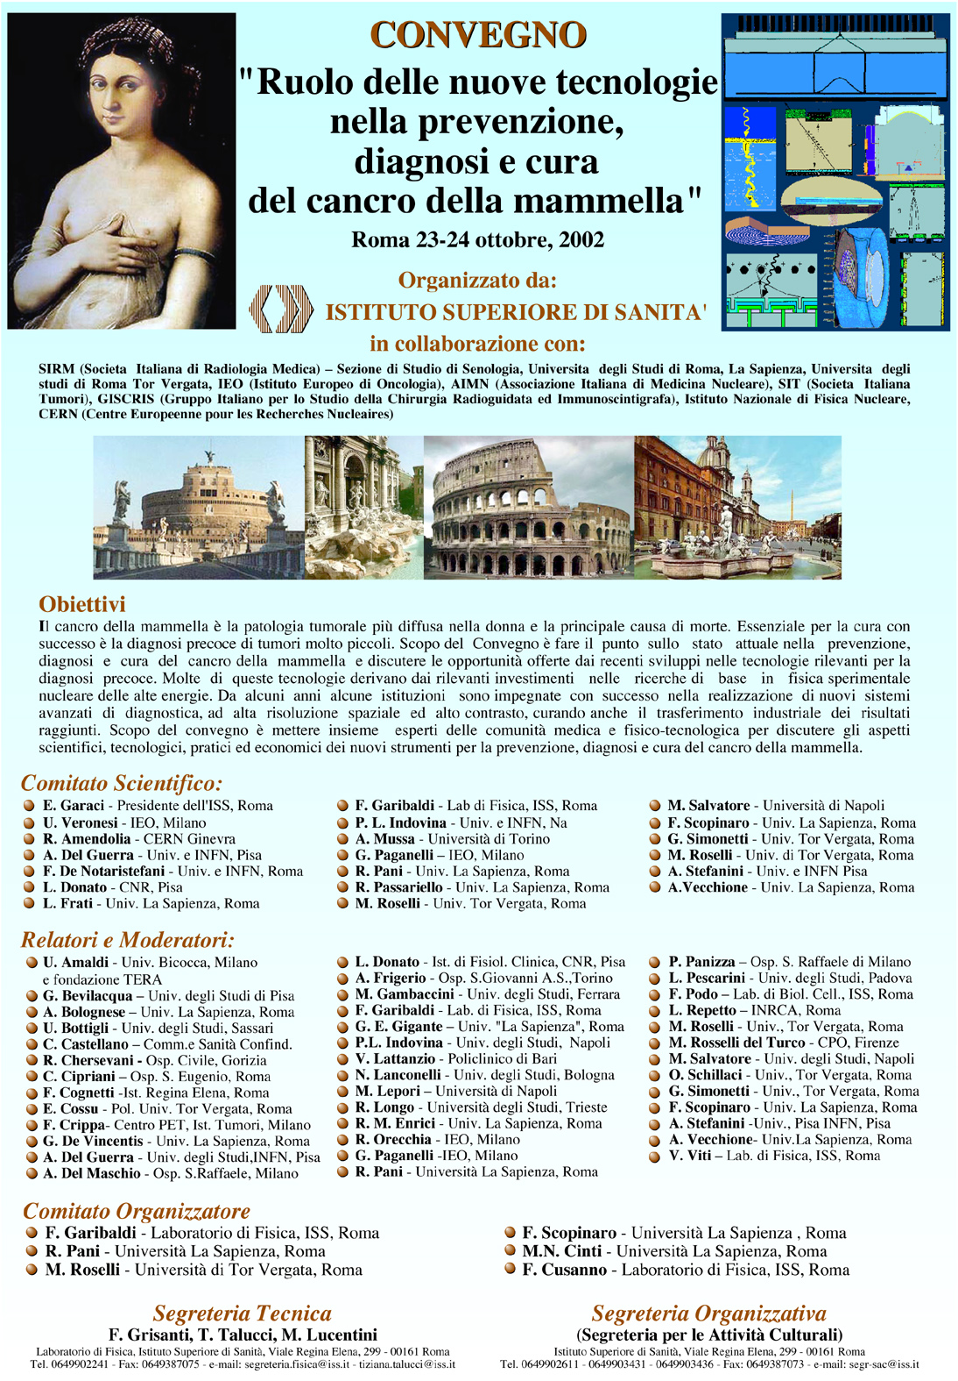
Workshop on Compton Camera Applications to Bio-medical Imaging
Mattinata 5-7 September 2002

Slide 3
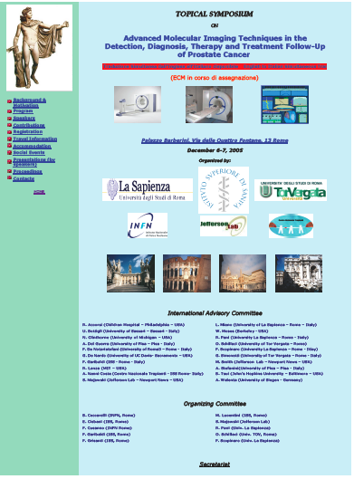
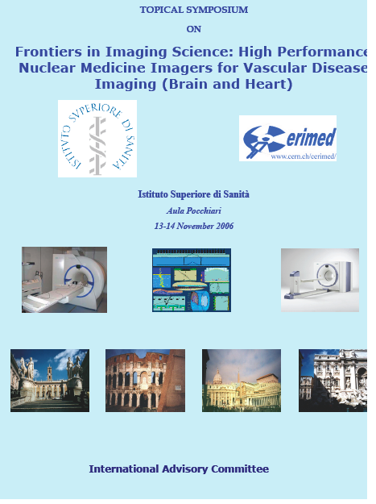

Slide 4
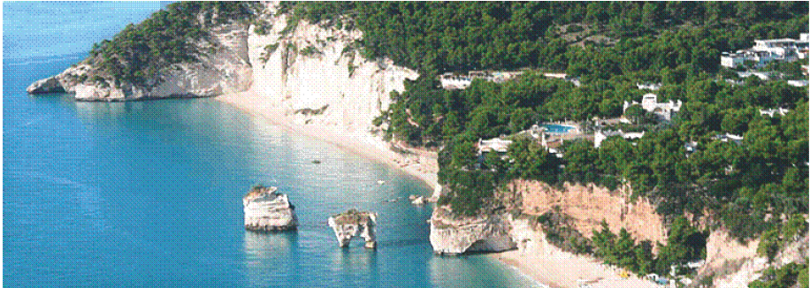
Stem cell workshop – Marseille - December 2008
Topical Symposium on Advanced molecular intraoperative probes assisting surgical interventions
TOF PET workshop
Baia delle Zagare September 2009
Endoscopy
Marseille – January 2011

Slide 5
Palma de Mallorca – September 2013

Slide 6
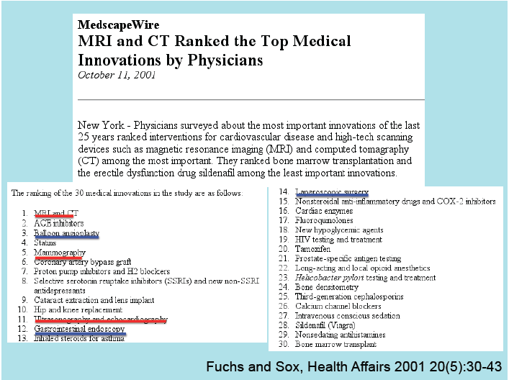

Slide 7
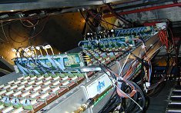
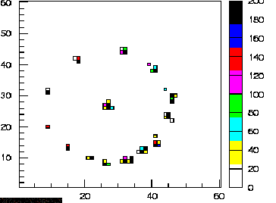
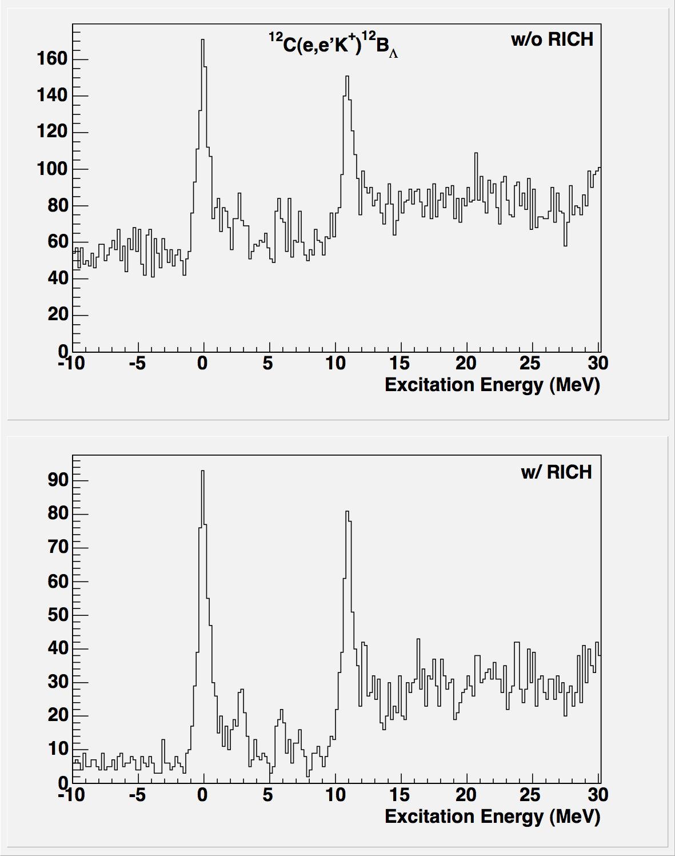
Freon/CsI RICH detector (like ALICE)
Spectroscopy analysis of ¹²B_{Λ} : Aerogel vs. RICH K-selection
¹²C(e,e’K)¹²B_{Λ}
Aerogel Kaon
selection
Hermes areogel RICH
RICH Kaon
selection

Slide 8
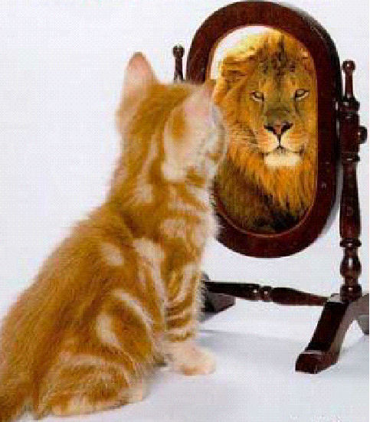
similar is not
always the same
Notes:
In 2009 it is appealing the concept that two patients with SIMILAR urological tumoral pathology but DIFFERENT for aggressiveness can get a different and customized treatments

Slide 9
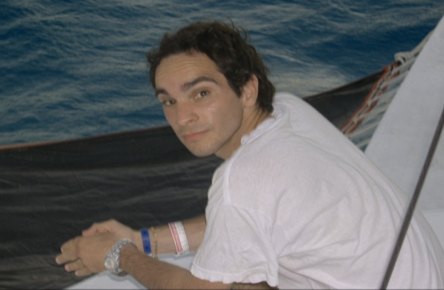
Francesco Cusanno December 1971 - 29 – 08 2014
A great scientist, man, friend
“The world is a lesser place for his having left it, but a better place for his having been here”

Slide 10
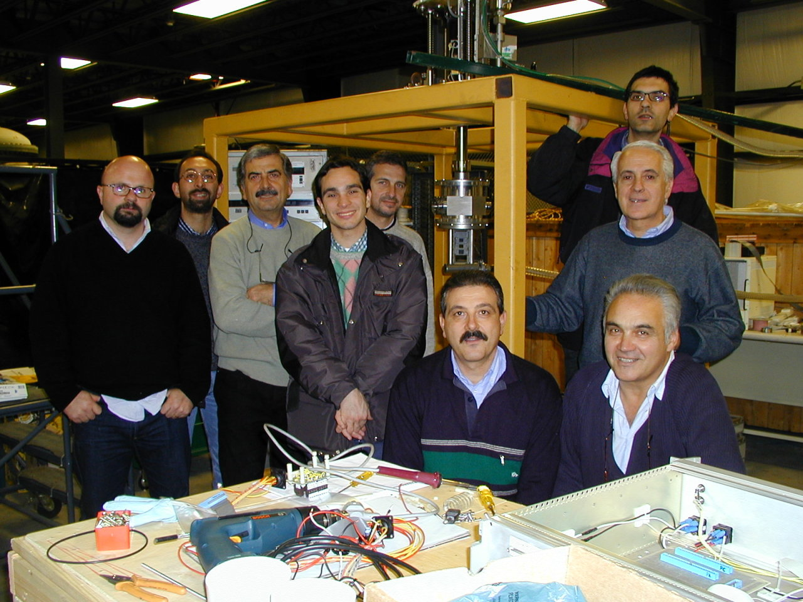

Slide 11
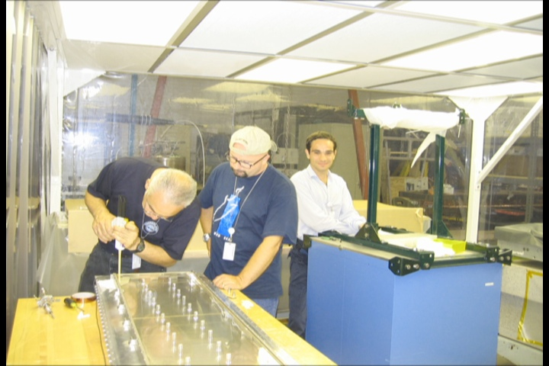
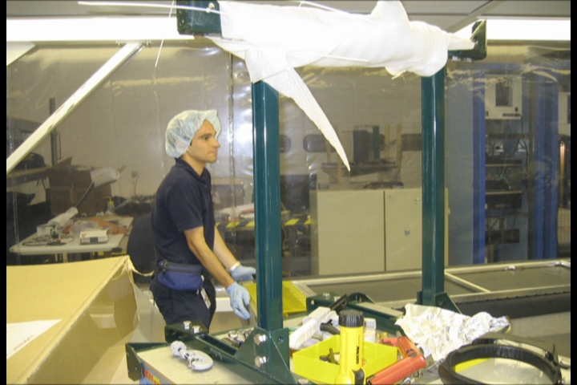

Slide 12
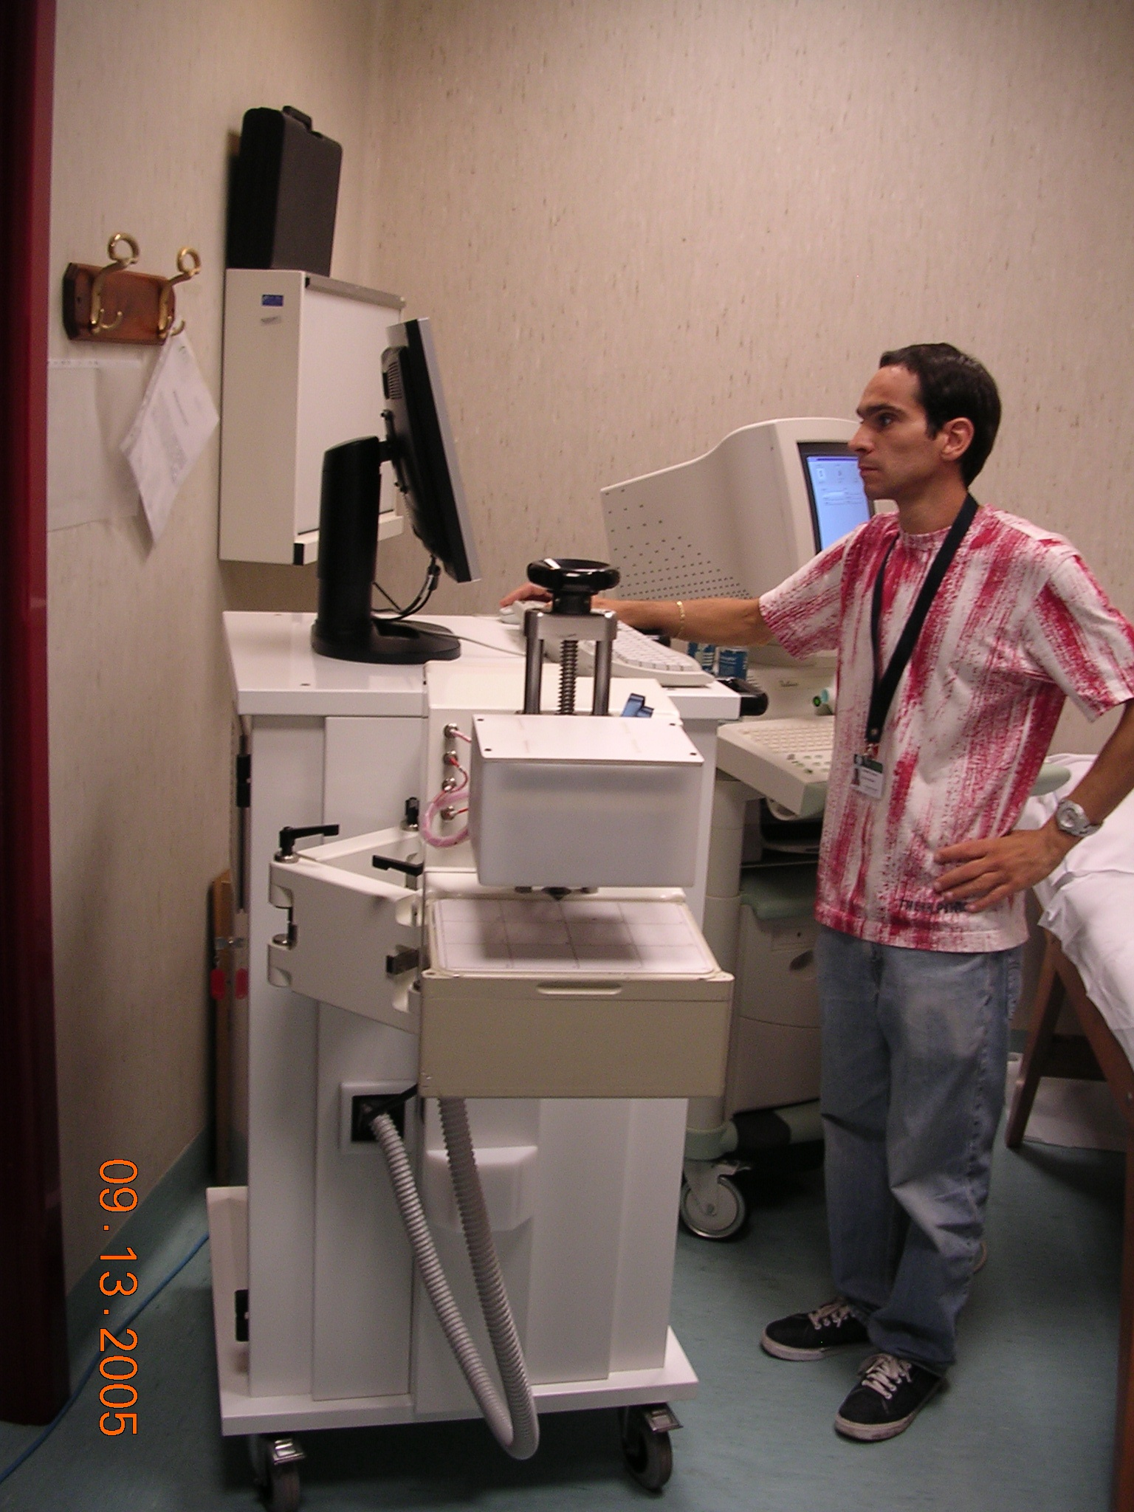

Slide 13
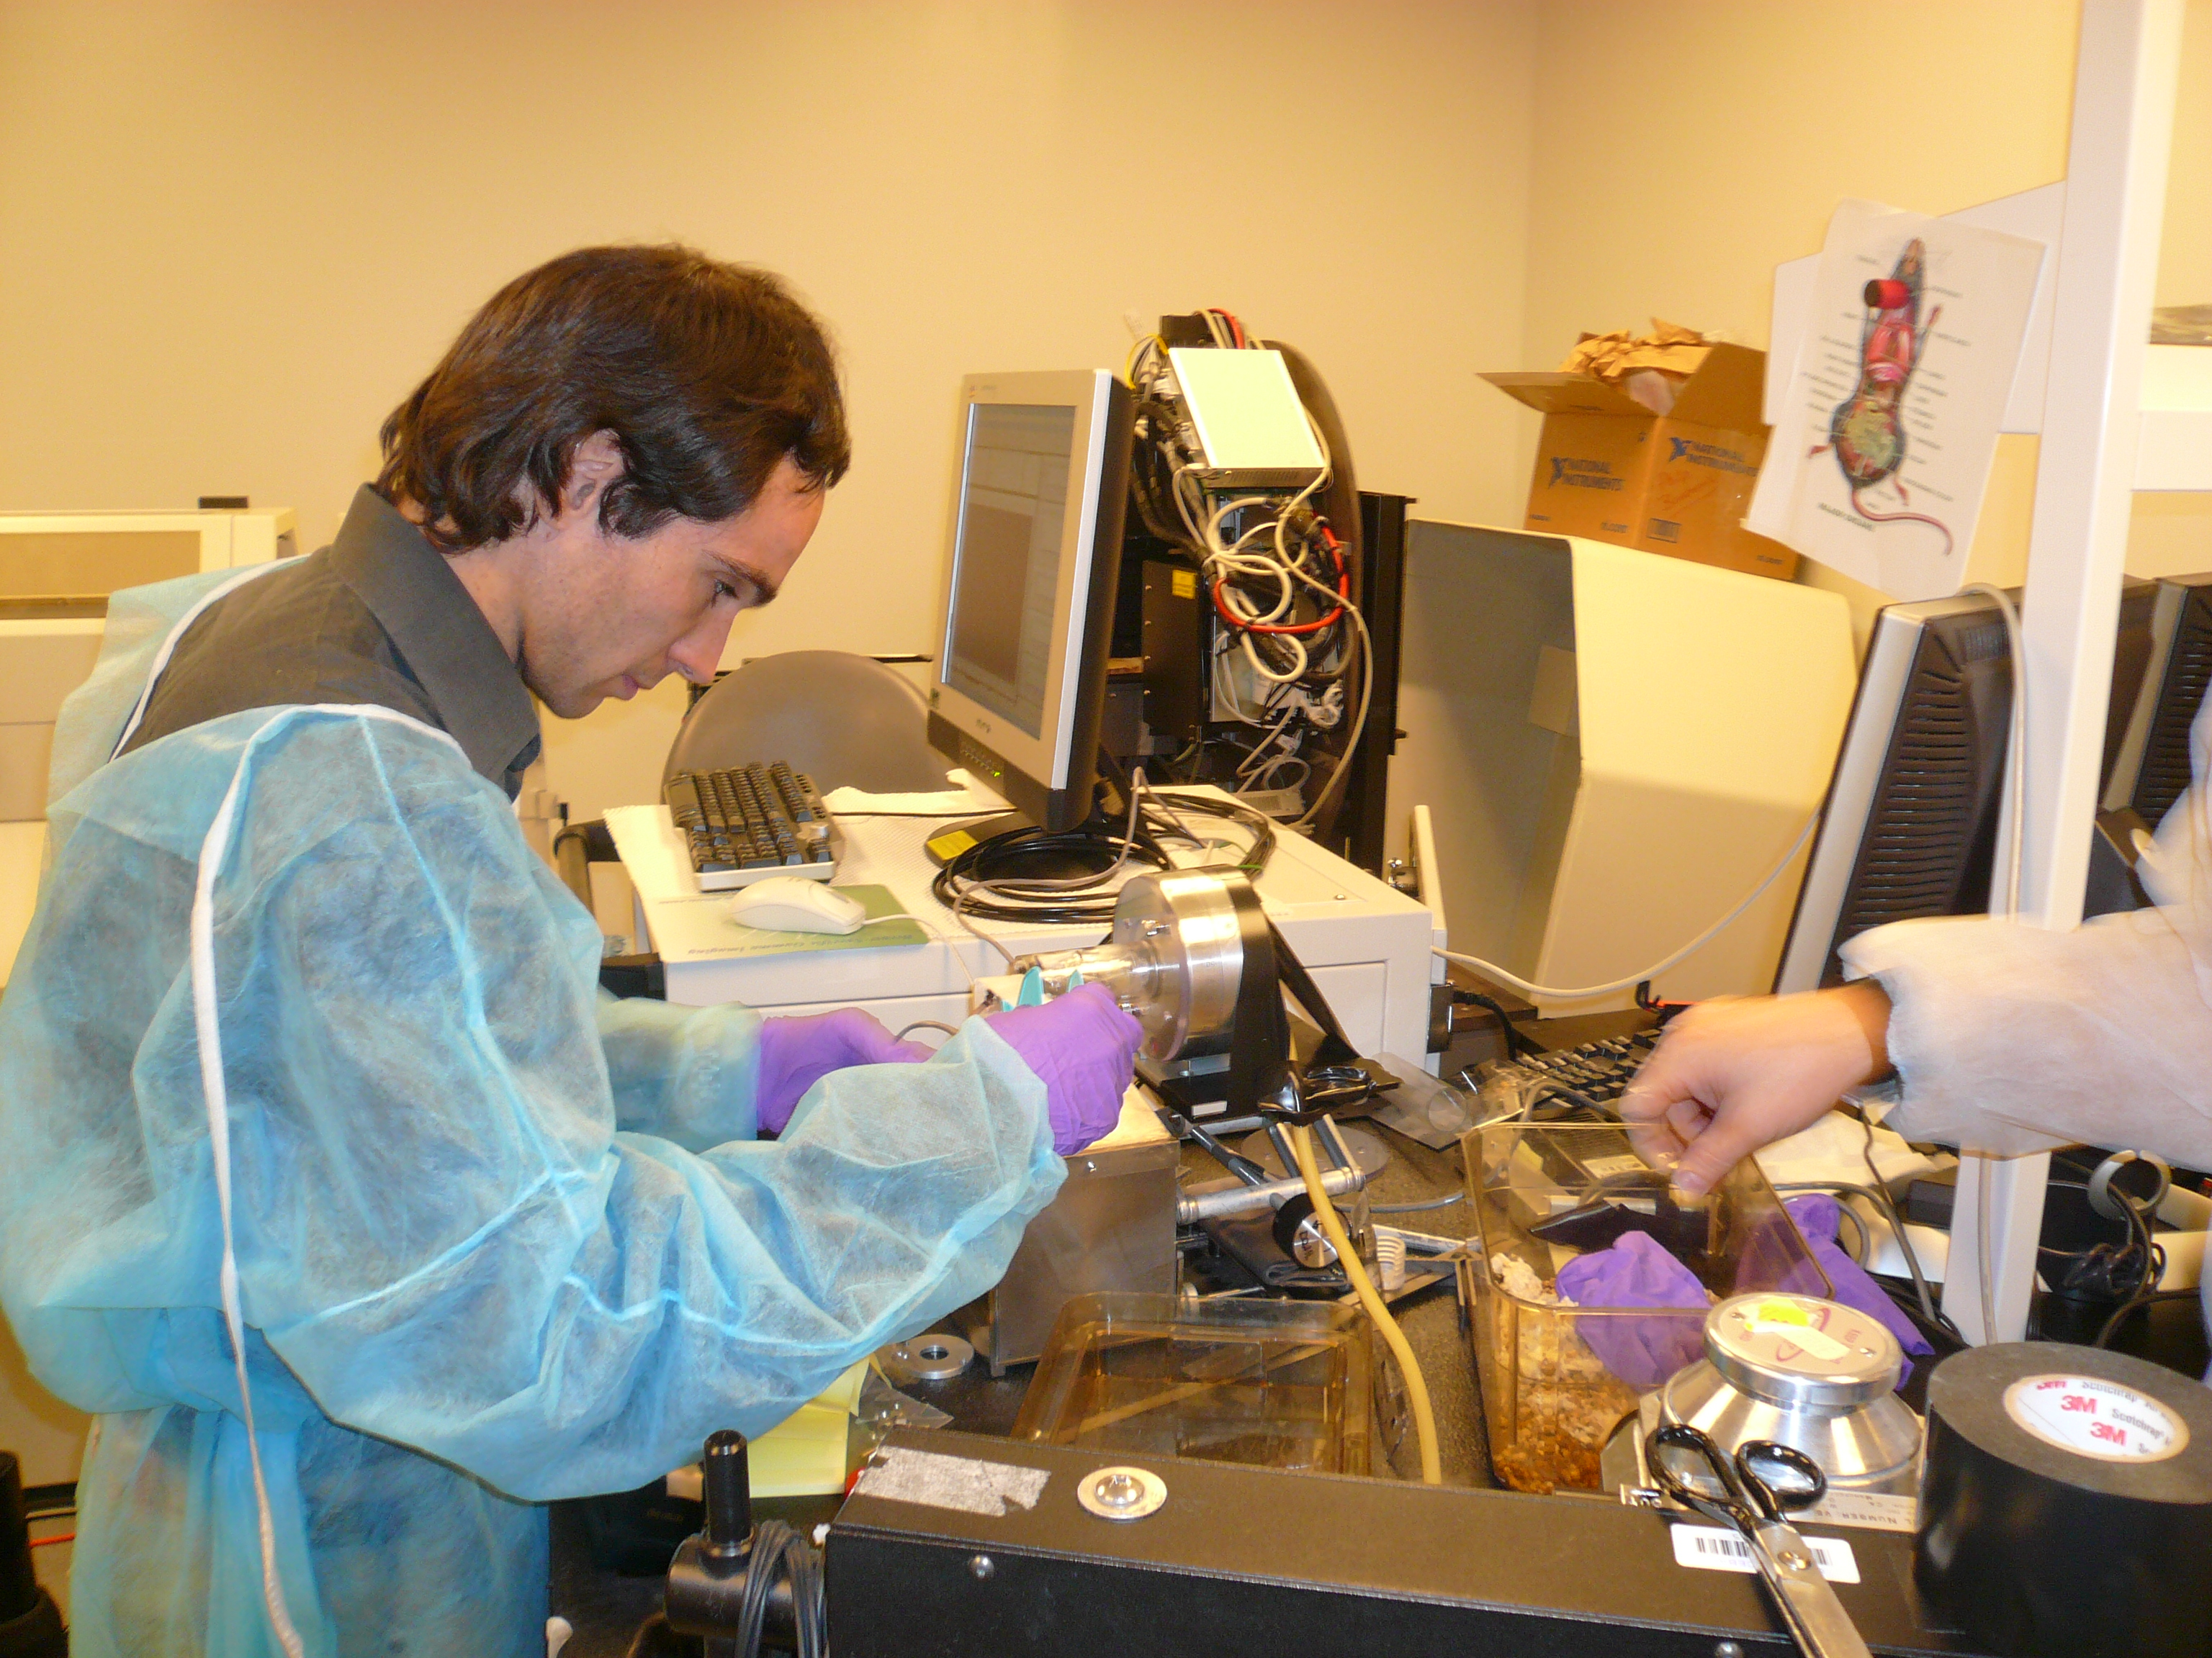
For me this is the Francesco’s workshop

Slide 14
Thanks to E. Nappi
EPJ-plus Focus point
~ 10 selected papers

Slide 15
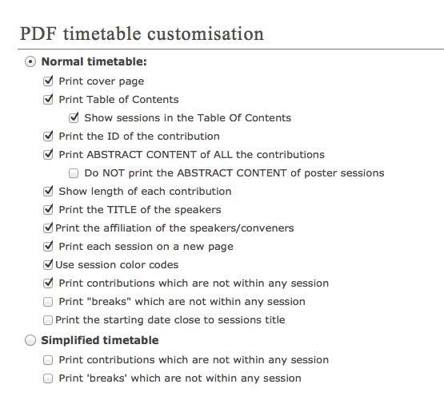
INFNX pswd: mediwork
Agenda updated on the web site,
https://agenda.infn.it/conferenceDisplay.py?confId=8263
Notes:
https://agenda.infn.it/conferenceDisplay.py?confId=8263

Slide 16
Social events
Thursday September 4 after dinner: piano bar
Friday September 5 : workshop dinner & piano bar
Saturday September 6 :
@ 10.45 Boat trip to “grotta di Nettuno” and
swimming in some nice beach
after dinner: folk Sardinian singers and dancers

