Slide 1
THE ORIGIN OF COSMIC RAYS: data, theories and challenges
Pasquale Blasi
INAF/Arcetri Astrophysical Observatory, Firenze &
GSSI/Gran Sasso Science Institute, L’Aquila
Napoli, June 19 2014

Slide 2
DO WE HAVE A STANDARD MODEL?
THE MAIN GUIDANCE FROM DATA HAS COME FROM:
PROTON KNEE AT ~ THE ALL-PARTICLE KNEE
B/C RATIO (and other secondary/primary ratios)
THE MOST ‘STANDARD’ MODEL WE HAVE CONSISTS OF TWO PIECES:
Particles propagate diffusively in the Galaxy, which should explain the secondary/primary ratios and unstable isotopes + diffuse bkgnds.
Particles are accelerated in supernova remnants (SNRs) through Diffusive Shock Acceleration

Slide 3
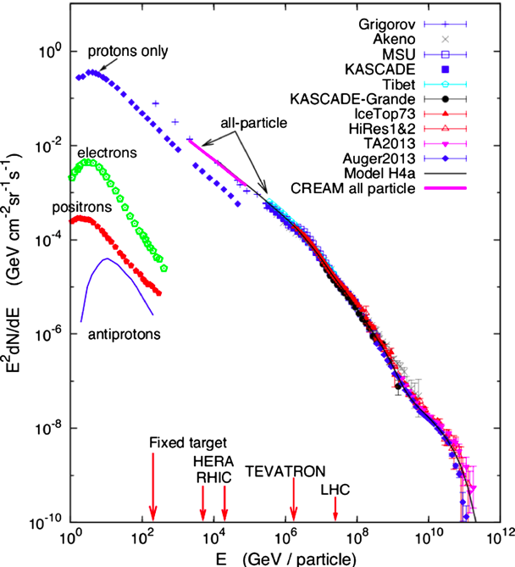
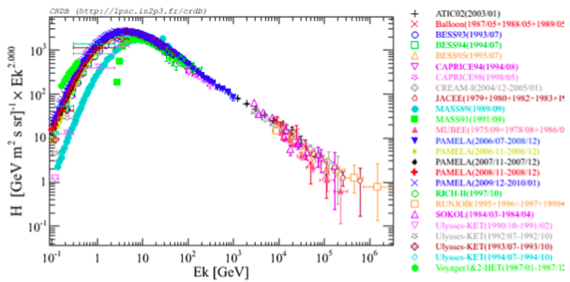
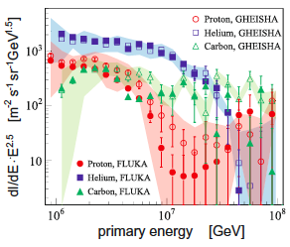
SPECTRA
ALL PARTICLE SPECTRUM
PROTONS
KNEE
P+He (KASCADE)
TRANSITION ?
GZK or SOMETHING ELSE?

Slide 4
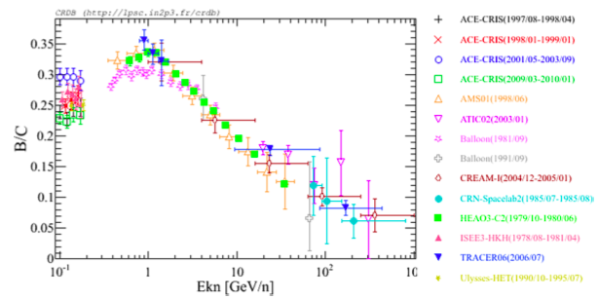
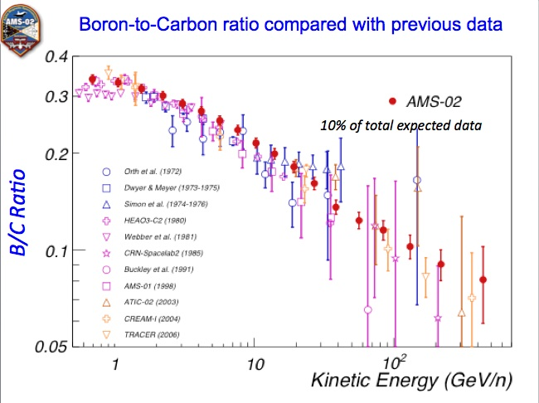
B/C RATIO
THE DECREASE OF B/C WITH Energy/nucleon IS THE BEST SIGN OF A RIGIDITY DEPENDENT GRAMMAGE TRAVERSED BY COSMIC RAYS ON THEIR WAY OUT OF THE GALAXY
For relativistic E

Slide 5
HOW STANDARD IS THE STANDARD MODEL OF TRANSPORT?
EVEN COMPLEX COMPUTATION CODES SUCH AS GALPROP ADOPT IMPORTANT SIMPLIFICATIONS… RELAXING THESE ASSUMPTIONS → CORRECTIONS AT THE ZERO ORDER
SEVERAL COMPLICATIONS:
DIFFUSION COEFFICIENT NON SPATIALLY CONSTANT
ANISOTROPIC DIFFUSION (PARALLEL vs PERPENDICULAR)
EFFECT OF SELF-GENERATION OF WAVES INDUCED BY CR
DAMPING OF WAVES AND ITS EFFECTS ON CR PROPAGATION
CR INDUCED GALACTIC WINDS
CASCADING OF MODES IN WAVENUMBER SPACE
EACH ONE OF THESE PHYSICAL MECHANISMS CHANGES THE PREDICTED
SPECTRA AND ANISOTROPIES IN A SUBSTANTIAL WAY

Slide 6
NON SEPARABLE D(E,z)
THE STANDARD RULE OF THUMB THAT
n(E)~Q(E) t(E) ~ Q(E)/D(E)~E^{-g-d}
IS ONLY VALID FOR SPATIALLY CONSTANT DIFFUSION OR FOR SEPARABLE D(E,z)=F(E)G(z)
EASIEST INSTANCE OF NON-SEPARABILITY:
H₂
H₁
D₁
H₁
D₂
H₂
D(E)
D₂
D₁
E

Slide 7
NON SEPARABLE D(E,z)
THE SIMPLEST FORM OF THE TRANSPORT EQUATION CAN BE WRITTEN AS:
WHERE THE CR DENSITY IN THE DISC IS (e.g. Dogiel 2001, Tomassetti 2012):
D(E)
D₂
f(E)
D₁
E
E

Slide 8
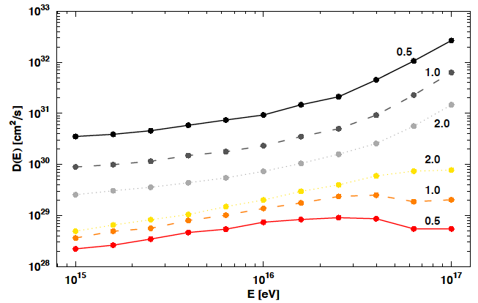
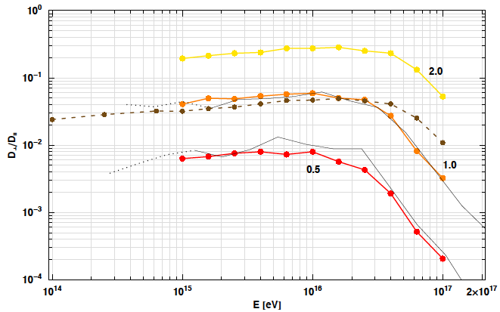
ANISOTROPIC DIFFUSION
EVEN FOR ISOTROPIC TURBULENCE, DIFFUSION IS NOT ISOTROPIC
De Marco, PB, Stanev 2007
ISOTROPIC TURBULENCE
PARALLEL
PERPENDICULAR
De Marco +, 2007
NUMERICAL SIMULATIONS OF PARTICLE PROPAGATION IN ISOTROPIC TURBULENCE SHOW THAT
1) EVEN FOR dB/B~1, D_{par} > D_{perp}
2) PAR AND PERP D(E) HAVE DIFFERENT ENERGY DEPENDENCES

Slide 9
AN OLD PROBLEM … Ion-Neutral Damping
Kulsrud & Cesarsky (1971)
ION-NEUTRAL DAMPING IS EFFECTIVE FOR LARGE WAVENUMBER NAMELY FOR LOW PARTICLE MOMENTUM (IN TERMS OF RESONANT SCATTERING).
FOR V_{A}=20 km/s and n_{i}<<n_{H}:
EFFECTIVE SPATIAL SEGREGATION (MOLECULAR CLOUDS) IS REQUIRED IN ORDER TO ALLOW FOR DIFFUSION IN THE GALACTIC DISC

Slide 10
CR INDUCED SCATTERING
ENSAMBLES OF CHARGED PARTICLES WITH SUPERALFVENIC VELOCITY INDUCE STREAMING INSTABILITY ON k ~ 1/LARMOR RADIUS
IN THE CONTEXT OF CR PROPAGATION IN THE GALAXY, THIS WAS FIRST DISCUSSED BY Skilling (1975). Holmes (1975) DISCUSSED THE RELATIVE IMPORTANCE OF GROWTH AND DAMPING OF THE WAVES RESPONSIBLE FOR CR SCATTERING
COSMIC RAYS MAY PLAY AN ACTIVE ROLE IN THEIR OWN DIFFUSIVE PROPAGATION

Slide 11
THE ROLE OF CR ON THEIR OWN TRANSPORT
THE GROWTH RATE OF THE UNSTABLE MODES INDUCED BY CR IS PROPORTIONAL TO THEIR SPATIAL GRADIENT
WHERE THE DISTRIBUTION FUNCTION OF CR IS FOUND FROM THE DIFFUSION EQUATION WITH:

Slide 12
CR TRANSPORT IN SELF-GENERATED WAVES
PB, Amato & Serpico 2012, Aloisio & PB 2013
a DENOTES THE TYPE OF NUCLEUS (BOTH PRIMARIES AND SECONDARIES ARE INCLUDED)
TRANSPORT EQUATION FOR WAVES

Slide 13
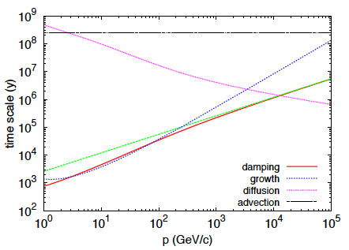
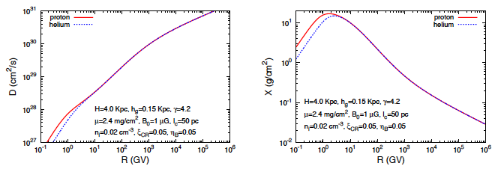
GENERAL TRENDS, D(E), X(E)
ADVECTION
Aloisio & PB 2013
DIFFUSION
LOW ENERGY
HARDENING
DIFFUSION
COEFFICIENT
GRAMMAGE
HIGH ENERGY
HARDENING
Aloisio & PB 2013

Slide 14
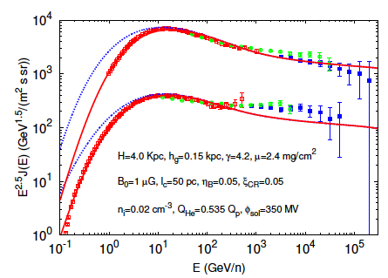
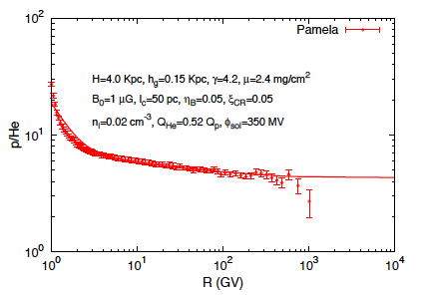
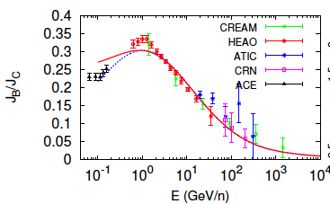
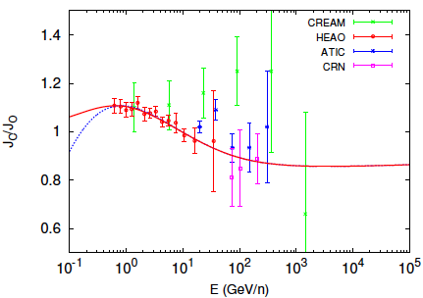
MAIN IMPLICATIONS
B/C
Aloisio & PB 2013
C/O

Slide 15
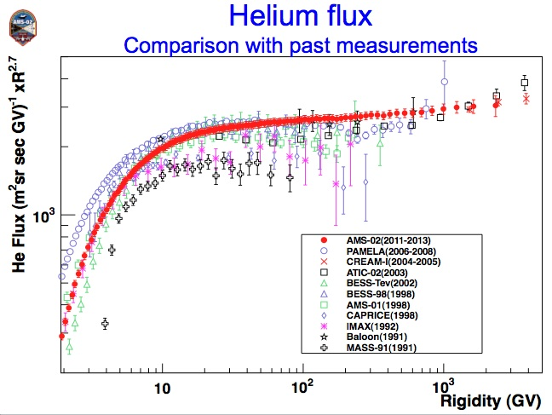
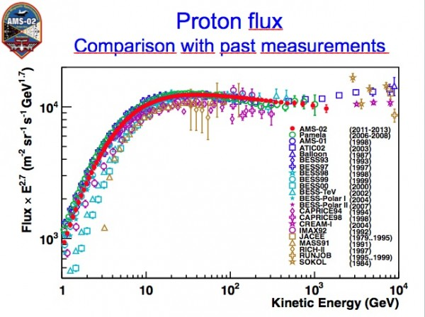
NO BREAKS IN AMS-02
APPARENTLY NO SIGN OF SPECTRAL BREAKS
OVERALL SPECTRAL STRUCTURE RATHER DIFFERENT
ALL AGREE THAT He SPECTRUM IS HARDER THAN H SPECTRUM
NORMALIZATION OF FLUXES IN GOOD AGREEMENT WITH CREAM

Slide 16
HOW STANDARD IS THE STANDARD MODEL OF CR ACCELERATION?
CR ACCELERATION EFFICIENCIES OF 10-20% → NON LINEAR DSA
MAXIMUM ENERGIES → MAGNETIC FIELD AMPLIFICATION, MOST LIKELY DUE TO ACCELERATED PARTICLES (ADDITIONAL NON LINEARITY)
SPECTRUM AT THE EARTH ← A RATHER COMPLEX SUPERPOSITION OF PARTICLES ADVECTED DOWNSTREAM AND ESCAPING FLUX
BUT THERE ARE NUMEROUS ASPECTS OF DSA THAT GO WAY BEYOND THIS QUASI-STANDARD PICTURE…

Slide 17
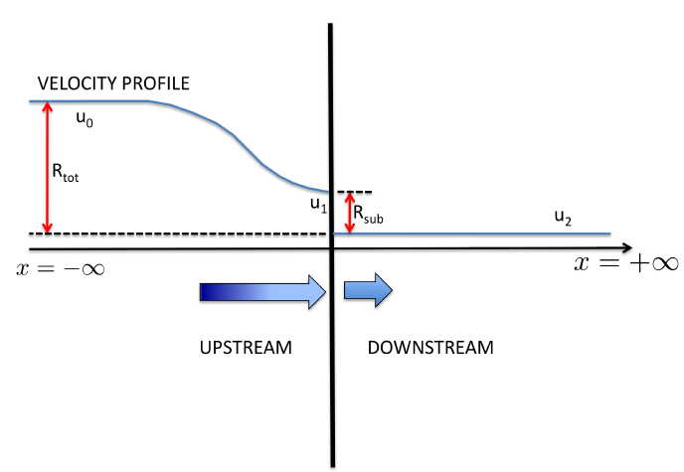
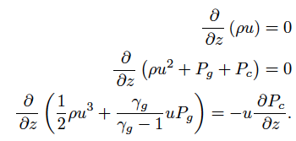
ACCELERATION AT SNR SHOCKS
MASS
MOMENTUM
ENERGY
CR
TRANSPORT
TWO MAIN IMPLICATIONS:
CONCAVE SPECTRA
MODIFIED SHOCK HEATING

Slide 18
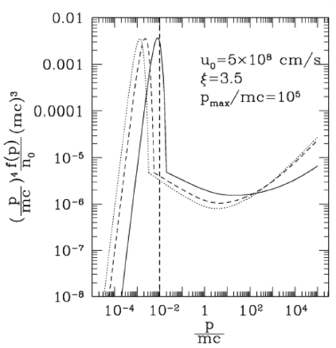
EFFECTS OF NLDSA
THERMAL
EFFECTS
CONCAVITY
PB, Gabici & Vannoni, 2005

Slide 19
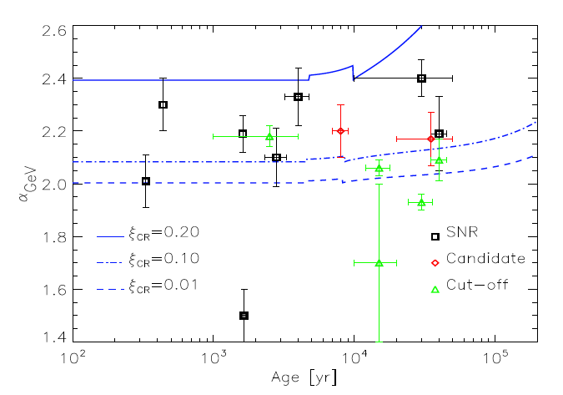
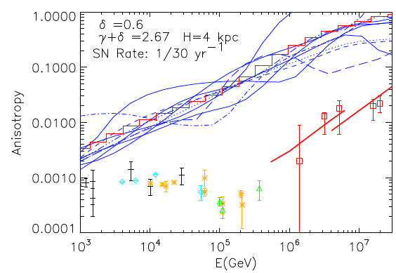
PROBLEMS WITH PREDICTED SPECTRA
The non linear theory of DSA (as well as the test particle theory) all predict CR spectra close to E⁻² and even harder than E⁻² at E>10 GeV
This finding does not sit well with:
CR Anisotropy (the required D(E) has to scale as E^{0.75})
Gamma Ray Spectra from selected SNRs
Caprioli 2011
Amato & PB 2012

Slide 20
POSSIBLE REASONS FOR STEEPER SPECTRA
DYNAMICAL REACTION OF AMPLIFIED MAGNETIC FIELD (Caprioli +, 2008,2009)
2. SHOCK MODIFICATION INDUCED BY NEUTRALS IN THE SHOCK REGION (PB+, 2012)
SEE TALK BY G. MORLINO AND DISCUSSION LATER IN THIS TALK
3. FINITE VELOCITY OF SCATTERING CENTERS (Caprioli+, 2010, Zirakashvili, Ptuskin, Seo 2010)
IF MAGNETIC FIELD AMPLIFICATION LEADS TO FAST MOVING WAVES IN THE PLASMA FRAME, THEN THE COMPRESSION FACTOR RELEVANT FOR ACCELERATION IS THAT OF THE SCATTERING CENTER’S VELOCITY. THIS EFFECT MAY LEAD TO STEEPENING AS WELL AS TO HARDENING DEPENDING ON HELICITY.
CHANGE IN THE EQUATION OF STATE→ LESS
COMPRESSION @ SHOCK → STEEPER SPECTRA

Slide 21
HARD He SPECTRUM
THE ONLY VIABLE EXPLANATION OF THE HARDER He SPECTRUM SO FAR IS BASED ON THE INJECTION MODEL OF Malkov et al. 2012.
THE PREFERENTIAL INJECTION OF He²⁺ IS DUE TO ITS LARGER LARMOR RADIUS, BUT THEN IT IS REQUIRED TO DECREASE WITH M_{A}
INDEPENDENT OF THIS MODEL PROVIDING OR NOT THE CORRECT INTERPRETATION OF THE DATA, IT GIVES US A FLAVOR OF HOW MUCH OUR ‘STANDARD MODEL’ IS SENSITIVE TO POORLY KNOWN ASPECTS OF THE MICROPHYSICS
THIS IS, IN A WAY, A RECENT FINDING, DUE TO THE FACT THAT THE EFFECTS WE ARE SEARCHING FOR ARE AT THE SAME LEVEL OF EXPERIMENTAL SYSTEMATICS…

Slide 22
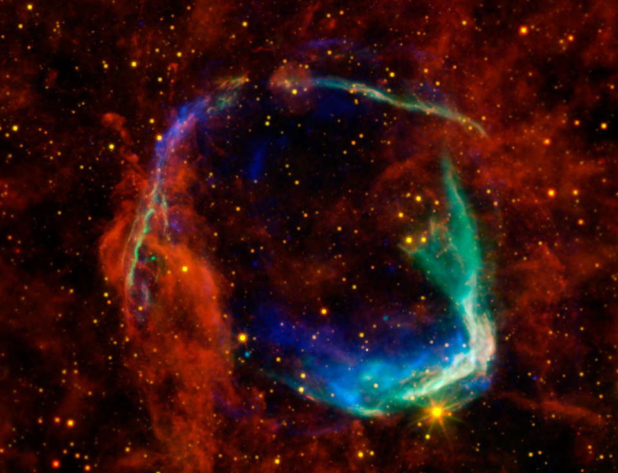
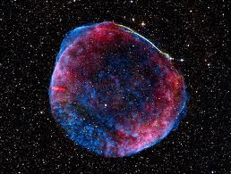
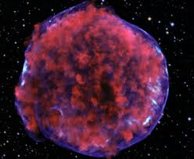
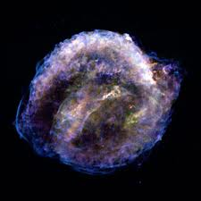
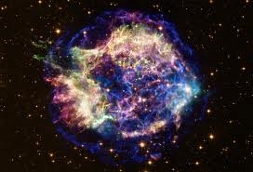
MAGNETIC FIELD AMPLIFICATION
TYPICAL SIZE OF THE FILAMENTS ~ 10⁻² parsec
The emission in the filaments is non-thermal synchrotron of the highest energy electrons in the accelerator
Comparison with the observed thickness leads to an estimate for the local field

Slide 23
MAGNETIC FIELD AMPLIFICATION AND P_{MAX}
THE EVIDENCE FOR B-FIELD AMPLIFICATION IS CRUCIAL FOR AT LEAST TWO REASONS:
IN THE ABSENCE OF THIS PHENOMENON THE MAXIMUM ENERGY OF ACCELERATED PARTICLES IS ~1-10 GeV ONLY
MAGNETIC FIELD AMPLIFICATION HAS LONG BEEN EXPECTED AS A BY-PRODUCT OF CR ACCELERATION (STREAMING INSTABILITY)
IN THE BOHM ASSUMPTION FOR THE TURBULENT COMPONENT:
CLOSE TO THE TIME OF BEGINNING OF THE SEDOV PHASE…

Slide 24
THE QUESTION IS ‘WHETHER THE CR INDUCED INSTABILITIES GROW FAST ENOUGH TO ACHIEVE THE GOAL
A RELEVANT QUANTITY IS
WEAK CR INDUCED MODIFICATION
Alfven waves are excited, with a small imaginary part of frequency. The growth rate reads:
The resonant nature of the instability limits it to dB/B~1
STRONG CR INDUCED MODIFICATION
Quasi-purely growing non resonant modes are excited (Bell 2004) together with aperiodic resonant modes with Im[w]~Re[w].
In the absence of additional dynamics the non resonant modes do not scatter CR effectively [k>>1/r_{L}(p)]

Slide 25
STRONGLY CR MODIFIED REGIME
THE MAX GROWTH RATE IS:
WHERE J_{CR} IS THE CR CURRENT. IN THE PICTURE OF Schure, Bell, Reville THE RELEVANT CURRENT IS THAT OF PARTICLES THAT ATTEMPT TO ESCAPE THE ACCELERATOR AT ENERGY E
THE dB GROWS BUT ALSO CHANGES SCALE (PLASMA IS MOVED AROUND WITH FORCE ~(1/c) J_{CR} dB). SATURATION OCCURS WHEN

Slide 26
MAXIMUM ENERGY FOR A SNR IN THE ISM
THE SATURATION IS TYPICALLY REACHED WHEN g_{W,max} t ~ 5, WHICH IMPLIES, EVALUATED AT THE BEGINNING OF THE SEDOV PHASE:
THIS VALUE OF A FEW HUNDRED TeV IS RATHER WEAKLY DEPENDENT UPON THE VALUES OF PARAMETERS
IT APPEARS UNLIKELY THAT PROTONS MAY BE ACCELERATED UP TO THE KNEE IN A SN TYPE Ia, ALTHOUGH THE PROBLEM IS BY A FACTOR ~10
Schure et al. 2012

Slide 27
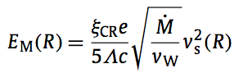
MAXIMUM ENERGY FOR A SNR IN A SUPERGIANT WIND
CORE COLLAPSE SN OFTEN EXPLODE IN THE WIND OF THE GIANT PROGENITOR. THE GAS DENSITY IN THE WIND IS
THE MAX ENERGY OF ACCELERATED PARTICLES IS
IN THE DENSE WIND THE SEDOV PHASE IS REACHED AT DISTANCE
CHOOSING:
AND WITH A SHOCK SPEED 20000 km/s
close to the knee…
STILL, PARAMETERS NEED TO BE PUSHED TO EXTREME VALUES

Slide 28
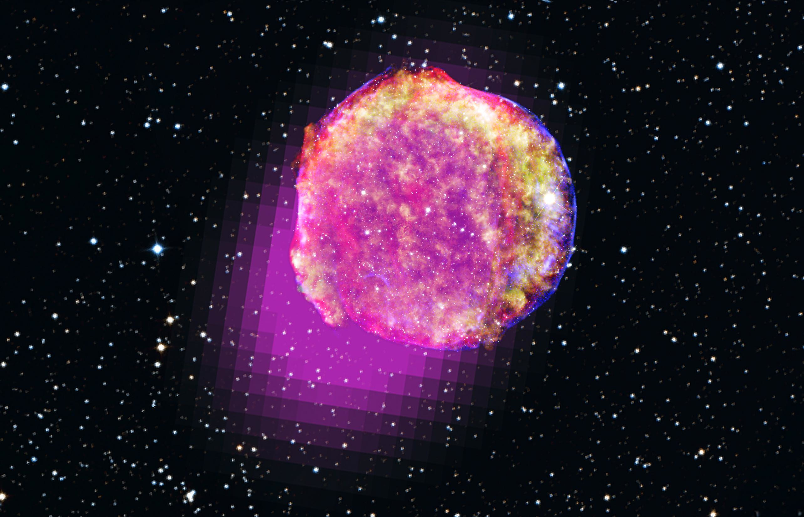
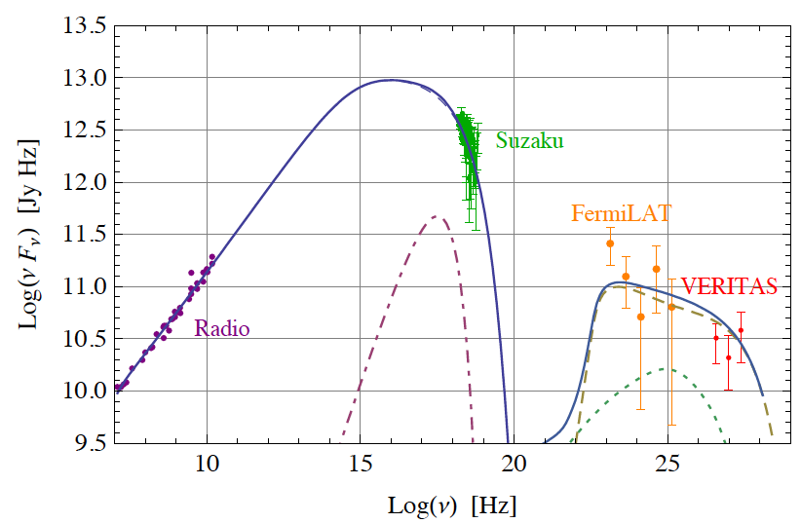
TYCHO
STEEP SPECTRUM HARD
TO EXPLAIN WITH LEPTONS
Morlino & Caprioli 2011
E_{max}~500 TeV
THE STEEP SPECTRUM MAY BE THE RESULT OF FINITE VELOCITY OF SCATTERING CENTERS (Caprioli et al. 2010, Ptuskin et al. 2010, Morlino & Caprioli 2011) OR MAY RESULT FROM AN INHOMOGENEOUS MEDIUM (Berezhko et al. 2013)

Slide 29
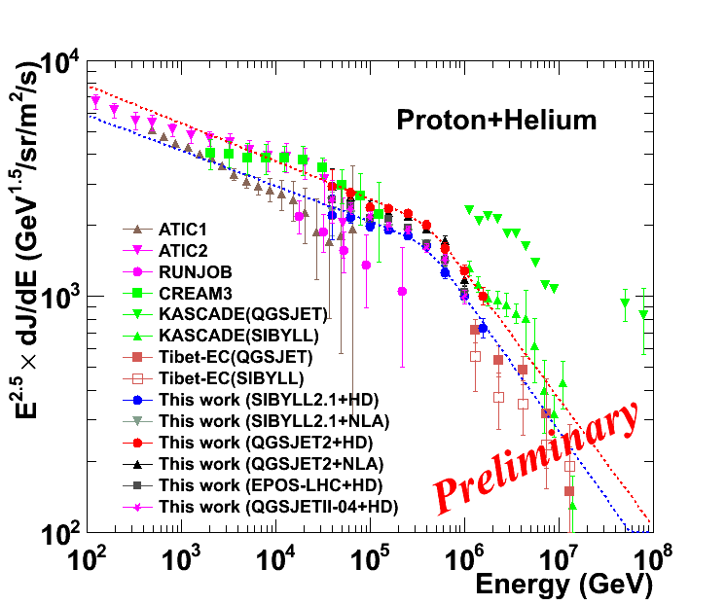
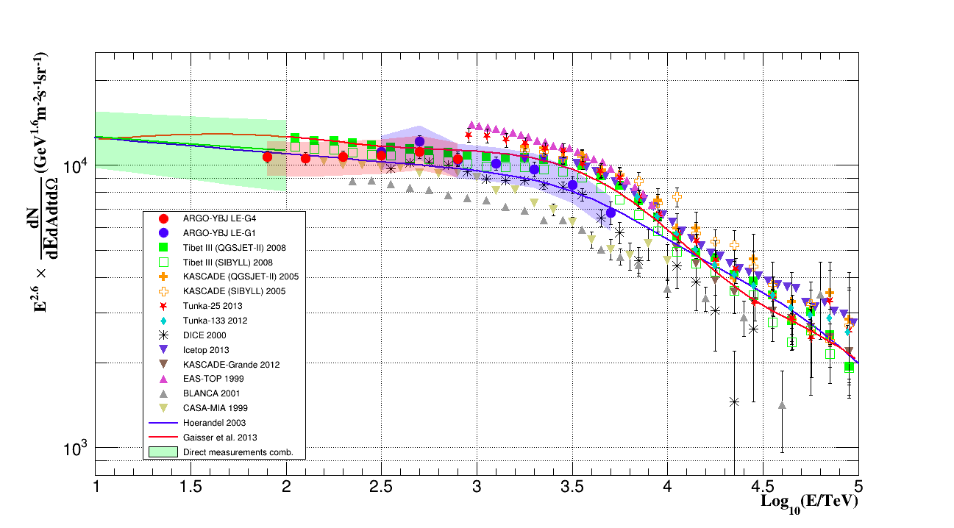
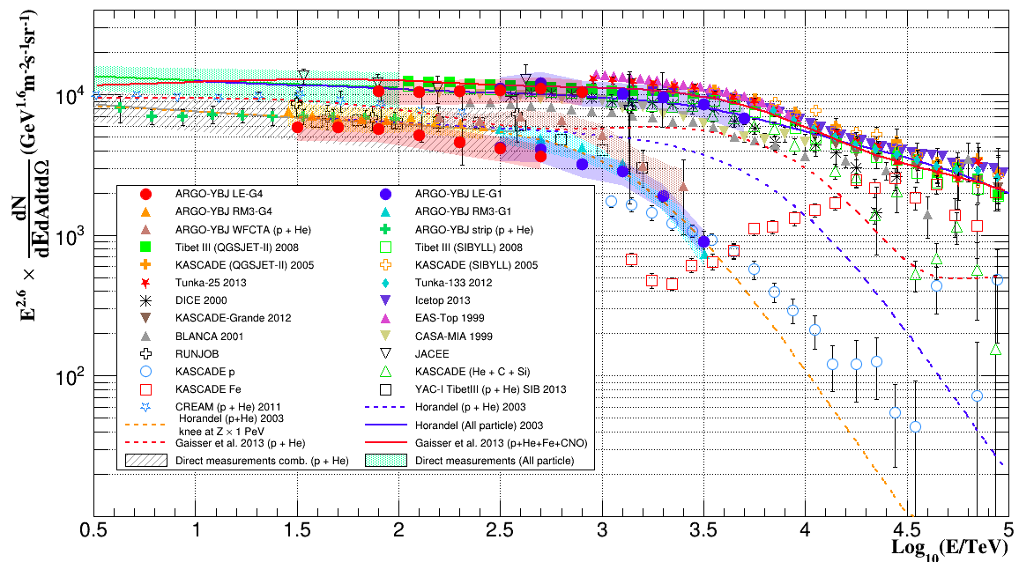
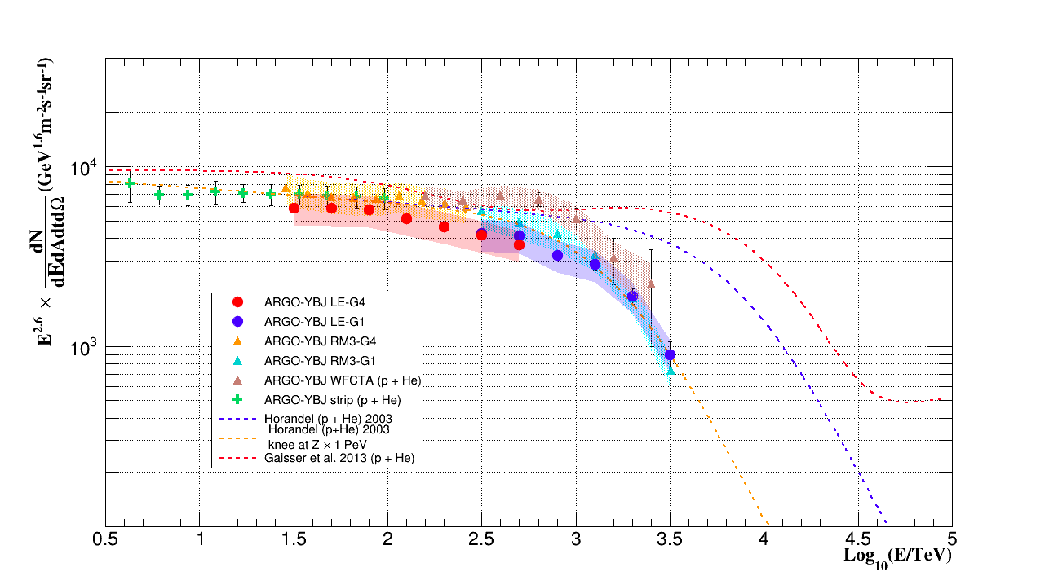
ALL PARTICLE SPECTRUM
P+He SPECTRUM

Slide 30
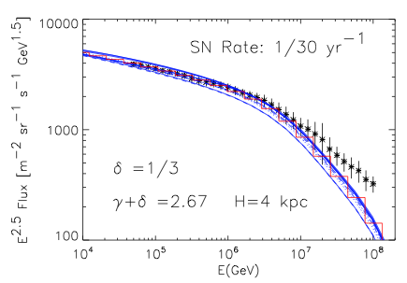
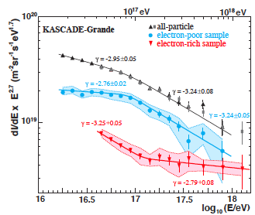
WHERE DO GALACTIC CRs END?
Amato & PB 2012
Apel et al. 2013
A SUPERPOSITION OF EXPONENTIAL CUTOFFS SCALING WITH Z FROM THE KNEE LEADS TO A DEFICIT AT E>10⁷ GeV
KASCADE GRANDE DATA SHOW A RATHER COMPLEX IMPLEMENTATION OF THE TRANSITION REGION, WHICH IS NOT EASY TO RECONCILE WITH OBSERVATIONS OF UHECR SPECTRA AND MASS COMPOSITION

Slide 31
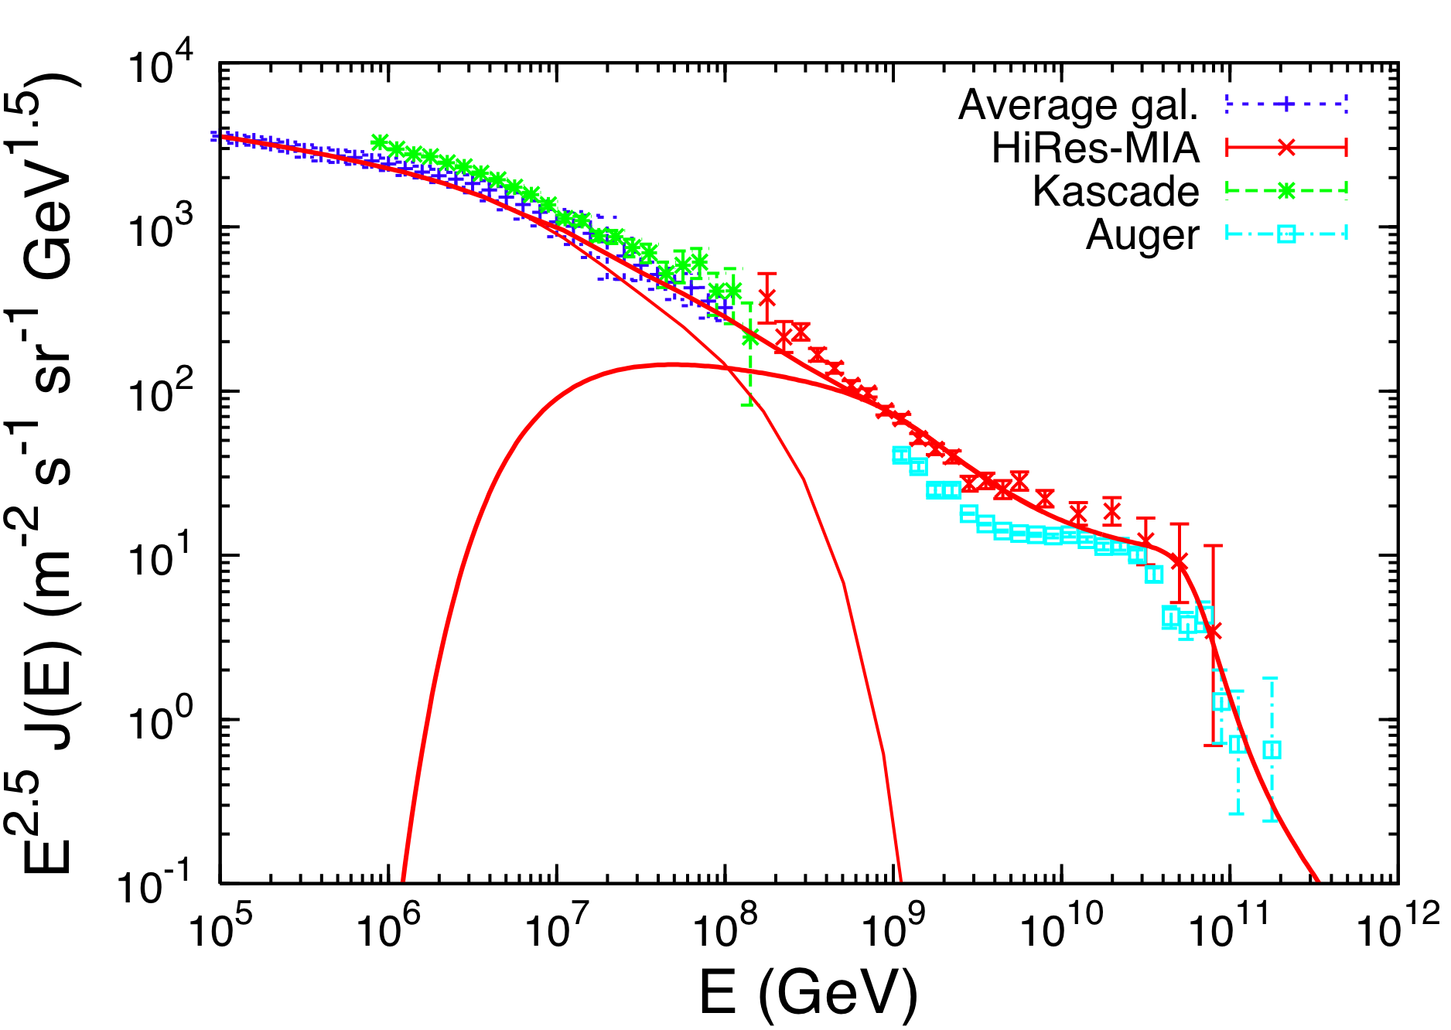
A LOOK FROM THE OTHER END…
DIP
THE DIP IS THE ONLY EXPLANATION OF THE TRANSITION THAT IS COMPATIBLE WITH THE BASIC PREDICTIONS OF THE SNR PARADIGM FOR GALACTIC COSMIC RAYS
BUT IT IS INCOMPATIBLE WITH THE OBSERVED COMPOSITION

Slide 32
PHOTODISINTEGRATION OF NUCLEI
FOR NUCLEI THE MOST IMPORTANT PHYSICAL PROCESS IS THE PHOTO-DISINTEGRATION OF THE NUCLEI IN SCATTERING WITH PHOTONS OF THE EBL+CMB
INTERESTINGLY, THE FACT THAT THE BINDING ENERGY OF A NUCLEON IN A NUCLEUS DOES NOT DEPEND DRAMATICALLY UPON THE NUCLEUS, LEADS TO A WEAK DEPENDENCE OF THE CRITICAL LORENTZ FACTOR:

Slide 33
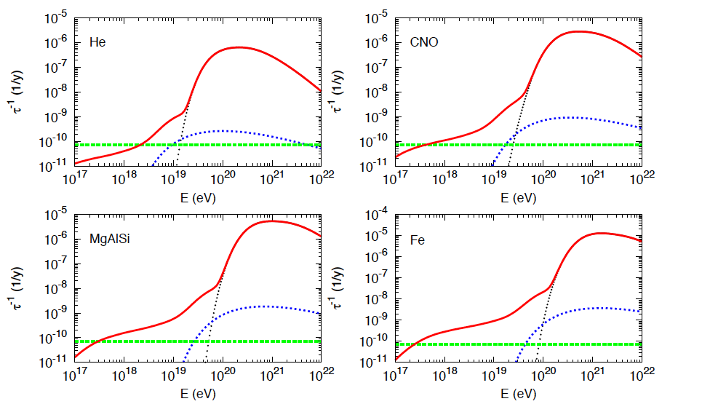
Aloisio et al. 2013

Slide 34
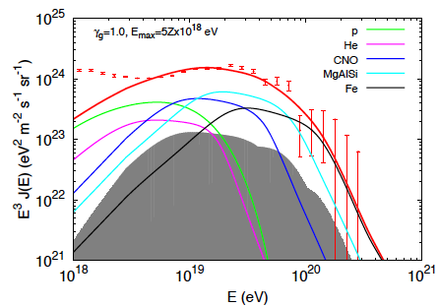
TRANSITION AND UHECR
VERY HARD INJECTION SPECTRA REQUIRED IF SOURCES GENERATE NUCLEI
Aloisio, Berezinsky & PB 2014

Slide 35
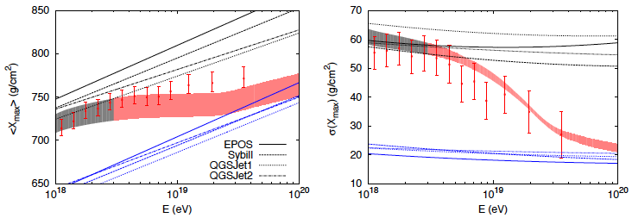
TRANSITION AND UHECR
Aloisio, Berezinsky & PB 2014

Slide 36
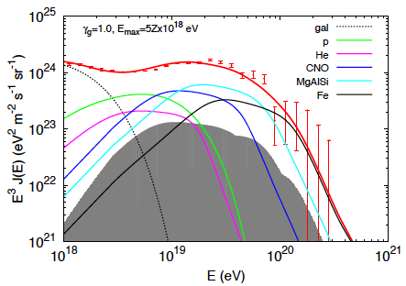
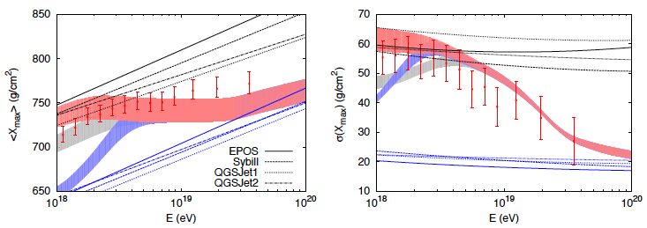
TRANSITION AND UHECR Additional Galactic Component
IF THE REQUIRED ADDITIONAL COMPONENT IS GALACTIC IN ORIGIN, IT HAS TO BE LIGHT.
BUT THIS IS NOT CONSISTENT WITH THE ANISOTROPY MEASURED BY AUGER AT 10¹⁸ eV
Aloisio, Berezinsky & PB 2014

Slide 37
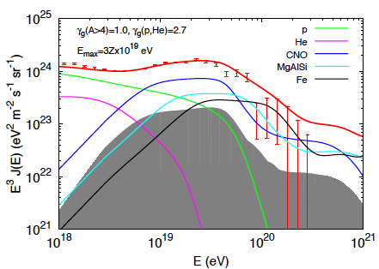
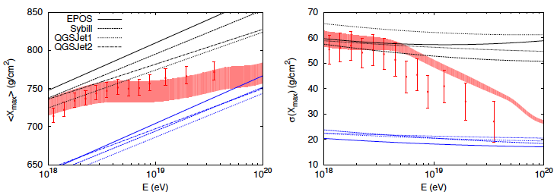
TRANSITION AND UHECR Additional Extragalactic Component
Aloisio, Berezinsky & PB 2014

Slide 38
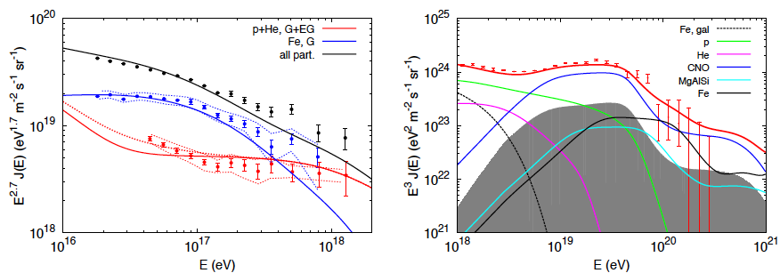
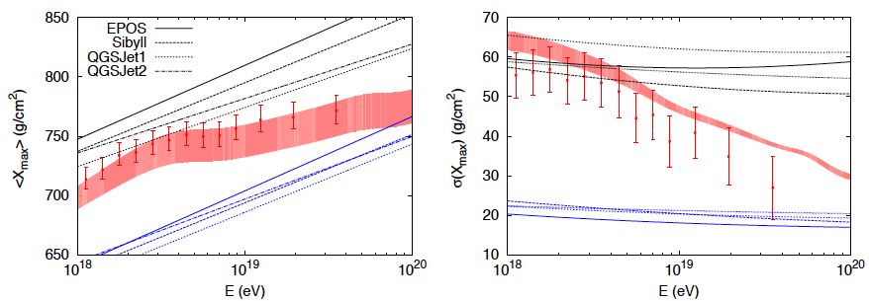
TRANSITION AND UHECR Additional Extragalactic Component
Aloisio, Berezinsky & PB 2014

Slide 39
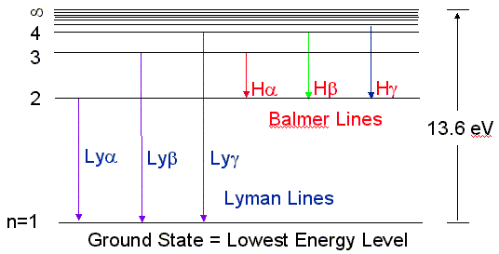
BALMER LINES
THIS FIELD IS STILL YOUNG, BUT IT HAS A HUGE POTENTIAL IN TERMS OF ‘MEASURING’ THE AMOUNT OF COSMIC RAYS CLOSE TO SNR SHOCKS
THE PHYSICS QUESTION IS: “WHAT HAPPENS WHEN A COLLISIONLESS SHOCK CROSSES A PARTIALLY IONIZED MEDIUM?”
THE WIDTH OF THE BALMER LINE(S) PROVIDES POWERFUL INFORMATION ON THE IONS TEMPERATURE DOWNSTREAM OF THE SHOCK → CR CALORIMETRY !!!
NEUTRALS
SHOCK VELOCITY
INFLOWING
NEUTRALS AND IONS
Dv
IONS

Slide 40
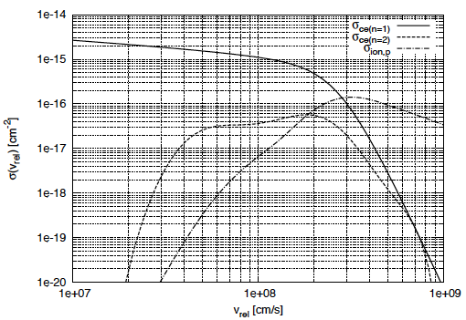
BROAD AND NARROW Ha LINE
TWO PROCESSES GET ACTIVATED:
CHARGE EXCHANGE
IONIZATION OF NEUTRAL HYDROGEN
BALMER LINE FROM
ATOMS WITH
CE DOWNSTREAM
Ha REFLECTS
TEMPERATURE OF
IONS DOWNSTREAM
BROAD BALMER LINE
n=1
BALMER LINE FROM
ATOMS WITH NO
CE DOWNSTREAM
Ha REFLECTS
TEMPERATURE
UPSTREAM
NARROW BALMER LINE
+
+
n=2
Hot
ion
Cold
ion
Cold neutral
hot neutral

Slide 41
ANOMALOUS Ha LINE WIDTHS
IN THE PRESENCE OF PARTICLE ACCELERATION TWO THINGS HAPPEN:
LOWER TEMPERATURE DOWNSTREAM
A PRECURSOR APPEARS UPSTREAM
BROAD BALMER LINE GETS NARROWER
NARROW BALMER LINE GETS BROADER
NEUTRALS
Dv
IONS

Slide 42
MATHEMATICAL APPROACH
PB, Morlino, Bandiera, Amato & Caprioli, 2012
IONS ARE TREATED AS A PLASMA WITH GIVEN DENSITY AND A THERMAL DISTRIBUTION
NEUTRAL ATOMS ARE DESCRIBED USING A BOLTZMAN EQUATION WITH SCATTERING TERMS DESCRIBING CHARGE EXCHANGE AND IONIZATION

Slide 43
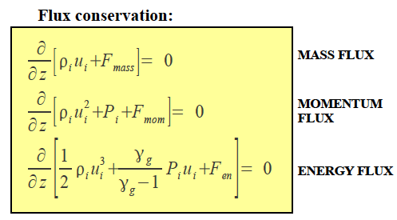
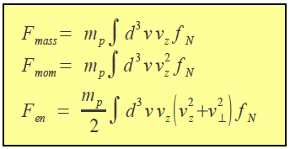
MATHEMATICAL APPROACH
PB, Morlino, Bandiera, Amato & Caprioli, 2012
IONS AND NEUTRALS ARE CROSS-REGULATED THROUGH MASS, MOMENTUM AND ENERGY CONSERVATION:

Slide 44
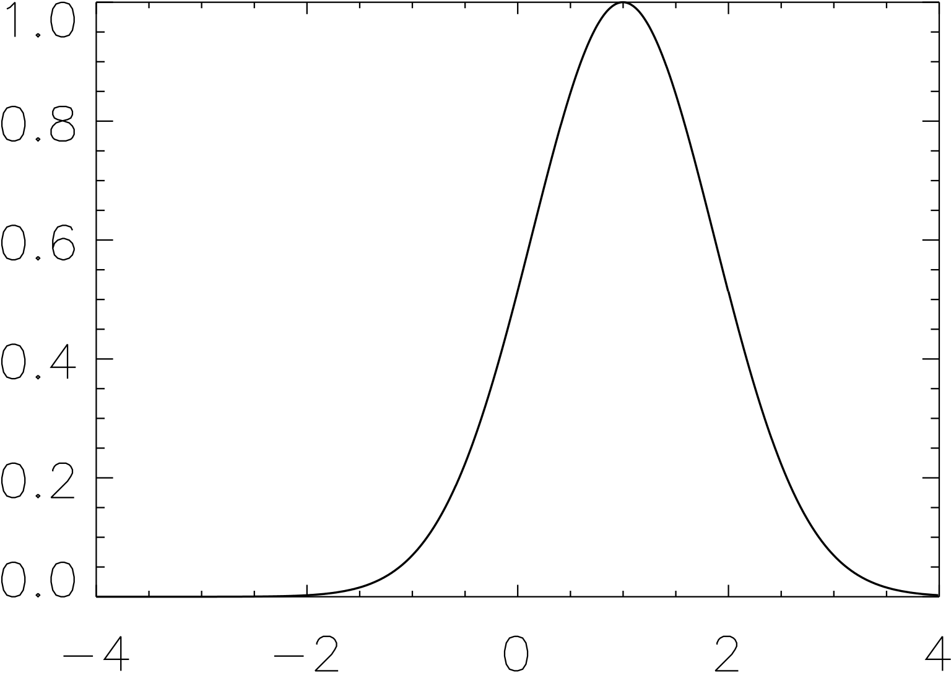
neutral return flux
PB et al. 2012
NEUTRALS
AND IONS
SHOCK VELOCITY
A NEUTRAL ATOM CAN CHARGE
EXCHANGE WITH AN ION WITH
V<0, THEREBY GIVING RISE TO
A NEUTRAL WHICH IS NOW FREE
TO RETURN UPSTREAM
THIS NEUTRAL RETURN FLUX
LEADS TO ENERGY AND
MOMENTUM DEPOSITION
UPSTREAM OF THE SHOCK!
V_{perp}=0
V<0
v/(Vs/4)
1

Slide 45
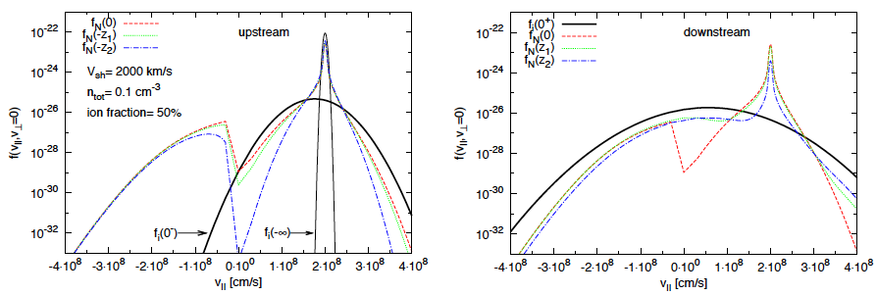
distribution Functions in phase space
PB+ 2012
NEUTRAL
RETURN
FLUX
THE DISTRIBUTION FUNCTIONS OF NEUTRALS ARE
NOT MAXWELLIAN IN SHAPE BUT APPROACH SUCH
SHAPE AT DOWNSTREAM INFINITY

Slide 46
NEUTRAL INDUCED PRECURSOR
PB+ 2012
EVEN FOR A STRONG SHOCK (M>>1) THE EFFECTIVE MACH NUMBER OF
THE PLASMA IS DRAMATICALLY REDUCED DUE TO THE ACTION OF THE
NEUTRAL RETURN FLUX

Slide 47
ACCELERATION OF TEST PARTICLES
PB+ 2012

Slide 48
NON LINEAR CR ACCELERATION IN PARTIALLY IONIZED PLASMAS
BOLTZMANN EQUATION FOR NEUTRALS
CR TRANSPORT EQUATION
TRANSPORT OF WAVES
GENERALIZED CONSERVATION
EQUATIONS

Slide 49
Morlino +, 2012
HEATING
IN THE PRECURSOR
SHAPE OF THE BALMER LINE
Balmer
Line
Zoom on
the narrow
Balmer line

Slide 50
SNR 0509-67.5
Helder et al. 2009
NE
SW
SHOCK VELOCITY RATHER UNCERTAIN
DISTANCE WELL KNOWN (LMC): 50±1 kpc
Morlino et al. 2013

Slide 51
SNR 0509-67.5
Morlino et al. 2013
FOR SHOCK VELOCITY ~5000 km/s A LOWER LIMIT OF 5-10% TO THE CR ACCELERATION EFFICIENCY CAN BE IMPOSED

Slide 52
RCW 86
Helder, Vink and Bassa 2011
DISTANCE TO THIS SNR RATHER UNCERTAIN WITH VALUES RANGIND FROM 2 TO 3 kpc, WITH MOST LIKELY VALUE OF 2.5 kpc
Balmer line + proper motion
Thermal X-ray spectrum
IN THE ABSENCE OF AN INDEPENDENT INFORMATION ON THE ELECTRON-ION EQUILIBRATION, THE BALMER LINE WIDTH IS COMPATIBLE WITH NO CR ACCELERATION
IN 3 REGIONS HOWEVER THERE ARE X-RAY MEASUREMENTS OF THE ELECTRON TEMPERATURE

Slide 53
RCW 86
IF THE MEASURED ELECTRON TEMPERATURE IS THE ACTUAL T_{e} DOWSNTREAM, THEN ALL MEASURED FWHM OF THE BROAD BALMER LINE SUGGEST EFFICIENT CR ACCELERATION

Slide 54
RCW 86 – FILAMENT SE_{OUT}
CASE A CASE B
10% neutrals 50% neutrals
A NON THERMAL PRESSURE OF ABOUT 20-30% IS REQUIRED TO EXPLAIN AT THE SAME TIME THE FWHM OF THE BALMER LINE AND THE VALUE OF T_{e}

Slide 55
RCW 86 – FILAMENT SE_{OUT}: a case of return flux
INTERMEDIATE
BALMER LINE
HIGH NON THERMAL PRESSURE DOES NOT NECESSARILY IMPLY A
LARGE FLUX OF HIGH ENERGY COSMIC RAYS…

Slide 56
SUMMARY
MAXIMUM ENERGY AND MAGNETIC FIELD AMPLIFICATION
ESCAPE OF CR FROM THEIR SOURCES
INJECTION SPECTRA AND ANISOTROPY
THEORETICAL ISSUES
AND SUCCESSES
2. OBSERVATIONAL ISSUES
AND SUCCESSES
PROPAGATION IN THE GALAXY (DIFFUSION, WINDS, SELF-GENERATED WAVES VS PRE-EXISTING TURBULENCE, CASCADING
TRANSITION TO EXTRAGALACTIC CR
POTENTIAL FOR DISCOVERY IN BALMER LINE
OBSEVRATIONS OF SNR – A LOT PHYSICS INVOLVED
POSITION OF THE KNEE IN THE LIGHT COMPONENT
STILL UNCLEAR
STRONG DEPENDENCE OF RESULTS ON MC OF
SHOWERS (KNEE AND ABOVE)
SPECTRAL BREAKS POTENTIALLY INTERESTING
BUT NOT CONFIRMED (PAMELA vs AMS) – ROLE OF
SYSTEMATICS
B/C STILL NOT CONCLUSIVE IN NAILING DOWN
D(E)

