Slide 1
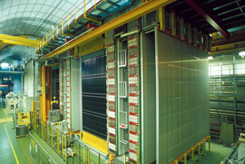


OPERA
Status analysis
New candidate
First measurement of Δm² in appearance mode
Sterile neutrino in the tau channel
Prospect

Slide 2
Status of the analysis
Year | P.O.T. (10¹⁹) | neutrino interactions | Located | 0-μ | 1-μ P_{μ}<15 GeV
2008 | 1.74 | 1931 | 682 | 148 | 534
2009 | 3.53 | 4005 | 1269 | 250 | 1019
2010 | 4.09 | 4515 | 1023 | 209 | 814
2011 | 4.75 | 5131 | 972 | 223 | 749
2012 | 3.86 | 3923 | 739 | 149 | 590
Total | 17.97 | 19505 | 4685 | 979 | 3706
Analysis completed (up to the 4th most probable brick)
only 1st brick analyzed
~86% predicted in the bricks
80% of the design
The completion of of residual 1st brick and extension of the analysis to multi brick increase the expected events by ~ 30%
Sample | Selection | Expected events
All runs | Multi brick analysis (MC) | 3.2
All runs | Multi brick analysis (data) | 2.8
Current sample | 1st brick all run, 2nd for 2008-09 (data) | 2.1

Slide 3
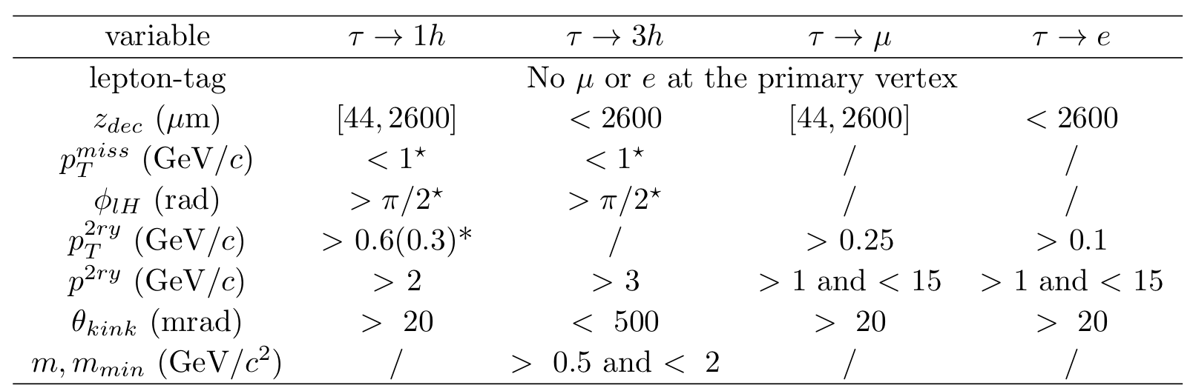
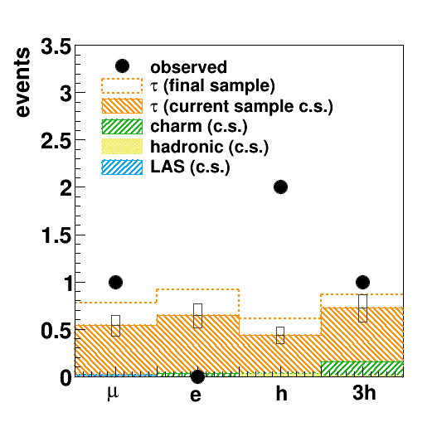
Oscillation results
Kinematical selection cuts kept fixed since beginning of the experiment.
Data sample:
2008/09 : 1st and 2nd probable brick
2010/11/12 : 1st probable brick
5522 events analysed
Expected 2.1 ± 0.4
(Δm₂₃² = 2.32x10⁻³eV², θ₂₃=π/4)
Observed 4

Slide 4
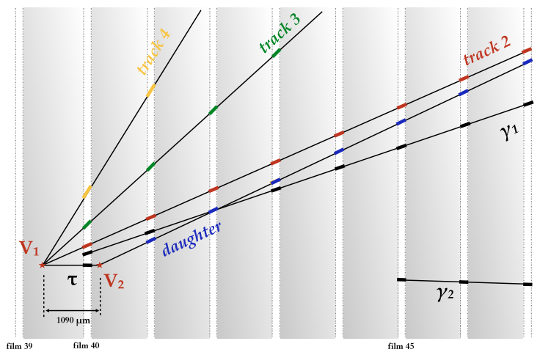
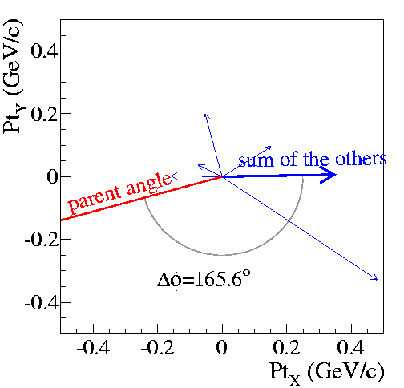
4th ν_{τ} candidate (𝝉→h) (2014)
Important contribution from Padova (A.Bertolin) on muon-ID test.
4
3
γ1
2
Track 2 from neutrino interaction vertex, p = 1.9 GeV stopping in first iron slab of the magnet
γ2

Slide 5
Data sample:
2008/09 : 398 (0μ events) + 1553 (1μ events)
2010/11/12 : 582 (0μ events) + 2153 (1μ events)
The expected signal and background is normalized to the number of located events
Decay channel | Expected signal Δm₂₃² = 2.32 meV² | Total background | Observed
τ→h | 0.4 ± 0.08 | 0.033 ± 0.006 | 2
τ→3h | 0.57 ± 0.11 | 0.155 ± 0.03 | 1
τ→μ | 0.52 ± 0.1 | 0.018 ± 0.007 | 1
τ→e | 0.61 ± 0.12 | 0.027 ± 0.005 | 0
Total | 2.1 ± 0.42 | 0.23 ± 0.04 | 4
Two statistical method :
Fisher combination of single channel p-value
Likelihood ratio
p-value = 1.03 x 10⁻⁵ of no oscillation
no oscillation excluded at 4.2 σ CL

Slide 6
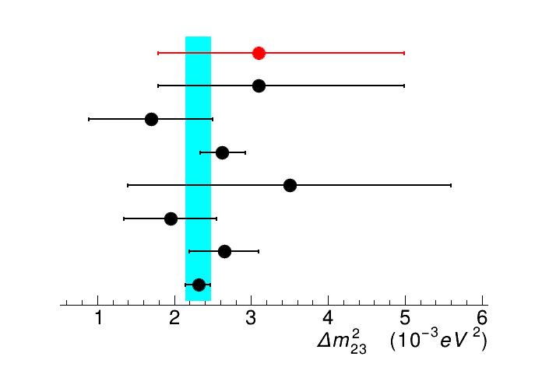
First measurement of Δm²₃₂ with tau appearance
OPERA Off-peak
L/<E> ~ 43 Km/GeV
(L/<E>)_{peak} ~ 500 Km/GeV
strong dependence on Δm² → measure Δm² with counting experiment
90% CL intervals on Δm²₃₂ assuming sin2(2θ₂₃) = 1
Feldman&Cousin
[1.8 – 5] x 10⁻³ eV²
Bayesian
[1.9 – 5] x 10⁻³ eV²
OPERA Preliminary (tau appearance)
ANTARES (atm. neutrino)
MINOS (pure atm. anti-nu)
MINOS (anti-nu beam)
MINOS (pure atm. nu)
MINOS (atmospheric)
T2K
MINOS (2ν, maximal mixing)
PDG

Slide 7
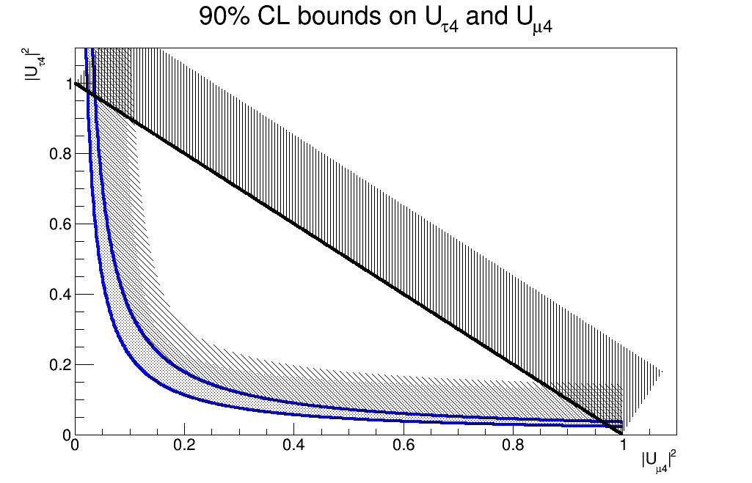
Sterile neutrinos
Important contribution from Padova (SD) on the analysis
Tau appearance in the presence of sterile neutrino (3+1)
Solar driven oscillation neglected Δ₂₁ ~ 0
~ standard oscillation
pure exotic oscillation
Profile likelihood
using Tau rate only
Normal hierarchy
interference
terms
OPERA Preliminary
Unitary bound
Two extreme values (π/2, 3π/2) of
Kopp et al. JHEP 1305 (2013) 050
Complementary measurement wrt disappearance experiments

Slide 8
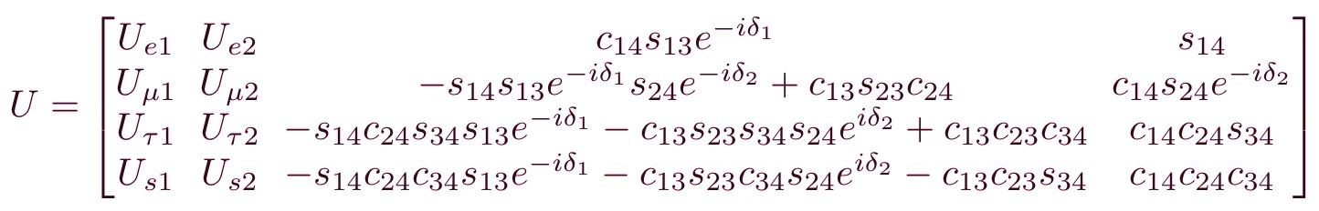
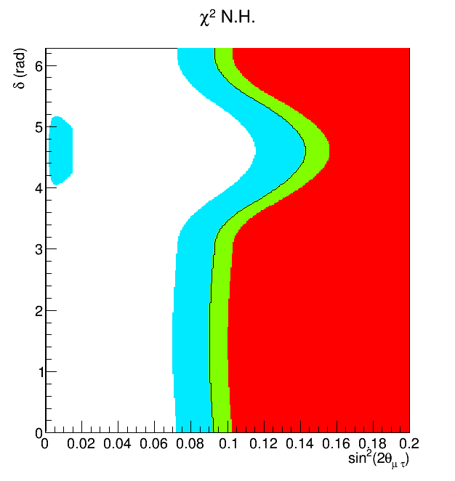
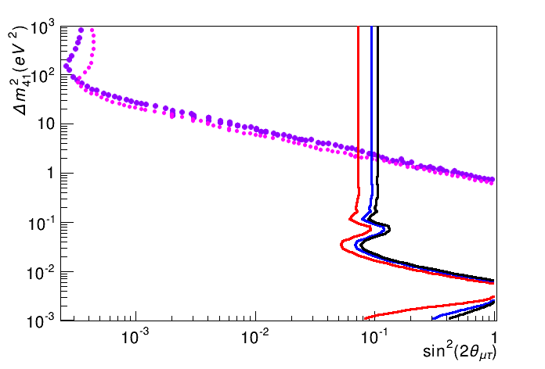
Choosing a particular representation (same as MINOS)
Δ₂₁ ~ 0 (solar oscillation)
s₁₄ ~ 0 (reactor anomaly)
→ δ₁ = 0
Effective mixing
Profiling over δ₂
Δm₄₁² = 1 eV²
OPERA preliminary
68% CL
90% CL
95% CL
CHORUS ν_{μ} → ν_{t} (2ν)
NOMAD ν_{μ} → ν_{t} (2ν)
OPERA Preliminary
68% CL
90% CL
95% CL

Slide 9
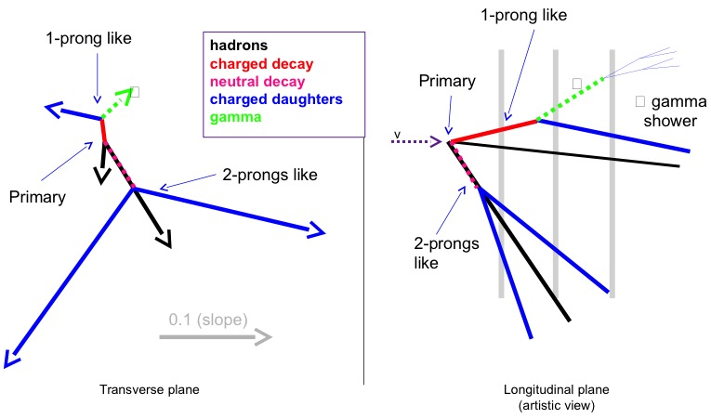
Double decay-vertex event found in Padova-Bologna scanning lab.
muon less event with two decay vertex
1-prong like long decay
2-prong short decay
Possible interesting
sources
tau + charm
double charm in NC

Slide 10
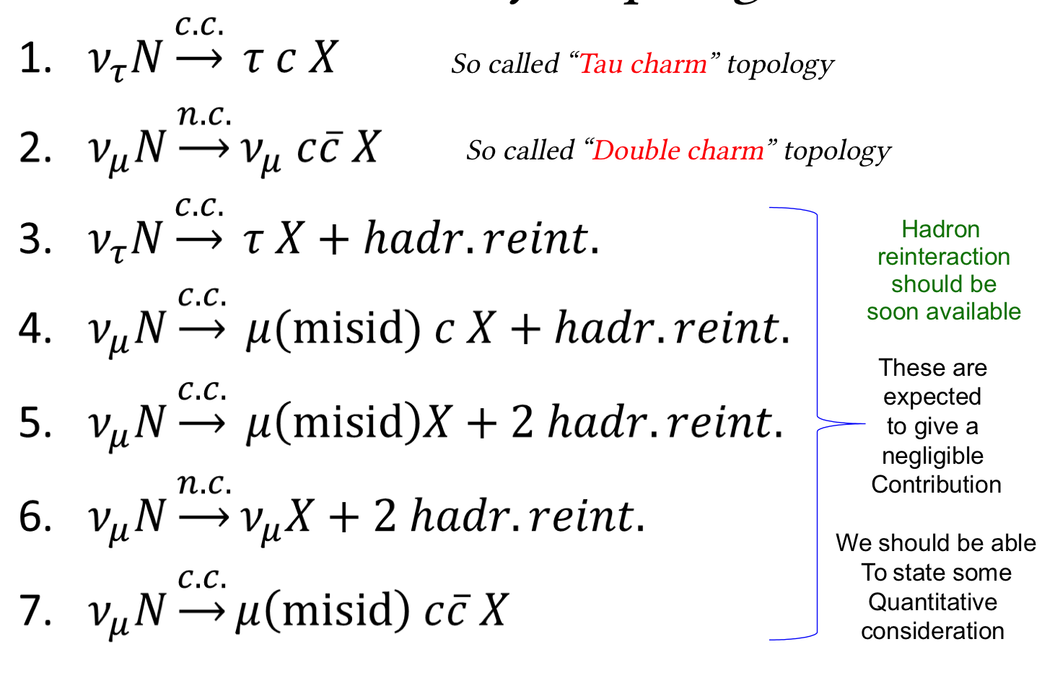
Marco Roda Ph.D. thesis
Multi variable analysis using TMVA
Signal = tau + charm
Background = double charm
in NC
Simulation using several generators:
Herwig, Genie, Pythia, Madgraph
Simulation of these channels in progress

Slide 11
Papers OPERA 2014
Submitted
Submitted
Submitted
Published
Published

Slide 12
STAFF
Dusini | 50 %
Sirignano | 60 %
Stanco | 20 %
Tempo determinato
Roda | 80 %
Medinaceli | 30 %
Totale | 2,4 FTE
OPERA
Padova
Attività nel 2015
Smontaggio OPERA (18 mesi a partire
da gennaio 2015)
completamento dell’analisi del 2º (3º e 4º per un sotto campione) attività di sviluppo e scanning emulsioni (8 mesi).
Missioni
  4 riunioni collab. + 4 analysis/scanning 16.0
  Shift dei Fisici al GS (3 week per 8 firme) 30.0
  Tecnici supporto per CS e sviluppo (7 week) 9.0
  Coordinamento analisi 8.0
  Coordinamento sviluppo emulsioni 8.0
  Presentazioni conferenze 5.0
Consumo
  Metabolismo sede 10.0
  Manutenzione Microscopi 18.0
Contributi dall’OE e OM (1 m.u.) per turni specializzati al Gran Sasso per sviluppo fotografico delle emulsioni in camera oscura e analisi automatica di Scanning dei CS

Slide 13
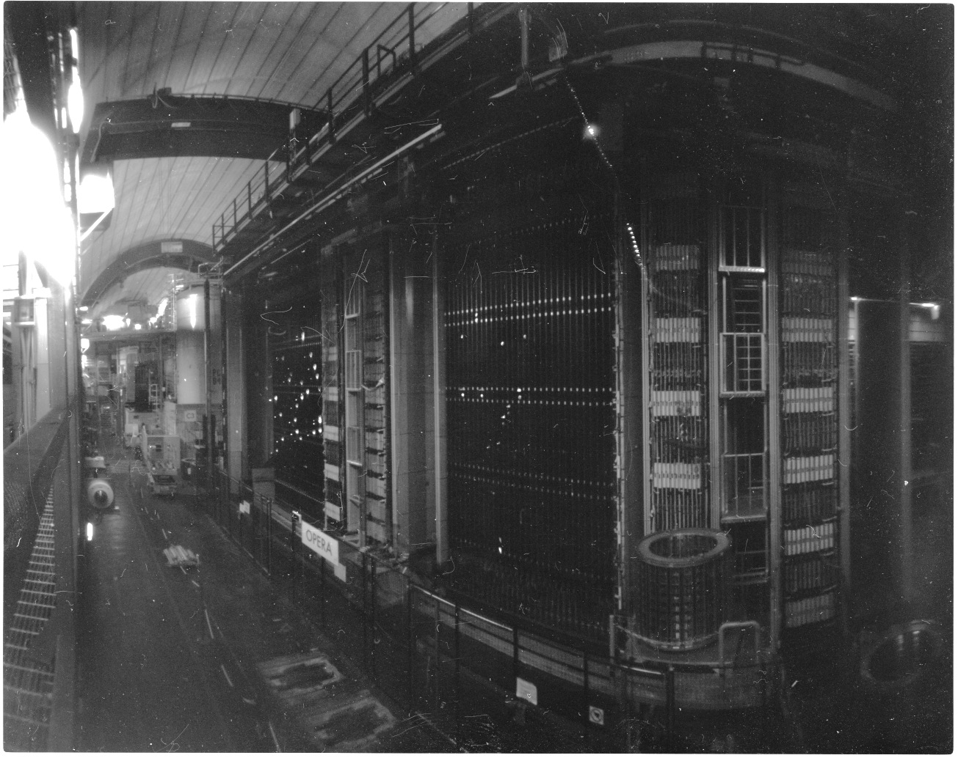
Thank you for your attention
Image taken using OPERA emulsion film with pinhole hand made camera
courtesy by D.onato Di Ferdinando (INFN –Bologna)

Slide 14
Backup

Slide 15
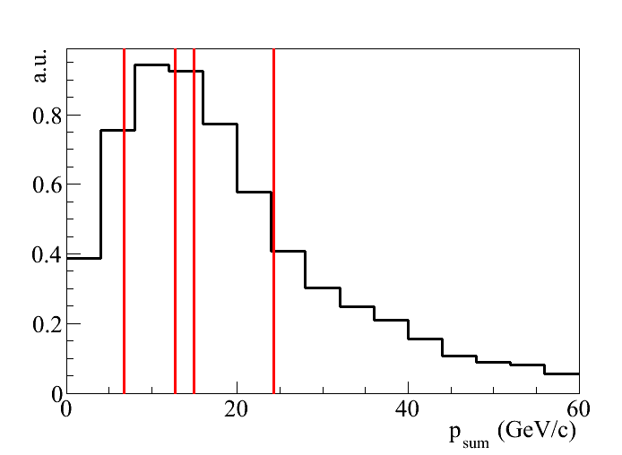
Visible energy of all the candidates
Sum of the momenta of charged particles and γ’s measured in emulsion
1st candidate
3rd candidate
2nd candidate
4th candidate

Slide 16
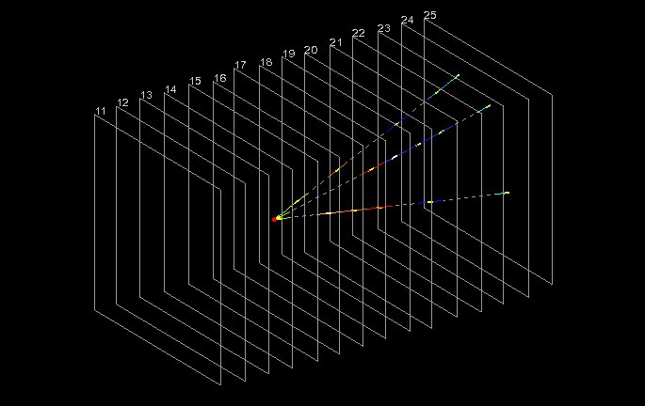
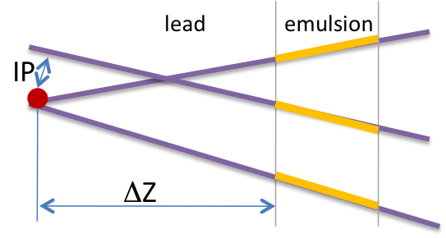
Vertex location and decay topology Search
The first two steps of the analysis chain are:
location of neutrino interaction
search of decay topologies (e.g. large Impact Parameter-IP)
1 cm
arXiv:1404.4357v1
JHEP 11 (2013) 036
Full MC simulation including all steps of the scanning procedure followed in the scanning labs.

Slide 17
 | Values | Selection
P daughter (GeV/c) | 6.0 ^{+2.2} | > 2
Kink P_{t} (GeV/c) | 0.82 ^{+0.30} | > 0.6
P_{t} at 1ry (GeV/c) | 0.55 ^{+0.30} | < 1.0
Phi (degrees) | 166 ⁺² | > 90
Kink angle (mrad) | 137 ± 4 | > 20
Decay position (μm) | 1090 ± 30 | < 2600
Kinematics of
3rd ν_{τ} candidate (𝝉→h)

Slide 18
ν_{e} search
ν_{e} beam contamination ~ 0.9%
Interface
films
Caveat: experiments
at different L/E
JHEP 1307 (2013) 004
ν_{e} searched in 505 (~ 50% full statistic) neutrino interaction without the muon in the final state
Extension to full statistic in progress
 |  | E < 20 GeV
Candidate ν_{e} | 19 | 4
Expected | 19.8 ± 2.8 (sys) | 4.6
sin²(2θ_{new}) < 7.2 x 10⁻³ (90% CL)
sin²(2θ₁₃) < 0.44 (90% CL)

Slide 19
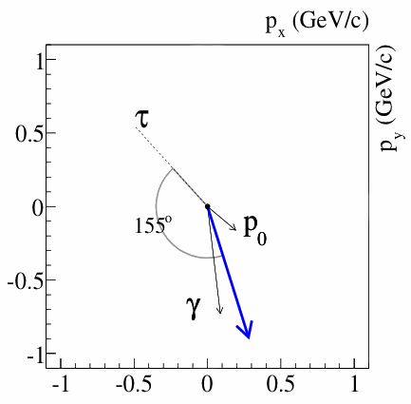
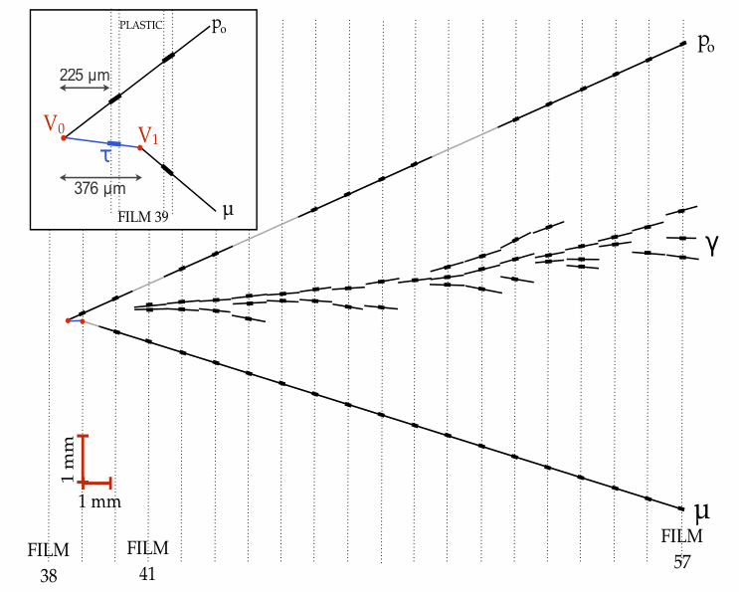
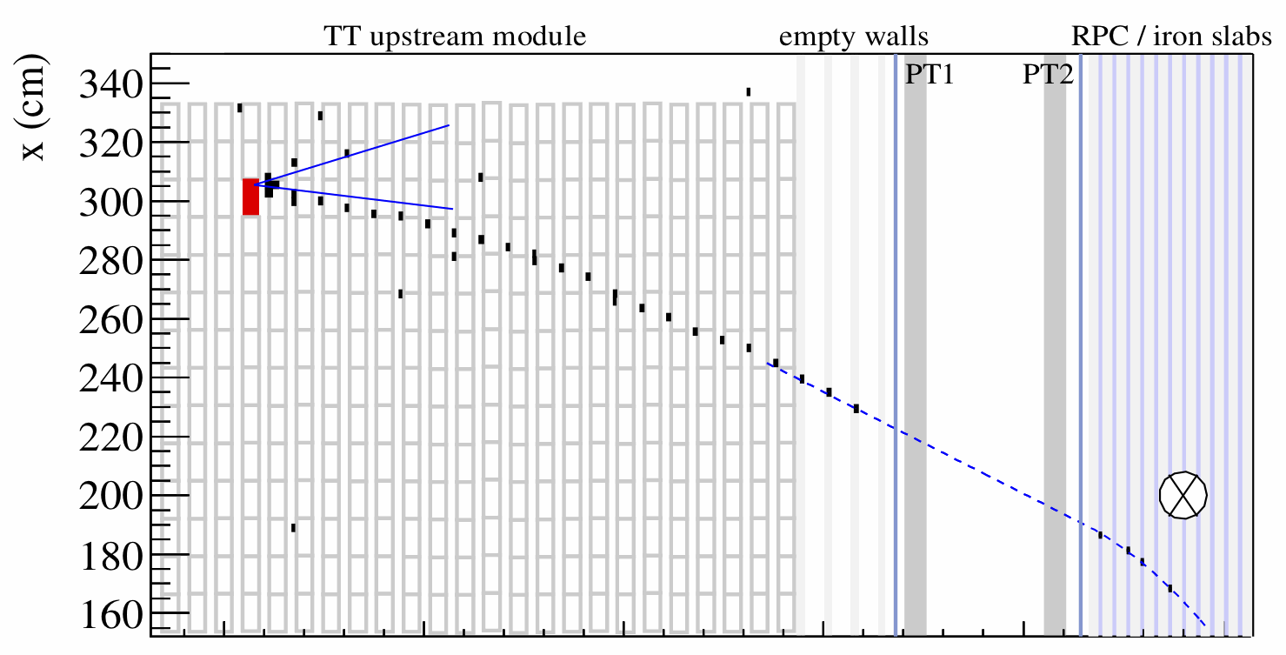
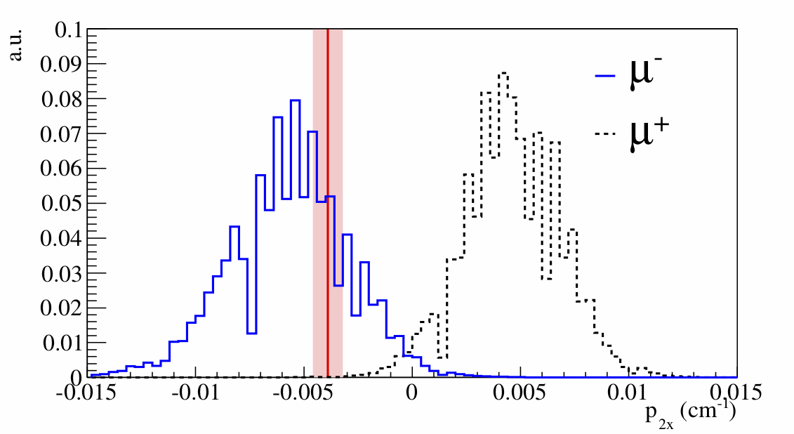
3rd ν_{τ} candidate (𝝉→μ) (2013)
PHYSICAL REVIEW D 89 (2014) 051102(R)
Negative muon measured in the muon spectrometer
B
First measurement of the lepton charge in appearance mode

Slide 20
Background to
τ⁻
μ^{-,},e, h, 3h
ν_{τ}
Production of charmed particles in
CC interactions
(affect all decay channels)
μ⁻,e⁻
MC tuned on CHORUS data (cross section and fragmentation functions), validated with measured charm events in OPERA
ν_{μ,e}
μ⁺
e⁺
h⁺
D⁺
Hadronic interactions in lead:
Bck. to τ → h
or to τ → μ
(if hadron misid or
mismatched with muon)
ν_{μ}
ν_{μ}
In decreasing order of relevance
h
FLUKA + test beam data (OPERA bricks exposed to pion beams)
ν_{μ}
μ⁻⁻, ν_{μ}
h
μ⁻
Lare angle Coulomb scattering of muons in lead
Bck. to τ → μ
ν_{μ}
MC tuned on old measurements on lead form factor + dedicated test beam (in progress)

Slide 21
Search for decay topologies: charm control sample
Charmed hadrons produced by ν_{μ}CC interactions → muon at the primary vertex,
Mass and lifetime charmed hadrons ~ tau lepton
→ similar decay topology
μ
Φ
D, Λ_{c}
 | charm | back- ground | expected | data
1 prong | 21 ± 2 | 9 ± 3 | 30 ± 4 | 19
2 prong | 14 ± 1 | 4 ± 1 | 18 ± 2 | 22
3 prong | 4 ± 1 | 1.0 ± 0.3 | 5 ± 1 | 5
4 prong | 0.9 ± 0.2 | - | 0.9 ± 0.2 | 4
All | 40±3 | 14±3 | 54±4 | 50
2008-2010 OPERA data set
54 ± 4 charm events expected
50 observed in control sample

