Slide 1
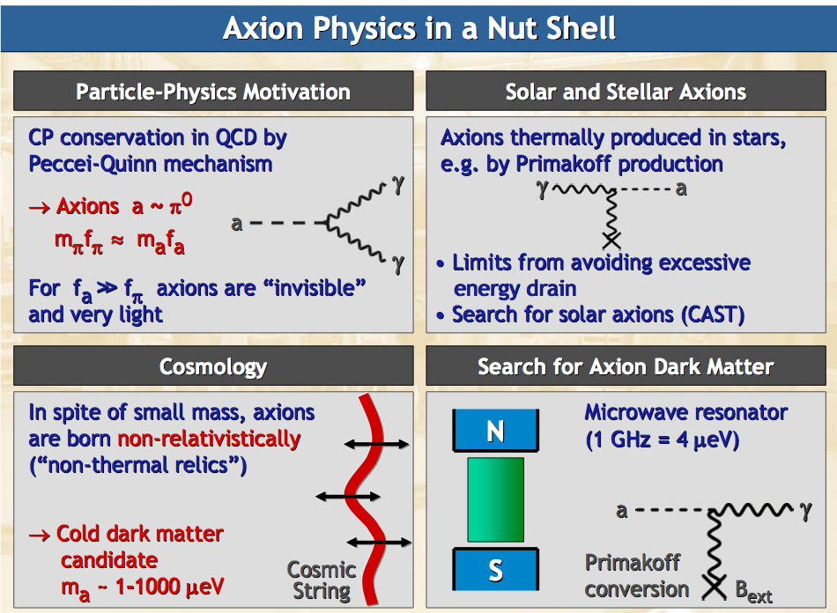

Slide 2
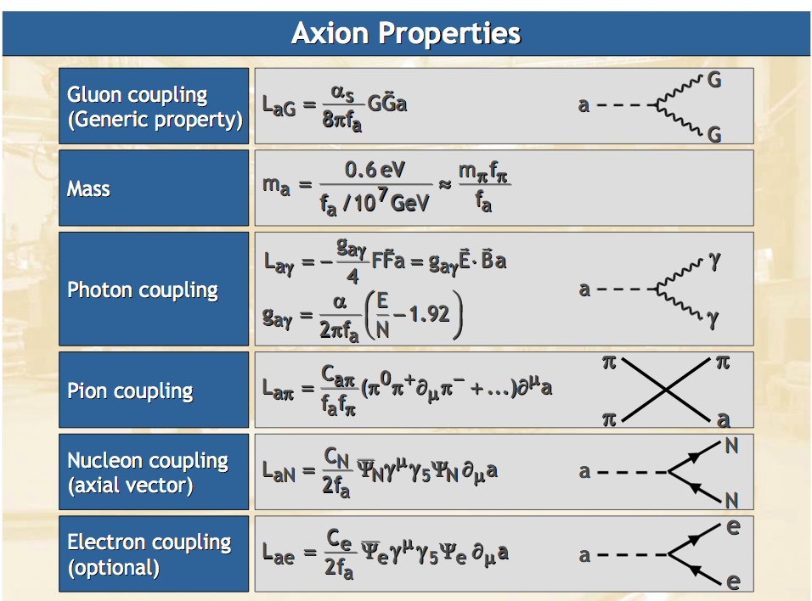

Slide 3
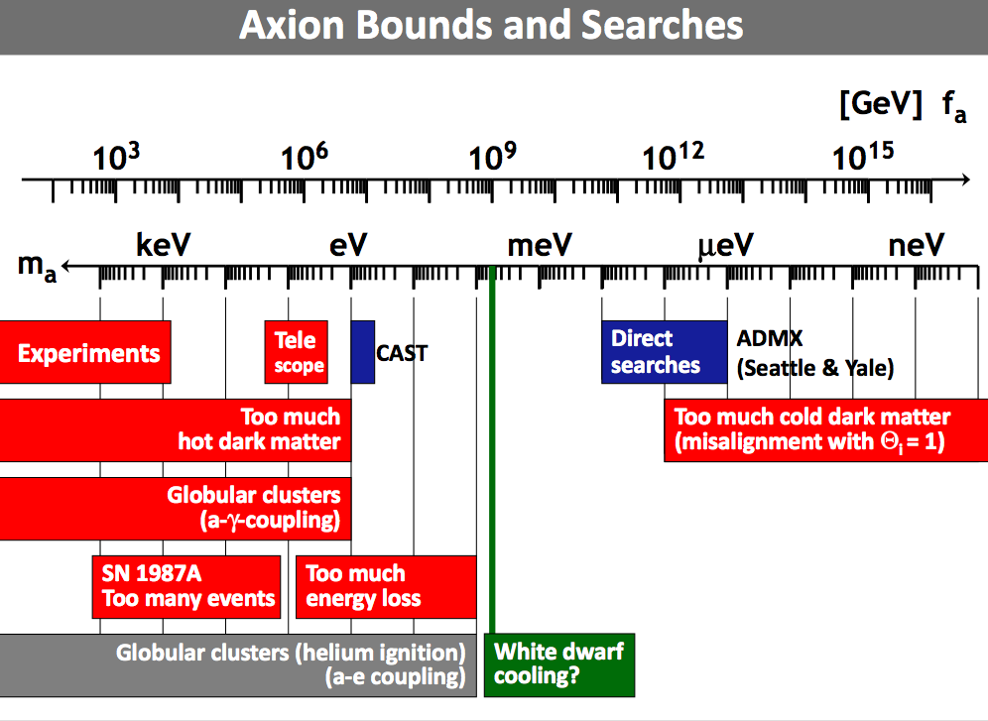

Slide 4
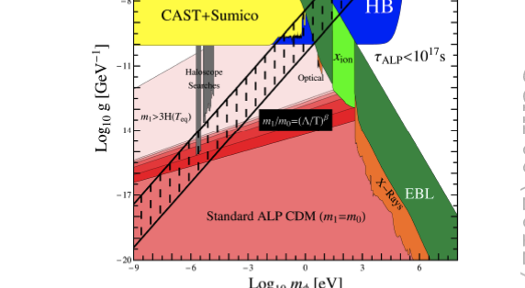
Current experimental limits
Primakov Conversion

Slide 5
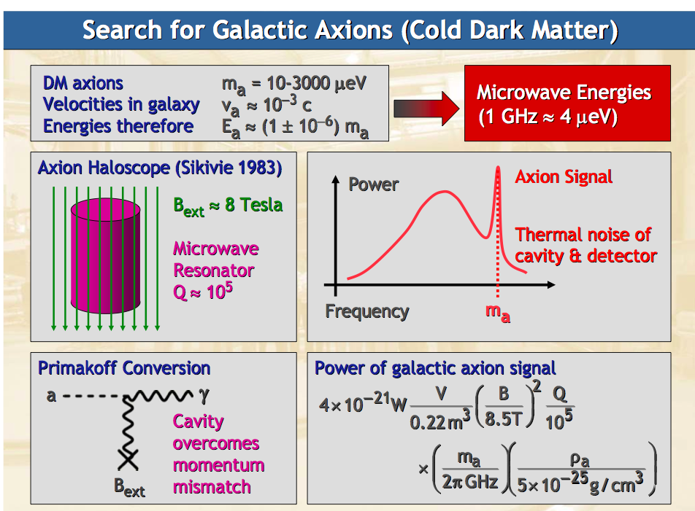

Slide 6
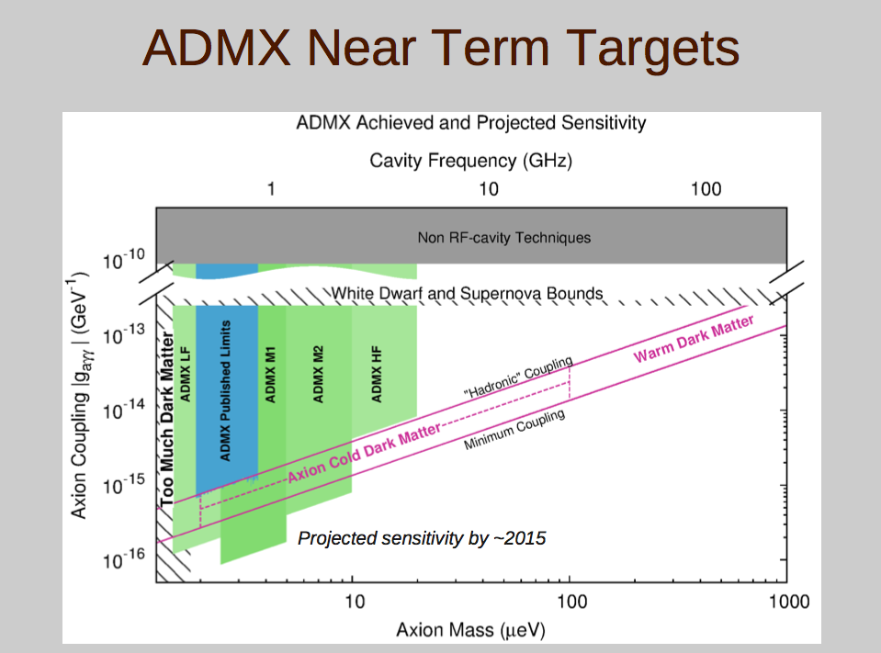
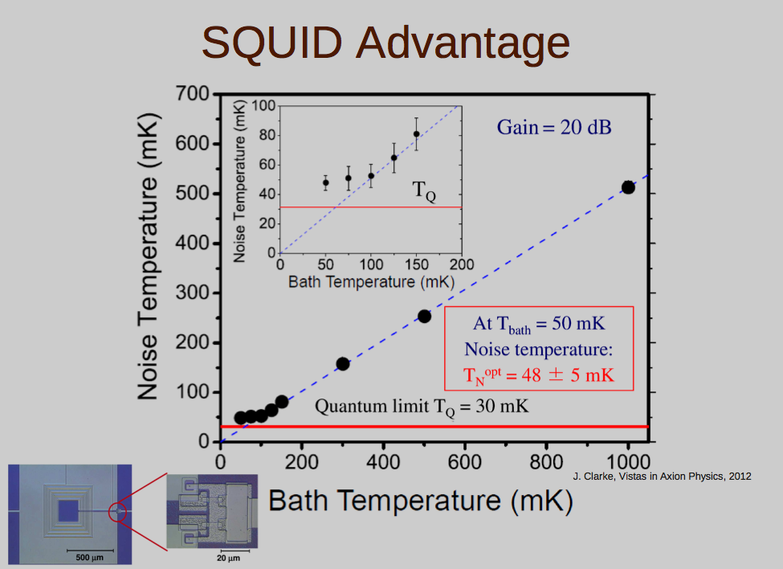

Slide 7




Search for galactic axion – new proposal
Exploit the axion-electron coupling
Axion wind equivalent to magnetic field
Ce ≤ 10-13Gev-1
(only DFSZ axion)
Detection using EPR magnetometry
- Excess Noise in Magnetized Crystal
-Zeeman Transition in Optical Crystals
Static external field
on paramagnetic
crystal sample
Modulated RF field
Low frequency detection of induced magnetization
Axion
RF
Power
YIG
Wind
For both schemes annual modulation expected

Slide 8
ELECTRON – AXION interaction through SPIN
F. Wilczek, J.M. Martín, J. Leon, R. Barbieri, I.V. Kolokolov, G. Raffelt
The energy of interaction
between spin and axion-field is
This looks like a magnetic coupling through electron spin
Effective magnetic field for cosmological axion
DETECTION TECHNIQUES :
Electron Spin Resonance Magnetometry with Paramagnetic Materials
Optical Spectroscopy in Paramagnetic Crystals
Effective B RF field @ 10^-22 T seems feasible to attain

Slide 9




ESR Magnetometry/Zeeman Spectroscopy:
from 10μeV to meV ( GHz to THz)
DC magnetic field B₀
SAMPLE: DPPH , TbF3 , YIG, Ruby
B₁₀cosωt+B_{a}cosω_{a}t

Slide 10
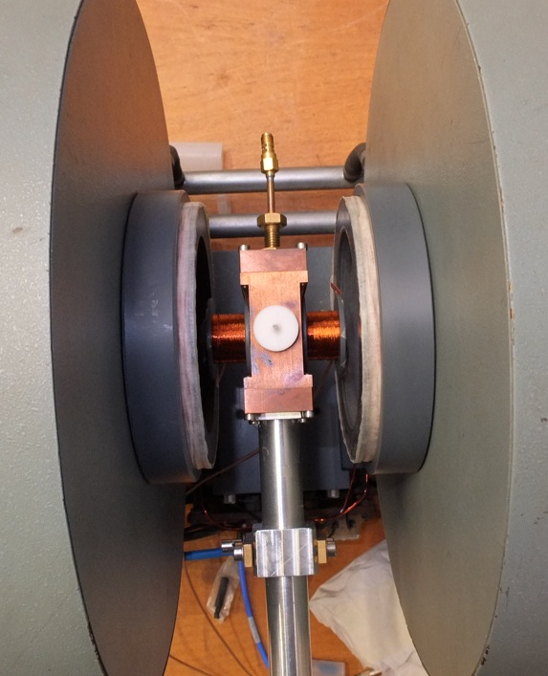
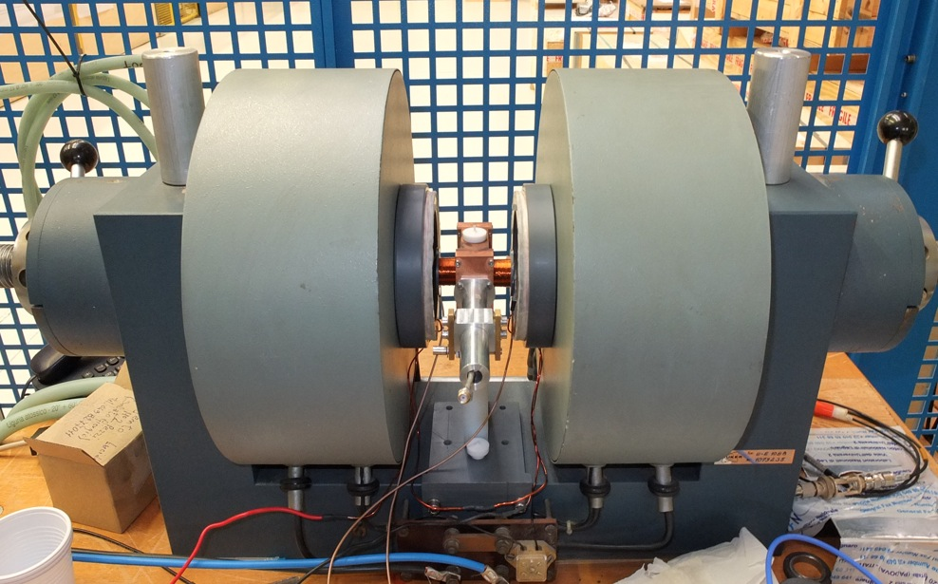
LNL EPR SET UP

Slide 11
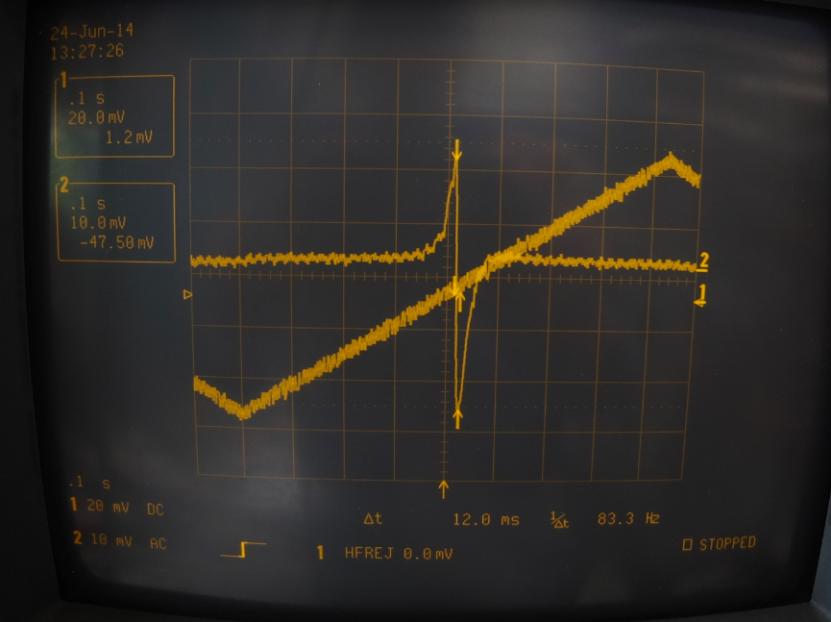

Slide 12
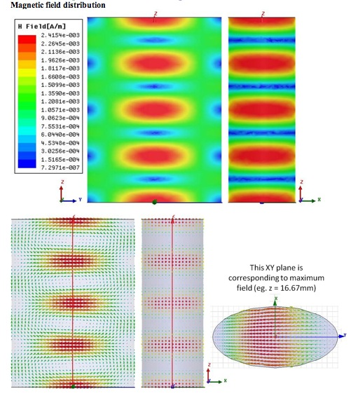
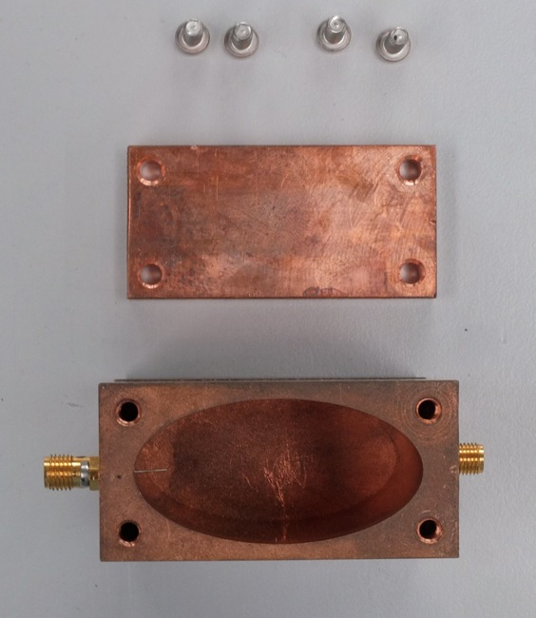

Slide 13
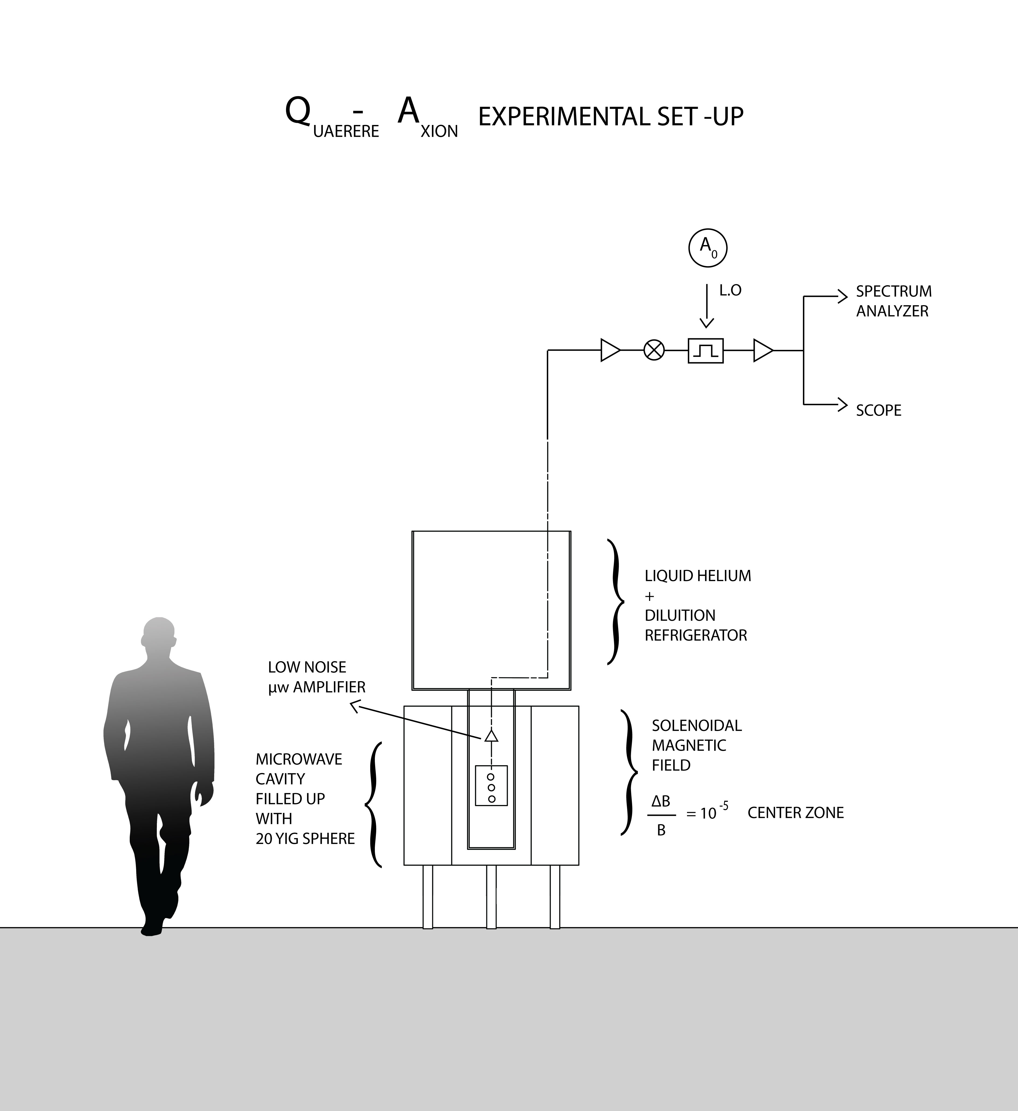

Slide 14
QUAX Activities ( 2015 – 2017/8) :
1) High Susceptivity Material , Low Dissipation (LNL-INRIM.TO )
2) Low Noise Receiver : Linear / Quantum @ near QL( PD-LNL)
3) High Frequency High Q Microwave Cavity 10^5: (PD-LNL)
4) High Magnetic Field : 05-1 Tesla ( GE-LNL )
5) Cryogenics @ 100 milliKelvin ( TN-PD )
6) Optical Spectroscopy on Paramagnetic Single Crystals Zeeman

Slide 15
Ricerca Assioni Cosmologici attorno 17 GHz
Attraverso Emissione di Radio Frequenza alle Microonde
Piano Ricerca 3/4 Anni:
Sezioni :
Padova 1,6 FTE, Torino INRIM 1,5 FTE , LNL 1,5 FTE , Genova …. FTE
C.Speake - Birmingham U. I.Kolokolov - Landau Institute
Richieste Finanziarie : KE 2015 , KE 2016 , KE 2017 , Tot. =800 Ke
Keuro (..) PD
2015 Keuro ( ) LNL
Keuro ( ) TO
Keuro ( ) GE
Richieste Servizi : 15 MU OM , 14 MU OE , 5 MU UT

Slide 16
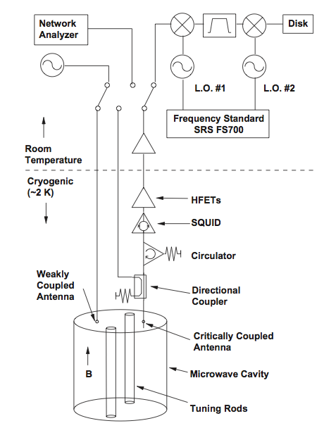

Slide 17
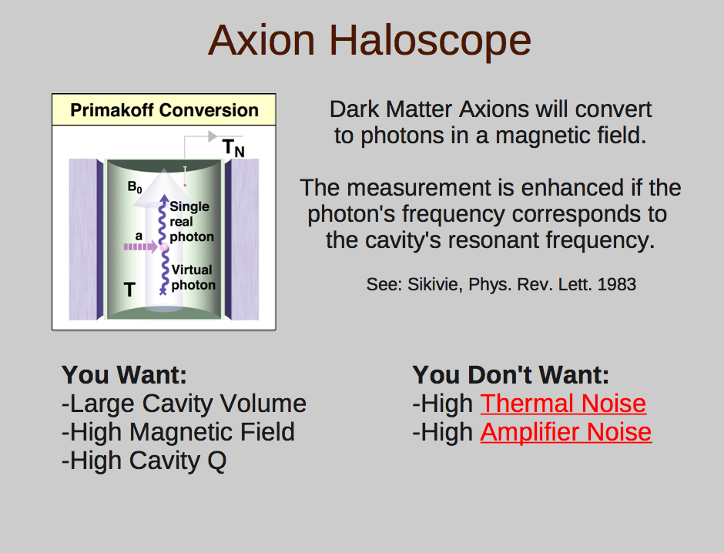

Slide 18
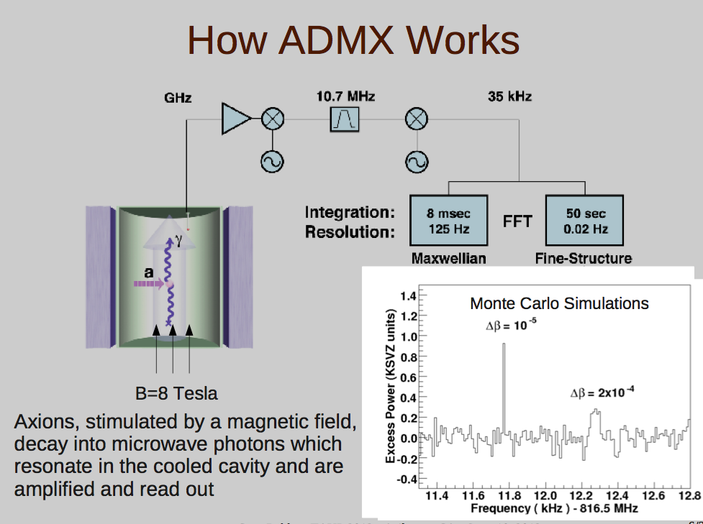

Slide 19
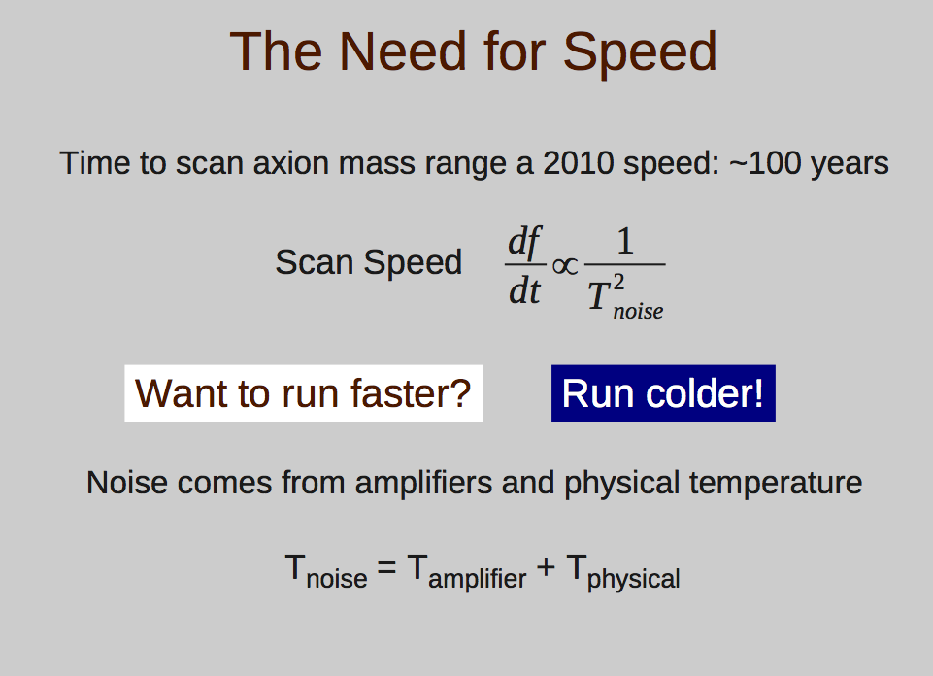

Slide 20
