Slide 1
Progetti CLOUD
CdS Padova - 30 Giugno 2014
Marco Verlato

Slide 2
Sommario
Progetti approvati
Bando "Smart Cities and Communities"
Open City Platform
Progetti in attesa di approvazione
Call H2020-ICT-2014-1
FONDACloud
XZELCloud
Progetti in fase di preparazione
Call H2020-EINFRA-1-2014
DataCloud

Slide 3
Progetto approvato: OCP
OCP (Open City Platform) e' un Progetto inter-regionale di innovazione sociale, vincitore nell' ambito di "Cloud computing technologies per smart government", proposto per il bando "Smart Cities and Communities" D.D. 391/Ric del 5 luglio 2012
Durata: 30 mesi (1/1/2014-30/6/2016, ma primi kick-off meetings dal 10/6/2014)
Budget: 12M€, di cui 1.6M€ all’INFN (278PM), di cui 300k€ a INFN-Padova (45PM)
Soggetti attuatori:
Almaviva the Italian Innovation Company SpA
Maggioli SpA
Santer Reply SpA
TD group SpA
Pluservice s.r.l capofila della ATI Marche (E-LINKING ONLINE SYSTEMS SRL, ETT SpA, FILIPPETTI SpA, APRA PROGETTI SRL, LOGIC SRL, HALLEY INFORMATICA SRL, ESALAB SRL, SEDA SpA - Gruppo KGS, ITALSOFT SRL, JEF SRL)
Infomobility SRL capofila della ATI Toscana-ER (SISTEMI TERRITORIALI SRL, SINED SRL, PHOOPS SRL, 3D INFORMATICA SRL, LASCAUX SLR, AGENZIA ESPRESSI SAS )
INFN - Istituto Nazionale di Fisica Nucleare (CNAF, Padova, Perugia, Torino, Bari)
UniCam - Università degli Studi di Camerino
Enti sperimentatori:
Regioni Marche, Toscana, Emilia Romagna + 21 comuni

Slide 4
OCP: Obiettivi
OCP intende ricercare, sviluppare e sperimentare nuove soluzioni tecnologiche open, interoperabili e utilizzabili on-demand nell’ambito del Cloud Computing, insieme a nuovi modelli organizzativi sostenibili nel tempo per innovare l’erogazione di servizi da parte delle Pubbliche Amministrazioni Locali e Regionali
I principali ambiti della ricerca condotta da OCP sono riconducibili a:
Sfide scientifiche e tecnologiche
Sfide di tipo giuridico, organizzativo e funzionale e nuovi modelli di business che faranno riferimento a 4 segmenti di mercato:
Comuni e loro aggregazioni
Cittadini e imprese destinatari dei servizi
Imprese del settore Smart Cities
Imprese ICT fornitrici della PA

Slide 5
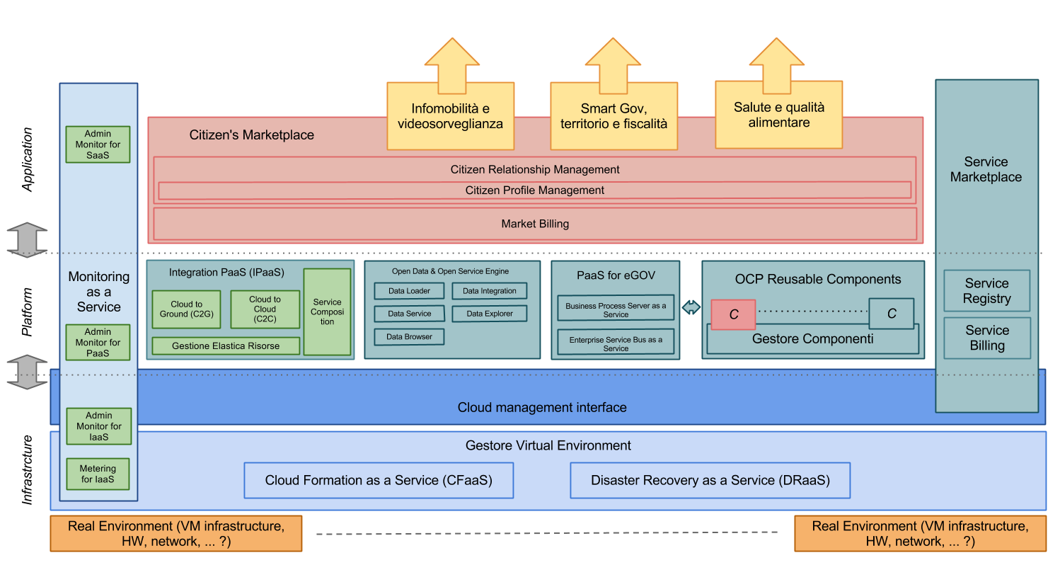
OCP: Principali tematiche
Gestione federata di piattaforme cloud IaaS eterogenee
Conversione di applicazioni verso il modello Cloud
Monitoraggio integrato e supporto a sistemi di billing
Modellizzazione delle applicazioni Cloud
Integrazione delle componenti PaaS
Federazioni di identità
Disaster recovery
Open data
Marketplace
Forti sinergie
col progetto PRISMA

Slide 6
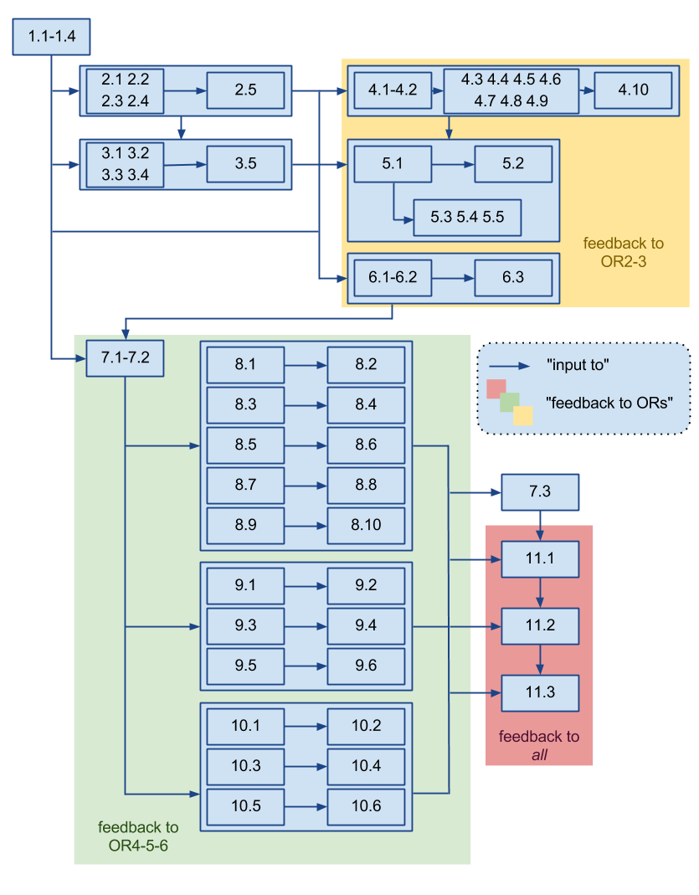
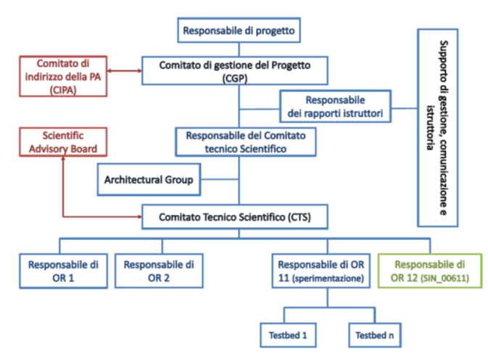
OCP: Organizzazione

Slide 7
OCP: Organizzazione
OR1: Analisi delle soluzioni e sinergie con progetti esistenti per favorire il riuso delle componenti open-source e la definizione della governance di una Smart City (INFN)
AR1.1 Analisi dello stato dell'arte sulla normativa, tecnologia, interoperabilità e standard (2PM)
AR1.4 Studio e definizione del modello architetturale di riferimento (4PM)
OR2: Metodi e strumenti per gestione cloud (INFN)
AR2.3 Studio di modelli e strumenti per il dispiegamento di applicazioni e servizi in cluster (21PM)
AR2.5 Implementazione e test di una interfaccia di cloud management comprendente funzionalità di monitoring avanzato, deployment di applicazioni in cluster, disaster recovery (2PM)
OR3: Studio e progettazione di un middleware abilitante l’interoperabilità nella PaaS (Almaviva)
AR3.1 Studio metodologie e sviluppo di middleware per interoperabilità (6PM)
OR4 Studio e progettazione delle componenti PaaS per l’e-government da integrare nel cloud per offrire funzionalità comuni e abilitare l’implementazione di servizi applicativi (Santer Reply)
OR5: Studio e realizzazione del provisioning on-demand di formati Open Data, correlati tra loro, per lo sviluppo di servizi applicativi (UniCam)
AR5.2 Realizzazione strumenti per la generazione automatica di API di fruizione del dato attraverso toolkit opensource (5PM)
OR6: Studio, progettazione e realizzazione di un Citizen's Marketplace per cittadini e imprese che renda disponibili i servizi applicativi forniti da PA e privati (Maggioli)
OR7: Studio e progettazione di metodologie e strumenti per la trasformazione dei servizi applicativi, basati sulle componenti fornite dalla PaaS (UniCam)
OR8: Realizzazione e trasformazione di servizi applicativi: SmartGov, Territorio e Fiscalità (Esalab)
OR9: Realizzazione e trasformazione di servizi applicativi INFOMOBILITA' E VIDEOSORVEGLIANZA (Pluservices)
OR10: Realizzazione e trasformazione di servizi applicativi SALUTE E QUALITA' ALIMENTARE, basati sulle API fornite dalla PaaS (Almaviva)
OR11: Validazione soluzioni cloud del progetto, con la sperimentazione di IaaS, PaaS e SaaS tramite la predisposizione di ambienti di test (Almaviva)
AR11.2 Realizzazione del testbed IaaS, implementazione dei primi prototipi PaaS e SaaS e definizione e realizzazione del piano di validazione (3PM)
AR11.3 Realizzazione del testbed IaaS, implementazione della seconda serie di prototipi PaaS e SaaS e definizione e realizzazione del piano di validazione (2PM)

Slide 8
Call H2020-ICT-2014-1
Main pillar: Industrial leadership
Topic: Advanced Cloud Infrastructures and Services (ICT-07-2014)
Scope: Research & Innovation actions (Budget: 66M€)
Items:
High performance heterogeneous cloud infrastructures. The focus is on development, deployment and management of cloud-based infrastructures and services (IaaS, PaaS, SaaS) over large-scale, distributed, heterogeneous, dynamic computing and storage environments…
Federated cloud networking: Techniques for the deployment and management of federated and decentralised cloud infrastructures, in particular cloud networking techniques…
Dynamic configuration, automated provisioning and orchestration of cloud resources: Tools for automatic and dynamic deployment, configuration and management of services to enhance availability, flexibility, elasticity and to meet targeted performance constraints; techniques for managing big data taking into account integrity, consistency and maintenance aspects…
Automated discovery and composition of services: Innovative ways to facilitate collaboration between public administrations, users and other stakeholders as to produce, discover, mix and re-use different service components…
Cloud security: Mechanisms, tools and techniques to increase trust, security and transparency of cloud infrastructures and services, including data integrity, localisation and confidentiality, also when using third party cloud resources.

Slide 9
Call H2020-ICT-2014-1
Due proposte che prevedono il coinvolgimento di INFN-Padova sono gia’ state sottomesse il 23 Aprile 2014:
FONDACloud: Federated EnvirONment for Data Analysis in the Cloud
Coordinatore: EGI.eu (NL)
Durata prevista: 30 mesi
Consorzio: 21 partners, di 10 membri di EGI
Sezioni INFN: CNAF, Padova, Torino
Budget: ~7M€ (833 PM)
Budget INFN: 630K€ (9%, 93 PM)
XZELCloud: Cloud Advanced Services on large-scale Federated Infrastructures
Coordinatore: T-System (GE)
Durata prevista: 24 mesi
Consorzio: 11 partners, tra cui i principali players di Helix Nebula
Sezioni INFN: CNAF, Padova, Bari
Budget: ~4M€ (437 PM)
Budget INFN: 550K€ (14%, 82 PM)

Slide 10
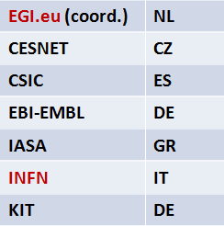
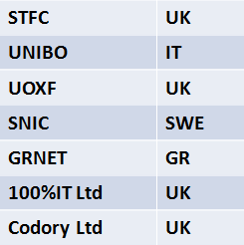
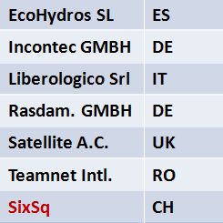
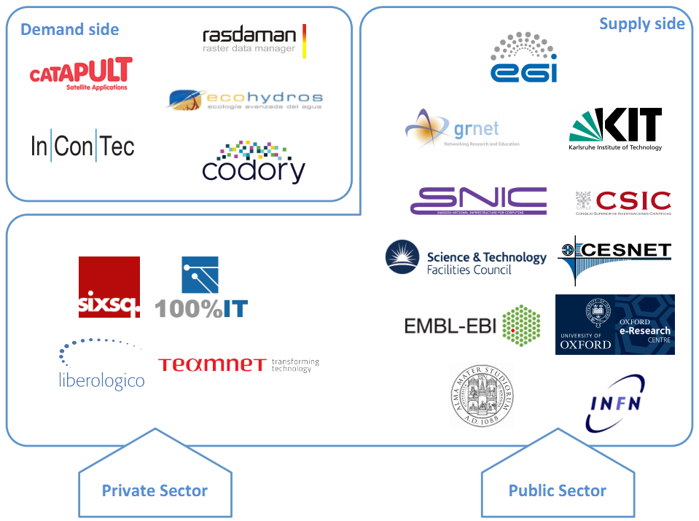
Call H2020-ICT/Partners
FONDACloud: Federated EnvirONment for Data Analysis in the Cloud
XZELCloud: Cloud Advanced Services on large-scale Federated Infrastructures
Partecipante | Nazione
T-Systems (coord.) | DE
CGI | UK
CloudSigma | BG
EGI.eu | NL
Indra | ES
INFN | IT
PIN-SME | BE
Santer Reply | IT
SixSq | CH
The Server Labs | UK
Gnubila | FR

Slide 11
Call H2020-ICT/Objectives
FONDACloud: Federated EnvirONment for Data Analysis in the Cloud
XZELCloud: Cloud Advanced Services on large-scale Federated Infrastructures
Investigate, develop and deploy solutions to boost the adoption of innovative cloud services in Europe based on resource federation
Provide a toolkit for the federation of heterogeneous cloud infrastructures
Provide a suite of PaaS and SaaS services for high performance big data management and processing
Build trust and confidence in cloud services
Business development through innovation:
Specialized technical tools for ICT companies to provide a federated IaaS
New high performance tools to commercially offer PaaS services for data analysis
Best practices for the deployment of user-friendly and customer-specific SaaS
To increase cloud take-up in the SME and Public Sector in Europe and build an ecosystem of cloud consumers and cloud solution providers supported by the current Helix Nebula Initiative
Enable new business models for SMEs and public sector administrations
Create a generic, user-friendly and open source set of advanced cloud services to enable definition, discovery, composition and use of the services in the cloud
Implement the advanced cloud services on heterogeneous large-scale federated cloud infrastructures that give users a choice e.g. between public and/or private providers
To establish trust in advanced and highly automated cloud services

Slide 12
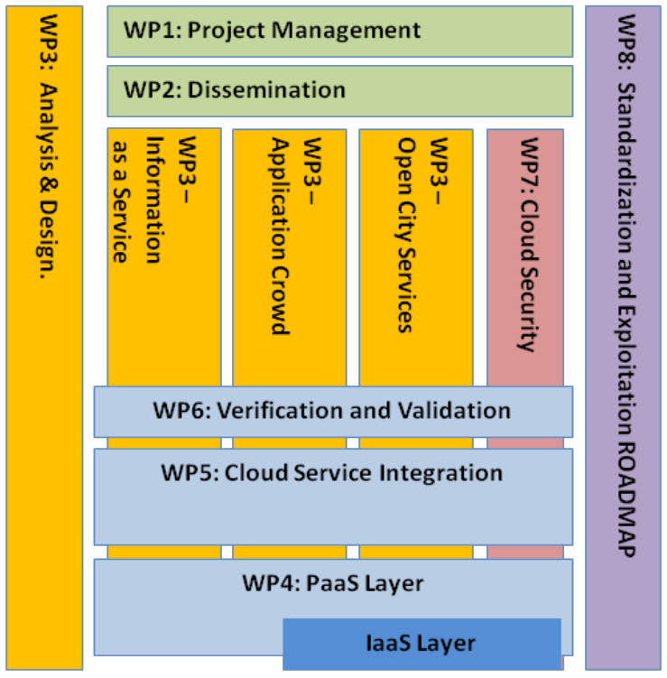
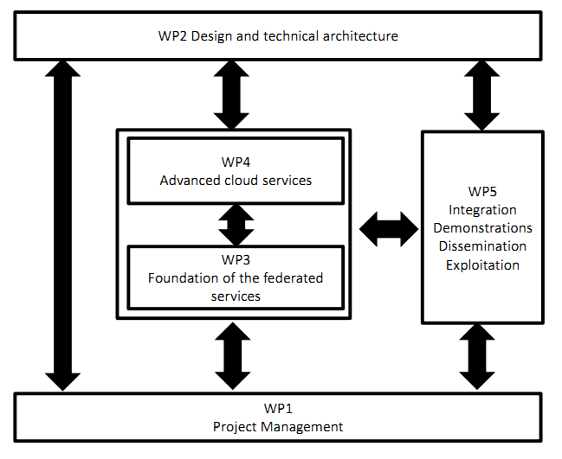
Call H2020-ICT/Implementation
FONDACloud: Federated EnvirONment for Data Analysis in the Cloud
XZELCloud: Cloud Advanced Services on large-scale Federated Infrastructures

Slide 13
Call H2020-ICT/INFN role
FONDACloud: Federated EnvirONment for Data Analysis in the Cloud
XZELCloud: Cloud Advanced Services on large-scale Federated Infrastructures
Leadership del WP3: Analysis and design
AAI con particolare riguardo a data encryption e data integrity per block, object e personal storage
Algoritmi, workflow e interfacce per il livello di brokeraggio infrastrutturale + Monitoraggio e billing a vari livelli
(Open) Data Management → Importante per le smart cities. Catalogo per object storage
Interfacce e tools per l’Information-as-a-Service, Application Crowd e Open City PaaS services
Definizione degli scenari dimostrativi, in particolare nel fornire gli use-case della PA (dai progetti PRISMA e OCP) per validare la piattaforma
AAI and Security Services: sviluppo di un framework per l’autorizzazione federata (task leader INFN)
Brokering: sviluppo algoritmo di scheduling, interfacciamento con federated authorization and monitoring (UNIBO) e “integrazione” in SlipStream
Federated Appliance Factory: contributo allo sviluppo di container
Integration, Testing and Demos preparation: coordinamento
Dissemination and Event: collaborazione (training)

Slide 14
Call H2020-ICT/Conclusioni
Questi progetti non intendono costruire infrastrutture, ma sviluppare prototipi di servizi cloud avanzati, possibilmente estendendo e integrando soluzioni PaaS open source esistenti (e.g. Cloud Foundry, Slipstream, etc.)
Tutte tecnologie utili per la piattaforma generale di cloud federatata per l'eScience che vorremmo sviluppare in “DataCloud” (EINFRA-1/Topics 4-5)
Call molto competitiva… >140 proposte sottomesse
Scrittura dei progetti a ridosso della scadenza della call
In particolare per FONDACloud:
processo lungo (e faticoso) per la definizione del consorzio
nonostante questo… ricevuto supporto prezioso da parte del Servizio Fondi Esterni per ricerca documentazione, lettura critica e analisi documenti amministrativi (Collaboration Agreement)

Slide 15
Call H2020-EINFRA-1-2014
Main pillar: Excellent Science
Topic: Managing, preserving and computing with big research data (EINFRA-1-2014)
Scope: at least one of the first 5 activities, or activities 6, 7 or 8 individually. Proposers are encouraged to leverage on prior work on open prototype services… (Budget: 55M€)
Type of action: Research and innovation actions . Activities:
Establishing a federated pan-European data e-infrastructure.
Services to ensure the quality and reliability of the e-infrastructure.
Federating institutional and, if possible, private data management and curation tools and services.
Large scale virtualization of data/compute centre resources.
Development and adoption of a standards-based computing platform (with open software stack).
Support to the evolution of EGI (max. 8M€)
Proof of concept and prototypes of data infrastructure-enabling software (e.g. for databases and data mining) for extremely large or highly heterogeneous data sets.
Enable the creation of a platform and infrastructure for mining text aggregated from different sources/publishers.

Slide 16
Call H2020-EINFRA-1-2014
Scadenza: 2 Settembre 2014
La proposta DataCloud si concentra sulle attivita’:
Large scale virtualisation of data/compute centre resources to achieve on-demand compute capacities, improve flexibility for data analysis and avoid unnecessary costly large data transfers
Development and adoption of a standards-based computing platform (with open software stack) that can be deployed on different hardware and e-infrastructures (such as clouds providing infrastructure-as-a-service (IaaS), HPC, grid infrastructures…) to abstract application development and execution from available (possibly remote) computing systems. This platform should be capable of federating multiple commercial and/or public cloud resources or services and deliver Platform-as-a-Service (PaaS) adapted to the scientific community with a short learning curve. Adequate coordination and interoperability with existing e-infrastructures (including GÉANT, EGI, PRACE and others) is recommended

Slide 17
Proposta DataCloud
Main goal: to develop a comprehensive computing platform, including and expanding a PaaS framework, which will allow public and private e-infrastructure service providers (such as EGI, EUDAT, PRACE, HelixNebula), to integrate their existing services and make them available to a wider user base in both the public and private sectors, for the benefit of scientific communities.
Key objectives:
Integration of Grid and Cloud computing models into existing data centers.
Support of hybrid (private/public) Clouds.
Dynamic, fair-share based scheduling of local resources for both Clouds and Grids.
Cloud federations and data center virtual extensions.
Support for new models (e.g. distributed objects, Cloud based) for data access and management
Simplification of resource instantiation and use.
PaaS-level reusable component selection.

Slide 18
Proposta DataCloud/
Consorzio (1)
“The DataCloud project wants to exploit the formidable know-how that was built along the past ten years of collaborations through a consortium composed by the best European software developers, resource providers and e-infrastructures involved in distributed computing and directly involving key scientific communities.”

Slide 19
Proposta DataCloud/
Consorzio (2)
Technology developers, resource and infrastructure providers:
INFN (IT)
EGI.eu (NL)
CSIC (ES)
KIT (DE)
DESY (DE)
LIP (PT)
CERN (CH)
IN2P3 (FR)
STFC (UK)
CESNET (CZ)
PSNC (PL)
Cyfronet (PL)
CEA (FR)
CMCC (IT)
UPV (ES)
Industry participation currently under discussion
Scientific communities:
BBMRI (Biobanking and Biomolecular Resources Research Infrastructure)
EuroBioImaging (pan-European distributed imaging infrastructureto provide open access to innovative biological and medical imaging technologies)
LBT and other astro-physics communities
LifeWatch (European e-Science infrastructure for biodiversity and ecosystem research)
DCH-RP (Digital Cultural Heritage – Roadmap for Preservation)
Dariah (Digital Research Infrastructure for the Arts and Humanities)
EMSO (European Multidisciplinary Seaﬂoor & Water Column Observatory)
WeNMR/INSTRUCT
Elixir ES, CZ, IT (European infrastructure for biological information)
CMCC (Euro-Mediterranean Center on Climate Change)
High-Energy Physics

Slide 20
Proposta DataCloud
Aree di innovazione tecnologica identificate:
Scheduling within IaaS
Exploitation of Virtualization Techniques
Dynamically Distributed Virtual Data Centers
Service Orchestration
Exploitation of Data Locality
Security/AAI
Big Data: Management, Access, Transfer
Pilot Test Bed

Slide 21
Proposta DataCloud/Scheduling
Introduction of flexible local, batch-like scheduling and prioritization capabilities into the most popular IaaS solutions.
Scheduling across hybrid Clouds.
On-demand resource pooling (“Cluster-as-a-Service”-like).
Scheduling of virtual distributed clusters.
Scheduling associated to network bandwidth allocation/availability.
Scheduling based on resource location.
Services for resource discovery and monitoring.

Slide 22
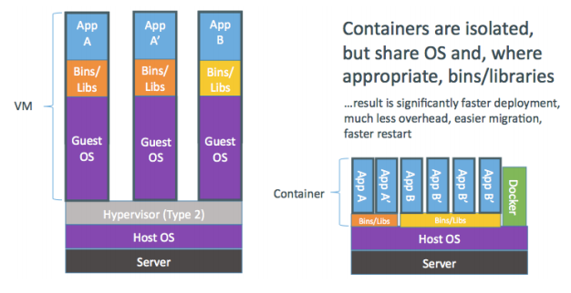
Proposta DataCloud/
Exploitation of Virtualization
Techniques
Support of new patterns for application development and shipment through containers associated to Cloud provisioning.
Use of special-purpose hardware (e.g.: GPUs, accelerators, low-latency networks) coupled with virtualization.

Slide 23
Proposta DataCloud/
Dynamically distributed virtual data centers
Given the constant increase and commoditizing of network bandwidth, the project will make it possible to dynamically:
Exploit hybrid Cloud deployments.
Transparently extend data centers to remote locations.

Slide 24
Proposta DataCloud/
Service Orchestration
Extend/connect different IaaS layers into a PaaS layer.
Selection of components needed for a particular task and instantiation of the appropriate resources in multiple, federated, possibly hybrid Clouds. Components might for example be related to:
Highly-available solutions (mission-critical apps, disaster recovery).
Specific capabilities (low-latency connections, GPU devices e.g. for HPC-type resources).
Composition of data analysis workflows, potentially serving multiple scientific communities.
Interactive use-cases, providing services covering small/medium fast execution environments, with possible specific focus on QoS.
Component/service selections will be made easier through the use and extension of Scientific Portals.

Slide 25
Proposta DataCloud/
Exploitation of Data Locality
The focus of this area is on the dynamic exploitation of data locality according to user requirements:
E.g. automatic data distribution to/across multiple zones of a given data centre
This can be useful at both local (single data center) and distributed (multiple, federated data centers) levels.
This is linked to the Scheduling area and requires consideration of network and storage topologies.
Users should not be aware of the details of data distribution.

Slide 26
Proposta DataCloud/
Security-AAI
Secure data access for all types of data.
Federated user authentication and SSO based on the user credentials provided by home hosting laboratory or institutions.
Support for VO attributes and policies in existing open-source Cloud platforms and in PaaS/SaaS solutions.
“Catch-all” Identity Federation and Identity Providers for “homeless” users.
Policy management and distribution service enabling Cloud federation-wide access control services for attribute and credential-based access requirements.
Integration of SAML-based federated authentication and authorization mechanisms in order to simplify credential management and delegation.

Slide 27
Proposta DataCloud/
“Big Data”: Management, Access, Transfer (1)
Creation of a distributed archive and catalogue for the federation of storage systems with automatic failover for data access; implementation of mechanisms to enforce consistency checks and self-recovery procedures of data for both object and block data types.
Development/support of platforms to provide high performance data analysis.
Consolidation of technologies for data access and archiving through standard protocols (e.g. HTTP/WebDAV); definition and development of a Federated Data Storage-as-a-Service solution to satisfy different types of requests and needs, leveraging multiple storage solutions in different infrastructures, associated to standard protocols such as S3, CDMI, etc.

Slide 28
Proposta DataCloud/
“Big Data”: Management, Access, Transfer (2)
Definition of an abstraction layer aiming to provide a high-level and advanced data managements features.
Definition of high level services to move very large data sets, able to deal with failures of software and hardware components in an heterogeneous Cloud infrastructure.
Address topics such as integrity, security and privacy.
Provide “personal-storage” services for small to medium scientific collaborations.
Development of a Data Life Cycle management system (policy-based data management).

Slide 29
Proposta DataCloud/
Pilot Test Bed
Some of the project partners will make available a distributed pilot test bed to enable full testing of the new services and to provide a smooth migration path from current batch-based Grid Data Center to a new heterogeneous, hybrid Cloud-based federated distributed infrastructure.

Slide 30
Proposta DataCloud/
Organizzazione
WP1: Administrative and Technical Management
WP2: Requirements, outreach, collaborations and sustainability
WP3: Product evolution, quality and support management
WP4: Resource Virtualization
4.1: Cloud Computing
4.2: Cloud Storage
4.3: Network Virtualization
WP5: PaaS Platform
5.1: Portals / User interfaces / APIs
5.2: High-level Data Access
5.3: Security/AAI
5.4: High-level geographical scheduling
5.5: Support for data workﬂows and HPC applications
5.6: Data management
Very preliminary

Slide 31
Proposta DataCloud/
Timeline
2 phonecall settimanali da qui a Settembre, un F2F a fine Luglio
Sottomissione del primo draft al Servizio Fondi Esterni dell’INFN entro il 15 Luglio per revisione
Atteso feedback entro il 25 Luglio e versione semi-finale della proposta pronta per il F2F del 31 Luglio
Risultato valutazione EC (single stage) atteso entro 5 mesi dal 2 Settembre → 2 Febbraio 2015
Data indicativa per la firma dei grant agreements: fino a 3 mesi dalla notifica del successo

