Slide 1
MC simulations for the improvement of hadronic energy resolution using Cherenkov signal
M. Bongi, S. Bottai
1st Calocube collaboration meeting - 20th June 2014 - Firenze

Slide 2
THE SIMULATION & RECONSTRUCTION TOOL
CaloFlukaSim
( CaloPrototypeFlukaSim ; a version with prototype geometry)
Developed by florence groups (Paolo Papini) for internal use
mori@fi.infn.it to get the code (via GIT)
Fluka-based MC simulation
  3,6cm CsI Scintillating crystals Scintillation Light collection efficiency and PD quantum efficiency
  Photodiode Energy deposits in the photodiodes due to ionization are taken into account
  Carbon fiber support structure (filling the gaps between crystals)
  Number of crystals passed via parameter
  New dedicated versions for Cherenkov and Neutrons detection added recently (to be finalized and eventually ‘unificated’ with standard version)
C++ reconstruction tools
  Noise
  Shower axis reconstructed by fit
  Lateral and longitudinal profiles respect to axis
  Point of first interaction along axis
  Length from first interaction to end of calorimeter
  ............................................................................
No MC truth is needed
in the analysys

Slide 3
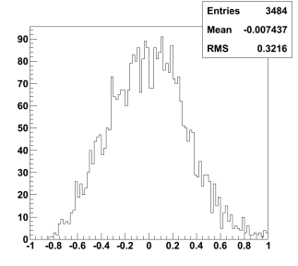
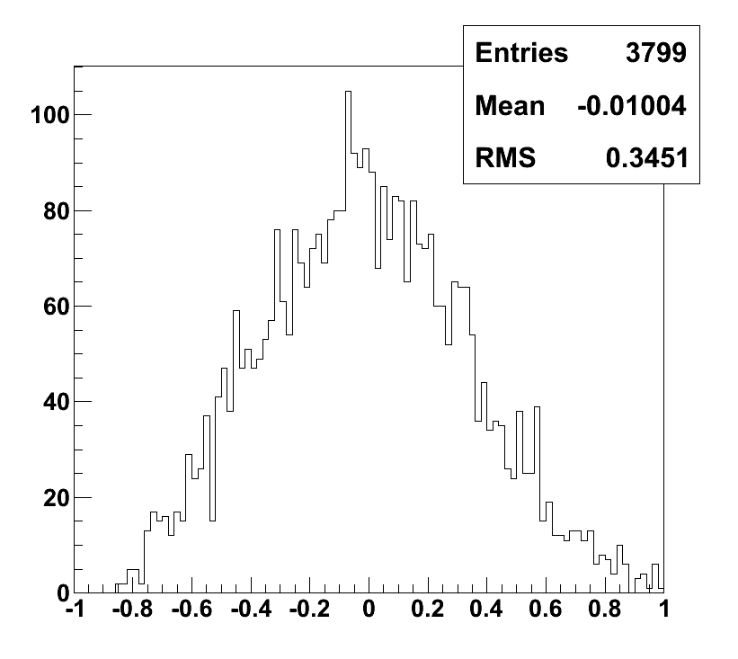
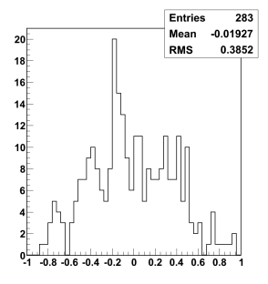
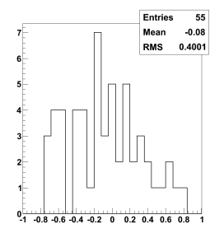
Proton energy resolution
32%
35%
100 – 1000 GeV
1 TeV
39%
10 TeV
40%
100 TeV
( Measured Energy – Real Energy ) / Real Energy

Slide 4
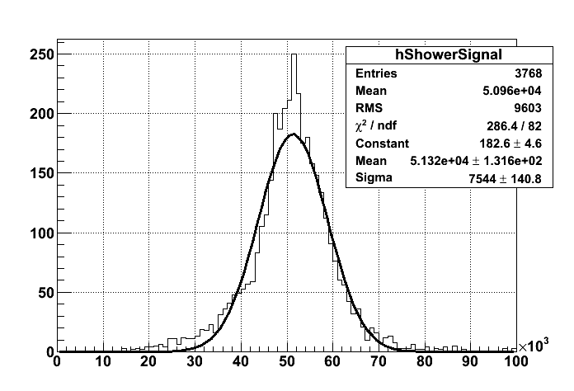
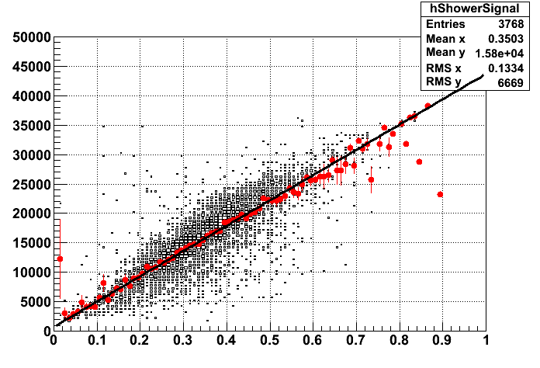

IF THE ELECTROMAGNETIC FRACTION IS GIVEN FOR EACH SHOWER IT CAN BE
USED TO IMPROVE THE RESOLUTION fem=E_{em}/E
for 1 TeV vertical proton the resolution scale from 35% to 15%
PERFECT fem CORRECTION
Slices
has lower RMS

Slide 5
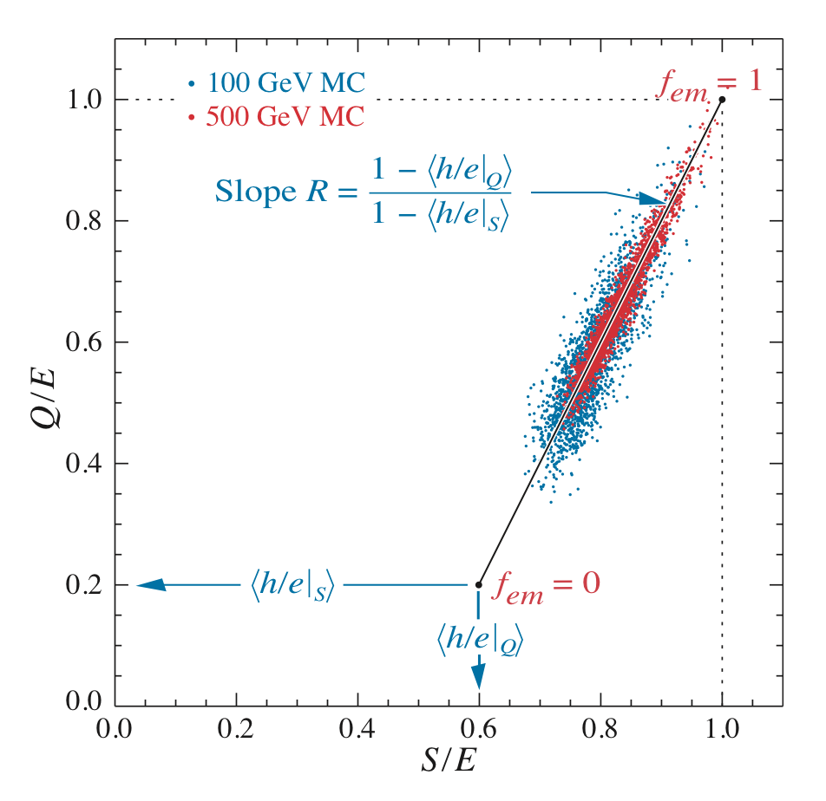

The DREAM concept : USE CHERENKOV LIGHT [ Q ]
As far as η_{S} ≠ η_{Q}
2 equation, 2 variables
Otherwise we have only 1 equation
Degeneration !

Slide 6
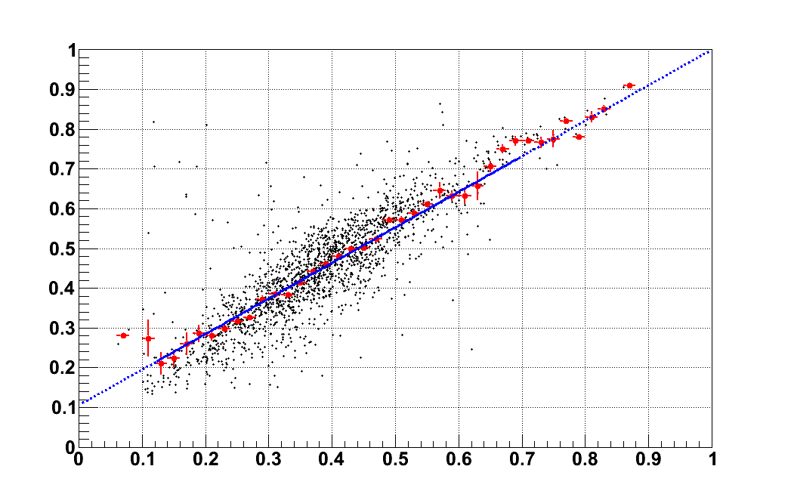
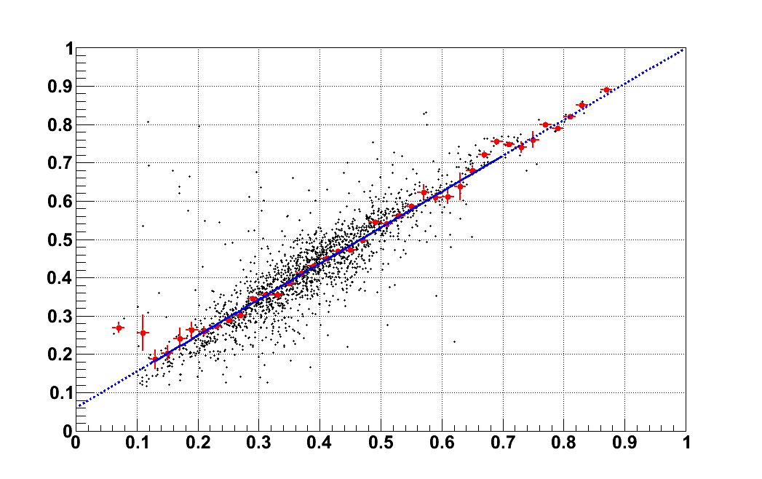
Preliminary simulation studies seems to indicate that in the standard CsI CALOCUBE
η_{S} ~ η_{Q}
In such configuration the method can’t work !
small calorimeter thickness for pure hadronic component ?
Index of refraction ?
TO BE STUDIED
Is it possible to improve the situation using the high segmentation
to combine topology and Cherenkov ? TO BE STUDIED
S/E
Q/E

Slide 7
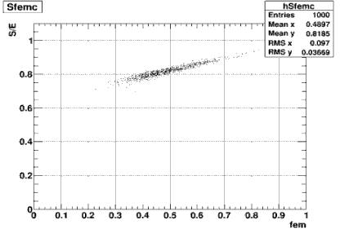
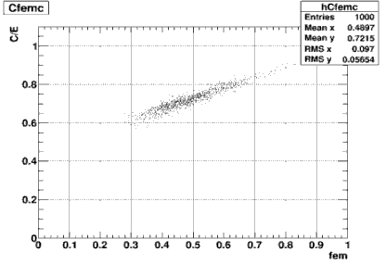
TOTAL ABSORPTION CALORIMETER
LET’S SIMULATE SIMPLER CONDITION AND COMPARE TO LITTERATURE
In order to compare with published results:
20 x 20 x 20 BGO cubes
side of each cube = 18 cm
>16 interaction lengths (for vertical tracks)
E=100 GeV, 1000 events
Signal integrated for t<20ns
ηs=(h/e)_{S} $≃$ 0.64 ηc=(h/e) _{C} $≃$ 0.45

Slide 8
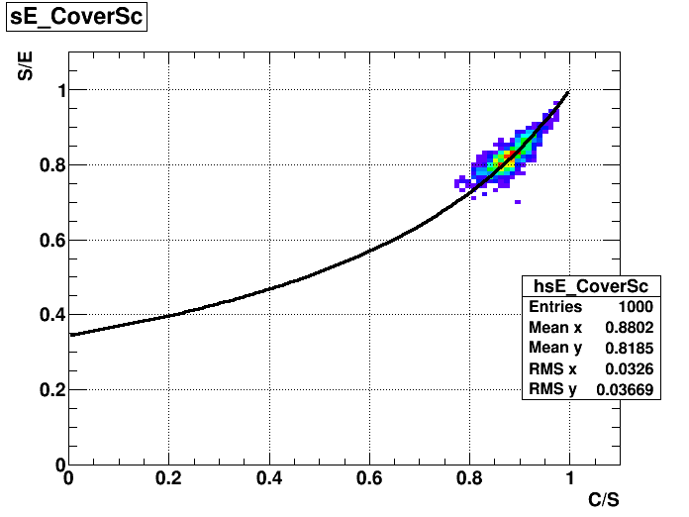

TOTAL ABSORPTION CALORIMETER
BEST METHODS : SEE CORRELATION S versus C/S
Without corrections
$$\frac{ΔE}{E}≃4.5\%$$

Slide 9
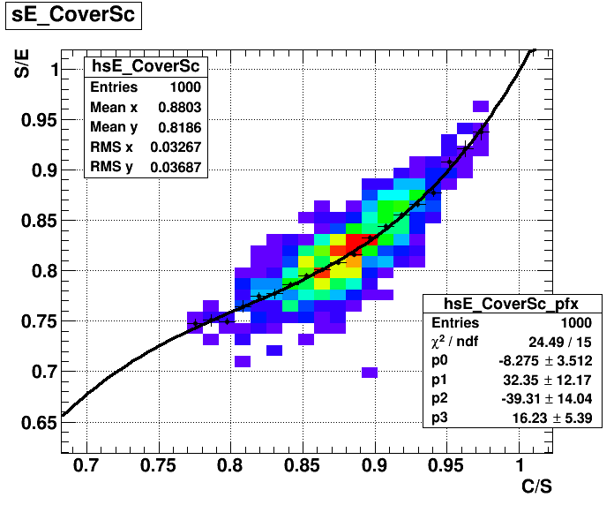
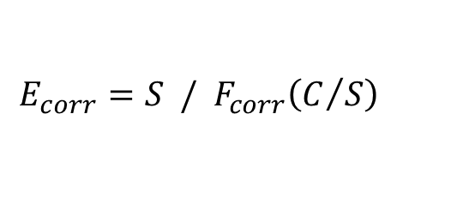
“A. PARA-LIKE” CORRECTION
A better result can be obtained taking into account the shape of the distribution
Correct the scintillation signal with a function F_{corr} obtained from a polynomial fit (e.g. 3rd grade) of the profile-X histogram of the scatter plot
$$E_{corr}=S / F_{corr}\left(C/S\right)$$

Slide 10
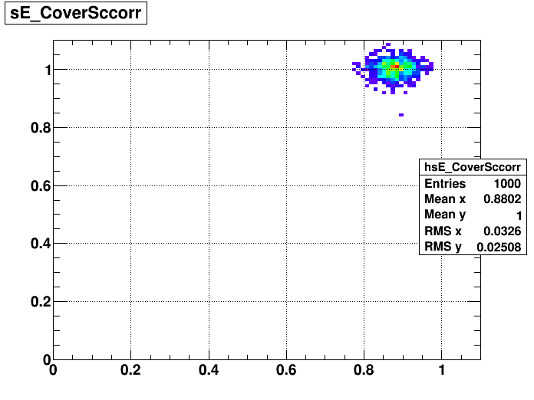


“A. PARA-LIKE” CORRECTION
S_{corrected}/E
Without corrections
$$\frac{ΔE}{E}≃4.5\%$$
With correction
$$\frac{ΔE}{E}≃2.5\%$$
C/S

Slide 11
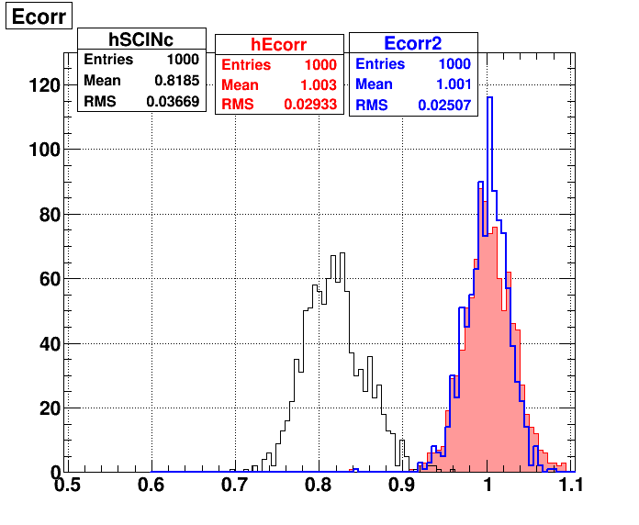
NORMALIZED ENERGY DISTRIBUTION
Resolution Improvement ~ 40%
improvement of energy resolution:
Here ~ 40%
~34% (DREAM)
~44% (PARA)
consider blue line
We controll the
method !
S_{corrected}/E

Slide 12
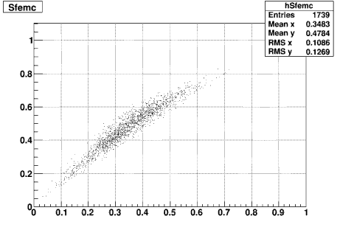
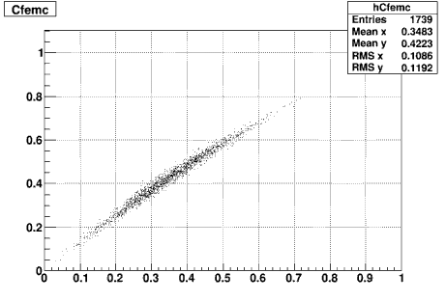
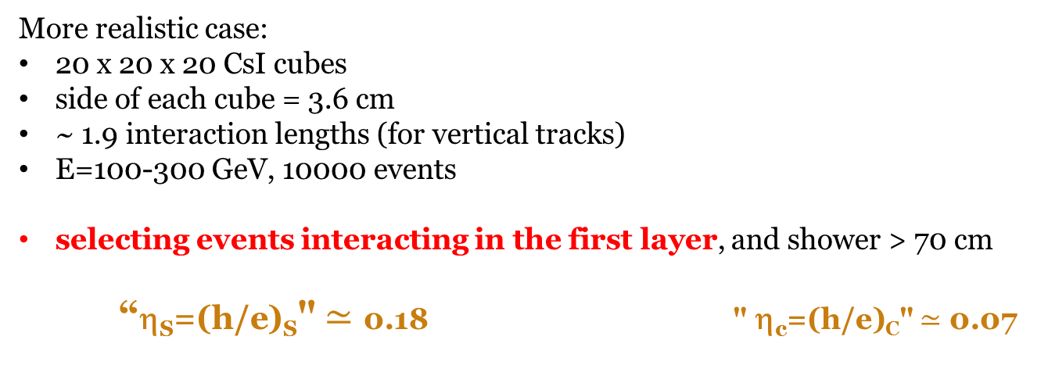
LET’s come back to CALOCUBE
More realistic case:
20 x 20 x 20 CsI cubes
side of each cube = 3.6 cm
~ 1.9 interaction lengths (for vertical tracks)
E=100-300 GeV, 10000 events
selecting events interacting in the first layer, and shower > 70 cm
“η_{S}=(h/e)_{S}" $≃$ 0.18 " η_{c}=(h/e)_{C}" $≃$ 0.07
SCINTILLATION
CHERENKOV

Slide 13
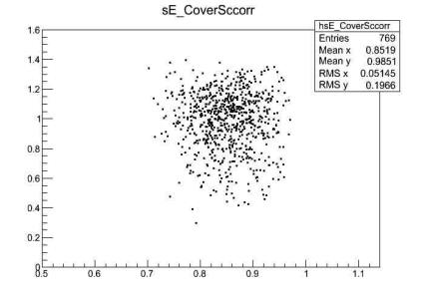
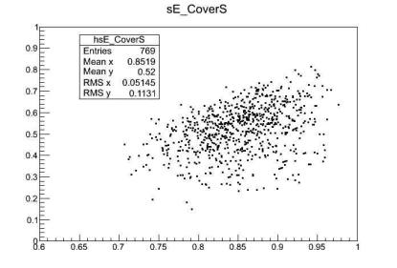
Apply the ‘standard’ correction to CALOCUBE
Vertical protons E=100 GeV, interacting in the first layer
S/E
S_{corrected}/E
RMS=22%
RMS=20%
C/S
C/S
RESOLUTION IMPROVEMENT ~ 10%
IF WE GET A SAMPLE OF SHOWERS INTERACTING DEEPER AND HENCE WITH MORE LEAKAGE THE IMPROVEMENT IS AGAIN
~ 10%
35% 31%

Slide 14
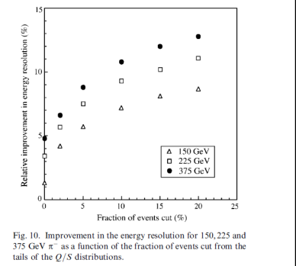
ACCESS CALORIMETER : THIN SAMPLING CALO
Vladimir Nagaslaev, Alan Sill, Richard Wigmans
~ 10%
TEST BEAM ANALYSIS
IMPROVEMENT DUE TO DUAL REDOUT ~ 10% IN ACCORDANCE TO WHAT WE FIND !
FOR THEM IS A GOOD RESULT
FOR US ????? (personally I think not)

Slide 15
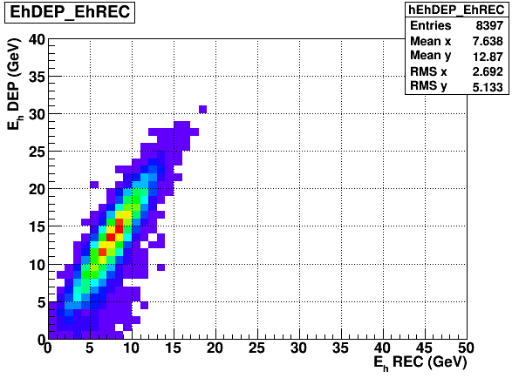
USING CHERENKOV WE CAN MEASURE QUITE WELL S_{had} and S_{em}
S=S_{em}+S_{had}
EE
Eh
S_{em} ~Ee
S_{had}
π+/-
Scintillation and Cherenkov give direct info only on S_{em} and S_{had} (not on Eh)
S_{hahd}
S_{had} is strongly correlated with
S-C=scintillation-Cherenkov
S-C

Slide 16
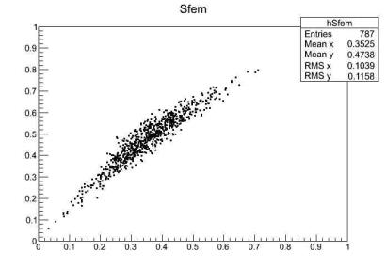
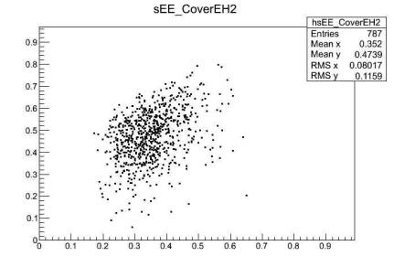
SUPPOSE TO HAVE AN IDEAL DUAL DETECTOR !
S=S_{em}+S_{had}
EE
Eh
S_{em} ~Ee
E=E_{e}+E_{h}=S_{em}+S_{had}*<1/η>
S_{had}
<1/η>=<1/η_{t}>*<1/η_{leak}>
Nuclei Excitation,
neutrons
Pions leakage
π+/-
MEASURE WITHOUT ERRORS separately Sem and Shad (Visible Em and had energy deposited )
BUT WE DO NOT KNOW fem WITHOUT ERRORS ! (fem=Eem/E )
Fem(reconstructed)= S_{em} /[S_{em} +S_{had}∗<1/η>]
S/E
S/E
Each slice ΔS/S~20%
Each slice ΔS/S~10%
Fem=Eem/E
Fem(reconstructed)

Slide 17
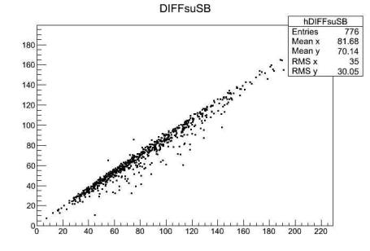
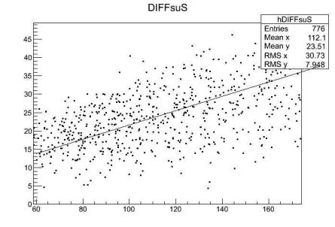
LEAKAGE fluctuations prevent cherenkov correction !
Even if we suppose to have perfect access to the scintillation signal produced by e.m. particles Sem and separately tp the scintillation signal produced by hadrons S_{had}…
100-300GeV protons
interacting first layer
100-300GeV protons
interacting first layer
S_{em}(GeV)
Shad(GeV)
Ee (GeV)
Eh(GeV)
Sem, Shad = Energia Ionizzazione Depositata effettivamente (em , had)
E=E_{e}+E_{h}=S_{em}+S_{had}*<1/η>
EE
Eh
S_{em} ~Ee
<1/η>=<1/η_{t}>*<1/η_{leak}>
<η_{t}>~ 0.85
<η_{leak}>~ 0.25
S_{had}
Nuclei Excitation,
neutrons
Pions leakage
RMS ~ 40% !
ΔE/E ~ 20%
π+/-

Slide 18
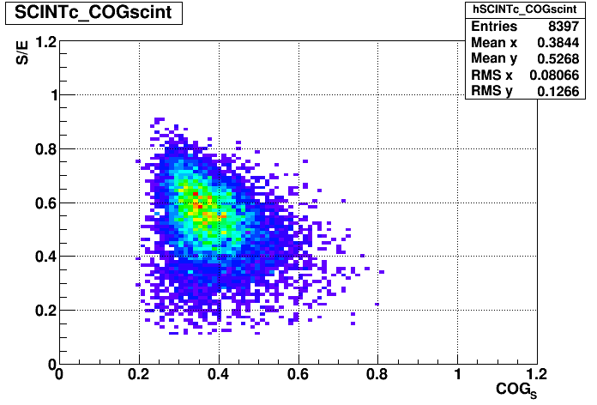
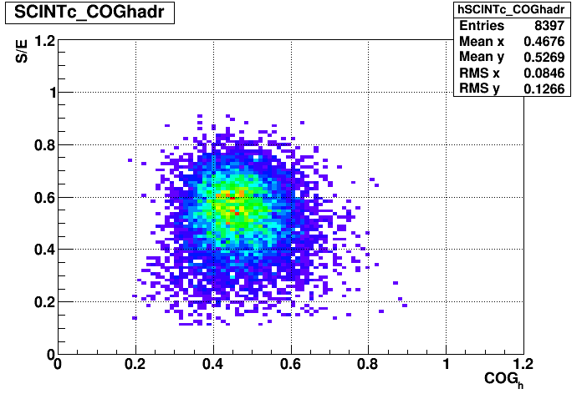
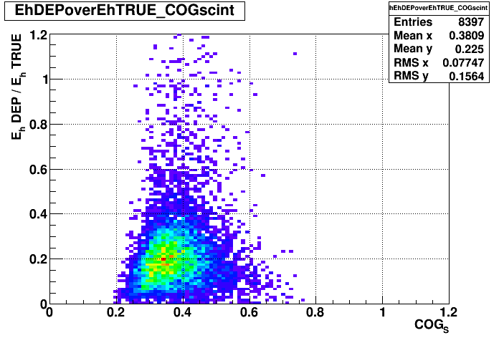
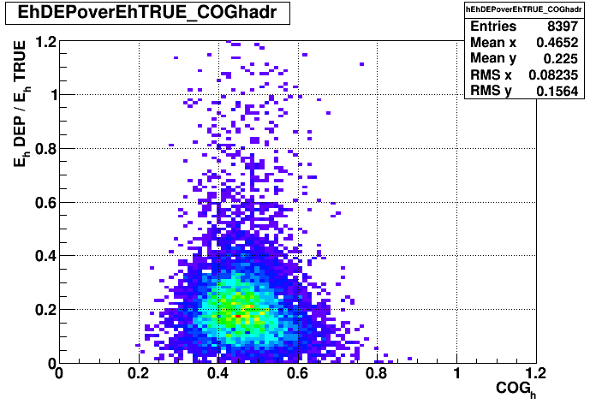
CAN the spatial distribution of signals help?
E_{h} = energy of hadrons
Shad = energy of hadrons deposited by ionization in the calorimeter
    ‘SHAPE’ VARIABLES
COG_{S} and COG_{h}: center of gravity of scintillation (S) and hadronic (S-C) signals
along the longitudinal development (expressed in fraction of total length)
Shad/Eh
Shad/Eh

Slide 19
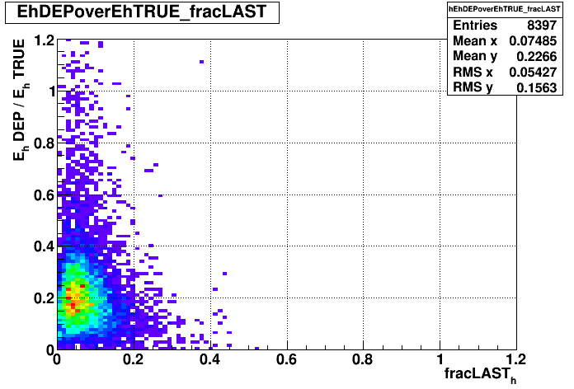
CAN the spatial distribution of signals help?
fracLAST_{h}: fraction of hadronic energy (S-C) released in the last two layers
Shad/Eh
hoped distribution

Slide 20
conclusion
Simulations indicate that the possibilities to improve energy resolution
using Cherenkov light are only marginal !
10-15% improvement
Chenrenkov light is also very important for cross-calibration and
Cross linearity-check

