Slide 1
Aggiornamento sullo sviluppo di una nuova versione del chip CASIS per CALOCUBE
Valter Bonvicini, Giulio Orzan, Nicola Zampa, Gianluigi Zampa
INFN Trieste
CALOCUBE meeting
Firenze, 20 giugno 2014

Slide 2
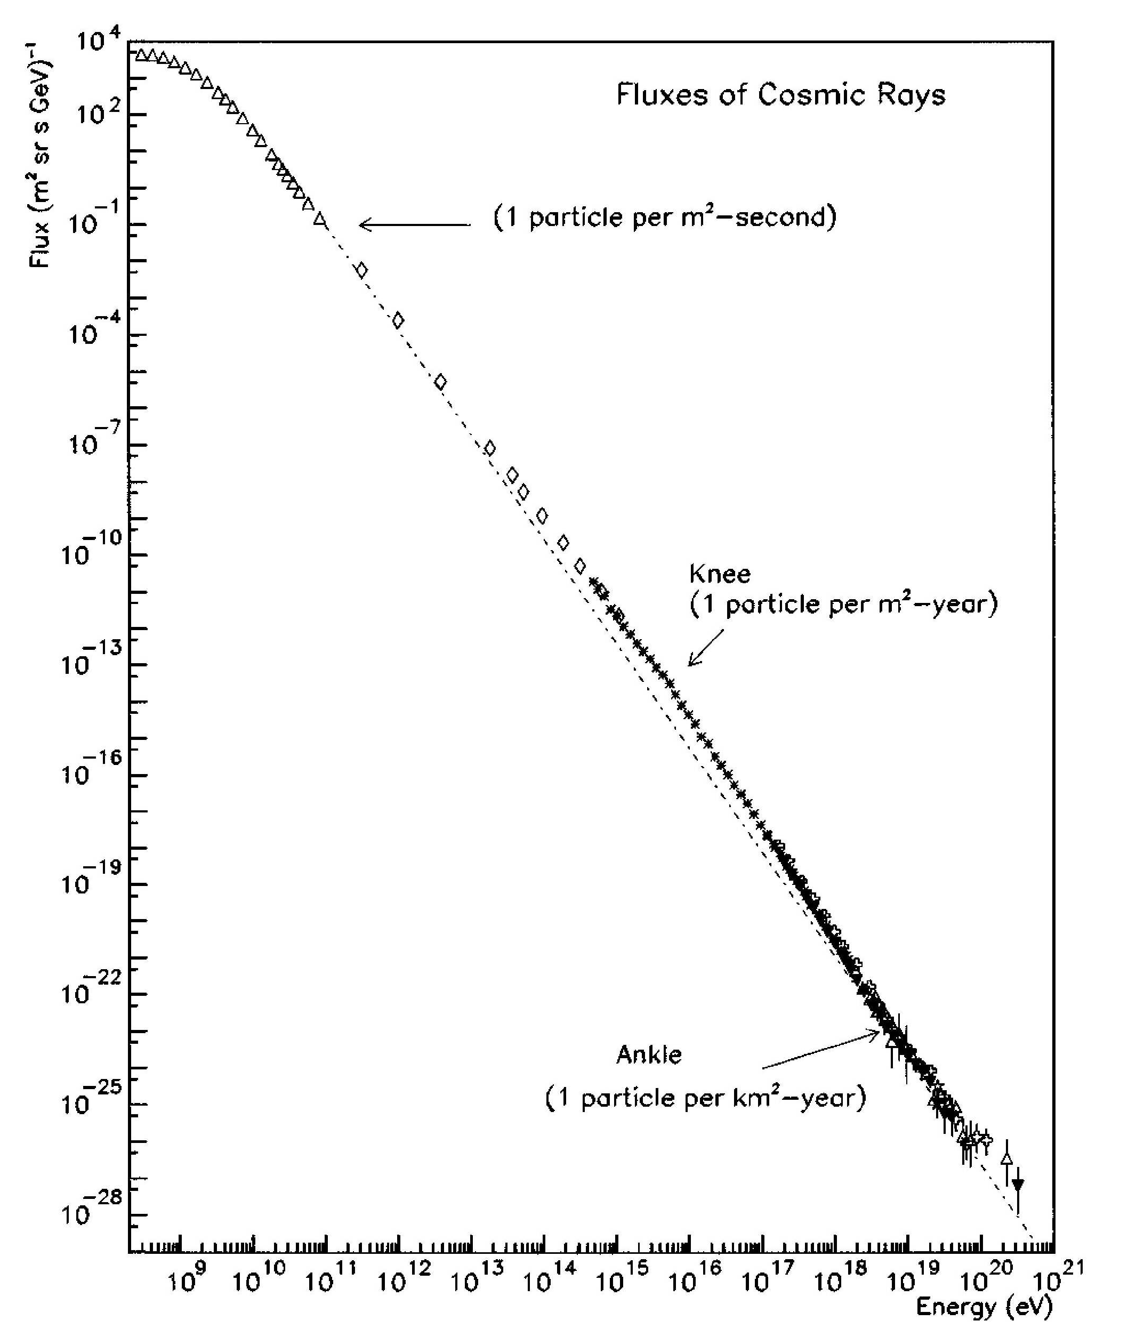
Front-end electronics
(a big challenge…)
Scientific interest: direct measurement of the cosmic-ray fluxes above the TeV region. Examples:
Direct observation of cosmic-ray electrons
up to 10 TeV
Measurement of cosmic-ray nuclei flux and
elemental composition up to the “knee”
(∼ 10¹⁴ – 10 ¹⁵ eV)
A major concern: dynamic range!!!
(with sensitivity down to fractions of a MIP)

Slide 3
Front-end electronics
R&D carried on in Trieste through the CSN 5 experiments CASIS and CASIS2
Several prototypes designed, realized and tested
CASIS1.2A ASIC (used for the prototypes of calorimeters realized in Florence):
  Double-gain (double-range) CSA
  Double-correlated sampling, MUX and output buffer
  Input calibration circuit (with arbitrary channel pattern)
  16 channels
  Noise: 2700 e⁻ + 8e⁻/pF
  Power consumption: 2.8 mW/channel
  Dynamic range (low gain): 53 pC

Slide 4
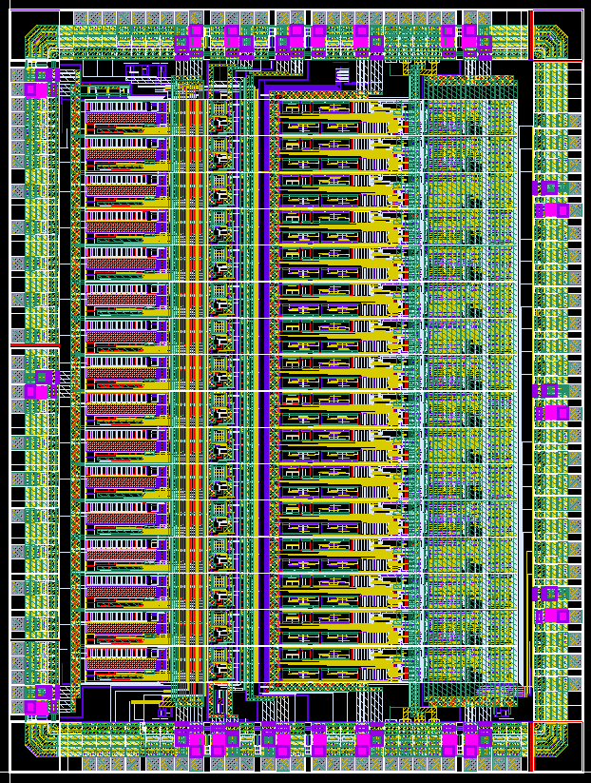
Next step: CASIS1.2B
16 FE channels with A/D conversion
function integrated in the ASIC;
1 12-bit cyclic ADC /channel with
capacitor averaging and digital
correction;
Design submitted in August 2013
(prototypes arrived at the end of 2013);
5300 µm
4000 µm

Slide 5
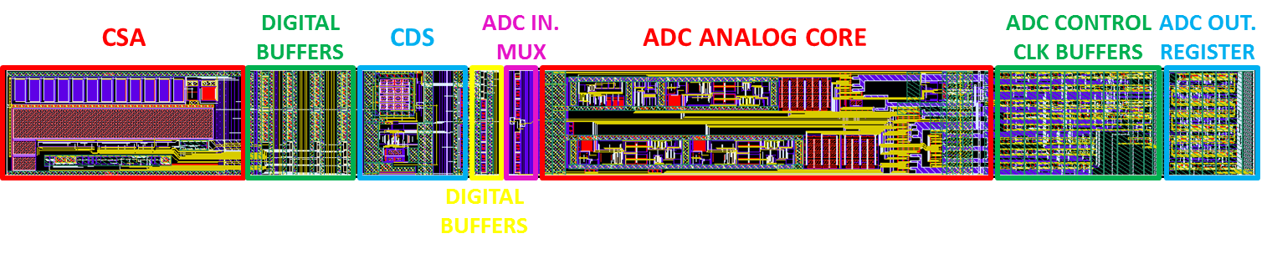
CASIS1.2B: layout of a complete channel
250 µm
2970 µm

Slide 6
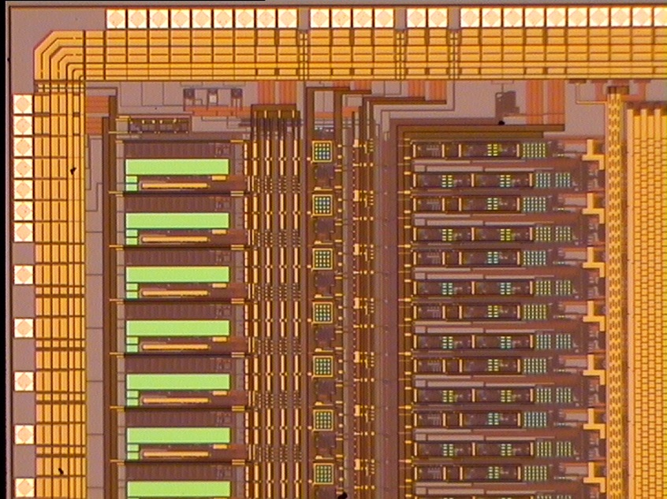
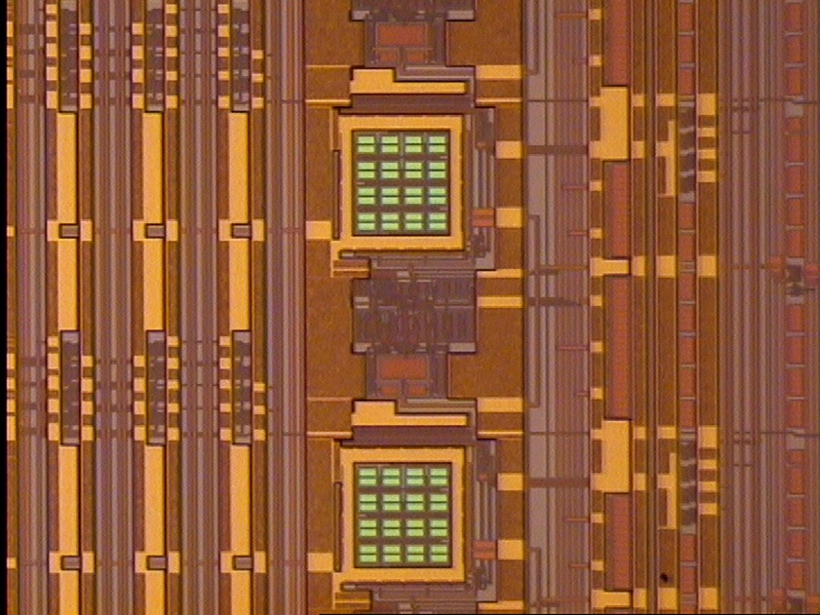
CASIS1.2B
Details of one chip (AMS 0.35 um CMOS C35B4 technology)

Slide 7
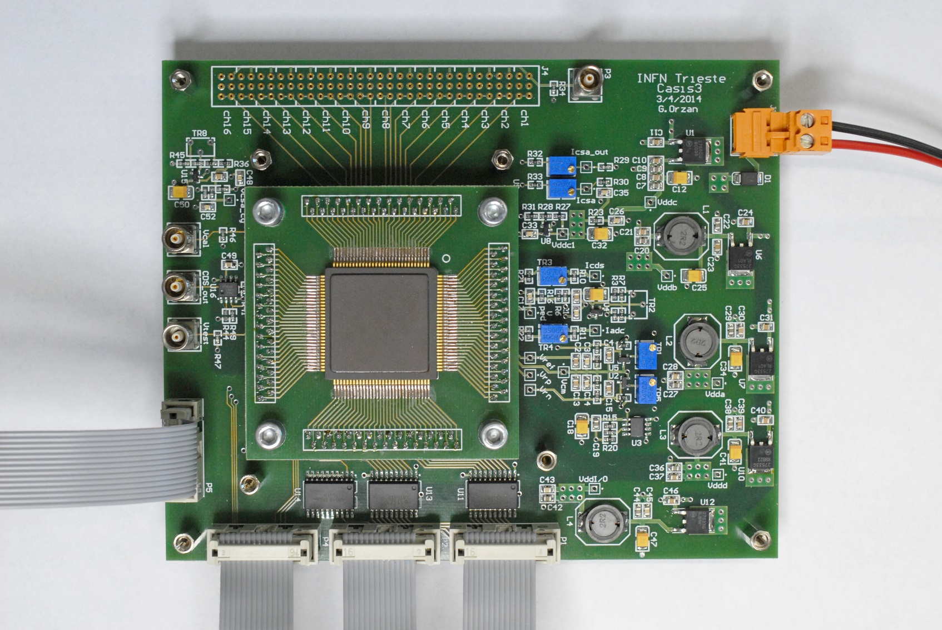
CASIS1.2B
Detail of the test boards designed and realized in Trieste for the characterization
of the new ASIC

Slide 8
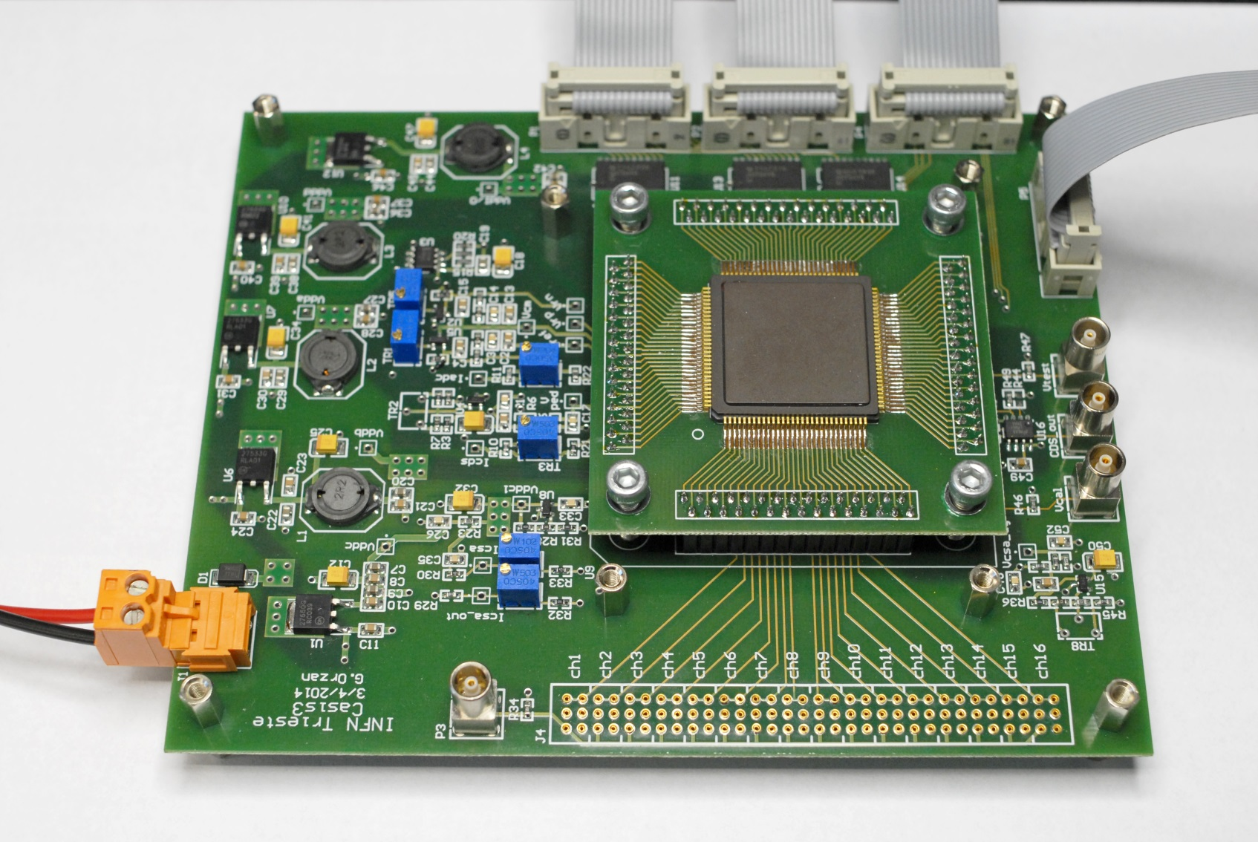
CASIS1.2B
CASIS1.2B chip in
CQFP120 package
“Daughter board”
“Mother board”

Slide 9
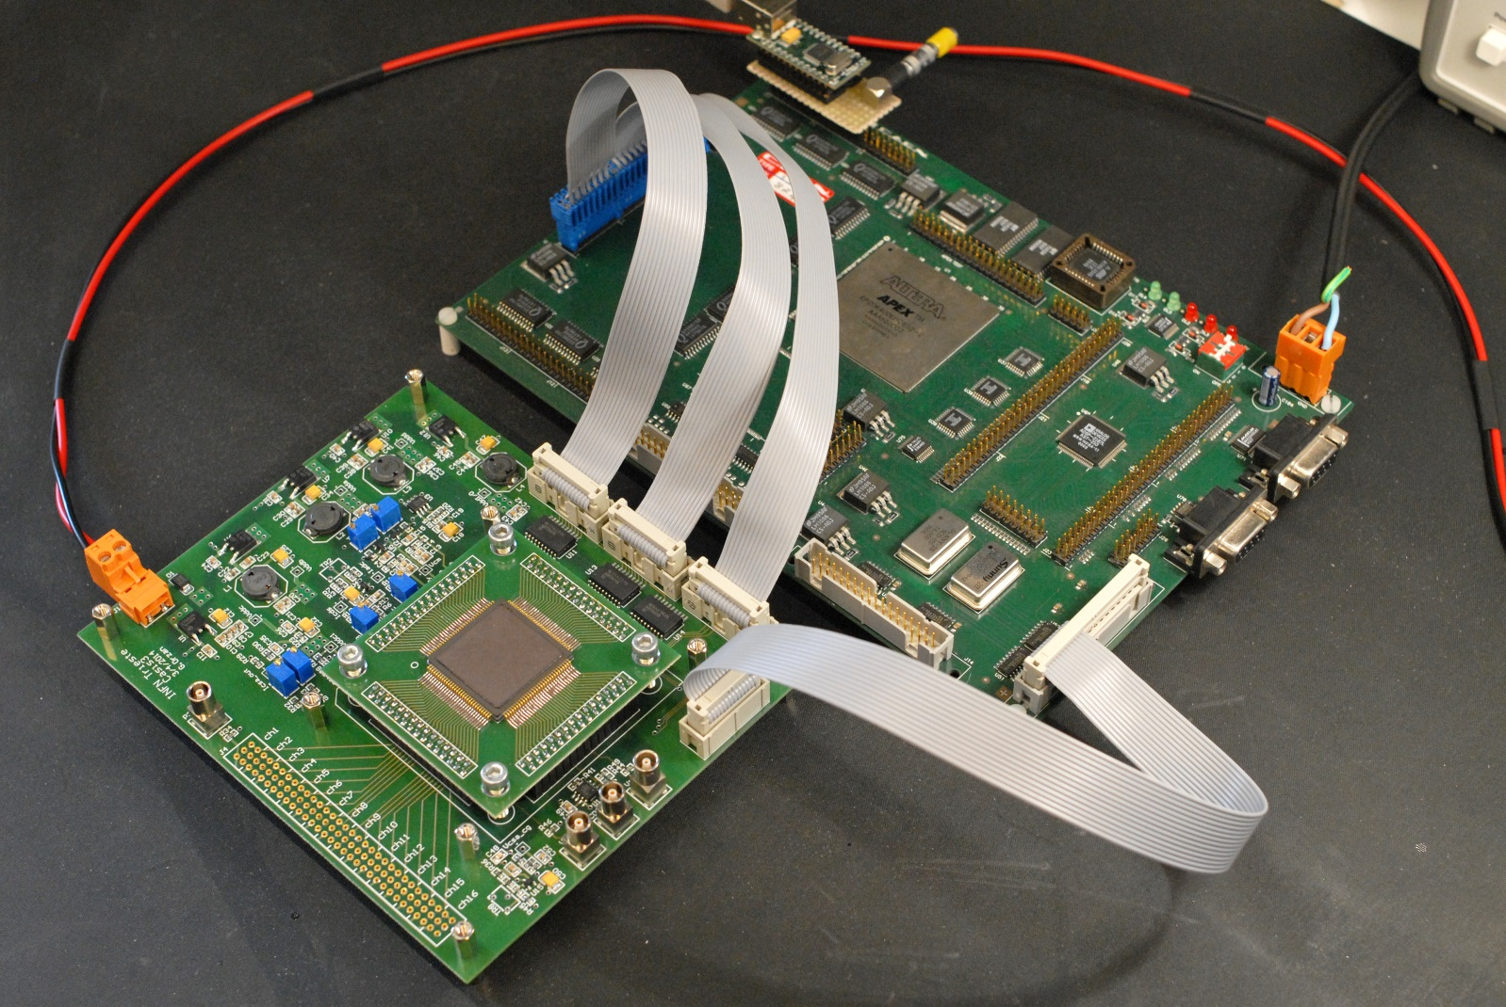
CASIS1.2B
Test set-up in Trieste

