Slide 1
INFN is in charge of the management of the WP3-Normal Conducting Linac
This part of the linac is made of Ion Source & LEBT (INFN-Laboratori Nazionali del Sud, Italy), RFQ (CEA-IRFU, France),
MEBT (ESS Bilbao, Spain) Drift Tube Linac (INFN-Laboratori Nazionali di Legnaro, Italy)
Other INFN groups are involved in ESS @Turin and @Milan (expertise about superconducting elliptical cavities for WP5)
→ useful know-how for ESS design and construction
→ expression of interest for ESS construction (in-kind)
INFN – Italy
contribution to the Pre-construction phase
of the European Spallation Source

Slide 2
Redesign and pre-construction phase
(1.2 M€ for 2013, 2.5 M€ for 2014)
PS-ESS proton source & LEBT
    Construction of the source started in 4th quarter 2013 (coils, power supplies, high voltage components have been ordered and will be delivered in 3rd quarter 2014)
    Mechanics of the PS-ESS source was revised after the increase of requirements from ESS-AB.
    Chopper tests have been carried out successfully (Dec. 2013 and spring 2014) at the testbench
    Some other components have been already built and tested (collimator).
Drift Tube Linac
  The DTL technical design is proceeding to engineering design and prototyping.
  The redesign has driven the choice of a higher injection energy (3.6 MeV instead of 3.0) and a higher final energy (above 90 MeV)
  The DTL team has begun prototype programs to develop drift tube along with permanent quadrupole, beam position monitor (BPMs) and steering corrector, to be located inside drift tubes.
  Production sequence is well established
Superconducting cavities
  The Milan-LASA team expertise is now available for the ESS and a series of meeting with CEA partners has been scheduled to maximize the common efforts, in view of the future In-Kind contribution to the Construction phase.

Slide 3
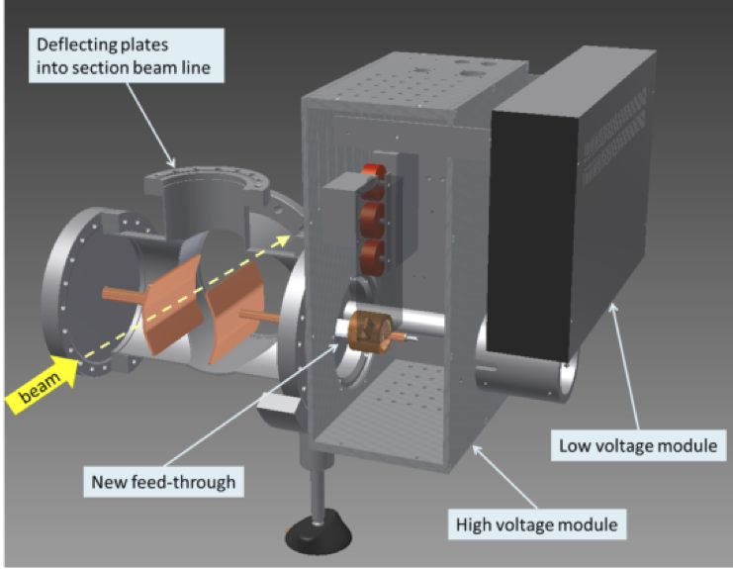
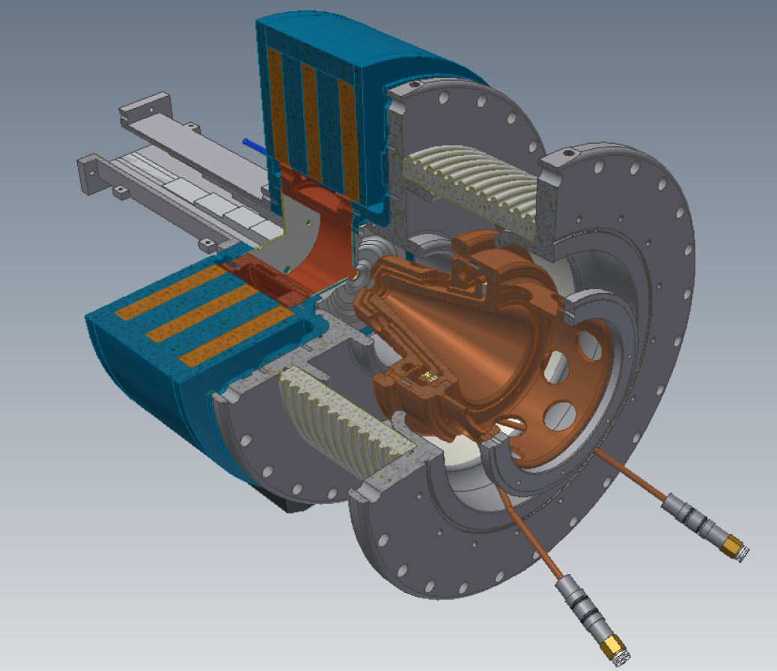
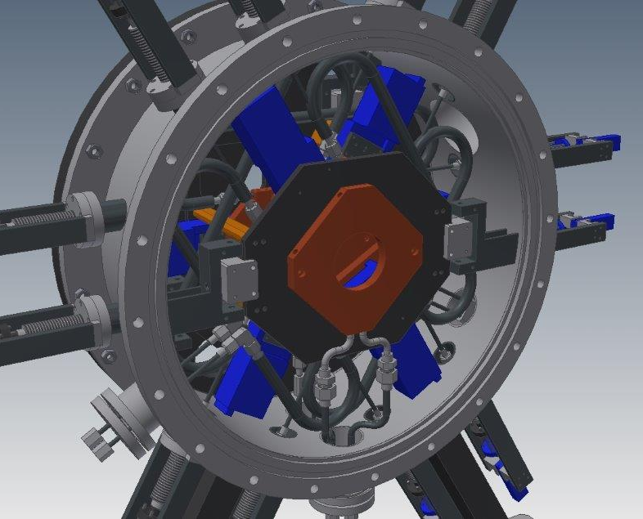
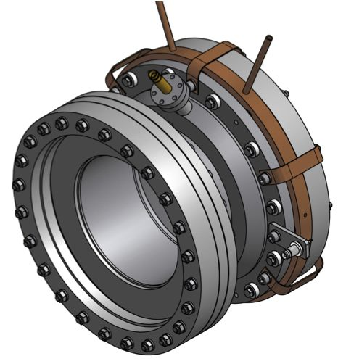
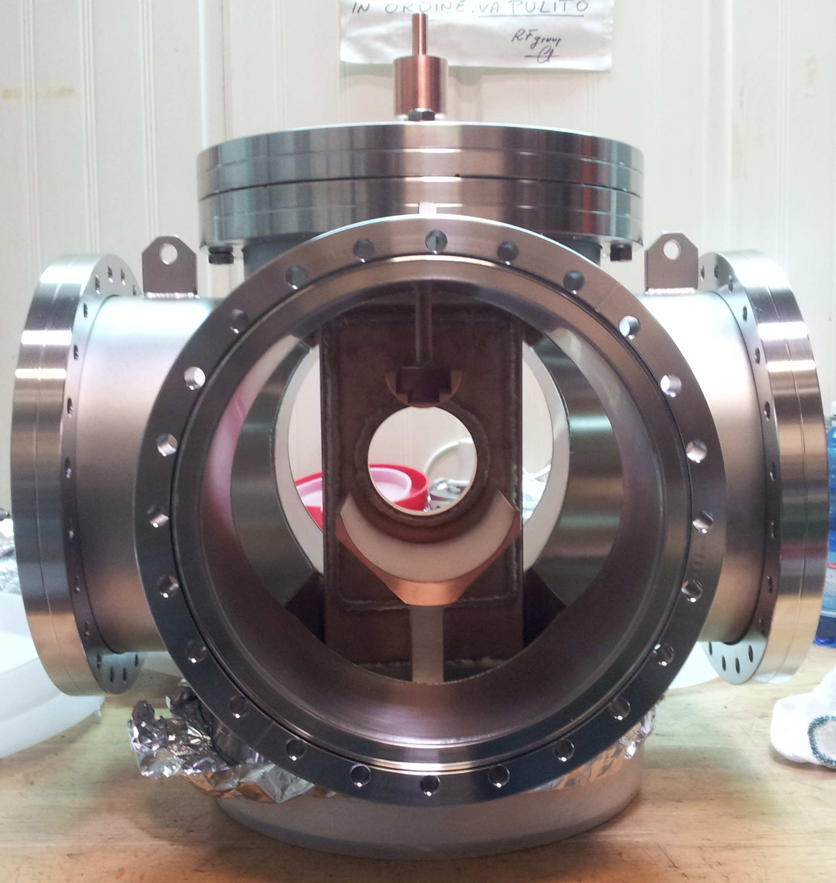
PS-ESS Source
Chopper
Iris
Collimator

Slide 4
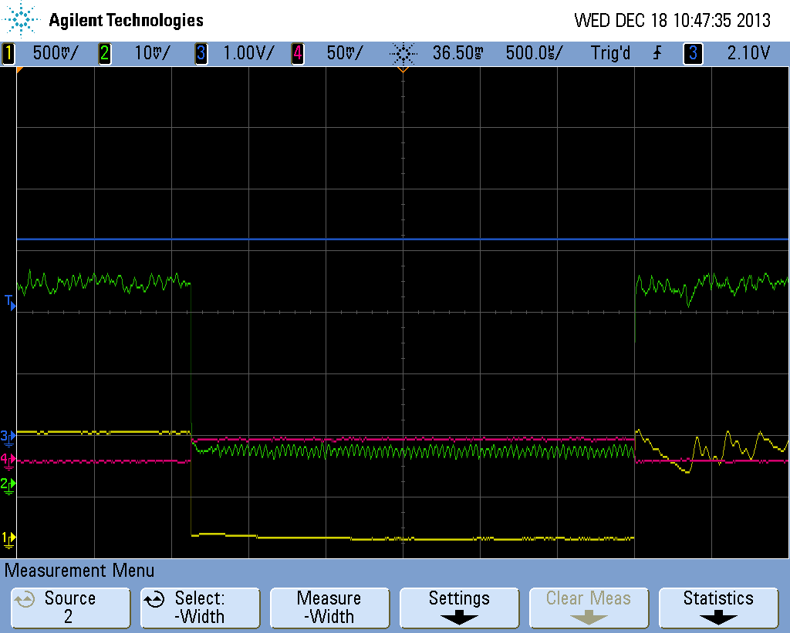
Achievement: Clean beam pulse, width of 2.87 ms
→ chopper OK!
CH4: beam stop after the LEBT collimator
CH2: beam at LEBT collimator
CH1: chopper HV probe
CHOPPER FULLY OPERATIONAL
Space charge effect minimization promising
Beam ripple still not acceptable: solution available

Slide 5
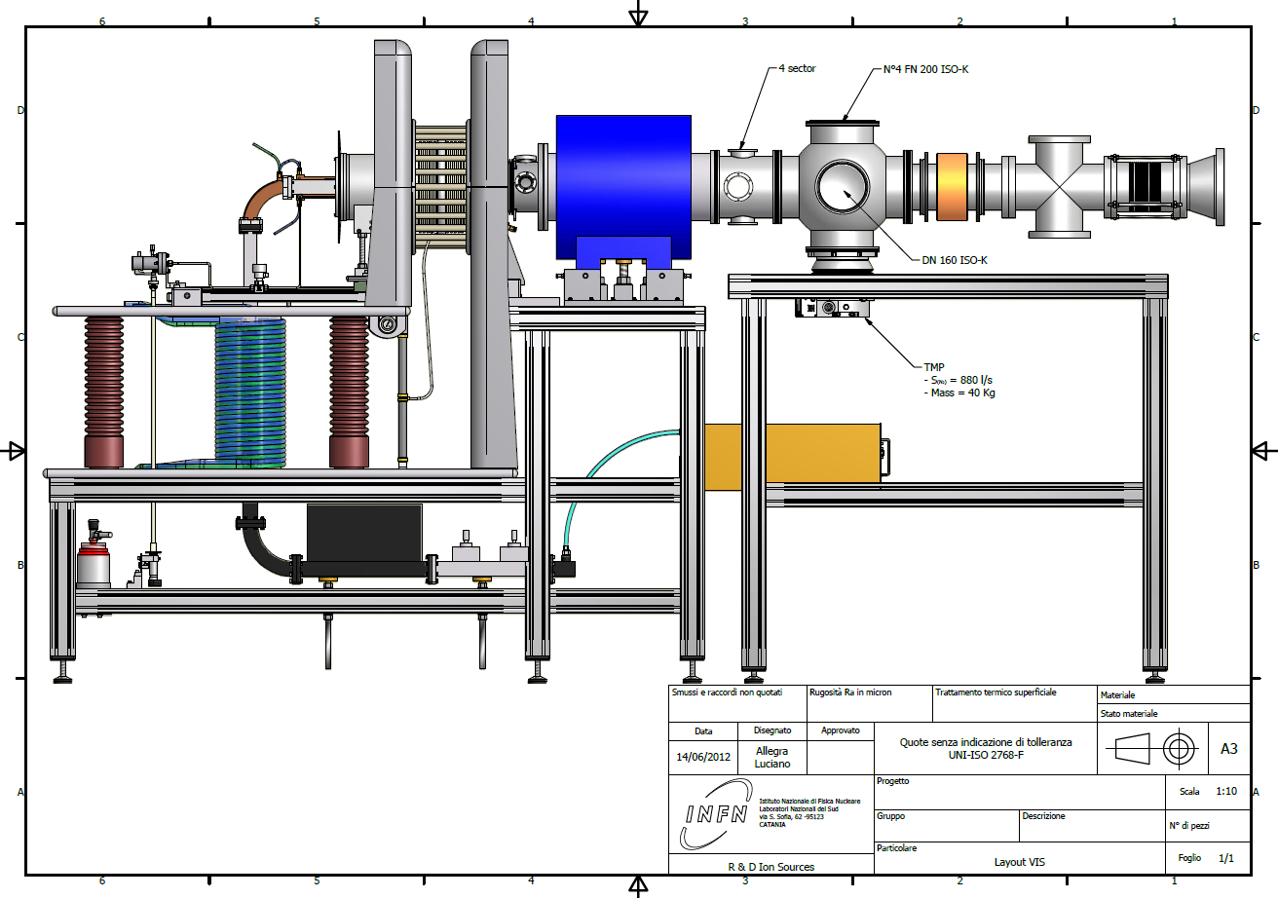
PS-ESS Optimized layout

Slide 6
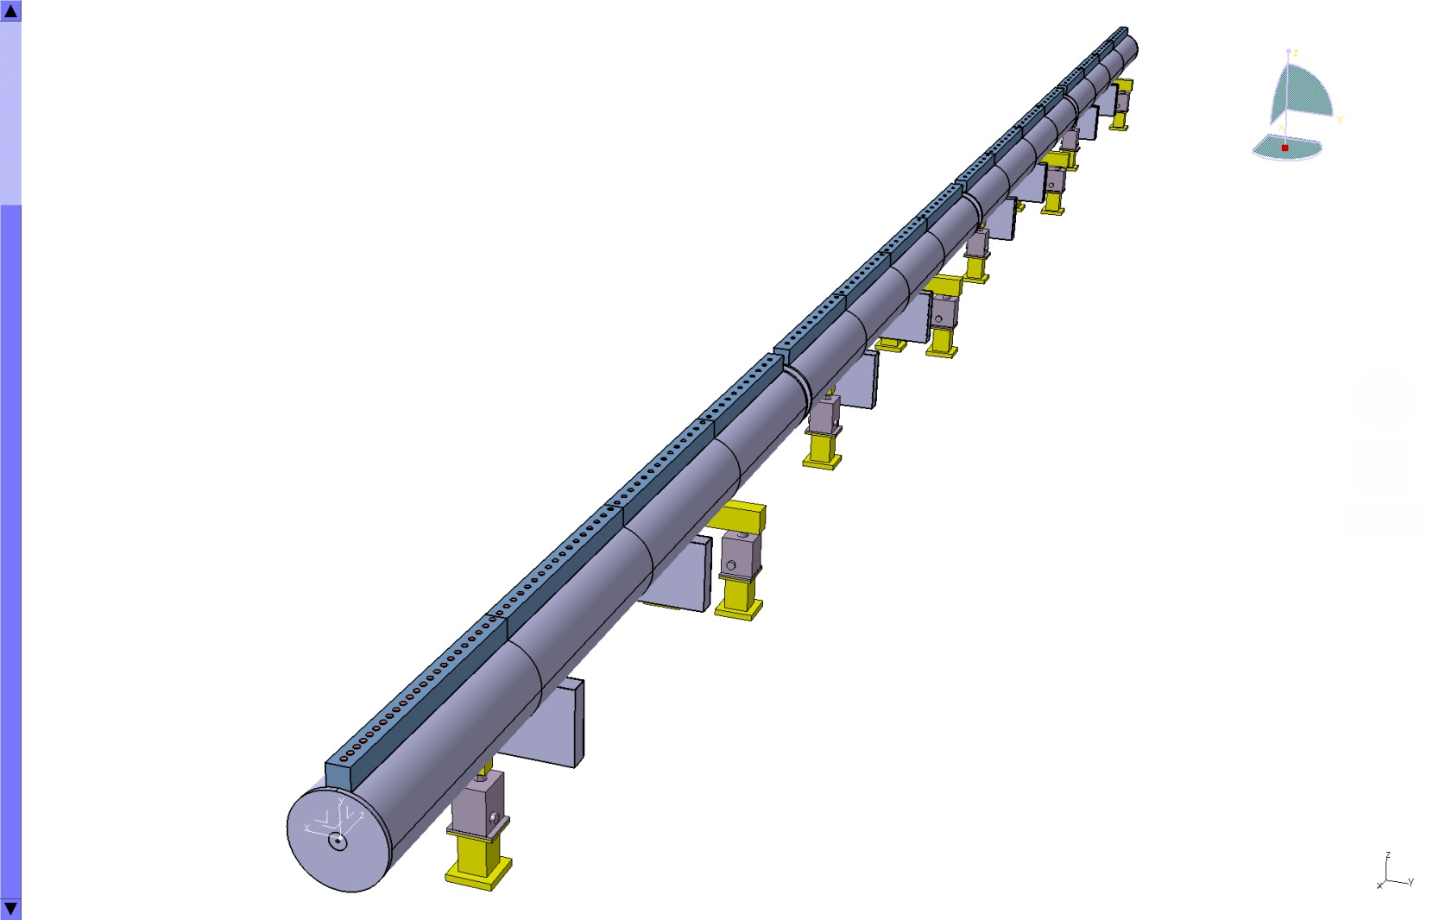
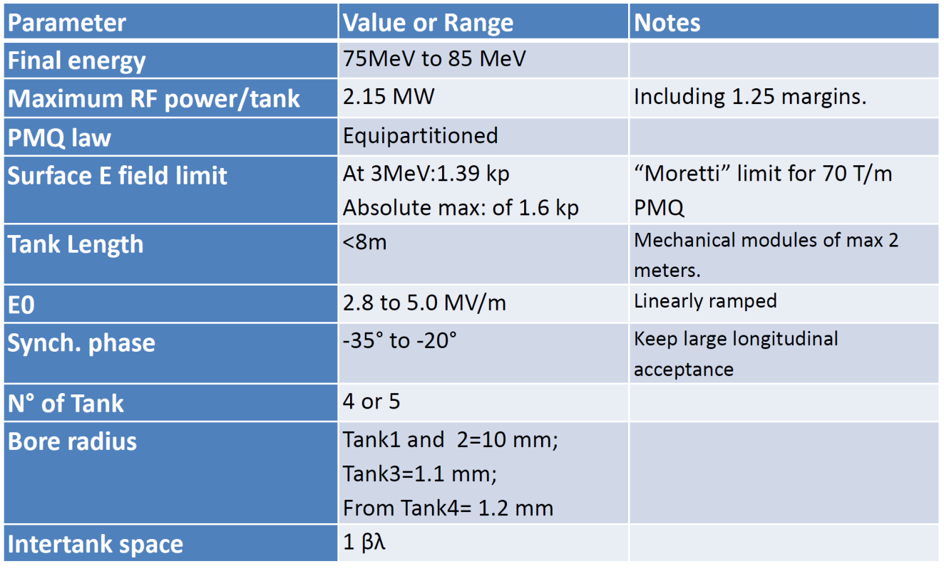
Drift tube Linac (DTL) parametri di progetto
With 5 tanks, about 2.1 MW per each, the maximum energy may reach 93 MeV

Slide 7
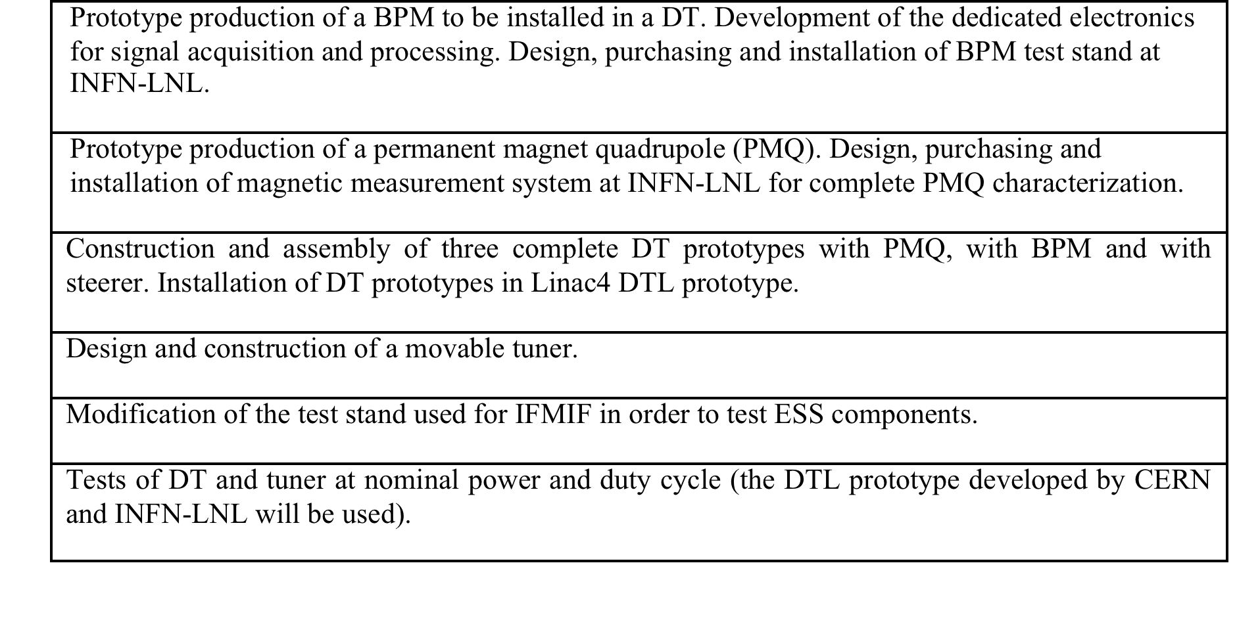
Further development before the DTL construction
Superconducting Cavities @ INFN-Milano
Analysis and possible revision of the conceptual design of the multicell structure;
Realization of a complete fabrication drawing package, including an analysis of a fabrication cycle aimed for the production of a small cavity series (ranging from several tens of units up to the whole, approx. 100 cavities, of the high beta section)
Start of the procurement contract for two five-cell structures

Slide 8
In Kind Contribution italiano sarà definito nei prossimi 2-3 mesi.
Il contributo totale dovrebbe essere intorno ai 100 M€
I LNS faranno due copie della sorgente PS-ESS e della LEBT (oltre al milione di € circa, già disponibili, dovrebbero arrivare circa 3,5 M€ nei prossimi anni per questa Work Unit). Altri possibili impegni potranno essere avviati nel corso dell’anno.
Audizione in CSN5 entro fine anno ?

