Slide 1
why a summersible medium voltage converter
scientific purpose
industrial purpose
deep sea environment is one of the more challenging and wide field of research in the near future.
Everywhere around the world (Europe, North America, China, Japan, etc..) the Administrations are financing the construction of large cabled deep sea infrastructures aiming to permanently monitor the sea environment .
These infrastructures need to be power supplied and the distance from the shore requires that the power is transferred by high voltage system
Renewable energies sea field (tidal and wind based) are quickly growing up and the energy need to be transferred to the shore with a good efficiency level.
The other side of the medal are the oil and gas field that are moving deeper and farer from the shore, requiring remote power supply.

Slide 2

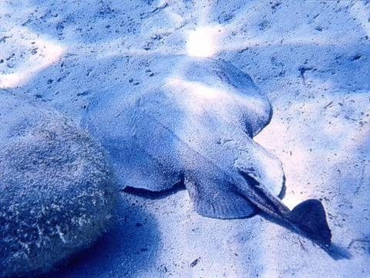
TORPEDINE
new generation
of
subsea medium voltage converter
M.S. Musumeci

Slide 3
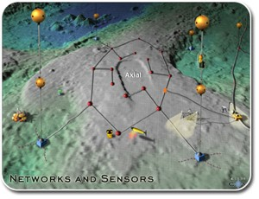
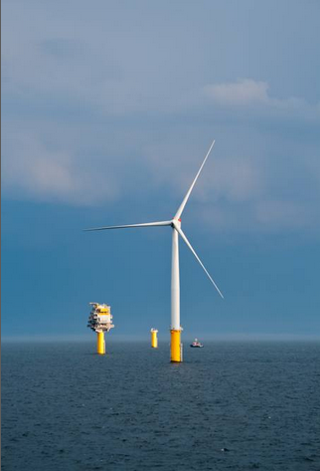
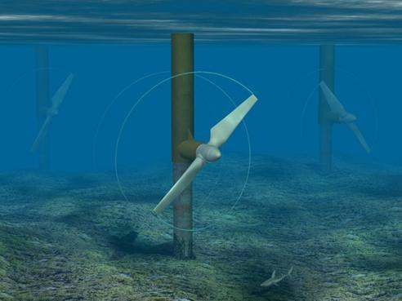
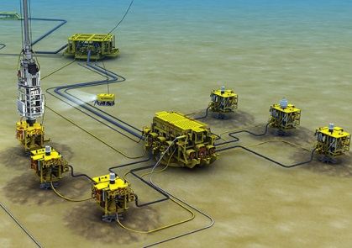
Scope of the project
To develop a new generation of medium voltage converter for subsea application (shallow water to deep water).
Scientific Application
Industrial Application
Renewable
Oil&Gas

Slide 4




why a summersible medium voltage converter
Scientific purpose
Deep sea environment is one of the more challenging and wide field of research in the near future.
Everywhere around the world (Europe, North America, China, Japan, etc..) the Administrations are financing the construction of large cabled deep sea infrastructures aiming to permanently monitor the sea environment .
These infrastructures need to be power supplied and the distance from the shore requires that the power is transferred by high voltage system
……………

Slide 5
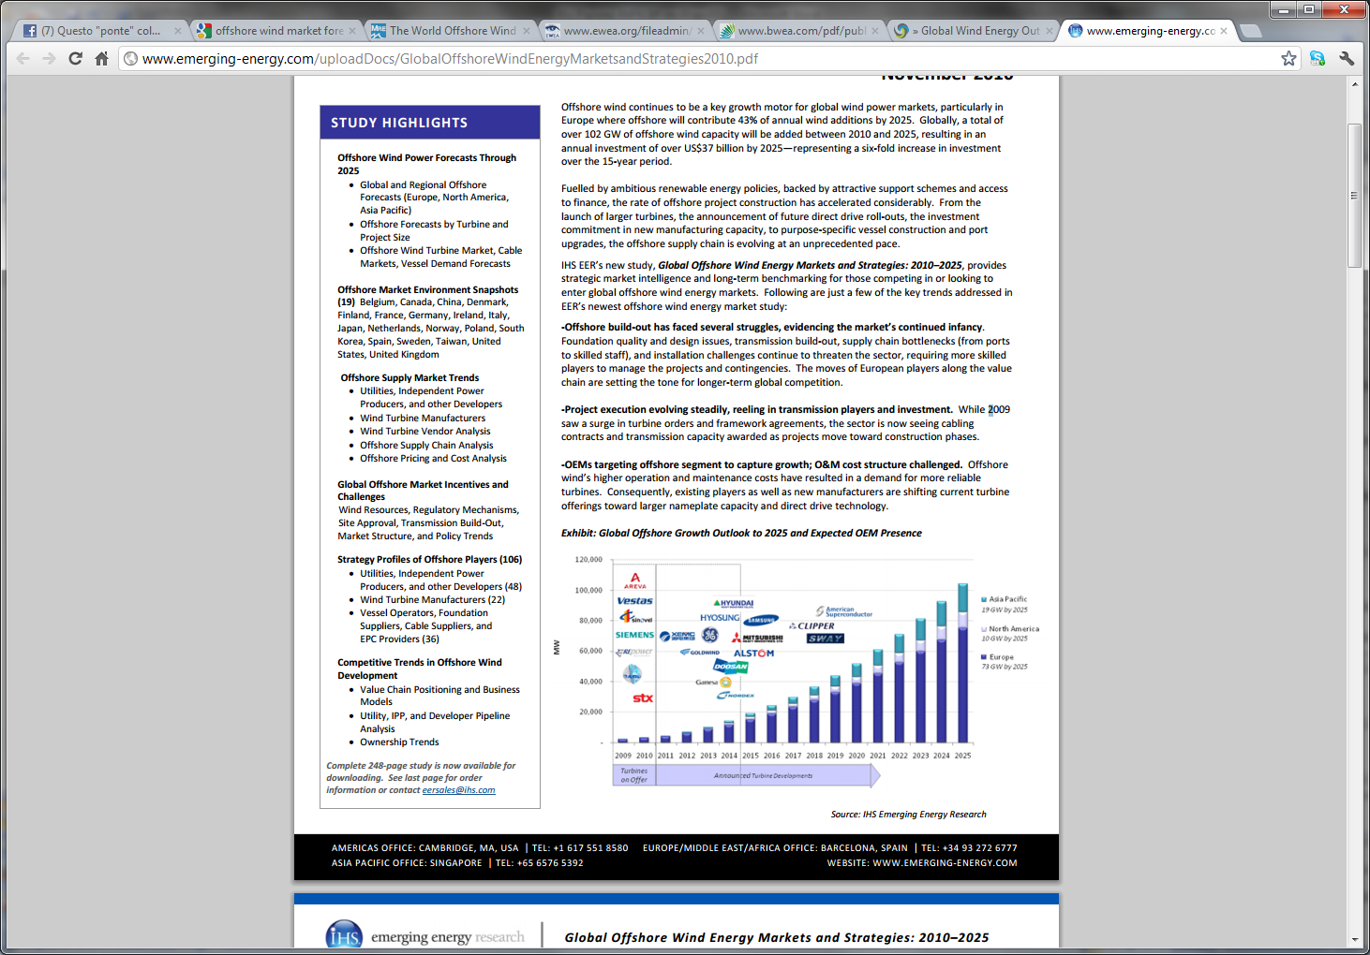
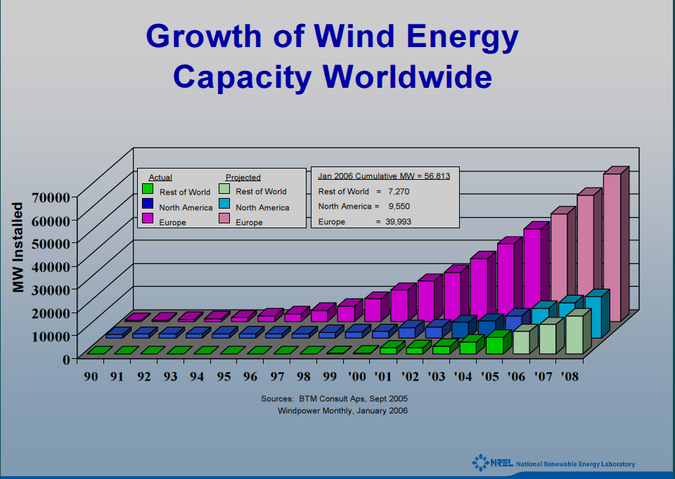
why a summersible medium voltage converter
industrial purpose
Renewable energies sea field (tidal and wind based) are quickly growing up and the energy need to be transferred to the shore with a good efficiency level.
The other side of the medal are the oil and gas field that are moving deeper and farer from the shore, requiring remote power supply.
Forecast analysis of Eolic Offshore
Dott. Robinson - National Renewable Energy Lab (USA)

Slide 6
Proposed Energy Conversion Systems
Basically, the research activity is focused on the analysis and design of different energy conversion systems able to operate under a high voltage ratio, by exploiting rotating and stationary machineries, suitable interfaced to high reliable power converters.
Based on Rotating Transformer
Based on Stationary Transformer

Slide 7
Proposed Energy Conversion Systems
“Rotating Transformer”
High voltage ratio is achieved by means of the mechanical coupling between two electrical machines connected to the input (HVDC) and output (LVDC) voltage levels, running at the same rotational speed.

Slide 8
Proposed Energy Conversion Systems
“Rotating Transformer”
Medium Voltage Inverter: Because of the high voltage level at the input of the DC bus, different converter topologies will be analyzed to mitigate the stresses on the stator windings of the motors and power devices.

Slide 9
Proposed Energy Conversion Systems
“Rotating Transformer”
c
Two levels and multilevel topologies will be compared in terms of reliability, control complexity and total harmonic distortion in the voltages and currents.
The modulation technique will be selected on the base of the high frequency harmonic content of the inverter currents and voltages. It will be evaluated the possibility to include in the control algorithm a suitable dead time compensation algorithm.
Two Level
n levels

Slide 10
Proposed Energy Conversion Systems
“Rotating Transformer”
A suitably designed Induction Machine is supplied by a Voltage Source Inverter (VSI).
Model Based Sensorless Field Oriented Control will be studied and implemented
Estimate the rotor position and speed of the rotational part of the electrical motor avoiding to use an additional sensor.
Keep high dynamic behavior of the drive.
Avoid the use of rotor position sensors and thus increasing the reliability of the drive.

Slide 11
Proposed Energy Conversion Systems
“Rotating Transformer”
The motor is controlled by applying two nested control loops:
An inner current control loop operating in order to mantain a decoupled torque and flux control of th machine.
An external speed control loop necessary to keep constant the rotational speed at different load conditions.
Block diagram of a sensorless vector control strategy

Slide 12
Proposed Energy Conversion Systems
“Rotating Transformer”
SG is designed to produce a three phase symmetrical voltage set to its stator terminals, whose amplitude and frequency are controlled by acting on the rotational speed of the machine and on the excitation field placed in the rotor of the SG.
The synchronous generator SG is mechanically coupled to the same shaft of the IM would rotate at the same speed of the induction motor.
The output voltages of the SG are connected to a three phase inverter and a low voltage passive filter, obtaining a controllable DC voltage.
By acting on the design of stator winding distribution and/or by designing a suitable filtering unit the output ripple superimposed to the DC low voltage can be limited to negligible values.

Slide 13
Proposed Energy Conversion Systems
“Stationary Transformer”
Differently than “Rotating Transformer”, this solution uses a single phase or three phase transformer to perform the energy conversion.
The AC drive is used to generate the three sinusoidal voltages applied to the transformer primary windings. Even in this case suitable control algorithms will be analyzed in order to guarantee a high accuracy in the voltage regulation. The frequency of these quantity coincides with the rated frequency of the transformer.

Slide 14
Proposed Energy Conversion Systems
“Stationary Transformer”
A single phase and three phase version of this configuration will be studied and tested, including the possibility to use an high efficiency three phase medium voltage transformer, as well as a three phase transformer where the two sets of secondary windings are star (wye) and delta connected, respectively.
The use of two secondary windings in the transformer will be analyzed because it could improve the quality of the DC voltage supply and increases the reliability of the system to fault occurring to the this rectifier. Moreover, the reduction of the voltage ripple leads to a reduction of the capacitor bank.

Slide 15
Proposed Energy Conversion Systems
“Rotating Transformer”
“Stationary Transformer”
Possibility to exploit more freedom degrees in the control system. The output voltage (375V) can be modified by acting on the excitation field of the synchronous generator or by modifying the rotational speed.
It does not include movement parts and potentially could provide higher efficiency.
High Reliability.
Higher control complexity.
It could show higher THD.

Slide 16
Required HW
testing/measurement equipments
HW to be designed/tested
10kV 3A power supply
dummy load
dSpace control board
Oscilloscope
Differential oscilloscope probes, 20kV rated
Current sensor (Hall effect)
Insulation transformer
Multimeters
Multimeter probes 10kV rated
MV induction motor (and/or transformer)
LV synchronous generator
MVAC drive
  suitable for induction motor;
  suitable for transformer;
LV DC drive

Slide 17
Required HW
testing/measurement equipments
HW to be designed/tested
10kV 3A power supply
available from km3net
dummy load
    available from km3net
dSpace control board
    TBA 4k€
Oscilloscope
    available
Differential oscilloscope probes, 20kV rated
    TBA 2k€
Current sensor (Hall effect)
    TBA 1k€
Insulation transformer
    TBA 0,5k€
Multimeters
    available
Multimeter probes 10kV rated
    TBA 1k€
MV induction motor (and/or transformer)
TBA 5k€
LV synchronous generator
TBA 5k€
MVAC drive
  suitable for induction motor;
  TBR 30k€
  suitable for transformer;
        TBR 30k€
LV DC drive
  TBR 5k€

Slide 18
scheduling
1st year
  Theoretical study
  Numerical simulations
  Test bench setting up
2nd year
  Designing /implementation DC/AC drive
  Designing /implementation MV machines
  HW and control algorithms validation
3rd year
  Testing and validation of the implemented setup
  results analysis and conclusions

Slide 19
Involved people
INFN-LNS
UNICT-DIEES
Mario Salvatore MUSUMECI 50%
Riccardo PAPALEO 50%
Giacomo SCELBA 100%
INFN-RM1
Fabrizio AMELI 30%
INFN-LNS
Rosanna COCIMANO 0%
Angelo ORLANDO 0%
eventuali ulteriori interessati sono ovviamente i benvenuti

