Slide 1
SPD COOLING STATUS
RT

Slide 2
10 in a row (nearly) .
The ten filters have been drilled one per week, except last four
#9, #7 & #6 February & March 2012
#4 & #5 April 2012, #3 April 2013
#8 & #0 December 2013
#1 & #2 January 2014
We wanted to finish before the 6-weeks water maintenance…
Experience told us we could do 2 a week, with some care
Eventually it worked nearly perfect (already reported)

Slide 3
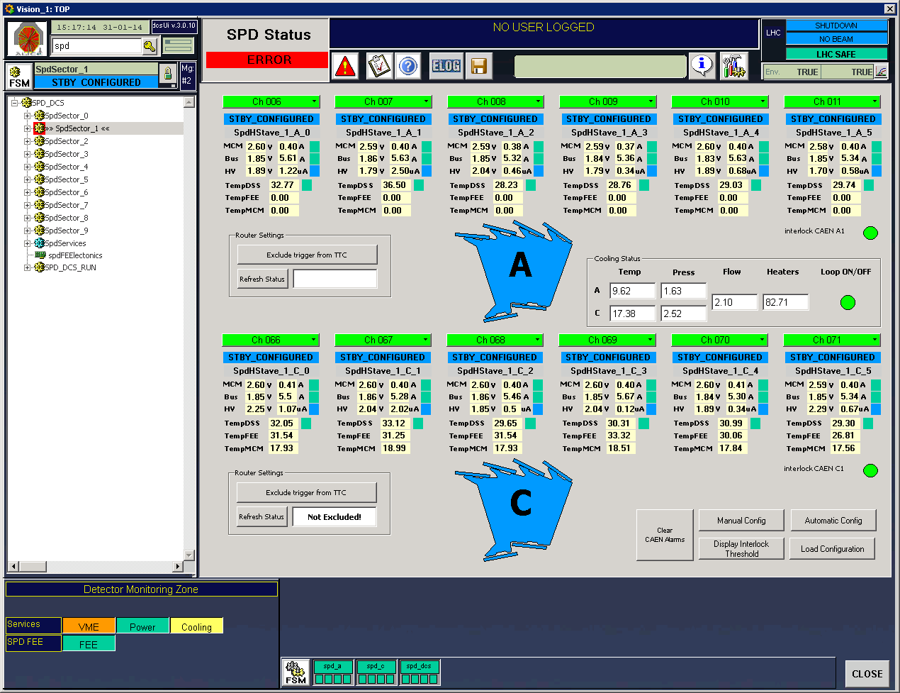
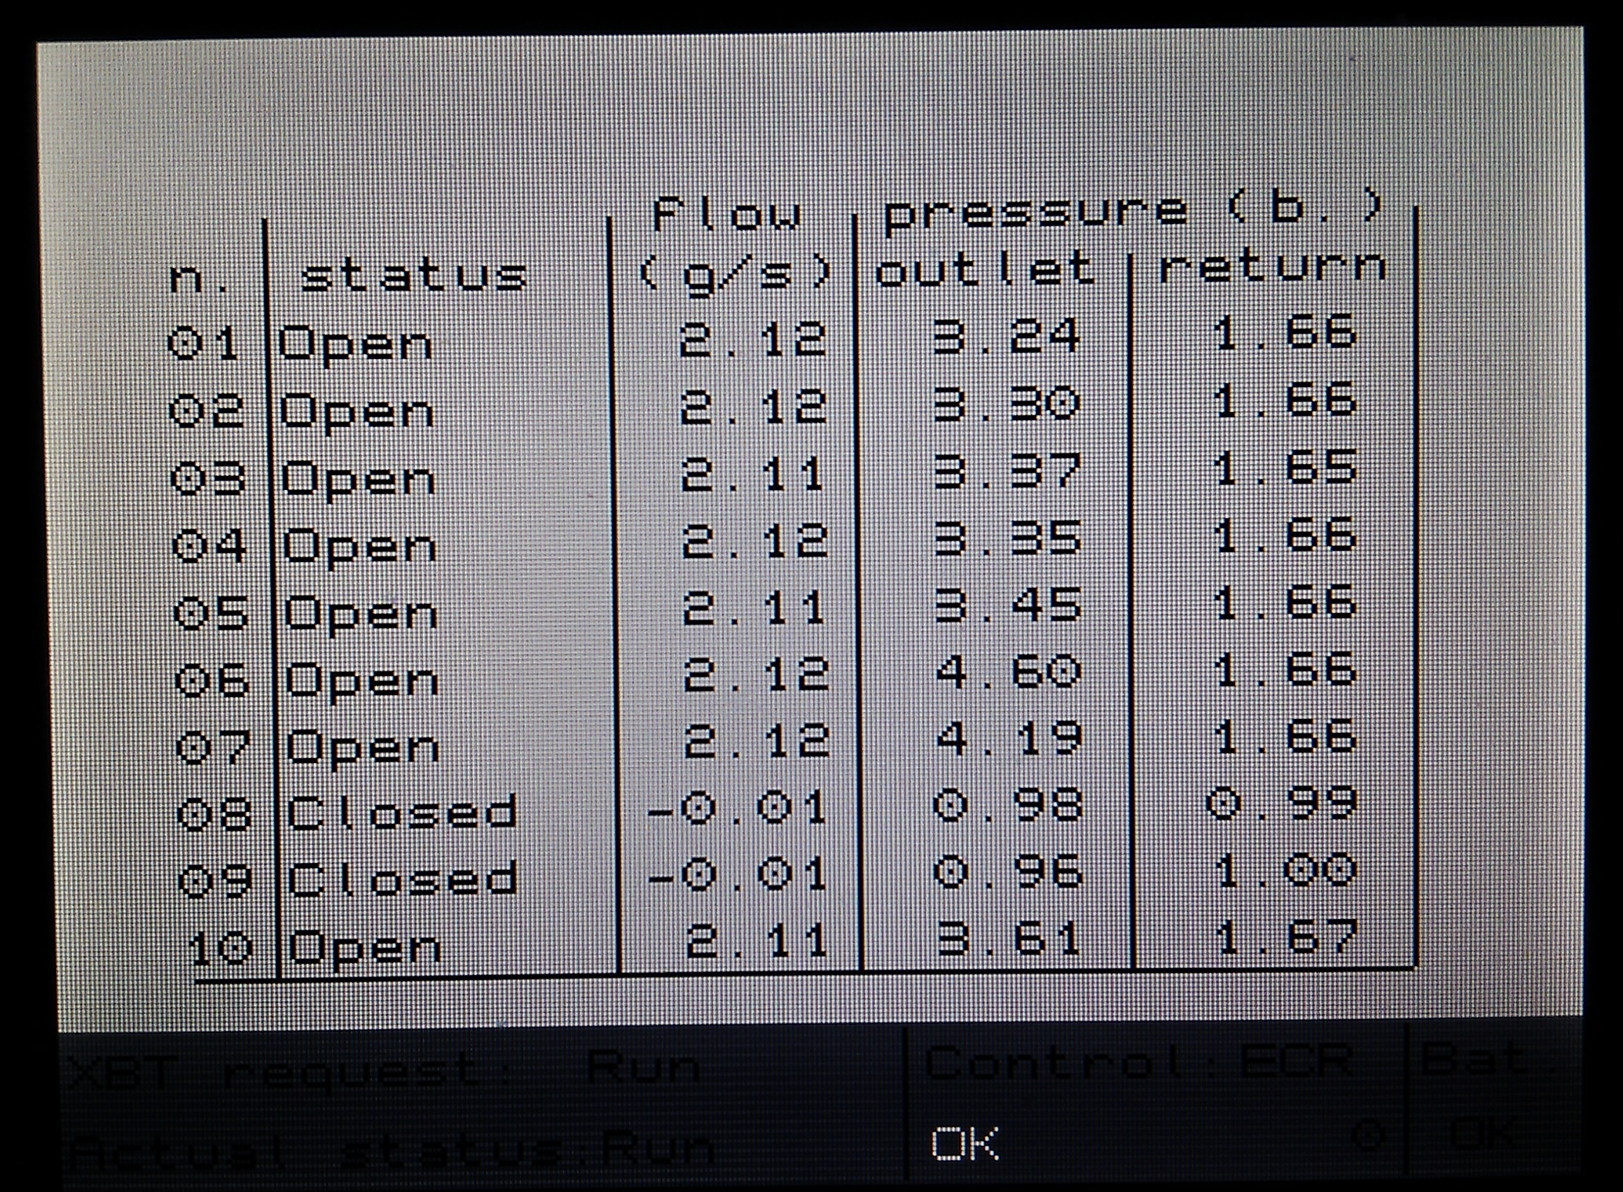
Rebirth of the cool…
121 W total

Slide 4
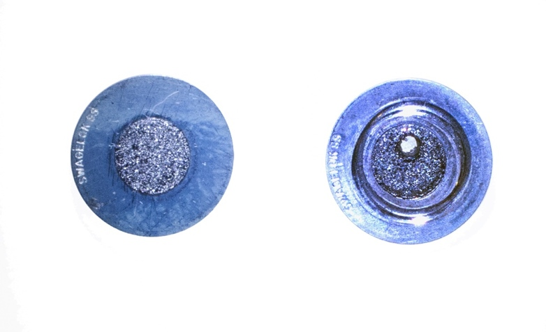
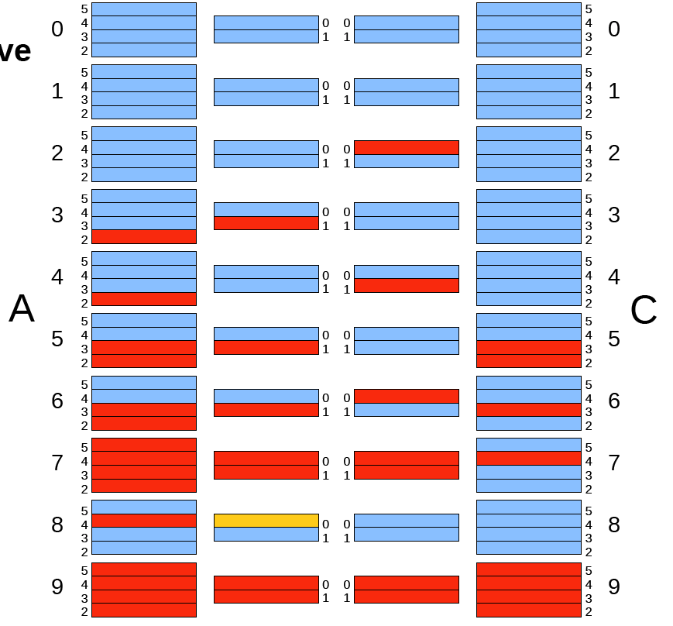
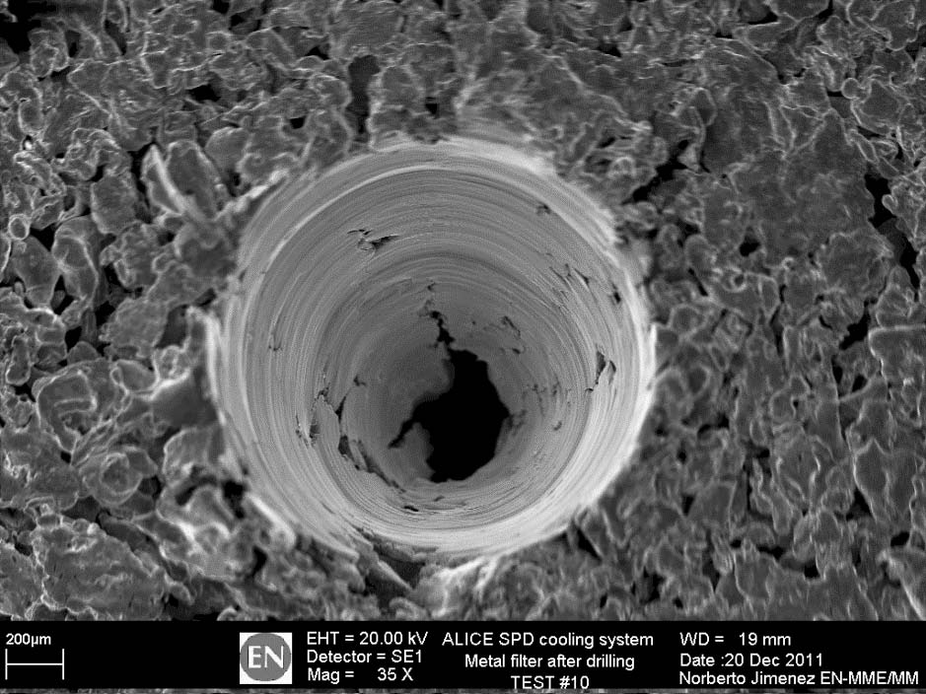
SPD cooling efficiency
Old SPD acceptance New SPD acceptance
3.5 mm
65/120 modules ‘’on’’ - 62.5%
snapshot from November 10, 2011
111/120 modules ‘’on’’ - 92.5% latest status 2013 before maintenance
Cooling efficiency 100%!!!
200 μm
cannot be recovered
could be recovered
hot

Slide 5
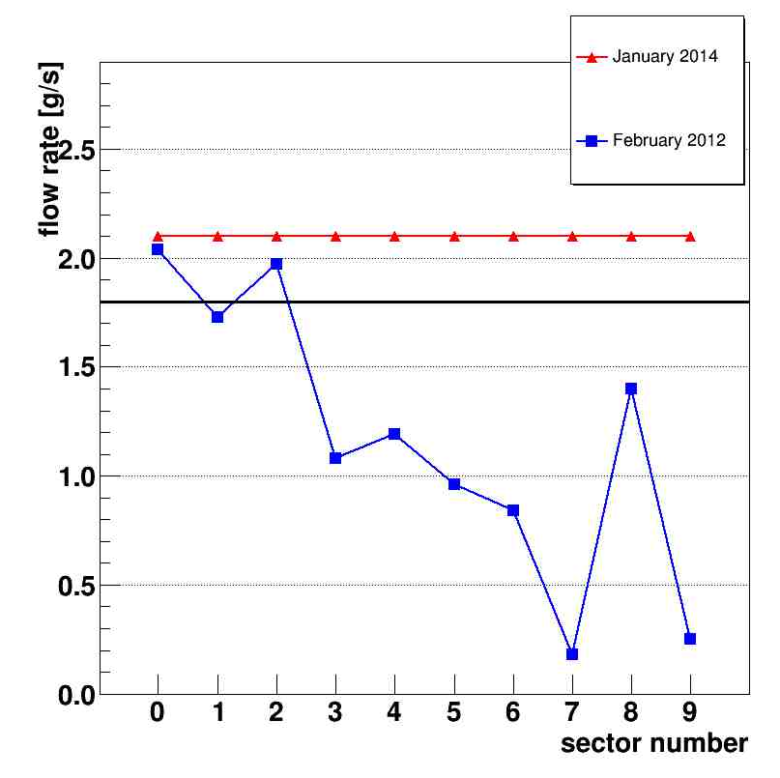
C₄F₁₀ flow
Comparison with February 2012, before the drilling started
New values of freon flow set at 2.1, i.e. nominal value + contingency
Still can push a factor 1.5 beyond nominal !!!
hs on
12
12
11
11
12
11
11
10
10
12
2.1 g/s
common setpoint
1.8 g/s
minimum value for
total heat drain
new flow rate values
old flow rate values
drilled filters

Slide 6
What’s next
Check of all sensor calibrations (pressure, temperature)
Long term pumps test (with SPD recommissioning)
Removal of close-detector subcooling
Rack consolidation
to happen this/next month
Then ready for SPD recommissioning

