Slide 1
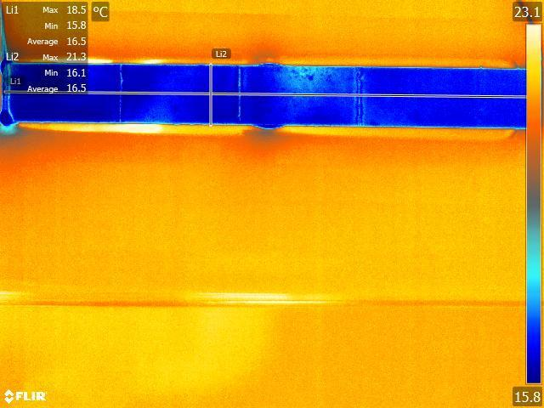
ALICE PD group meeting
06.06.14
Andrea Francescon

Slide 2
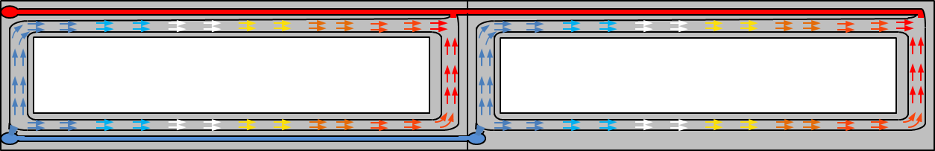
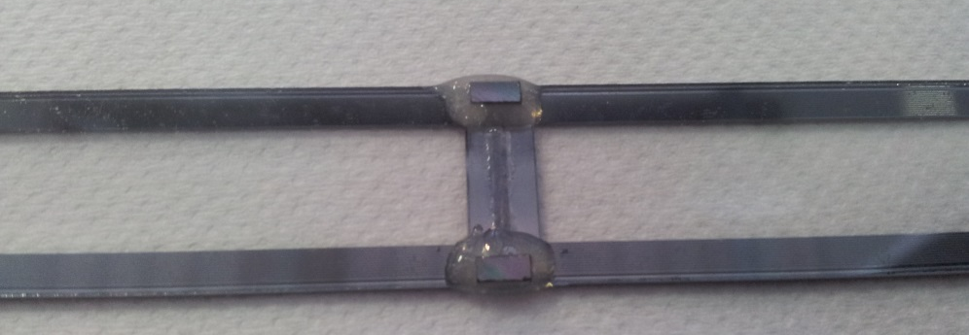
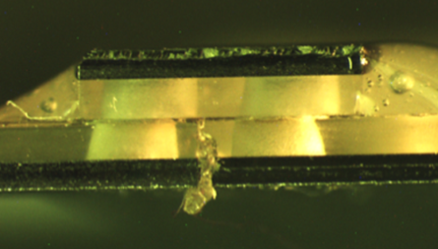
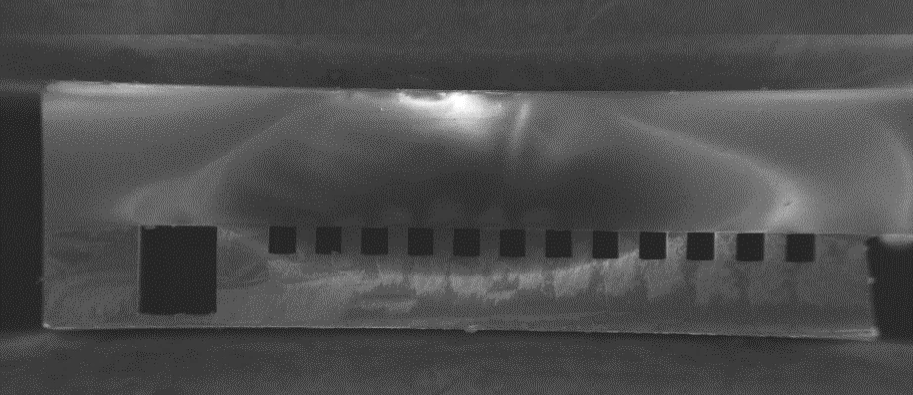
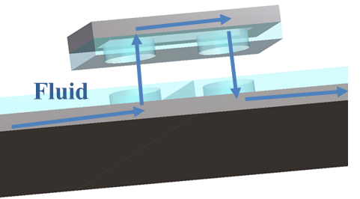
New prototype: fabrication
A new test section with two frames (representing half ITS IB stave) have been fabricated in the EPFL Centre of Micro and Nanotechnology (CMi) class 100 clean room. The aim of this prototype is:
Reduce the complexity of the system in order to perform a complete characterization;
Simulate the two frames – one interconnection prototype that TMEC is fabricating on 6” wafers.
Fluid outlet
Second frame
Outlet manifold
First frame
Inlet manifold
Fluid inlet
Microchannels
Distribution line
Bridge
Cross sectional view
Glass cover plate 525 μm
Silicon wafer 380 μm
Bonding interface
Distribution line
Microchannels

Slide 3
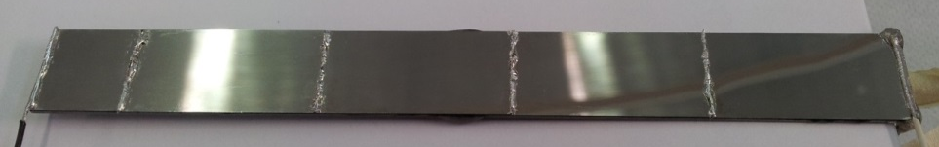
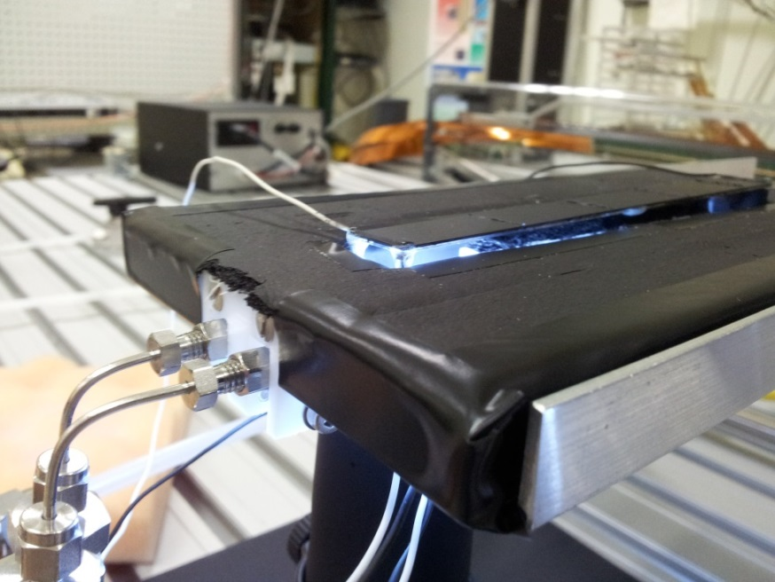
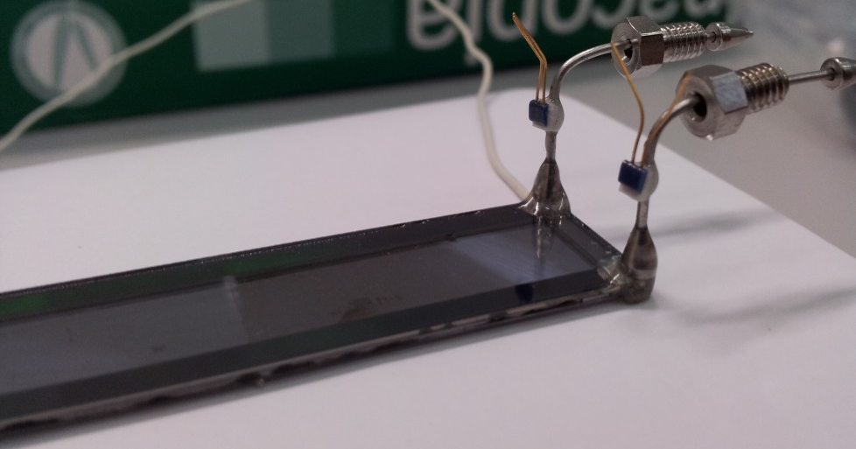
New prototype: assembly
The test section is equipped with 4.5 100 μm thick silicon dummy chips with 20/200 nm Ti/Pt thin films for simulating the thermo-mechanical behavior of the ITS MAPS.
After the installation of I/O fluidic connector, the prototype was installed in the DSF facility with an IR camera on top for thermal measurements and a microscope below for two-phase flow visualization.

Slide 4
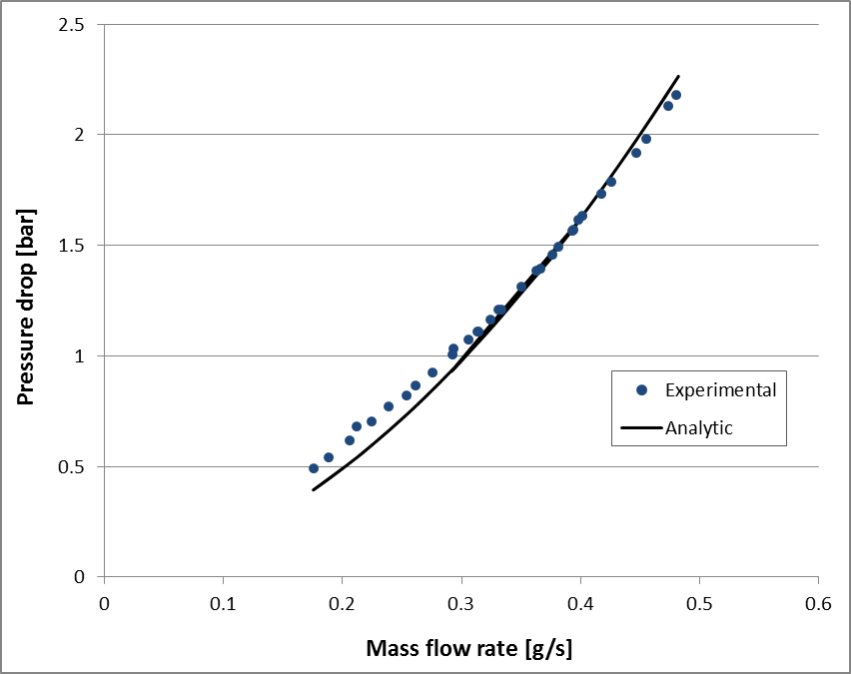
Single-phase pressure drops
Liquid flow single-phase tests were performed prior the flow boiling tests.
Contraction and expansion coefficients selected from Kays and London (1984) according to the exact flow areas.
90° bend coefficient K90=1.2 as suggested by Phillips for microscale flows.

Slide 5
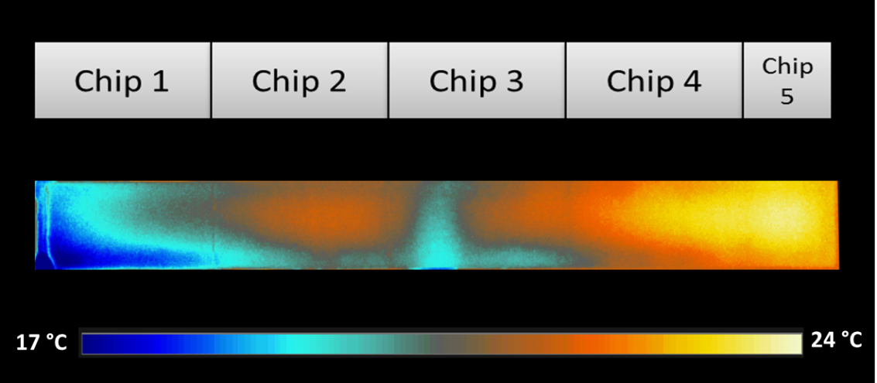
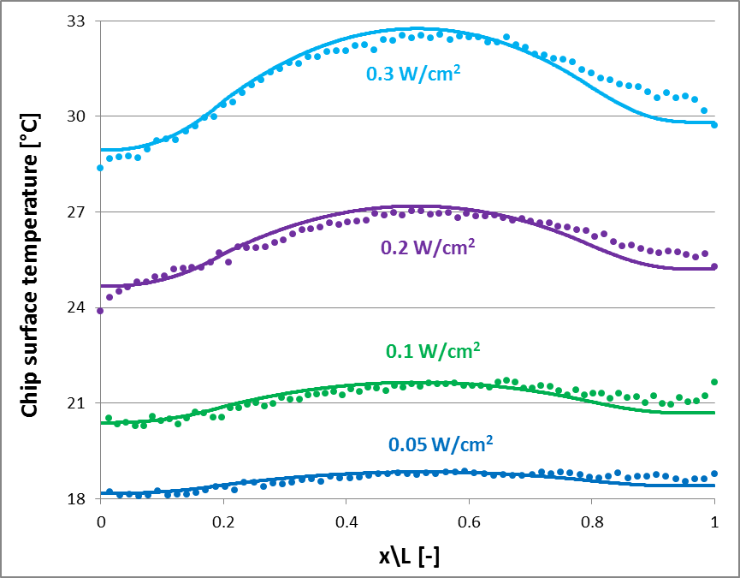
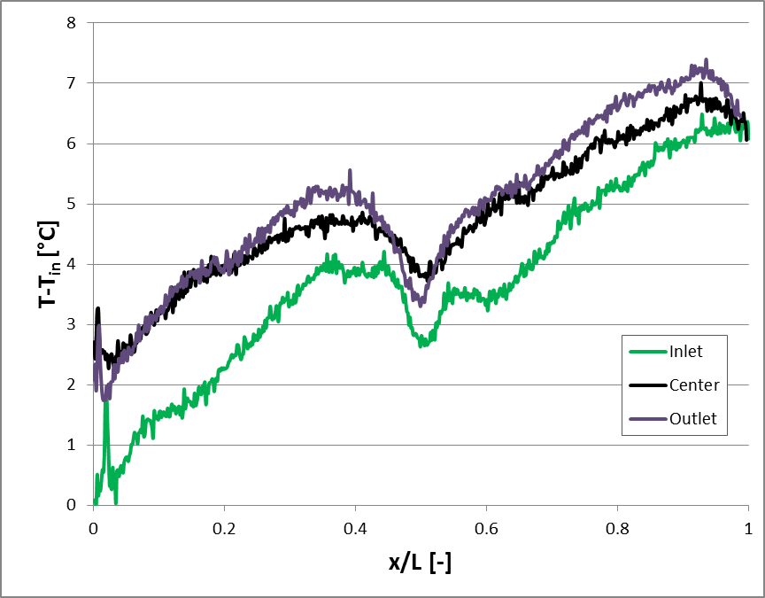
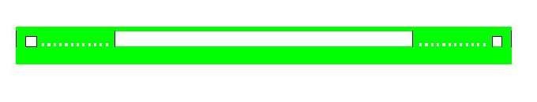
Single-phase heat transfer
Test performed at q=0.1 W/cm2 and ṁ=0.4 g/s
Tin=17 C.

Slide 6
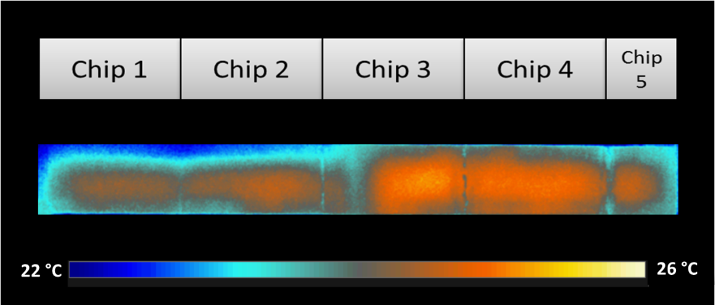
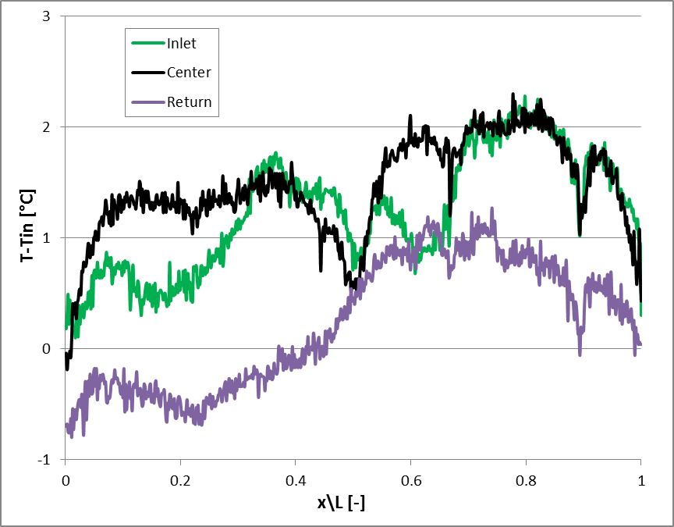
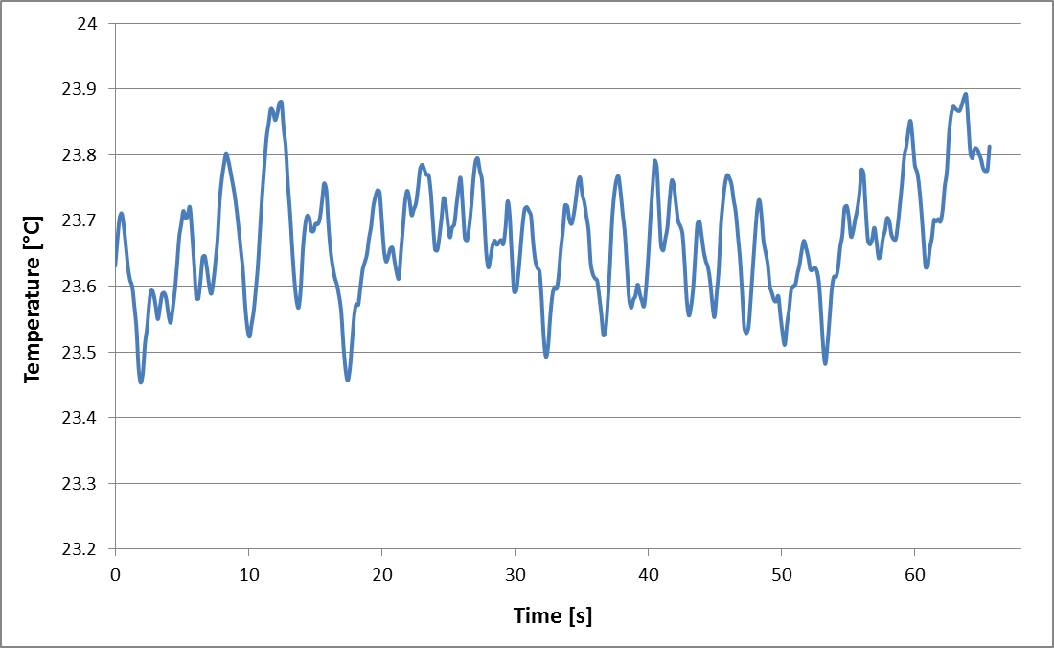
Flow boiling tests
Chip surface temperature oscillation recorded by the IR camera during two-phase flow
Test performed at q=0.1 W/cm2 and ṁ=0.05 g/s
Tin=23 C

Slide 7
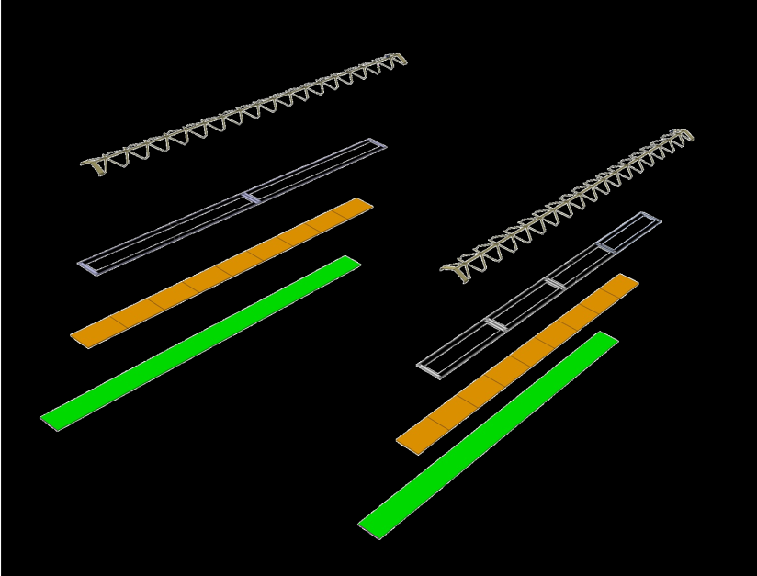
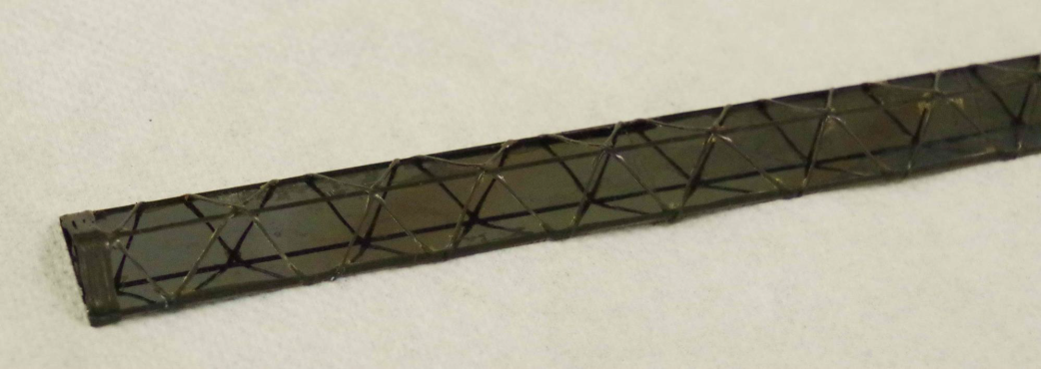
Integration tests
Studies for the integration of the silicon frames into the carbon fiber structure for the realization of the IB are ongoing. First winding test completed successfully and the first stave has been produced.
Fabrication of silicon prototypes for further integration tests is ongoing at CMi.

Slide 8
Silicon dummy chips
Uniform power dissipation chips
Fabrication of 50 μm thick silicon dummy chips with 20/200 nm Ti/Pt films for cooling and integration tests.
Non-uniform dissipation chips
Studies ongoing for the fabrication of silicon dummy chips with non uniform power dissipation trying to reproduce the dissipation map of the real chip.
30 mm
2 mm
0.5 mm
Top view
Thin film deposition
(sputtering)
PR stripping
Photolithography
dicing
Plasma etching
thinning

Slide 9
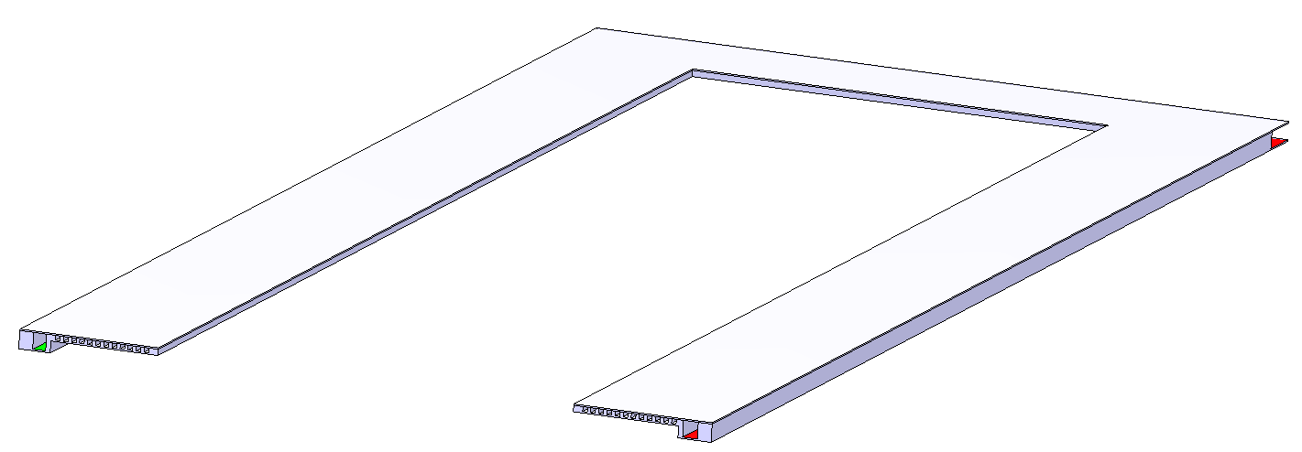
Fabrication @ TMEC
The second fabrication run on 6ˮ wafers performed at the Thai MicroElectronic Center in Bangkok (Thailand) ended with only one wafer successfully completed. This wafer was sent to CERN this Tuesday and should arrive next week.
After dicing and post processing, the prototype will be assembled and tested.
Discussions for a third fabrication run are ongoing: last details will be finalized next week.
Full silicon frame (Si-Si direct bonding) with optimized thickness for material budget minimization.

