Slide 1
Lotto planare
Vidyo meeting
30 Maggio 2014

Slide 2
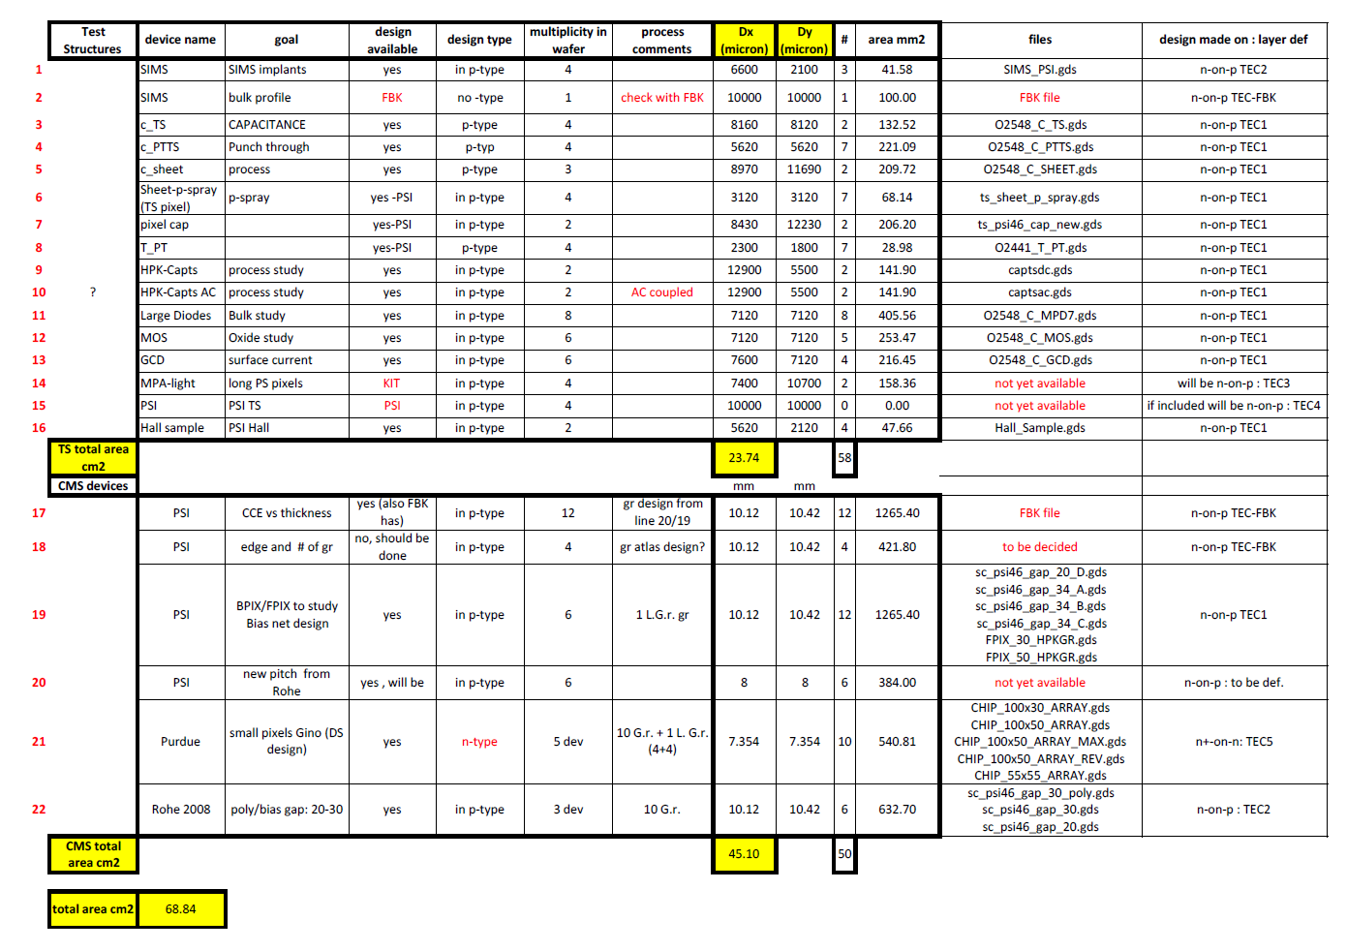
OK
OK
OK

Slide 3
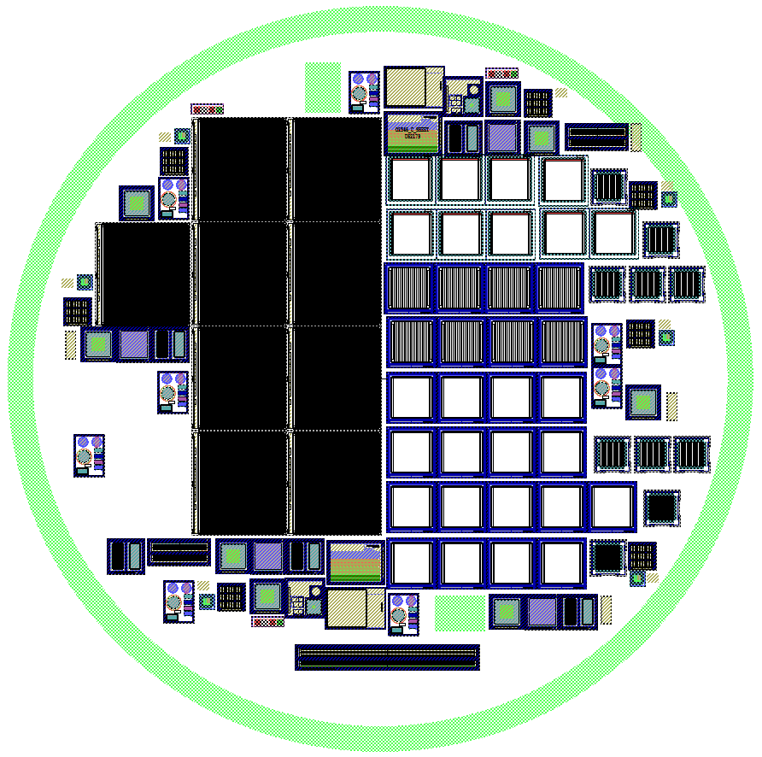
To do: check compatibility with FBK tech on each device
poly
No GRID
NA62
Ex n-on-n
No GRID
poly
One type of BPIX/FPIX per row

Slide 4
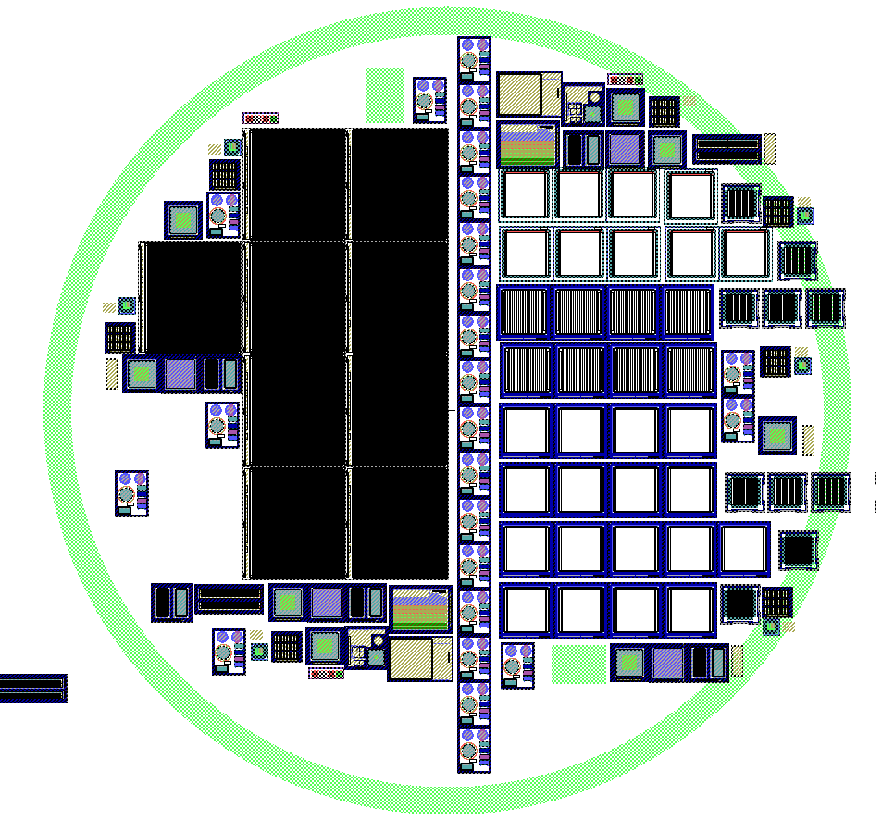
Test Strip along a diameter
→ To be measured at the automatic PS
NA62
Splitting: w vs w/o p-stop?

Slide 5
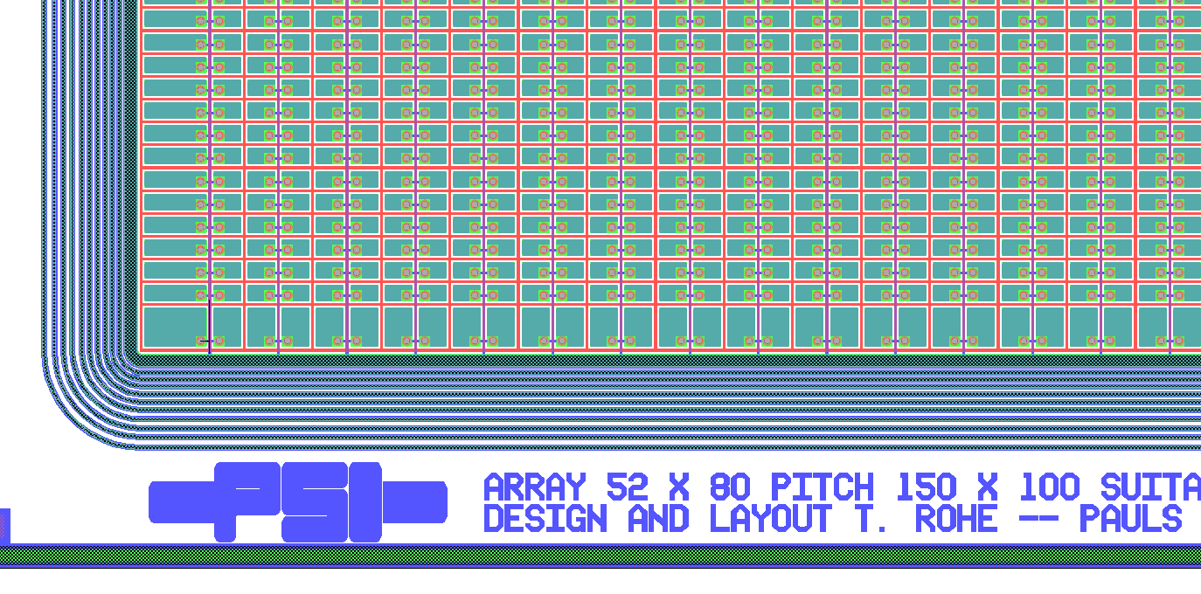
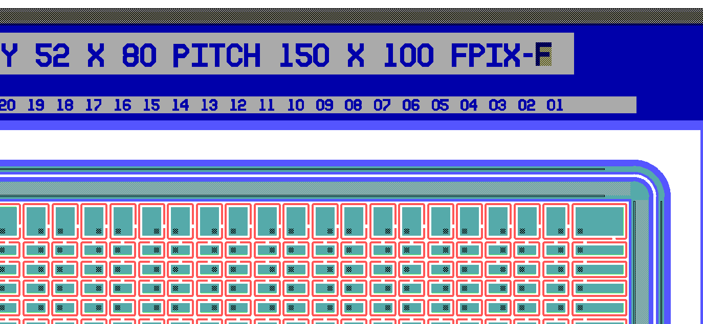
Same GR as in FBK
Grid biased
no GRs
no Grid

