Slide 1
Electron accelerator for the AWAKE experiment at CERN
Experimental requirements
Accelerator design
Expected performance
Outlook and conclusions

Slide 2
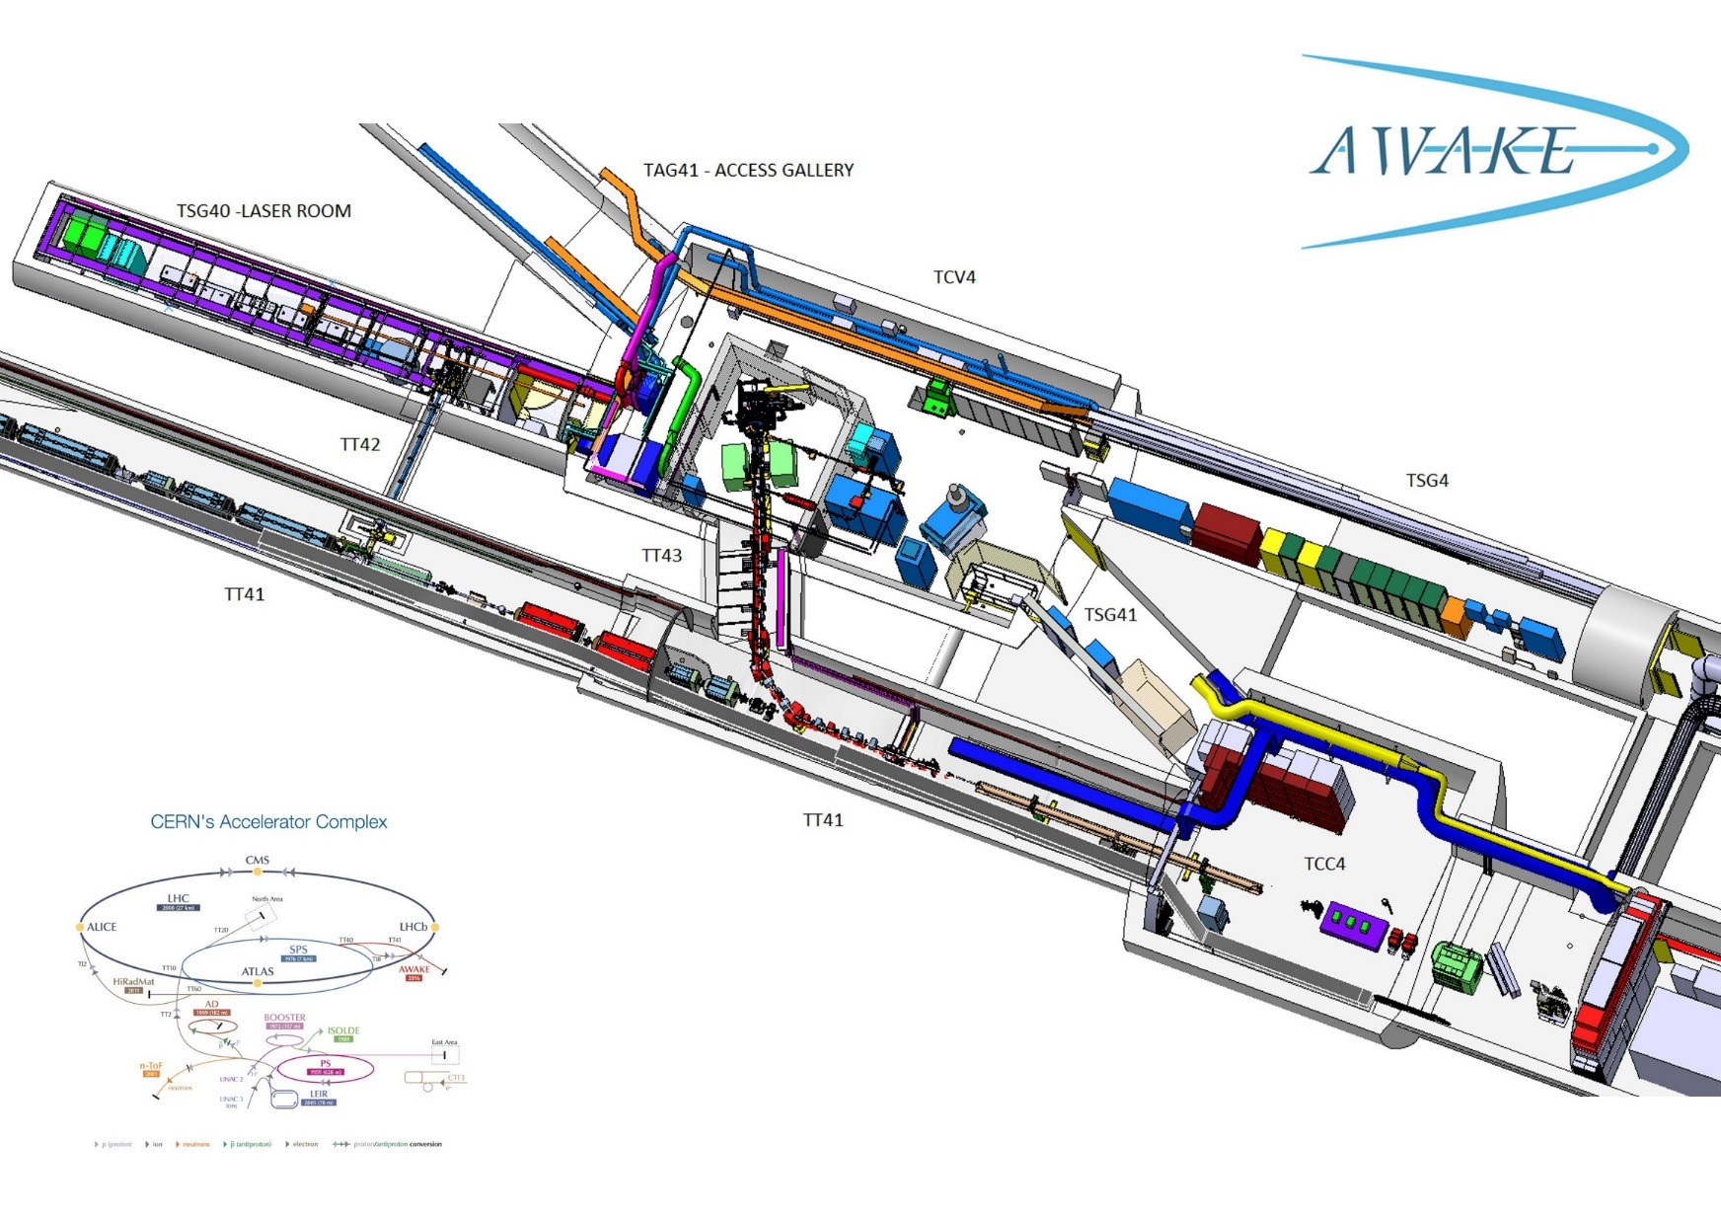
AWAKE layout

Slide 3
Awake electron beam requirements
Parameter | Baseline Phase 2 | Range to check
Beam Energy | 16 MeV | 10- 20 MeV
Energy spread (σ) | 0.5 % | < 0.5 % ?
Bunch Length (σ) | 4 ps | 0.3-10 ps
Beam Focus Size (σ) | 250 μm | 0.25 – 1mm
Normalized Emittance (rms) | 2 mm mrad | 0.5 - 5 mm mrad
Bunch Charge | 0.2 nC | 0.1 - 1 nC

Slide 4
PWA-simulations
Injection of realistic electron beams into realistic density plasma
with a = 5 mm (orifice radius)
Beam phase portrait taken from simulations of Ulrich Dorda
Plasma density slope along 10 m
Oblique electron injection
presented by K.Lotov at 11th AWAKE Physics Board Meeting, CERN 26.06.2015

Slide 5
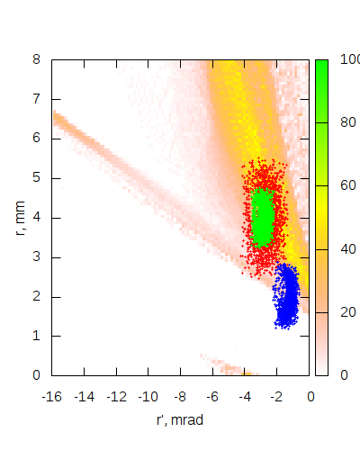
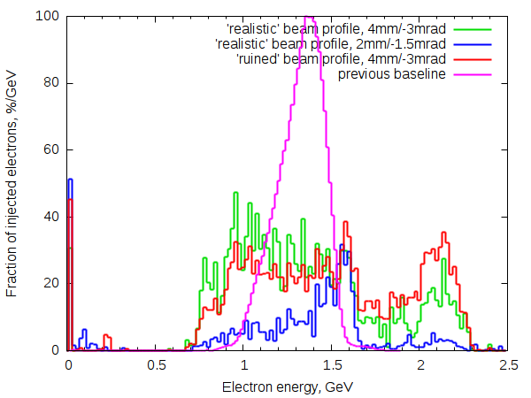
PWA-simulations
Trapping is good even for twice larger size and angular spread of the electron beam
Injection parameters can be further optimized for more narrow energy spread
The result is not very sensitive to injection parameters
Beam parameters against acceptance at z=-40cm
Electron energy distribution
presented by K.Lotov at 11th AWAKE Physics Board Meeting, CERN 26.06.2015

Slide 6
AWAKE electron source
schematic
Klystron
Incident, Reflected Power and phase
A,φ
Spectrometer
Laser +Diagnostics
Incident, Reflected, transmitted Power
E, ΔE
MTV
Matching triplet
FCT
Emittance
MS
FC
BPT
BPT
RF GUN
VPI
MTV,
Emittance
Corrector
Accelerator
Length ~ 4 m

Slide 7
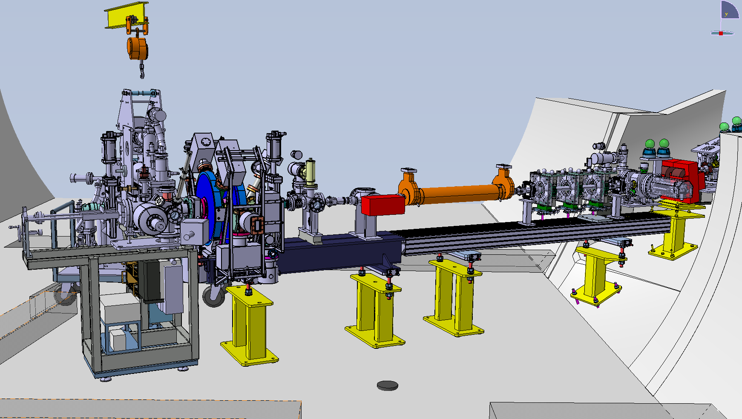
Electron source layout

Slide 8
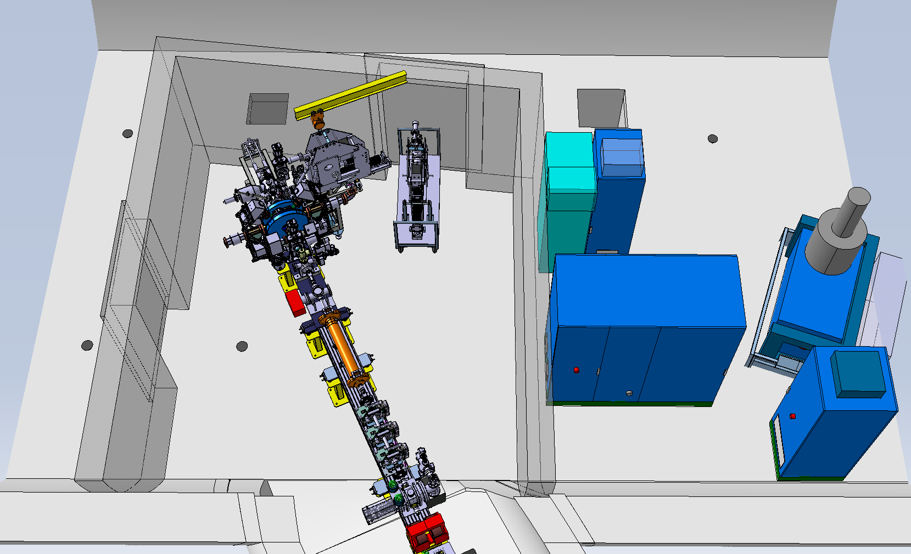
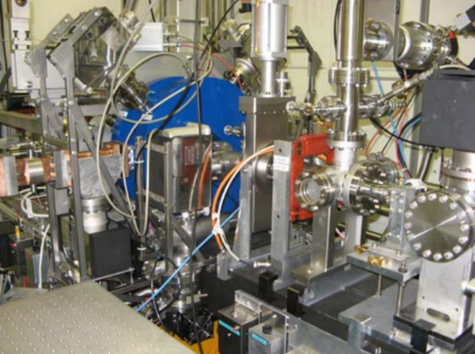
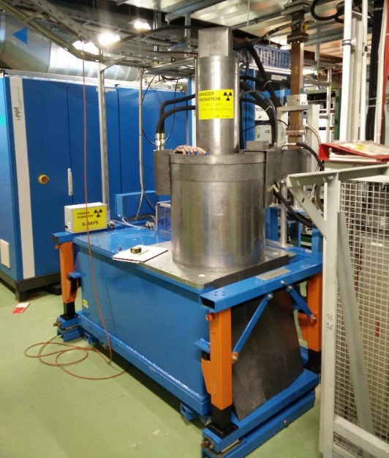
Load lock cathode system
Decided to use the load lock cathode system to allow for different type of cathodes:
Baseline: copper cathode Qe ~10⁻⁴
Option: CsTe Qe ~ 10⁻²
→ Flexibility in future beam parameters

Slide 9
Laser requirements
Mechanical pulse selector
Splitter
650 mJ amplifier
atten
Vacuum compressor
To plasma
2.5 mJ
25 mJ amplifier
atten
Compressor
THG
UV to e-gun
Wavelength : 262 nm
Phase 1
Phase 1
Phase 2
Requirements to Amplitude | 0.1 nC | 0.2 nC | 1 nC
Pulse duration | 0.3 ps | 10 ps | 10 ps
Pulse energy to the Cu-cathode in UV | 50 uJ | 100 uJ | 500 uJ
IR laser output | 2.5 mJ | 2.5 mJ or 25 mJ | 25 mJ
Main limitation: ablation threshold on copper cathode

Slide 10
Beam instrumentation
Instrument | How many | Resolution | Who
BPMs | 3 | 50 μm | TRIUMF, new
Screens | 2 | 20 μm | CERN, partly existing
Pepper pot | 1 | < mm mrad | Cockcroft, new
FCT | 1 | 10 pC | CERN, existing
Faraday Cup | 1 | 10 pC | TRIUMF, new
Spectrometer | 1 | 10 keV | CERN, MTV
Streak Camera | 1 | < ps | CERN, merging point
Instrumentation contributed by TRIUMF (Canada) and Cockcroft (UK)

Slide 11
Beam instrumentation
Pepper pot diagnostic developed by University of Manchester/Liverpool
Strip line BPM’s developed by Triumf for electron beam line and common beam line

Slide 12


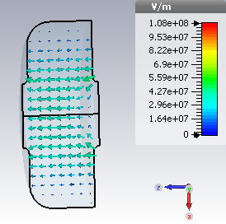
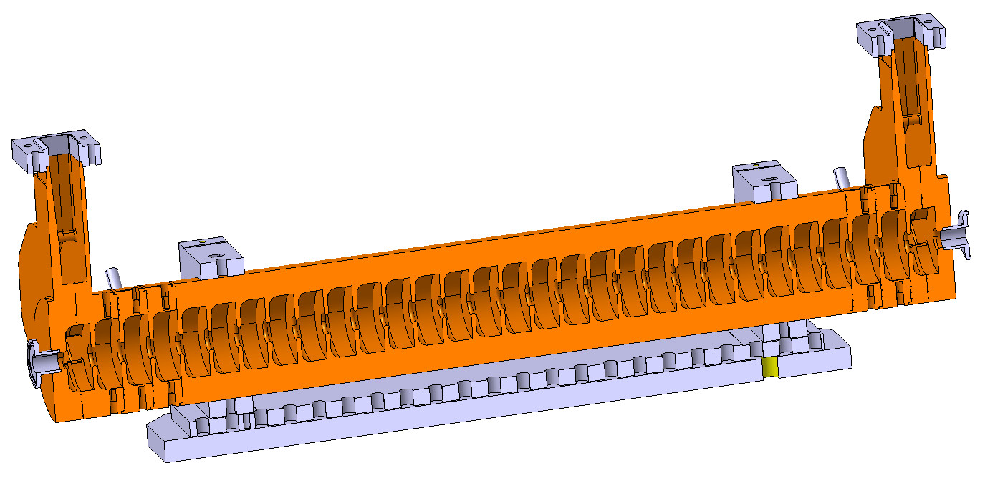
Graeme Burt and Ron Apsimon, The university of Lancaster
Booster structure
Constant gradient 2p/3 travelling wave structure at 2.99855 GHz
30 cells is just under 1 metre long
9.6 MW input power gives 15 MV
Average group velocity is 1.23% c.
The filling time is equal to 273 ns

Slide 13
Electron Beam Dynamics
Parmela simulation with r= 0.5mm, E=100 MV/m, Q=0.2 nC
→ ε = 1.3 mm mrad

Slide 14
PHIN emittance
measurements
PHIN Emittance measurements for Awake 22.8.2014
Laser size: ~ 1 mm sigma, Charge 0.2 , 0.7, 1.0 nC, Energy 5.5 – 6 MeV
Normalized emittance for 0.2 nC: 3.2 mm mrad ( big errors !)
E_{n} (1nC): 5.5 mm mrad
E_{n}(0.7 nC): 4.6 mm mrad
Qe measurement for copper cathode: 5 10⁻⁴, surprisingly good

Slide 15
Timing and Synchronization
Goal: ~ 100 fs jitter
GPS receiver
10 MHz (reference)
BA4
TSG40
BA3/Faraday Cage
3 GHz master
Laser PLL
Laser
2997.9 MHz
(reference)
88.2 MHz (laser)
9.97 Hz, 8.68 kHz, 400.4 MHz, 10 MHz
Main RF divider
Fiber receiver/transmitter
Fiber receiver/
transmitter
Electron
LLRF
400.4 MHz
Fractional divider SPS
Buffer amplifiers
SPS synchro crate
200.2 MHz
Timing
Buffer amplifiers
176.3 MHz
Fast pulse triggers
Fast pulse triggers
Proton LLRF
Timing
Various frequencies distributed (many!)
Fast pulse triggers (~20 adjustable)
Extraction and bunch rotation triggers

Slide 16
Outlook
Anticipate future electron beam parameters for the AWAKE experiment
What will be needed to advance towards a plasma accelerator for high energy physics ?
Shorter pulses: to better probe the wake fields ?
Higher current: yield, efficiency, beam loading ?
Higher Energy: for better injection ?
Positrons: proof of principle

Slide 17
Awake simulations
Phin gun, 20 MV/m structure, 0.2 nC, 1 mm laser,
1 ps laser

Slide 18
Awake simulations
Phin gun, 20 MV/m structure, 0.1 nC, 0.25 mm laser

Slide 19
Conclusions
The electron accelerator for AWAKE has been defined and construction started
We are working towards installation and commissioning in 2017
Have to start thinking about the future evolution of AWAKE and the necessary equipment and developments
Collaborations:
Cockcroft (University of Lancaster, Liverpool, Manchester), TRIUMF, CLIC

Slide 20
End

Slide 21
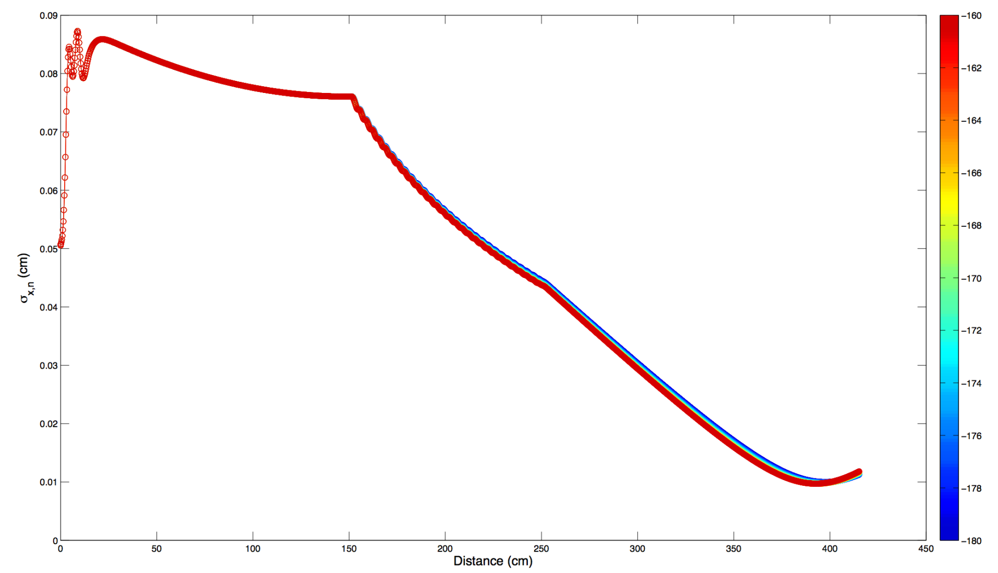
Electron source design
Oznur Mete, Cockcroft

Slide 22
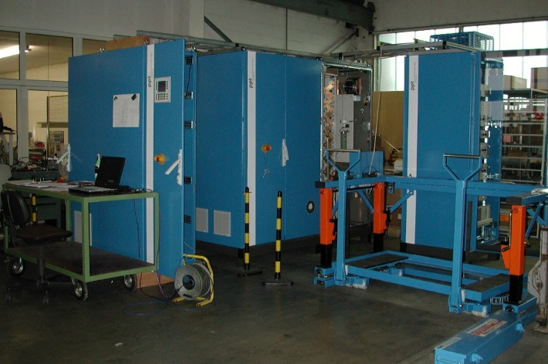
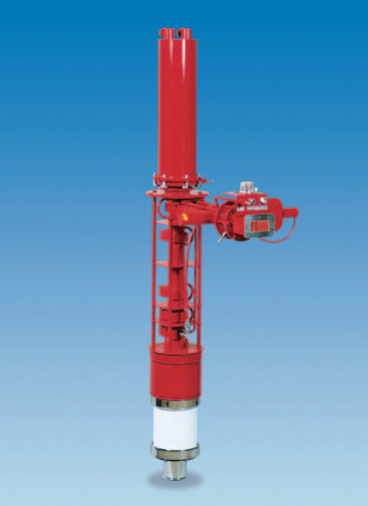

Klystron and modulator
Thales TH2100
Parameters | Specifications
RF frequency | 2998.5 MHz
Peak RF power | 45 MW
RF gain | 54 dB
Efficiency | 43 %
Anode voltage | 307 kV
Beam current | 340 A
High voltage pulse length @75% | 7.6 us Needed : 1-2 us
Total height | 1.7 m

Slide 23
Laser requirements

Slide 24
PHIN to AWAKE
Parmela simulation with r= 1mm, E=85 MV/m, Q=0.2 nC
→ ε = 3.2 mm mrad ( by chance)

