Slide 1
Simulation of the Effect of Errors in Multiple Pulse Laser Wakefield Acceleration
Christopher Arran, Roman Walczak, Simon Hooker
John Adams Institute & Department of Physics, University of Oxford, UK

Slide 2
Overview
Why is the Multiple Pulse technique needed?
What are the effects of errors in pulse train spacing?
Systematic - tuning
Random - jitter
How well do we need to control these errors?
Develop simple analytic theory and compare to PIC simulations

Slide 3
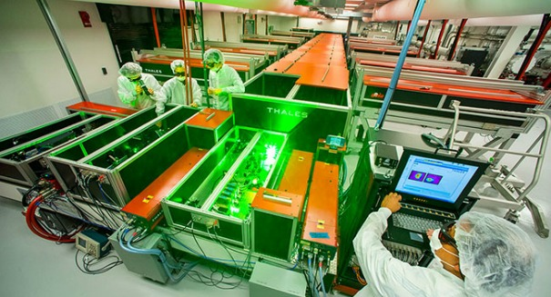
Motivation
Current laser systems use single laser pulses
Energy few J, Pulse duration tens of fs
But repetition rates and efficiencies very low
eg. Ti:sapphire: Rep rate < 10 Hz, Efficiency < 0.1% wall-plug _{(Hooker et al 2014)}
Many applications require kHz repetition rates
BELLA laser, LBNL
Credit: Mark Gable

Slide 4
Multiple Pulse-LWFA
Use smaller, more efficient laser systems in resonance
Several small pulses as effective as one large pulse
Higher repetition rates become possible
Vital for pulses to remain in resonance with wakefield
Throughout both i) pulse train and ii) length of accelerator
S. M. Hooker, R. Bartolini et al, J. Phys. B: At. Mol. Opt. Phys. 47 pp. 234003, (2014).

Slide 5
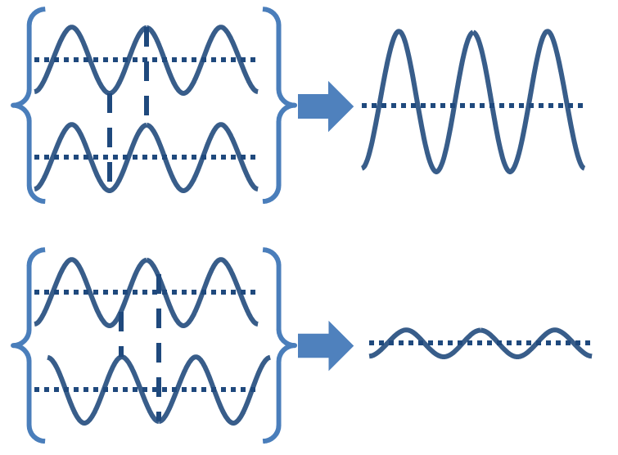
Effect of Pulse Train Spacing
In linear regime each pulse produces a sinusoidal plasma wave
What happens if these are mistimed with error $ε_{n}={∆τ}_{n}/τ_{p}$?
Now compare to simulations with Particle In Cell code EPOCH…
$$g_{n}\left(t\right)=a cos\left[ω_{p}\left(t−\{n+ε_{n}\}τ_{p}\right)\right]$$
$\sum_{n}^{N}{g_{n}=}A a\cos\left(ω_{p}t+φ\right)$ for:
$$A^{2}={ \left[\sum_{n}{\cos\left(2πε_{n}\right)}\right]}^{2}+{ \left[\sum_{n}{\sin\left(2πε_{n}\right)}\right]}^{2}$$
$=N+ \sum_{n=1}^{N}{\sum_{m≠n}^{N}{\cos\left[2π(ε_{n}−ε_{m})\right]} }$
Incoherent
Coherent

Slide 6
Simulation Parameters
Parameters in line with concept paper (Hooker et al 2014)
Linear regime, a₀ = 0.052
Broad Gaussian pulses, t_{FWHM} = 100 fs
Low density, n_{e} = 1.75x10¹⁷ cm⁻³
Plasma wavelength, λ_{p} = 80 μm
EPOCH PIC code
Resolution 25 cells per feature size (λ_{L} = 1 μm)
20 pseudo-particles per cell – avoids numerical heating
Window 80 μm to capture exactly one plasma wavelength
Output taken once per plasma period, 266 fs
100 repeats over random jitter

Slide 7
Calculating a Wakefield Amplitude
Use Fourier amplitude to calculate wakefield amplitude
Require a consistent plasma wave, moving with electrons
Smoothing is better than a low pass filter
Faster than a fitting technique
Simulation window of length L = n λ_{p}
Best captures Fourier peak
Introduces artefact at beginning
Only works close to linear regime

Slide 8
Example Simulation Results
Example of a pulse train with added 5% Jitter
Non uniform pulse spacing

Slide 9
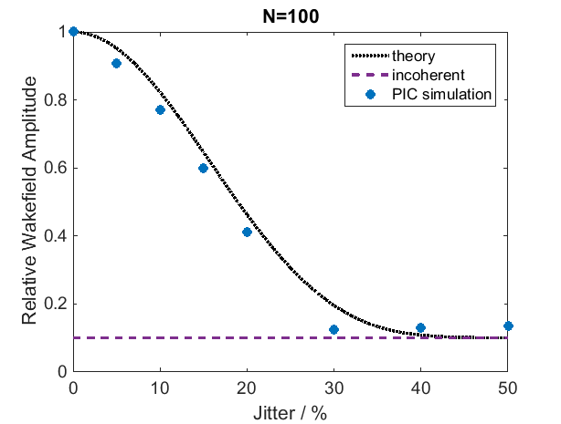
Random Spacing Error-Jitter
Eg. vibrations on optic bench, thermal fluctuations
$$ε_{n}\sim Gaussian\left(0,σ\right) ⇒ A≈\sqrt{ N+N^{2}exp⁡\left[−{\left(2πσ\right)}^{2}\right]}$$
Good agreement with theory
10% scale jitter acceptable
$$\frac{\sqrt{N}}{N}=0.1$$

Slide 10
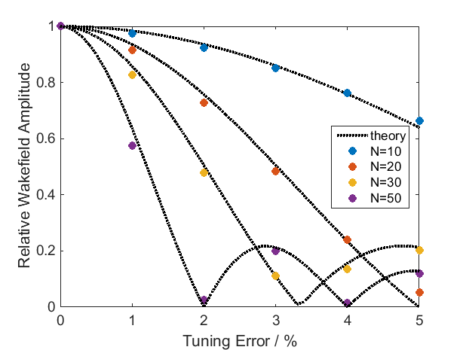
Systematic Spacing Error-Tuning
Eg. target density error, misaligned optics error
$ε_{n}=an ⇒A=\left|sin\left(πaN\right)/sin⁡(πa)\right|$
Required accuracy: a < N⁻¹
Limits useful pulse train length: N < (2a)⁻¹

Slide 11
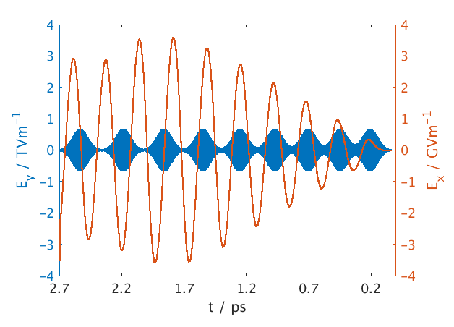
Autoresonance Set Up
Exploit autoresonance to overcome errors
R.R. Lindberg, A.E. Charman et al, Phys.Rev.Lett., 93 5, pp. 055001, (2004).
Change pulse spacing to pass downwards through resonance
Pulse rate chirped: $ω_{pulses}=ω_{initial}−α{ω_{p}}^{2}t$ for $ω_{initial}>ω_{p}$
After the $n$^{th} pulse at $t_{n}$, the next separation is $τ_{n}≈ τ_{1}+\frac{α{ω_{p}}^{2}{τ_{1}}_{}^{2}}{2π}{(t}_{n}−t_{1})$
$$τ_{7}$$
$$τ_{3}$$
Example simulation
α=0.01, τ₀= 0.9 τ_{p}
$$t_{8}$$
$$t_{7}$$
$$t_{4}$$
$$t_{3}$$

Slide 12
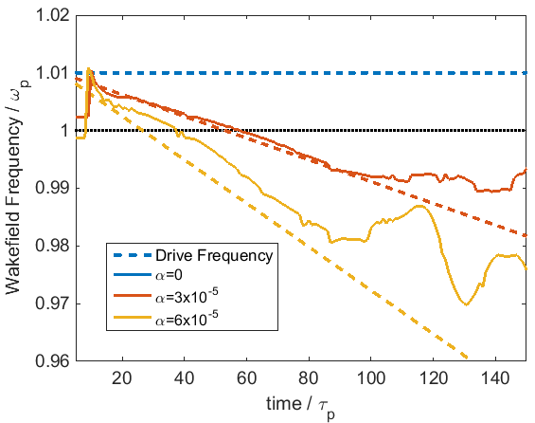
Autoresonance Results
Wakefield frequency becomes ‘locked’ to driver, not to plasma
Pushes wakefield amplitude beyond the detuning limit
Wakefield becomes resilient against plasma density fluctuations
1% initial detuning

Slide 13
Conclusions
High stability to random jitter (≈10%)
But require accurate mean spacing (< 1% for 50 pulses)
Requires tuning plasma density within 2%
PIC simulations in good agreement with simple linear theory
Next steps
Experimental demonstration – J. Cowley
Ion motion further limits pulse train length – J. Holloway
Investigate autoresonance for resilience to pulse spacing and density error

Slide 14
Thank you
Simon Hooker Roman Walczak Laura Corner Gavin Cheung James Cowley Stephen Dann Rob Shalloo Christopher Thornton
STFC UK (grant no. ST/J002011/1)
Helmholtz Association of German Research Centres (grant no. VH-VI-503)
Air Force Office of Scientific Research, Air Force Material Command, USAF (grant no. FA8655-13-1-2141)
The EPOCH code was developed as part of the UK EPSRC funded projects (grant no. EP/G054940/1)

Slide 15
Bibliography
S. M. Hooker, R. Bartolini et al, J. Phys. B: At. Mol. Opt. Phys. 47 pp. 234003, (2014).
L. Corner, R. Walczak et al, AIP Conf. Proc., 1507, pp. 872-873, (2012).
R. Walczak, Presentation at LPAW, (2013).
R.R. Lindberg, A.E. Charman et al, Phys.Rev.Lett.,93 5, pp. 055001, (2004).
R.J. Shalloo, Personal Correspondence, (2015).
W. L. Kruer, The Physics of Laser Plasma Interactions, Westview Press, (2003).
P. Gibbon, Short Pulse Laser Interactions With Matter, Imperial College Press, (2005).
T. Tajima and J. Dawson, Phys. Rev. Lett., 43 4, pp. 267-270, (1979).
S. M. Hooker, Nat. Photonics, 7 775, pp. 1-11, (2013).
S. P. D. Mangles, C. D. Murphy et al, Nature 431, pp. 535-538, (2004).
W. P. Leemans, A. J. Gonsalves et al, Phys. Rev. Lett., 113, pp. 245002, (2014).
K. Nakamura, B. Nagler et al, Phys. Plasmas, 14 5, pp. 056708, (2007).

Slide 16
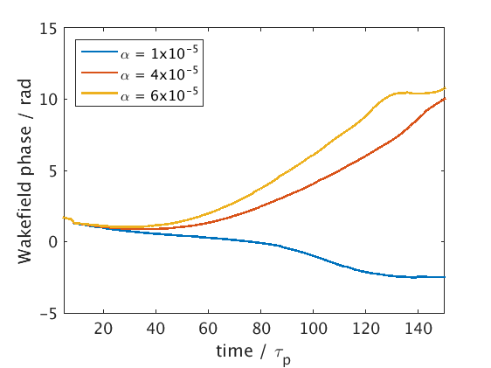
Further Autoresonance
Wakefield phase changes smoothly with pulse spacing
More work ahead on testing this in realistic density profiles
Will plasma waves match between different density regions?

