Slide 1
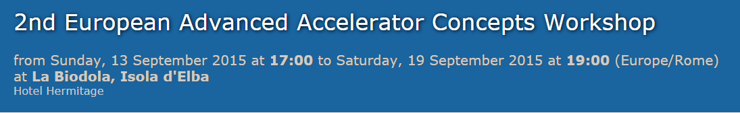
Summary of
WG3 - Electron beams from electromagnetic structures,
including dielectric and laser-driven structures
conveners: Walter Wuensch (CERN), Peter Hommelhoff (FAU Erlangen)
Dielectric accelerators
IFEL acceleration
P. Musumeci
Wakefield
Laser driven
P. Hommehoff
Experiment
B. O’Shea
J. Power
G. Andonian
Theory/application
A. Zholents
S. Shchelkunov
R. Kniaziev
A. Kanareykin
High-gradient limits
Electron linacs
Dielectric
S. Shchelkunov
Photo-injectors
D. Alesini
L. Faillace
A. Kanareykin
Test Facilities
M. Conde
V. Tsakanov
Y. Saveliev
Technology
B. Spataro
D. Alesini
Metal
W. Wuensch

Slide 2
Dielectric accelerators
Voltage gain of witness beam
Transformer ratio =
Voltage loss of drive beam

Slide 3
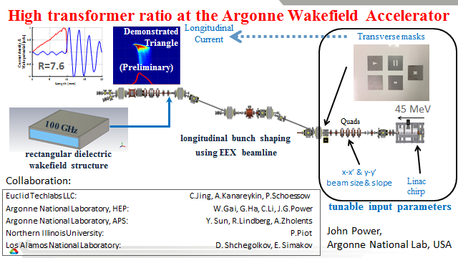
Notes:
John Power, Argonne National Labs
The emittance exchange (EEX) beamline at the Argonne Wakefield Accelerator Facility has recently demonstrated longitudinal bunch shaping with an EEX Beamline. They are now planning to produce triangular and double-triangular longitudinal currents to produce high transformer ratios needed for collinear wakefield acceleration.
WW, PH. Proof-of-principle that they could shape the bunch; now target bunch shape to obtain large transformer ratio of 7.6

Slide 4
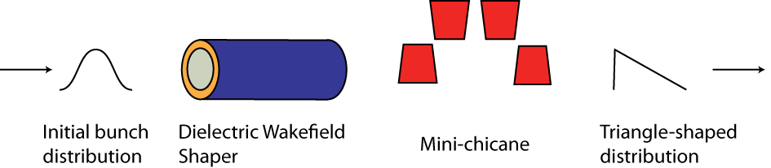
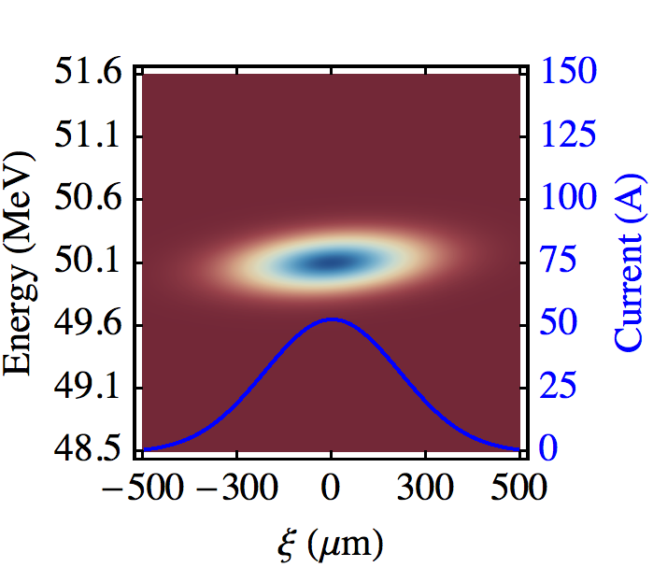
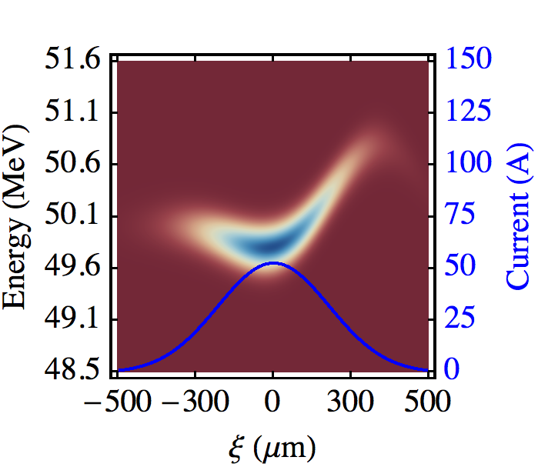
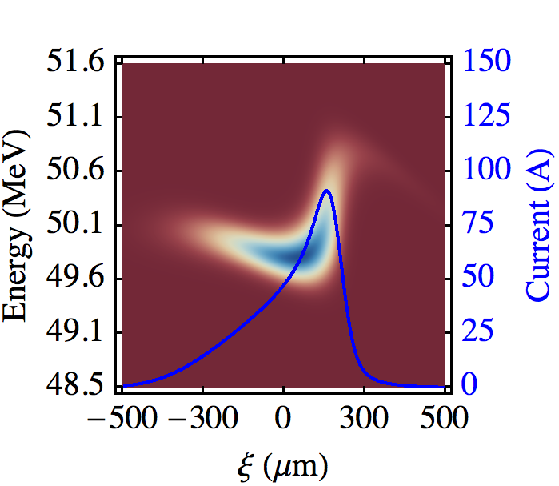
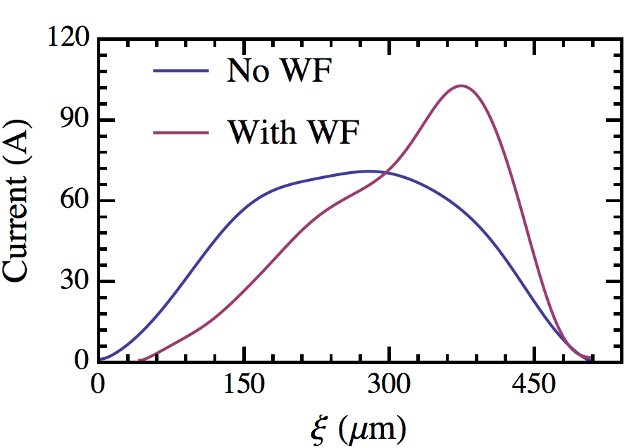


Ramped bunch profile shaping in dielectric structures
G. Andonian, et al.
Motivation: Ramped bunches for enhanced transformer ratio
Phase space manipulation using self-wakes in DWA
Followed by compact chicane (R₅₆)
Compact, passive, no loss of beam charge
Recent results demonstrated at BNL ATF
Data from BNL ATF
Notes:
Gerald Andonian, UCLA. The goal of the measurement is to generate longitudinally ramped (or triangle) shaped beams for applications in collinear wakefield advanced acceleration (PWFA or DWA). The slide follows the phase space of the beam as it goes through a dielectric structure and a chicane and shows the resultant current profile is linearly ramped. An experiment was conducted at the BNL ATF to demonstrate this scheme and the results using CTR-interferometry show a resultant bunch with nearly linear ramp.

Slide 5
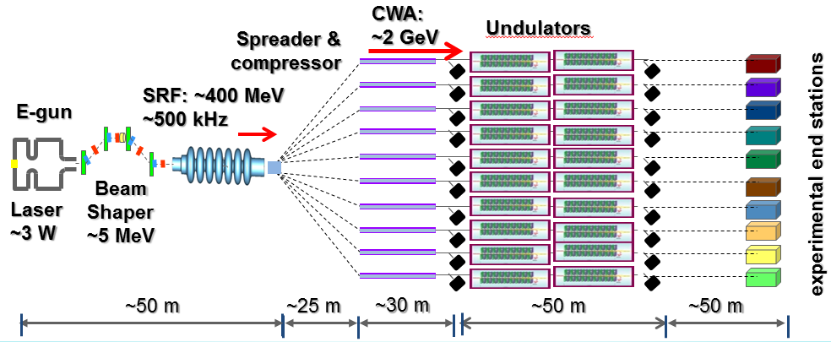
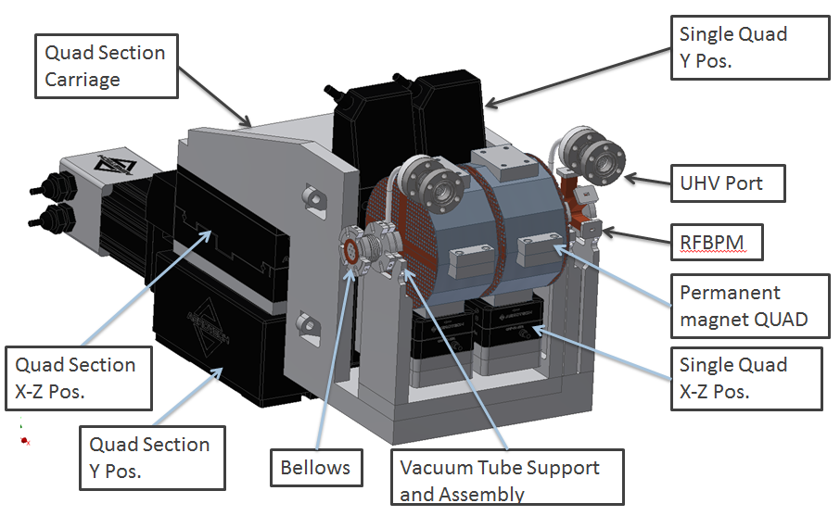
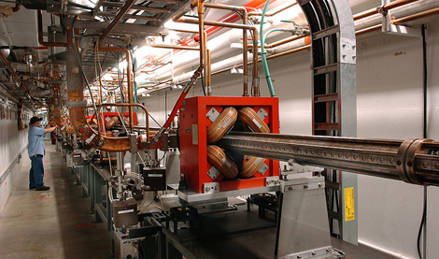
A concept of a multi-user FEL facility based on Collinear Wakefield Accelerator (A. Zholents for a large team)
Dielectric Wakefield Accelerator
2b
2a
Witness bunch
Drive bunch
Dielectric
Cu
Drive and Witness bunches made from the same source bunch produced in a high rep. rate injector based on a low energy SRF
Dielectric channel imbedded into strong focusing quadrupole wiggler used to suppress beam instability.
~ 10 cm
Sub-μm alignment capability
APS 450 MeV injector linac
The initial goal is to test a 1 m long accelerator unit using 450 MeV APS injector linac
Notes:
Alexander Zholents, Argonne National Labs
It shows a concept of the facility based of the collinear wakefield accelerator where a high charge drive beam produces Cherenkov radiation and creates the wake field used to accelerate a low charge witness bunch. A tight synchronization between two bunches is needed and it is expected that drive and witness bunches will be made from one initial bunch using bunch shaping technique (also discussed in J. Power talk, slide 1).
Efficient use of the energy of the drive bunch (up to 80%) is a key and thus propagation to long distance (20 m in the considered example) is essential (to achieve 2 GeV in witness bunch). Beam stability will be provided using BNS damping and, thus, the dielectric is imbedded into the strong focusing wiggler. In result, tight sub-micrometer quadrupole alignment tolerance must be obtained.
Several CWAs can be used in a single tunnel and be fed by a common high rep. rate injector supplying drive and witness bunches.
The current plan is to build up to a 1 m long full scale unit and test it at the Advanced Photon Source in Argonne Lab using a 450 MeV injector linac.
ADDED: I noticed that I leave one place open for a confusion. The wiggler that I mentioned is the quadrupole wiggler, i.e. strong FODO type focusing, where O is reduced to a bare minimum.

Slide 6
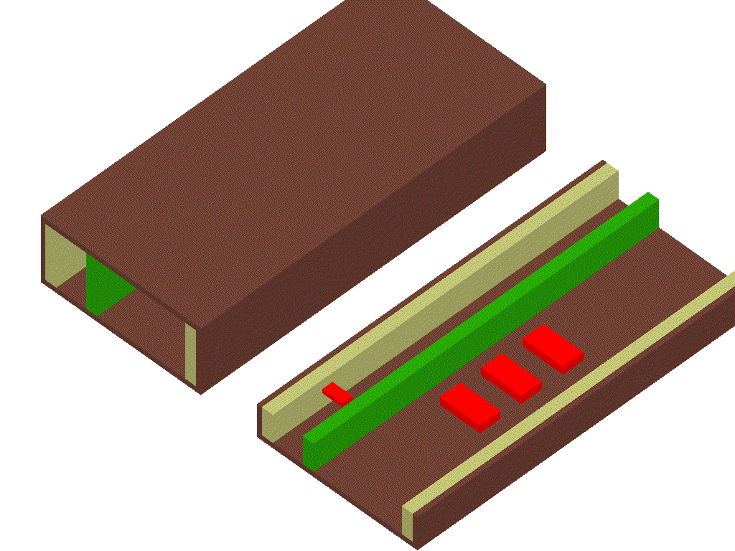
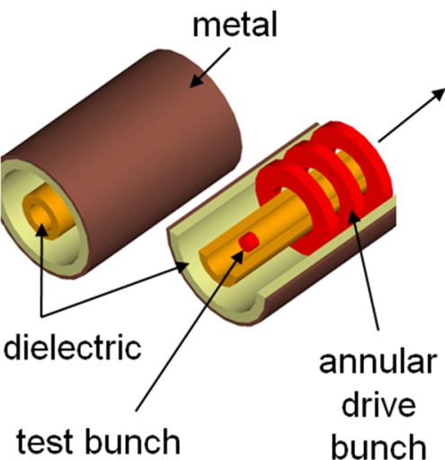

High transformer ratio of multi-channel dielectric wakefield structures and real-time diagnostic for charging and damage of dielectrics
presented by Sergey Shchelkunov ( Yale University and Omega-P R&D, Inc, USA, sergey.shchelkunov@gmail.com )
Overview of the published work on the subject…
energy is brought to structures directly by the drive beam… no need for generating externally and distributing RF power
mm-scale (THz-scale) structures can deliver high gradients (300-500 MeV/m);
these structures have high Transformer ratio (T) even when driven by one not-profiled drive bunch (T → 5-10) [collinear schemes cannot do that];
multi-channel schemes can use – very much like collinear schemes – ramped bunch trains and profiled bunches to boost T even further. Examples (published) suggest the boost by another factor of 5 (at least).
these together allows for very high T which reduces the total project costs of the machine (M)… large T → smaller cost
dielectric
metal
drive
bunches
test bunch
two channel rectangular (above)
& coaxial (below)
Issues/ problems with keeping bunches stable:
Tapered solenoids of FODO cells to control drive bunches;
Plasma-filled witness-bunch channels, or interleaving drive channels to fight instabilities of witness bunches;
Lost of work to address these stability issues is still required
in 100-200 micron diam.-channel
Notes:
Sergey Shchelkunov, Omega-P

Slide 7




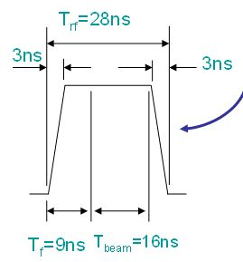
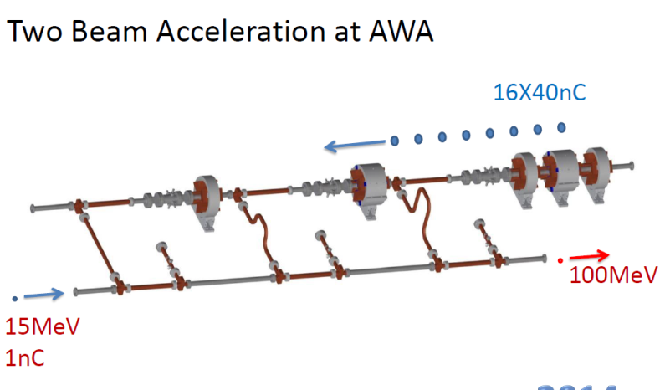
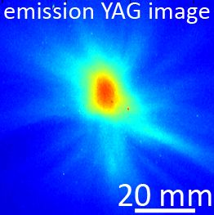
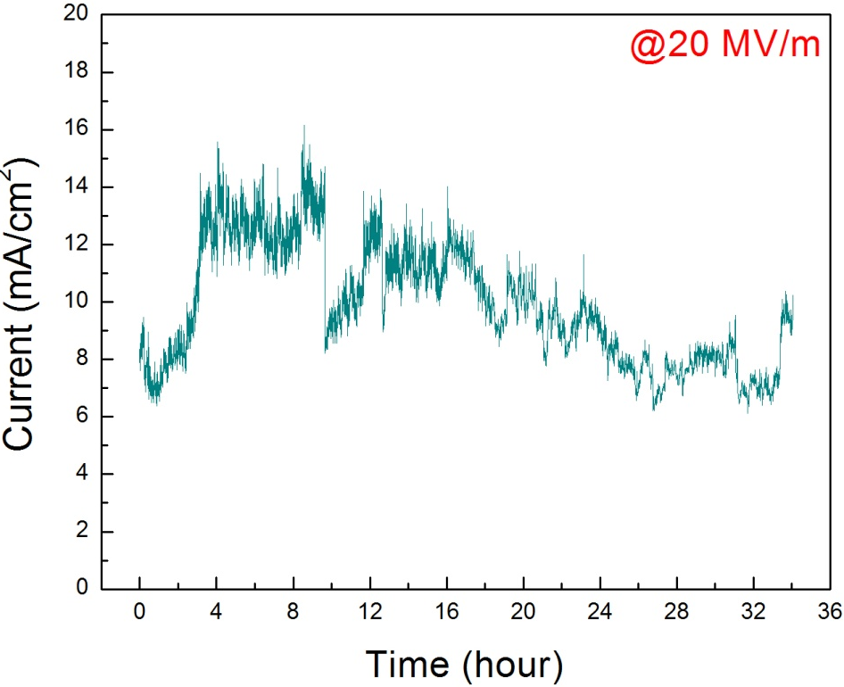
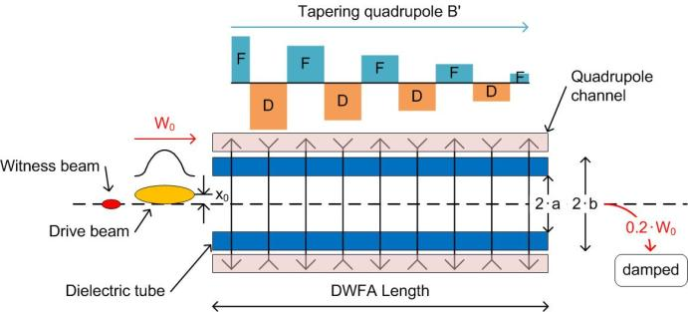
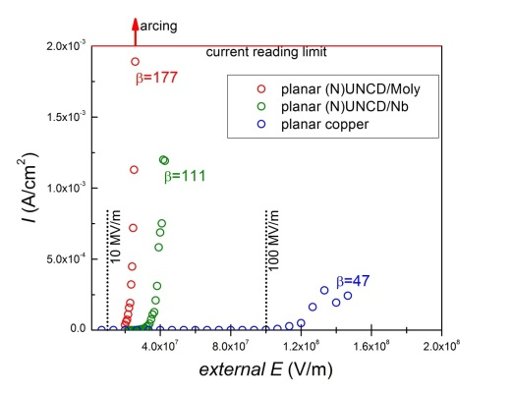
Advanced Acceleration and THz Generation by Dielectric Based Structures: ANL/BNL/Euclid Collaboration. A.Kanareykin
Argonne Wakefield Accelerator
AWA
Argonne 26 GHz Flexible Collider
A Strategic Plan for Accelerator R&D in the U.S:
…the AWA would be the only facility designed to conduct two-beam accelerator tests at cm wavelengths…”.
Collinear acceleration for FEL
Nano-diamond Cathode
Notes:
Alexei Kanareykin, Euclid Tech Labs & Argonne National Labs
WW., PH: AWA: flexible collider, soon: unique machine
With this talk, recent results of Argonne, Brookhaven and Euclid collaboration on THz wakefields-in-structures acceleration were presented.
First of all, the Argonne Wakefield Accelerator (AWA) facility upgrade was presented based on recent “A Strategic Plan for Accelerator R&D in the U.S” (or P5 report). The recently commissioned AWA upgrade can deliver a 75 MeV drive beam with up to 10 pulses of 100 nC charge with a few picosecond pulse length providing at 200 – 400 MV/m gradients.
It is stated in the report that AWA “…with the expected closure of the CTF3 at CERN, the AWA would be the only facility designed to conduct two-beam accelerator tests at cm wavelengths”
ANL/Euclid collaboration proposed the Argonne Flexible Linear Collider based on a short rf pulse (~22 ns flat top), high gradient (>250 MV/m) Two Beam Accelerator (TBA) design. The concept is scalable from the GeV to the TeV scale. This is a modular design and its unique locally repetitive drive beam structure allows a flexible configuration to meet different needs: an efficient (~7% overall), 31 MW beam power collider may be achievable. A novel staging design was presented.
One more project of AWA/APS/Euclid collaboration is using a high energy gain dielectric wakefield accelerator (DWA) instead of the conventional accelerator for X-ray free-electron lasers (FELs) development. It is shown that collinear dielectric wakefield accelerator can accelerate low charge and high peak current electron bunches to a few GeV energy with up to 100-kHz bunch repetition rate.
It was presented encouraging results on UNCD (ultro-nano-crystalline-diamond) cathodes to be used for the normal conducting and SRF field emission guns. The same technology is underway for photoinjector applications.
Finally, it was presented recent results on dielectric based high power narrow band THz source and energy chirp correction of the SRF FEL accelerators.

Slide 8
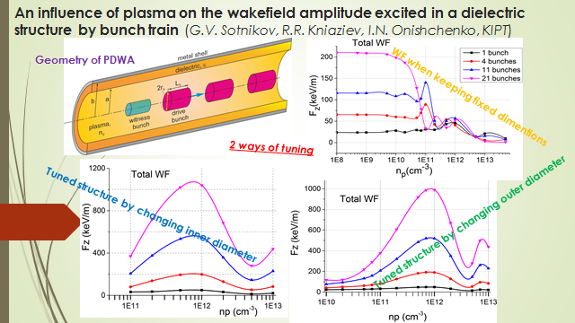
Combination of collinear dielectric acceleration with plasma focusing for beam stability.
Notes:
Roman Kniaziev for Gennadiy Sotnikov, Karkov Institute of Physics and Technology.
TF: total wake field

Slide 9


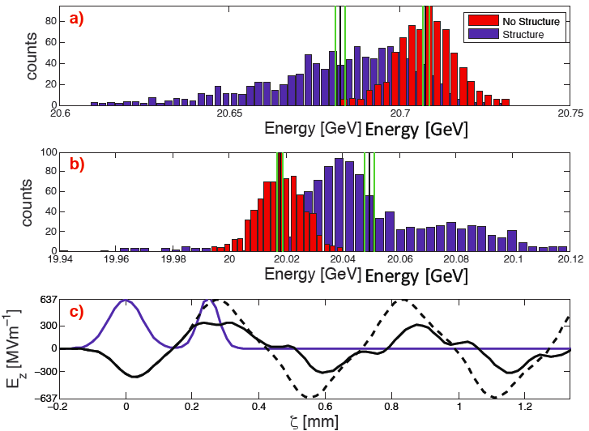
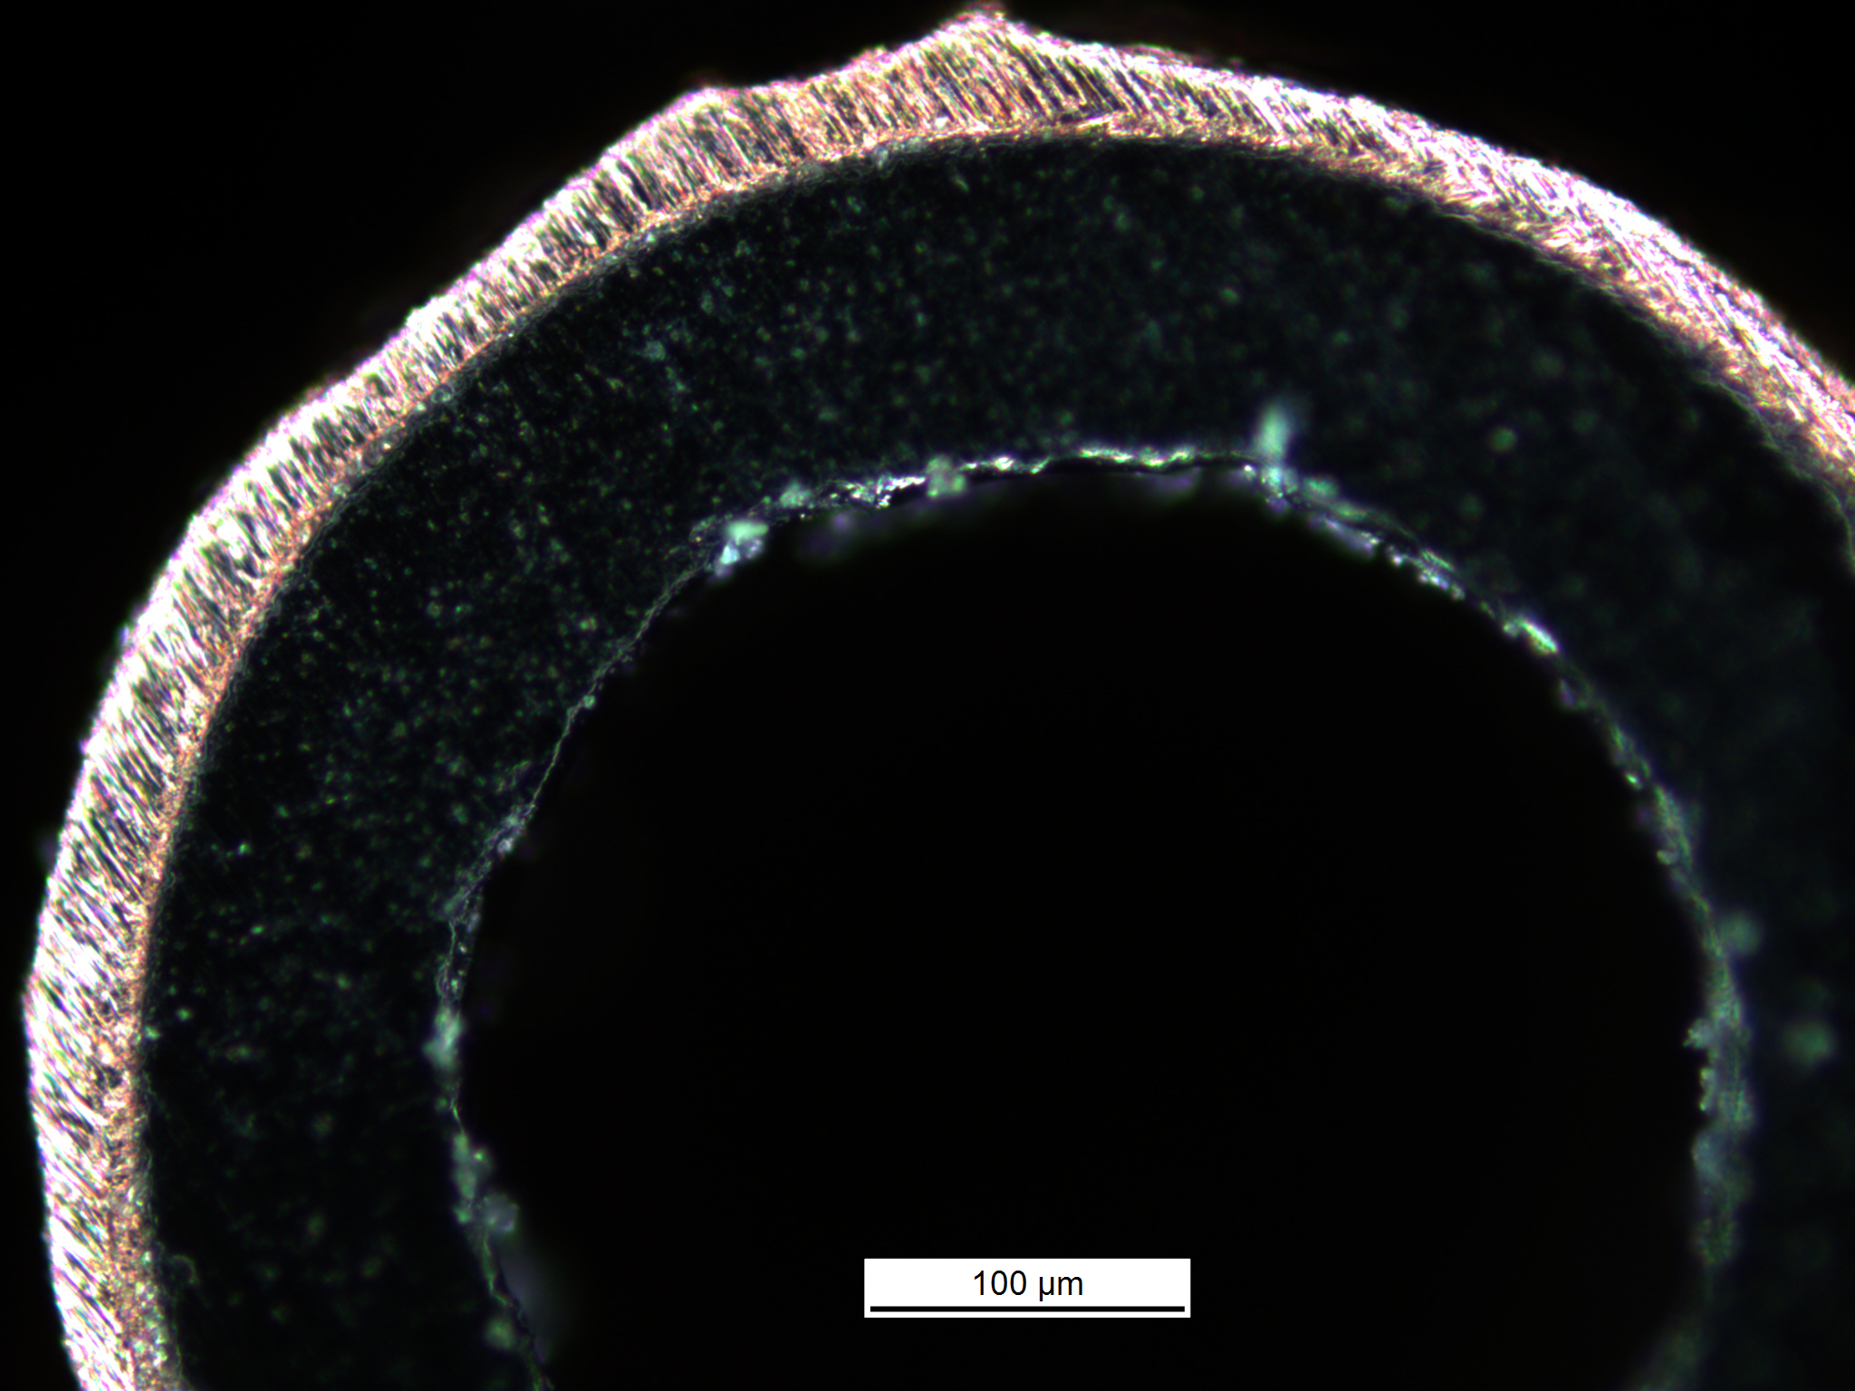
High Gradient Dielectric Wakefield Experiments
Brendan O’Shea
1.35 GV/m Gradients Measured for many 10’000s interactions
Witness Bunch Accelerated @ 320 MV/m
80% “beam-wave” efficiency, 80% of the energy extracted from the drive bunch is transferred to the witness.
Unexpected damping of the wakefield observed in reconstruction of wakefield using Kramers-Kronig techniques.
Driver:
1.53 nC @ 55 um
Witness:
0.96 nC @ 30 um
400 um (2a) ID, 530 um OD (2b), 10 cm long
Drive Beam Energy
Witness Beam Energy
Simulation of Fields
Notes:
Brendan O’Shea, SLAC
At FACET:
UCLA/E201/SLAC presented new experimental results that measured accelerating gradients of 320 MV/m (WW: in THz range), using a witness electron bunch, in a Dielectric Wakefield Accelerator (DWA). The DWA is fabricated from a ~500 um annular quartz dielectric structure of 10 cm length. The wakefield is driven by a 1.53 nC electron bunch of 55 um r.m.s. length and witnessed by an 960 pC electron bunch of 30 um r.m.s. length. This measurement builds on previously presented work demonstrating 1.35 GV/m gradients, which were sustained for many tens of thousands of interactions. Additionally, a reconstruction of the wakefield using Kramers-Kronig (minimum phase) techniques has shown an unanticipated damping of the wakefield. If this damping is unresolved it could have have serious implications for multi-bunch excitation of DWA structures as well as use of DWA structures to generate THz.

Slide 10
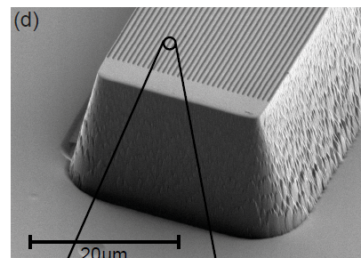
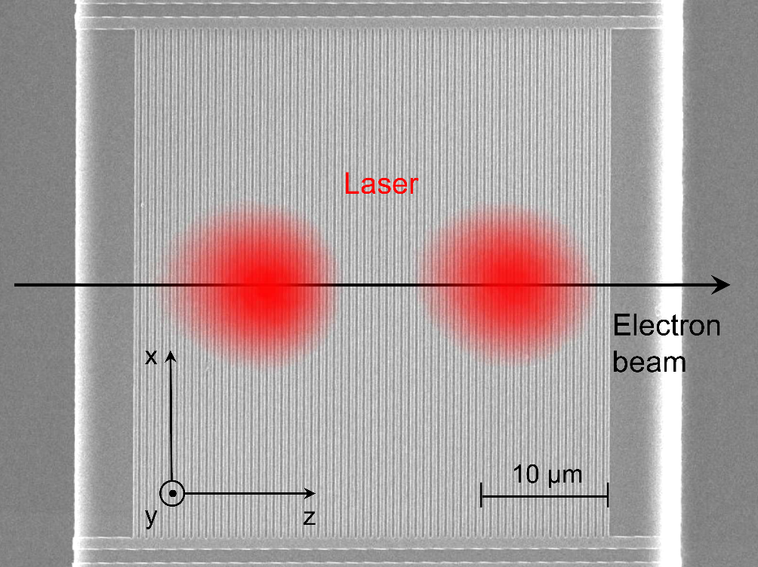
Elements of dielectric laser acceleration
P. Hommelhoff, now FAU Erlangen
Demonstration of
80 MeV/m (at 30 keV, β = 0.3) with Si structures and 2um laser; expect >1 GeV/m with relativistic electron energies
2-stage (phase dependent) acceleration
2-stage (phase dependent) deflection
acceleration at higher spatial harmonics (up to 5th); gradients of 35 MeV/m with 7 keV electrons
acceleration at tapered structures to prevent dephasing / slippage: 10% energy gain
DLA based sub-micron scale beam position monitor
Si structures made by Stanford partners: K. Leedle (Harris & Byer groups)
2-um lasers from partners I. Hartl, DESY and R. Holzwarth, Menlosystems

Slide 11
IFEL accelerators

Slide 12

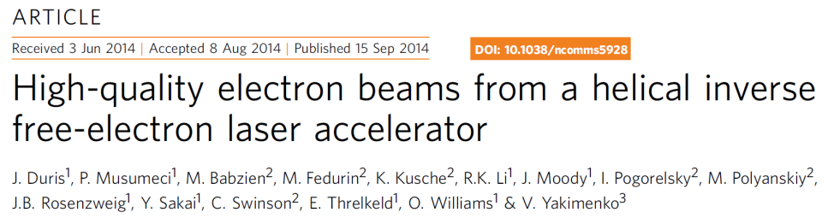
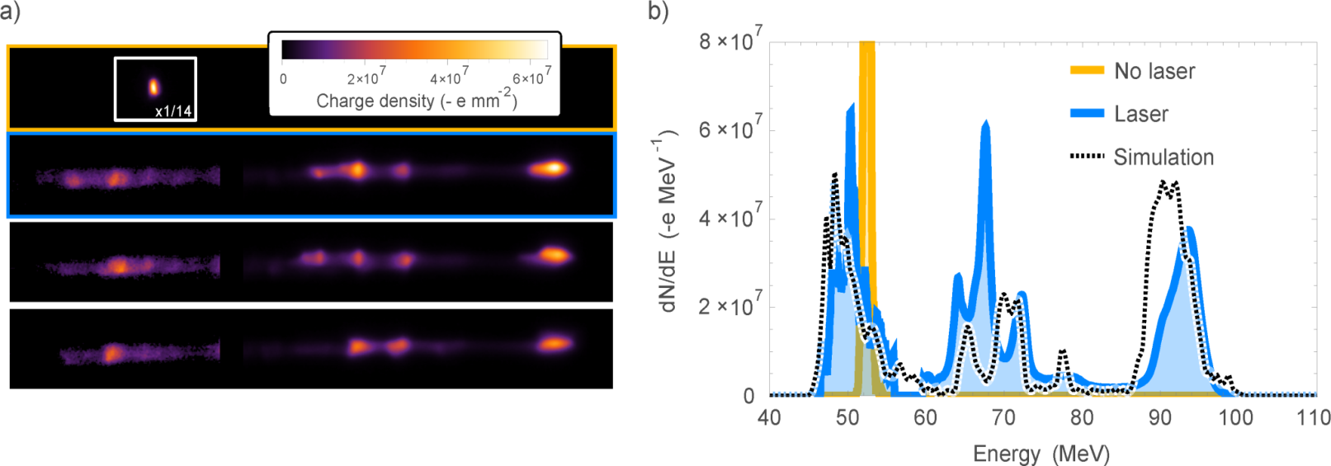
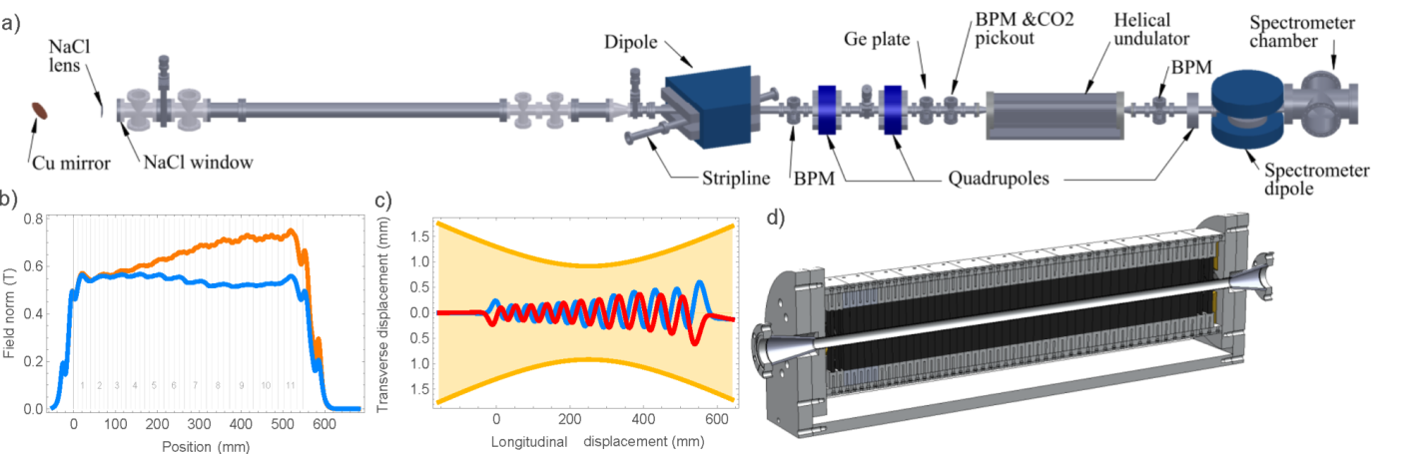

High gradient IFEL acceleration and deceleration in strongly tapered undulators
Pietr
P. Musumeci
IFEL deceleration - Nocibur
IFEL acceleration - Rubicon
Demonstrated
  High gradient (> 100 MV/m)
  High energy (energy doubling 50 –> 93 MeV)
  Low energy spread (< 2%)
  Emittance preservation
  Output energy stability
Observed 40 % energy extraction from relativistic e-beam
TESSA = Tapering Enhanced Superradiant Stimulated Amplifier
Can lead to very high efficiency light sources
BNL – ATF beamline # 2
Notes:
Pietro Musumeci, UCLA,
-1 * -1 is not 1 – the proof is underway...

Slide 13
High gradient limits

Slide 14
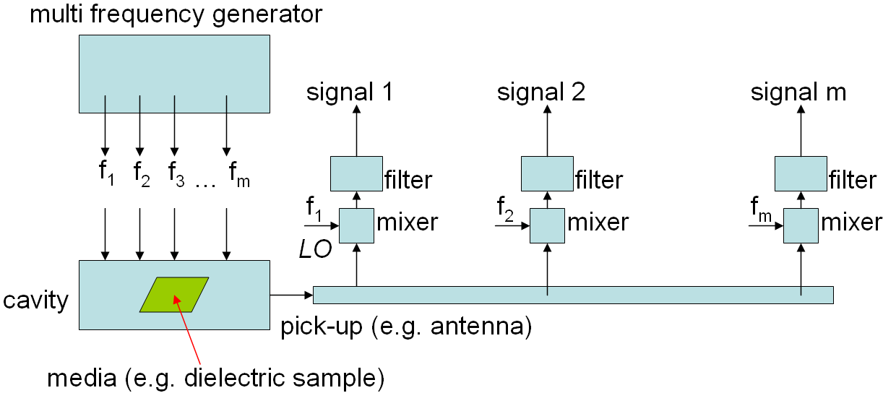
DIAGNOSTIC AND DETECTORS FOR CHARGING AND DAMAGE OF DIELECTRICS IN HIGH-GRADIENT ACCELERATORS
This research was supported by the DoE Phase I grant DE-SC0011347
S.V. Shchelkunov^{1,2}, T.C. Marshall¹, J.L. Hirshfield¹
¹Omega-P, Inc, New Haven, CT 06511, USA; ²Yale University, New Haven, CT, USA
Research is aimed to study charging effects in a thin walled dielectric wakefield accelerator from a passing charge bunch, and/or intense wake-fields
Approach/method:
* surround the dielectric by a microwave cavity;
* measure the changes in transmission through the cavity at pre-defined frequencies ( in the real time, [ micro-sec scales and above ]); this is done at frequencies in the GHz- or tens-of-GHz range.
* using the above, find the changes in the cavity resonant frequency and Q-factor;
* find then, corresponding changes in the dielectric constant and loss-tan ;
* use models to find corresponding density of free electrons/ charges (Ne), collision frequency (Fc), and the other relevant parameters (if any);
* use the info from above to predict changes in the dielectric constant and loss-tan in the THz-frequency range
* preliminary, proof-of-principle, measurements were done with plasma discharges;
* noise-rejection methods were developed for reliable detection;
* …was shown that as low as 3·10⁷ cm⁻³ electron density can be detected at the time scales > few micro-sec or more (transient processes);
* dynamic range = 20-35 dB (… and more is possible)
Notes:
Sergey Shchelkunov, Omega-P and Yale University
WW: Way of diagnosing the surface charging of dielectrics and a test setup reported. Test-run and benchmarked using a plasma.

Slide 15
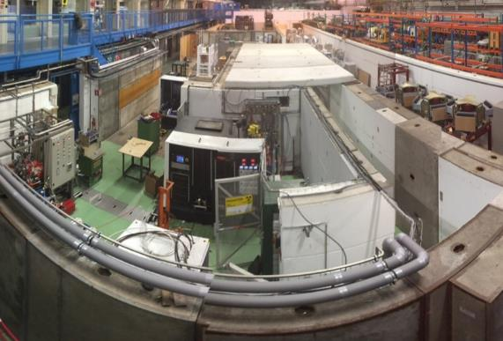
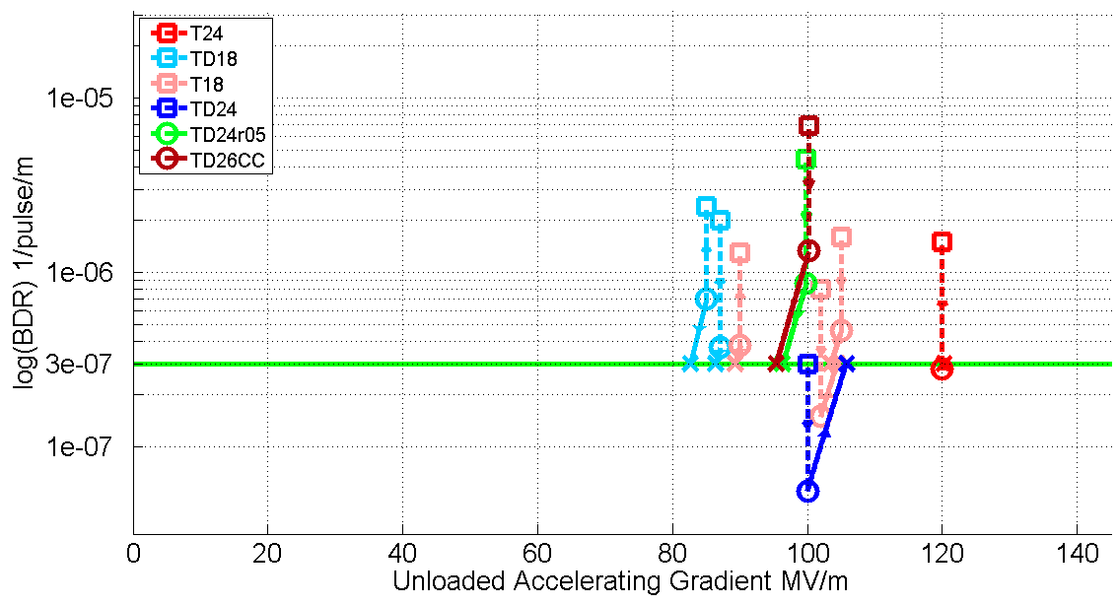
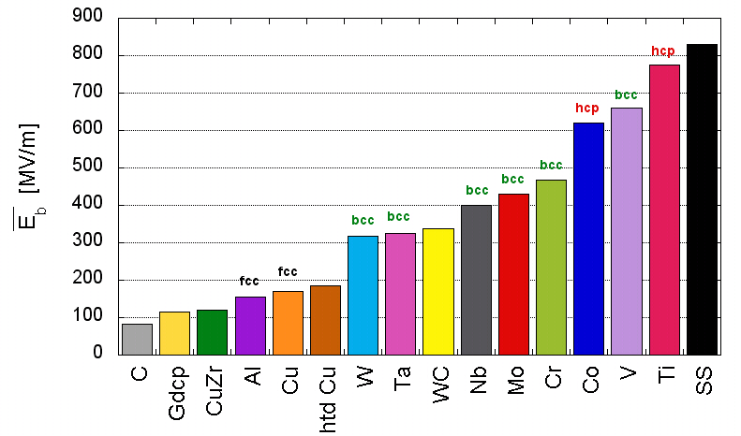
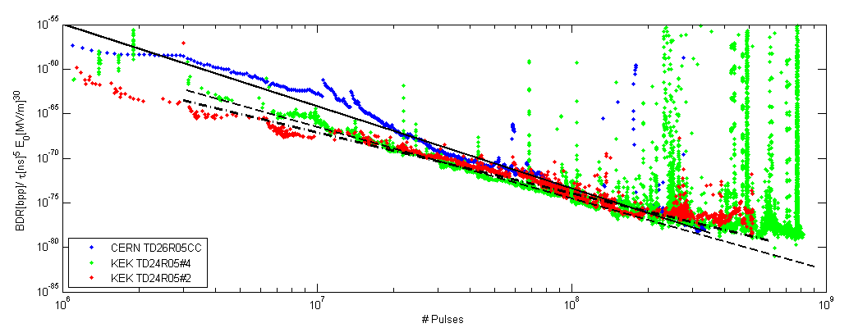
Dynamics of Metal Surfaces Under High Fields
W. Wuensch
Gradient of metal rf structures primarily limited by vacuum arcs. Understanding phenomenon is essential to pushing the gradient higher!
Expanded testing capability
100 MV/m performances at very low breakdown rates
Insight into breakdown mechanism through through long-term decrease in breakdown rate (rf conditioning)
Insight into materials and role of dislocations
Notes:
Walter Wuensch, CERN
The top left picture shows one of the klystron based test stands at CERN for high-gradient testing prototypes. The top right picture show a summary of performances achieved in structures we have tested over the past few years. On key point we (mostly) understand why the different give different performances, so we can improve progressively. The bottom left shows data of different materials taken with a pulsed dc system. The ranking in hold off gradient is apparently related to crystal structure. The right bottom pictures shows the steady decrease in breakdown rate of three identical design prototypes over multiple month running at 50 Hz. The structures actually improve with time, an effect we are investigating and may be related to hardening.

Slide 16
Electron linacs

Slide 17
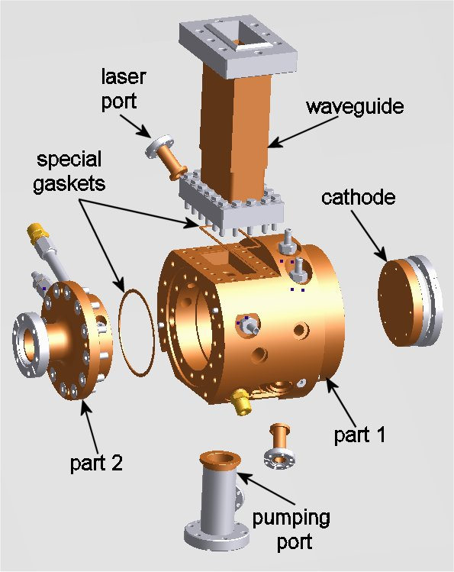
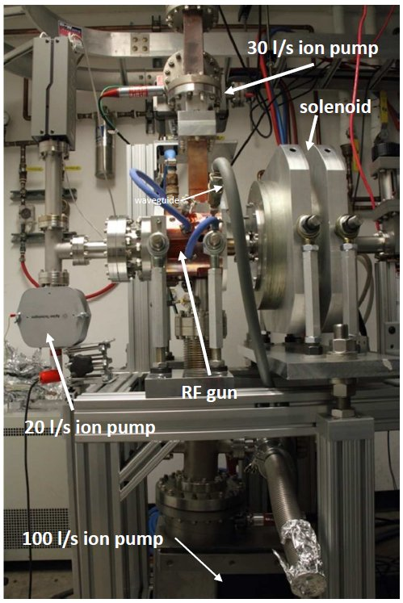
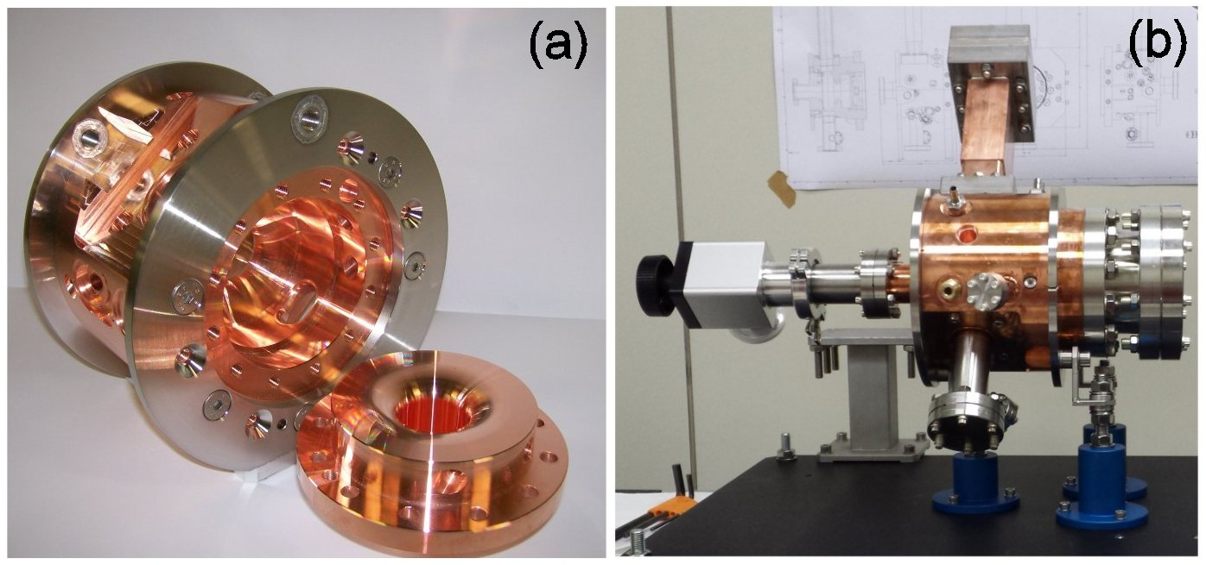
New Technology based on clamping for High Gradient RF Photogun
D. Alesini
⇒The new SPARC GUN has been realized without brazing using a novel process developed at LNF-INFN involving the use of special vacuum/RF gaskets.
⇒The new technique could be applied to other RF structures (S-Band, X band,…) and more high power tests (in X band as example) would be very useful to understand the criticalities and the limits of this new technology.
⇒The gun has been tested at high power at UCLA (Pegasus Laboratory). reaching about 92 MV/m cathode peak field.
⇒The results demonstrate the use of this novel technique for a high brightness photoinjectors (the ELI-NP RF gun, 100 Hz, multi-bunch has been built with this technology).
Notes:
David Alesini, LNF

Slide 18
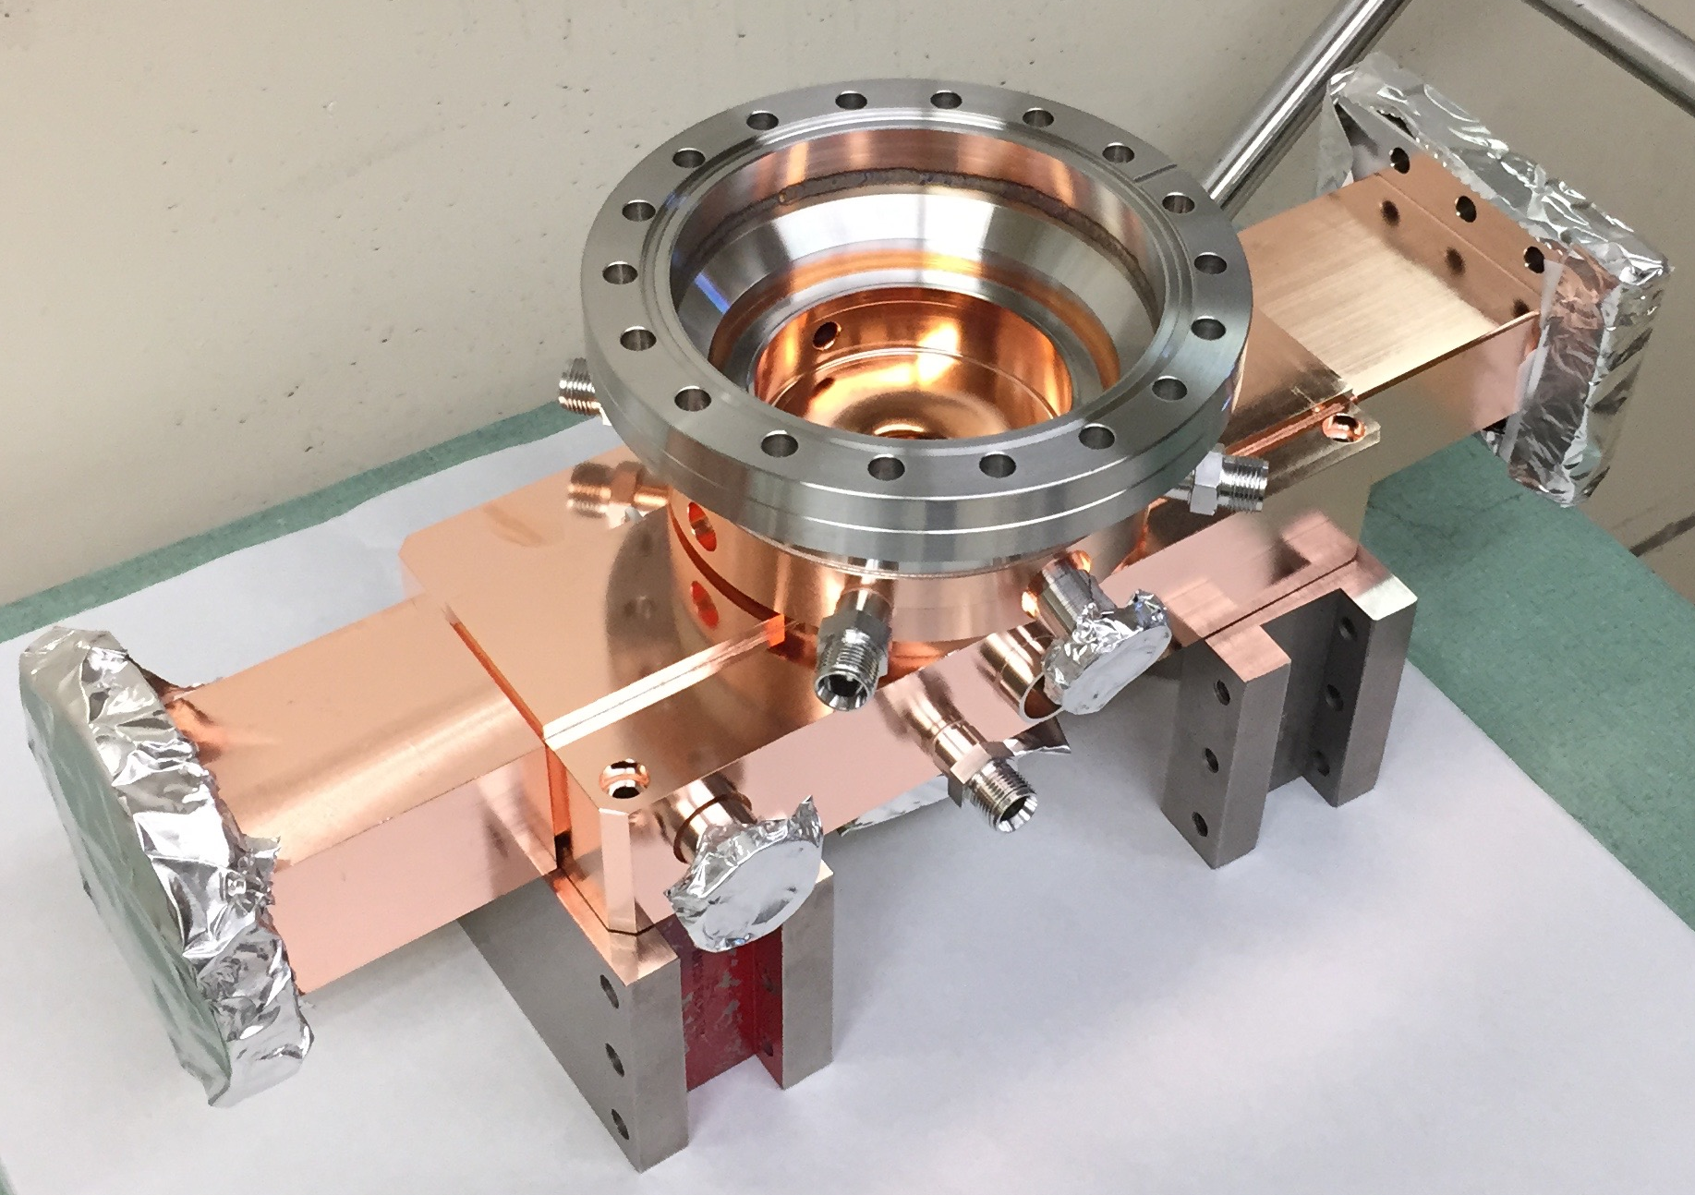
High-Gradient Normal-Conducting Radio-Frequency Photo-injector System for the STAR Project
L. Faillace
Radiabeam Technologies has recently performed the design, engineering, manufacturing, brazing and final tuning of a high gradient normal conducting radio frequency (NCRF) 1.6 cell photoinjector system for the STAR project (Southern european Thomson source for Applied Research), in progress at the University of Calabria (Italy).
The RF Gun is designed to operate with a peak accelerating electric field of 120MV/m, up to a repetition rate of 100Hz and 4μs RF pulse.
RF Gun main features:
Operation frequency: 2.856 GHz, π-mode
1.6 cell gun
Single feed with symmetric dummy waveguide to avoid field dipole component
Enhanced cell-to-cell coupling to produce a >15 MHz mode separation
Race track geometry to minimize field quadrupole component
“z-coupling” and “fat-lip” coupling slots to decrease surface magnetic field
Elliptical coupling irises for lowering surface electric field
RF Pulse Length ~ 4μs and 100 Hz repetition rate
Numeric codes for simulations: HFSS, Superfish.
The photoinjector system also includes the emittance-compensation solenoid
Resonant frequency f_{π} | 2.856 GHz
Mode separation Δf=f_{π}-f₀ | 15.3 MHz
Shunt Impedance R_{shunt} | 30 MΩ/m (avg.)
Unloaded Quality Factor Q₀ | 14,350
Coupling factor β | 2.0
Probe coupling | -73 dB
Peak E-field @ cathode | 120MV/m (P_{RF}=10.5 MW)
Peak surface E-field | 106MV/m
2nd European Advanced Accelerator Workshop (EAAC), 13-19 September 2015, Elba, Italy
Notes:
Luigi Faillace (RadiaBeam):
WW: Electron sources are key technology for all accelerator development. Here example for commercially available gun.

Slide 19
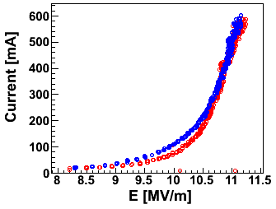
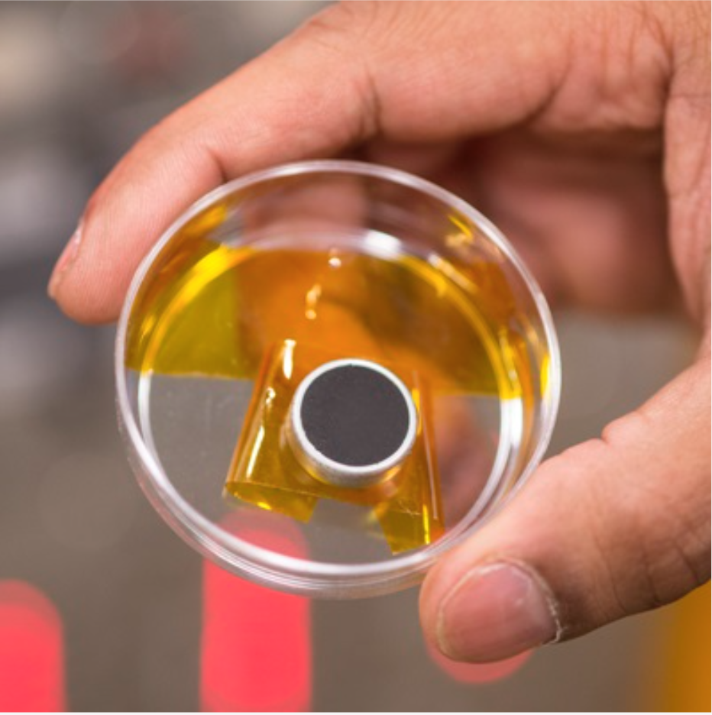
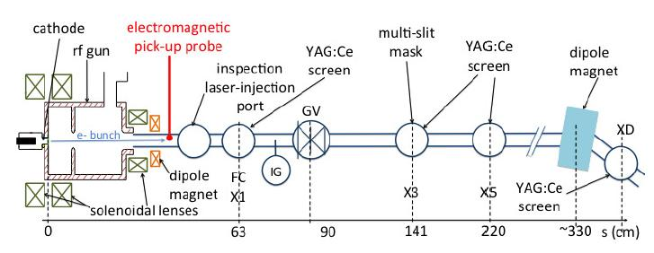
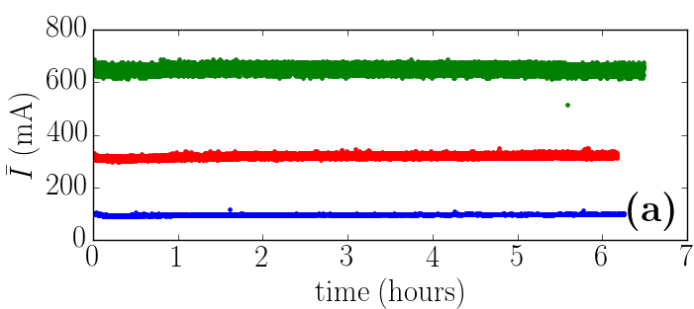
Experimental Results of Carbon NanoTube Cathodes inside RF Environment
L. Faillace
RadiaBeam has recently tested CNT cathodes both with DC and RF fields. We have observed beam currents up to about 1A (averaged over the macropulse) with a CNT cathode inside an L-band RF gun. Steady operation was observed up to 650 mA and the measured current versus surface field plot showed good agreement with the Fowler-Nordheim distribution with enhancement factor β~500 [1].
Max charge per bunch and length:
Single-bunch peak current:
Normalized transverse emittance (@5mA, 2.9 MeV):
ε_{x,n} = 2.6±0.8 μm
I-E curves. The measurements were performed with solenoids off (red) and solenoids on (blue).
Experimental Setup@HBESL (FermiLab)
[1] D. Mihalcea, L. Faillace, P. Piot et al., Ampère-Class Pulsed Field Emission from Carbon-Nanotube Cathodes in a Radiofrequency Resonator, Applied Physics Letters 107, 033502 (2015); doi: 10.1063/1.4927052
2nd European Advanced Accelerator Workshop (EAAC), 13-19 September 2015, Elba, Italy
Notes:
Luigi Faillace (RadiaBeam), second talk:
Photocathode material R&D with CNT

Slide 20
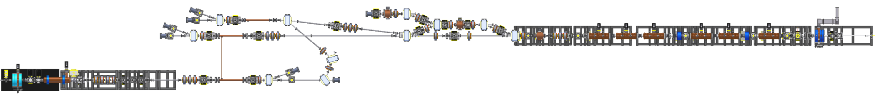
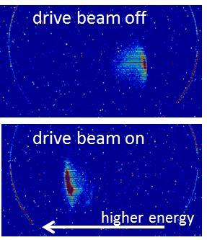
Argonne Wakefield Accelerator Facility (AWA)
M. Conde et al.
collinear & TBA
EEX
experimental area
70 MeV drive beam
15 MeV witness beam
bunch trains of up to 32 bunches
Maximum charge in single bunch 100 nC
maximum charge in bunch train 600 nC.
single bunches
bunch charge 0.05 to 60 nC
Initial experimental results using recently upgraded AWA facility:
Two-beam-acceleration (TBA) at 11.7 GHz: preliminary data shows 50 MV/m accelerating gradient with 90 nC drive bunch train
37 MW generated at 26 GHz TBA setup
EEX operating successfully
Collinear acceleration with 91 GHz structure (60 MV/m)
Notes:
Manoel Conde, Argonne National Labs
WW: Argonne Wakefield Accelerator Facility is up and running. Drive beam: new 70MeV, lots of charge. Beam point at each other, but they can also do collinear experiments. Cool stuff with drive beams: easy to switch frequencies. Up and running well.
AWA facility has good capabilities for wakefield acceleration experiments.
Recently upgraded facility has good initial results: Two-beam acceleration at 11.7 and 26 GHz, collinear acceleration at 91 GHz, and EEX experiment (emittance exchange).

Slide 21
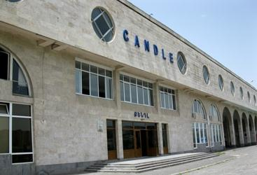

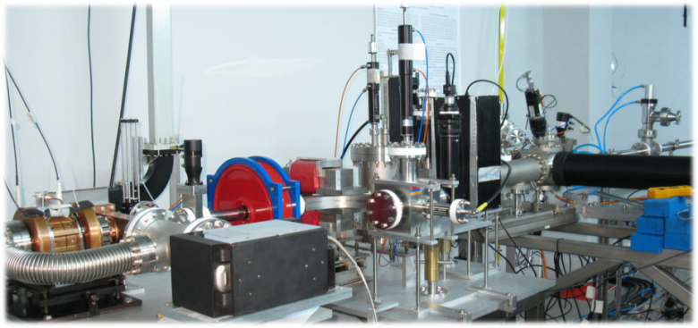
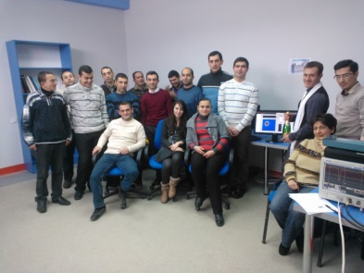
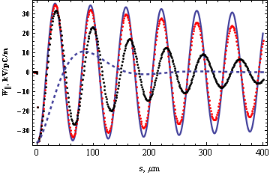
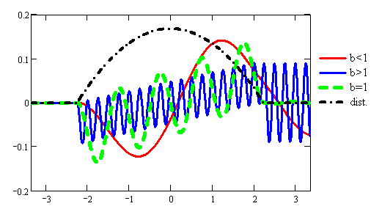
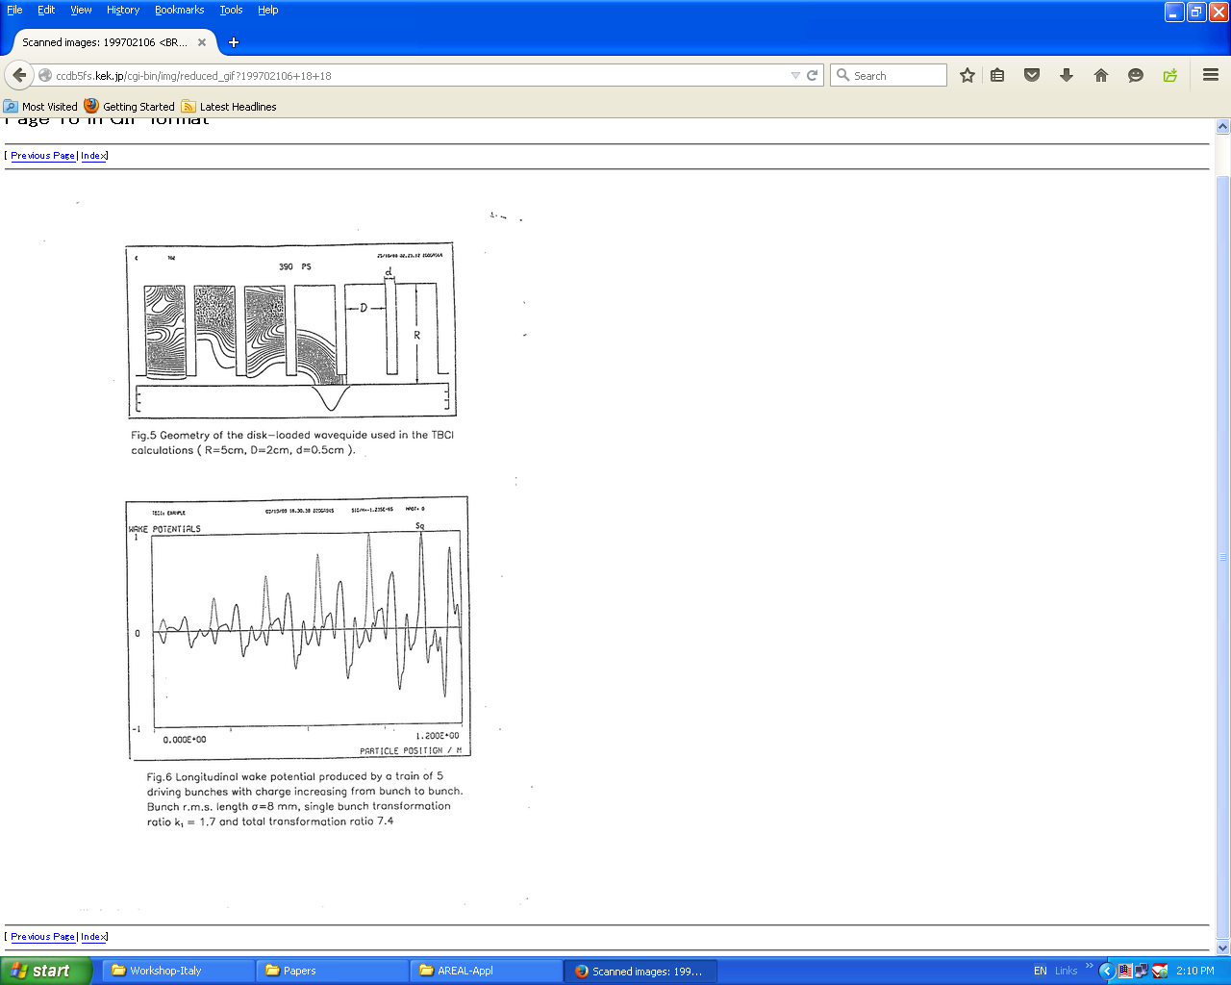
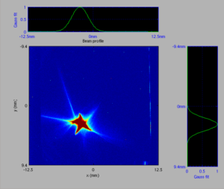
V.Tsakanov – AREAL Test Facility for Advanced Accelerator and Radiation Concepts
AREAL
New Single Mode Structure
Wakefield Microbunching
Beam parameters
Max Energy – 4.8 MeV
Bunch charge – 800 pC
Energy Spread < 1%
Norm emittance ~0.5um
AREAL R&D Program
New Accel. Concepts
New radiation sources
Novel Beam Diagnostics
Two-Beam Accel
Collinear Wake Field Accel
F1
F2
Driving Beam
Accel. Bunch
Notes:
Vasili Tsakanov, Candle Synchrotron Research Institute
WW: After tough post-Soviet Union times, great news from Armenia. ... 3 GHz linac, new laser system for photoinjector, RF gun from DESY (REGGAE). Accel. development but also user community and education.
AREAL – Advanced Research Electron Accelerator Laboratory – is Laser driven RF gun based linear electron accelerator under construction at CANDLE Institute in Armenia. The first stage – the 5 Mev RF photogun is completed in 2014. The 2016-2017 program foresees the energy increase to 50 MeV for driving the THz SASE FEL experimental station.
The R&D program at AREAL facility includes the study and test of novel accelerator and radiation sources concepts. The following experimental program are foreseen at the new facility
- Principle-proof experiment of the new two-layer metallic structure as a single mode accelerating structure in THz frequency range.
- Wakefield energy modulation and microbunching of Non-Gaussian bunches (rectangular, parabolic etc)
High transformer ration collinear wake field accelerator concepts
High transformer ratio two-beam Transformer Storage Accelerator Concept

Slide 22
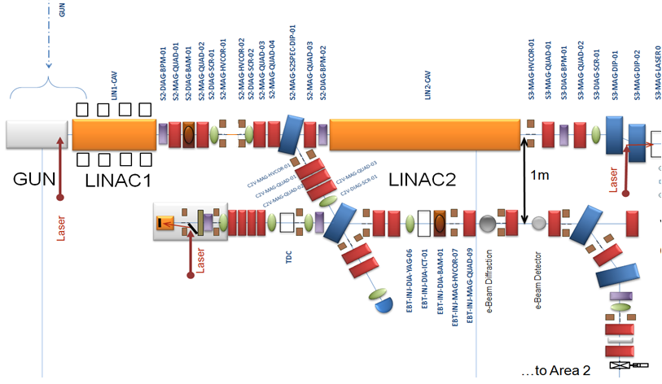
CLARA Front End (Compact Linear Accelerator for Research and Applications) – commissioning in 2016
Y. Saveliev
CLARA FE linked to VELA via a dog-leg section
Three potential “user” areas :
“straight on” (~50MeV or ~15MeV in velocity bunching mode)
BA1 (~50MeV)
BA2 (~25MeV)
Bunch compression in dog-leg
Beam in BA1:
Bunch charge ≤ 250pC
Emittance <10mm-mrad
Bunch length <0.3ps RMS
Energy spread <1.0% RMS
Beam size <0.1mm
CLARA FE
~50 MeV ; ~15 MeV in VB mode
To BA1 : ~50 MeV
~15 MeV in VB mode
VELA
To BA2
~25 MeV
Notes:
Yuri Saveliev, STFC, Daresbury Lab, ASTeC
WW. VELA (5MeV) up and running. Capability will be maintained. Now they add CLARA front-end to obtain 50 MeV. FEL test facility, hopefully also to be used for accelerator work.
22

Slide 23
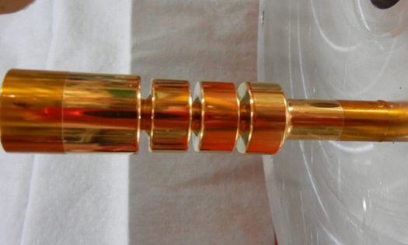



X-­Band accelerator structures:on going R&D at the INFN-LNF
B. SPATARO
1) Electroformed Au-Ni structure
The structure’s mandrel with a 3 µm thick of Au’s coating
Final structure after coating of Ni with a 4 mm thick
Iris cooling video of
the electroformed
Au-Ni structure
2) Sputtering activities: Enhanced conductivity via thermal annealing(Mo/Sapphire)
Mo coatings with an electrical conductivity comparable to that of copper can be obtained optimizing the thickness and the post-deposition annealing process
Resistivity values of BRN1 and BRN2 samples for different annealing temperatures. These annealed coatings are multiphase metallic films with negligible contributions of disordered oxide phases
Notes:
Bruno Spataro, INFN – LNF
WW: Tries to develop new electroforming techniques to expand materials and forming techniques for high-frequency RF structures.

Slide 24





Design and Test of Damped/High Gradient/High Repetition Rate C-Band Accelerating Structures for the ELI-NP LINAC
The linac energy booster of the European ELI-NP proposal foresees the use of 12, 1.8 m long, travelling wave C-Band structures.
Because of the multi-bunch operation, the structures integrate a very effective dipole HOM damping system to avoid beam break-up (BBU).
An optimization of the electromagnetic and mechanical design has been done to simplify the fabrication and to reduce their cost.
The high power test on the first full scale structure shown the feasibility of the 33 MV/m, 100 Hz, long RF pulse operation
D. Alesini
Notes:
David Alesini, LNF
WW: First prototy for LINAC for ELI-NP (Romania) has been competed and was succesfully high-power tested in Bonn.

Slide 25
Mille grazie!

