Slide 1
Consuntivi 2013 – Gruppo V
Il gruppo V – panorama
Esperimenti in sezione:
  Apollo (terminato) – A. Lanza*
  Apotema – A. Salvini
  Arco (terminato) – M. Prata
  Diapix (terminato) – G. Traversi
  MC-INFN – A. Rimoldi
  Meridian-Mira (iniziato nel 2014) – A. Ottolenghi
  Mice – A. Debari
  Mimo-Bragg (terminato) – F. Ballarini
  Nettuno – S. Bortolussi, S. Altieri*
  Neutargs – S. Bortolussi
  Normet – A. Buttafava
  Radiostem – A. Ottolenghi
  Redsox – P. Malcovati
  Spes – A. Tomaselli (progetti speciali)
  Vipix (terminato) – L. Ratti, V. Re*
* Responsabile nazionale

Slide 2
Gruppo V 2013
71 sigle (80 nel 2012, 90 nel 2011). A ottobre 2013 sono anche stati finanziati 296,5 k€ di anticipi 2014.
Nel 2013 sono state istituite le cosiddette “Call”, collaborazioni di piu’ ampio respiro delle normali sigle sia per numero di partecipanti che per richieste finanziarie. Nella riunione di ottobre 2013 ne sono state approvate 3 per circa 1M€ annuo totale (2 hanno gruppi pavesi).
Sempre nel 2013 sono stati istituiti I cosiddetti “Grant giovani”, che finanziano proposte di ricercatori con meno di 6 anni di anzianita’ dal PhD pagando al proponente una borsa biennale. A novembre ne sono stati assegnati 3 per il 2014-2015 (nessuno a Pavia).
CSN5 - Bilancio 2013
Descrizione | Richieste 2013 | Finanziato 2013 | Differenza rich – fin 2013 | Differenza fin 2013 - 2012
Esperimenti | 8653,6 | 4224,0 | -4429,6 | +1516,0
Esp. su dot. | 719,0 | 276,0 | -443,0 | -594,0
Dotazioni | 816,5 | 528,0 | -288,5 | +77,0
Totali | 10189,1 | 5028,0 | -5161,1 | +999,0

Slide 3
Distribuzione afferenti nel 2013 - nazionale
Ricercatori/tecnologi 2013
Ricercatori/tecnologi 2012

Slide 4
Distribuzione afferenti e finanziamenti nel 2013 - Pavia
Pavia e’ la 7ª struttura nazionale per numero di afferenti al gruppo V (era 5ª nel 2012), la 5ª per gli FTE (era 4ª nel 2012)
CSN5/Pavia
Ric - Tec
CSN5/Pavia
Richieste finanziarie
CSN5/Pavia
Finanziato CSN5/Pavia

Slide 5
NeTTuNO
BNCT group
CS June 2014

Slide 6
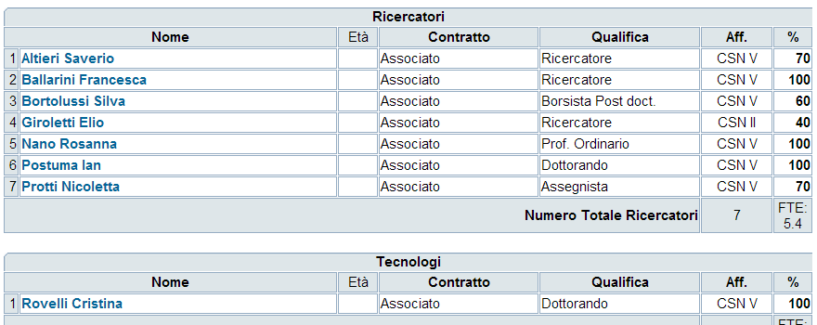
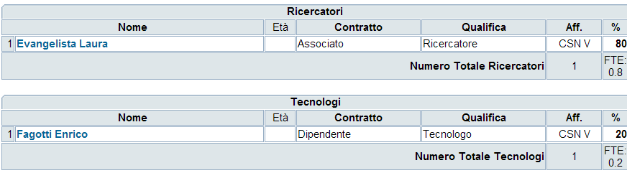
Responsabile Nazionale: Saverio Altieri
Sezione di Pavia
Budget 2013
Pavia: 53.5 k€
LNL: 12 k€
Laboratorio Nazionale di Legnaro

Slide 7
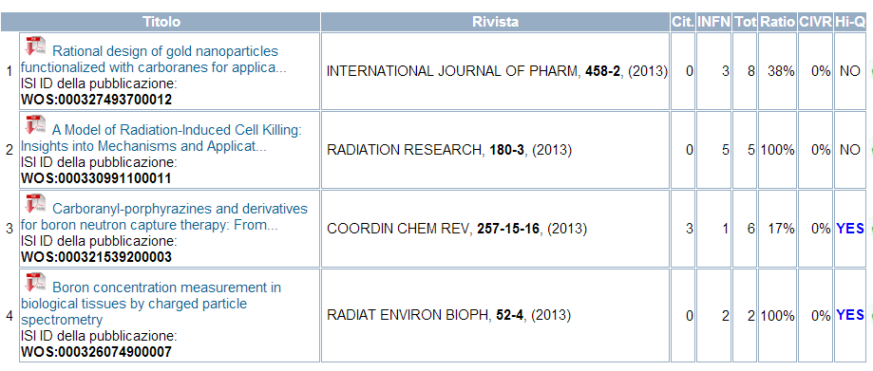
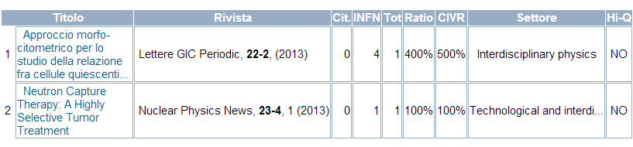
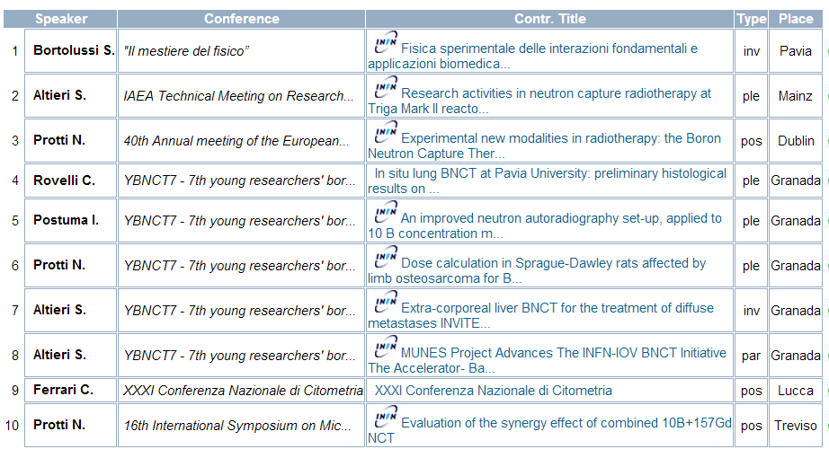
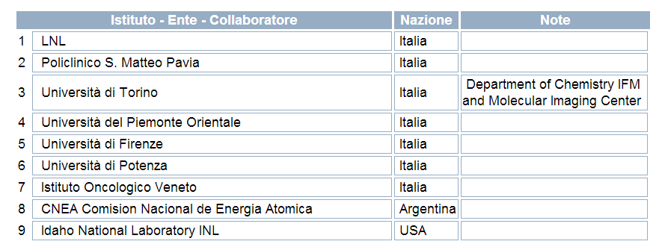
Pubblicazioni
Talks
Collaborazioni

Slide 8
Aim of the experiment
NeTTuNo
wants to study the necessary conditions to apply BNCT to thoracic tumours that today have no cure, in particular: tumours disseminated in lung, mesothelioma, cutaneous recurrences of breast cancer.
The research will be carried out first of all testing BPA, which is the boron carrier presently employed in clinic.
On the other hand, new boronated formulations that may be used in future as drugs for patients will be tested.
The experiments will be performed in cell cultures and in animal models concerning the study of new compounds, and measurements of boron uptake will be performed in patients of Istituto Oncologico Veneto (Padova) affected by skin recurrences of breast cancer. These measurements will be carried out by PET, administering to voluntary patients BPA labeled with F18.

Slide 9
Main activities during 2013
Summarizing, in 2013 experiments were performed:
In vitro experiments with new molecule
In vivo experiments
The in vivo tests of two new formulations have been initiated (LDL/AT101 and liposomes loaded with Gd-B-AC01 functionalized with a pegilated phospholipid containing a folic acid residue at the end of the PEG chain) on two lines of cells: human ovarian carcinoma cells (IGROV-1), mammary carcinoma cultured cells (TUBO); moreover in vivo tests have been initiated with liposomes loaded with lactosyl-carborane (LCOB) on a rat model with lung metastases and tests with AT101 on Balb/C mice inoculated with mammary carcinoma cells (TUBO).
The Unit of Legnaro is dedicated to the set-up of the boron concentration measurement in patients using 18F-BPA. In order to go on with this experiment it is necessary the approval by AIFA of the protocol of administration of this compound to patients. The protocol has been submitted to AIFA more than one year ago and we are still waiting for. Meanwhile, a contract with the company ACOM has been signed for the production of 18F-BPA and the experimentations necessary to administrate the compound to the patients. The company has tested the purity of the drug, with positive results (June 2013). A protocol for the dynamic of acquisition of PET/CT has been assessed in Padova for the use of 18F-BPA. The different methods of image reconstruction have been compared from the point of view of internalization of the boron compound in the neoplastic and healthy cells.
The Unit of Pavia performed Computational dosimetry calculations to evaluate the irradiation of lung tumours in patients with external epithermal neutron beams. MCNP5 was used together with a new TPS named MultiCell employing CT scans of patients with lung tumours.

Slide 10
BNCT with new carriers on human cells
BNCT was performed on mammary carcinoma cells(TUBO) and on a murine macrophages cell line (J777). Cells, after incubation with boron containing compound (LDL/AT101), were irradiated in the reactor. The proliferation curve obtained in the following 6 days shows a clear effect of neutron irradiation on cells irradiated after incubation with boron

Slide 11
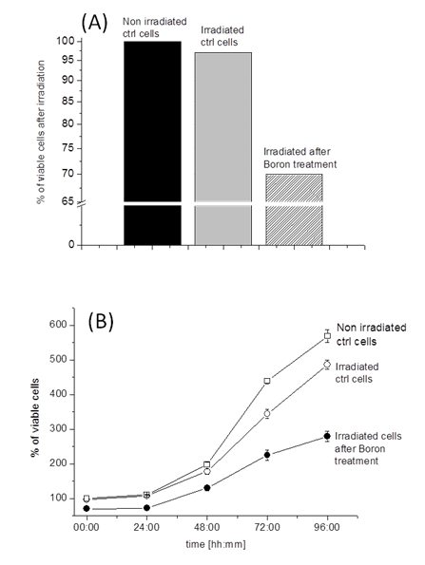
A formulation based on liposomes loaded with 10B and Gd was tested on human ovarian carcinoma cells (IGROV-1). The agent (Gd-B-AC01) consists of a carborane unit (10 boron atoms) bearing a cholesterol unit and a Gd. The number of survived cells was markedly smaller after BNCT with GdB10-AC01/liposomes.
Cell cultures of tumours with unknown primary obtained by patients are presently in preparation, to perform cell uptake measurements due to BPA and liposomes loaded with LCOB

Slide 12
In vivo studies
Liposomes loaded with lactosyl-carborane (LCOB)
Boron concentration measurements have been performed in healthy lung and tumours of a rat model with lung metastases, after administration of liposomes loaded with lactosyl-carborane (LCOB) and covered with PEG.
Different percentages of PEG have been tested in vitro in order to determine the best configuration regarding boron absorption in cells. The best results have been obtained with 1.25% and 2.5% PEG; these are the configurations used for the liposomes administration to rats. After the liposome intraperitoneal injection animals have been sacrificed at 4, 18 and 24 hours. Tumour, normal lung and liver samples have been collected and analyzed by means of quantitative neutron autoradiography. The results show a better uptake in the case of 2.5% PEG. Moreover is evident that the liver uptakes high concentration of boron, as expected being liposomes made of lipids.

Slide 13
study of effectiveness of BNCT mediated by the new formulation set-up by University of Turin
a boronated molecule with LDL and labeled with an MRI probe (AT101). A first experiment consisted in irradiating Balb/C mice inoculated intravenously with about 50000 mammary carcinoma cells (TUBO) three weeks before BNCT, when cells start to form pulmonary metastasis of about 1 mm diameter. The analysis of the irradiation effects are underway.

Slide 14
Legnaro Unit
The Unit of Legnaro is dedicated to the set-up of the boron concentration measurement in patients using 18F-BPA. After almost 2 years, all the burocratic steps have been completed in order to obtain AIFA approval for the employ of 18F-BPA produced by ACCOM.
A protocol for the dynamic of acquisition of PET/CT has been assessed in Padova for the use of 18F-BPA. The different methods of image reconstruction have been compared from the point of view of internalization of the boron compound in the neoplastic and healthy cells.

Slide 15
In Collaboration with CNEA (Argentina)
Computational dosimetry calculations have been performed to evaluate the irradiation of lung tumours in patients with external epithermal neutron beams. MCNP5 was used together with a new TPS named MultiCell employing CT scans of patients with lung tumours.
The work demonstrated that it is possible to deliver high doses to the lung tumour (shallow, deep-seated and even disseminated) while sparing normal tissues
The best beam has energy around 1 keV, while common opinion set the best mean energy around 10 keV.

Slide 16
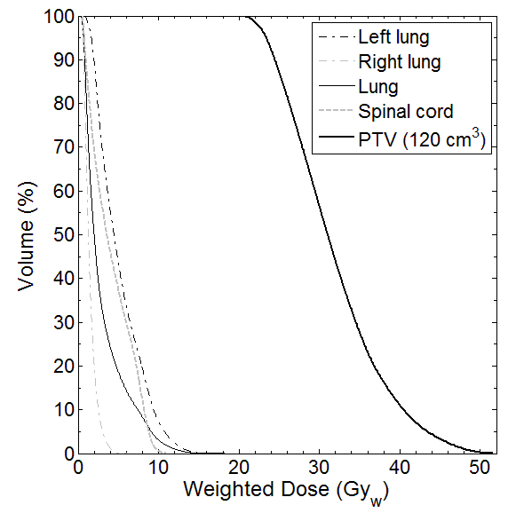
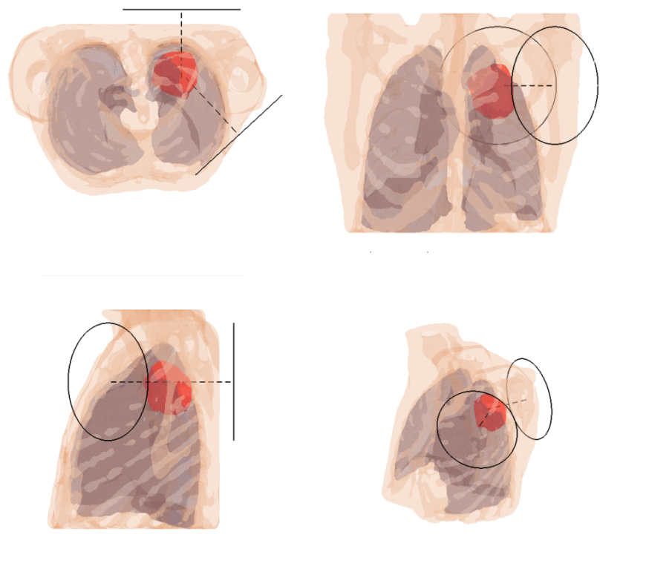
Example of treatment plan for a lung tumour

Slide 17
NEUTARGS
BNCT group Pavia

Slide 18
GOAL: develop high power neutron production targets, for different uses in particular “Thick” targets (beam stopped) with moderators, “Thin” targets, composite targets per diverse applicazioni tra cui la BNCT
Compiti di Pavia:
Simulazione radioprotezione sale di irraggiamento
Studio computazionale della reazione (p,n) con diversi codici M.C.

Slide 19
Partecipanti
Bortolussi 40 (resp locale)
Altieri 30
Protti 30
Responsabile Nazionale: Jeffry Wyss

Slide 20
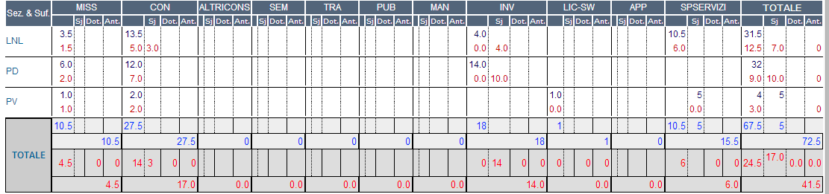
Assegnazioni

Slide 21
Conferenze
Workshop on Accelerator based Neutron Production ABNP 2014, Legnaro, Padova, Apr 2014 L. Silvestrin, “ANEM: a rotating composite neutron production target for Single Event Effects Studies at the 70 MeV Cyclotron of LNL-INFN”
UCANS-IV : 4th Int.Meeting of Union for Compact Accelerator-driven Neutron Sources 23rd - 27th Sept. 2013
Sapporo, Hokkaido, Japan, D.Bisello "The QMN beam line of the neutron-induced Single Event Effects facility at the 70 MeV Cyclotron of LNL-INFN“, published on Physics Procedia
HeRe in Italy 2-3 Dec. 2013 ENEA Centro Ricerche Frascati, L.Silvestrin NEPIR at SPES: a Versatile Neutron and Proton Irradiation Facility for Radiation Damage Studies and Industrial Applications

Slide 22
Simulazione di produzione neutronica in target di Be a varie energie e vari angoli

Slide 23
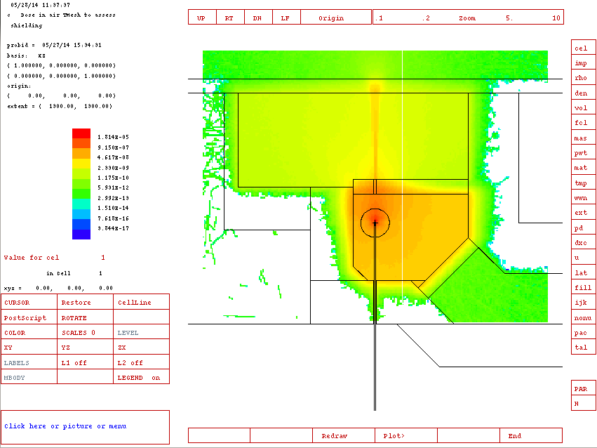
Shielding in experimental hall

Slide 24
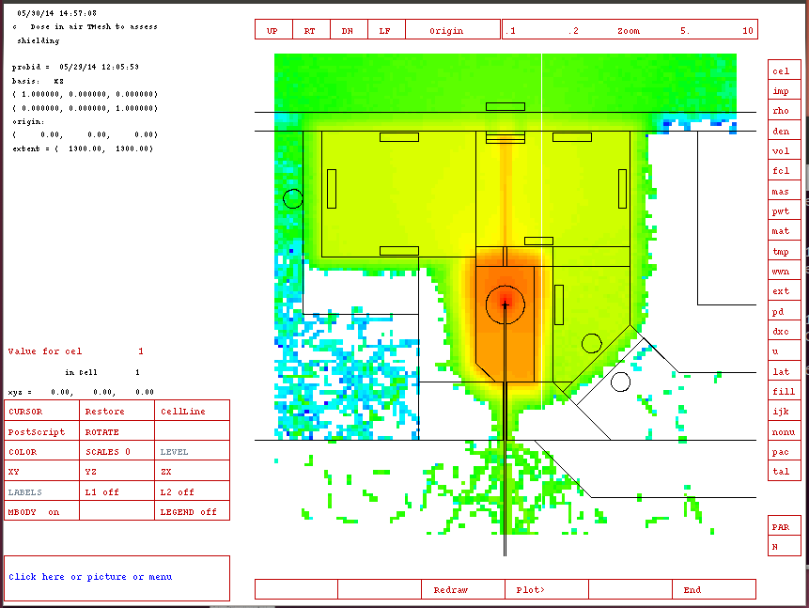
Neutron field in experimental hall, improved shielding
Beam dump:
20 cm Fe + 20 cm Al + 20 cm Polietilene borato

Slide 25
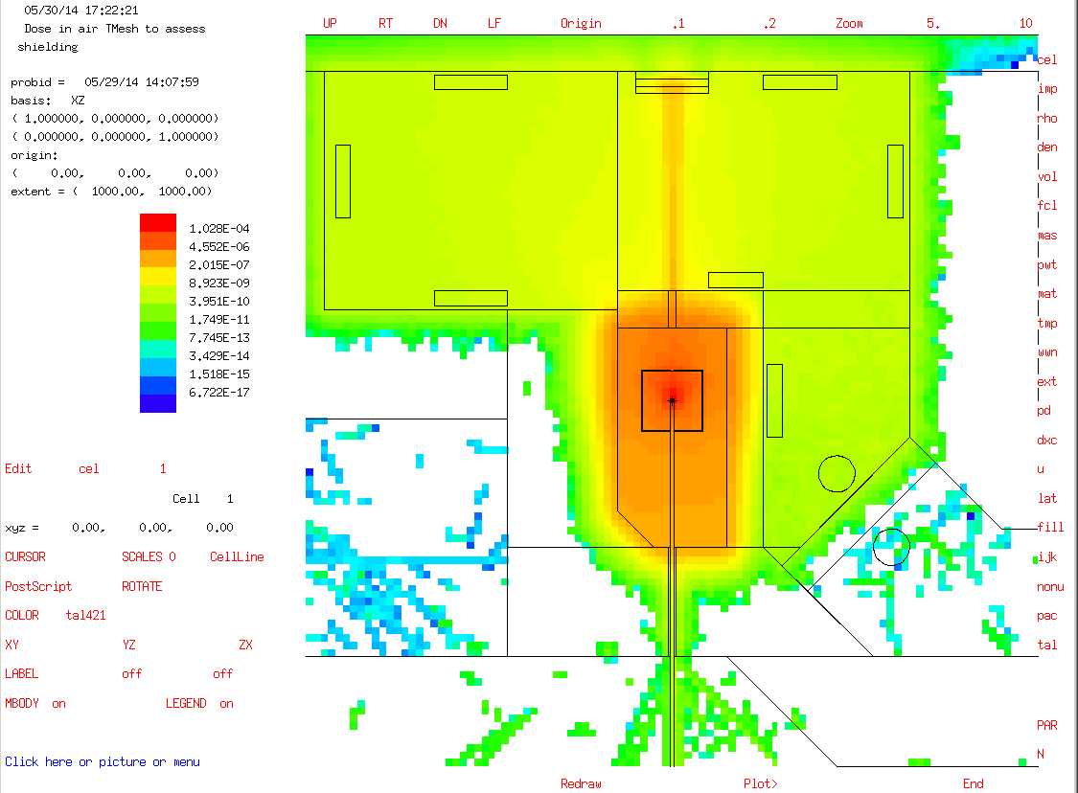
Neutron field in experimental hall, shielding suggested by Juan: a box with 2 layers:
1’ Fe and 1’ polyethilene enriched with Boron
Shielding composito di Juan: dentro e’ aria

Slide 26
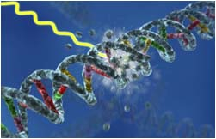
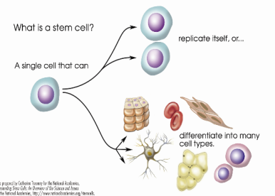
RADIOSTEM
Meccanismi di risposta RADIObiologica a fotoni e a particelle cariche di cellule STaMinali tumorali e derivanti da tessuto sano
Responsabile Nazionale: M.A. Tabocchini
(Istituto Superiore di Sanità, INFN-Roma1,Gruppo coll. Sanità)
(2012 – 2014)
Sezioni partecipanti:
Roma 1, Gruppo coll. Sanità (Responsabile locale: M.A. Tabocchini)
Pavia (Responsabile locale: A. Ottolenghi)
Aim of RADIOSTEM experiment: to investigate the metabolism and the radiobiological response of cancer stem cells isolated from glioblastoma patients (GSCs) as well as of human neural stem cells to photons, protons and C-ions using an integrated experimental and theoretical approach

Slide 27
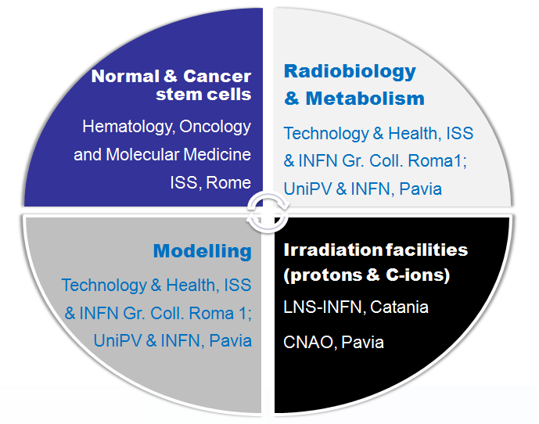
Rationale
Glioblastoma multiforme (GBM) is the most common and malignant primary brain tumor, with very poor prognosis. The high recurrence rate and failure of conventional GBM treatments are expected to be related to the presence of radio-resistant cancer stem cells (CSCs) inside the tumor mass. CSCs can both self-renew and differentiate into the heterogeneous lineages of cancer cells.
The response of normal human neural stem cells is also investigated in order to identify signalling pathways/molecules involved in the cross-talk between cancer and normal stem cells.
Pavia Role
MC simulation of DNA damage
Experimental investigation of radio-sensitivity for normal stem cells
Interplay between radio-stimulated signals for normal and tumour cell lines

Slide 28
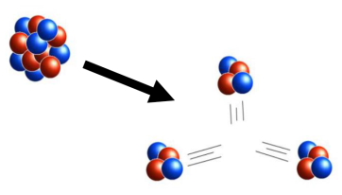
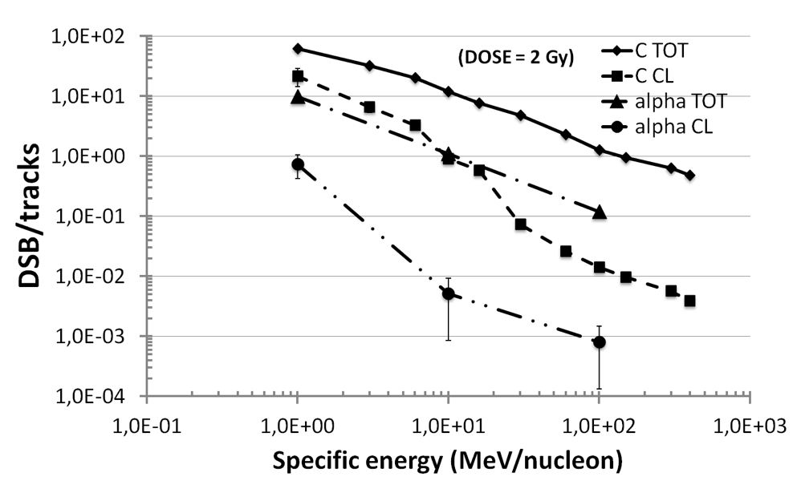
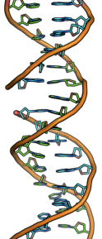
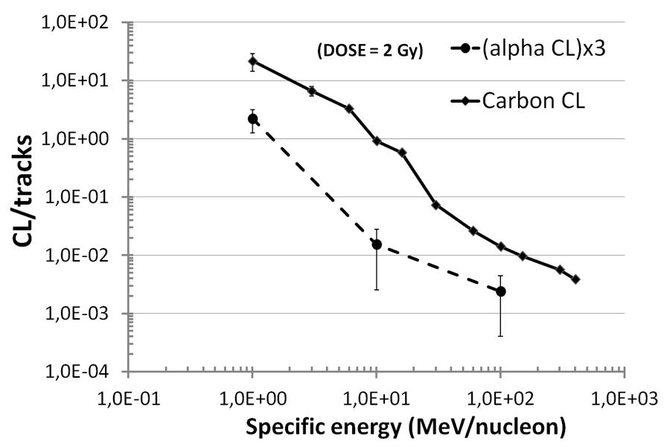
Monte carlo simulations of DNA-damage
1st year - systematic study on DNA-damage induction by primary carbon ions at different energies
(from 100 keV/u to 400 MeV/u), and LET (also equal values at the two opposite sides
of the Bragg peak), track structure code PARTRAC
2013 - focus on DNA-damage induction by secondary hadrons produced by nuclear reactions
(α’s from C fragmentation in from 1 to 10 MeV/u)
Double Strand Breaks and Complex Lesions (fragments < 30 bp) per ¹²C / α track
CLs per ¹²C track vs. CLs per (3 α tracks)
3α / primary carbon effectiveness
maximal for C fragmentation occurring:
* at the end of the path of a slowed down C (min Eα)
* at the beginning of the track for a higher energy C (max Eα)

Slide 29
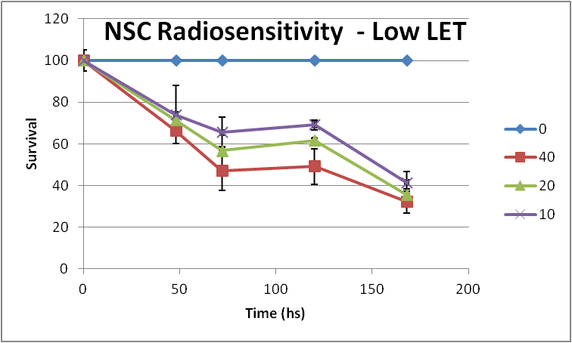
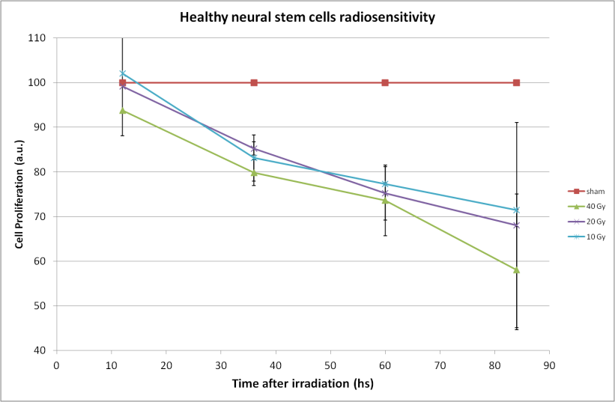
Radio-sensitivity for NSC
(Normal Stem Cells)
X Rays – Maugeri Hospital
80-87 keV/μm Carbon Ions @ CNAO 29/3/14
Viability study has been performed on NSC cells after low and high LET irradiation exposure.
reduction in the proliferation rate for cells irradiated with Carbon ions up to 128 hours after irradiation
mild dependence on radiation dose above 10 Gy, up to 40 Gy
Same dose-response curve obtained for survival in the corresponding tumor cell lines.
No significant role of different radiation quality

Slide 30
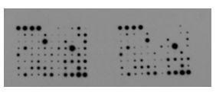
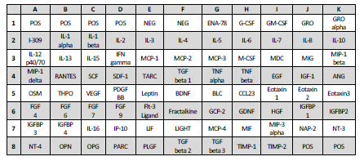
TSC: Cytokines Signalling
40 Gy C-ions
sham
Expression Cytokine “X” in irradiated sample
Fold
change =
Expression Cytokine “X” in sham sample
Se FC≥1.0 => FC
Se FC<1.0 => -(1/FC)
Glioblastoma stem cells (clone #83)

Slide 31
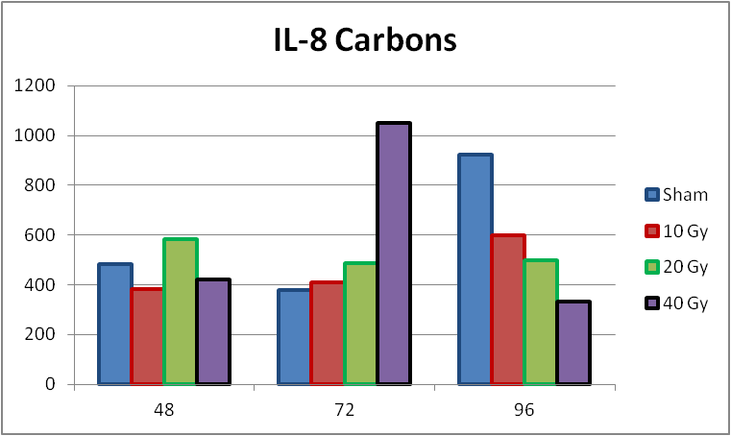
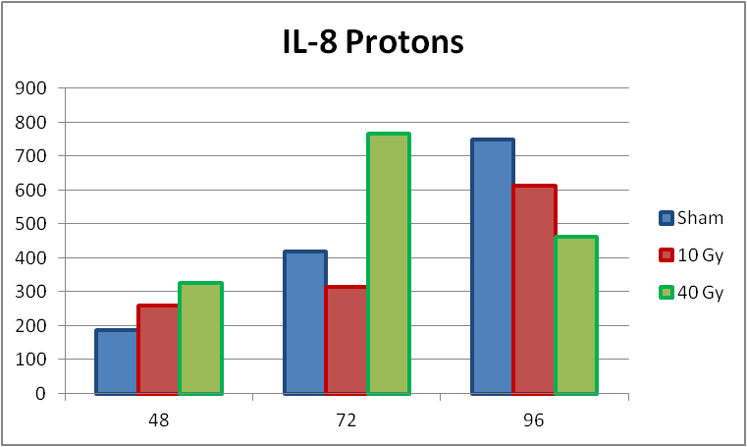
NSC and TSC Interplay
62 MeV/u Protons @ LNS 22/2/13
62 MeV/u Carbon Ions @ LNS 22/2/13
NSC cells
  substantial absence of the IL-6 and IL-8 in normal stem cells culture media.
TSC cells
  cytokine spectrum dramatically changed for the tumor cells, even between different clones.
  IL-8 release (molecule involved in the angiogenesis and migration) for the #83 cells, that decreased with the increase of the high LET dose up to 96 hours.
  #1 clone cells show a cytokine profile completely different, with no IL-6 and IL-8 release whatsoever.
The different secretome, combined with the different features at the metabolic and genomic level, provided useful insights in the mechanisms driving the different clinical outcomes of #1 and #83 (poorest diagnosis) tumour clones.

Slide 32
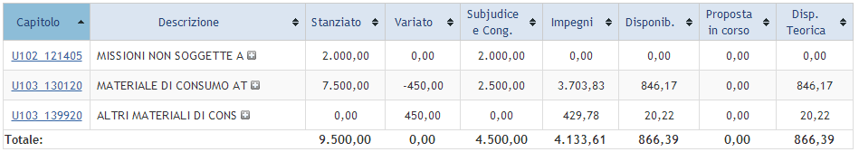
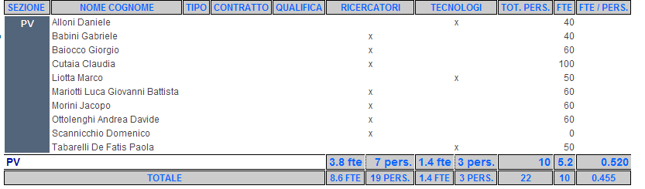
INFN-Pavia Financial Aspects
2014

Slide 33
MERIDIAN-MIRA
(Sezioni di Bologna, Pavia, Napoli e Trieste e collaborazione con UniVR)
Measuring the effect of radiation on differentiation and immunity
Purpose of this project: study the interplay between tumor model and the immune system and role of radiation in the enhancement/decrease of adaptive effects.
This project utilizes both an in vitro epithelial model with differentiated and proliferating cells (CaCo2), and dispersed leukemic cells (HL-60), which provide a simpler and cleaner setting than previous experimental models.
Pavia Role:
Evaluating tumour cells (CaCo2 cells) radiosensitivity
Evaluating effects of radiation of the CaCo2 Integrity (trans-epithelial membrane - TEER)
Evaluating radiation effect on the inflammatory molecules

Slide 34
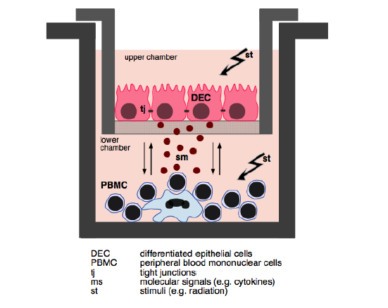
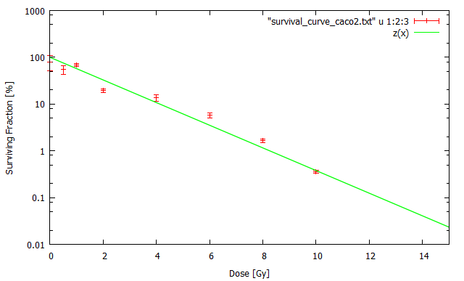
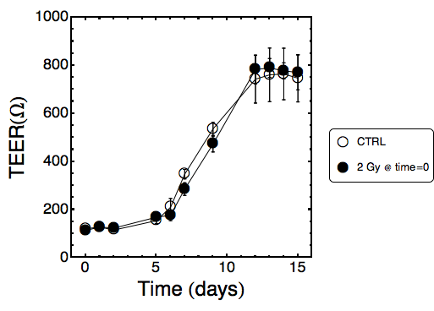
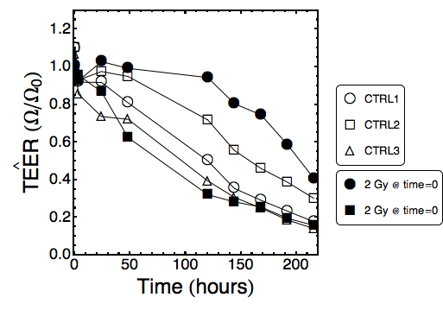
Preliminary results from the irradiation of the transwell system (CaCo2 cells)
Low dose radiation does not interfere with the differentiation program
Low dose radiation does not alter the integrity of the epithelium layer

Slide 35
CaCo 2 Signalling Spectrum
10 Gy γ-rays
sham
Differentially regulated cytokines were identified at 72 hours after irradiation.
Some of the more perturbed signaling proteins are known to be involved in macrophage recruitment and the inflammatory response --> deeper investigation at intermediate doses and more time points will be performed.
Colon Carcinoma cell line (Caco-2)

Slide 36
Preliminary Results & Way forward
Low (and moderate) doses of radiation do not seem to be able to alter the structural features of the cancer cells (trans-epithelial resistance)
On the other hand, high dose (of interest for radiation therapy) are able to deeply change the signalling spectrum (especially in its ability to recruit immune cells at the damage sites) with particular emphasis on
  MDC (60 time increase after irradiation)
    family of secreted proteins involved in immunoregulatory and inflammatory processes.
    The cytokine displays chemotactic activity for monocytes, dendritic cells, natural killer cells and for chronically activated T lymphocytes.
  IL-13
    IL-13 is suspected to be a more central mediator of the physiologic changes induced by allergic inflammation in many tissues.
  IGFBP – 3
  The effect of radiation in the release of these chemotactic molecules clearly suggests the hypothesis of a modulation of the immune system at the site of irradiation.
Way Forward: Co-culture of the CaCo2 Cells with PMBC (blood cells) to evaluate an enhanced levels of tumoural cell death due to the combined effect of direct radiation exposure and radiation-induced immune response.

Slide 37
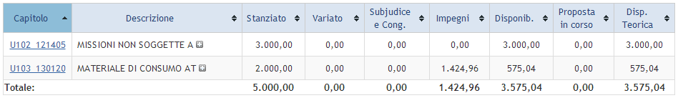
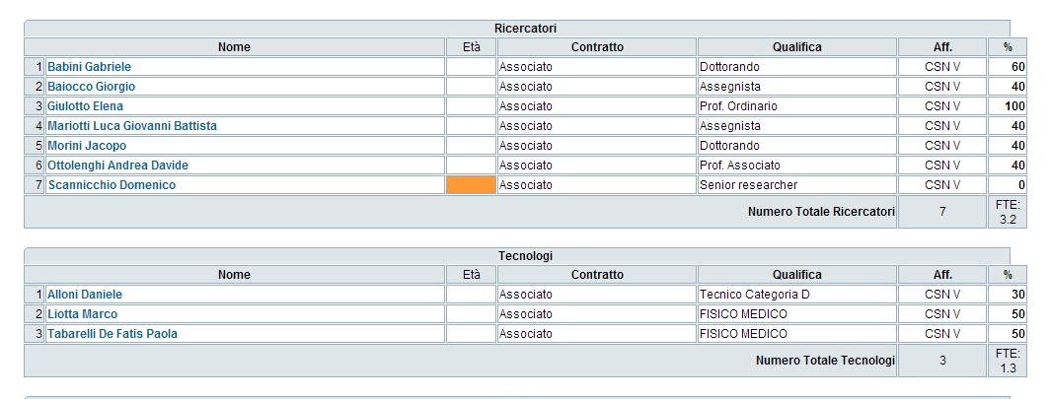
MERIDIAN
2014

Slide 46

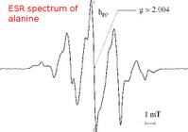
Obiettivi del progetto di ricerca
Sviluppo e studio di nuovi materiali dosimetrici per la caratterizzazione di campi di radiazioni prodotti da sorgenti di neutroni applicati anche nella BNCT.
Sviluppo di metodologie basate su spettroscopia paramagnetica elettronica (EPR) e termoluminescenza (TL) per la caratterizzazione delle modalità di rilascio dell’energia nel materiale da parte di fasci di diversa natura.
Durata del progetto: 2012-2014
Coordinatore nazionale: Dr. Maurizio Marrale, INFN Sezione di Catania
INFN Sezione di Padova: Coordinatore Dr. Antonio Barbon
INFN Sezione di Pavia: Coordinatore Armando Buttafava, Daniele Dondi, Alberto Zeffiro, Lorenzo Ventura
Assegnazioni 2013: 6.0 k€ (consumo)

Slide 47
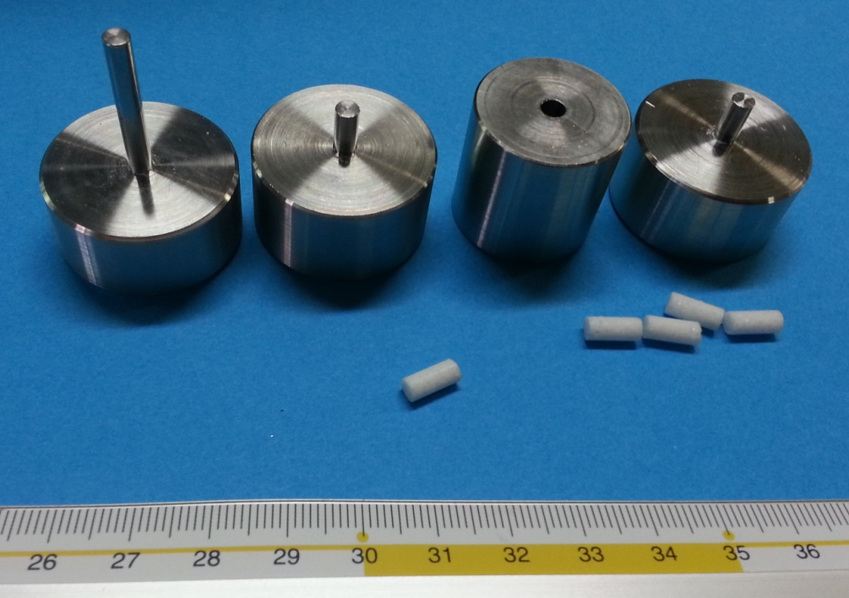
Nella prima parte di lavoro ci siamo occupati della preparazione di dosimetri basati su alanina e paraffina. E’ stato messo a punto un nuovo metodo di preparazione, basato sulla dissoluzione della paraffina e successiva rimozione del solvente (esano) sotto vuoto. Questo procedimento ha portato ad un incremento della riproducibilità dei dosimetri.
E’ stato inoltre realizzato, nell’officina INFN di Pavia, un pastigliatore in acciaio inox in grado di produrre cilindri dosimetrici di dimensioni opportune ad essere inserite in tubi EPR standard. L’uso dell’acciaio inox riduce il rischio di contaminazione con ioni metallici che potrebbe portare ad una attivazione del materiale quando è sottoposto ad irraggiamento a neutroni, oltre a perturbare il segnale EPR.

Slide 48
I dosimetri sensibili ai neutroni sono stati realizzati in prima istanza miscelando acido borico all’alanina (e paraffina).
Di fatto è stato notato che, per avere una buona risposta con i neutroni, il contenuto di acido borico deve essere elevato. Poiché aumentando il contenuto dell’assorbitore di neutroni si riduce quello del materiale dosimetrico, il compromesso migliore è stato trovato con il 50 % p/p di alanina e acido borico. Data la scarsa penetrazione delle particelle alfa prodotte, che è dell’ordine della dimensione dei grani utilizzati, si possono anche avere dei problemi legati alla riproducibilità dei dosimetri.
paraffina
n
alanina
acido
borico
Per questo motivo i materiali utilizzati, soprattutto l’alanina, sono stati setacciati e selezionati per ridurne la dispersione di dimensioni.

Slide 49
Oltre all’acido borico è stato utilizzato anche dell’ossido di gadolinio. Questo assorbitore di neutroni permette di ottenere una buona risposta dosimetrica anche con il solo 5% p/p rispetto all’alanina.
Studio di nuovi materiali dosimetrici
Sono stati testati vari materiali dosimetrici basati sulla formazione di radicali stabili nel tempo. Ci sono diversi fattori che influenzano la stabilità del radicale. Innanzitutto la natura cristallina del materiale può bloccare l’accesso dell’ossigeno (che nello stato fondamentale è tripletto con carattere biradicalico), come avviene per l’alanina. Abbiamo cercato di sfruttare questo effetto utilizzando cellulosa, un polimero a basso costo e facilmente disponibile. La cellulosa possiede infatti delle zone cristalline in cui i radicali possono sopravvivere per molto tempo. Purtroppo, dopo alcuni test abbiamo verificato che la stabilità del segnale non è sufficiente. Un altro modo per incrementare la stabilità dei radicali formati è basato sulla stabilizzazione del radicale mediante effetti elettronici o di ingombro molecolare, che rende quindi il radicale meno accessibile.
Tra i materiali più interessanti che sfruttano la stabilizzazione molecolare ricadono i fenoli, che sono largamente utilizzati nei polimeri per diminuire gli effetti di ageing. Molti fenoli a basso peso molecolare possiedono però punti di fusione bassi e quindi non sono direttamente utilizzabili. Tra i materiali testati, il più interessante è stato l’IRGANOX 1076.

Slide 50
IRGANOX 1076
Questo composto è risultato interessante dal punto di vista dosimetrico, in quanto i radicali formati sono stabili e anche perché è disponibile in grandi quantità e a basso costo in quanto appunto utilizzato come stabilizzante nei materiali polimerici. Con questo composto abbiamo preparato vari dosimetri in presenza di boro e gadolinio.
Film dosimetrici
I film dosimetrici preparati sono basati sull’idea di avere un materiale inerte di supporto (acetato di cellulosa) sul quale viene depositato il materiale dosimetrico in presenza di un opportuno agente di incollaggio. I materiali da noi preparati per ora si sono basati su alanina e una soluzione di polistirene (<10% p/p rispetto alanina) in opportuno solvente. Il materiale viene depositato e livellato e, dopo l’evaporazione del solvente, dovrebbe essere pronto all’uso.
I principali problemi riscontrati con questa tecnica sono dovuti a problemi di disomogeneità dello spessore e della composizione di film dosimetrico. Infatti per mantenere una certa stabilità strutturale lo spessore del film non può superare gli 0,5-1 mm. In questo caso anche la dimensione e dispersione dei cristalli di alanina deve essere controllata strettamente.

Slide 51


APOTEMA
Accelerator-driven Production Of TEchnetium/Molybdenum for medical Applications
  APOTEMA

Slide 52
  APOTEMA
MAIN project GOAL:
Assessment of accelerator-driven alternative production of ^{99m}Tc (⁹⁹Mo)
^{99m}Tc production ¹⁰⁰Mo(p,2n)^{99m}Tc

Slide 53
  Distribuzione fte partecipanti al progetto
LNL FTE INFN-Pd FTE NFN-Mi FTE
Esposito J. 0,6 Sartori P. 0,3 Groppi F. 1,0
Comunian M. 0,2 Gisella G. 1,0 Bonardi M. 1,0
Bello M. 0,3 Melendez L. 0,2 Manenti S. 1,0
Uzunov N. 0,3 Mammano F. 1,0 Gini L. 0,5
Rossi A. 0,2 De Nardo L. 0,2 Bazzocchi A. 1,0
Molakova A. 0,2 2,7 Sabbioni E. 0,3
1,8 Bellomo R. 0,2
5,0
INFN-Fe FTE INFN-PV FTE
Gambaccini M. 0,25 Salvini A. 0,5
Taibi A. 0,6 Oddone M. 0,5
Di Domenico G. 0,2 Alloni D. 0,3
Duatti A. 1,0 Prata M. 0,3
Pupillo G. 1,0 Manera S. 0,1
Uccelli L. 0,5 1,7
Pasquali M. 1,0
Boschi A. 1,0
5,4

Slide 54
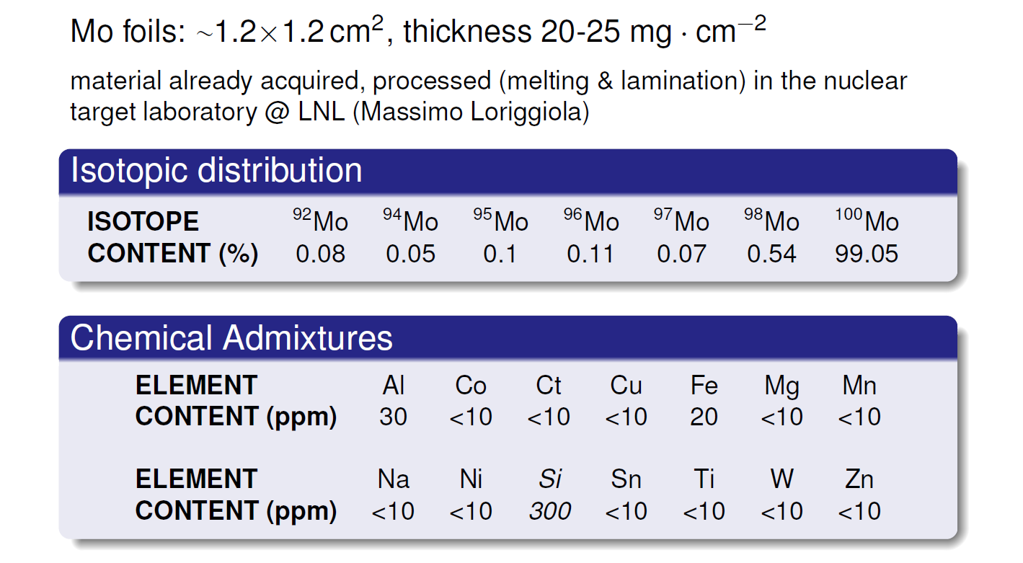
  Target material: ¹⁰⁰Mo-enriched metal powder, Isoflex company

Slide 55
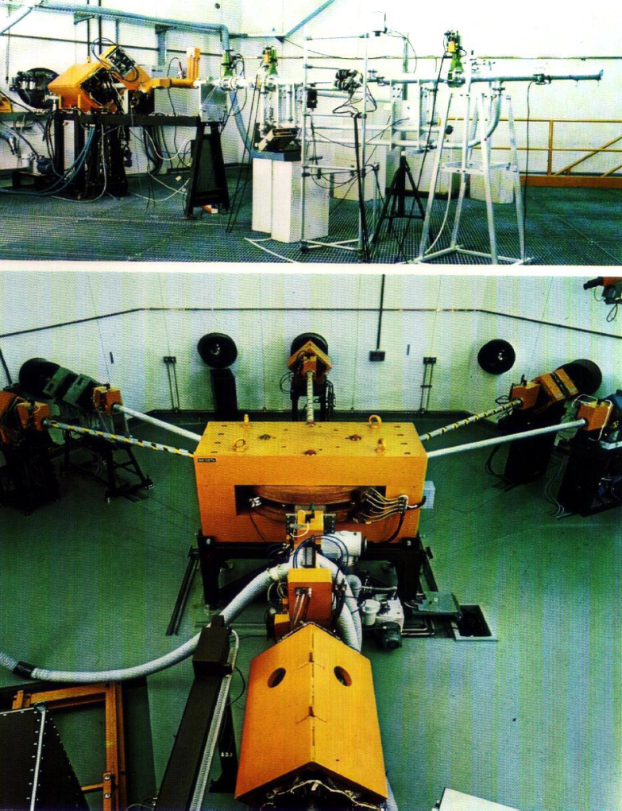
IRRADIATION FACILITIES
The irradiation facility at Joint Research Center (EU-JRC) lab in Ispra: The Scanditronix MC40 cyclotron
TRIGA MKII 250KW University of Pavia

Slide 56
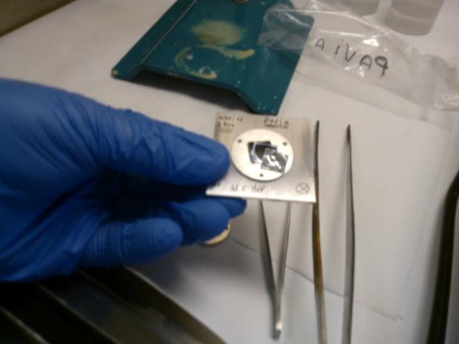
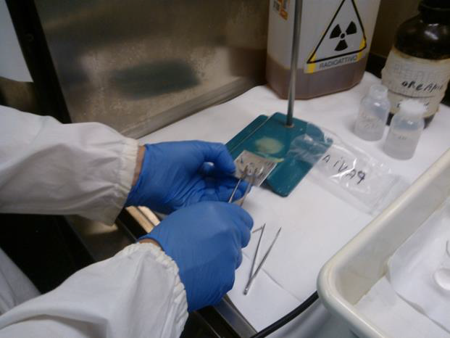
MAIN ACTIVITIES
Separation methodology for the extraction of ^{99m}Tc from ¹⁰⁰Mo target.
Some aspects of Methyl Ethyl Ketone (MEK) separation has been developed with particularly attention on the separation and recovery time that has big impacts to the final results.
Has been tested different digestion approaches in connection to different separation methods.

Slide 57
IMPORTO FINANZIARIO 2013
Trattamento missioni 1500,00€
Materiale di consumo da attività di laboratorio 4000,00€
Altre spese per servizi (trasporto materiale radioattivo) 5000,00€

Slide 69
SPES Selective Production of Exotic Species
RIB Facilities
Responsabile nazionale GianFranco Prete
Sezioni
Bologna
Lab. Naz. di Legnaro
Lab. Naz. del Sud
Milano
Napoli
Pavia

Slide 70
Istituzioni esterne all'Ente partecipanti
CERN
ORNL (USA)
ENEA
TRIUMF (Vancouver)
MSU(USA)
GANIL (Francia),
ASL Padova,
Università di Padova (Dipartimenti di Chimica e Ingegneria)
Universita' di Palermo (Dipartimento di Ing.Nucleare)
LASA (Milano).

Slide 71
SPES PAVIA
Laboratorio di Spettroscopia Laser (prof. Piero Benetti):
Alessandra Tomaselli ric. DIII: responsabile attività laser (70%)
Federico Pirzio ric. DIII(20%)
Farinello Paolo dottorando DIII
Damiano Grassi tecnico cat. D, Dip. Chimica (30%)
Scarpa Daniele art. 23 LNL (20%)
NESSUN FINANZIAMENTO PER IL 2013
BORSA DI DOTTORATO DI FARINELLO (LNL)

Slide 72
Advances in the SPES Project and its ion source systems
D. Scarpa, M. Manzolaro, J. Vasquez, L. Biasetto, A. Cavazza, S. Corradetti, J. Montano, M. Manente, D. Curreli, G. Meneghetti, D. Pavarin, A. Tomaselli, D. Grassi, P. Benetti, A. Andrighetto, G. Prete
3rd Workshop-Plasmi, Sorgenti, Biofisica ed Applicazioni
Conferenze e pubblicazioni
Photo-ionization of aluminum in a hot cavity for the selective production of exotic species project^{a)}
^{a)}Contributed paper, published as part of the Proceedings of the 15th International Conference on Ion Sources, Chiba, Japan, September 2013.
D. Scarpa^{1,b)}, L. Makhathini², A. Tomaselli³, D. Grassi⁴, S. Corradetti¹, M. Manzolaro¹, J. Vasquez¹, M. Calderolla¹, M. Rossignoli¹, A. Monetti¹, A. Andrighetto¹ and G. Prete¹
Rev. Sci. Instrum. 85, 02B908 (2014); http://dx.doi.org/10.1063/1.4828722

Slide 73
The SPES target chamber remote handling system
J. Vasquez1,6, R.Oboe2, A. Andrighetto1, I. Cristofolini3, M. Guerzoni4, A. Margotti4, G. Meneghetti5, D. Scarpa1, M. Bertocco6 and G. Prete1.
Published in:
Mechatronics (ICM), 2013 IEEE International Conference on
Ionization efficiency estimations for the SPES surface ion source
M. Manzolaro, A. Andrighetto, G. Meneghetti, M. Rossignoli, S. Corradetti, L. Biasetto, D. Scarpa, A. Monetti, S. Carturan, G. Maggioni
Nuclear Instruments and Methods in Physics Research B
Neutron-rich isotope production using a uranium carbide – carbon
S. Corradetti, L. Biasetto, M. Manzolaro, D. Scarpa, S. Carturan, A. Andrighetto, G. Prete, J. Vasquez, P. Zanonato, P. Colombo, C.U. Jost, and D.W. Stracener

Slide 74
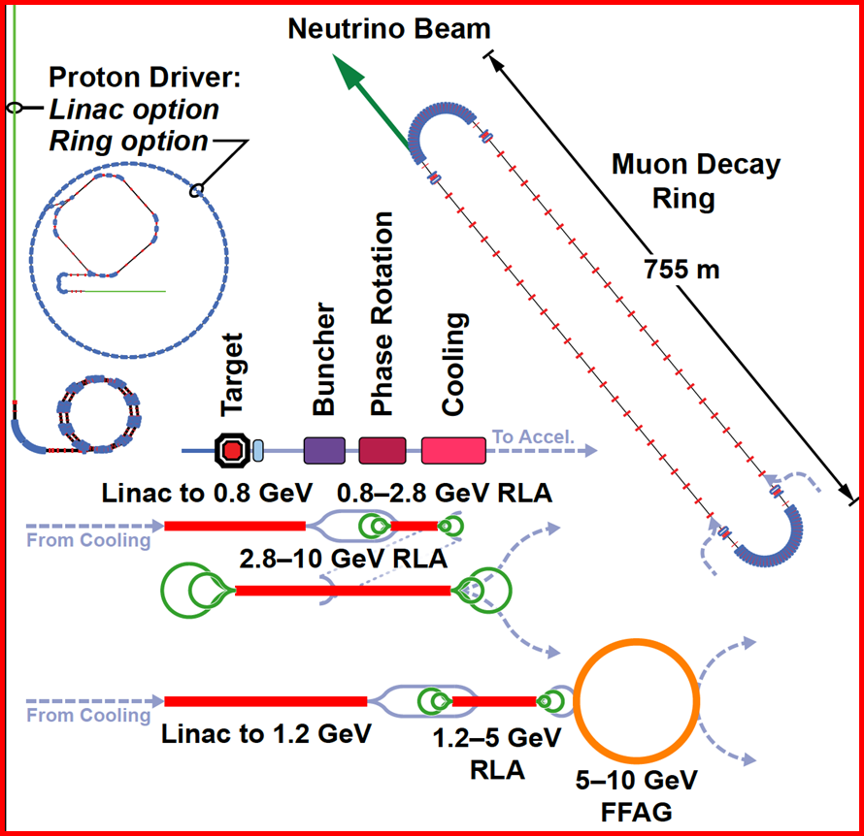
MICE - Neutrino Factory
Cooling dei muoni é essenziale per avere 10²¹ μ/anno
Notes:
74

Slide 75
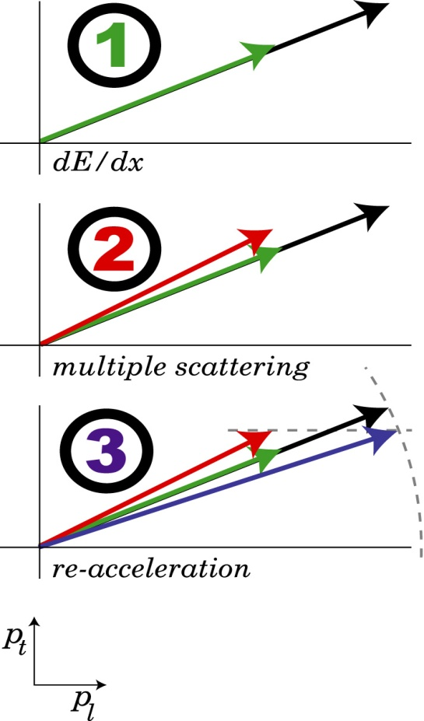
MICE (Muon Ionization Cooling Experiment)
Nuovo metodo proposto per il cooling di μ+ e μ-: ionization cooling
principle
reality (simplified)
reduce p_{t} and p_{l}
heating
increase p_{l}
Notes:
75

Slide 76










The MICE collaboration
Collaborazione internazionale
~ 140 collaboratori
Lista completa: http://www.mice.iit.edu/collaboration.html
Sono 10 i collaboratori italiani:
INFN Milano
INFN Napoli
INFN Pavia e Università di Pavia
A. de Bari
Fondamentale aiuto del servizio di elettronica
M. Prata, R. Nardo e M. Rossella
Collaborazione con Milano per responsabilità rivelatori TOF
INFN Roma III e Università Roma III
INFN Trieste e Università di Trieste

Slide 77
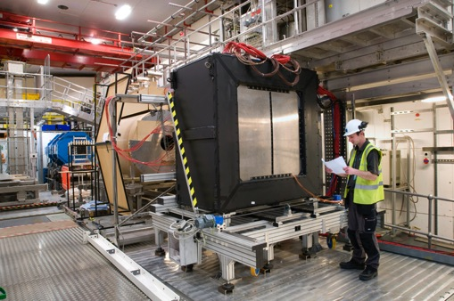
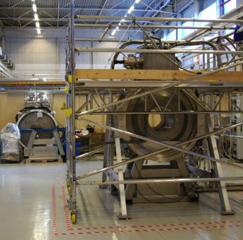
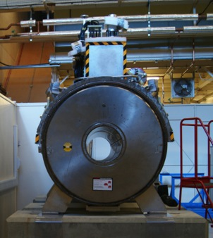
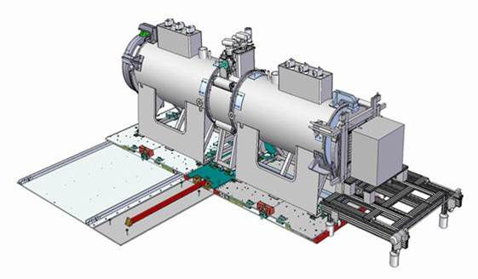
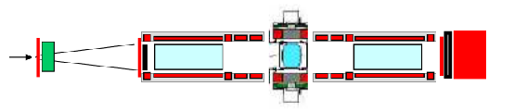
MICE schedule
- Parte dei componenti per l'assemblaggio dello step IV sono adesso al RAL:
– Spectrometer Solenoid, SS2 (upstream) è in MICE Hall con il suo tracker montato.
– SS1 è sala R9 per assemblare il tracker.
– Absorber and Focus Coil AFC1 è al RAL
– Power Supply per SS, harware per LH2, etc...

Slide 78
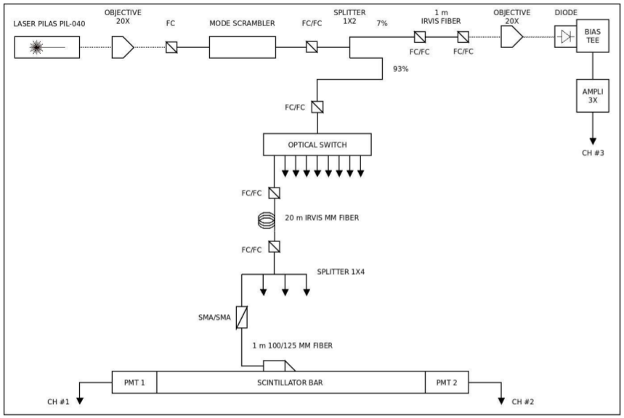
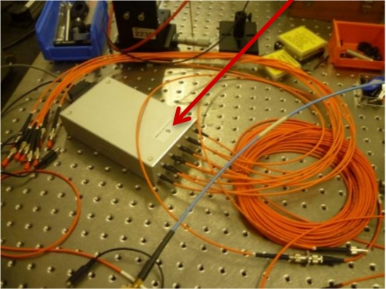
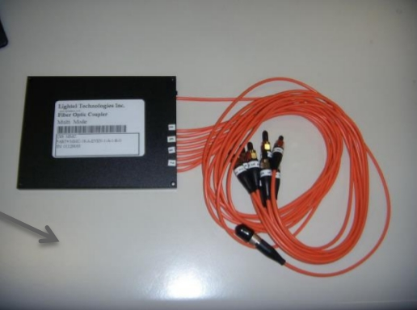
Attività per upgrade attuale sistema TOF
- Prototipo da laboratorio per il controllo del timing dei TOF (fino a 36 canali)
- Testati switch ottici
- Testati splitter ottici

Slide 79


Attività per upgrade attuale sistema TOF
- Finite misure di attenuazione e time spread per varie fibre ottiche:
– IRVIS
– AFS50
– AFS105
– SFS50
– SFS100
– UVVIS50
- Test utilizzo SiPMT
– Costruzione basetta di montaggio test
– Amplificatore custom (totalmente a PV)
- SiPMT in test
– SENSL array 3x3 mm²
– Hamamatsu array 3x3 mm²
– Advansid array 3x3 mm²
– Advansid array 4x4 mm²

Slide 80
Articoli, note e presentazioni
- MICE Collaboration, Characterisation of the muon beams for the Muon Ionisation Cooling Experiment, (2013) European Physical Journal C, 73 (10), pp. 1-14.
- M. Bonesini, The detector system of the Muon Ionization Cooling Experiment (MICE) experiment, (2013) Proceedings of Science, 3 p.
- M. Bonesini, R. Bertoni, A. de Bari, M. Rossella, Construction of a Fast Diode-Laser based Calibration System for Time-of-Flight Systems, (2013) Proceedings of Science, 3 p.
- M. Bonesini, Progress of the MICE experiment at RAL, (2013) Nuclear Physics B - Proceedings Supplements, 237-238, pp. 203-205.
- A. de Bari, The Particle Identification System for the MICE Beamline Characterization, MICE-CONF-DET-0407, 2013
- Presentazione a VCI 13th Vienna conference on instrumentation.

Slide 81
Ringraziamenti
Si ringrazia tutto il personale del servizio di elettronica dell’INFN e dell’Universitá di Pavia e l’officina meccanica.
Si ringraziano inoltre R. Bertoni e R. Mazza della sezione INFN di Milano Bicocca.

Slide 87
MC-INFN Pavia 2013-2014
Nuova attività FLUKA:
  Studio dei profili laterali di dose su linea CNAO con protoni e ioni ¹²C.
  Ottimizzazione parametri TPS con best fit su dati e MC.
Persone:
  V.E. Bellinzona (dottorato XXIX ciclo)
  A. Fontana (ric. INFN)
  G. Magro (dottorato XXVIII ciclo)
  + 1 neo-laureata magistrale (M. Mori)
Collaborazioni:
  UniPV (A. Rotondi)
  FLUKA team (A. Ferrari, P. Sala)
  CNAO (M. Ciocca, A. Mairani)
  HIT/LMU Munich (K. Parodi)
Pubblicazioni:
  - Tesi magistrale M. Mori
  Studio del profilo laterale di
  dose per piani di trattamento
  in Adroterapia
  - Presentazione ICTR-PHE 2014
Richieste 2015:
  - 5 k€ missioni
  - 2 k€ inventariabile (1 PC)

Slide 88


Parametrization of the lateral dose profiles with Double Gaussian model
62.28 MeV/u, 2D Dose profile
Dose MeV/cm³
ROOT Code
- MINUIT
FLUKA MC
10^{3 –} 10⁴
Lateral profiles
147 dose matrices
(60-230 MeV)
219.39 MeV/u, 2D Dose profile
Dose MeV/cm³
M. Mori, University of Pavia, Department of Physics - ICTR-PHE 2014
Notes:
ciao

Slide 89


E = 62.18 MeV/u - Comparison of MC & models z = 3.5 cm (Bragg Peak)
E = 156.32 MeV/u - Comparison of MC & models z = 16.7 cm (Bragg Peak)
M. Mori, University of Pavia, Department of Physics - ICTR-PHE 2014
Notes:
ciao

Slide 90

Modellizzazione dei profili laterali per ottimizzare calcolo dose con TPS

Slide 91
VIPIX
Vertically Integrated PIXels
Sistemi a pixel per tracciatori sottili di particelle cariche basati su tecnologie ad integrazione verticale
Consuntivo finale
Responsabile Nazionale: Valerio Re - INFN Sezione di Pavia
Inizio anno 2009 - Termine anno 2012
(2013 su dotazioni CSN5)
Referee: Nunzio Randazzo Gaetano Salina

Slide 92

The INFN VIPIX project
(Vertically Integrated PIXels)
VIPIX investigated the potential of 3D integration (“the vertical integration of thinned and bonded silicon integrated circuits with vertical interconnects between the IC layers”) for advanced pixel detectors and readout electronics
  ⇒ Denser (smaller form factor), lower cost (less expensive than aggressive CMOS scaling), integration of dissimilar technologies (sensor, analog, digital, optical)
Vertically integrated pixel detectors may be able to satisfy the needs of the next generation of tracking and vertexing devices in high energy physics experiments and of imagers at advanced X-ray sources:
small pitch pixels capable of handling high data rates.
complex functionalities at the pixel level (low-noise amplification, zero suppression, time stamping...)

Slide 93
VIPIX: publications and educational outreach
50 publications in international journals
72 talks at international conferences
23 BSc theses
13 MsC theses
4 PhD theses

Slide 94
Manpower
Bologna, Pisa, Pavia, Perugia, Roma3, Trento, Milano, Trieste, Torino
Average 2009-2012
~ 15 FTE

Slide 95
Local manpower
2009 | 2010 | 2011 | 2012
Valerio Re Valeria Speziali Luigi Gaioni Claudio Andreoli Lodovico Ratti | Valerio Re Valeria Speziali Fabio Bellotti Luigi Gaioni Massimo Manghisoni Lodovico Ratti Gianluca Traversi | Valerio Re Alessia Manazza Massimo Manghisoni Emanuele Quartieri Lodovico Ratti Gianluca Traversi Stefano Zucca | Valerio Re Alessia Manazza Massimo Manghisoni Emanuele Quartieri Lodovico Ratti Gianluca Traversi
1.5 FTE | 1.7 FTE | 2.2 FTE | 2.3 FTE

Slide 96
Finanziamenti ricevuti (INFN CSN5)
Anno | Missioni Interno | Missioni Estero | Inventario | Consumi | Totale (K€)
2009 | 26.5 | 14 | 8 | 137.5 | 186
2010 | 21.5 | 29.5 | 4 | 178 | 233
2011 | 7 | 6 | - | 125 | 138
2012 | 5 | 8 | - | 130 | 143
2013 (DTZ) | 6 | - | - | 7 | 13
Gran totale | 66 | 57.5 | 12 | 577.5 | 713
Forte sinergia (scientifica e finanziaria) con il progetto SUPERB

Slide 97
VIPIX international collaborations
VIPIX was proactive in establishing international collaborations that investigated diverse approaches to 3D integration:
- 3D-IC Consortium (Fermilab, INFN, IN2P3, et al): “via middle”, homogeneous 3D
AIDA Workpackage 3 (INFN, MPI, CERN, Bonn, CPPM, IPHC, LAL, LPNHE, RAL,…): a network for the qualification of 3D interconnection technologies “via last”, heterogeneous 3D
… to be continued in H2020 in a new project “AIDA-2”

Slide 98
Activity in 2013
Total ionizing dose (TID) tests of single transistors and monolithic sensors (MAPS) in 3D technology (Tezzaron/Globalfoundries, CMOS 130 nm)
Investigation of alternative vertical integration technologies (Tohoku-MicroTec, T-Micro) – vertical integration of a fully depleted pixel silicon detector and a front-end chip (128x32 channels)
Characterization of thinned (50 and 25 um, Aptek Industries) monolithic sensors in a quadruple well technology (TowerJazz, CMOS 180 nm)

Slide 99



TID tests on 3D transistors
3D processing steps do not result in any significant degradation of the radiation tolerance features – no significant degradation in terms of radiation tolerance performance in 3D transistors with respect to planar transistors

Slide 100
TID tests on 3D MAPS
The irradiation campaign has been performed with a ⁶⁰Co source up to a total dose of about 750 krad
M1 matrix: PA with standard layout input transistor
M2 matrix: PA with enclosed layout input transistor

Slide 101




Vertical integration with T-Micro
Preliminary test of the T-Micro integration process performed on pre-existing readout chips (Superpix0) and high resistivity n-on-n pixel sensors (VPix1)
Sensors in the red box have no metal layers under the markers
Superpix0 chip layout
Front-end chips and a pixel sensor wafer shipped to T-Micro in Dec. 2012
4 vertically integrated chips have been tested with a ⁹⁰Sr/⁹⁰Y source

Slide 102

Vertical integration with T-Micro – test results
Hit rate in samples exposed to a ⁹⁰Sr source (white pixels → hit rate=0)
Chip 62 - 94 pixels not connected (~2%)
Chip 63 - 324 pixels not connected (~8%)

Slide 103



4-well MAPS thinning
The aim is to understand whether and how the collection properties of quadruple well MAPS are changed by thinning the substrate (low material budget)
Chip thickness after processing
Processed chips

Slide 104


Charge collection tests and gain calibration
⁹⁰Sr/⁹⁰Y tests
⁵⁵Fe source tests
No substantial difference in the response between thick and thin samples

Slide 105

Conclusions
VIPIX was able to test the first demonstrators of 3D CMOS chips, and confirmed potential advantages of 3D integration for advanced pixel detector systems.
VIPIX tackled all the various technological problems associated with 3D integration (advanced IC design and architectures, wafer thinning and bonding, through-silicon vias, microcooling, high-performance DAQ,..), expanding INFN know-how in this hi-tech field.
The main focus of VIPIX was the very aggressive 3D technology by Tezzaron. Reliability issues show that (at least for us) this process is not yet at the maturity level that is required for a detector in a real application.
New concepts exploiting 3D integration (also with other vendors) for particle tracking and for X-ray imaging at FELs are being proposed in our community. INFN is now able to take advantage of these new ideas.

Slide 106
ReDSoX
Research Detectors for Soft X-Rays
Piero Malcovati
Dipartimento di Ingegneria Industriale e dell’Informazione
Università di Pavia

Slide 107
Scopi del Progetto
Linea di ricerca
  Sviluppo camere a deriva di silicio di grande superficie ed elettronica a basso rumore per spettroscopia ed imaging di X-ray
  Applicazioni in astrofisica X e , monitoraggio ambientale, diagnostica medica, Advanced Light Sources (Sincrotroni e FEL)
Sezioni partecipanti
  TS, BO (IASF-BO), ROMA2 (IAPS-ROMA), MI (PoliMI), PV (UniPV)
Collaborazioni
  FBK Trento, Sincrotrone Trieste
Durata progetto
  2013-2014
Responsabile nazionale
  A. Vacchi
Responsabile locale
  P. Malcovati

Slide 108

Risultati 2013: ASIC

Slide 109

Risultati 2013: Caratterizzazione ASIC

Slide 110

Risultati 2013: ASIC + Detector

Slide 111
Attività 2014
Ulteriore sviluppo di camere a deriva di silicio di grande superficie
Evoluzione e completamento dell’elettronica a basso rumore per spettroscopia ed imaging di X-ray (ADC, common-mode noise cancelation)
Applicazioni nei campi di astrofisica X e , diagnostica medica (camera Compton proposta da XDXL), Advanced Light Sources (Sincrotrone e FEL)
Stretta interazione con la proposta LOFT per la mission call M3 dell’ESA
Personale strutturato della Sezione di Pavia: 1 FTE
  Piero Malcovati: 40%
  Marco Grassi: 60%

Slide 112
Consuntivo 2013/Preventivo 2014
Voce | Consuntivo 2013 | Preventivo 2014
Servizi Trasporti e Facchinaggio Attività Laboratorio | 0.00€ | 0 €
Licenze Software | 2,000 € | 0 €
Trattamento Missioni | 2,000.00 € | 4,000 €
Materiale di Consumo Attività Laboratorio | 7,027.20 € | 4,000 €
Impianti Attrezzature Macchinari | 9,913.61 € | 0 €
Totale | 18,940.81 € | 8,000 €
Residuo | 59.19 € | —

Slide 113

APOLLO – consuntivo 2013
Alimentatori di POtenza per aLti Livelli di radiaziOne
Il gruppo di Pavia – finanziamenti 2013
Attivita’ di ricerca locale
Conferenze e pubblicazioni

Slide 114

Associati INFN alla collaborazione Apollo 2013
Carmine Abbate^{3,2}, Monica Alderighi^{10,4}, Stefania Baccaro^{1,2,B}, Giovanni Busatto^{3,2}, Mauro Citterio⁴, Paolo Cova^{5,6}, Nicola Delmonte^{5,6}, Valentina De Luca^{3,2}, Salvatore Fiore^{1,2}, Francesco Giuliani⁵, Francesco Iannuzzo^{3,2}, Agostino Lanza^{6,A,B}, Stefano Latorre⁴, Massimo Lazzaroni^{7,4,B}, Roberto Menozzi^{5,6}, Alessandro Paccagnella^{8,9}, Annunziata Sanseverino^{3,2}, Giorgio Spiazzi^{8,9,B}, Francesco Velardi^{3,2}
_________________________
1 – ENEA UTMATT Casaccia
2 – INFN Sezione di Roma
3 – DIEI - Dipartimento di Ingegneria Elettrica e dell’Informazione – Universita’ di Cassino e del Lazio meridionale
4 – INFN Sezione di Milano
5 – Dipartimento dell’Ingegneria dell’Informazione – Universita’ di Parma
6 – INFN Sezione di Pavia
7 – Dipartimento di Fisica – Universita’ di Milano
8 – Dipartimento dell’Ingegneria dell’Informazione – Universita’ di Padova
9 – INFN Sezione di Padova
10 – INAF/IASF Milano
A – Responsabile nazionale
B – Responsabili locali
Gruppo di Pavia: 4 associati su 14 (29%). FTE di Pavia: 2.3 su 8.7 (26%)
Finanziamenti ricevuti nel 2013: 29 k€ su 101 k€ (29%). Residuo 319.46 €.

Slide 115
Attivita’ 2013 del gruppo pavese
Continuazione delle simulazioni fluido-dinamiche per la progettazione dei dissipatori del convertitore principale
Misure termiche sul prototipo di alimentatore principale
Soluzioni migliorative dell’accoppiamento termico fra trasformatore planare del convertitore principale e dissipatore
Definizione dell’appalto per la produzione di 8 nuovi prototipi e contributo al disegno del layout
Test in campo magnetico di convertitori DC/DC commerciali (per la scelta del DC/DC sulle schede di front-end della NSW di Atlas)

Slide 116
Conferenze e pubblicazioni nel 2013 con autori del gruppo di Pavia
Sito web: http://www2.pv.infn.it/~servel/apollo/index.html
Pubblicazioni
S. Baccaro, P. Cova, N. Delmonte, E. Ghisolfi, A. Lanza: “A soft magnetic material for power supply systems of high energy physics experiments”, European Physical Journal Web of Conferences, vol. 40, 17005-p.1-p.4, 2013. ISSN: 2100-014X, doi: 10.1051/epjconf/20134017005, Scopus: 2-s2.0-84872730377
P. Cova, N. Delmonte, F. Giuliani, M. Citterio, S. Latorre, M. Lazzaroni, A. Lanza: “Thermal optimization of water heat sink for power converters with tight thermal constraints”, Microelectronics Reliability, vol. 53, pp. 1760-1765, 2013. ISSN: 0026-2714. doi: 10.1016/j.microrel.2013.07.035, Scopus: 2-s2.0-84886908592
N. Delmonte, F. Giuliani, P. Cova: “Finite element modeling and characterization of lead-free solder joints fatigue life during power cycling of surface mounting power devices”, Microelectronics Reliability, vol. 53, pp. 1611-1616, 2013. ISSN: 0026-2714, doi: 10.1016/j.microrel.2013.06.021, Scopus: 2-s2.0-84886923504
F. Giuliani, N. Delmonte, P. Cova, R. Menozzi: “Temperature-dependent reverse-bias stress of normally-off GaN power FETs”,Microelectronics Reliability, vol. 53, pp. 1486-1490, 2013. ISSN: 0026-2714. doi: 10.1016/j.microrel.2013.07.068, Scopus: 2-s2.0-84886890799
C. Abbate, M. Alderighi, S. Baccaro, G. Busatto, M. Citterio, P. Cova, N. Delmonte, V. De Luca, S. Gerardin, E. Ghisolfi, F. Giuliani, F. Iannuzzo, A. Lanza, S. Latorre, M. Lazzaroni, A. Paccagnella, M. Riva, A. Sanseverino, G. Spiazzi, F. Velardi: “Developments on DC/DC converters for the LHC experiment upgrades”, Journal of Instrumentation, vol. 9, C02017, 2014. ISSN: 1748-0221. doi: 10.1088/1748-0221/9/02/C02017, WOS:
M. Lazzaroni, M. Citterio, S. Latorre, A. Lanza, P. Cova, N. Delmonte, F. Giuliani: “Thermal modeling and characterization for designing reliable power converters for LHC power supplies”, ACTA IMEKO Journal, ISSN: 2221-870X, in press, 2014

Slide 117
  Conferenze
P. Cova, N. Delmonte, F. Giuliani, M. Citterio, S. La Torre, A. Lanza, M. Lazzaroni, “Thermal modeling and characterization of power converters for LHC power supplies”, presented by M. Lazzaroni at 12th IMEKO TC10 Workshop on Technical Diagnostics - New Perspectives in Measurements, Tools and Techniques for Industrial Applications, Firenze (Italy), Jun. 6-7, 2013. ISBN: 978-88-903149-8-8
C. Abbate, M. Alderighi, S. Baccaro, G. Busatto, M. Citterio, P. Cova, N. Delmonte, V. De Luca, S. Gerardin, E. Ghisolfi, F. Giuliani, F. Iannuzzo, A. Lanza, S. Latorre, M. Lazzaroni, G. Meneghesso, A. Paccagnella, F. Rampazzo, M. Riva, A. Sanseverino, R. Silvestri, G. Spiazzi, F. Velardi, E. Zanoni: “Radiation performance of new silicon devices for the LHC experiment upgrades”, presented by S. Gerardin at the 11th International Conference on Large Scale Application and Radiation Hardness of Semiconductor Detectors, Florence, Italy, Jul. 3-5, 2013
M. Lazzaroni, M. Citterio, S. Latorre, A. Lanza, P. Cova, N. Delmonte, F. Giuliani: “Ottimizzazione termica di dissipatori per convertitori di potenza per applicazioni in ambienti ostili”, poster presented by M. Lazzaroni at the XXX Congresso Nazionale “Gruppo Misure Elettriche ed Elettroniche” (GMEE 2013), pp. 123-124, Trento (Italy), Sep. 8-11, 2013. ISBN: 978-88-8443-496-8
C. Abbate, M. Alderighi, S. Baccaro, G. Busatto, M. Citterio, P. Cova, N. Delmonte, V. De Luca, S. Gerardin, E. Ghisolfi, F. Giuliani, F. Iannuzzo, A. Lanza, S. Latorre, M. Lazzaroni, A. Paccagnella, M. Riva, A. Sanseverino, G. Spiazzi, F. Velardi: “Developments on DC/DC converters for the LHC experiment upgrades”, poster presented by A. Lanza at TWEPP 2013 - Topical Workshop on Electronics for Particle Physics, Perugia (Italy), Sep. 23-27, 2013
S. Fiore, C. Abbate, S. Baccaro, G. Busatto, M. Citterio, F. Iannuzzo, A. Lanza, S. Latorre, M. Lazzaroni, A. Sanseverino, F. Velardi:“Radiation and magnetic field effects on new semiconductor power devices for HL-LHC experiments”, presented by S. Fiore at the 14thInternational Conference on Astroparticle, Particle, Space Physics and Detectors for Physics Applications (ICATPP 2013), Villa Olmo, Como (Italy), Sept. 23-27, 2013
M. Lazzaroni, M. Citterio, S. Latorre, A. Lanza, P. Cova, N. Delmonte, F. Giuliani: “Power supply system for the ATLAS experiment: design specifications, implementation, test and first results”, poster presented by M. Lazzaroni at the 14th International Conference on Astroparticle, Particle, Space Physics and Detectors for Physics Applications (ICATTP 2013), Villa Olmo, Como (Italy), Sep. 23-27, 2013
F. Giuliani, N. Delmonte, P. Cova, R. Menozzi: “Temperature-dependent reverse-bias stress of normally-off GaN power FETs”, presented by P. Cova at ESREF 2013 - 24rd European Symposium on Reliability of Electron Devices, Failure Physics and Analysis, Arcachon (France), Sept. 30 - Oct. 4, 2013
N. Delmonte, F. Giuliani, P. Cova: “Finite element modeling and characterization of lead-free solder joints fatigue life during power cycling of surface mounting power devices”, poster presented by N. Delmonte at ESREF 2013 - 24rd European Symposium on Reliability of Electron Devices, Failure Physics and Analysis, Arcachon (France), Sept. 30 - Oct. 4, 2013
P. Cova, N. Delmonte, F. Giuliani, M. Citterio, S. Latorre, M. Lazzaroni, A. Lanza: “Thermal optimization of water heat sink for power converters with tight thermal constraints”, presented by N. Delmonte at ESREF 2013 - 24rd European Symposium on Reliability of Electron Devices, Failure Physics and Analysis, Arcachon (France), Sept. 30 - Oct. 4, 2013

