Slide 1

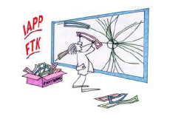


Our work field
Trigger at Hadron Colliders
Paola Giannetti
INFN Pisa

Slide 2
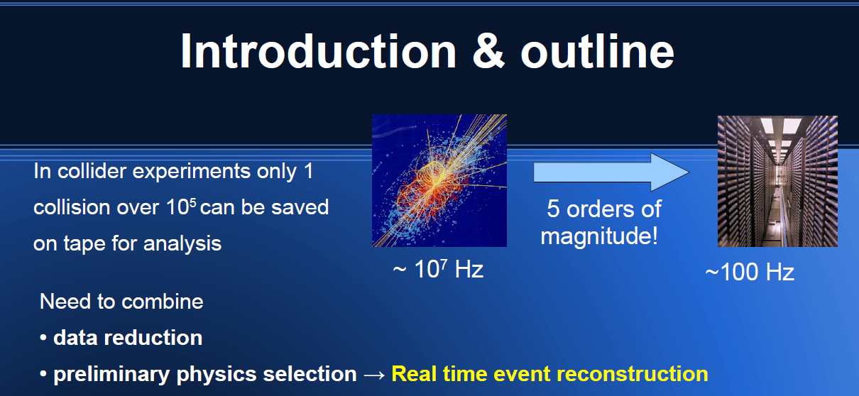
5-7
~10⁷ -10⁹ Hz
~ 10² -10³ Hz

Slide 3
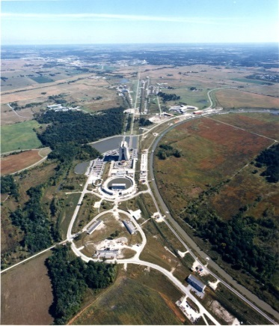
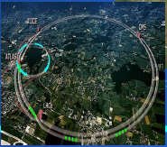
Highly parallelized, pipelined electronics at Hadron colliders:
We worked at CDF in the past (Tevatron, CDF)
What is going on in the present (LHC, ATLAS)
Spinoff in the FTK – IAPP project

Slide 4
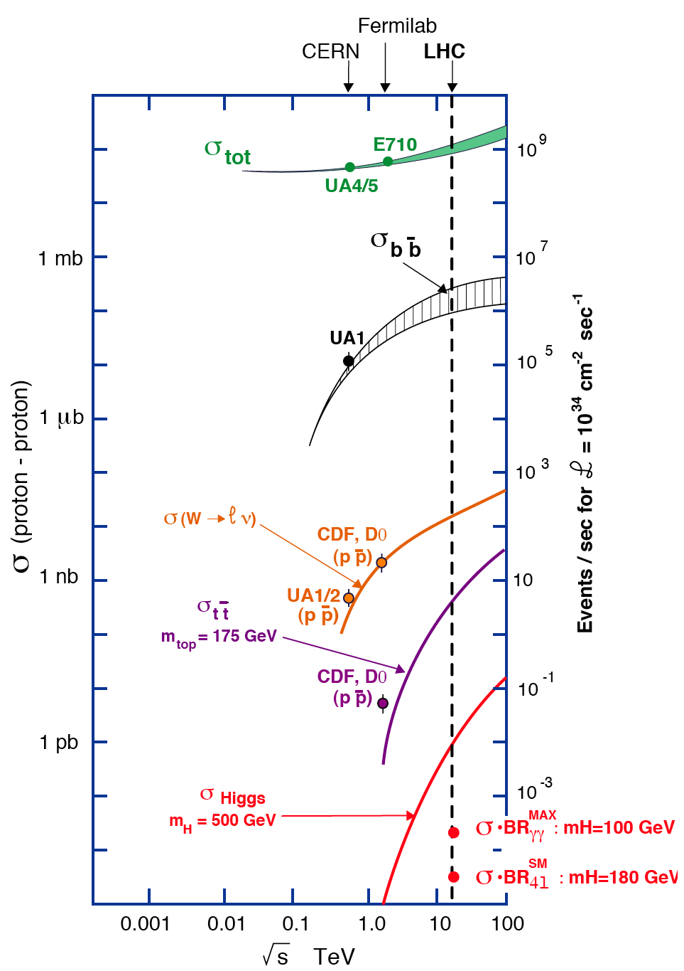
Hadron Colliders
HARD LIFE
Common
EVENTS
10⁹
10⁷
p
p
Event & Underlying event
10⁵
Events at L = 10³⁴ cm⁻²s⁻¹
10³
Bunch Crossing
10
Pile-up:
25 events @10³⁴ cm⁻²s⁻¹
40 MHz coll. Rate
~400 events @10³⁵ cm⁻²s⁻¹
40 MHz coll. Rate HL-LHC
Pile-up:
25 eventi @10³⁴ cm⁻²s⁻¹
40 MHz coll. Rate
500 eventi @10³⁵ cm⁻²s⁻¹
20 MHz coll. Rate SLHC
10⁻¹
RARE
EVENTS
10⁻³
H
S^{1/2} (TeV)

Slide 5
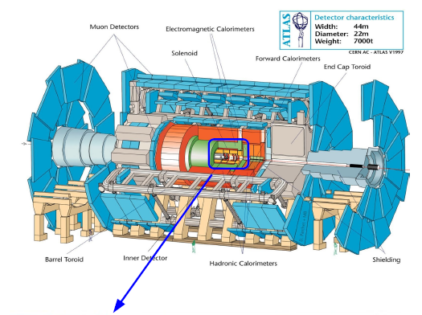
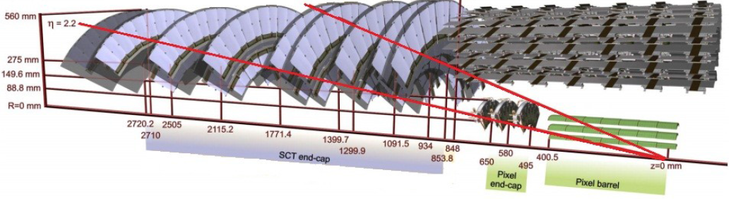
The DETECTOR: photos to Bunch Crossings
ATLAS
ATLAS
Silicon tracker

Slide 6

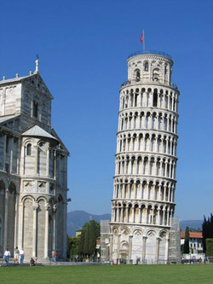

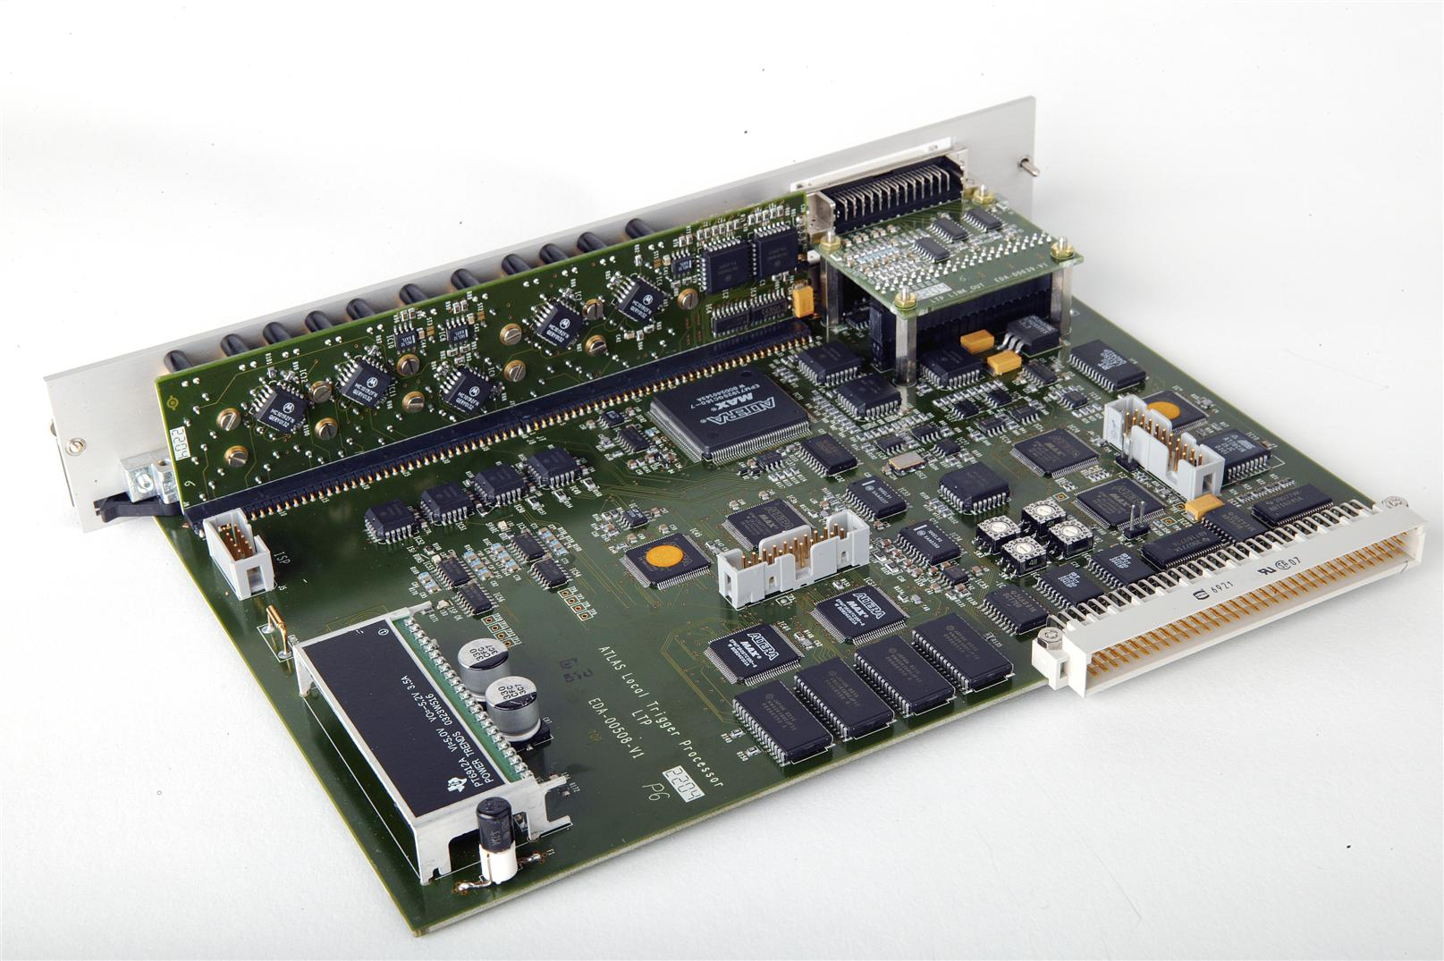
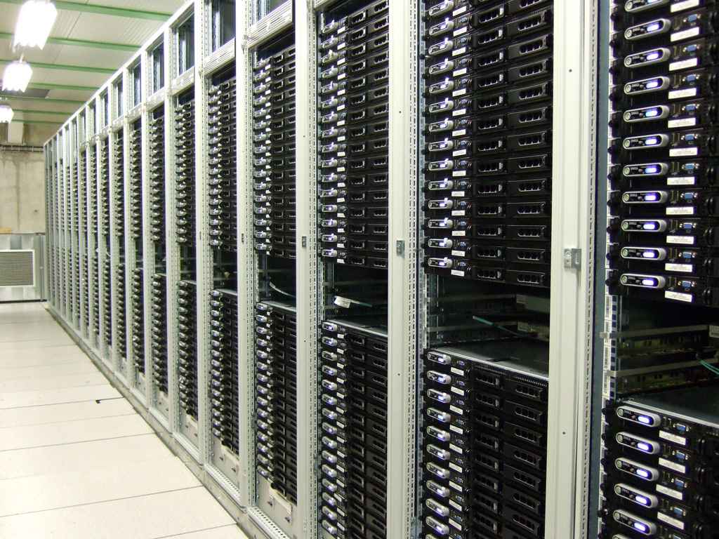
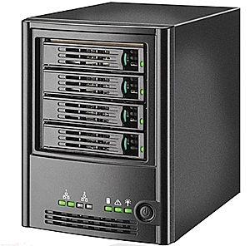
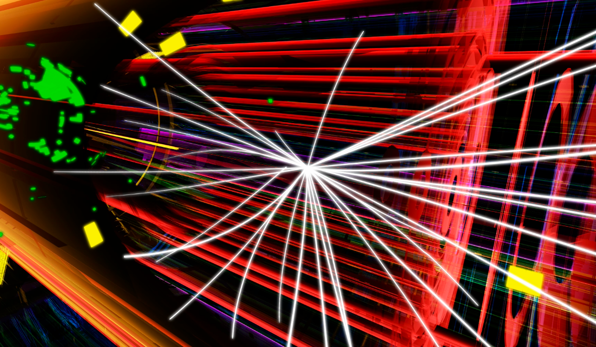
The Trigger is the brain of the Detector
Multilevel selection of events made with advanced electronics
LOW Level: HW dedicated processors
Low-resolution & fast decision
HIGH Level: CPU farms
High-resolution

Slide 7
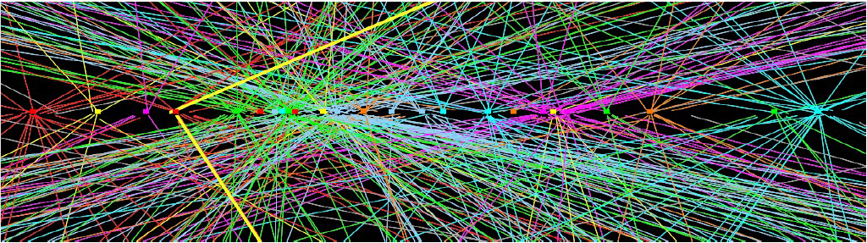
The online tracking processors
in a average time of 20 μs
with enough precision to see b quarks decays
π
π
B
200 μm
p
p
P
P
A Bunch Crossing at LHC
observed by the ATLAS TRACKER

Slide 8
CDF vs ATLAS TDAQ Architecture
40 MHz Crossing rate
ATLAS
7.6 MHz Crossing rate
CDF
L1 pipeline 100 clock cycles
L1 pipeline
42 clock cycles
L1
L1
L1
7.6 MHz Synchromous
Pipeline
5.5 μs Latency
30 kHz accept rate
Level 1
40 MHz Synchromous
Pipeline
2.5 μs Latency
75 kHz accept rate
L2 buffer
4 events
L 2 buffer many events
L2
L2
L2
Asynchronous 2 Stage Pipeline
20 μs Latency
1000 Hz accept rate
Level 2
Asynchromous
10 ms Latency
2000 Hz accept rate
DAQ buffers
DAQ buffers
L3 Farm
L3: CPU farm
Full event reconstruction
with speed optimized offline code
L3 Farm
Mass Storage
(~100 Hz)
Mass Storage
(~200 Hz)

Slide 9
CDF vs ATLAS TDAQ Architecture
40 MHz Crossing rate
ATLAS
7.6 MHz Crossing rate
CDF
XFT here
L1 pipeline 100 clock cycles
No
Tracking
L1 pipeline
42 clock cycles
L1
L1
L1
7.6 MHz Synchromous
Pipeline
5.5 μs Latency
30 kHz accept rate
Level 1
40 MHz Synchromous
Pipeline
2.5 μs Latency
75 kHz accept rate
SVX read out after L1
L2 buffer
4 events
L 2 buffer many events
L2
Late
Tracking
L2
SVT here
L2
Asynchronous 2 Stage Pipeline
20 μs Latency
1000 Hz accept rate
Level 2
Asynchromous
10 ms Latency
2000 Hz accept rate
DAQ buffers
DAQ buffers
L3: CPU farm
Full event reconstruction
with speed optimized offline code
L3 Farm
CPUs FARMs
L3 Farm
Mass Storage
(~100 Hz)
Mass Storage
(~200 Hz)

Slide 10
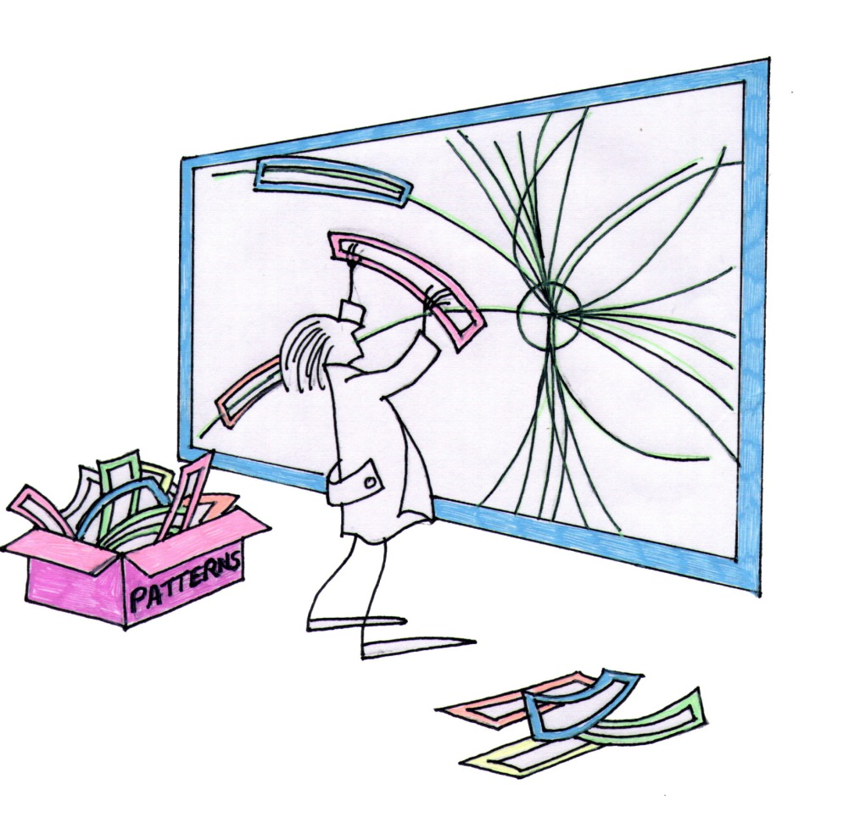
HOW we can do it?
TRACKING WITH
PATTERN MATCHING
We need a Highly
Parallelized Comparison
The Event
The Pattern
Bank
...

Slide 11
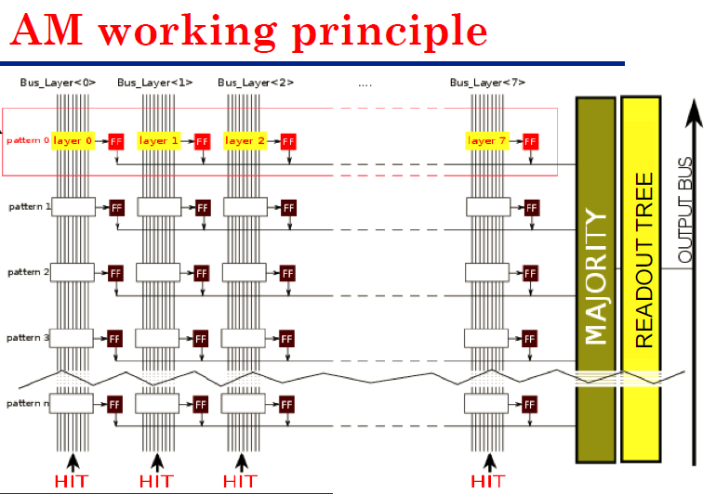
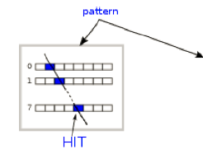
- very parallelized ASIC x pattern matching
pattern
Bus_layer0 Bus_layer1 Bus_layer2 …….. Bus_layer7
layer0
layer1
layer2
pattern0
layer7
layer0
layer1
layer2
pattern1
layer7
pattern2
pattern3
See
F. Crescioli
Talk after me!
Associative
Memory (AM)
….

Slide 12
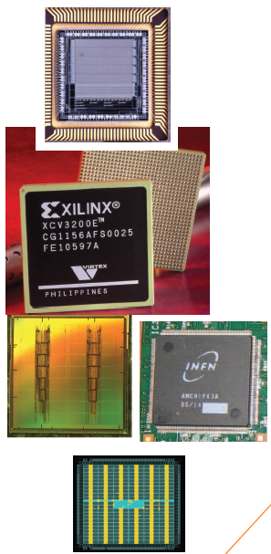
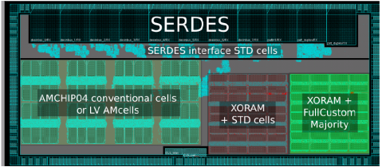
History
Associative Memory (AM)
90’s Full custom VLSI chip – 0,7 mm AMS (INFN-Pisa) 128 patterns, 6x12 bit words each (F. Morsani et al., The AM chip: a Full-custom MOS VLSI Associative memory for Pattern Recognition, IEEE Trans. on Nucl. Sci.,vol. 39, pp. 795-797 (1992).) 25 MHz clock
1998 FPGA (Xilinx 5000) for the same AMchip (P. Giannetti et al., A Programmable Associative Memory for Track Finding, Nucl. Intsr. and Meth., vol. A 413/2-3, pp.367-373, (1998) ).
1999 first standard cell project presented at LHCC
2006 AMChip 03 Standard Cell UMC 0,18 mm, 5k patterns in 100 mm² for CDF SVT upgrade total: AM patterns (L. Sartori, A. Annovi et al., A VLSI Processor for Fast Track Finding Based on Content Addressable Memories, IEEE TNS, Vol 53, Issue 4, Part 2, Aug. 2006). 50 MHz clock
2012 AMchip04 (Full custom/Std cell) TSMC 65 nm LP technology, 8k patterns in 14mm² Pattern density x12. First variable resolution implementation. (F. Alberti et al, 2013 JINST & C01040, doi:10.1088/1748-0221/8/01/C01040) 100 MHz
2013 AMchip05, 4k patterns in 12 mm² a further step towards final AMchip version. Serialized I/O buses at 2 Gbs, further power reduction approach. BGA 23x23 package.
2014 AMchip06: 128k patterns in 180 mm². Final version of the AMchip for the ATLAS experiment.
CDF
ATLAS
See F. Crescioli talk

Slide 13
APPLICATIONS OUTSIDE HEP
Large info - Complex images
Proposal: Image processing with Associative Memories & FPGAs
(by steps)
(1)
Relevant Feature’s Extraction
Find relevant shapes SW on GPUs or other commercial processors?
AM
(2)
Clusterization of contiguous pixels over TH to find shapes
Analysis of shapes SW on GPUs or other commercial processors?
FPGA
(3)
Understanding
& measuring
Shapes
Take an Action
Take an Action

Slide 14
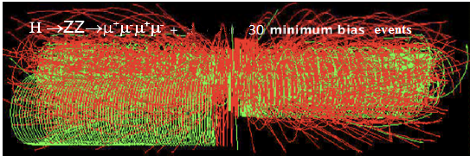
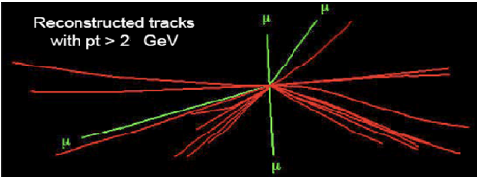

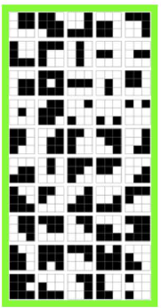
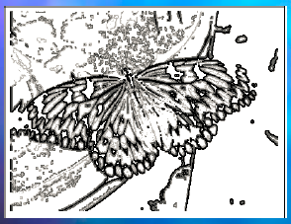


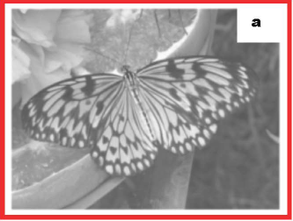
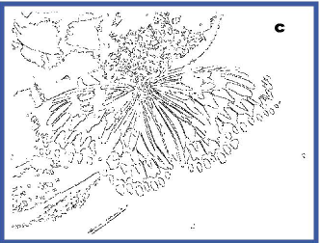
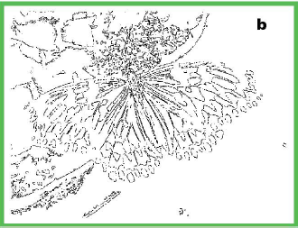
The AM as a filter to detect the
relevant features of the IMAGE
HEP
FILTERING NATURAL IMAGES: edge detector → AM as neurons?
/www.plosone.org/article/info%3Adoi%2F10.1371%2Fjournal.pone.0069154
Calculate frequency of
3x3 bit patterns in the image
Accepting only
these 50 patterns
Accepting only
these 16 patterns
...
2⁹=512 patterns
9.8%
5.5%
4 grey level:
2¹⁸ patterns
Stored N=2000
Michela Del Viva e Giovanni Punzi (Universita’ di Firenze e Universita’ di Pisa)

Slide 15

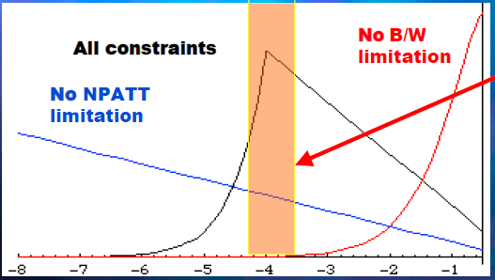



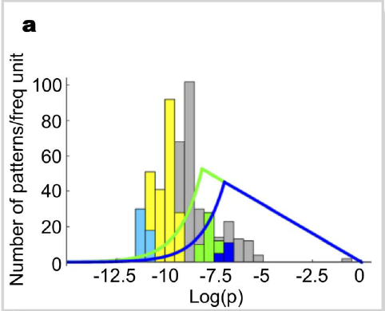

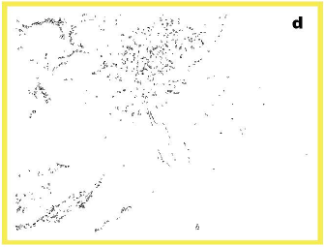

How we select the relevant patterns to be
stored in the AM bank?
under real constraints
Patterns that are
efficient carriers
of information
given the bandwidth (W)
&memory limits (N),
All 512 patterns
W=0.5, N=50
W=0.5, N=16
Low p

Slide 16
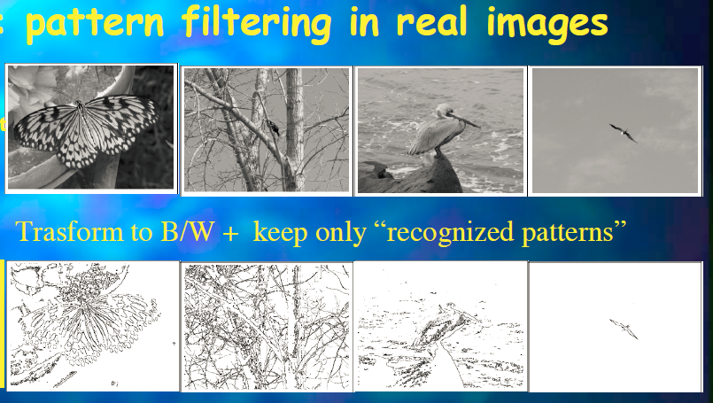
CLEAR to human eyes
Michela Del Viva e Giovanni Punzi (Universita’ di Firenze e Universita’ di Pisa)

Slide 17
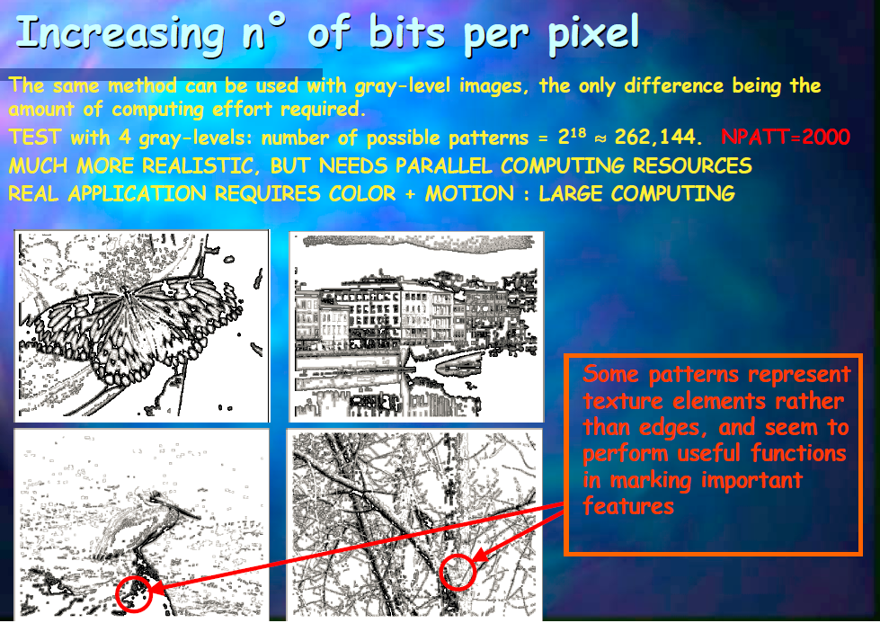
Michela Del Viva e Giovanni Punzi (Universita’ di Firenze e Universita’ di Pisa)

Slide 18
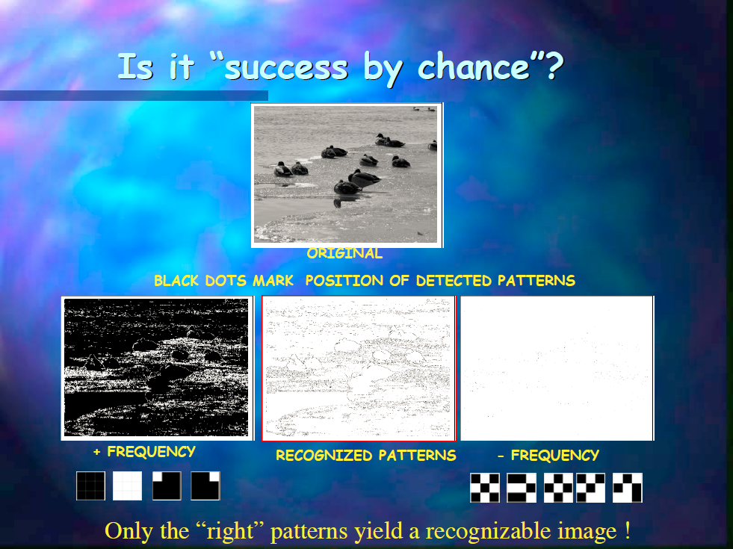
Michela Del Viva e Giovanni Punzi (Universita’ di Firenze e Universita’ di Pisa)

Slide 19
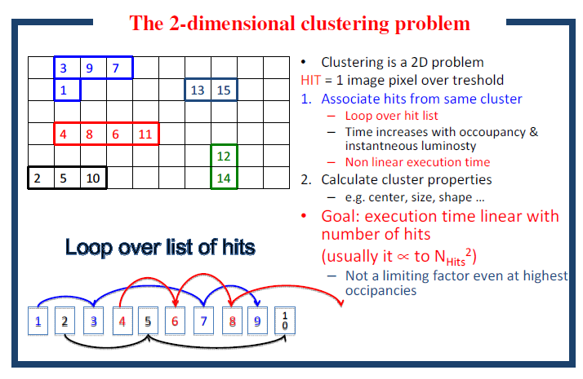
Step (2): Clustering contiguous pixels over threshold – very suited for FPGAs
A. Annovi et al., "A fast FPGA-based clustering algorithm for real time image processing," NSS Conference Record (NSS/MIC), 2009 IEEE, pp.4138,4141, Oct. 24-Nov. 1 2009

Slide 20
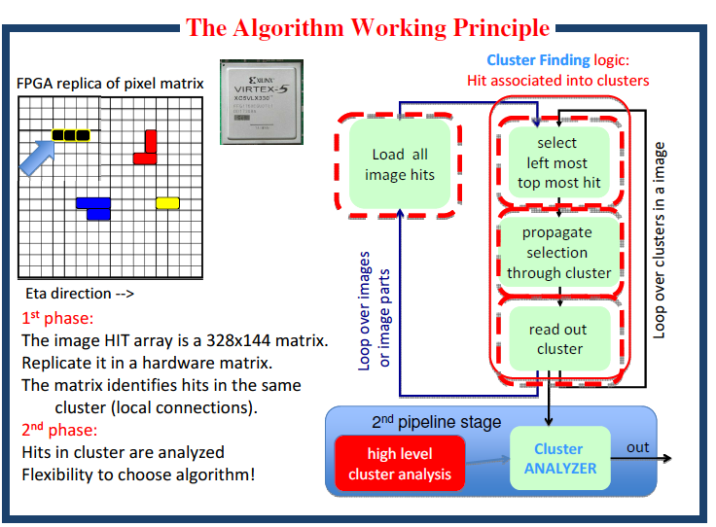

Slide 21
Step (3): identifying objects
High level task
Many different ways to solve it, both FPGAs and AM can do their part on this, but also GPUs
Less general, more application dependent
Let’s try few examples

Slide 22
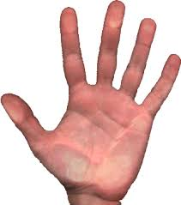
AM application
If we know which shapes are extracted & found by step 1 & 2, we can prepare low resolution templates (patterns) and look for known shapes.
For example if our goal is to detect commands from hands observed by a camera: with AM we can find & count fingers in a hand (any position), determining if they are horizontal or vertical, …. different possible codes identified by the hand. For each configuration a different action can be taken

Slide 23
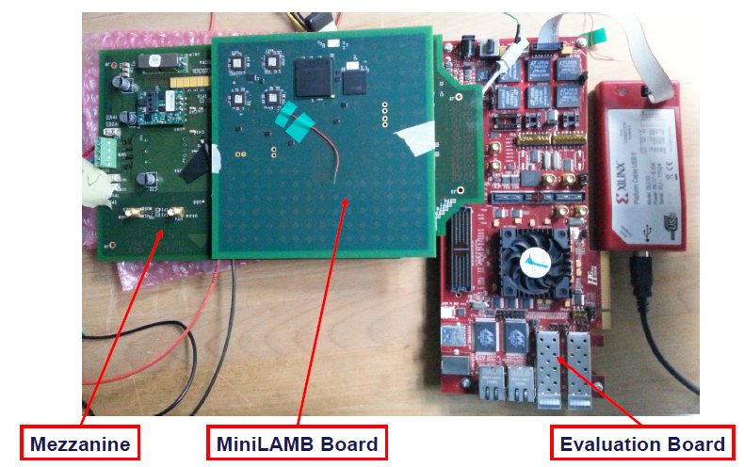
Smart Cameras or AM-based Coprocessor
Abbiamo una ditta che ha in progetto un embedded system con video-camera e wi-fi. Sarebbe interessata a integrare la AM ed FPGA
Abbiamo un primo nucleo di possibile coprocessore
Che ne pensate
del nostro edge
detector?
Ditta che lavora
in OCT
Tomografia Ottica ad
alta definizione
(Spectral domain)
e tridimensionale

Slide 24
Conclusion on image processing
Many possibilities to be studied – implemented for applications. An example smart cameras
Needed money to pay people in the project
We would like to apply to Horizon 2020
ITN, Cofund, FET, Pillar II (we have a SME interested & greek & french colleagues) ?
Regional funds?

