Slide 1
The NoES vision on CV
Claudio Salvadori
Research assistant @ TeCIP Institute
Meeting INFN, May 19th, 2014

Slide 2
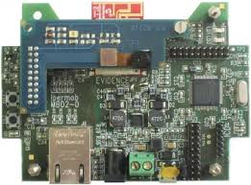
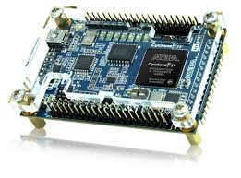
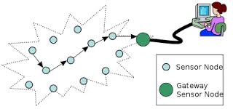
Our objectives
Realisation of a distributed and IoT oriented sensor network capable to understand the events happened in the real world:
Low cost devices, scalable and pervasive network
Heterogenous sensors
Scalar sensors
Embedded signal processing
Camera sensors
Embedded computer vision
Pervasive systems:
Distributed logic
Distributed computer vision algorithms
Contextual analysis

Slide 3
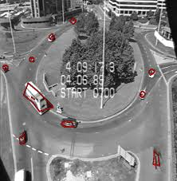
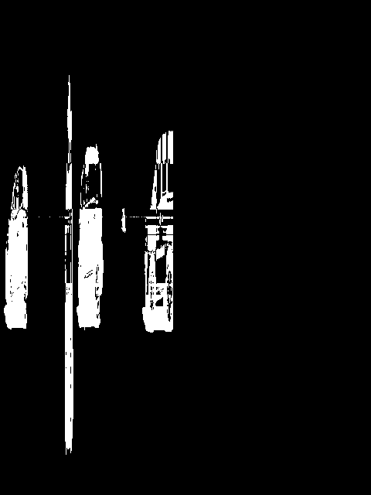
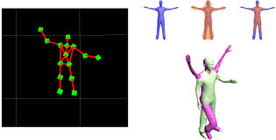
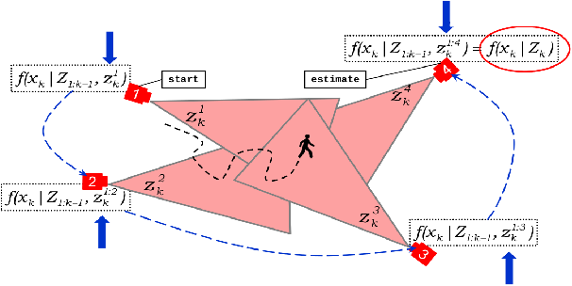
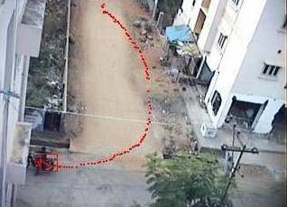
Application fields
Intelligent transport systems
Vehicles counter
Distributed vehicles tracking
Smart factories
Distributed people tracking and localisation
Video-surveillance
Object recognition
Action recognition and tracking
Contextual analysis
For example, recognise the “sit-down” action by recognising a chair
Public transport
People counter
Video-surveillance
Action recognition

Slide 4
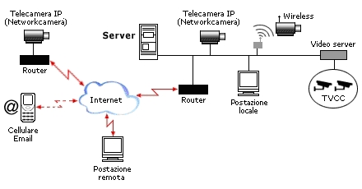
Classical CV system architecture

Slide 5
Classical CV system architecture
How to satisfy both the pervasivity and scalability issues?

Slide 6
Smart Camera Network rationale
The heaviest processing operation are performed by the camera node
The network is used to send aggregated features (few bytes)
In-network processing to perform the distributed algorithms

Slide 7
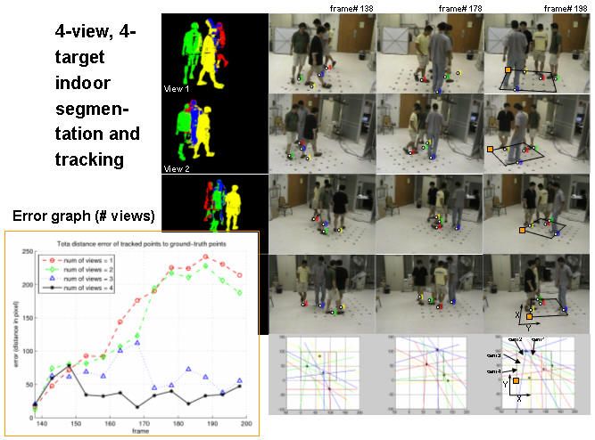
Example: tracking
Using classical computer vision system architecture

Slide 8
Example: tracking
Using Smart Camera Network architecture

Slide 9
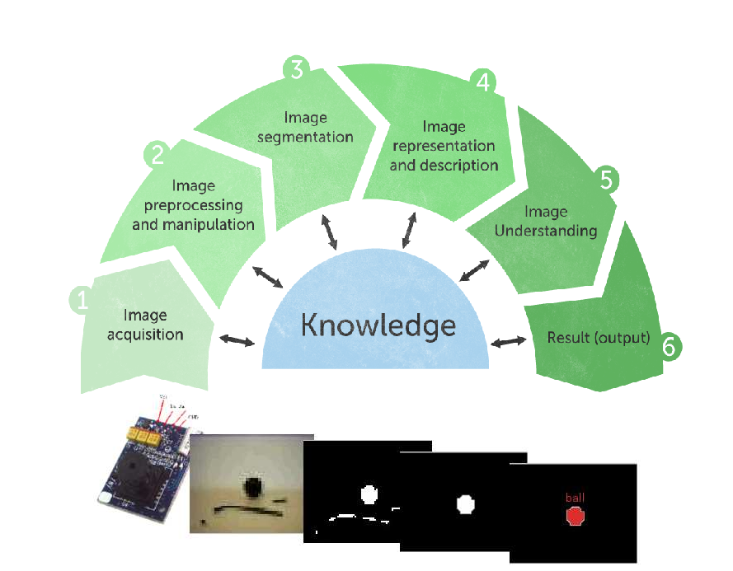
The computer vision pipeline
From block 1 to block 3:
Conceptually simple operations
Pixel wise operations
Heavy processing
From block 4 to block 6:
Complex algorithms
Few data to be processed

Slide 10
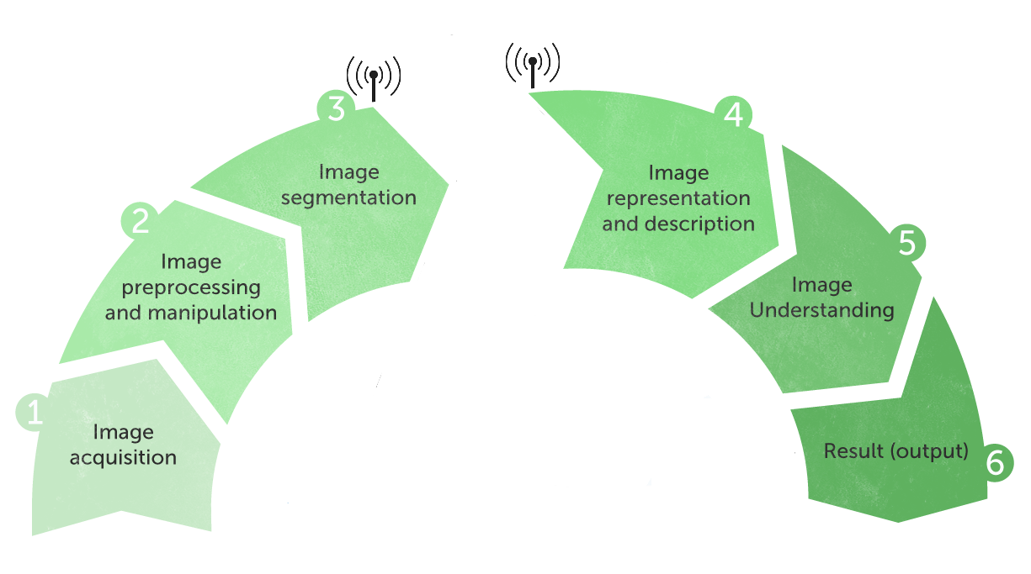
The CV pipeline VS. SCN
Embedded processing
In network processing

Slide 11
In network processing
We have implemented an IoT-based middlleware, which manages:
Routing protocols
Resource abstraction
Distributed processing
Python scripting, to enable both the reconfigurability and reprogrammability issues

Slide 12
Embedded Computer Vision
Since we consider low cost devices characterized by low memory and low computational capabilities, the main problem is to implement the heavy pixel-wise operation.
PIC32:
Clock: 80MHz
RAM: 128 Kbytes
Flash: 512 Kbytes

Slide 13
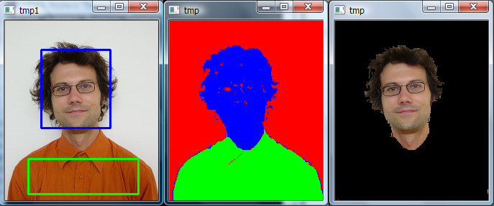
Embedded Computer Vision
EXAMPLE of a pixel wise block
Image segmentation: the process of partitioning a digital image into multiple segments

Slide 14
Embedded Computer Vision
To fit both the hardware and the real-time constraints, we have followed a twofold way:
Reduction of data to be processed
State-of-the-art algorithms approximation

Slide 15
Reduction of data to be processed
Reduction of data to be processed…
… means to consider only part of the images (a.k.a. Region of Interests, RoIs), exploiting the environmental condition of the considered applications.

Slide 16
Reduction of data to be processed
Example 1: Parking lots monitoring application
The Markov chain is triggered by the output of a frame differencing based algorithm applied on each ROI (complexity O(N)).
C. Salvadori, M. Petracca, M. Ghibaudi and P. Pagano, “On-board Image Processing in Wireless Multimedia Sensor Networks: a Parking Space Monitoring Solution for Intelligent Transportation Systems”, in the book ”Intelligent Sensor Networks: Across Sensing, Signal Processing, and Machine Learning”, CRC Press, ISBN 978-1-43-989281-7.

Slide 17
Reduction of data to be processed
Example 2: Linesensor based vehicles counter
The environmental conditions given by the vehicles movement permit to process only a line (1D vector) instead an image (2D vector). The second dimension is the time vector.
C. Salvadori, M. Petracca, S. Bocchino, R. Pelliccia, P. Pagano, "A low-cost vehicle counter for next-generations ITS", Journal of Real Time Image Processing, March 2014, doi: 10.1007/s11554-014-0411-4

Slide 18
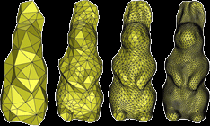
SOTA algorithms approximation
State-of-the-art algorithms approximation, by:
using (sub-)integer representation
unit conversion operation, by multiplying by a constant
redefinition of the updating rules based on floating point numbers)
“playing” with maths behind the algorithm

Slide 19
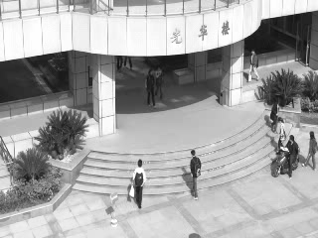
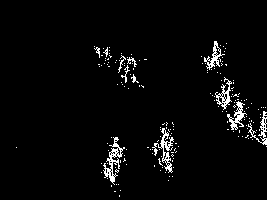
SOTA algorithms approximation
Example 1. GMM approximation
Sub-integer representation of a Gaussian (2 bytes instead of 24)
Redefinition of the round operation (for both mean value and variance updating equations)
Pseudo-random updating (for weight updating equations)
Original
Approx
C. Salvadori, M. Petracca, J. Martinez del Rincon, S. A. Velastin, D. Makris, "An optimisation of Gaussian mixture models for integer processing units", Journal of Real Time Image Processing, February 2014, doi: 10.1007/s11554-014-0402-5

Slide 20
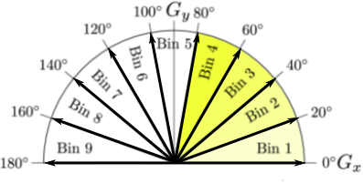
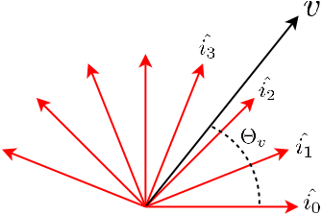
SOTA algorithms approximation
Example 2. HOG approximation
Approximate the complete set of versors using a subset of N elements, so that:
Parallel processing oriented (FPGA)
0 | sinϑ_{k} | 0
- cosϑ_{k} | 0 | cosϑ_{k}
0 | - sinϑ_{k} | 0

Slide 21
Objectives: tracking
Centralized tracking on SEED EYE board:
Segmentation (GMM): DONE
Connected component labeling: IN FIERI
Kalman filter: IN FIERI
In September 2014 we could have a low cost Smart Camera capable to perform centralized tracking (not crowdy environments)!

Slide 22
Objectives: tracking
Distributed tracking on a IoT oriented network:
Camera calibration ??
We have done some study on “distributed particle filter”. Open issues:
Network latencies
Camera selection
… but maybe could do some simplification ...

Slide 23
Objectives: tracking
Since GMM does not introduce any semantic in the detected blob, we implement HoG for people and vehicles detection.
Gradient extraction
Histogram
Normalization
Classification

Slide 24
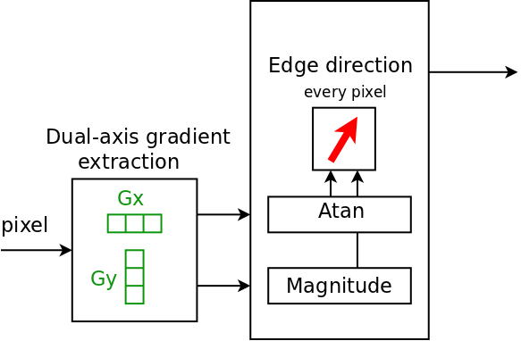
Histogram of Gradient (HoG)
Edge detector
(m, ϑ)

Slide 25
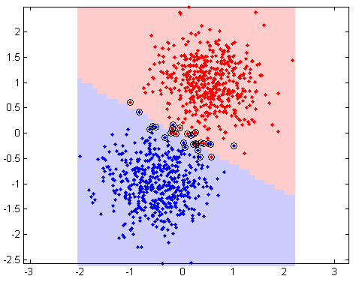
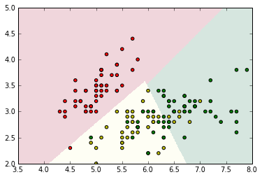
Histogram of Gradient (HoG)
SVM is supervised learning binary classifier
Given a set of training examples, an SVM training algorithm builds a model that assigns new examples into one category or the other
New examples are then mapped into that same space and predicted to belong to a category based on which side of the gap they fall on

Slide 26
Objectives: Linesensor
We would like to improve the Linesensor, since the current version implement only a detection algorithm.

Slide 27
Possible collaborations

Slide 28
Histogram of Gradient (HoG)
Can we use “associative memories” as the first block of the HoG? (Gradient Extractor)
Could we use “associative memories” to implement the classification block? Can they be seen as “machine learning” techniques?
Could we re-design a sort of HoG using “associative memories”?

Slide 29
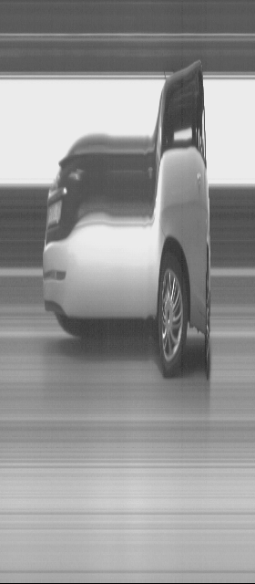
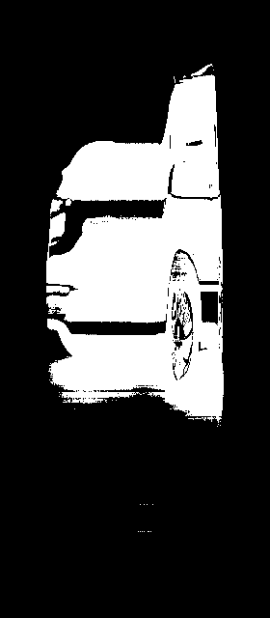
Linesensor
Requirements:
Vehicles detection
Vehicles classification
Measuring vehicles speed
The pipeline:
Spatial and temporal edge detector
Temporal reconstruction rules
High throughput spatial and temporal classifier: “associative memories”?

Slide 30
Vibro-meter
System capable to understand the machine faults by using vibrations. Usually processed by using:
a transform (DCT, FT)
a machine learning technique to classify the faults
Could we use “associative memories” in this scenario?

Slide 31
Thank you
Claudio Salvadori: claudio.salvadori@sssup.it

